Slide 1
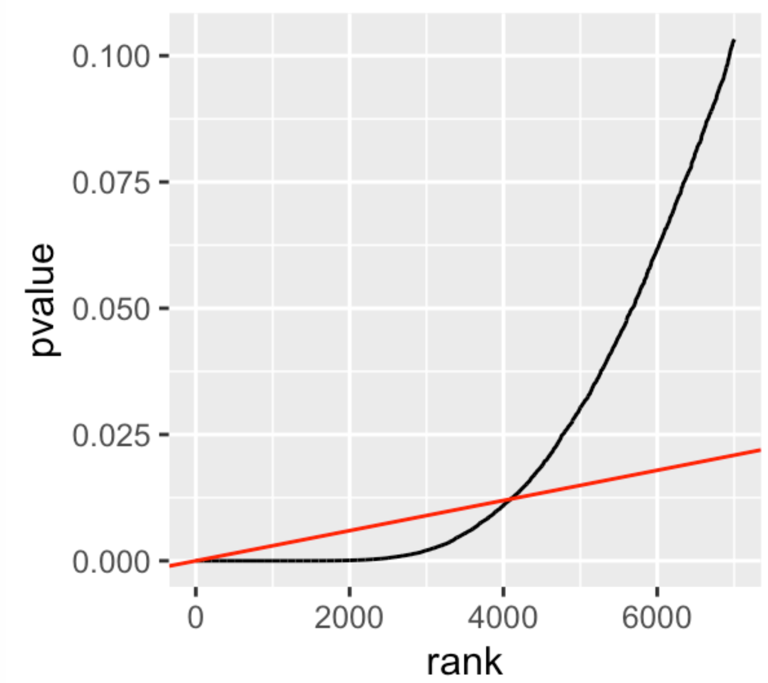

p-values
Slope of $α_{FDR}/m$
Reject p-values to the left of intersection

