Slide 1

We get better when we feel the BUZZT

Slide 2
Dance BUZZT Problem
Beginners dancers struggle to find the rhythm and learning the dance moves.
Is hard for self train dancers to have a feedback .
Big groups of dancers have difficult time synchronizing their movements.
Dancing classes are expensive.

Slide 3
Dance BUZZT Solution
Facilitate the feedback to the learner in order to keep track of his progress.
The learning of proper movement and positioning with the use of Technology.
Make accessible and affordable high-quality dancing classes.

Slide 4
Value Proposition
We will offer a device featuring novel way of delivering a sensorial feedback via vibration and LED lights .
We will offer a flexible design that can be utilized in another areas besides dancing such as sports and self training, physical therapy.
Help people with the use of technology to develop in a fast peace the muscle memory require in the different activities .
https://www.nytimes.com/2007/05/28/arts/28iht-dance.html

Slide 5
Operations Flow Chart
Connect to software upload station for firmware upload
Select electronic components (microprocessor, vibration motors, Bluetooth module, LEDs)
15 Minutes
5 Minutes
Perform device testing and verification
20 Minutes
Place and solder components onto custom PCB
20 Minutes
Package BUZZT device
5 Minutes
Assemble the BUZZT bracelet with PCB and wristband
10 Minutes
Quality Check
Pass
Fail
Total: 75 Minutes

Slide 6
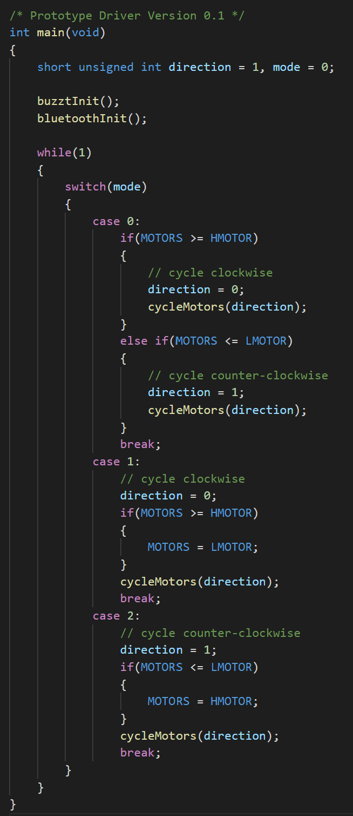
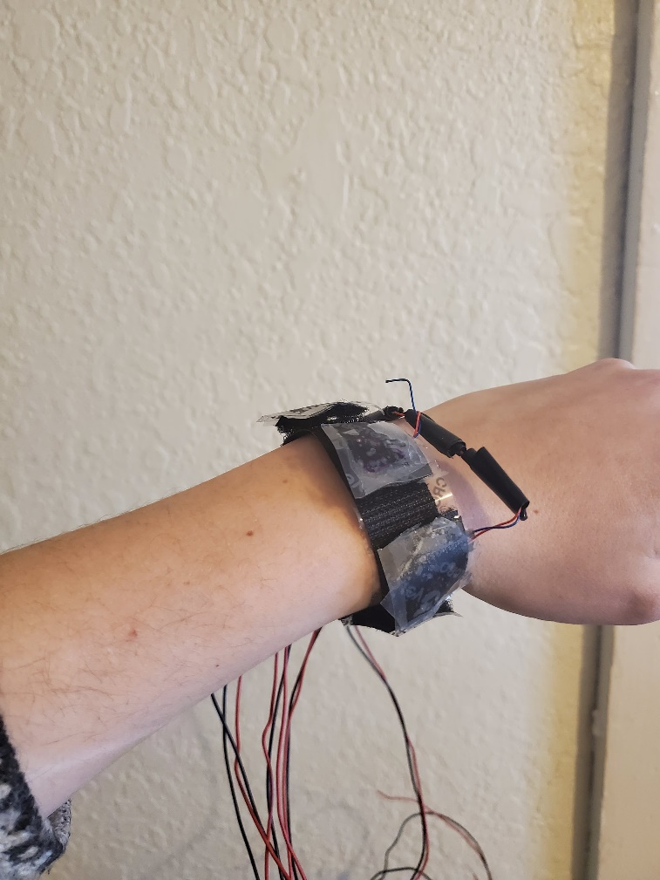
Early Prototype Version 1

Slide 7


Tools Selected
Internet Search
Questionnaire to UTEP students and people in El Paso and Juarez
Questionnaires to experienced individuals from dance studios and dancers

Slide 8
Market Segmentation
Market Segmentation | Dance Academies | Universities | Self dance training video programs
Target Markets | 35 Academies in El Paso | The University of Texas El Paso Community College | People who want to learn by themselves with a device that provides feedback

Slide 9
Initial Market Survey (40 people)

Slide 10
Market
Dance Studio Revenue: 53,140
Avg cost per class : $15 $53140/$15= 3543 classes
Avg Cost private class: $75-100
Online Dance Academies:
Steezzy Revenue : $5M $5M/19.99 = 250125 subscribers
Cost per month:$19.99
CLI Studio Revenue $2.7M $2.7M/100 = 27000 subscribers
Cost per month:$100

Slide 11
References
Dance Studio Revenue:
https://www.ibisworld.com/united-states/market-research-reports/dance-studios-industry/
Steezzy revenue
https://www.owler.com/company/steezyinc
CLI Studio revenue
https://www.owler.com/company/clistudios

