Slide 1
Modeling the inductively-shunted Cooper pair box
By Jack O'Connor
with Jens Koch,
Steven Girvin,
Vlad Manucharyan,
Lev Bishop,
Schoelkopf et al,
Devoret et al

Slide 2
Quantum Computing
Factoring (Shor's algorithm)‏
Searching (Grover's algorithm)‏
Need qubits

Slide 3
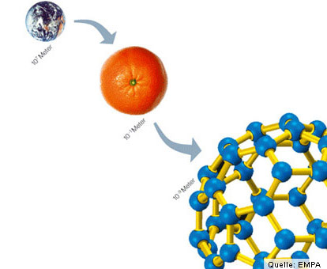
Qubit Challenges
Decoherence
Atoms are quite small.

Slide 4
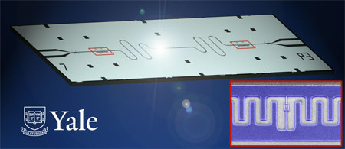
Circuit QED

Slide 5
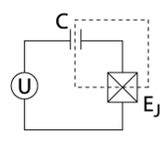
The Cooper Pair Box (CPB)‏
Extensively studied
Two parameters:
EC & EJ

Slide 6
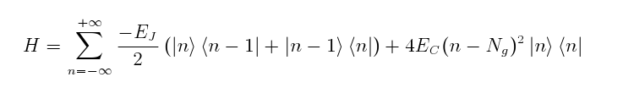
Modeling the CPB
Express as a tridiagonal matrix with each element H[n][m] = <n|H|m>.
Truncate.
Calculate eigenvalues numerically in terms of the offset charge, Ng.

Slide 7
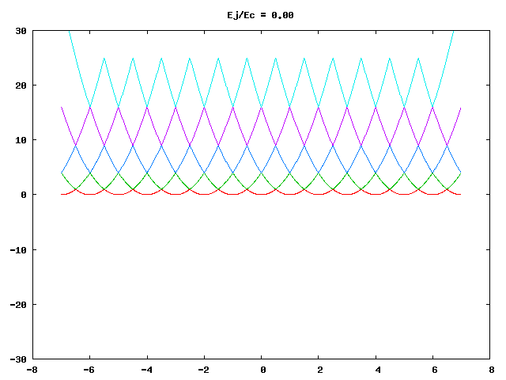

Slide 8


Slide 9
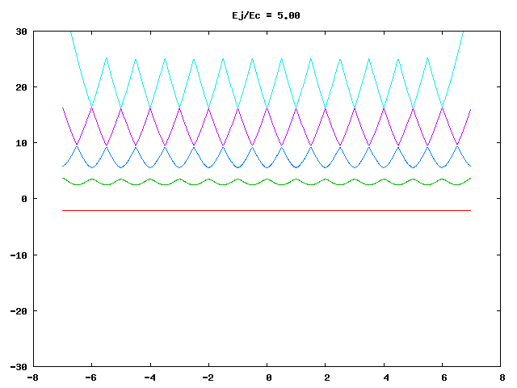

Slide 10
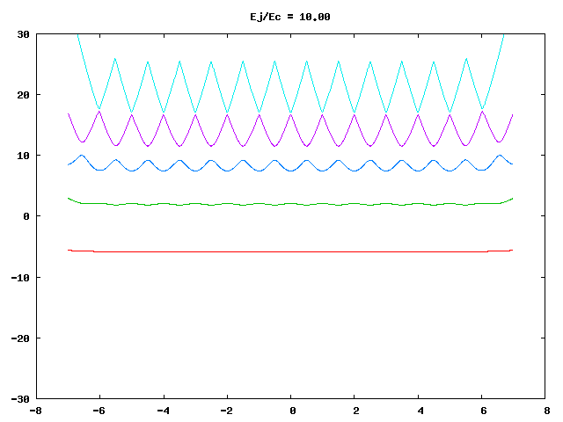

Slide 11
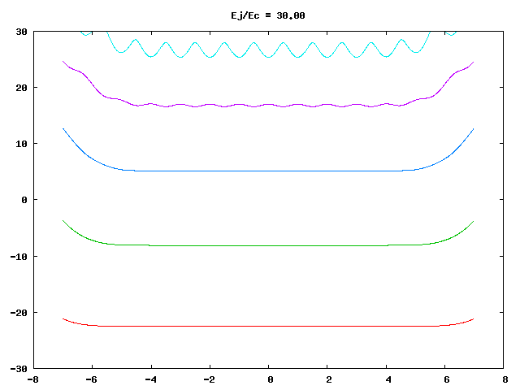

Slide 12
Problem with the CPB
Charge noise leads to decoherence.
Solutions:
  Operate the CPB at local extrema
  Pick a large value for EJ/EC (the “transmon” regime)‏
Or...

Slide 13
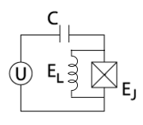
The Inductively-Shunted Cooper Box (CPBL)‏
An inductive shunt acts like an closed circuit for low-frequency charge noise.
Three parameters: EC, EJ, & EL
New and interesting features in the energy spectrum.
Not extensively studied.

Slide 14
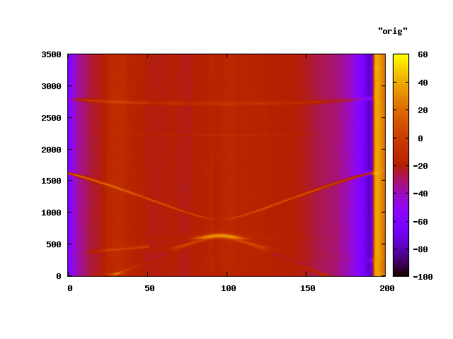

Slide 15
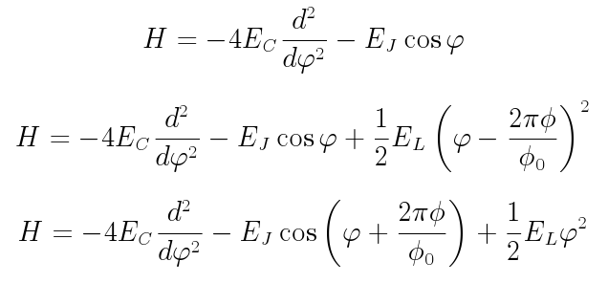
Modeling the CPBL

Slide 16
Modeling the CPBL
Switch to harmonic oscillator basis over phi.
Express in matrix form again, truncate, and solve for eigenvalues in terms of applied magnetic flux.

Slide 17
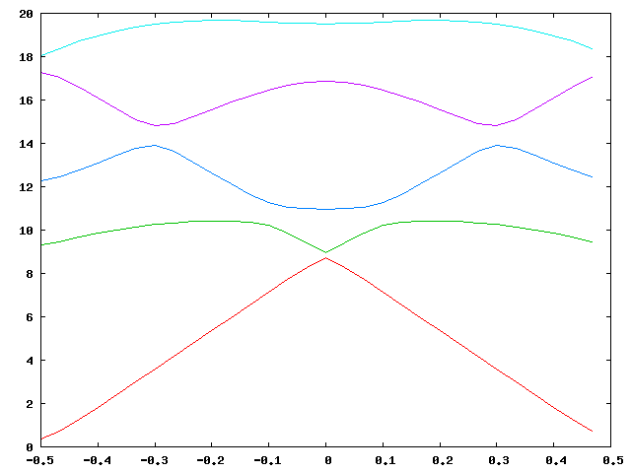

Slide 18
Why is this useful?
Explore new parameter regimes.
Automated routines can fit our experimental data.

Slide 19
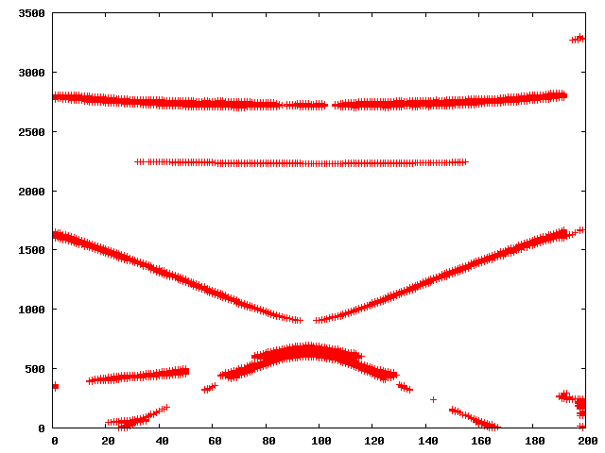
Data Processing
Strip curves from spectral data.

Slide 20
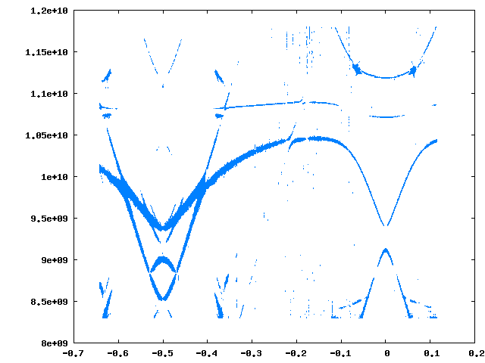
What values of EC, EJ, & EL produce this spectrum?

Slide 21
Automated Curve Fitting
References
  R. H. Byrd, P. Lu and J. Nocedal. A Limited Memory Algorithm for Bound Constrained Optimization, (1995), SIAM Journal on Scientific and Statistical Computing , 16, 5, pp. 1190-1208.
  C. Zhu, R. H. Byrd and J. Nocedal. L-BFGS-B: Algorithm 778: L-BFGS-B, FORTRAN routines for large scale bound constrained optimization (1997), ACM Transactions on Mathematical Software, Vol 23, Num. 4, pp. 550 – 560
  SciPy

Slide 22
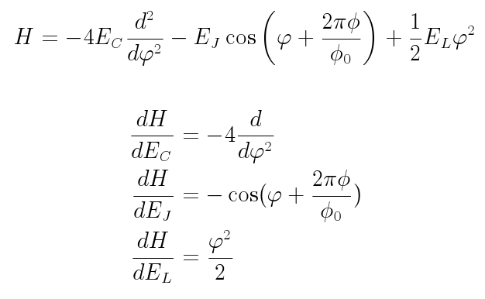
Speeding it up
Partial derivatives

Slide 23
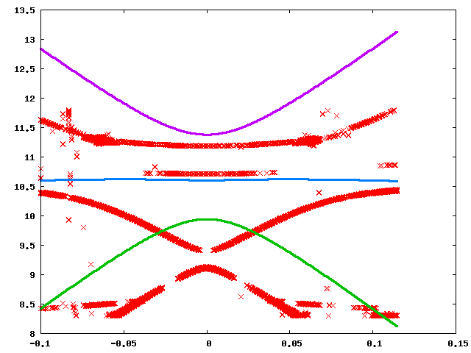

Slide 24
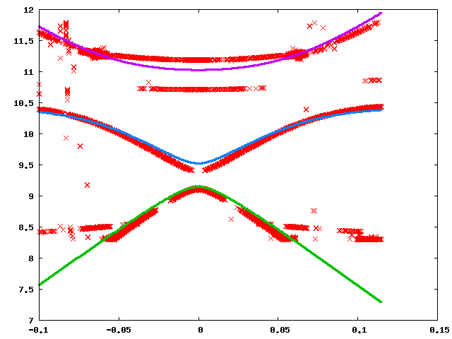

Slide 25
Modeling the inductively-shunted Cooper pair box
By Jack O'Connor
with Jens Koch,
Steven Girvin,
Vlad Manucharyan,
Lev Bishop,
Schoelkopf et al,
Devoret et al

