Slide 1
Modeling the inductively-shunted Cooper pair box
By Jack O'Connor
with Jens Koch,
Steven Girvin,
Vlad Manucharyan,
Lev Bishop,
Schoelkopf et al,
Devoret et al

Slide 2
Summary
Circuit QED
What is an inductively-shunted Cooper pair box?
Numerical methods
How do we find its energy spectrum.
Pretty pictures

Slide 3
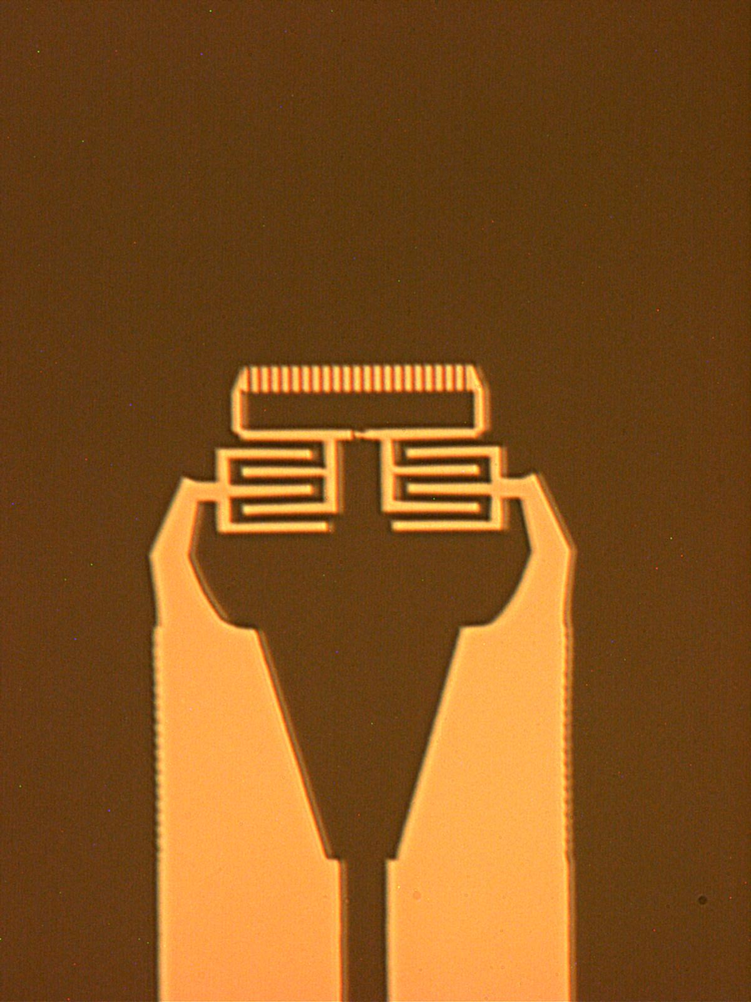
Circuit QED
Artificial atoms.
Possible qubit.

Slide 4
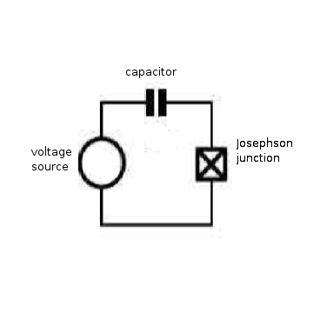
Cooper pair box
Well-studied

Slide 5
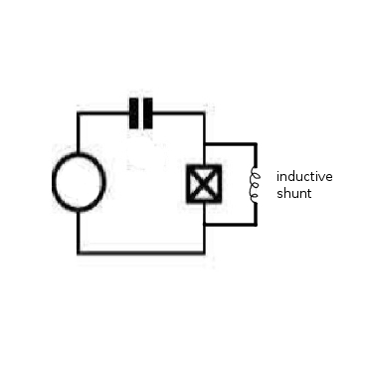
Inductive-shunting
Changes the energy spectrum dramatically
Benefit: noise reduction
Not well-studied

Slide 6
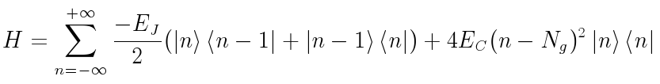
Numerical Methods
CPB Hamiltonian
Diagonalize resulting tridiagonal matrix.

Slide 7
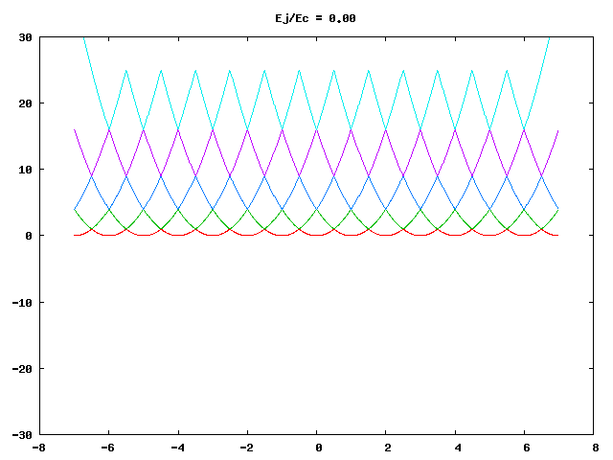
Numerical Methods

Slide 8

Numerical Methods

Slide 9
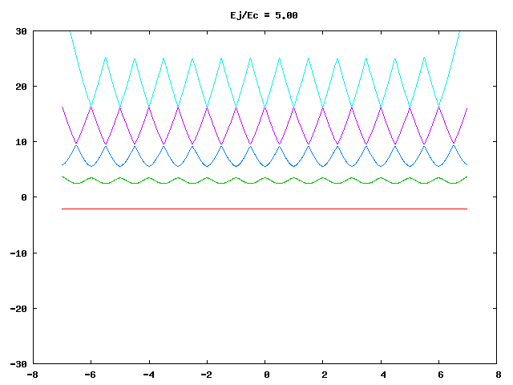
Numerical Methods

Slide 10
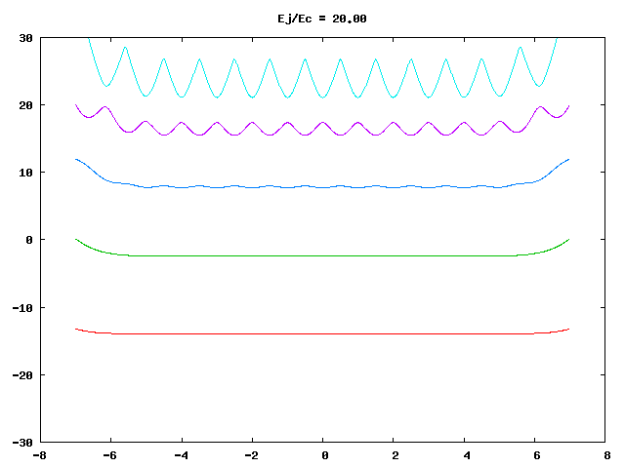
Numerical Methods

Slide 11
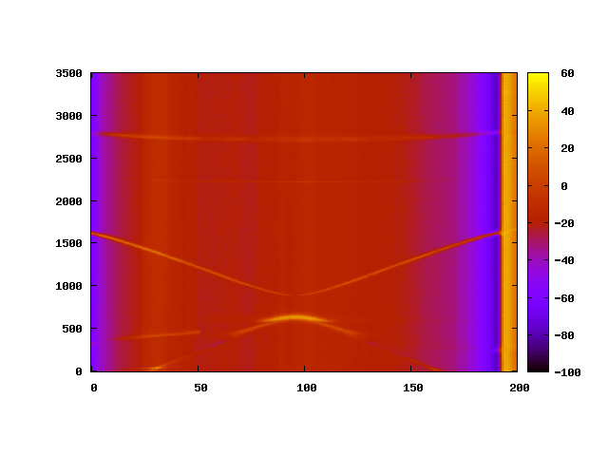
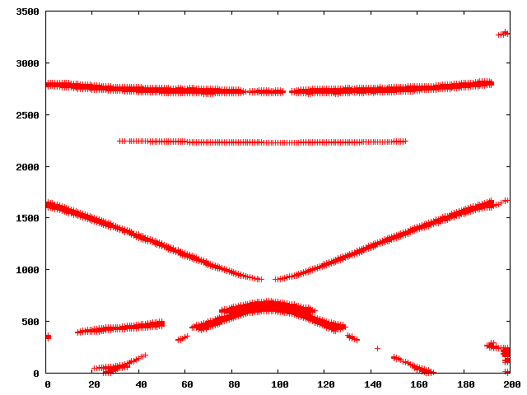
Curve Recognition
Raw data
Acquired
points

Slide 12
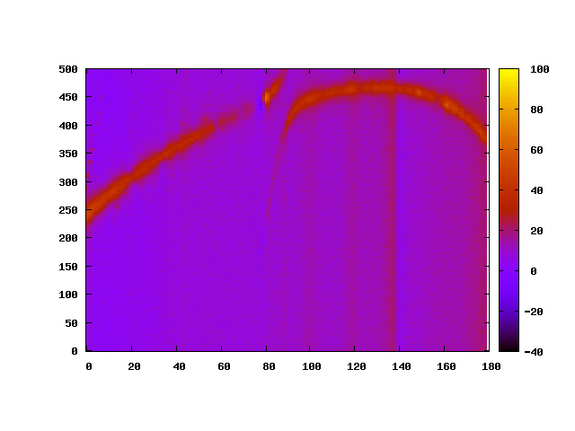
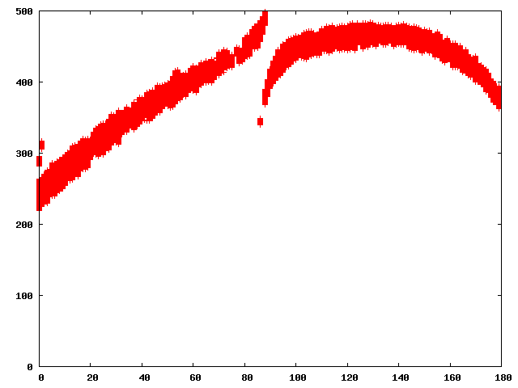
Curve Recognition
Raw data
Acquired
points

Slide 13
To Conclude
Energy spectra can be pulled from experimental data effectively.
These can be compared to calculated spectra to determine experimental parameters.
Those data will help guide us into new parameter regimes of the relatively unexplored LCPB.

