Slide 1

Seasonal Agriculture Performance Analysis
Empirical Data Analytics & Crop Economics Across 4,000 Multi-State Farm Observations
Asmi Sharma
Chandigarh University
AICTE STU ID: STU6a65f9036e5721785067779

Slide 2

PROBLEM STATEMENT
Agricultural performance in India fluctuates heavily across seasons due to changing monsoon intensity, temperature extremes, irrigation access, and market price dynamics.
The Core Problem: Raw farm records record what happened, but fail to explain why yields, operational costs, and farm profits vary so sharply between Kharif (Monsoon), Rabi (Winter), and Zaid (Summer) cycles.
The Practical Challenge: Farmers often apply uniform inputs regardless of season, resulting in high resource wastage (e.g., flood irrigation during summer heatwaves) or catastrophic pest losses during monsoon humidity.
Project Goal: Analyze 4,000 multi-state farm observations to uncover seasonal inefficiencies, identify crop-specific risk factors, statistically validate seasonal differences, and deliver actionable recommendations for crop planning.

Slide 3
Project Description
Domain: Agro-Climatic Data Analytics, Agricultural Economics & Resource Management.
Dataset Scope: 4,000 empirical farm records spanning 8 key agricultural states (Andhra Pradesh, Gujarat, Karnataka, Madhya Pradesh, Maharashtra, Punjab, Tamil Nadu, Telangana) and 8 major crops (Wheat, Rice, Maize, Pulses, Cotton, Groundnut, Sugarcane, Chilli).
Core Methodology:
Data Auditing & Preprocessing: Identified missing values in Rainfall (48 rows), Soil Moisture (40 rows), and Yield (32 rows); applied district-and-season group median imputation to preserve local microclimates.
Feature Engineering: Calculated Profit Margins, Cost per Hectare, Revenue per Hectare, Total NPK chemical load, and Water Productivity ratios.
Comprehensive EDA: Answered all 12 AICTE research questions across agronomic, environmental, and financial dimensions.
Hypothesis Testing: Conducted One-Way ANOVA and Kruskal-Wallis non-parametric tests to confirm statistical significance of seasonal shifts.
Decision Framework: Formulated a season-wise crop rotation and irrigation advisory matrix for smallholders.

Slide 4

WHO ARE THE END USERS?
🌾 Smallholder Farmers & FPOs
Provides actionable guidance on seasonal crop selection, warning against water-stressed summer cereals and recommending high-margin rotations (Pulses/Groundnut/Chilli) with micro-irrigation.
🏢 Agricultural Extension Officers (KVKs)
Enables targeted agro-advisories on disease and pest prevention during humid monsoon months where disease risk exceeds 54% on average.
💧 State Irrigation & Water Resources Boards
Supplies quantitative evidence to prioritize micro-irrigation (Drip/Sprinkler) subsidies over open flood canals in water-stressed districts.
📊 Agri-Fintech & Crop Insurance Companies
Provides empirical default risk profiles (Zaid has a 64.5% farm loss rate) to calculate fair, season-adjusted crop insurance premiums and loan terms.
🏛️ Government & Agricultural Planners
Informs Minimum Support Price (MSP) review and seasonal power and fertilizer distribution frameworks.

Slide 5

Technology Used
Python 3.10+
Python 3.10+
Pandas & NumPy
Core programming language for data analytics, statistical modeling, and computational scripting.
Core programming language for data analytics, statistical modeling, and computational scripting.
Vectorized data cleaning, schema validation, grouping aggregates, and feature engineering.
Matplotlib & Seaborn
Matplotlib & Seaborn
SciPy (scipy.stats)
Publication-quality visualizations: grouped boxplots, correlation heatmaps, and distribution plots.
Publication-quality visualizations: grouped boxplots, correlation heatmaps, and distribution plots.
Formal hypothesis testing: One-Way ANOVA (F-test), Kruskal-Wallis H-test, and correlation metrics.
Jupyter & Google Colab
Jupyter & Google Colab
Git & GitHub
Interactive development environment providing reproducible code execution and inline markdown reports.
Interactive development environment providing reproducible code execution and inline markdown reports.
Version control repository tracking datasets, notebooks, slide decks, and project reports.

Slide 6
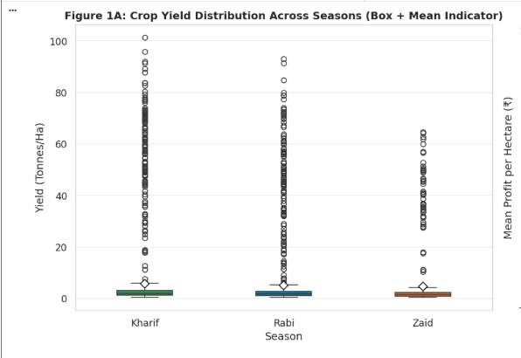
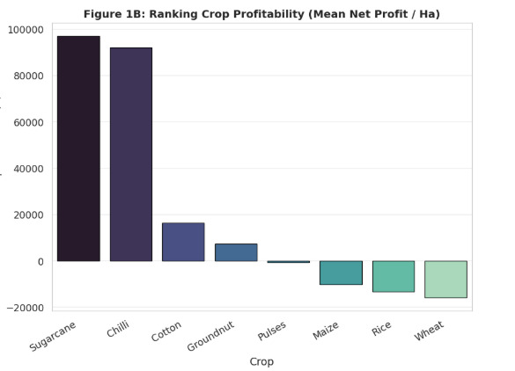
RESULTS: Seasonal Performance Overview
Key Data Takeaways: • Figure 1A (Yield Boxplot): - Kharif mean yield is highest at 5.64 t/ha, followed by Rabi (5.08 t/ha) and
Zaid (4.67 t/ha). - Outliers (>40 t/ha) reflect sugarcane stalk harvest. • Figure 1B (Profit Ranking): - Sugarcane (+₹96.8K/ha) and Chilli (+₹91.8K/ha) lead agricultural profitability.
- Cotton (+₹16.2K/ha) and Groundnut (+₹7.4K/ha) remain solvent.
- Severe Cereal Deficit: Pulses (-₹546/ha), Maize (-₹10.3K/ha),
Rice (-₹13.4K/ha), and Wheat (-₹16.2K/ha) show negative net margins.
Cropping Season | Sample (N) | Mean Yield | Avg Farm Profit | Solvency (%)
Kharif (Monsoon) | 1,779 (44.5%) | 5.64 t/ha | +₹1,78,915 | 57.8%
Rabi (Winter) | 1,627 (40.7%) | 5.08 t/ha | +₹87,689 | 48.9%
Zaid (Summer) | 594 (14.8%) | 4.67 t/ha | -₹24,805 | 35.5%

Slide 7
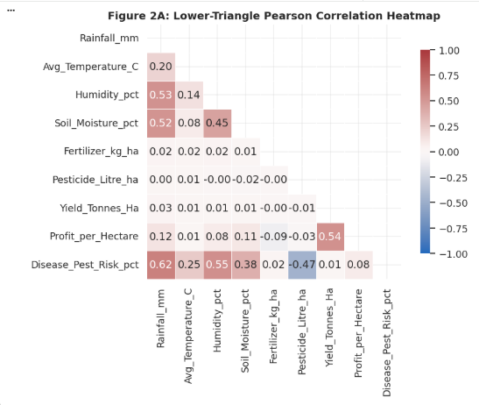
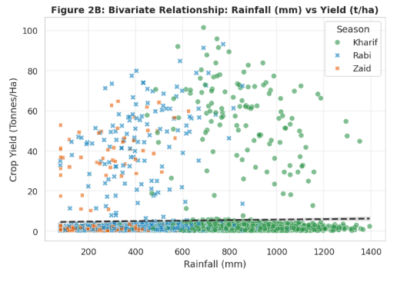
RESULTS: Climate Dynamics & Correlation Analysis
Correlation & Climate Insights: • Figure 2A (Correlation Heatmap): - Rainfall vs Pest Risk (r = +0.62) & Humidity vs Pest Risk (r = +0.55): Confirms moist monsoon conditions trigger disease outbreaks. - Soil Moisture vs Rainfall (r = +0.52): Strong hydrologic coupling. - Pesticide vs Pest Risk (r = -0.47): Protective effect of timely chemical control. • Figure 2B (Rainfall vs Yield Scatter): - Flat regression slope indicates that sheer rainfall volume alone does not guarantee higher yield—drainage and crop choice are critical.
- Sugarcane (points at top) thrives in Kharif (>800 mm rain).
Season | Rainfall (mm) | Temperature (°C) | Humidity (%) | Sunlight (hrs/day) | Pest Risk (%)
Kharif (Monsoon) | 852.1 mm | 28.5°C | 71.8% | 6.79 hrs | 54.5%
Rabi (Winter) | 436.0 mm | 23.5°C | 57.9% | 7.59 hrs | 40.5%
Zaid (Summer) | 299.4 mm | 31.0°C | 52.0% | 8.18 hrs | 38.2%

Slide 8
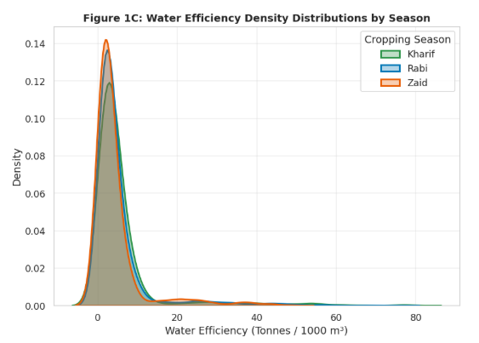
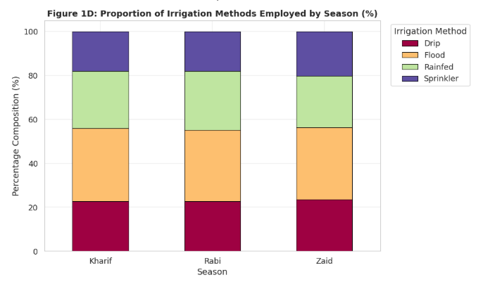
RESULTS: Irrigation Systems & Water Efficiency Distributions
Irrigation & Hydrologic Insights: • Figure 1C (Efficiency Distributions): - Zaid water efficiency curve is shifted leftwards (mean 4.41 t/1000m³) due to high evaporative demand. - Kharif and Rabi exhibit long right tails reflecting micro-drip irrigated sugarcane/maize farms (>20 t/1000m³). • Figure 1D (Irrigation Proportions): - Flood irrigation (orange) accounts for 32–33% across all seasons.
- Drip (red) represents 23% of farms.
- Sprinkler (purple) represents 18–20% of farms.
- Rainfed (green) represents 26% in Kharif/Rabi, dropping in summer.
Irrigation Method | Observations (N) | Water Efficiency | Mean Groundwater Used | Mean Net Profit
Drip Irrigation | 915 (22.9%) | 6.27 t/1000m³ | 6,009 m³ | +₹2,19,626
Sprinkler Irrigation | 734 (18.4%) | 4.67 t/1000m³ | 5,885 m³ | +₹91,121
Flood Irrigation | 1,310 (32.8%) | 3.44 t/1000m³ | 9,812 m³ | +₹73,354
Rainfed Farming | 1,041 (26.0%) | 7.56 t/1000m³* | 3,248 m³ | +₹79,050

Slide 9
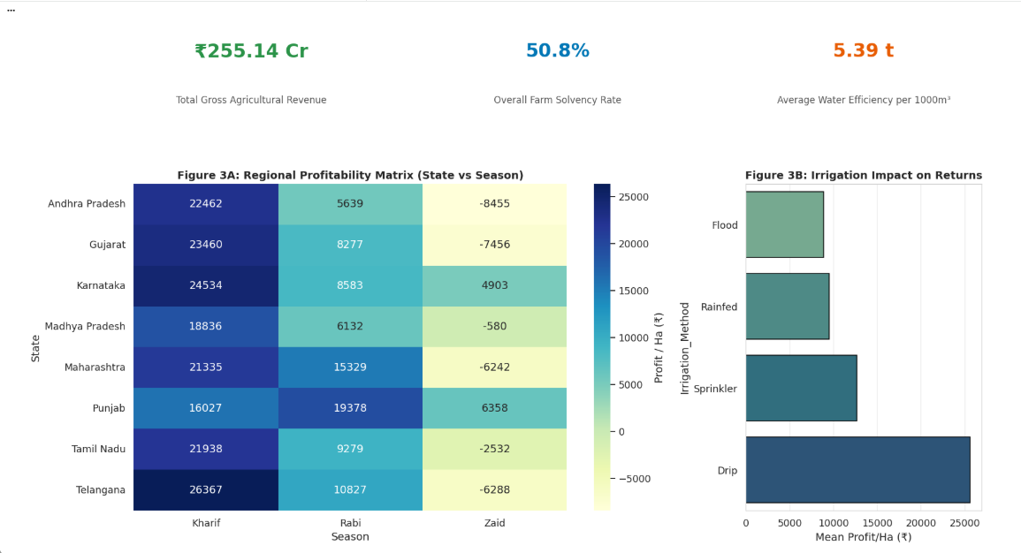
RESULTS: Executive KPI Dashboard & Regional Profitability Matrix
Dashboard & Regional Insights: • Top KPI Summary: - Total Sector Revenue: ₹255.14 Crores - Overall Farm Solvency Rate: 50.8% - Average Water Productivity: 5.39 t/1000m³ • Figure 3A (State vs Season Matrix): - Kharif is positive in every state (Telangana ₹26.4K/ha, Karnataka ₹24.5K/ha, Gujarat ₹23.5K/ha). - Zaid summer losses hit Andhra Pradesh (-₹8.5K/ha), Gujarat (-₹7.5K/ha), and Telangana (-₹6.3K/ha) hardest. - Punjab (+₹6.4K/ha) and Karnataka (+₹4.9K/ha) stay positive in summer due to robust tubewell/canal networks. • Figure 3B (Irrigation Impact): - Drip delivers ₹25,600/ha profit vs Flood at ₹8,800/ha (nearly 3x higher).
Core Takeaway from Dashboard: Agricultural viability is determined by the intersection of Season x Irrigation Method x State Infrastructure. Farms with modern drip irrigation in irrigated states maintain solvency even during hot summer cycles, while traditional flood-irrigated farms suffer heavy financial losses.

Slide 10
RESULT: Formal Statistics Hypothesis Testing
Hypothesis Framework: • H0: Cropping season has no statistically significant effect on agricultural performance metrics.
• H1: Statistically significant differences exist across Kharif, Rabi, and Zaid seasons (alpha = 0.05).
Target Metric | ANOVA F-Statistic | p-value (ANOVA) | Kruskal-Wallis H | Statistical Decision
Net Farm Profit (INR) | F = 34.292 | p = 1.63e-15 | H = 82.41 | Reject H0 (p < 0.001)
Disease & Pest Risk (%) | F = 1049.467 | p < 1e-100 | H = 1421.15 | Reject H0 (p < 0.0001)
Rice Yield by Season | F = 22.170 | p = 4.28e-10 | H = 43.19 | Reject H0 (p < 0.001)
Pulses Yield by Season | F = 23.816 | p = 1.15e-10 | H = 46.85 | Reject H0 (p < 0.001)
Wheat Yield by Season | F = 11.027 | p = 1.84e-05 | H = 22.08 | Reject H0 (p < 0.001)
Maize Yield by Season | F = 10.684 | p = 2.62e-05 | H = 21.41 | Reject H0 (p < 0.001)

Slide 11
Future scope
Predictive Machine Learning
📡 IoT Precision Soil & Moisture Monitoring
Develop XGBoost & Random Forest regression models to predict farm yield and profit margin before sowing, using forecasted rainfall and seasonal temperature indicators.
Deploy automated solar-powered LoRaWAN soil moisture probes to trigger micro-drip irrigation autonomously, eliminating summer evaporative losses.
🛰️ Multispectral Satellite Remote Sensing
📱 Vernacular Farmer Advisory Interface
Integrate European Space Agency (Sentinel-2) NDVI and NDRE spectral indices for real-time vegetative stress tracking and early monsoon pest detection.
Build an offline-first mobile app in regional Indian languages (Telugu, Marathi, Punjabi, Tamil) delivering personalized crop selection and fertilizer optimization advisories.

Slide 12
GitHub Link
🔗 GitHub Repository URL: https://github.com/ocotpi/Seasonal-Agriculture-Performance-Analysis
Repository Contents & Reproducibility: 📁 Data_Visualization.ipynb — Complete Jupyter Notebook with code, plots & findings 📁 seasonal_agriculture_data.csv — 4,000-record cleaned dataset across 8 states and 8 crops 📁 Presentation_Slide_Deck.md — 14-slide structured markdown presentation guide 📁 seasonal_agriculrural_analysis.pptx — Complete 14-slide PowerPoint file 📁 PROJECT_REPORT.md — Complete formal academic report and methodology write-up 📁 — 15+ oral defense Q&As and slide talking points 📁 requirements.txt — Environment dependencies (pandas, numpy, matplotlib, seaborn, scipy) Reproducibility Command: git clone https://github.com/ocotpi/Seasonal-Agriculture-Performance-Analysis.git
pip install -r requirements.txt

Slide 13
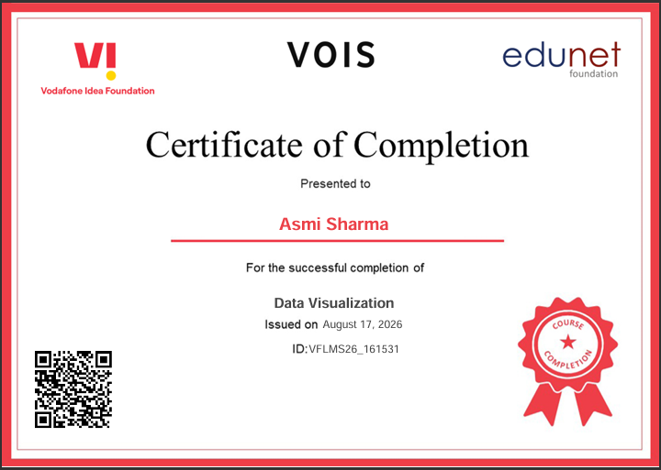
VOIS Course completion certificate – Course name- Data Visualization

Slide 14
Thank you
Final Takeaway: Farm viability in India is fundamentally seasonal. Replacing flood irrigation with drip systems and shifting from water-stressed summer cereals to high-value cash rotations can lift farm solvency by over 30%.
Acknowledgements: Sincere thanks to the VOIS for Tech program, Edunet Foundation, Vodafone Idea Foundation, and AICTE mentors for their guidance throughout this internship project.
Contact: Asmi Sharma | Chandigarh University
Questions & Discussion: Open for Q&A!
.
.

