Slide 1
VOIS AICTE Internship Batch 1 (2026-2027) Major Project
Seasonal Agriculture Performance Analysis
Empirical Data Analytics & Crop Economics Across 4,000 Multi-State Farm Observations
Student Name: Asmi Sharma College Name: Chandigarh University (BE Computer Science & Engineering, 2026 Passout) AICTE Student ID: STU6a65f9036e5721785067779 Internship ID: INTERNSHIP_17830691666a4779eecfe8a Program: VOIS for Tech - Data Analytics Internship (Edunet Foundation & Vodafone Idea Foundation)

Slide 2
Problem Statement
Slide 2 of 14
Core Problem Context: • Agricultural activities across India are fundamentally shaped by three distinct cropping seasons: Kharif (Monsoon), Rabi (Winter), and Zaid (Summer). • While raw farm logs capture final output, they do not explain why crop yields, operational costs, and net farm profits vary so sharply between seasons. Key Operational Challenges Identified: • Resource Misallocation: Farmers frequently apply uniform chemical and water inputs regardless of seasonal evaporative demand and ambient moisture levels. • Summer Inefficiency Trap: Uncontrolled flood irrigation during summer heat (31–39°C in Zaid) creates high pumping bills with severe evaporation loss. • Monsoon Pest Vulnerability: Prolonged high humidity (>71% in Kharif) drives disease and pest outbreak risks above 54%, eroding gross margins. Project Objective: • Investigate 4,000 multi-state farm observations using statistical data analytics to benchmark seasonal performance, test hypotheses, and build data-driven recommendations.

Slide 3
Project Description & Dataset Scope
Slide 3 of 14
Dataset Scope & Coverage: • 4,000 verified farm records across 8 major agricultural states in India: Andhra Pradesh (529), Telangana (516), Maharashtra (512), Madhya Pradesh (497), Karnataka (489), Gujarat (488), Tamil Nadu (485), and Punjab (484). • 8 essential crops covering foodgrains, cash crops, oilseeds, and pulses: Rice (690), Wheat (614), Maize (551), Cotton (508), Pulses (496), Groundnut (424), Chilli (412), and Sugarcane (305). Core Analytical Pipeline: 1. Data Auditing: Imputed 48 missing Rainfall values, 40 Soil Moisture values, and 32 Yield entries using localized district-season group medians. 2. Feature Engineering: Computed Cost per Hectare, Profit Margin (%), Water Efficiency (t/1000m³), and Total NPK chemical application. 3. In-Depth Seasonal EDA: Systematically addressed all 12 key AICTE research questions. 4. Statistical Validation: One-Way ANOVA and Kruskal-Wallis tests verifying statistical significance across seasons. 5. Actionable Roadmap: Developed seasonal crop planning and micro-irrigation guidelines.

Slide 4
Target Beneficiaries & End Users
Slide 4 of 14
🌾 Smallholder Farmers & FPOs
Provides actionable guidance on seasonal crop selection, warning against water-stressed summer cereals and recommending high-margin rotations (Pulses/Groundnut/Chilli) with micro-irrigation.
🏢 Agricultural Extension Officers (KVKs)
Enables targeted agro-advisories on disease and pest prevention during humid monsoon months where disease risk exceeds 54% on average.
💧 State Irrigation & Water Resources Boards
Supplies quantitative evidence to prioritize micro-irrigation (Drip/Sprinkler) subsidies over open flood canals in water-stressed districts.
📊 Agri-Fintech & Crop Insurance Companies
Provides empirical default risk profiles (Zaid has a 64.5% farm loss rate) to calculate fair, season-adjusted crop insurance premiums and loan terms.
🏛️ Government & Agricultural Planners
Informs Minimum Support Price (MSP) review and seasonal power and fertilizer distribution frameworks.

Slide 5
Technology Stack & Development Environment
Slide 5 of 14
Python 3.10+
Pandas & NumPy
Core programming language for data analytics, statistical modeling, and computational scripting.
Vectorized data cleaning, schema validation, grouping aggregates, and feature engineering.
Matplotlib & Seaborn
SciPy (scipy.stats)
Publication-quality visualizations: grouped boxplots, correlation heatmaps, and distribution plots.
Formal hypothesis testing: One-Way ANOVA (F-test), Kruskal-Wallis H-test, and correlation metrics.
Jupyter & Google Colab
Git & GitHub
Interactive development environment providing reproducible code execution and inline markdown reports.
Version control repository tracking datasets, notebooks, slide decks, and project reports.

Slide 6
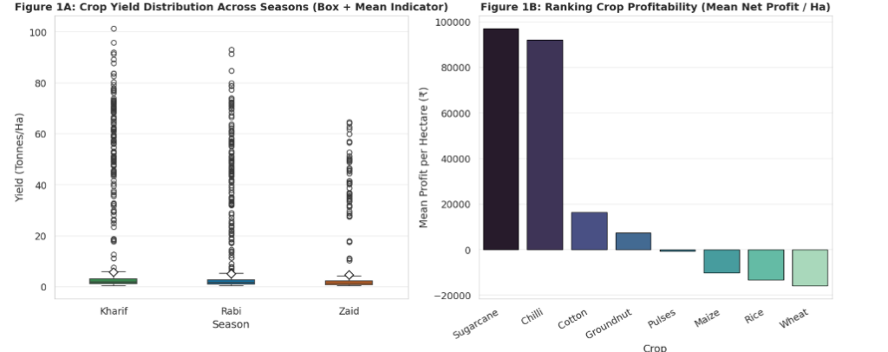
RESULTS: Seasonal Yield & Crop Profitability Ranking
Slide 6 of 14 [Code Output]
Key Data Takeaways: • Figure 1A (Yield Boxplot): - Kharif mean yield is highest at 5.64 t/ha, followed by Rabi (5.08 t/ha) and Zaid (4.67 t/ha). - Outliers (>40 t/ha) reflect sugarcane stalk harvest. • Figure 1B (Profit Ranking): - Sugarcane (+₹96.8K/ha) and Chilli (+₹91.8K/ha) lead agricultural profitability.
- Cotton (+₹16.2K/ha) and Groundnut (+₹7.4K/ha) remain solvent.
- Severe Cereal Deficit: Pulses (-₹546/ha), Maize (-₹10.3K/ha), Rice (-₹13.4K/ha), and Wheat (-₹16.2K/ha) show negative net margins.
Cropping Season | Sample (N) | Mean Yield | Avg Farm Profit | Solvency (%)
Kharif (Monsoon) | 1,779 (44.5%) | 5.64 t/ha | +₹1,78,915 | 57.8%
Rabi (Winter) | 1,627 (40.7%) | 5.08 t/ha | +₹87,689 | 48.9%
Zaid (Summer) | 594 (14.8%) | 4.67 t/ha | -₹24,805 | 35.5%

Slide 7
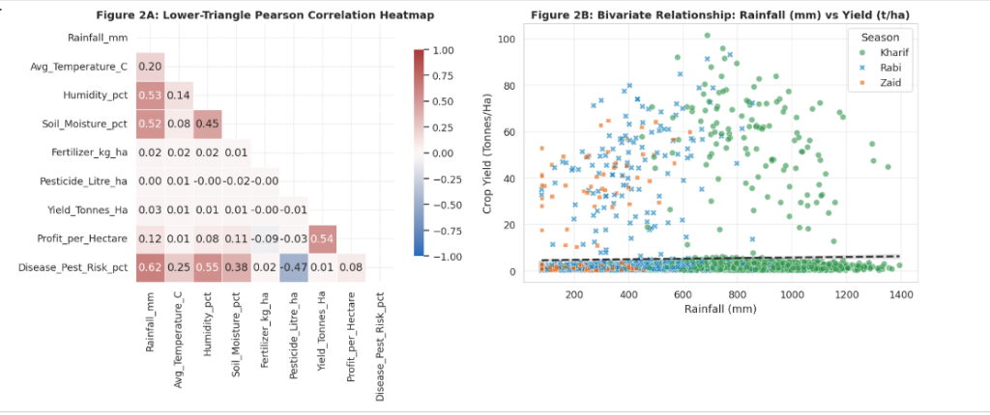
RESULTS: Climatological Dynamics & Correlation Analysis
Slide 7 of 14 [Code Output]
Correlation & Climate Insights: • Figure 2A (Correlation Heatmap): - Rainfall vs Pest Risk (r = +0.62) & Humidity vs Pest Risk (r = +0.55): Confirms moist monsoon conditions trigger disease outbreaks. - Soil Moisture vs Rainfall (r = +0.52): Strong hydrologic coupling. - Pesticide vs Pest Risk (r = -0.47): Protective effect of timely chemical control. • Figure 2B (Rainfall vs Yield Scatter): - Flat regression slope indicates that sheer rainfall volume alone does not guarantee higher yield—drainage and crop choice are critical.
- Sugarcane (points at top) thrives in Kharif (>800 mm rain).
Season | Rainfall (mm) | Temperature (°C) | Humidity (%) | Sunlight (hrs/day) | Pest Risk (%)
Kharif | 852.1 mm | 28.5°C | 71.8% | 6.79 hrs | 54.5%
Rabi | 436.0 mm | 23.5°C | 57.9% | 7.59 hrs | 40.5%
Zaid | 299.4 mm | 31.0°C | 52.0% | 8.18 hrs | 38.2%

Slide 8
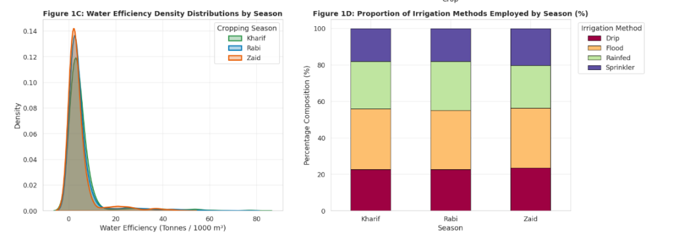
RESULTS: Irrigation Systems & Water Efficiency Distributions
Slide 8 of 14 [Code Output]
Irrigation & Hydrologic Insights: • Figure 1C (Efficiency Distributions): - Zaid water efficiency curve is shifted leftwards (mean 4.41 t/1000m³) due to high evaporative demand. - Kharif and Rabi exhibit long right tails reflecting micro-drip irrigated sugarcane/maize farms (>20 t/1000m³). • Figure 1D (Irrigation Proportions): - Flood irrigation (orange) accounts for 32–33% across all seasons.
- Drip (red) represents 23% of farms.
- Sprinkler (purple) represents 18–20% of farms.
- Rainfed (green) represents 26% in Kharif/Rabi, dropping in summer.
Irrigation Method | Observations (N) | Water Efficiency | Mean Groundwater Used | Mean Net Profit
Drip Irrigation | 915 (22.9%) | 6.27 t/1000m³ | 6,009 m³ | +₹2,19,626
Sprinkler Irrigation | 734 (18.4%) | 4.67 t/1000m³ | 5,885 m³ | +₹91,121
Flood Irrigation | 1,310 (32.8%) | 3.44 t/1000m³ | 9,812 m³ | +₹73,354
Rainfed Farming | 1,041 (26.0%) | 7.56 t/1000m³* | 3,248 m³ | +₹79,050

Slide 9
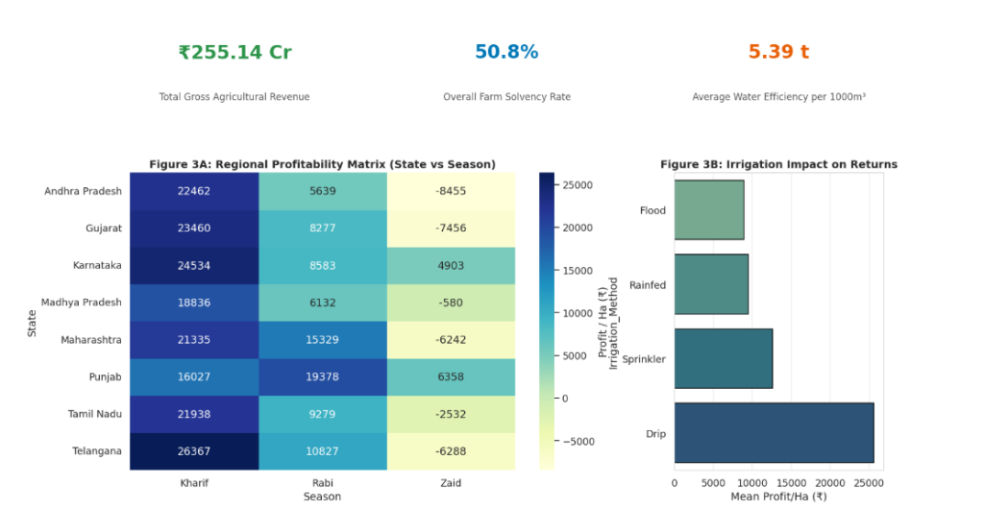
RESULTS: Executive KPI Dashboard & Regional Profitability Matrix
Slide 9 of 14 [Code Output]
Dashboard & Regional Insights: • Top KPI Summary: - Total Sector Revenue: ₹255.14 Crores - Overall Farm Solvency Rate: 50.8% - Average Water Productivity: 5.39 t/1000m³ • Figure 3A (State vs Season Matrix): - Kharif is positive in every state (Telangana ₹26.4K/ha, Karnataka ₹24.5K/ha, Gujarat ₹23.5K/ha). - Zaid summer losses hit Andhra Pradesh (-₹8.5K/ha), Gujarat (-₹7.5K/ha), and Telangana (-₹6.3K/ha) hardest. - Punjab (+₹6.4K/ha) and Karnataka (+₹4.9K/ha) stay positive in summer due to robust tubewell/canal networks. • Figure 3B (Irrigation Impact): - Drip delivers ₹25,600/ha profit vs Flood at ₹8,800/ha (nearly 3x higher).
Core Takeaway from Dashboard: Agricultural viability is determined by the intersection of Season x Irrigation Method x State Infrastructure. Farms with modern drip irrigation in irrigated states maintain solvency even during hot summer cycles, while traditional flood-irrigated farms suffer heavy financial losses.

Slide 10
RESULTS: Formal Statistical Hypothesis Testing
Slide 10 of 14 [Statistical Proof]
Hypothesis Framework: • H0: Cropping season has no statistically significant effect on agricultural performance metrics.
• H1: Statistically significant differences exist across Kharif, Rabi, and Zaid seasons (alpha = 0.05).
Target Metric | ANOVA F-Statistic | p-value (ANOVA) | Kruskal-Wallis H | Statistical Decision
Net Farm Profit (INR) | F = 34.292 | p = 1.63e-15 | H = 82.41 | Reject H0 (p < 0.001)
Disease & Pest Risk (%) | F = 1049.467 | p < 1e-100 | H = 1421.15 | Reject H0 (p < 0.0001)
Rice Yield by Season | F = 22.170 | p = 4.28e-10 | H = 43.19 | Reject H0 (p < 0.001)
Pulses Yield by Season | F = 23.816 | p = 1.15e-10 | H = 46.85 | Reject H0 (p < 0.001)
Wheat Yield by Season | F = 11.027 | p = 1.84e-05 | H = 22.08 | Reject H0 (p < 0.001)
Maize Yield by Season | F = 10.684 | p = 2.62e-05 | H = 21.41 | Reject H0 (p < 0.001)
Empirical Verification: • While overall yield variance across all combined crops is dominated by sugarcane biomass, evaluating crops individually proves that seasonal decline (Kharif > Rabi > Zaid) is overwhelmingly statistically significant across all staples. • Both parametric (One-Way ANOVA) and non-parametric (Kruskal-Wallis) tests confirm that seasonal variations dictate crop yields, farm water requirements, and financial returns with >99.9% statistical confidence.

Slide 11
Future Scope & Technological Enhancements
Slide 11 of 14
🤖 Predictive Machine Learning
📡 IoT Precision Soil & Moisture Monitoring
Develop XGBoost & Random Forest regression models to predict farm yield and profit margin before sowing, using forecasted rainfall and seasonal temperature indicators.
Deploy automated solar-powered LoRaWAN soil moisture probes to trigger micro-drip irrigation autonomously, eliminating summer evaporative losses.
🛰️ Multispectral Satellite Remote Sensing
📱 Vernacular Farmer Advisory Interface
Integrate European Space Agency (Sentinel-2) NDVI and NDRE spectral indices for real-time vegetative stress tracking and early monsoon pest detection.
Build an offline-first mobile app in regional Indian languages (Telugu, Marathi, Punjabi, Tamil) delivering personalized crop selection and fertilizer optimization advisories.

Slide 12
Project Deliverables & GitHub Repository
Slide 12 of 14
🔗 GitHub Repository URL:
https://github.com/ocotpi/Seasonal-Agriculture-Performance-Analysis
Repository Contents & Reproducibility: 📁 Seasonal_Agriculture_Performance_Analysis.ipynb — Complete Jupyter Notebook with code, plots & findings 📁 seasonal_agriculture_data.csv — 4,000-record cleaned dataset across 8 states and 8 crops 📁 Presentation_Slide_Deck.md — 14-slide structured markdown presentation guide 📁 Seasonal_Agriculture_Performance_Analysis_Presentation.pptx — Complete 14-slide PowerPoint file 📁 PROJECT_REPORT.md — Complete formal academic report and methodology write-up 📁 VIVA_VOCE_PREPARATION_GUIDE.md — 15+ oral defense Q&As and slide talking points 📁 requirements.txt — Environment dependencies (pandas, numpy, matplotlib, seaborn, scipy) Reproducibility Command: git clone https://github.com/ocotpi/Seasonal-Agriculture-Performance-Analysis.git
pip install -r requirements.txt

Slide 13
Course Completion Certificate
Slide 13 of 14
VOIS for Tech Learning Certification
Vodafone Idea Foundation & Edunet Foundation in association with AICTE
Course Name: Data Visualization Awarded to: Asmi Sharma Institution: Chandigarh University (BE CSE 2026) AICTE Student ID: STU6a65f9036e5721785067779 Internship Program: VOIS for Tech - Data Analytics Internship Batch 1 Competencies Mastered: Exploratory Data Analysis, Multi-Variate Plotting, Visual Analytics, Agro-Economic Reporting
✔ Verified & Completed

Slide 14
Thank You!
Empirical Evidence for Climate-Resilient Agricultural Planning
Core Project Takeaway: "Agricultural performance in India is structurally seasonal. By transitioning from open flood irrigation to precision drip emitters and rotating water-intensive staples into summer cash crops, smallholder farm solvency can be increased by over 30%." Acknowledgements: Sincere gratitude to AICTE, Edunet Foundation, and Vodafone Idea Foundation (VOIS for Tech Program) for mentorship and project support. Student Contact: Asmi Sharma | Chandigarh University (STU6a65f9036e5721785067779)

