Slide 1

Few words on Docker – key Concepts
Image
References a list of read-only Layers that represent FileSystem differences
Portal format to package Runtimes and Applications
Including RunTime Dependencies (external Libraries, Adapters, …)
Container
Creates a writable layer over a specified Image
Designed to running a process from it
Once running – running in a isolationed namespace and context
Constrained by Linux CGroups and NameSpaces
CGroups limits how much you can use… (CPU, Memory… resource allocation)
NameSpaces limits what you can see… (process ID’s, filesystem, network)
LightWeight Portable Format to be shipped around to different Environments
OS not packaged !!!

Slide 2

Packaging Runtimes and Applications through Docker Images
Thin R/W layer
Container Layer
JEE Deployment Archives (EAR/WAR)
Applied changes to JBoss Configuration
Image layers (R/O)
Application Specific Configuration
Base Image - JDK/JBoss EAP
Reliable Base Image

Slide 3
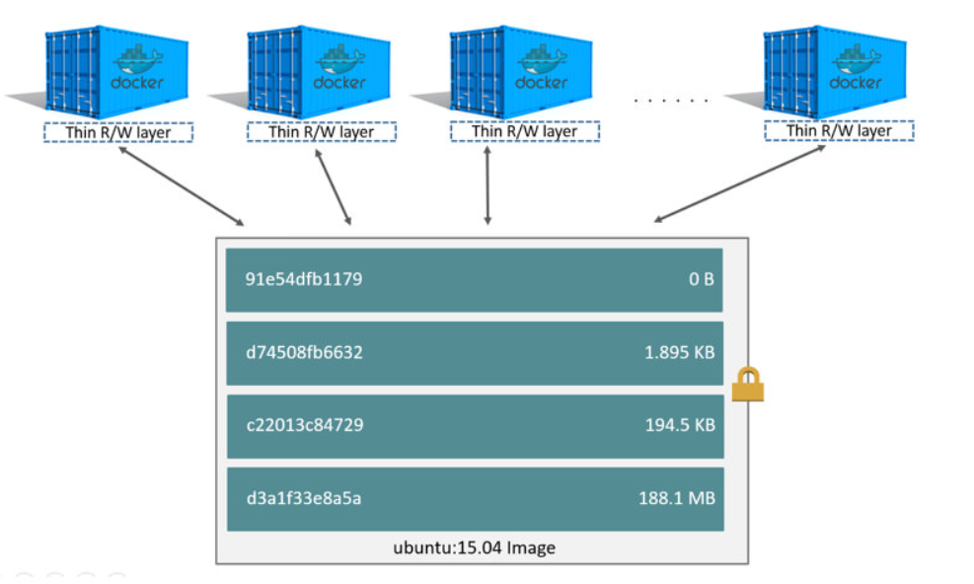
Running Multiple Containers from Image

Slide 4
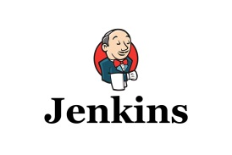
Package & Deploy before Docker
3
Deployment
Deployment
Build
1
APP Libraries x.x
APP Config
2
APP Server x.x
JVM x.x
OS
Builld Server
Runtime Server
Weaknesses
Building up the complete runtime stack over and over
Lifecycle each and every runtime component
Sync up runtime dependencies and configs

Slide 5
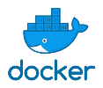
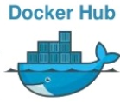


Package & Deploy with Docker
4
container
container
container
run
run
run
Runtime Server A
Runtime Server B
Runtime Server C
pull
3
pull
pull
Central Registry
2
push
Advantages
Image
Deployment
Central point for LifeCycling Runtimes
One build covering all Environments
Base Images reliably provided
APP Libraries x.x
APP Config
APP Server x.x
JVM x.x
reliable Base Image
from Vendor
1
Build
Builld Server

Slide 6
Key Benefits using Docker in JEE Development
Provides elegant mechanism to LifeCycle and Package our JEE Runtimes
Runtime garanteed to be identical over all SDLC phases
Ability to package Configurations and Infrastructure Dependencies
High level of Isolation -
Each containers owns it’s private resources isolated away from others
On removal, nothing is left behind on the host OS
Shorten time for Packaging and Delivering Runtimes to development teams
Encourages repeatable Development, Build, Test and Productional Delivery
CI/CD efficiency – fluently integrates with continuous integration tools (later more)
Runtime Security – completely segrated and isolated away from others

Slide 7
Constructing Custom Images – Build File
1. docker build –t MyNewImage –f DockerFile
1. FROM jboss/jboss-eap7.0.4:latest
2. COPY ./**/*.war /opt/jboss/wildfly/standalone/deployments
3. RUN curl --silent --insecure -o /opt/jboss/wildfly/bin/initial.cli https://jctd/rest/profile/cli/655
4. RUN /opt/jboss/wildfly/bin/execute.sh
5. EXPOSE 8080
6. CMD /opt/jboss/wildfly/bin/standalone.sh -b 0.0.0.0
docker run -d MyNewImage –p 8091:8080

Slide 8
Constructing Custom Images – Interactively
docker run –ti –name draft jboss/jboss-eap7.0.4:latest /bin/bash
"docker cp" additional artifacts into container
Apply BJB specific configuration changes
docker commit –m "lifecycle eapx.x.x" draft MyNewImage
docker rm draft
push MyNewImage to BJB central registry
docker run -d MyNewImage –p 8091:8080

Slide 9
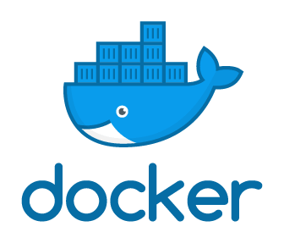
Bringing Visibility to the Team with PipeLines & Containers
Three Pillars of Scrum (Agile Development)
Transparancy (visibility) – ability to verify Code and Functionality
Inspection – Check quality of Code & Functionality
Adaption – Apply changes before moving to DONE (Merge to Master branch)
Every Development Branch gets a full featured Test Environment for running
Integration and Functional tests through a private Docker Container

Slide 10
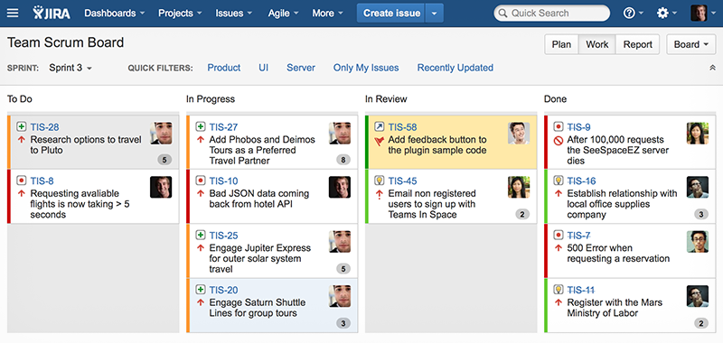
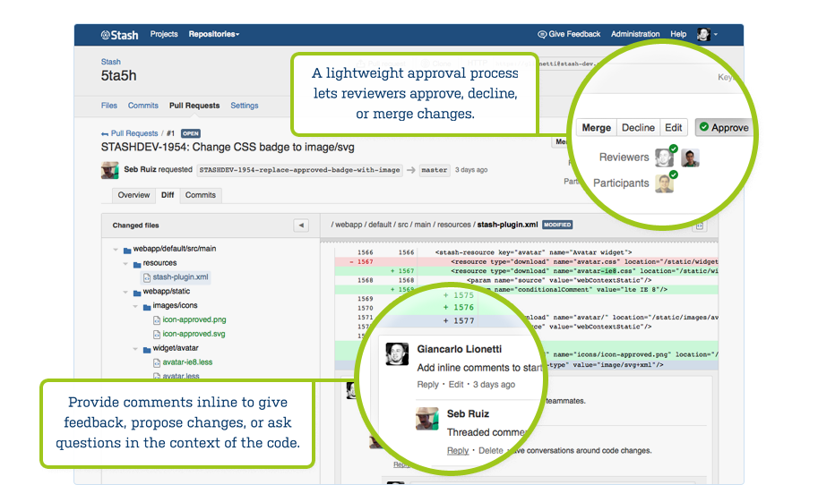

Development Process (Feature Branch Workflow) the before PipeLine/Docker situation
4
5
Branch level visibilty
Code visible !
Functionality not visible !
2
In Review - LightWeight Code Review
Atlassian JIRA Agile
1
In Progress -
Create feature branch
master
3
Atlassian Stash/Bitbucket

Slide 11
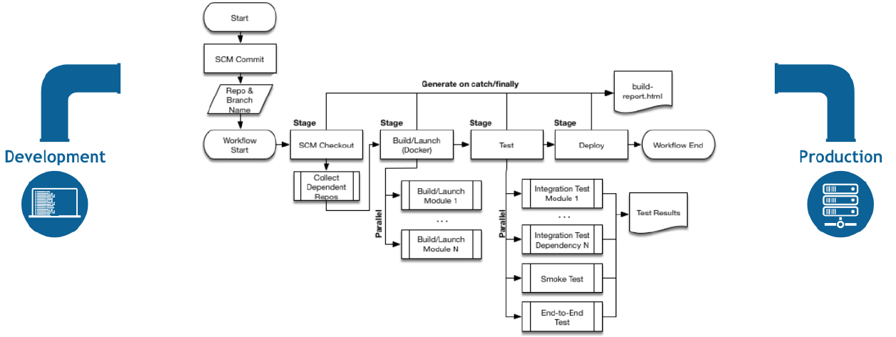
Docker & Jenkins PipeLine the perfect Marriage
About Jenkins Pipelines
Continuous Delivery to Docker Images and Containers
Pipeline-as-Code : Groovy (generified Java Language)
Fully featured and OO programming environment (Inheritance & Typing)
Offers flexibility and extensibility (shared libraries)
Checked into source control
Powerful integration JIRA, BitBucket and more through shared Libraries
Automatically create & cleanup Pipelines for all Branches
Requirements review/iteration on the Pipeline

Slide 12
Jenkins PipeLine – example Groovy Code
pipeline {
agent any
stages {
stage('Build') {
steps {
sh 'mvn -Dmaven.test.skip=true install'
}
}
stage('Docker') {
steps {
echo "Building Docker Image $BRANCHNAME:$VERSION“
sh "docker build --rm -t $BRANCHNAME:$VERSION ."
sh "docker rm -f $BRANCHNAME || exit 0"
sh "docker run -d -p $PORT:8080 --name=$BRANCHNAME
}
}
stage('JIRA') {
jiraAddComment idOrKey: calculateIssueKey(BRANCH_NAME) , comment: 'Test your application at http://xxxx:' + getfreeport().trim()
}
}
1
2
3

Slide 13



Jenkins PipeLine isolated Test Environment per feature Branch
<Build & Run workflow – for all Branches>
End
Build
Package
Run
Comment
Notify
On each
Commit
1
Java Build
Build Image
Start Container
URL to test page
Build Status
2
3
4
5
6

Slide 14
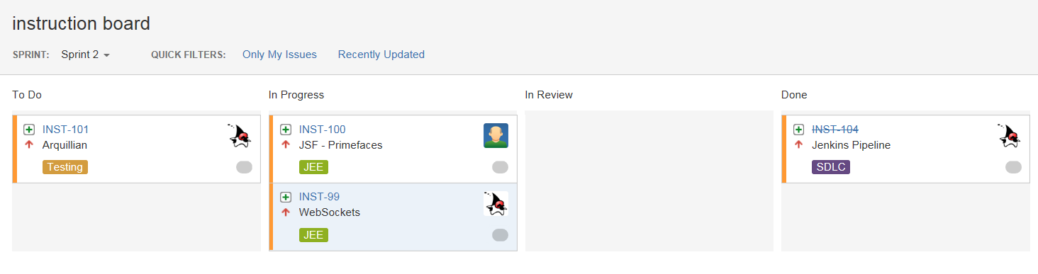
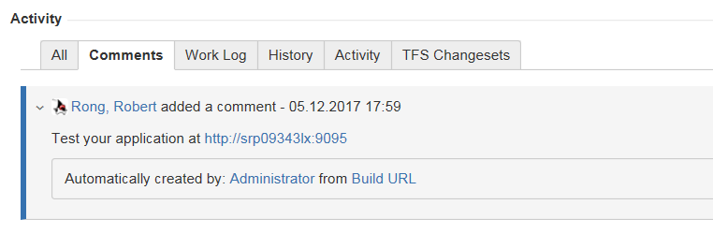
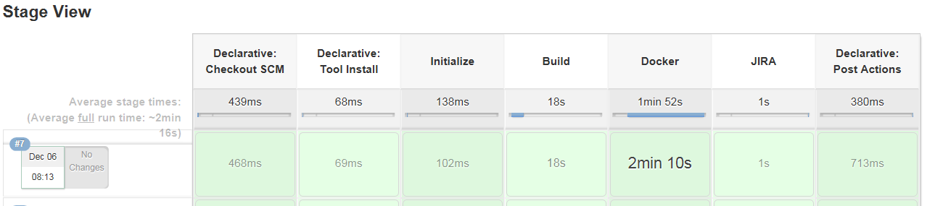
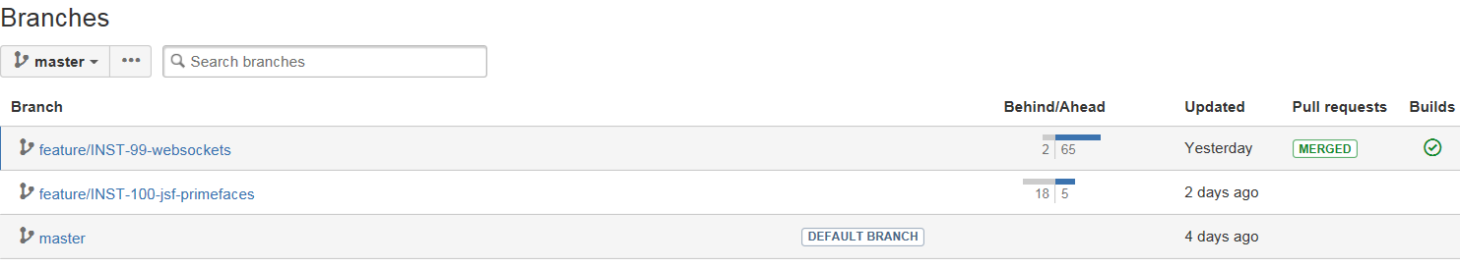

Scrum Board & Sprint
1
commit Code Change on Branch
2
comment testing URL on Ticket
trigger Branch specific Build
4
3
view Build Status on Bitbucket

Slide 15


Jenkins PipeLines – and the future
<Automating Provisioning to Productive environments>
End
REST
Package
Run
Update
Notify
On Deploy
1
Build Image
Status Mail
Pull Deployments
Start Container
Change Status
2
3
4
5
6
Full fledged BPMN 2.0 Workflow (decision, user interaction, fork… steps)
JIRA Ticket workflow triggers (Ticket State change tiggers Workflow to run)
Notification (JIRA ticket audit log , Email notifications….)
Full Backup & Recovery (revert deployments, change ticket status)
Graphical Workflow designer (Blue Ocean)

Slide 16
Wrapping up the Benefits
Software Packaging becomes simpler and saver
LifeCycling your Runtime stack largely delegated to the Software Vendor
LifeCycling BJB specific Components requires less effort
Share one transparent Runtime Stack over all SDLC Phases (dev, test, prod…)
Improved QA and Quality Gates before you ship out Products
Brings full Visibility to the X-Functional Development Team (Review, Inspection and Adaption)

