Slide 1
ELEC3844 Engineering Management and Society Organization structure
Dr. Wilton Fok

Slide 2
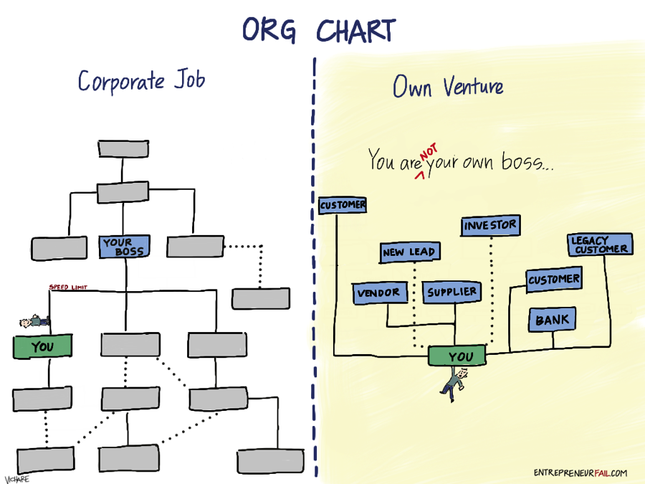

Locating your position in an organisation
When you graduate, many of you will work in a company, or run your own business.
The structure of the organization may be one of the factors for your success or failure!
You should be clear about your position and role, and the interactions with other colleagues
Where am I? Who is my boss?

Slide 3
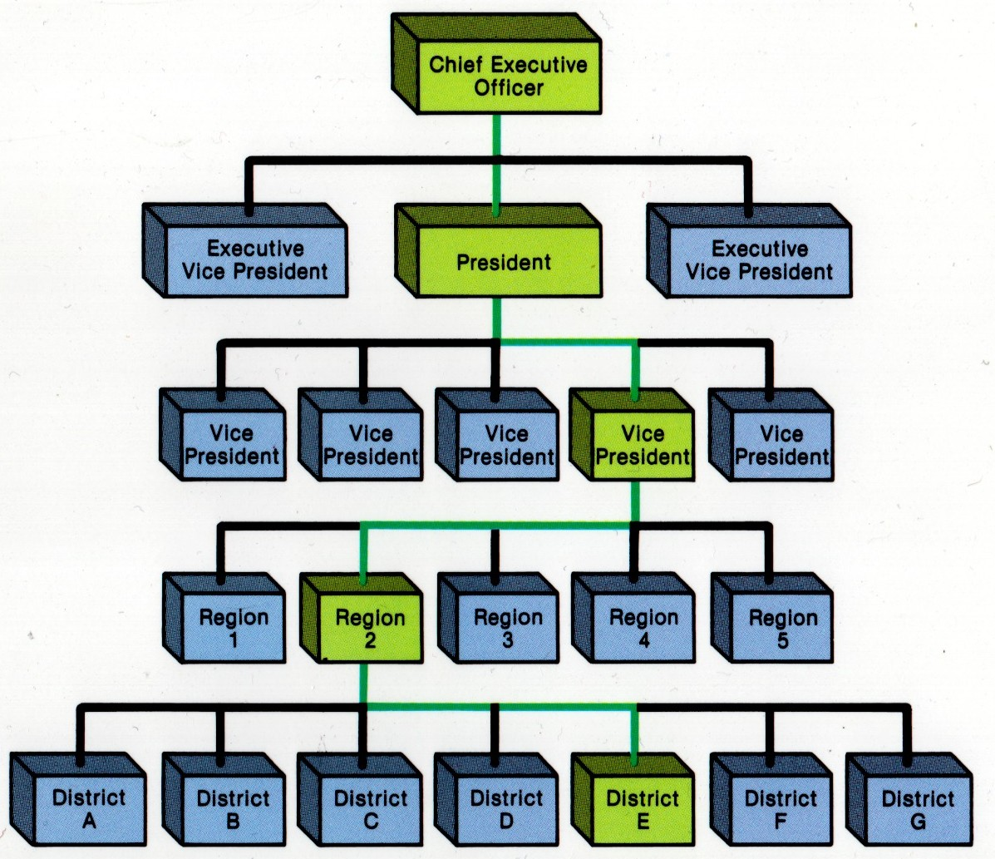
Organization Structure
Top
Middle
Front-Line

Slide 4
Organization Structure
4 main purposes of Organization Structure
Basic framework to link everybody with unity of command within which the executive’s decision-making behavior occurs.
Grouping of tasks/ activities for objectives which contributes to achievement of organization objectives.
Allocation of responsibilities to departments with an aim to minimize cost (time and money) and to maximize utilization of resources & efficiency .
Provision for power, authority, delegation & coordination to improve effectiveness of staff performance, decision making, and communication as well as to clarify accountability and obligation.

Slide 5
Organization Structure
Functional Structure
Divisional Structure
Matrix Structure

Slide 6


Functional structure
Employees within the functional divisions of an organization tend to perform a specialized set of tasks
E.g. engineering department would be staffed only with software engineers.

Slide 7
Departmentalization in Function Structure
Process departmentalization divides a firm according to production processes used to create a good or service
Functional departmentalization divides a firm according to a group’s functions or activities

Slide 8
Functional structure
Pros:
operational efficiencies within that group.
Cons
lack of communication between the functional groups within an organization, making the organization slow and inflexible.

Slide 9
Functional structure
Suitable for organizations when:
producer of standardized goods and services at large volume and low cost.
Coordination and specialization of tasks are centralized in a functional structure
→ makes producing a limited amount of products or services efficient and predictable.

Slide 10
Divisional structure
Also called a "product structure“
Groups each organizational function into a division.
Each division within a divisional structure contains all the necessary resources and functions within it.

Slide 11
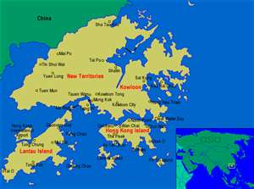
Divisional structure
Divisions can be categorized from different points of view. E.g.
Geographical basis
a US division and an EU division
Product/service basis
different products for different customers: households or companies
Customer base
Different customer segments: Government/ commercial customers

Slide 12




Divisional structure
E.g. an ICT company with a divisional structure might have:
1 division for Tablet PC
1 division for Desktop
another division for printer
Each division may have its own sales, engineering and marketing departments.

Slide 13
Divisional structure
Pros
Highly specialized
Best knowledge on the particular products
Cons
Costly: Large number of staff required
M divisions x N functions
Lack of flexibility

Slide 14
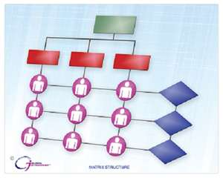
Matrix structure
Matrix structure groups employees by both function and product (division).
This structure can combine the best of both separate structures.
A matrix organization frequently uses teams of employees to accomplish work, in order to:
take advantage of the strengths,
make up for the weaknesses
People with similar skills are pooled for work assignments.

Slide 15
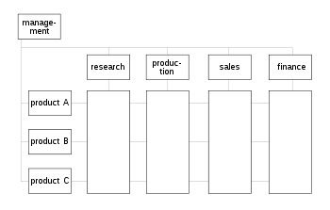
Matrix Structure
E.g.
Researchers in the research department report to the R&D manager
But these researcher may be assigned to different projects and report to a different engineering manager or a project manager while working on that project.
Therefore, each researcher may have to work under several managers to get their job done.

Slide 16
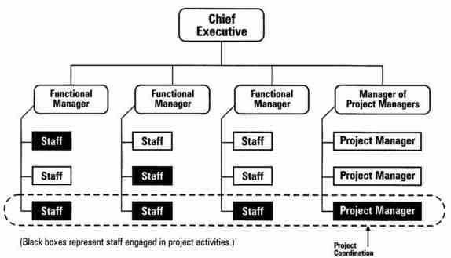
Actual structure

Slide 17


Discussion: What are the Pros and Cons of matrix structure?
Download and install “iClass Cloud” from Appstore”,
Setting> School: [HKU]
For other devices: hku.iclass.hk
Login through HKU Portal
Join the course: (code: GR5182)
Click the question “Pros and Cons of matrix structure”
Wipe the screen (Left and right) for next category
Submit word and click submit

Slide 18
Pros and Cons of matrix structure
Pros
Individuals can be chosen according to the needs of the project.
allows for specialization that can increase depth of knowledge and allow professional development and career progression to be managed.
The use of a project team which is dynamic and able to view problems in a different way as specialists have been brought together in a new environment.
it allows team members to share information more readily across task boundaries.
Project managers are directly responsible for completing the project within a specific deadline and budget.

Slide 19
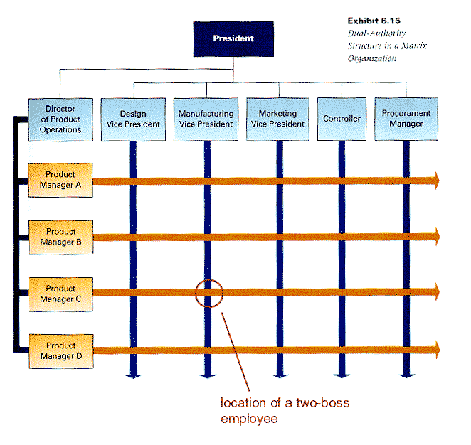
Pros and Cons of matrix structure
Cons
employees can become confused due to conflicting loyalties.
Solution: Need a proper managed cooperative environment to neutralize these disadvantages.
Doubles the number of managers when compared to line management
As the time to reach a decision increases with the number of managers the result may be an increase in management related overhead expenses.
Who is my boss?

Slide 20
Pros and Cons of matrix structure
Cons
Projects can be difficult to monitor if teams have a lot of independence.
Costs can be increased if more managers (i.e. project managers) are created through the use of project teams.

Slide 21



A bad example: Collapse of Barings Bank
Barings Bank (1762 to 1995) was the oldest merchant bank in London
The bank collapsed in 1995 after one of the bank's employees, Nick Leeson, lost £827 million ($1.3 billion) due to speculative investing, primarily in futures contracts, at the bank's Singapore office.
Direct boss
In the UK
Local boss
In Singapore

Slide 22
An hybrid of functional and divisional
Some organizations fall somewhere between the fully functional and pure matrix.
E.g.
even a fundamentally functional or matrix organization may create a special project team to handle a critical project.

Slide 23
Also called project-centered organizations
Project-centered organizations
have structures built around project teams as their functional units, matrix organizations follow the traditional structures, with some adjustments to their hierarchy to support project units.
E.g. engineering, construction or the aerospace industries

Slide 24
Types of Matrix Structure
Weak Matrix
Balanced Matrix
Strong Matrix
Functional
Divisional/Project

Slide 25
Weak/Functional Matrix:
A project manager with only limited authority is assigned to oversee the cross- functional aspects of the project.
The functional managers maintain control over their resources and project areas.

Slide 26
Balanced Matrix
A project manager is assigned to oversee the project.
Power is shared equally between the project manager and the functional managers.
Pros:
It brings the best aspects of functional and projectised organizations.
Cons
A difficult system to maintain as the sharing power is delicate proposition.

Slide 27

Strong/Project Matrix
A project manager is primarily responsible for the project.
Functional managers provide technical expertise and assign resources as needed.

Slide 28
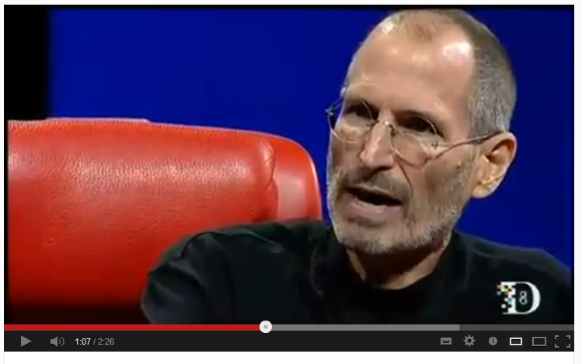
Learn from Steve Jobs Steve Jobs talks about managing people
http://www.youtube.com/watch?v=f60dheI4ARg

Slide 29
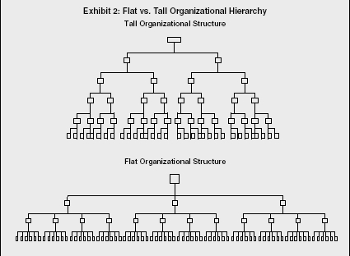
Cycle of organizational structure back to flat
The flat structure is common in small companies
entrepreneurial start-ups, university spin offs
As the company grows it becomes more complex and hierarchical, which leads to an expanded structure, with more levels and departments.

Slide 30
From flat to hierarchical Structure
Drawbacks
Result in bureaucracy, the most common structure in the past.
top-heavy and hierarchical, multiple levels of command and duplicate services existing in different regions.
Reluctant to market changes
Incapacity to grow and develop further.
→ move towards a matrix structure

Slide 31
The new trend
Forces of flattening organizational structure
Globalization,
Competition
More demanding customers
Structure of many companies has become:
Flatter
Less hierarchical
More fluid
Even virtual

Slide 32
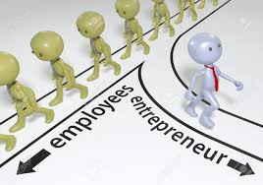
Organizational structure for start-up

Slide 35
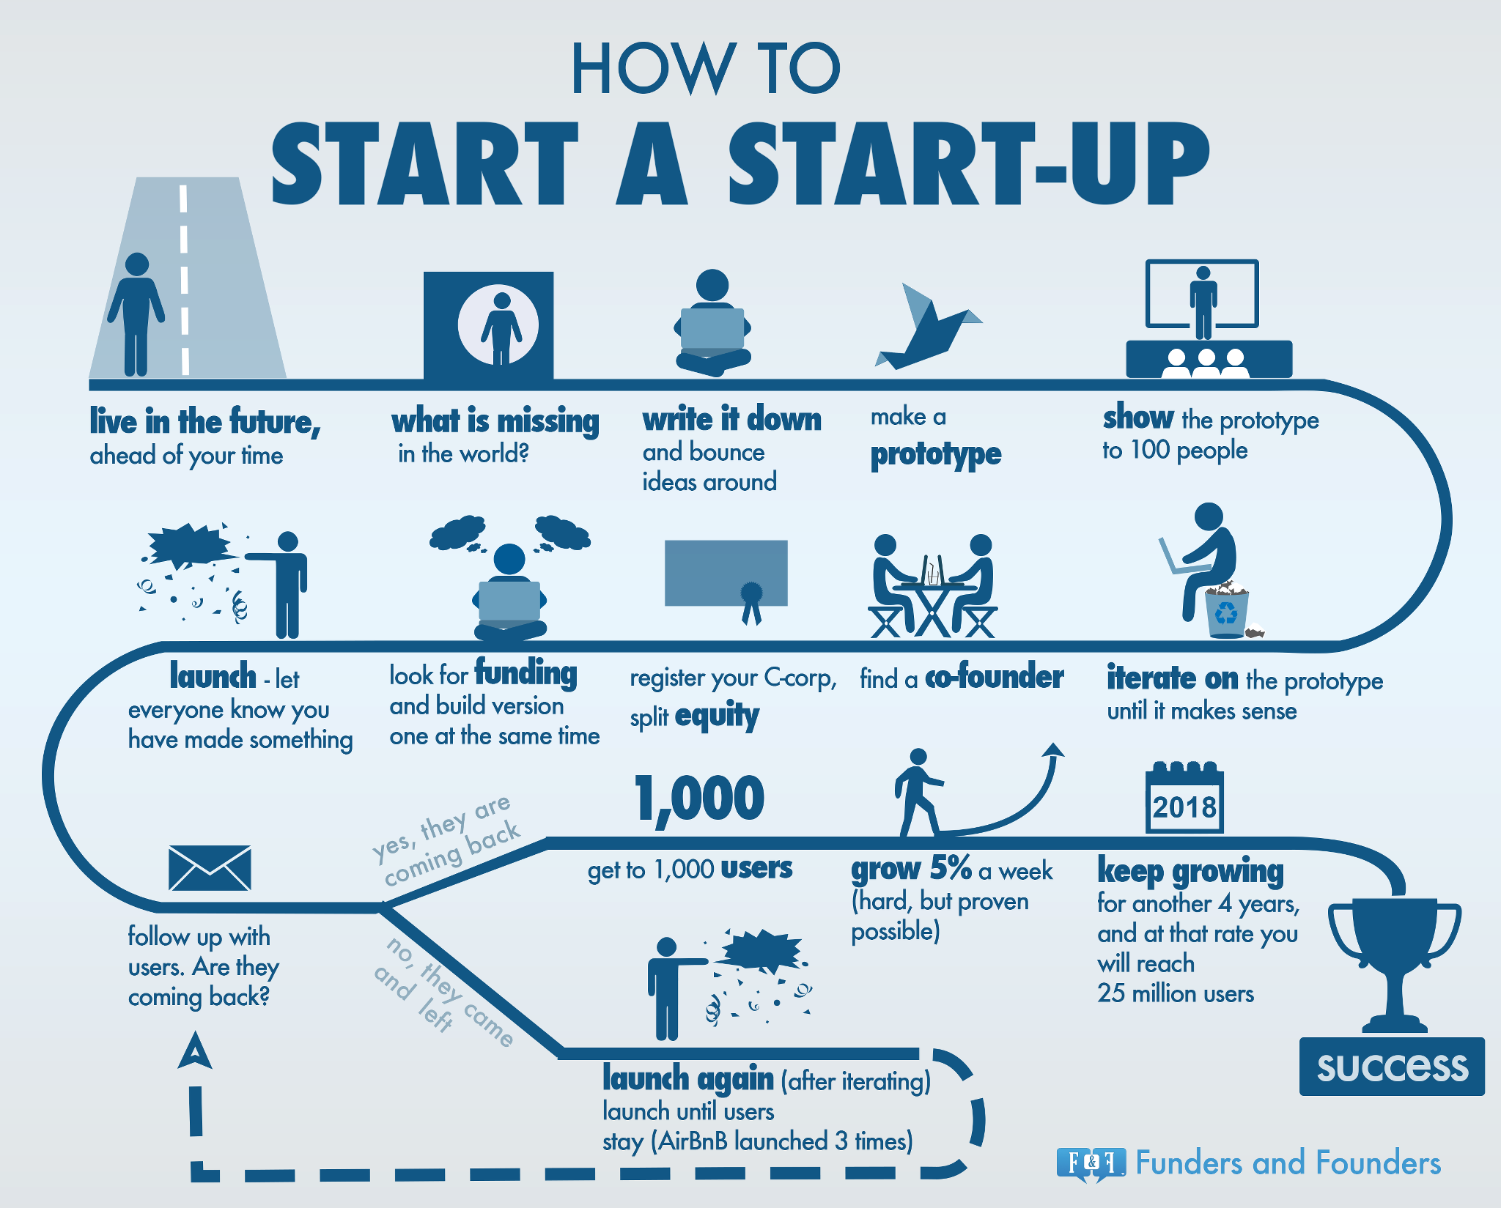

Slide 36
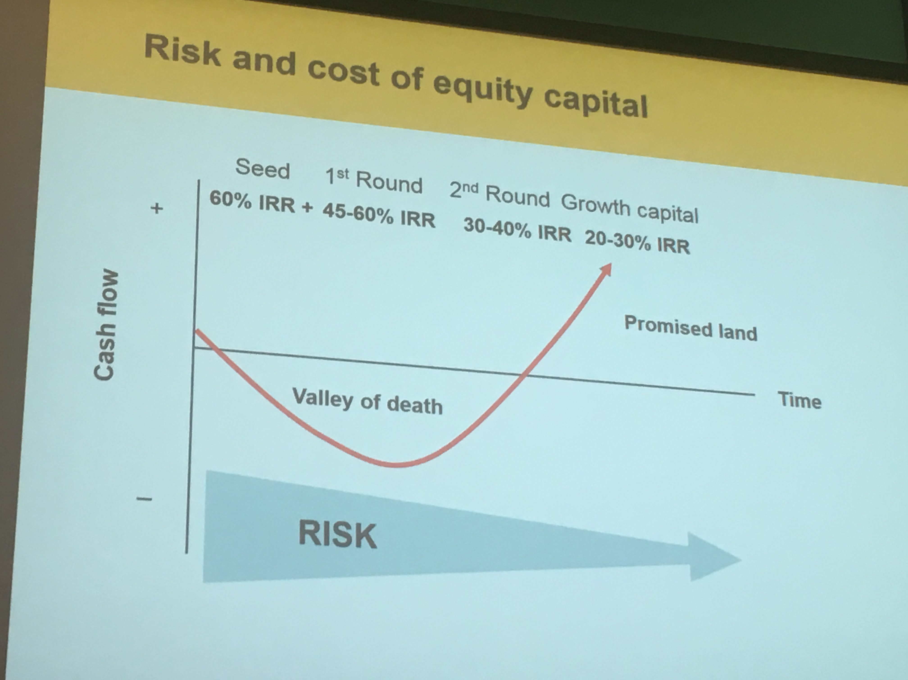
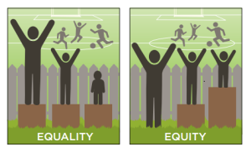
How to share the equity in the right way?

Slide 37
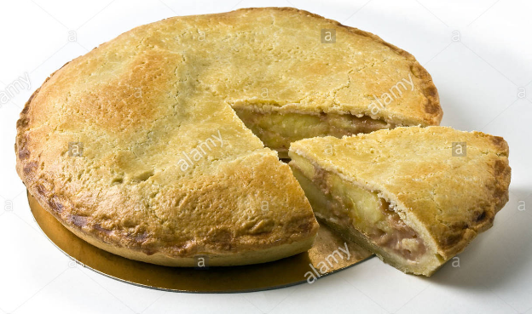
How to allocate the founder’s pie?
Stage 1: Think carefully about the divers of success in your new venture. Agree a weighting (1-10) for each of these
The idea
The core technology
Domain expertise
Commitment and risk
Role and responsibilities
Sweat equality
Social capital…etc.
 | Weight
The idea & technology | 6
Domain expertise | 2
Commitment and risk | 6
Role and responsibilities | 5
Sweat equality | 2
Social capital | 3

Slide 38
Stage 2
Consider the past, current and (likely )future contributions of each founding team member to the ultimate success of company. Score these from 1-10
 | Weight | Peter | Mary | John
The idea & technology | 6 | 10 | 5 | 0
Domain expertise | 2 | 4 | 3 | 4
Commitment and risk | 6 | 6 | 7 | 5
Role and responsibilities | 5 | 8 | 2 | 9
Sweat equality | 2 | 1 | 2 | 9
Social capital | 3 | 0 | 10 | 2

Slide 39
Stage 3: Multiply the weighting by the contribution to calculate the “fair” Share
 | Weight | Peter | Mary | John
The idea & technology | 6 | 60 | 30 | 0
Domain expertise | 2 | 8 | 6 | 8
Commitment and risk | 6 | 36 | 42 | 30
Role and responsibilities | 5 | 40 | 10 | 45
Sweat equality | 2 | 2 | 4 | 18
Social capital | 3 | 0 | 30 | 6
 |  | 146 | 122 | 107
 |  | 38.9% | 32.5% | 28.5%

Slide 40
Share vesting
Share vesting protects the interest of business and investors should someone become a bad leaver during the vesting period (usually 4 years)
It enables the company to buy back all, or a proportion of the leavers shares of the nominal value f those shares
A typical share vesting schedule
Founder leaves during year | Company buys back | Equity entitlement
1 | 100% | 0%
2 | 75% | 25%
3 | 50% | 50%
4 | 25% | 75%
5 | 0% | 100%

Slide 41
Tips for start-up
Balance between fairness, motivation, reward and productivities
Shares are valuable resources
→ don’t give away easily
Lack of cash flow for startup, stock option may be an option
→ give your employees a dream!
Beware of free-rider
→ Share vesting arrangement

Slide 42
Q&A

