Slide 1
Version Control (II)
GitHub

Slide 2
GitHub
GitHub is a remote storage service of git repositories
“(…) GitHub is a development platform inspired by the way you work (…)”
There…”(…) you can host and review code, manage projects, and build software (…)”
https://github.com/

Slide 3
Git
Create a Git repository on GitHub
Create GitHub account
Login in GitHub
Create an empty Git repository (without readme, .gitignore)

Slide 4
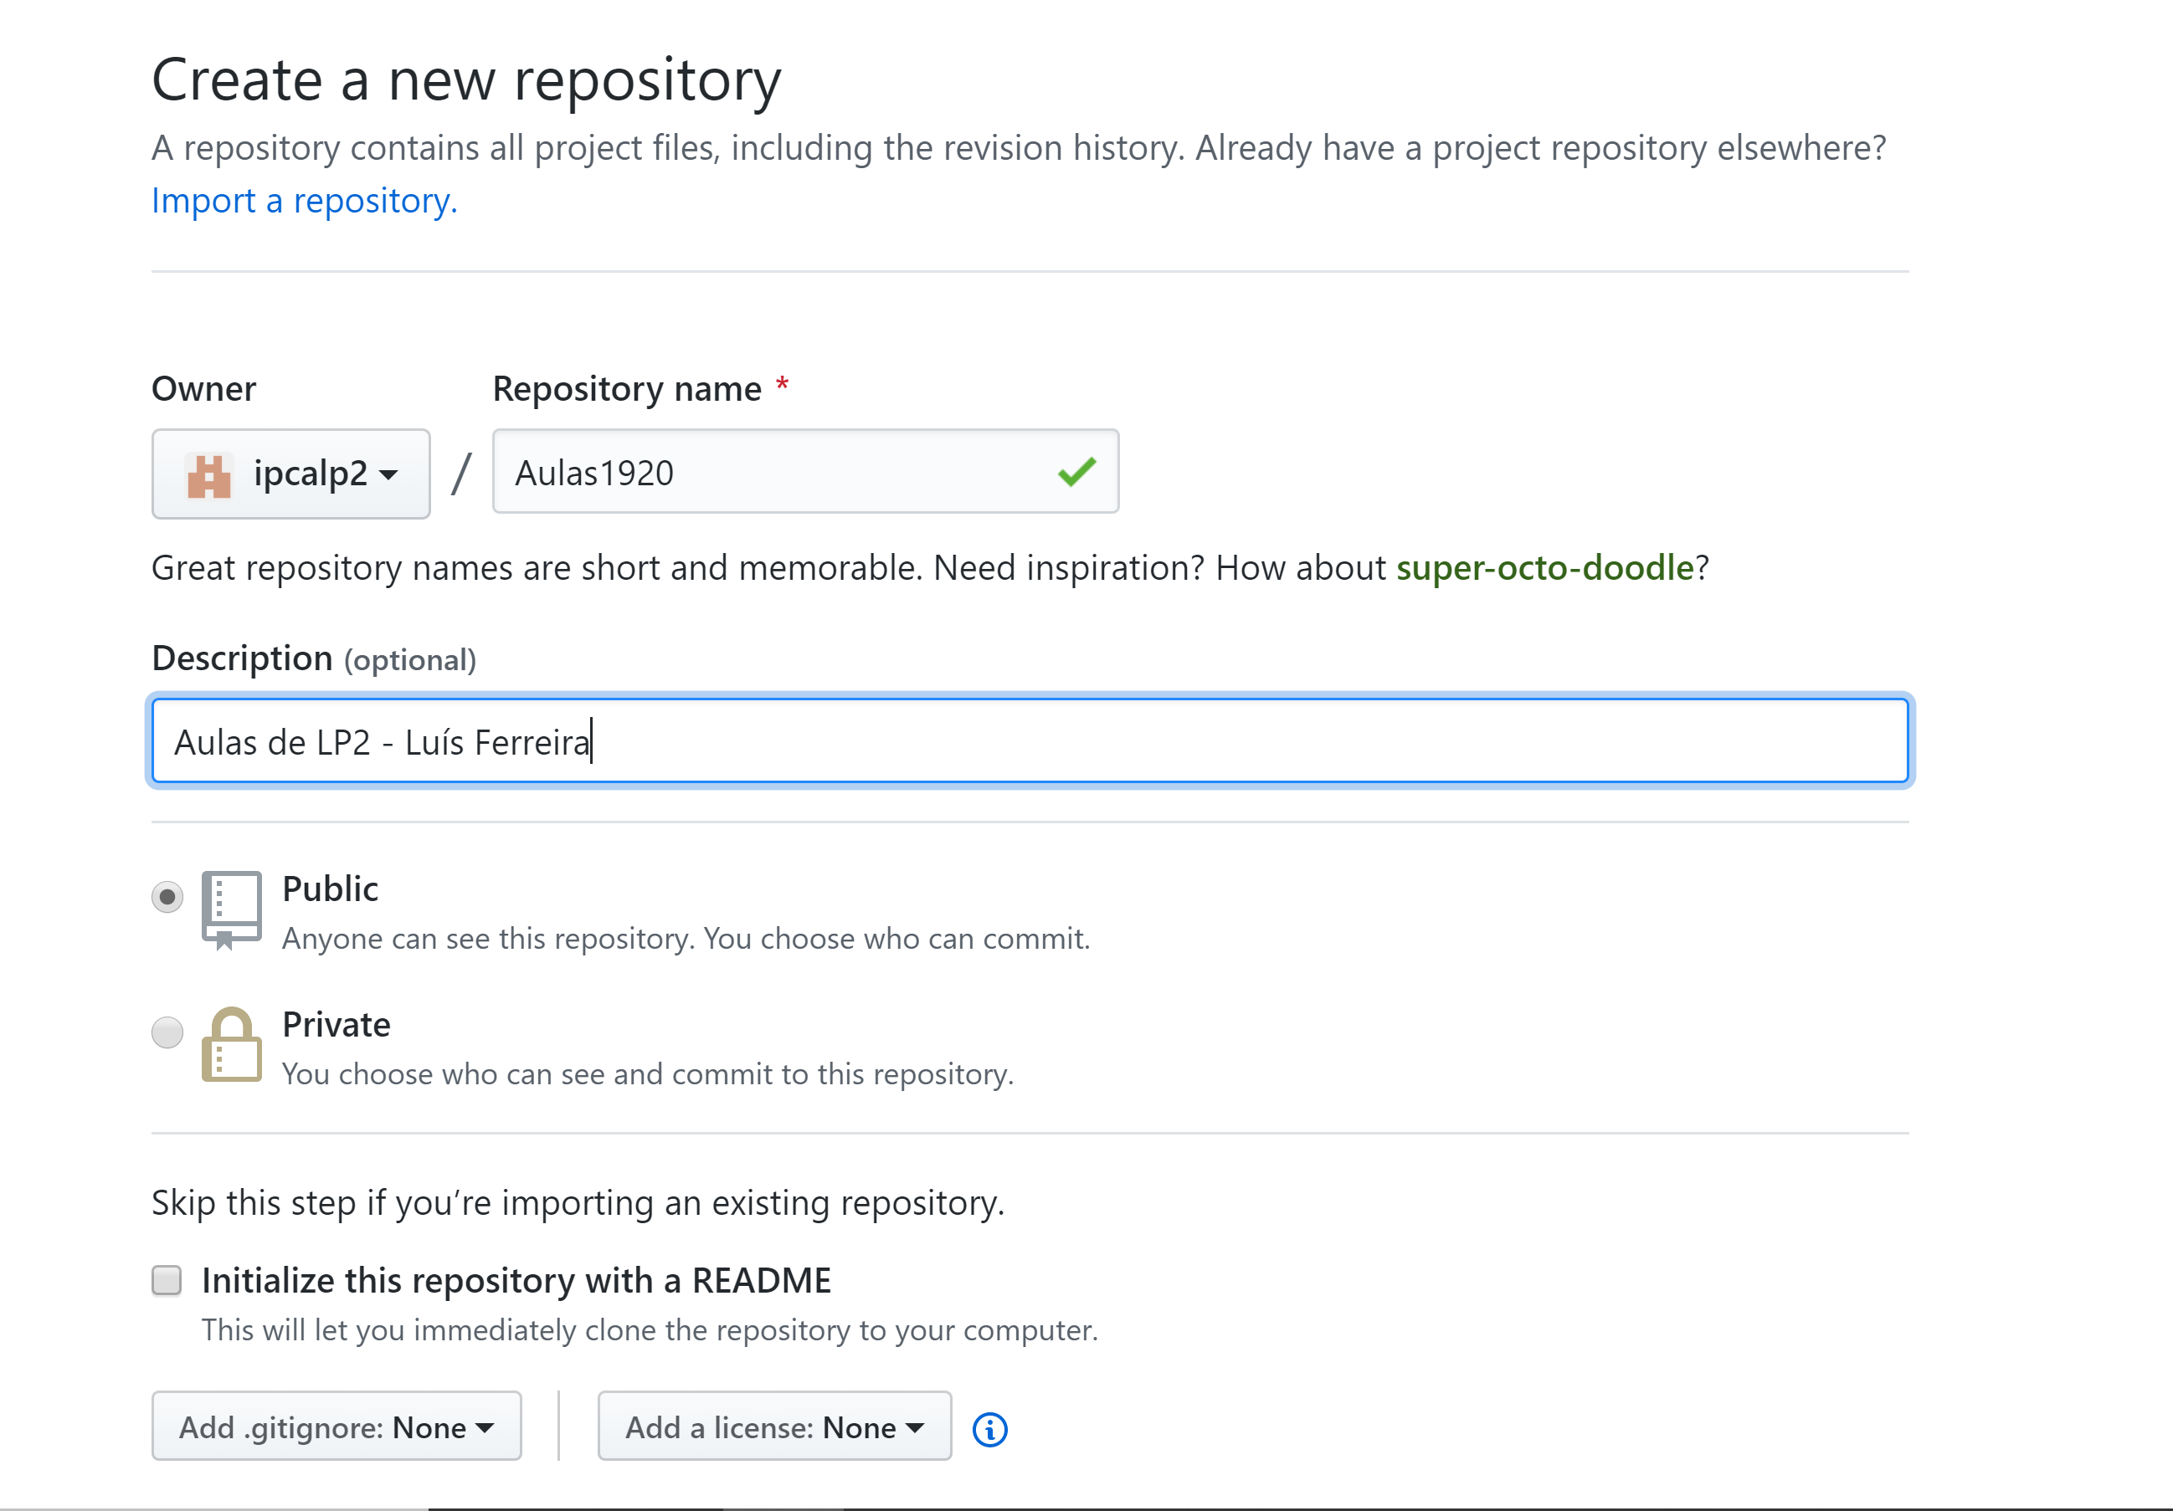
Git
Create a Git repository on GitHub
Create GitHub account
Login in GitHub
Create an empty Git repository (without readme, .gitignore)

Slide 5
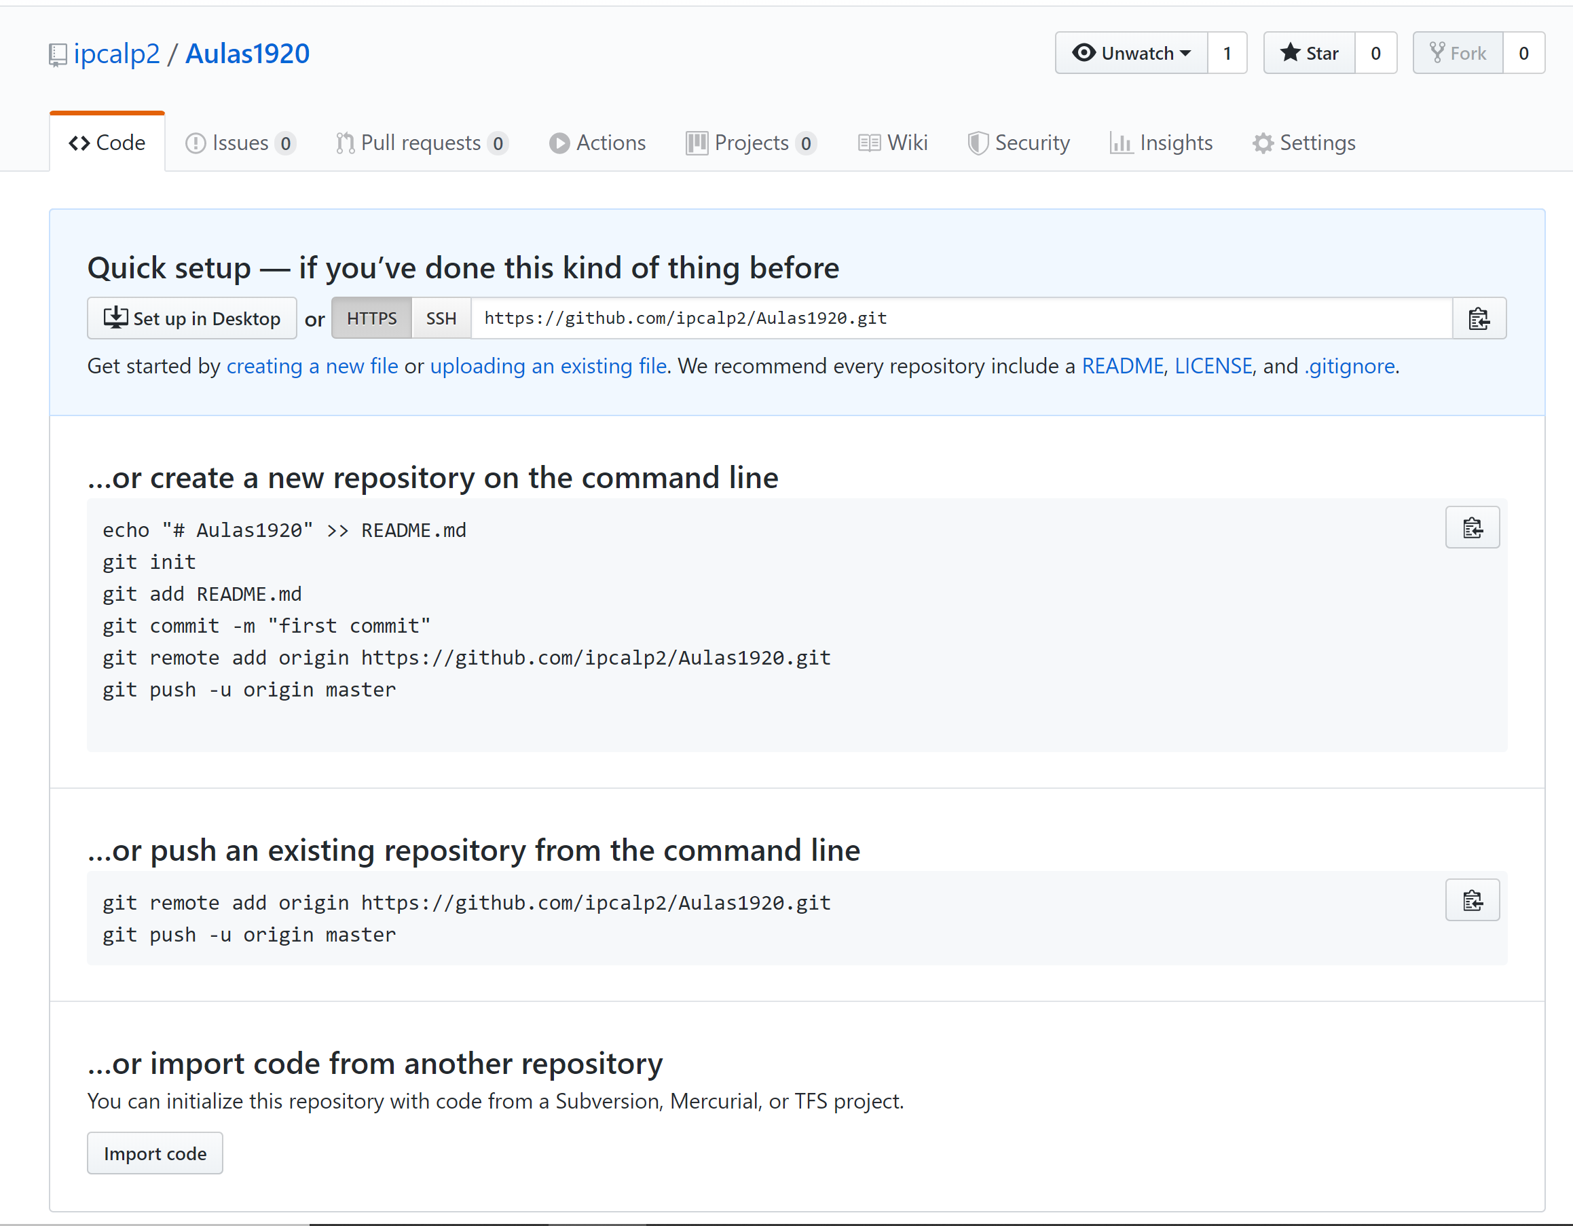
Git
Create a Git repository on GitHub
Create GitHub account
Login in GitHub
Create an empty Git repository (without readme, .gitignore)

Slide 6
Git
Associate remote Git repository to local one
Associate local repository to remote repository. Remote repository has local name “origin”
  git remote add origin <URI_GIT_Remote>
  Exemplo:
    git remote add origin https://github.com/ipcalp2/Aulas1920.git
Associate local repositor to another remote repository, maintaining the same name “origin”
  git remote set-url origin <URI_GIT_Remote>

Slide 7
Git
Associate remote Git repository to local one
Check if the association worked:
  git remote –v
Check that the remote URL is correct
  git remote show origin
$ git remote -v
origin https://github.com/ipcalp2/Aulas1920.git (fetch)
origin https://github.com/ipcalp2/Aulas1920.git (push)

Slide 8
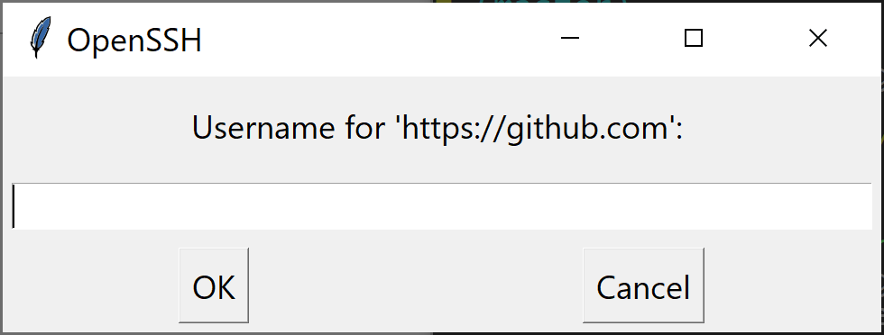
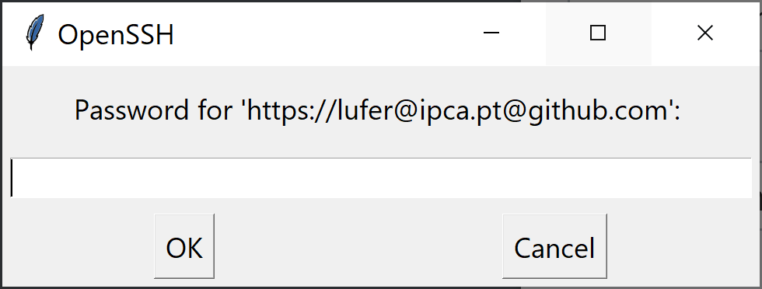
Git
Pushing local changes to remote Git
Synchronizing both repositories. Send local to remote
  git push -u origin master // remote git name is “origin” // branch name “is master”
  Set credentials

Slide 9
Git
Pushing local changes to remote Git
Synchronizing both repositories
  - Any local changes must be “pushed” to remote Git
  git push / / only in the first time requires “–u”
  Exercise:
    change local code
      - actualize local git with that change
      git add .
      git commit –m “Local change”
    synchronize remote git with local changes
      git push

Slide 10
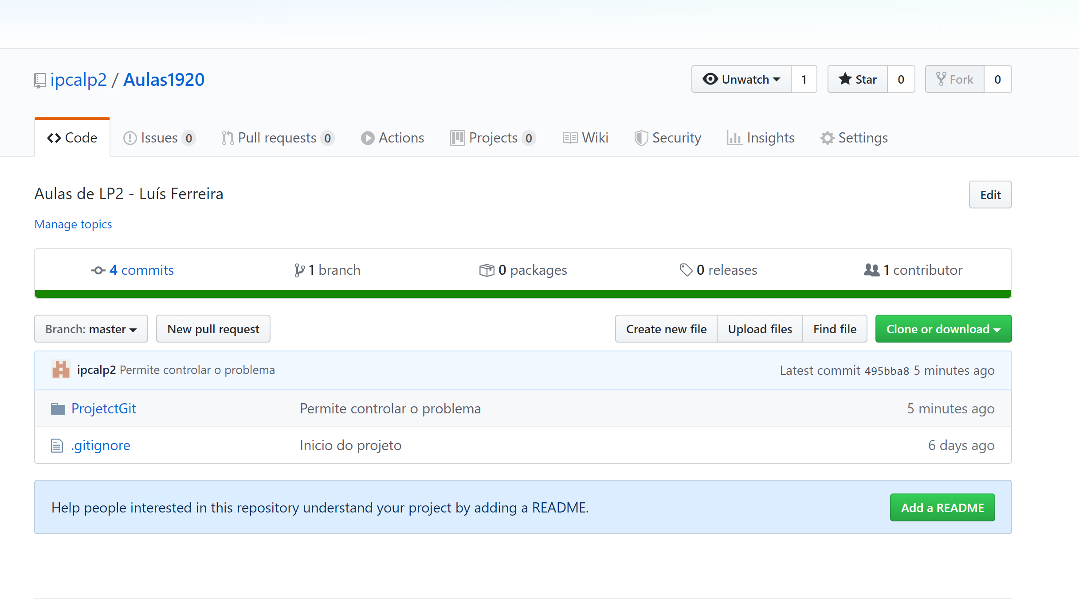
Git
Pushing local changes to remote Git
Synchronizing both repositories. Send local git to remote git:
  - Any local changes must be “pushed” to remote Git
  git push
  Exercise:
    change local code
      - actualize local Git with these changes
      git add .
      git commit –m “Local change”
    synchronize remote git with local changes
      git push

Slide 11
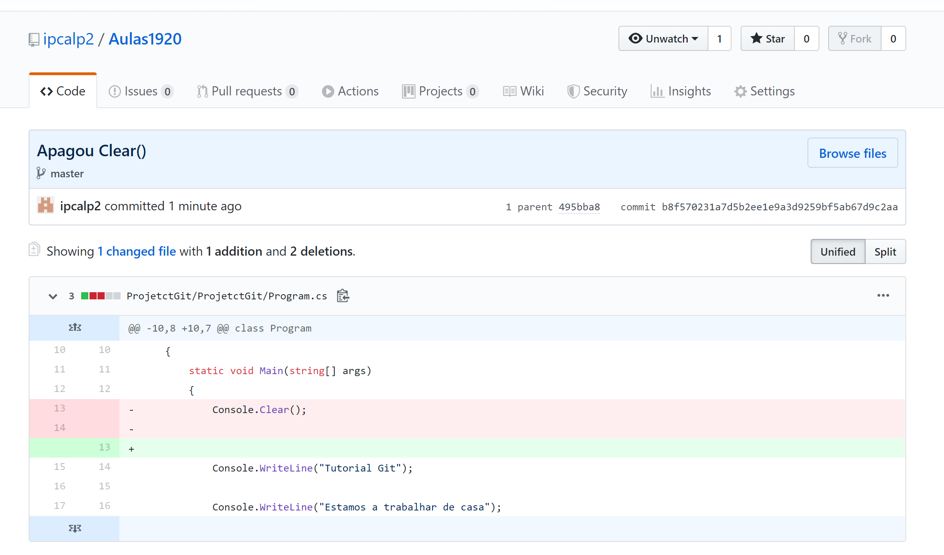
Git
Pushing local changes to remote Git
Synchronizing both repositories. Send local git to remote git:
  - Any local changes must be “pushed” to remote Git
  git push
  Exercise:
    change local code
      - actualize local Git with these changes
      git add .
      git commit –m “Local change”
    synchronize remote git with local changes
      git push
Red:
Deleted code
Green:
Inserted code

Slide 12
Git
Pushing local changes to remote Git
Saving credentials
  Cache //default 15 minutes
  Local File // PATH: C:\Users\<username>\.git-credentials
  Credentials Manager
    https://github.com/Microsoft/Git-Credential-Manager-for-Windows
https://git-scm.com/book/en/v2/Git-Tools-Credential-Storage

Slide 13
Git
Pushing local changes to remote Git
Saving credentials in local file
  git config credential.helper store [--file filename]
  default text file name: .git-credentials
  Path: C:\Users\<username>\.git-credentials
  Example:
  git config credential.helper 'store --file ~/.my-credentials'
https://git-scm.com/docs/git-credential-store

Slide 14
Git
Pushing local changes to remote Git
Saving Credentials in Cache
  git config credential.helper cache [--timeout <seconds>]
  default time: 15 minutes (9000 s)
  Example for 5 minutes:
    git config credential.helper 'cache --timeout=300'
https://git-scm.com/docs/git-credential-cache

Slide 15
Git
Transfer remote repository to local PC
Create a full local copy of remote repository
  git clone URL
    git clone https://github.com/ipcalp2/AulasLP2-19-20.git
  Attention: downloading files from github does not copy the git history

Slide 16
Git
Check if a git remote is properly synced
Check if local repository is synced with remote one
  git fetch
  git diff master origin/master

Slide 17
Git
Local and remote repository synchronization
Synchronizing local and remote repositories
  git pull
  Attention: It is not possible to push if the local and remote commits are not synced

Slide 18
Git Hub
More…
Managing conflicts
Several users
Several branches
https://help.github.com/en/github

Slide 19
Git
Local and remote repository synchronization
Reset local repository
  git reset --hard origin/branch-name
  git reset --hard HEAD
  Exemplo:
  git reset –hard origin/master
https://codewithhugo.com/fix-git-failed-to-push-updates-were-rejected/

Slide 20
Git
Git/GitHub References
https://github.com/
https://help.github.com/en/github
https://git-scm.com/book/en/v2/Getting-Started-First-Time-Git-Setup
https://swcarpentry.github.io/git-novice/
https://stateofther.github.io/finistR2019/d-utilisation_GitHub.html
https://marklodato.github.io/visual-git-guide/index-en.html

