Slide 1
JavaScript and Node.JS
A brief introduction

Slide 2
Agenda
Configure your environment and tools
A reintroduction to JavaScript
Language news and Core node modules
Node.JS testing
Buffers and Streams
Compatibility with browsers
Build and deploy a node.js server
Code documenting
Useful small modules

Slide 3
Configure your environment and tools
See https://github.com/ocroz/js-trials/tree/master/install
git/
bash/
node-and-npm/
shell-on-windows/
sublime-text-3/

Slide 4
A reintroduction to JavaScript
But what is JavaScript?
Javascript best asynchronous
Node.JS event loop
Node.JS vs Play Framework
Strict
Coding styles
Async/Await vs Callback hell/Pyramid of doom

Slide 5
But what is JavaScript?
JavaScript is notorious for being the world's most misunderstood programming language.
See https://developer.mozilla.org/en-US/docs/Web/JavaScript/A_re-introduction_to_JavaScript
Dynamic client-side scripting
JavaScript is a programming language that allows you to implement complex things on web pages. It is the third layer of the layer cake of standard web technologies along with HTML and CSS.
Server-side website programming
JavaScript allows to create dynamic websites too; websites that deliver customised information in response to HTTP requests.

Slide 6
Javascript is best asynchronous
Javascript is (one of) the most faster, reliable, and efficient programming language for Web Server/Client Applications as of today.
Javascript provides faster responses while using less hardware resources.
It recompiles any code at any time at runtime,
Javascript uses only one thread and asynchronous mechanismes to run other pending tasks when the process is waiting (better than thread sleep)

Slide 7
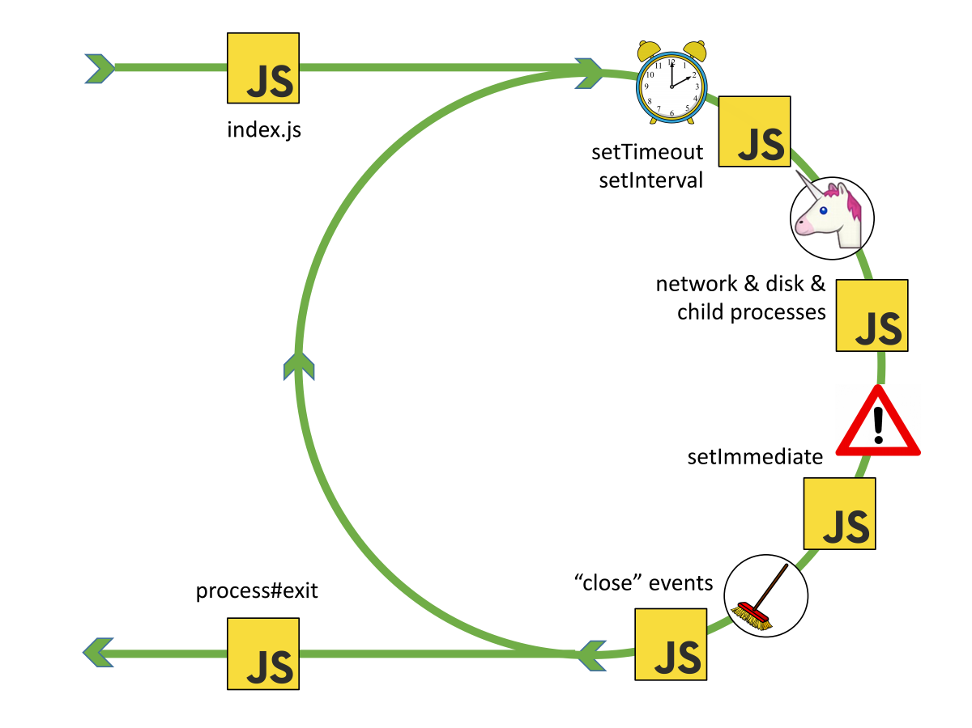
Node.JS event loop
https://drive.google.com/file/d/0B1ENiZwmJ_J2a09DUmZROV9oSGc/view

Slide 8
Node.JS vs Play Framework
Play Framework: with Java (JVM), Scala, Akka
https://www.slideshare.net/brikis98/nodejs-vs-play-framework
See the conclusion when to use node.js or play
Node.JS Maintenance: The bad parts
'==', var scope, a+b (!types), this, callback hell
How to fight that?

Slide 9
'use strict'
Throw errors: typedef, syntax, reference, etc.
https://developer.mozilla.org/en/docs/Web/JavaScript/Reference/Strict_mode
This syntax has a trap {...}. It is thus recommended that you enable strict mode on a function-by-function basis.
PS: From the tests I did, bundling javascript files via browserify or webpack uses function closures so a 'use strict' on the top of a javascript file falls on the top inside of a function in the javascript bundle.

Slide 10
Coding styles
Code linting = static analysis to find problematic patterns or code that doesn’t adhere to certain style guidelines.
See https://www.sitepoint.com/comparison-javascript-linting-tools/
The first linter for JavaScript was JSLint. It is very opinionated.
The next step to JSLint was JSHint. It allowed for more customization.
ESLint (http://eslint.org/) is the newest tool in vogue. It has learned from its predecessors and takes linting to the next level.
standard (https://standardjs.com/) powered by ESLint
One JavaScript Style to Rule Them All
No configuration,
Automatically format code,
Catch style issues & programmer errors early.
semistandard - standard, with semicolons (if you must)
ESLint & standard well integrated with ST3, webpack…
See https://github.com/ocroz/js-trials/tree/master/tutos/coding-style

Slide 11
Async/Await vs Callback hell or Pyramid of doom
https://github.com/tdd/async-variations
Callback hell or Pyramid of doom
Async/Await
spawnCommand('git', 'init', () => { spawnCommand('git', 'add', __filename, 'package.json', 'package-lock.json', '.gitignore', () => { spawnCommand('git', 'commit', '-m', '"Initial import"') }) })
(async () => { await spawnCommand('git', 'init') await spawnCommand('git', 'add', __filename, 'package.json', 'package-lock.json', '.gitignore') await spawnCommand('git', 'commit', '-m', '"Initial import"') })()

Slide 12
Some other best practices
No shebang
#!node // not runable under browser
'use strict‘
A clean javascript has no traditional loop anymore
array.sort((a,b) => a-b) // sort alpha numeric
array.sort((s1,s2) => s1.localCompare(s2)) // sort upper/lower case (-i)
A clean javascript uses no jquery (use react…) and no ajax (use fetch…)

Slide 13
Language news
Objects and Classes: classes more strict than objects
Class extends, super, and static: specific to classes
Concise properties and methods: (Next slide)
Destructurations: const { Strategy: TwitterStrategy } = require('passport-twitter')
Spread and Rest: function rest (option, ...arr) { console.log(arr) }; rest(...array); // spread array to rest()
Default value: function (option = {}) { ... }; Object.assign(defaultobject, { newprop: true });
Template string: `this is a multilines \n text with \n variable ${string}.`
let and const (not deep immutable)
Arrow functions: (error, data) => { if (!error) console.log(data) }
Map and Set: myMap.map(key,val); mySet.set(key); myMap.get(key); for (let thisSet of mySet) { ... };
Named exports/imports [ES2018]: import { Strategy as TwitterStrategy } from 'passport-twitter'
Configurable modules
https://team.goodeggs.com/export-this-interface-design-patterns-for-node-js-modules-b48a3b1f8f40
Promisees, error first, then/catch (error neutralized when catched like a try/catch)
https://developer.mozilla.org/en-US/docs/Web/JavaScript/Guide/Using_promises
http://bevacqua.github.io/promisees/ (promise visualization playground for the adventurous)
Async functions best with ASYNC/AWAIT (ES2017)
https://developer.mozilla.org/en-US/docs/Web/JavaScript/Reference/Statements/async_function

Slide 14
Concise properties and methods
var [first, last, age, propName] = ["Olivier","Crozier",42,"date"];
var object = {
first,
last,
age,
[propName]: new Date(),
greet () { return "Hello, my name is " + this.first; },
get fullName () { return this.first + ' ' + this.last; },
};
// -> {first: "Olivier", last: "Crozier", age: 42, date: "now", greet: function greet() {return...} }
object.greet(); // -> Concise method
object.fullName; // -> Concise property

Slide 15
Core node modules
console: log, error, trace, assert…
util: format, inspect…
process: on, stdin, kill, exit, nextTick(fn)
os: platform, cpus, uptime, totalmem…
fs: readdir, stat, readFile, chown, link, watch…
Global objects:
global (window in browser) === this (excepted if 'use strict')
process and console
Buffer from module buffer
require, module, exports
__dirname, __filename
setTimeout, clearTimeout, setInterval, clearInterval, from timers

Slide 16
Other core node modules in brief
events : event manager
path, url, querystring and punycode : management of paths and URLs
stream : the core of node
net, dns, http, https and dgram : the network in all its states
timers : because setImmediate
zlib : because Zip and Gzip, it's basic
readline, repl and tty : for a fun interactive experience in a terminal
crypto, tls : security before all
assert : simple assertions for automated tests
domain : exception capture contexts (FBI !)
child_process and cluster :
It is not because we are mono-thread that we cannot exploit the multi-core.
vm : for the mad scientists

Slide 17
Node.JS testing
Useful npm modules
jest: testing framework
cross-env: 'cross-env NODE_ENV=dev jest'
chai: advanced syntaxes on "assert", "should", and "expect" functions
sinon & sinon-chai: spy and stub modules or functions
nightmare: high-level browser automation library
'--watch' automatically restart the test on code saves
See https://github.com/ocroz/js-trials/tree/master/tutos/is-node

Slide 18
Buffers and Streams
spawn system commands
write, read, or tail files
fetch URLs with GET, POST, PUT, DELETE methods
pipe streams of type readable, transform, or write
receive/send buffer chunks of data from/to a stream
'npm install through2' provides an easy way to transform streams via a function
See:
https://nodejs.org/api/stream.html
https://gist.github.com/joyrexus/10026630
https://community.risingstack.com/the-definitive-guide-to-object-streams-in-node-js/
See https://github.com/ocroz/js-trials/tree/master/studies/node/async

Slide 19
Compatibility with browsers
See https://kangax.github.io/compat-table/es6/
Or use babel (code transpiling)
Well integrated with webpack
Code replacement*, bundles (code splitting), loaders (ex babel) and plugins (ex optimise), hot module replacements (reinjected within the page without reloading it), tree shaking (rm unused).
*Example of reusable code:
fetch() in browser
'node-fetch' in node
PS: lebab – the other way
See https://github.com/ocroz/js-trials/tree/master/tutos/fetch-anywhere
See https://github.com/ocroz/js-trials/tree/master/tutos/zero-to-webpack

Slide 20
Build and deploy a node.js server
A simple server with express and pug
server possible actions:
receive http requests of method GET, POST...
render html (thanks you jade) including javascript,
redirect to another page,
return json (web api)…
nodemon, webpack --watch
See https://github.com/ocroz/js-trials/tree/master/tutos/express-pug

Slide 21
Advanced server & server deployment
A more advanced server
mongo and mongoose: Database and JS connector with our models
passport: Authentication with any strategy such as saml, facebook, twitter…
websocket: Send data from the backend server & Process data on received event from the frontend browser
react: To create large web applications that use data which can change over time, without reloading the page
Server deployment
pm2 monit // or via https://keymetrics.io/
pm2 start --name wazaaa -i max src/boot.js
pm2 list // or ls
pm2 show wazaaa
See https://github.com/ocroz/js-trials/tree/master/studies/webnode/wazaaa
PS: See 'src/boot.js' which allows to use the named export/import from ES2018.

Slide 22
Code documenting
Use groc on your annoted code
Example
https://github.com/ocroz/js-trials/tree/master/install/git/Training-Git-Total.zip
index.html > §Introduction > §Training slides and exercises > Link git-total-training.zip
node-js-training > app > doc > app.html

Slide 23
Useful small modules
Don't reinvent the wheel:
lodash for so many methods on any kind of js objects: we can load all submodules at once or only parts
q-io/fs for recursive fs commands such as mkdir, unlink, copy
debug for clever debug messages
nconf for persistent configuration from argv, process.env, or any json (ex a config file)
colors for printing colored message to the console
optimist for loading argv as a hash (like nconf does)
commander for a complete argv processing with either short option or long option for the same parameter, etc.
event-stream for any stream transforming
See https://delicious-insights.com/fr/articles/libs-node-js/ (in French)

Slide 24
Questions on what we reviewed?
Configure your environment and tools
A reintroduction to JavaScript
Language news and Core node modules
Node.JS testing
Buffers and Streams
Compatibility with browsers
Build and deploy a node.js server
Code documenting
Useful small modules

