Slide 1
Data Manipulation with Tidy Tools
OCRUG Data Science Hackathon
11-09-2019
Presented by:
Arlo Randall
arlorandall@gmail.com

Slide 2
Outline
Resources
Presentation by Alyssa Columbus at Previous OCRUG Hackathon
R for Data Science by Garrett Grolemund & Hadley Wickham
Tidy Data
Example Dataset - NFL rushing data
Example Dataset – Protein Microarray Data from Vaccine Study

Slide 3
Presentation from last Hackathon
Free online version:
Presentation on RPubs
http://rpubs.com/acolumbus/ocrug-data-manipulation-with-tidy-tools
Source files
https://github.com/ocrug/hackathon-2019-05/tree/master/tutorials/data-manipulation-with-tidy-tools

Slide 4
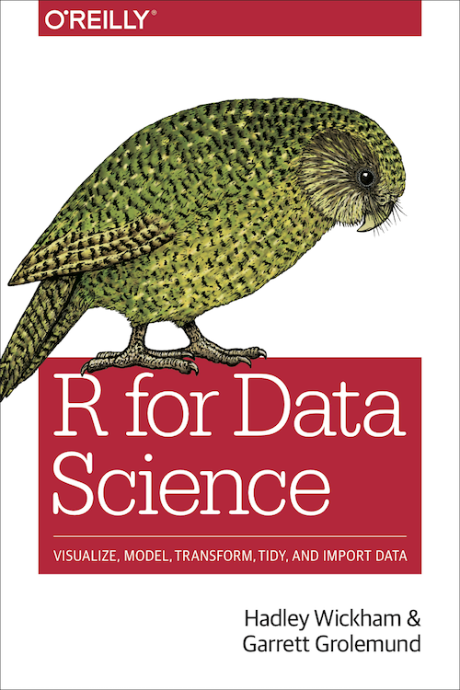
R for Data Science
Free online version:
https://r4ds.had.co.nz/
Code examples on github:
https://github.com/Hadley/r4ds

Slide 5
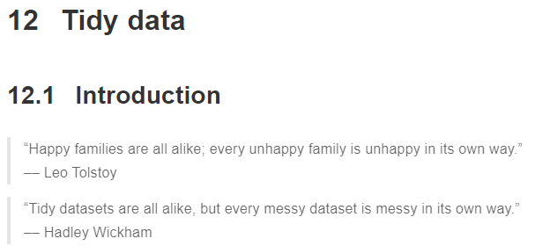

Slide 6
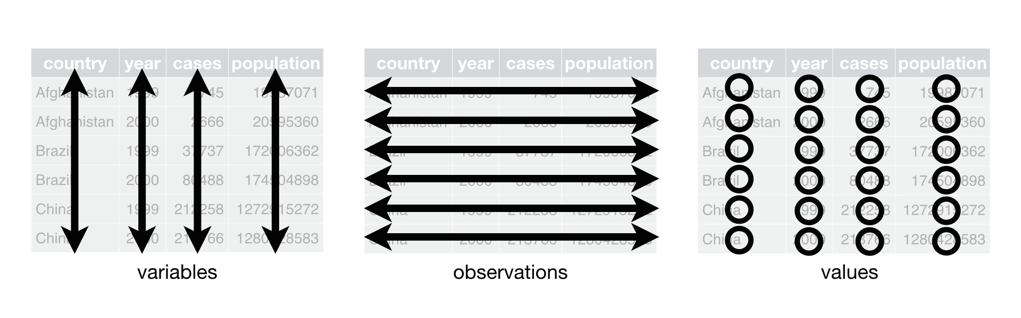
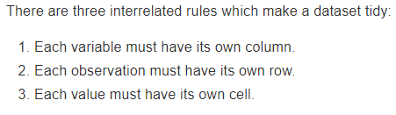
12.2 Tidy Data

Slide 7
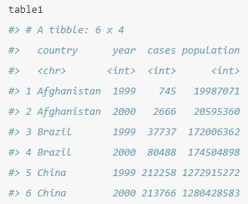
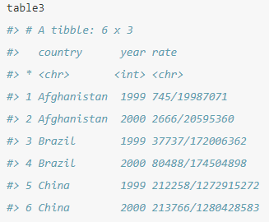
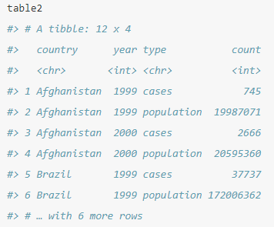
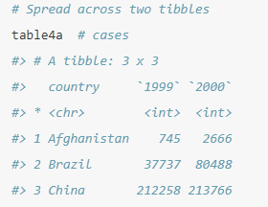
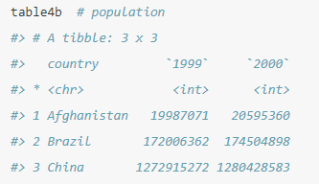
Below are 4 Different Ways To Organize the Same Data
You can represent the same underlying data in multiple ways. The example below shows the same data organized in four different ways. Each dataset shows the same values of four variables country, year, population, and cases, but each dataset organizes the values in a different way.

Slide 8
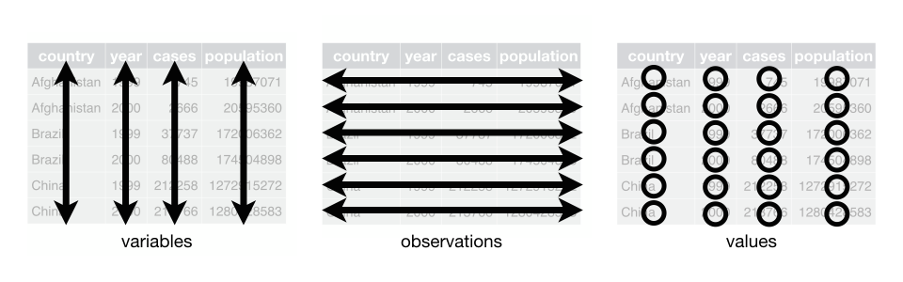
Is table 3 ‘tidy’?

Slide 9
Is table 2 ‘tidy’?

Slide 10
Are tables 4a and 4b ‘tidy’?

Slide 11
Is table 1 ‘tidy’?

Slide 12
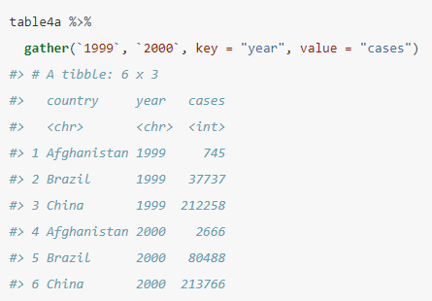
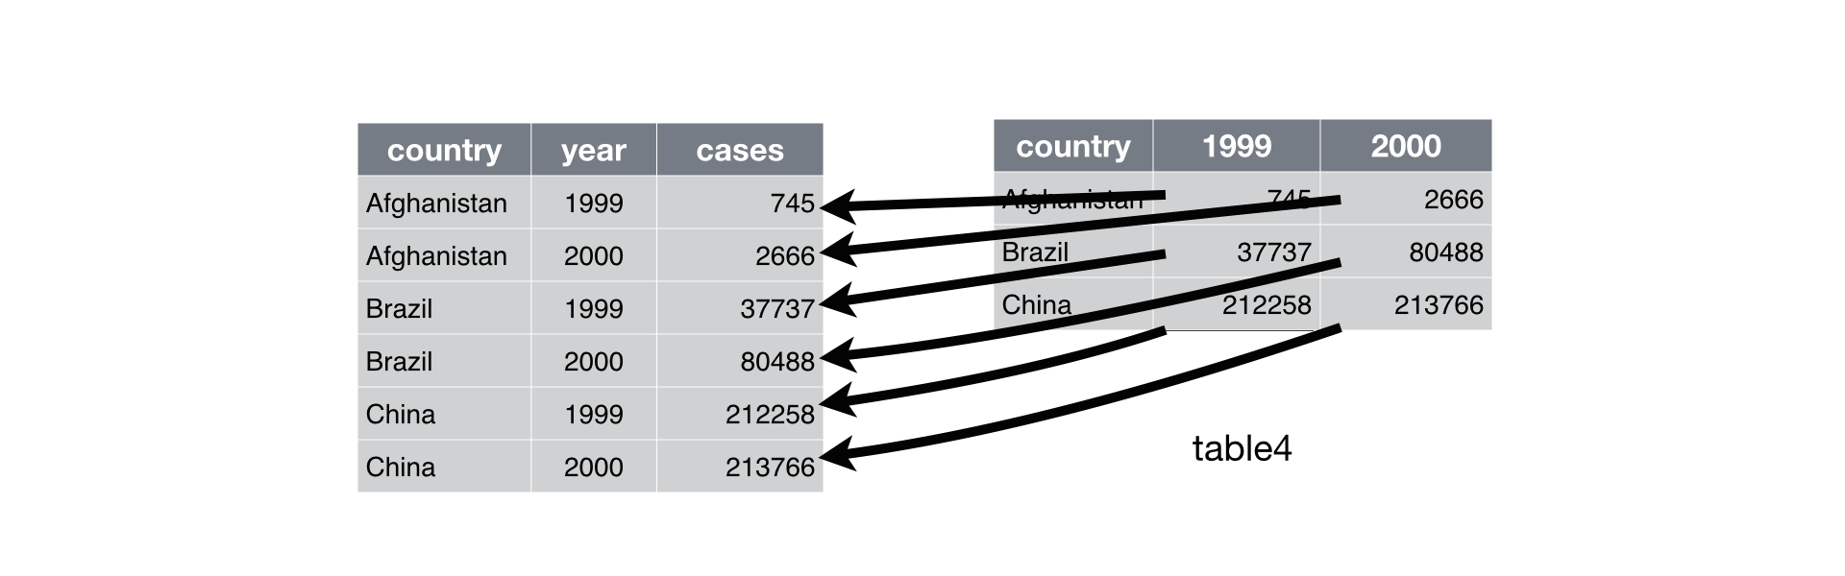
12.3.1 Gathering

Slide 13
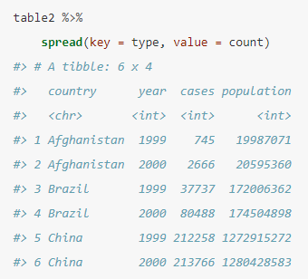
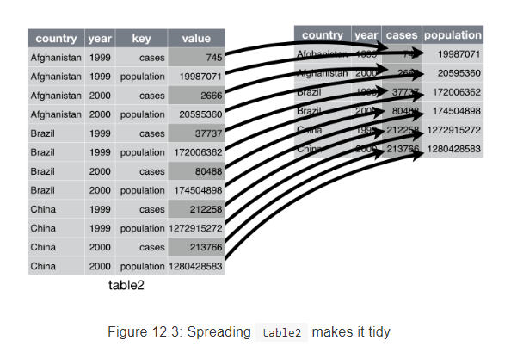
12.3.1 Spreading

Slide 14
Example Dataset - NFL Rushing Data
Kaggle Competition Data
Predict yards a player will gain (or lose) on each play
https://www.kaggle.com/c/nfl-big-data-bowl-2020
Data
Train on 2017 and 2018 full season data.
Predict on weeks 13-17 of 2019 season.
Question we would like to answer from data:
For a given team (or player) how well does performance in weeks 1-12 of the same season the predict performance of weeks 13-17?

Slide 15
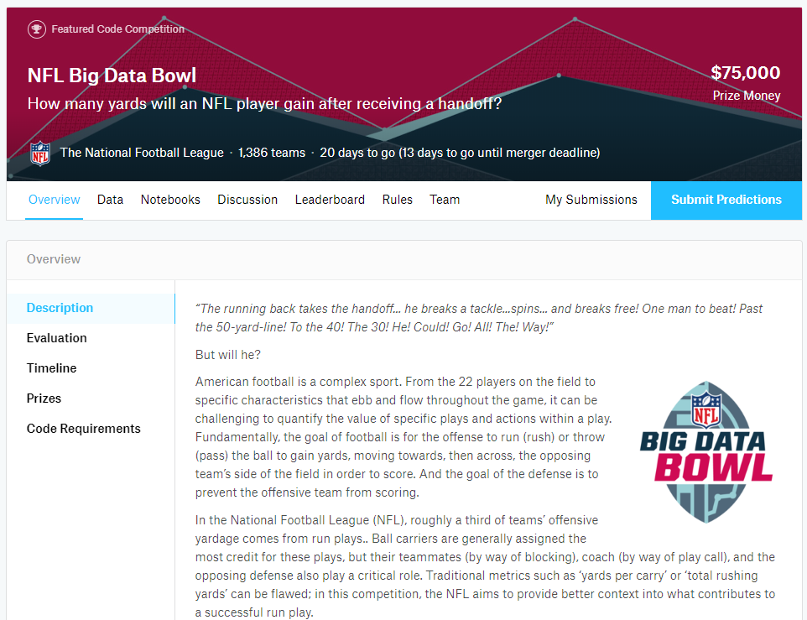

Slide 16
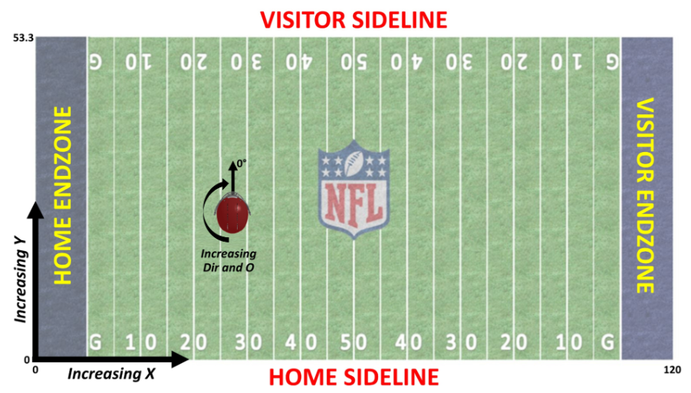

Slide 17
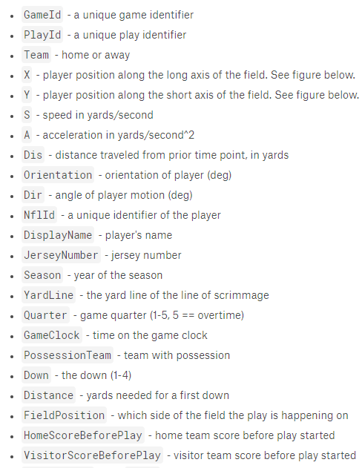
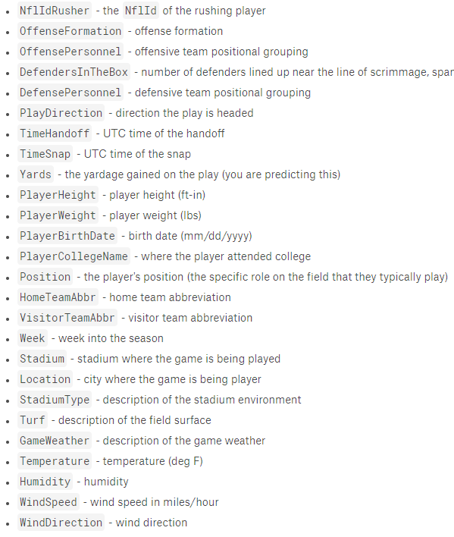
NFL - Feautures/Columns

Slide 18
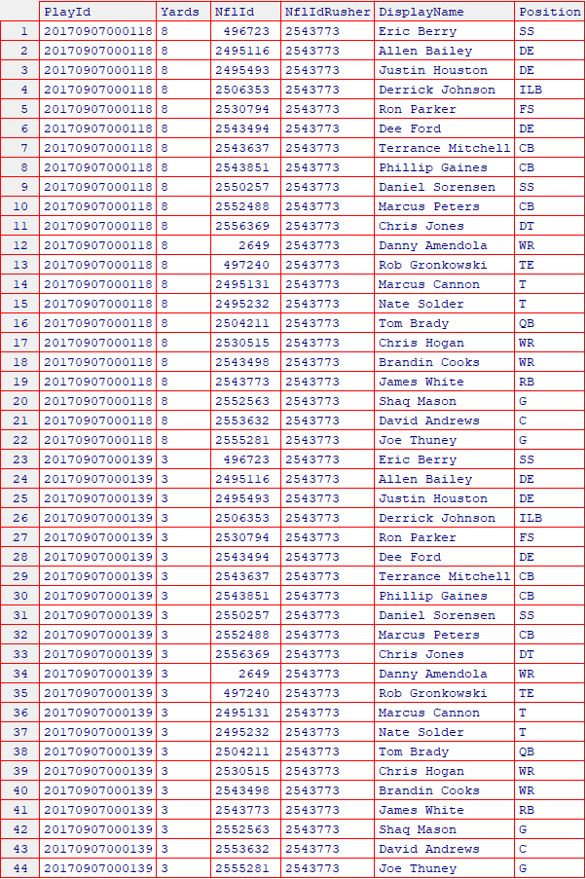
NFL – Data Structure
Play 1:
One row for each player on the field.
22 total: 11 offense, 11 defense
Ball carrier indicated by:
‘NflId’ == ‘NflIdRusher’
Play 1 Rusher
Play 2:
Play 2 Rusher

Slide 19
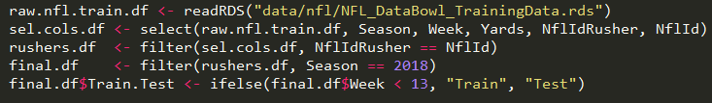
NFL – select & filter
Data processing goal:
Reduce columns
Only runner with ball
Only 2018 season
Add flag for train/test
Example Script: ex1_nfl_dplyr.R

Slide 20
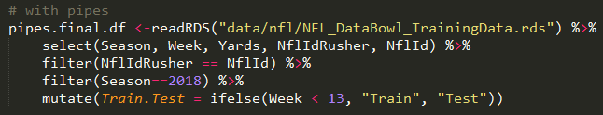
NFL – select & filter with pipes
6
1
Data processing goal:
Reduce columns
Only runner with ball
Only 2018 season
Add flag for train/test
2
3
4
5
Example Script: ex1_nfl_dplyr.R

Slide 21
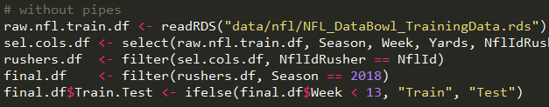
NFL – select & filter with pipes
?
final.df == pipes.final.df
Example Script: ex1_nfl_dplyr.R

Slide 22
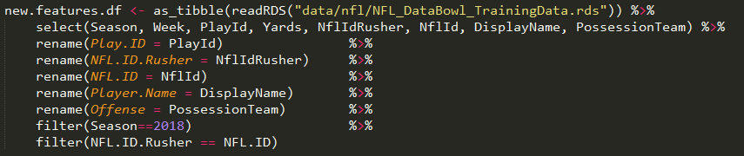
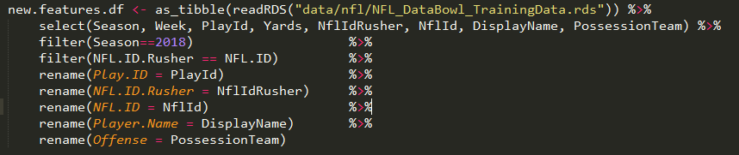
NFL – dplyr: more with pipes & order matters
Example Script: ex2_nfl_piples_order_matters.R

Slide 23
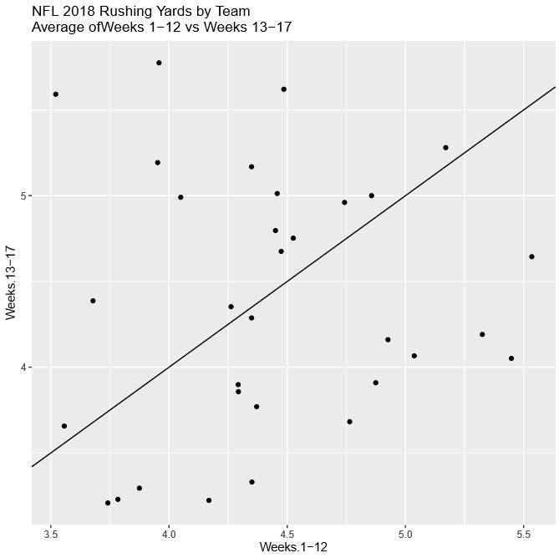
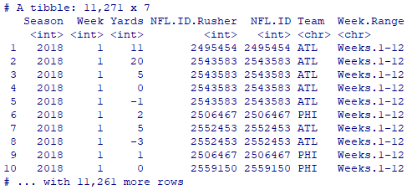

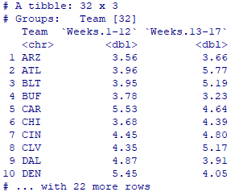
NFL – summarize teams
Example Script: ex3_nfl_summarize.R

Slide 24
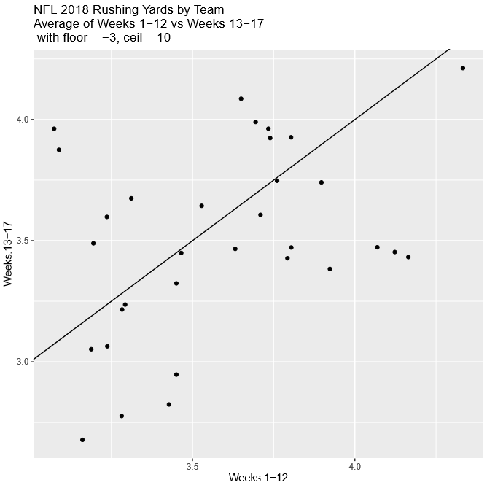
NFL – summarize teams
Example Script: ex3_nfl_summarize.R
Example Script: ex4_nfl_summarize_floor_ceil.R

Slide 25
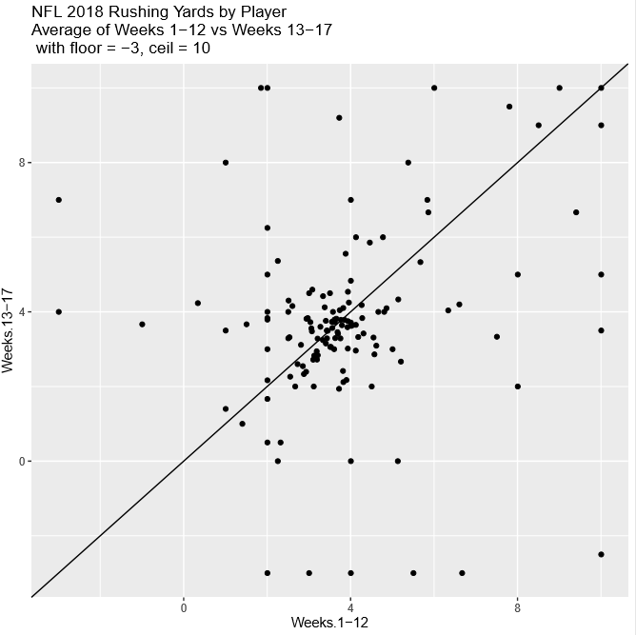
NFL – summarize players
Example Script: ex5_nfl_summarize_player.R

Slide 26
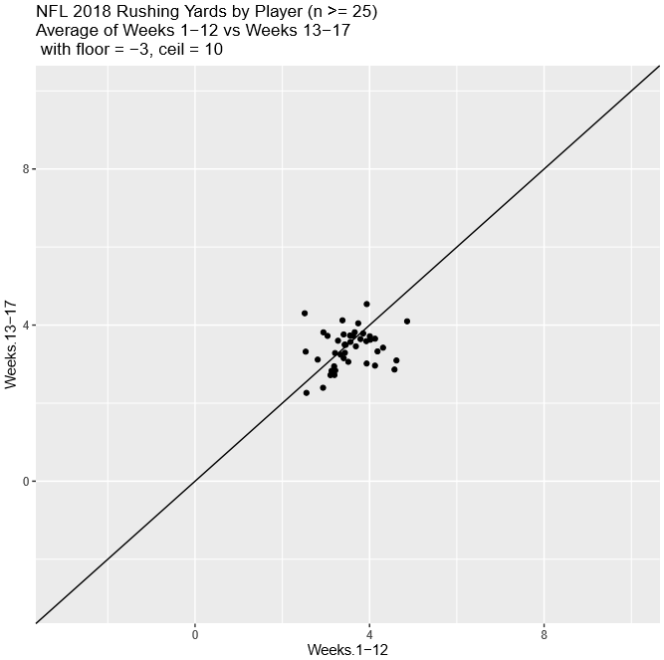
NFL – summarize players
Example Script: ex5_nfl_summarize_player.R
Example Script: ex6_nfl_summarize_player_min25.R

Slide 27
Example Dataset - Protein Array Data
ETEC (toxic E.coli) vaccine and challenge study
Question to ask from the data:
What proteins do subjects have the strongest immune response to after vaccination and after challenge?

Slide 28
Protein Array - Vaccine Study
ETEC (toxic E.coli) vaccine and challenge study
36 human subjects
v1
v2
v3
challenge
Day 7
Day 35
Day 63
Day 0
Day 28
Day 56
Day 7 Post

Slide 29
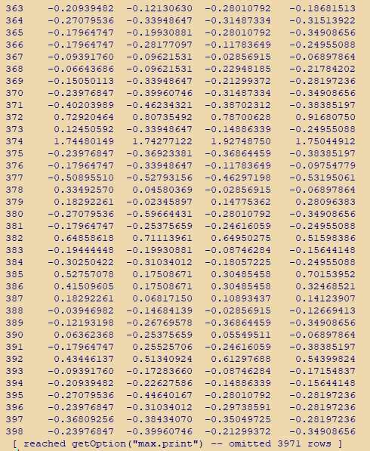
Protein Array – Data Structure
One row for each protein on array
One column for each sample
Cells contain normalized intensity

Slide 30
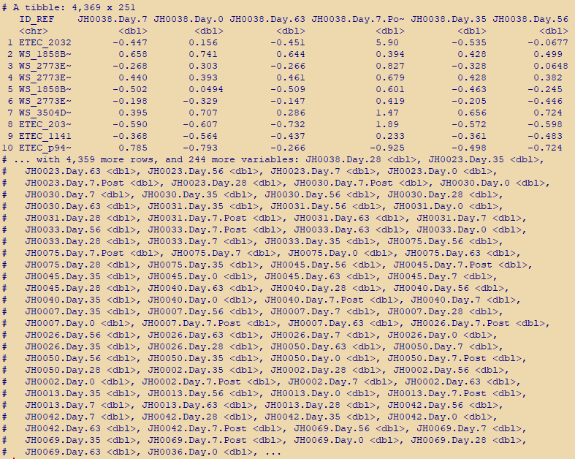
Protein Array – Data Structure
One row for each protein on array
One column for each sample
Cells contain normalized intensity

Slide 31

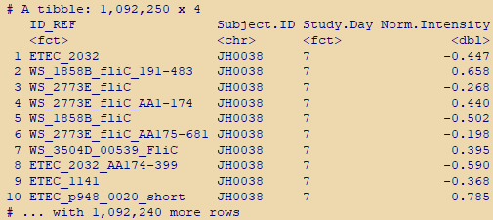
Protein Array – gather
Data processing goal:
Create a single column for Normalized Intensity
Create a new column Sample.ID
Create a new column Study.Day
Example Script: ex6_prot_array_gather.R

Slide 32
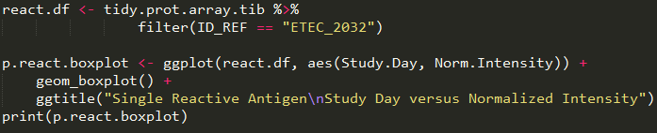
Protein Array – gather
Example Script: ex6_prot_array_gather.R

Slide 33
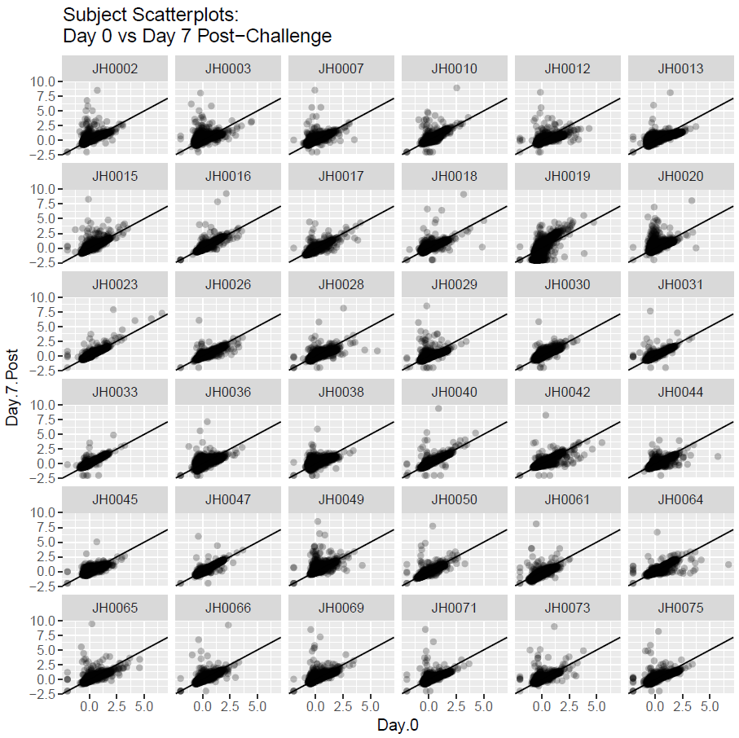
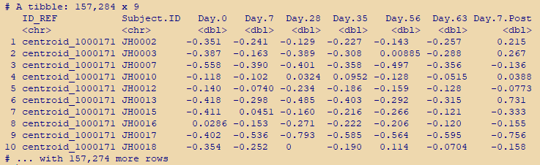
Protein Array – spread
Example Script: ex7_prot_array_spread.R

Slide 34
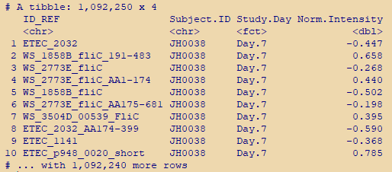
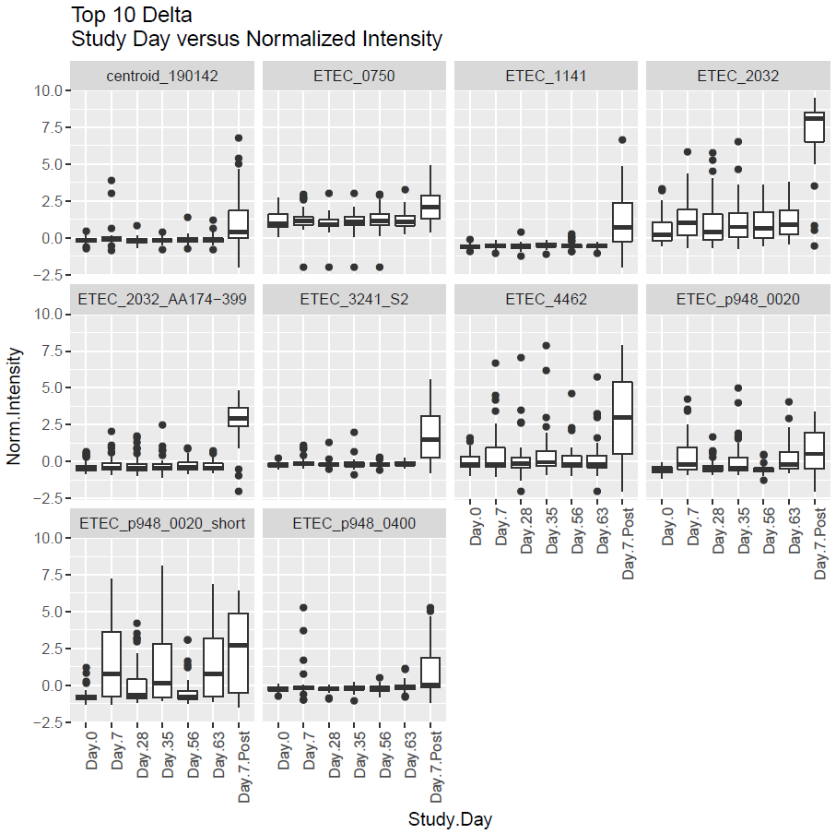
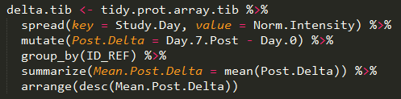
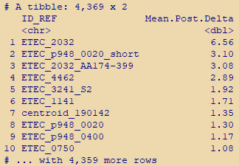
Protein Array – summarize
Example Script: ex8_prot_array_summarize.R

Slide 35
Questions?
Please email me at:
arlorandall@gmail.com

Slide 36
Kaggle
Level 0:
Get the data. Understand the basic task.
Level 1:
Get a test submission scored by the site. Often non-trivial.
Level 2:
Develop a model that is clearly better than random (or baseline model)
Level ++:
Compete/win

