Slide 1

Banking Dataset
2019 Hackathon
Team member: Howard, Steven, Ailing, Vivian, Issac

Slide 2
MISSION
- Find out which variable is most important in determining the term deposit.
- Find out correlation between important variables and gain insight from it.

Slide 3
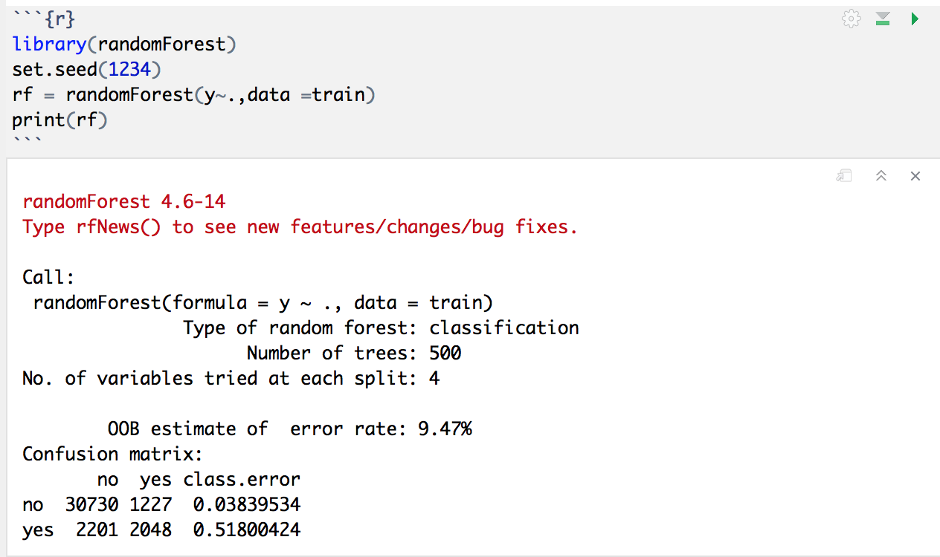
Codes – Training Data

Slide 4
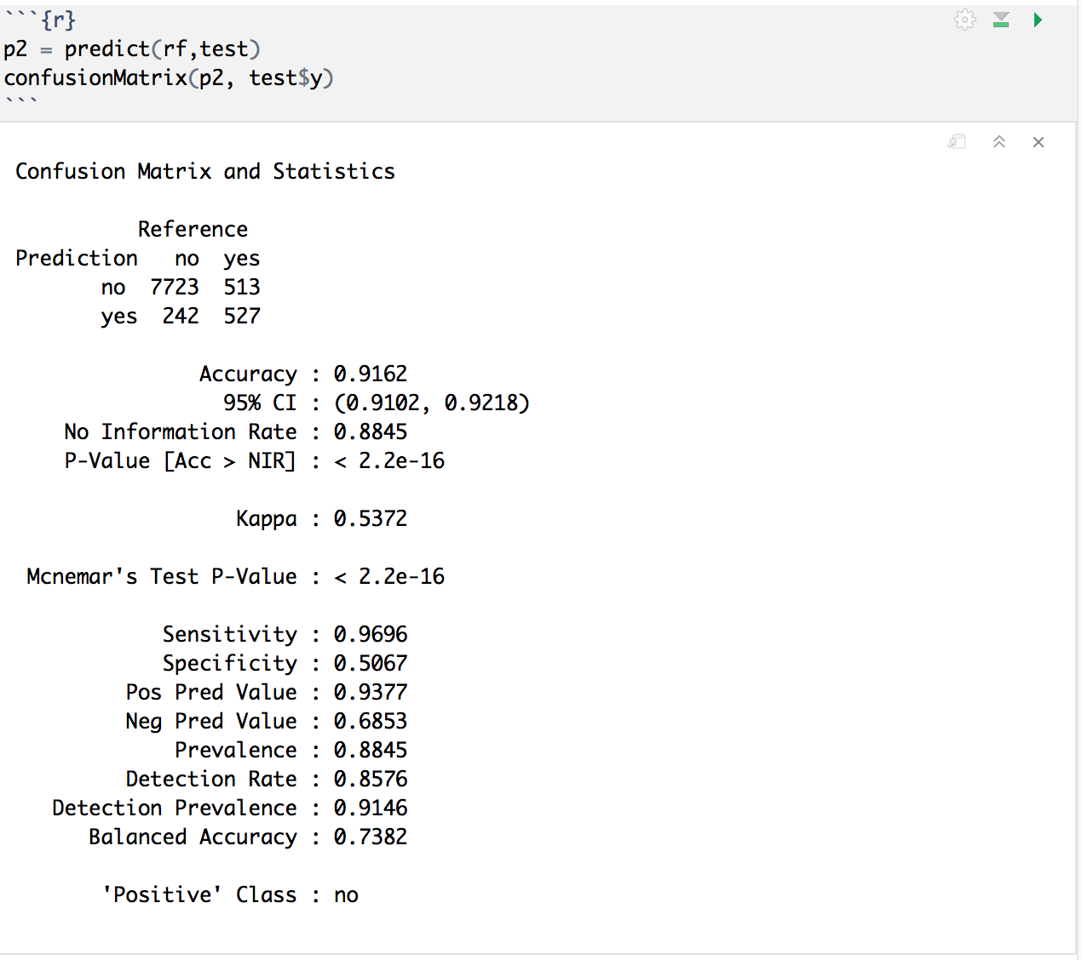
Codes – Testing Data

Slide 5
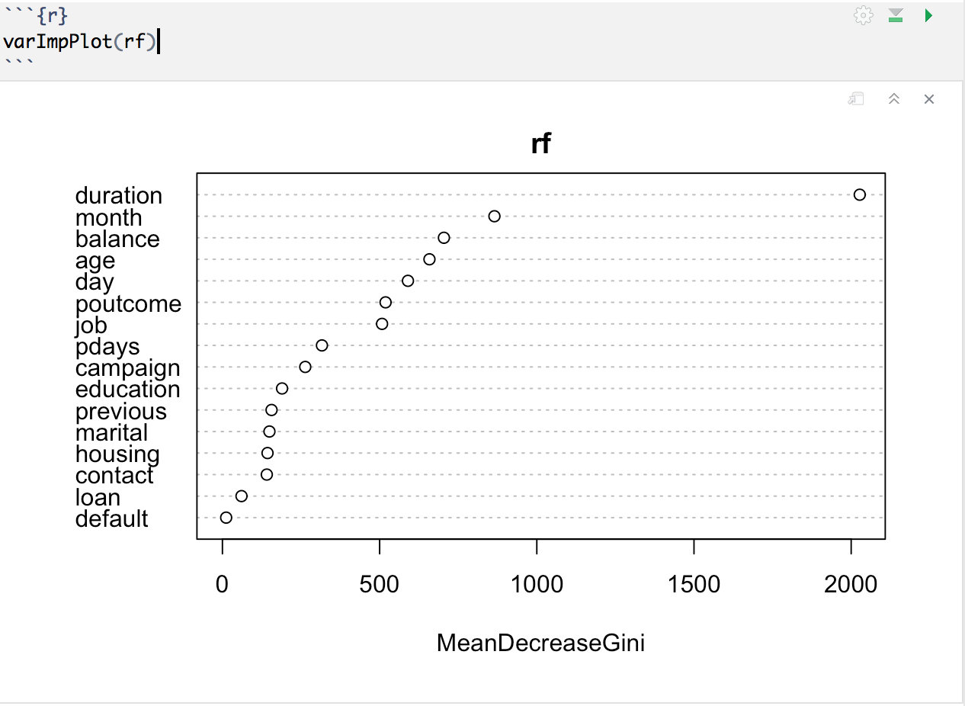
Codes – Random Forest

Slide 6
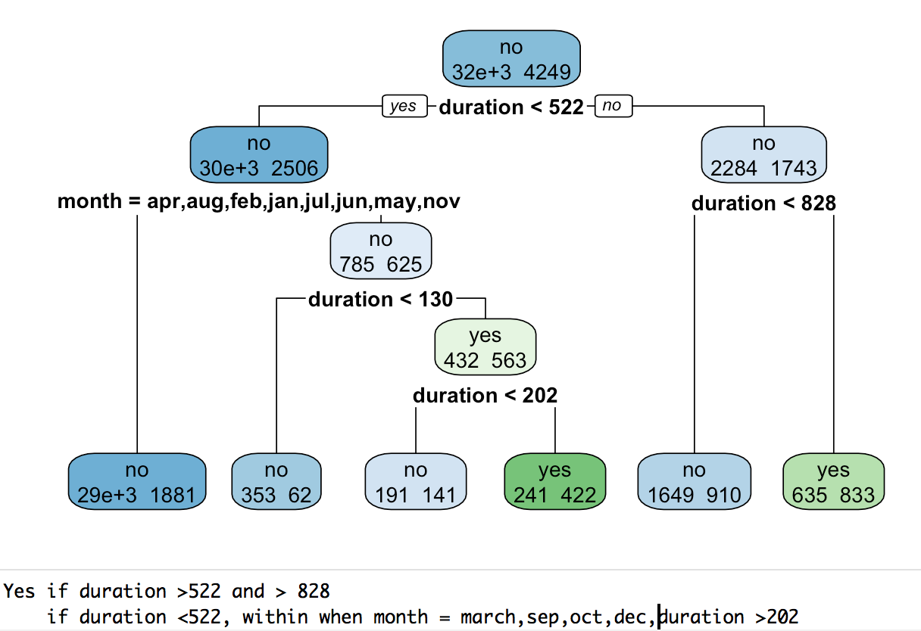
Codes – Decision Tree

Slide 7
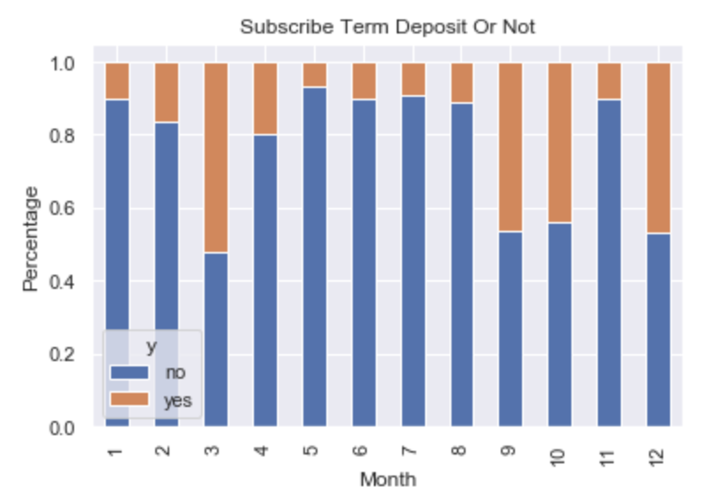
Visualization – Acceptance of term deposit by month

Slide 8
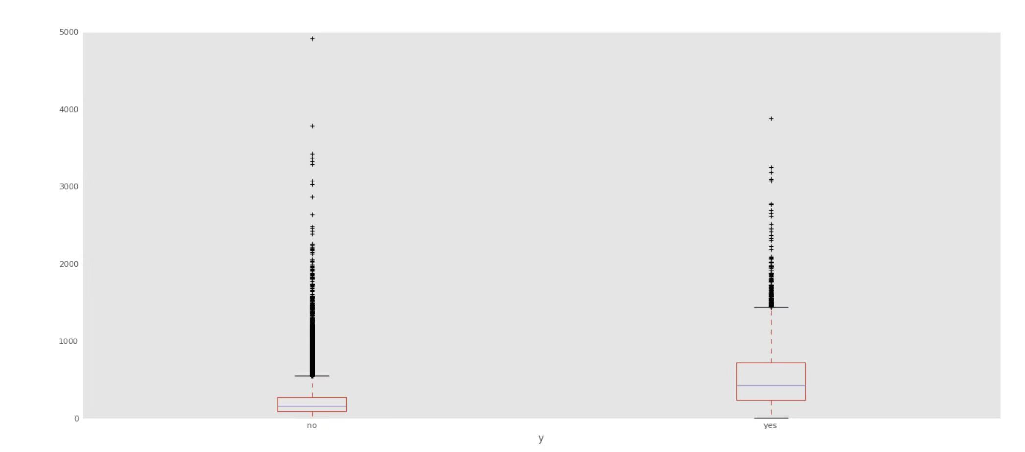
Visualization - Boxplot of Duration and term deposit

Slide 9
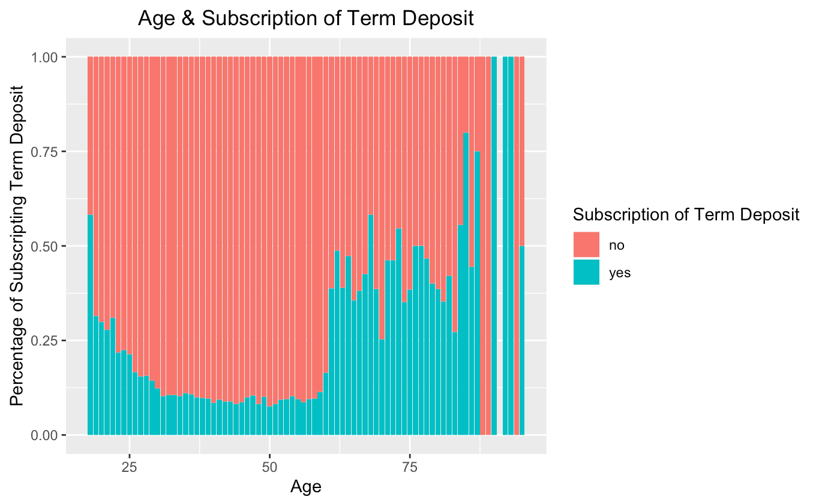
Visualization – Acceptance of term deposit by age

Slide 10
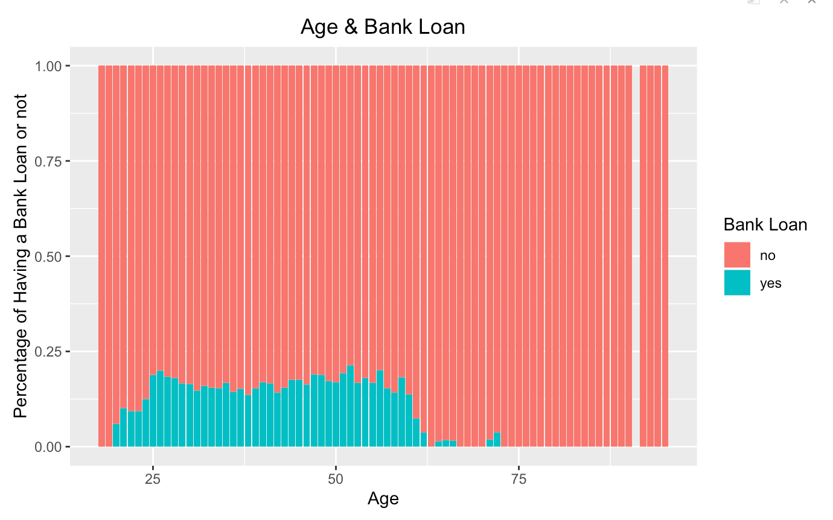
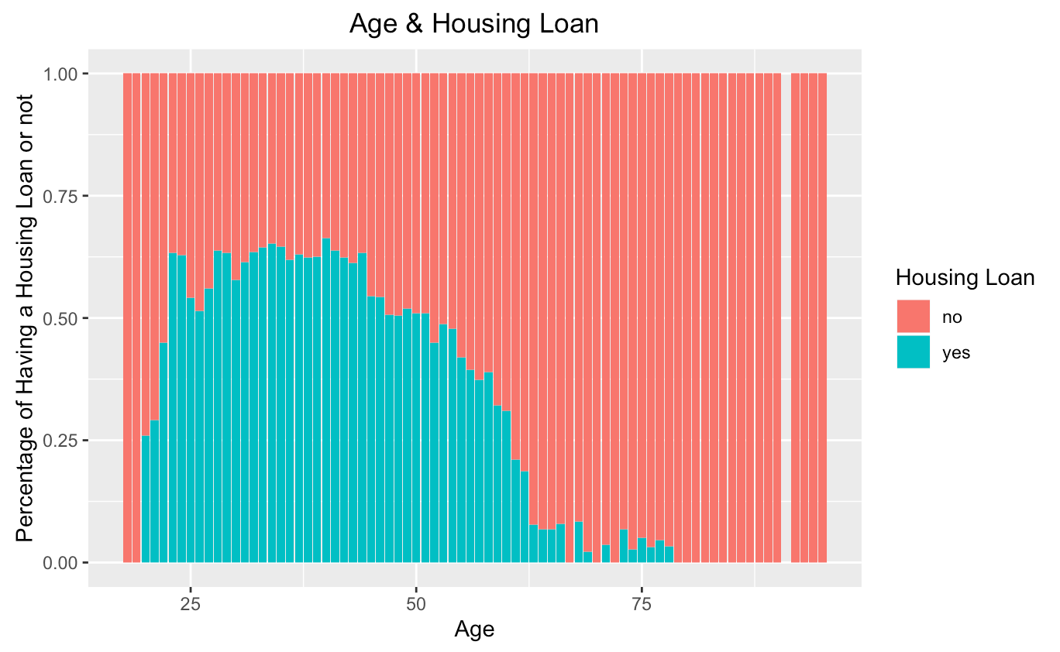
Visualization – Acceptance of term deposit by loan

Slide 11
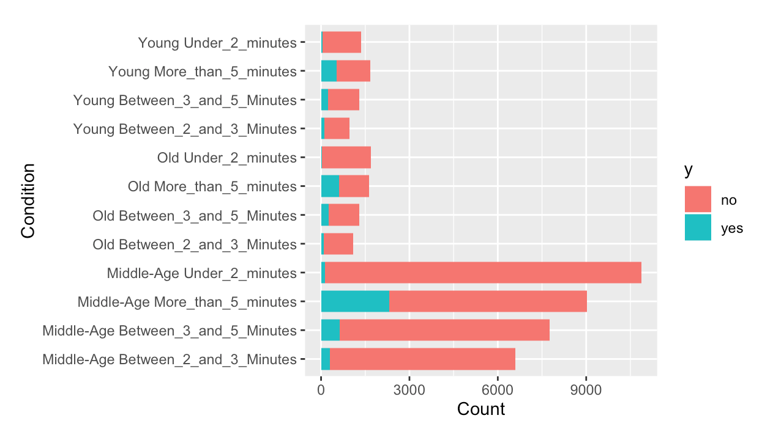
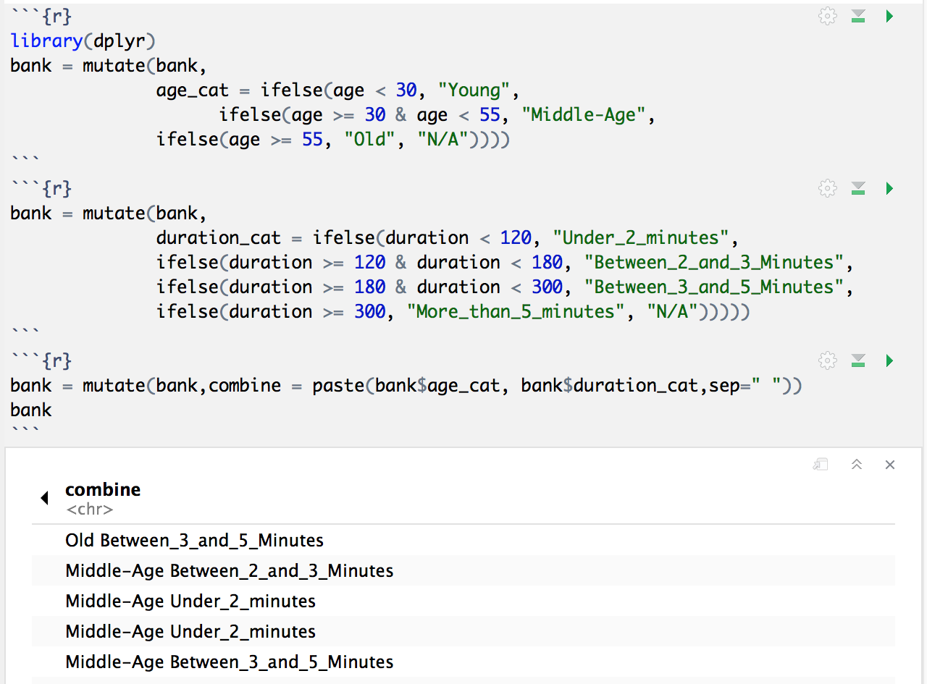
Visualization – Acceptance of Term Deposit grouped by Age Range and Duration

Slide 12
Recommendations For the Next Campaign
- Age : target under 25 and older than 60
- Month of Marketing Activity : March, September, October and December
- Duration : Make the call more interesting

