Slide 1
An Introduction to Predictive Modeling in R
Ryan Benz • OCRUG Hackathon 2019 Tutorial November 9, 2019

Slide 2
Build Something Useful!
Predictive modeling: the process of combining data and algorithms in order to build useful models
In contrast with explicitly programming rules, predictive modeling algorithms attempt to learn patterns from the data itself
Predictive modeling has deep mathematical foundations, but in the end, it’s extremely practical

Slide 3
Predictive Modeling is Everywhere
Is this email message spam?
Will this person default on their loan?
Which other products might this person also buy?
Is that a cat?
Which group of people should I target for my ad campaign
Is this person sick or healthy?

Slide 4
Lots of Contexts, Lots of Terms
People have been predictively modeling for a long time, and in lots of different fields
Therefore, lots of different terms used for similar things
The Subject
The Data
The Outcomes
Predictive modeling
Predictive analytics
Machine learning
Data mining
Statistics
Features
Predictors
(Independent) Variables
Measures
Attributes
Classes
Labels
Dependent Variables
Responses
Targets

Slide 5

Two Main Branches of Machine Learning
If you have the answer for your training data
If you don’t
Supervised Learning
Unsupervised Learning
Classification
Regression
Clustering
Anomaly Detection
…

Slide 6
Two Main Branches of Machine Learning
If you have the answer for your training data
If you don’t
Supervised Learning
most studied
more mature
most widely used
Unsupervised Learning
Classification
Regression
Clustering
Anomaly Detection
…

Slide 7


The Model Building Process
highly simplified
^
Start with a question
Invest
Get RICH!!!
Which stocks should I buy?
(How can I determine good & bad stocks?)
Collect relevant data
Good Stocks
Bad Stocks
Amass historical stock/company data
WITH good/bad calls
Train a model
Model
Trained Model
Input new data
computery stuff

Slide 8
Building Models with R and caret

Slide 9
Modeling in R
R has 100’s of modeling packages; if you know about it, there’s probably an R package for it
Lots (most?) modeling packages follow a somewhat standard way to work with models
train a model: model_func(training_matrix, training_labels, …)
make predictions: predict(model_obj, testing_matrix)
However, there are often subtle differences between packages so you have to be careful & read the documentation

Slide 10
Building Models
Training Data
Testing Data
Data Matrix
Labels, Responses
Data Matrix
Features
Features
Observational Units
Observational Units
Model Training
model_func(training_matrix, training_labels, …)
Model Predictions
predict(model_obj, testing_matrix)

Slide 11
Some Examples
e1071
svm(train_mtrx, train_lbls, probability = TRUE, ...)
predict(model_obj, test_mtrx, probability = TRUE)
randomForest
randomForest(train_mtrx, train_lbls, ...)
predict(model_obj, test_mtrx, type = “prob”)
stats
glm(formula, ...)
predict(model_obj, test_mtrx, type = “response”)
Can you spot the similarities and differences?

Slide 12
Tips on Working with Models
For a centralized listing of many of the models in R, check out the model listing on the caret repo http://topepo.github.io/caret/available-models.html
Model training functions are typically named after the model (see previous slide)
Use the documentation to remind yourself of the function arguments and what they mean - e.g. ?svm, ?randomForest, ?glm - for most predict functions use: ?predict.svm,?predict.randomForest,?predict.glm

Slide 13
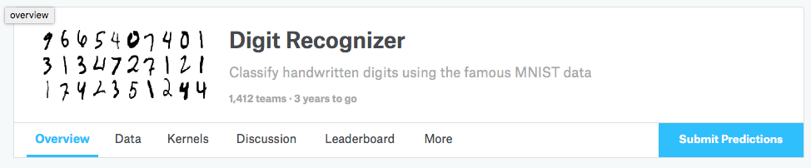
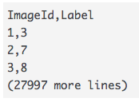
A Real Example:
Kaggle Digit Classification Competition
Task
Testing Data
Given an image of a handwritten digit, determine which one it is
4
A vector of length 784 for each new example; NO LABELS
Training Data
A vector of length 785 for each example (digit)
- first entry is the label (a digit 0 - 9)
- the remaining 784 entries are each numbers 0 - 255 representing a 28 x 28 gray-scale image of the digit
Submission
black
white
e.g.: 3,0,0,0,27,59,82,171,201,163,74,30,0,0…0,0,0
https://www.kaggle.com/c/digit-recognizer

Slide 14
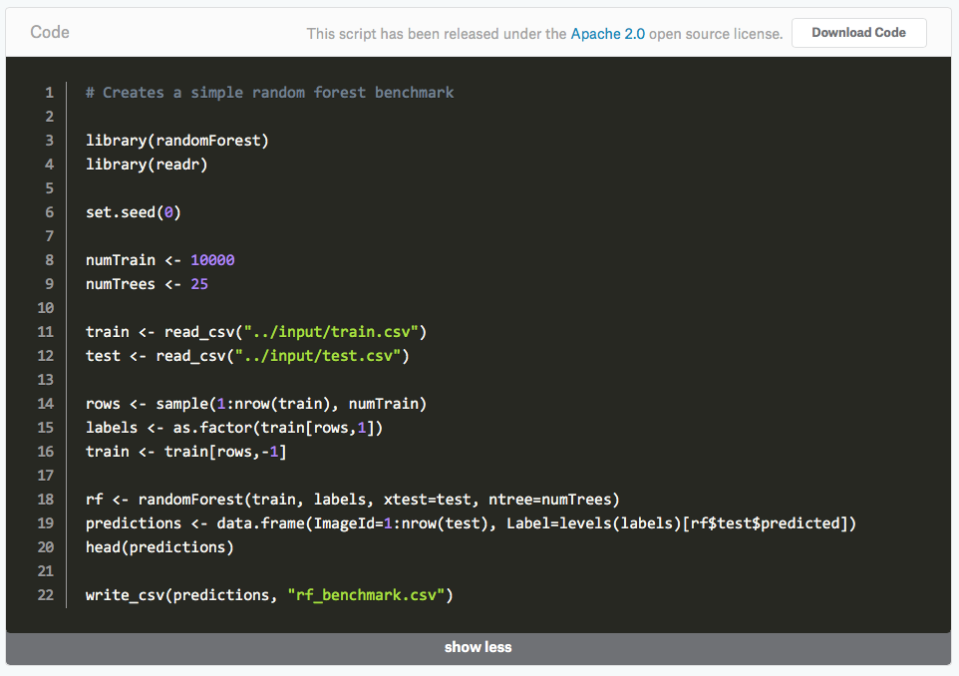
A Real Example:
Kaggle Digit Classification Competition
This model is
93.5%
accurate
Most of the code is about data prep!
One line to build the model, one line to make the predictions
https://www.kaggle.com/c/digit-recognizer

Slide 15
The caret Package
Classification And Regression Training
Provides a uniform interface for working with most of R’s modeling packages and a bunch of tools to streamline the modeling process
Pros: takes care of the details for you, can help you avoid modeling mistakes
Cons: can make modeling even more black-boxy, particularly for new users

Slide 16
Training, Tuning & Evaluating Models
Training: the process of fitting a model based on supplied data
Model method: the underlying algorithm used in the training process
Model parameters: adjustable parameters associated with a given modeling method that affect how the model is trained and the model output
Model tuning: the process of adjusting the model parameters to find the ones that give the “best” performance
Resampling: a process where you split your data into partitions, typically ones for training your model, and ones for evaluating it

Slide 17
Resampling
Lots of commonly used models have the flexibility to completely describe your training data
Model performance on your training data is often over-optimistic, may not represent how well the model will generalize to new data
Resampling can be used to help address this problem, e.g. - cross-validation - random splits

Slide 18
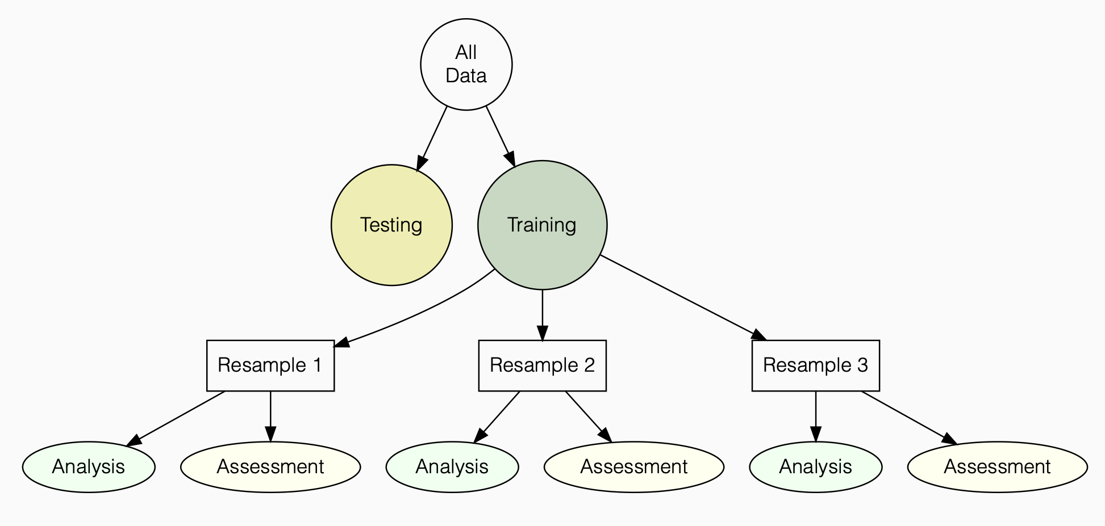
Resampling
This testing set never sees ANY part of the training process
Models are trained ONLY on analysis sets
Model performance is based on the assessment set
sometimes called training set
sometimes called testing set
https://github.com/topepo/rstudio-conf-2019

Slide 19
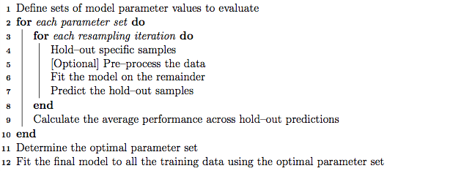
A Model Training Workflow
Caret will take care of all of this
http://topepo.github.io/caret/model-training-and-tuning.html

Slide 20
Building and Assessing Models with caret
caret can automatically choose parameter sets and optimize them within a resampling approach
Step 1: define a trainControl object
resampling method
how to evaluate performance
other model specific options
Step 2: perform model training workflow with train
Step 3: review performance and select “best” model

Slide 21
Main Code
fitControl <- trainControl(method = "repeatedcv",
number = 10,
repeats = 10,
## Estimate class probabilities
classProbs = TRUE,
## Evaluate performance using
## the following function
summaryFunction = twoClassSummary)
model_fit <- train(Class ~ ., data = training,
method = "gbm",
trControl = fitControl,
verbose = FALSE,
tuneGrid = gbmGrid,
## Specify which metric to optimize
metric = "ROC")

Slide 22
(live example) caret_example.R

Slide 23
Some Thoughts About Building Predictive Models
Ensuring your model is going to work on new, unseen data is really important - Is your training data representative of the new data? - Use resampling methods (e.g. cross validation) to estimate generalization performance
Information “leakage” can ruin your model, is often subtle and not immediately evident; be careful
Learning the mathematical/statistical details of various modeling algorithms and methods can be useful, though…
It’s usually advantageous to spend time understanding the problem domain, finding relevant data
Predictive modeling is very practical, and you get good at it through lots of practice

Slide 24
Resources
THE Book by Kuhn & Johnson Applied Predictive Modeling http://appliedpredictivemodeling.com
New Book by Kuhn & Johnson Feature Engineering and Selection: A Practical Approach for Predictive Models http://www.feat.engineering
Other books - Elements of Statistical Learning (Hastie, et.al.) - Pattern Recognition and Machine Learning (Bishop) - Data Mining with R: Learning with Case Studies (Torgo)

Slide 25
Resources
R Packages - 100’s of modeling packages are available (e.g. e1071, randomForest, glmnet) - caret: addresses the entire modeling workflow http://topepo.github.io/caret/index.html - tidymodels, parsnip, etc… - DALEX, lime — model explainers
Max Kuhn’s rstudio::conf workshops - 2018: https://github.com/topepo/rstudio-conf-2018 - 2019: https://github.com/topepo/rstudio-conf-2019

Slide 26
Resources
Where to Practice - Kaggle (www.kaggle.com) - Flowing Data (https://flowingdata.com/category/statistics/data-sources/) - UCI Machine Learning Repository (http://archive.ics.uci.edu/ml/index.php) - Take classes at a local university or extension programs

