Slide 1

OCRUG x Merage Hackathon Apr 2021
April 10 — 11, 2021 Saturday Evening Event

Slide 2
Goals of the Event
Connect with new people outside of your team
Work together on rapid fire data questions
Accumulate tickets for a prize drawing at the end of the event
Have some "data" fun

Slide 3
Event Structure
4 rounds, 10 minutes each
First 5 minutes: rapid fire introductions, < 1 min per person
Name
What do you do?
What data topics/areas are you interested in?
Last 5 minutes: work together on a data question
Participants will be randomly assigned into Zoom breakout rooms, each round, ~5 people each

Slide 4
Answering the Data Questions
Teams will work together to answer a data question and submit a single answer as a team (no individual submissions)
Questions will be sent to the #hackathon-2021-04 Slack channel, answers WILL NOT be submitted through Slack
Two types of answers:
Text answer (i.e. number or words) save to a text file and submit the file
Plot answer save the plot to a file or take a screen shot, submit the graphics file

Slide 5
Submitting Answers
IMPORTANT!!! name your response in the following format question#_team#.txt/gif/png/pdf/etc…
Upload your response here: https://www.dropbox.com/request/RrRuH7T2p2AokiA8ViJM
Should be 1 - 4
Your assigned breakout room number
WILL BE DIFFERENT EVERY ROUND

Slide 6
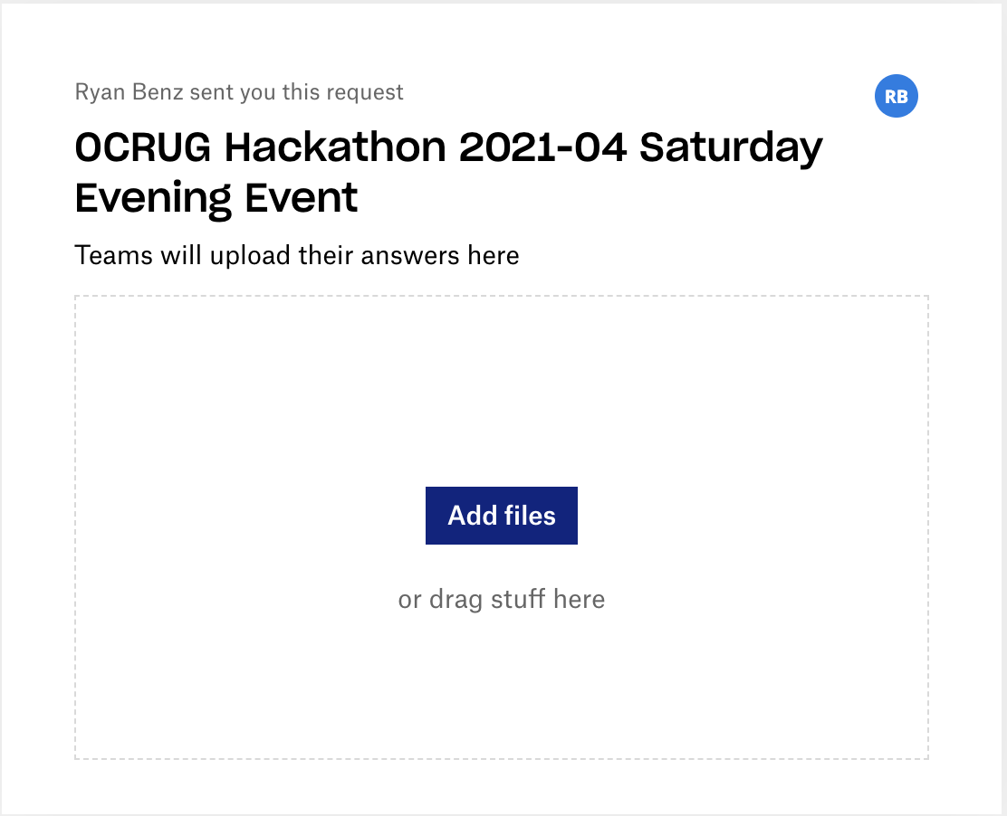
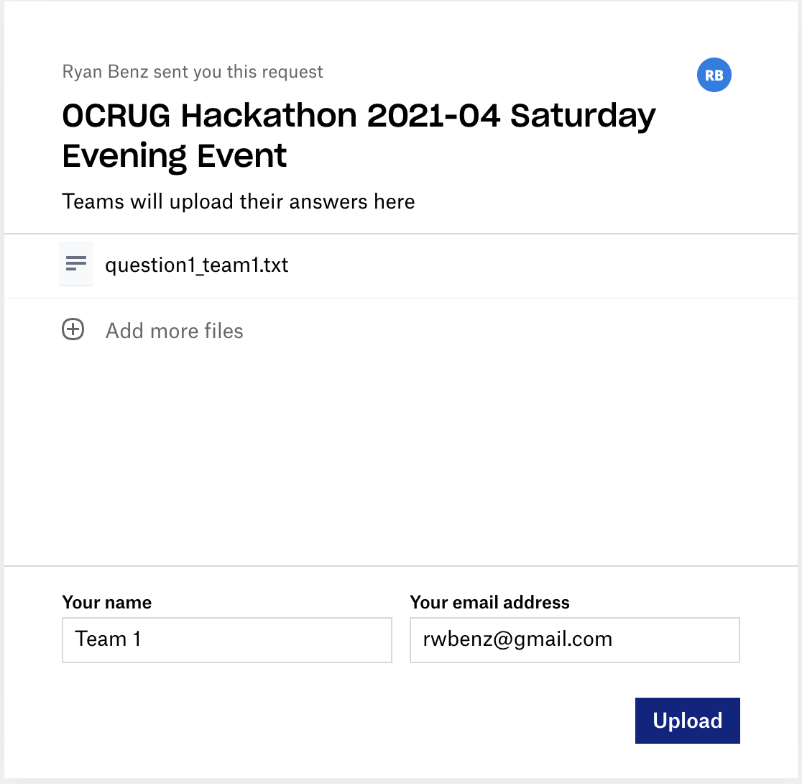
Submitting Answers
1. Visit link
https://www.dropbox.com/request/RrRuH7T2p2AokiA8ViJM
3. Enter your "Name", an email address, and click Upload
2. Add or drag/drop submission file
Use: Team #
Any email is fine

Slide 7
Earn "tickets" for Correct Answers
Everyone gets 1 ticket for attending the event
First submitted correct answer: 4 tickets
Second submitted correct answer: 3 tickets
Third submitted correct answer: 2 tickets
All remaining correct answers: 1 ticket
All participants on a given team will receive the same number of tickets,
e.g. all members on first correct answer will get 4 tickets each

Slide 8
Prizes
All earned tickets will be placed in a "virtual" hat
Three (unique) winners will be drawn at random
The more tickets you have, the higher chance of winning
Prizes: $25 Amazon Gift Card

