Slide 1
Process Mining & KRR
-GROUP 2-
Team:
- Octaviana Cheteles - Paola Joza - Vlad Alexe

Slide 2
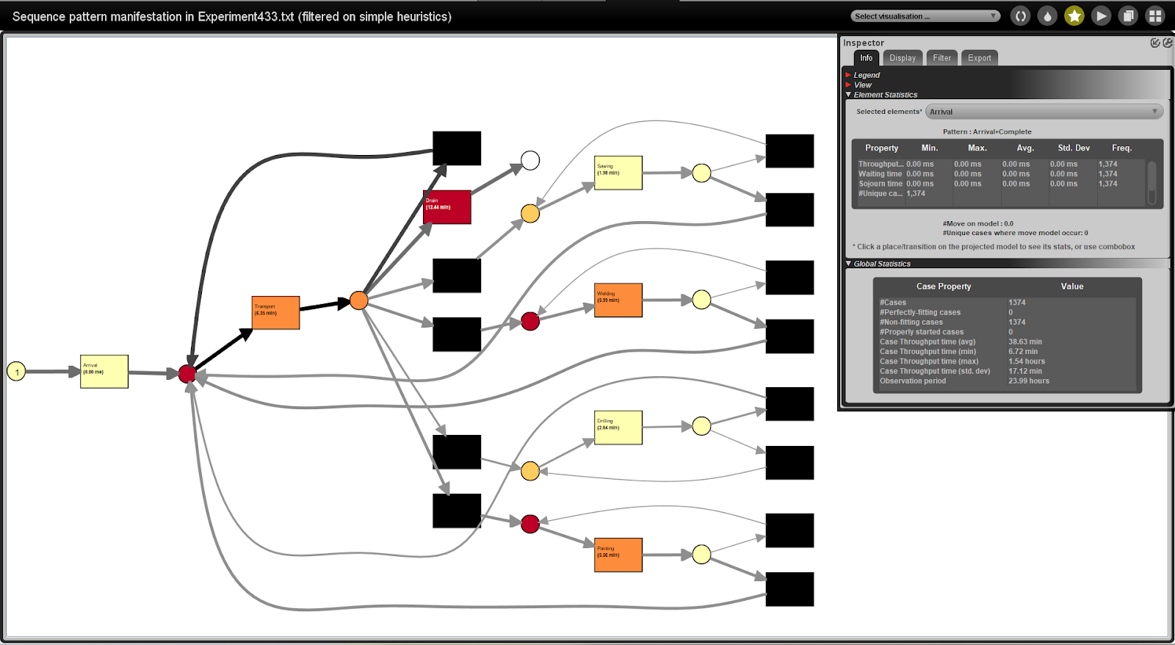
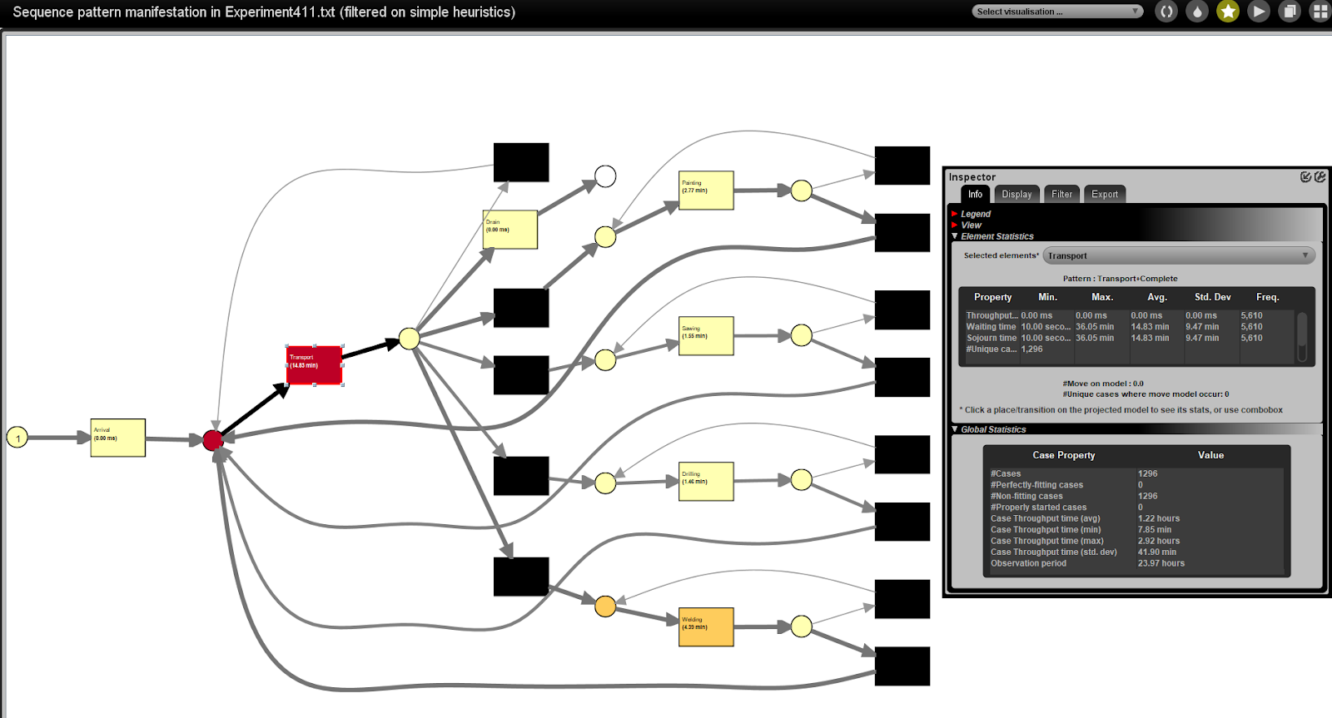
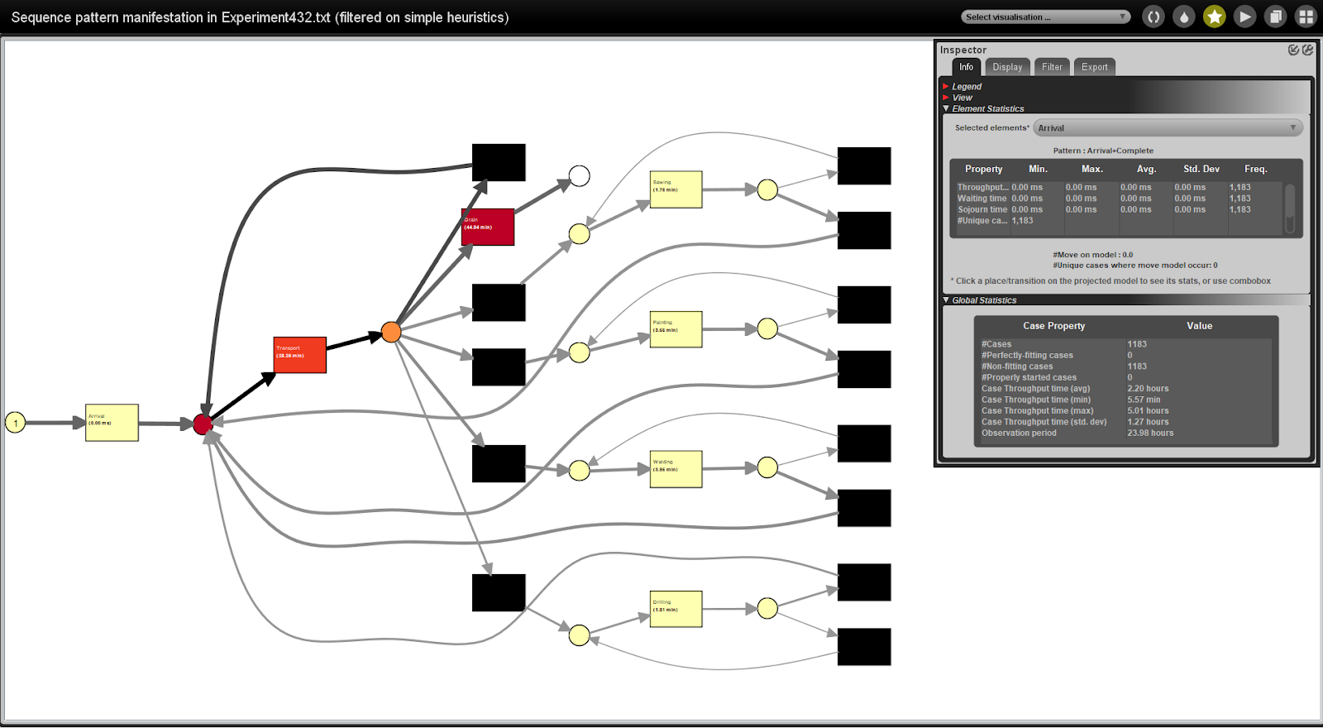
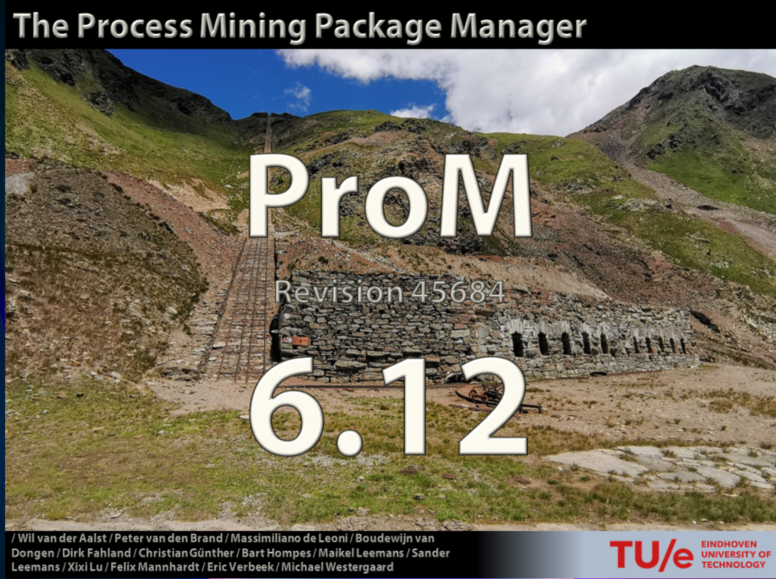



<trace>
<string key="concept:name" value=".MUs.Console:1"/>
<event>
<int key="ID" value="1"/>
<string key="concept:instance" value="Console"/>
<string key="org:resource" value=".Models.JobShop.Source"/>
<string key="lifecycle:transition" value="Start"/>
<string key="concept:name" value="Arrival"/>
<date key="time:timestamp" value="2019-04-18T00:00:00.000+02:00"/>
</event>
<event>
<int key="ID" value="2"/>
<string key="concept:instance" value="Console"/>
<string key="org:resource" value=".Models.JobShop.Source"/>
<string key="lifecycle:transition" value="Complete"/>
<string key="concept:name" value="Arrival"/>
<date key="time:timestamp" value="2019-04-18T00:00:00.000+02:00"/>
</event>
<event>
<int key="ID" value="3"/>
<string key="concept:instance" value="Console"/>
<string key="org:resource" value=".Models.JobShop.Buffer"/>
<string key="lifecycle:transition" value="Start"/>
<string key="concept:name" value="Transport"/>
<date key="time:timestamp" value="2019-04-18T00:00:00.000+02:00"/>
</event>
<event>
<int key="ID" value="4"/>
<string key="concept:instance" value="Console"/>
<string key="org:resource" value=".Models.JobShop.Buffer"/>
<string key="lifecycle:transition" value="Waiting"/>
<string key="concept:name" value="Transport"/>
<date key="time:timestamp" value="2019-04-18T00:00:00.000+02:00"/>
</event>
<event>
<int key="ID" value="10"/>
<string key="concept:instance" value="Console"/>
<string key="org:resource" value=".MUs.AGV:4"/>
<string key="lifecycle:transition" value="In progress"/>
<string key="concept:name" value="Transport"/>
<date key="time:timestamp" value="2019-04-18T00:00:54.000+02:00"/>
</event>
<event>
<int key="ID" value="15"/>
<string key="concept:instance" value="Console"/>
<string key="org:resource" value=".MUs.AGV:4"/>
<string key="lifecycle:transition" value="Complete"/>
<string key="concept:name" value="Transport"/>
<date key="time:timestamp" value="2019-04-18T00:01:44.000+02:00"/>
</event>
<event>
<int key="ID" value="16"/>
<string key="concept:instance" value="Console"/>
<string key="org:resource" value=".Models.JobShop.Welding.Input"/>
<string key="lifecycle:transition" value="Start"/>
<string key="concept:name" value="Welding"/>
<date key="time:timestamp" value="2019-04-18T00:01:44.000+02:00"/>
</event>
<event>
<int key="ID" value="17"/>
<string key="concept:instance" value="Console"/>
<string key="org:resource" value=".Models.JobShop.Welding.Input"/>
<string key="lifecycle:transition" value="Waiting"/>
<string key="concept:name" value="Welding"/>
<date key="time:timestamp" value="2019-04-18T00:01:44.000+02:00"/>
</event>
<event>
<int key="ID" value="33"/>
<string key="concept:instance" value="Console"/>
<string key="org:resource" value=".Models.JobShop.Welding.Machine"/>
<string key="lifecycle:transition" value="In progress"/>
<string key="concept:name" value="Welding"/>
<date key="time:timestamp" value="2019-04-18T00:02:57.159+02:00"/>
</event>

Slide 3

How do we identify a bottleneck ? (A point of congestion in a production system that slows down the over-all process)
Local average [time]
Local average [time]
Local average [time]
Local average [time]
Local average [time]
<Trace>
Global Average
Welding [time]
Local average [time]
<Trace>
Welding [time]
In this log, the highest event time was ‘Welding’, therefore it is the key bottleneck
Local average [time]
<Trace>
Welding [time]
<Trace>
Local average [time]
Welding [time]
<Trace>
Welding [time]

Slide 4
Some analytics we computed
Arrival
Welding
Sawing
Filename: 412.xes
Path: ['Arrival', 'Drilling', 'Sawing', 'Welding', 'Painting', 'Drain’]
Duration: 427.80397288377617
Dataframe:
Event Name Local Average Duration (Seconds)
0 Arrival 0 .000000
1 Transport 2866.071446
2 Welding 131.670648
3 Painting 123.751529
4 Drilling 82.242519
5 Drain 0.000000
6 Sawing 90.139278
Painting
Drilling
Drain

Slide 5
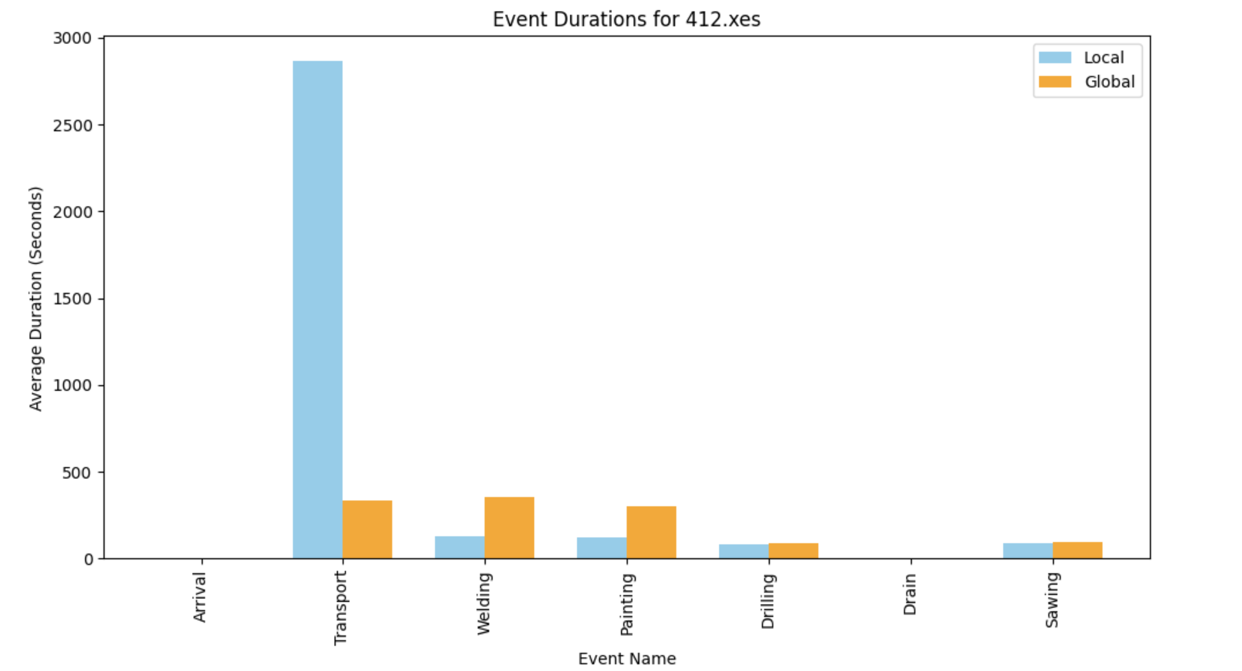

Slide 6
Live conformance checking implementation & Predicting end time of the trace
Live conformance checking implementation & Predicting end time of the trace
Actions and their average durations:
Action(Arrival, Duration: 0)
Action(Welding, Duration: 353.43)
Action(Painting, Duration: 298.45)
Action(Sawing, Duration: 97.95)
Action(Drilling, Duration: 91.54)
Action(Drain, Duration: 0)
Live conformance checking
Enter the activity:
Arrival
Enter the start time (hh:mm:ss):
12:00:00
Enter the end time (hh:mm:ss):
12:00:00
It took you 0 seconds which is the same as the average duration.
Following actions still need to be completed: Painting, Welding, Sawing, Drilling
Based on that, the end time of the process is now 12:19:01
Allen’s Interval Algebra we defined how the actions should be performed and this is one of the examples:
Meet(Arrival, Transport1) -> Meet(Transport1, Drilling) -> Meet(Drilling, Transport2) -> Meet(Transport2, Sawing) -> Meet(Sawing, Transport3) -> Meet(Transport3, Welding) -> Meet(Welding, Transport4) -> Meet(Transport4, Painting) -> Meet(Painting, Transport5) -> Meet(Transport5, Drain).
Enter the activity:
Sawing
Enter the start time (hh:mm:ss):
12:01:03
Enter the end time (hh:mm:ss):
12:03:04
It took you 23.05 seconds longer than expected to complete sawing
Following actions still need to be completed: Painting, Welding, Drilling
Based on that, the end time of the process is now 12:20:27

Slide 7
Optimizing with a job-shop scheduling problem
Because we only know what the first and last action should be and the others can be done in any order, we could not decide on a certain job scheduling. However, if we were to write this in a formal way it would look like this:
Jobs({Arrival ≺ Welding, Painting, Sawing, Drilling ≺ Drain}).
(Jobs)
Job 4
Job 3
Job 2
Job 1
(Time)

Slide 8
Thank you for your time!
Do you have any questions?
Reference article: “An agent-based process mining architecture for emergent behaviour analysis”

