Slide 1
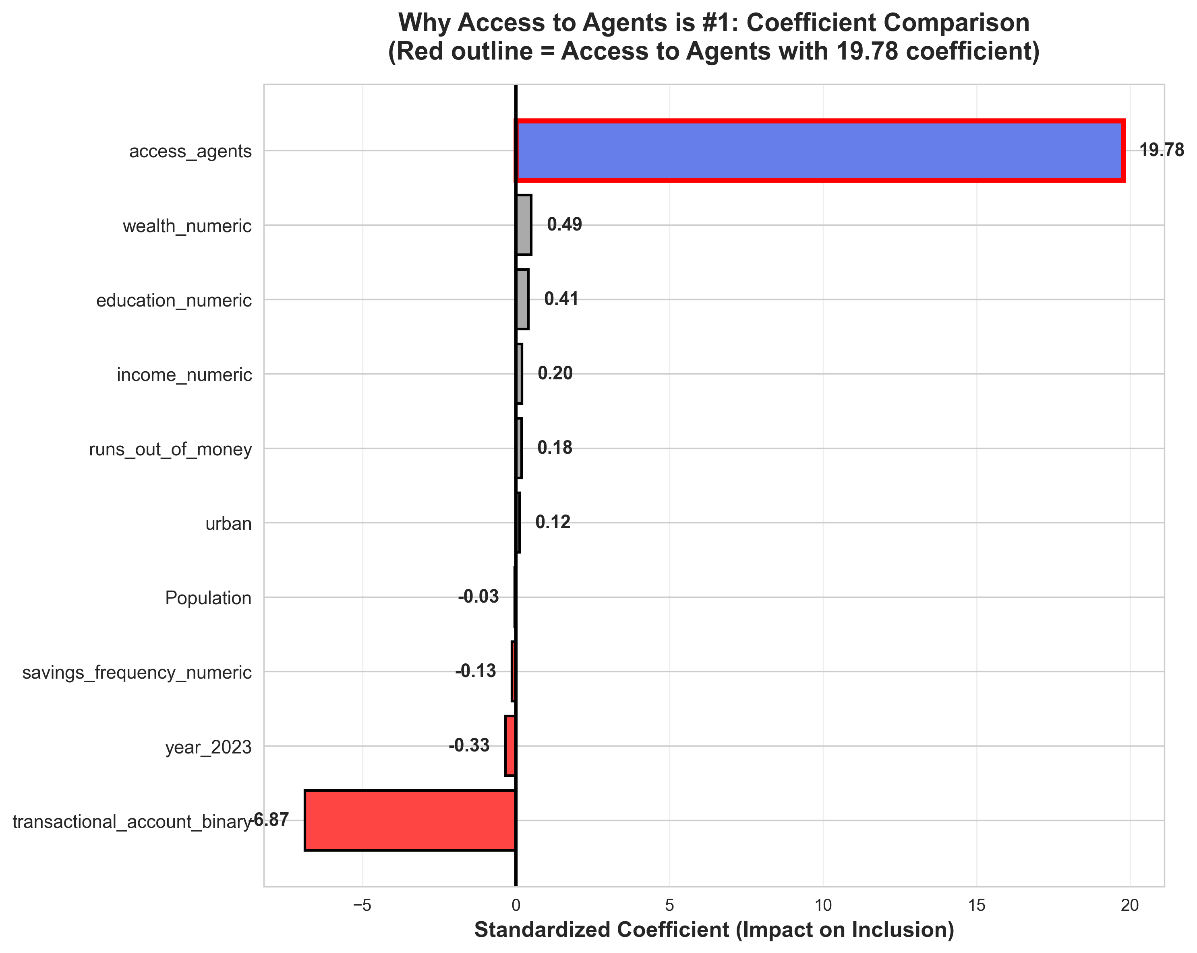
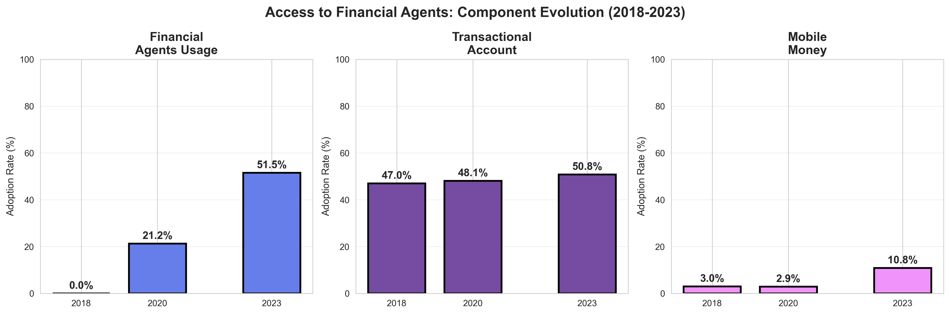
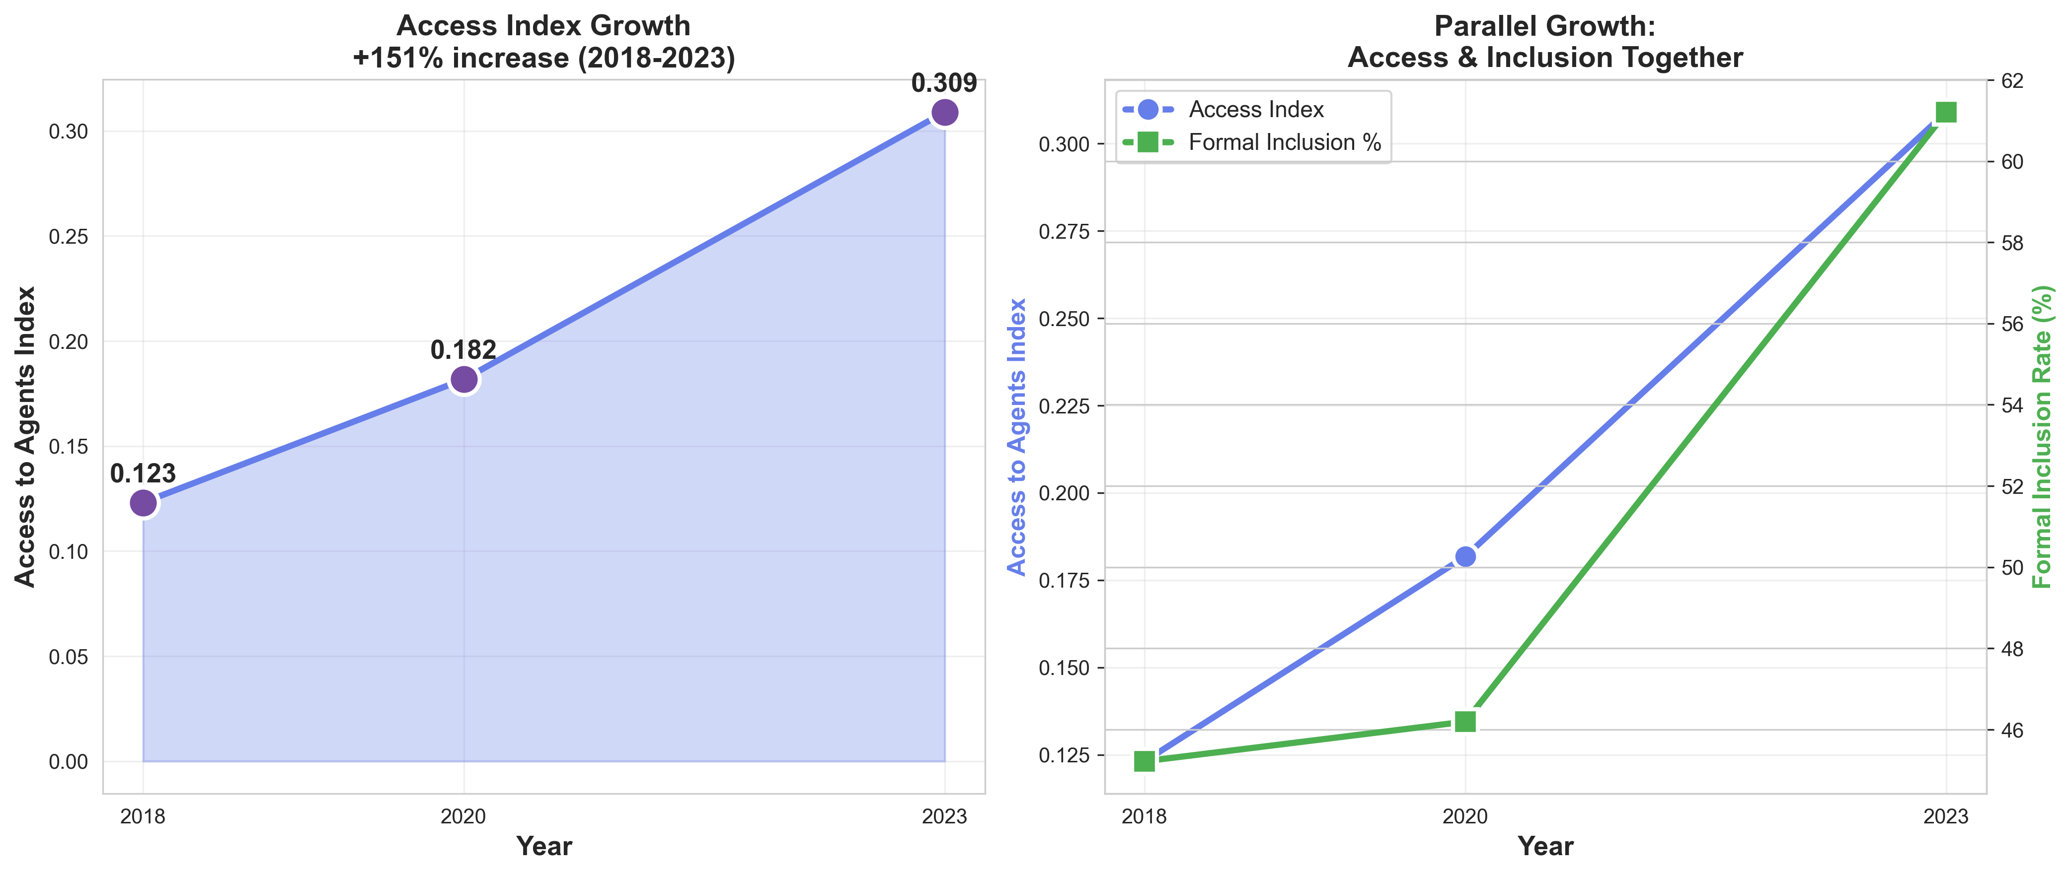
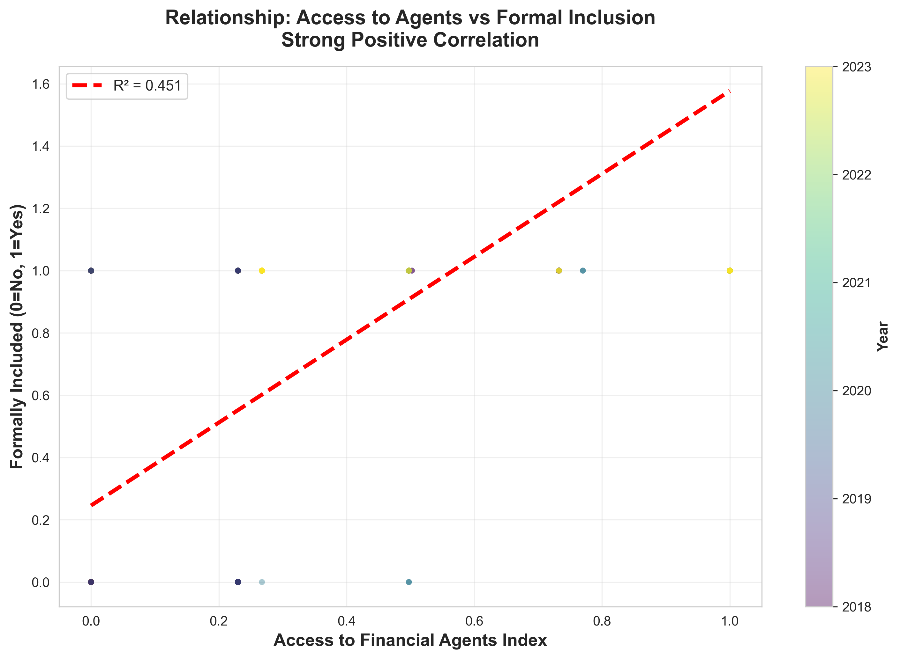
Access to Financial Agents: The #1 Driver of Formal Inclusion
Coefficient: 19.78 | Growth: +150.9% (2018-2023) | Impact: 86pp per unit increase

