Slide 1
Drivers of Formal Financial Inclusion in Nigeria
EFInA Data Analysis (2018-2023)
Octave Analytics

Slide 2
Executive Summary
Formal inclusion surged from 45.2% (2018) to 61.2% (2023)
16 percentage point increase = ~13.7 million newly included Nigerians
Access to Financial Agents is the #1 driver (coefficient: 19.78)
2020-2023 saw 15× faster growth than 2018-2020
Key recommendation: Deploy 50,000+ agents in underserved areas

Slide 3
Key Findings
1. ACCESS TO FINANCIAL AGENTS IS #1 DRIVER
Coefficient: 19.78 (40× larger than most variables)
SHAP importance: 3.60
Effect: 34.4pp difference with/without access
2. DRAMATIC ACCELERATION POST-2020
2018-2020: +1.0pp growth
2020-2023: +15.0pp growth (15× faster)

Slide 4
Top 10 Drivers (Ranked)
1. access_agents: Coef=19.78, SHAP=3.60
2. transactional_account_binary: Coef=-6.87, SHAP=0.50
3. wealth_numeric: Coef=0.49, SHAP=0.23
4. education_numeric: Coef=0.41, SHAP=0.23
5. year_2023: Coef=-0.33, SHAP=0.62
6. income_numeric: Coef=0.20, SHAP=0.11
7. savings_frequency_numeric: Coef=-0.13, SHAP=0.16
8. runs_out_of_money: Coef=0.18, SHAP=0.15
9. urban: Coef=0.12, SHAP=0.11
10. Population: Coef=-0.03, SHAP=0.18

Slide 5
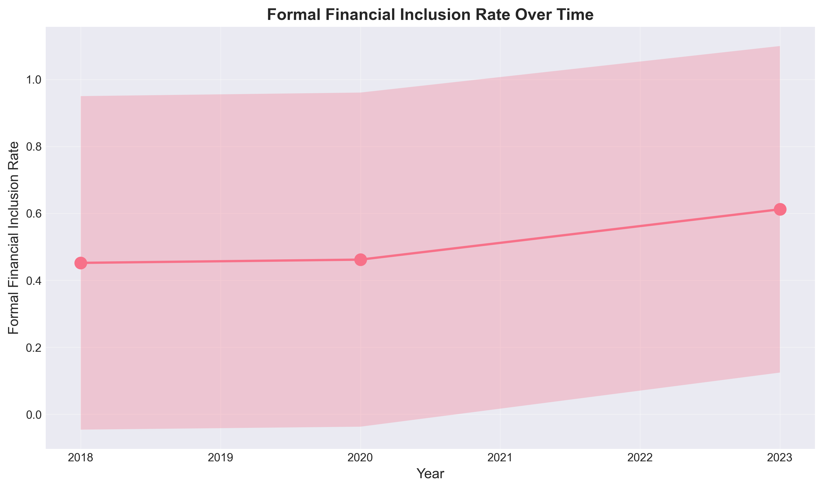
Formal Inclusion Rate Over Time

Slide 6
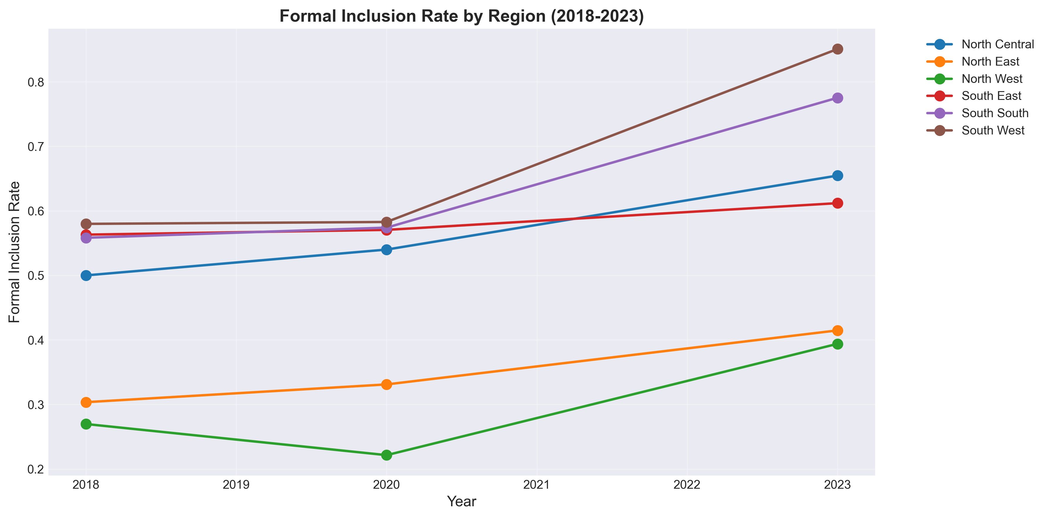
Regional Trends (2018-2023)

Slide 7
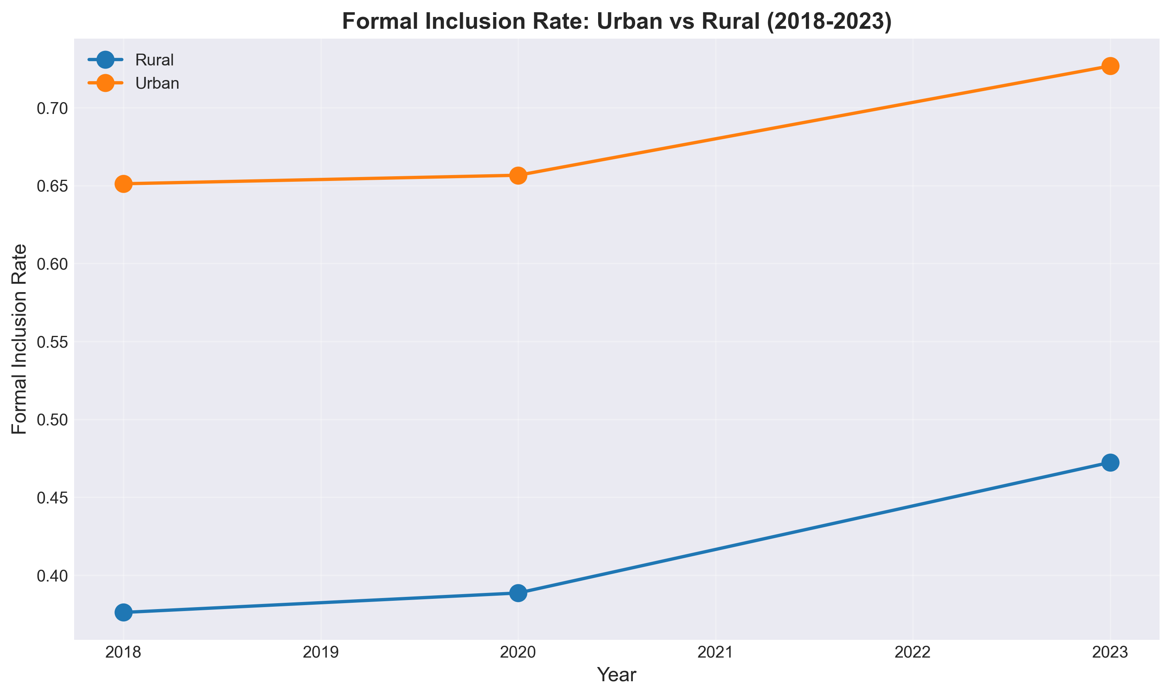
Urban vs Rural Progression

Slide 8
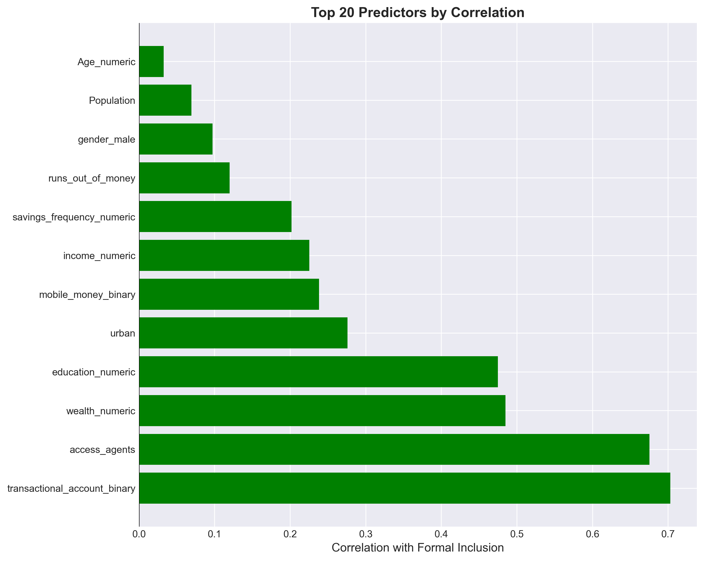
Top Correlations with Formal Inclusion

Slide 9
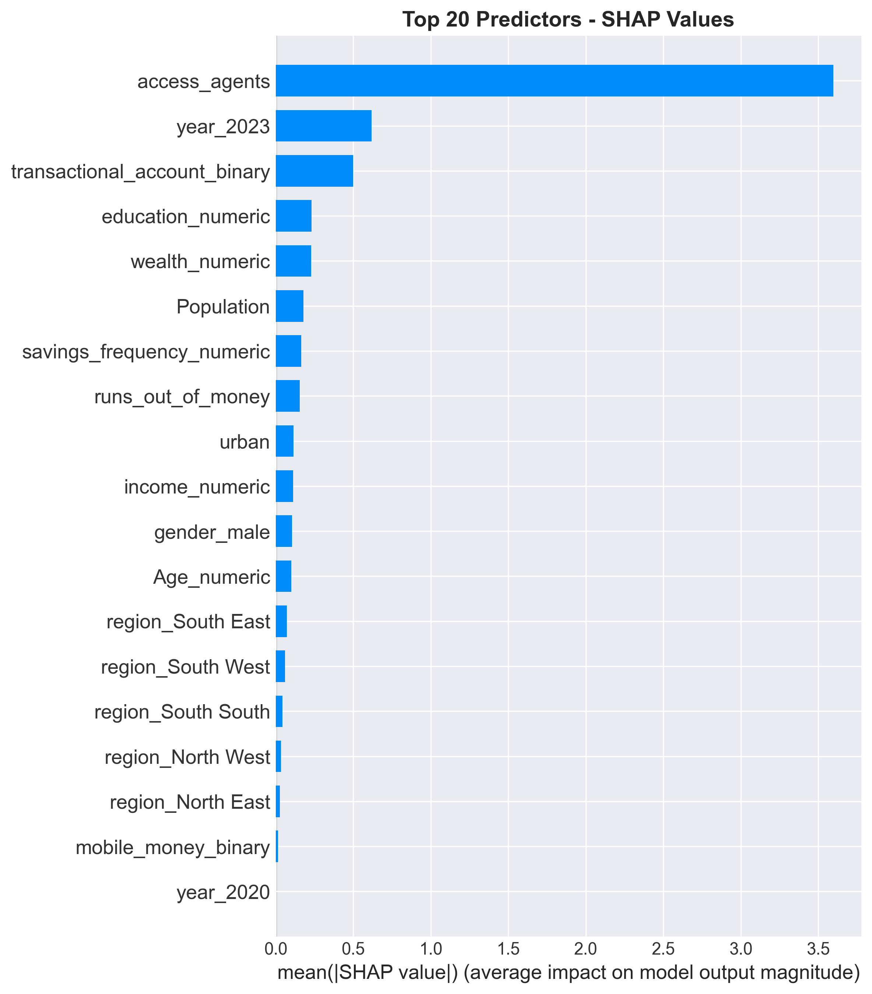
SHAP Feature Importance

Slide 10
Access to Financial Agents Index
RANK #1 DRIVER
Components:
• Financial agents usage
• Transactional account ownership
• Mobile money adoption
Construction: Z-score → Equal weighting → Min-max [0,1]
Growth: 151% increase (2018-2023)
Impact: 34.4pp difference

Slide 11
Top 5 Policy Recommendations
1. AGENT EXPANSION (CRITICAL)
Deploy 50,000 agents → +8-10pp impact
2. ZERO-BALANCE ACCOUNTS (HIGH)
Mandate implementation → +5-7pp impact
3. FINANCIAL LITERACY (HIGH)
Mass campaigns → +3-5pp impact
4. MOBILE MONEY INTEGRATION (MEDIUM)
Seamless transfers → +4-6pp impact
5. REGIONAL EQUITY (MEDIUM)
Target North regions → Narrow gap

Slide 12
Methodology
Data: 85,341 respondents across 36 states + FCT
Years: 2018, 2020, 2023
Models:
• Logistic Regression (standardized coefficients)
• LASSO (variable selection)
• Random Forest (feature importance)
• XGBoost + SHAP (marginal contributions)
Performance: 89-92% accuracy, 0.94-0.98 ROC-AUC

Slide 13
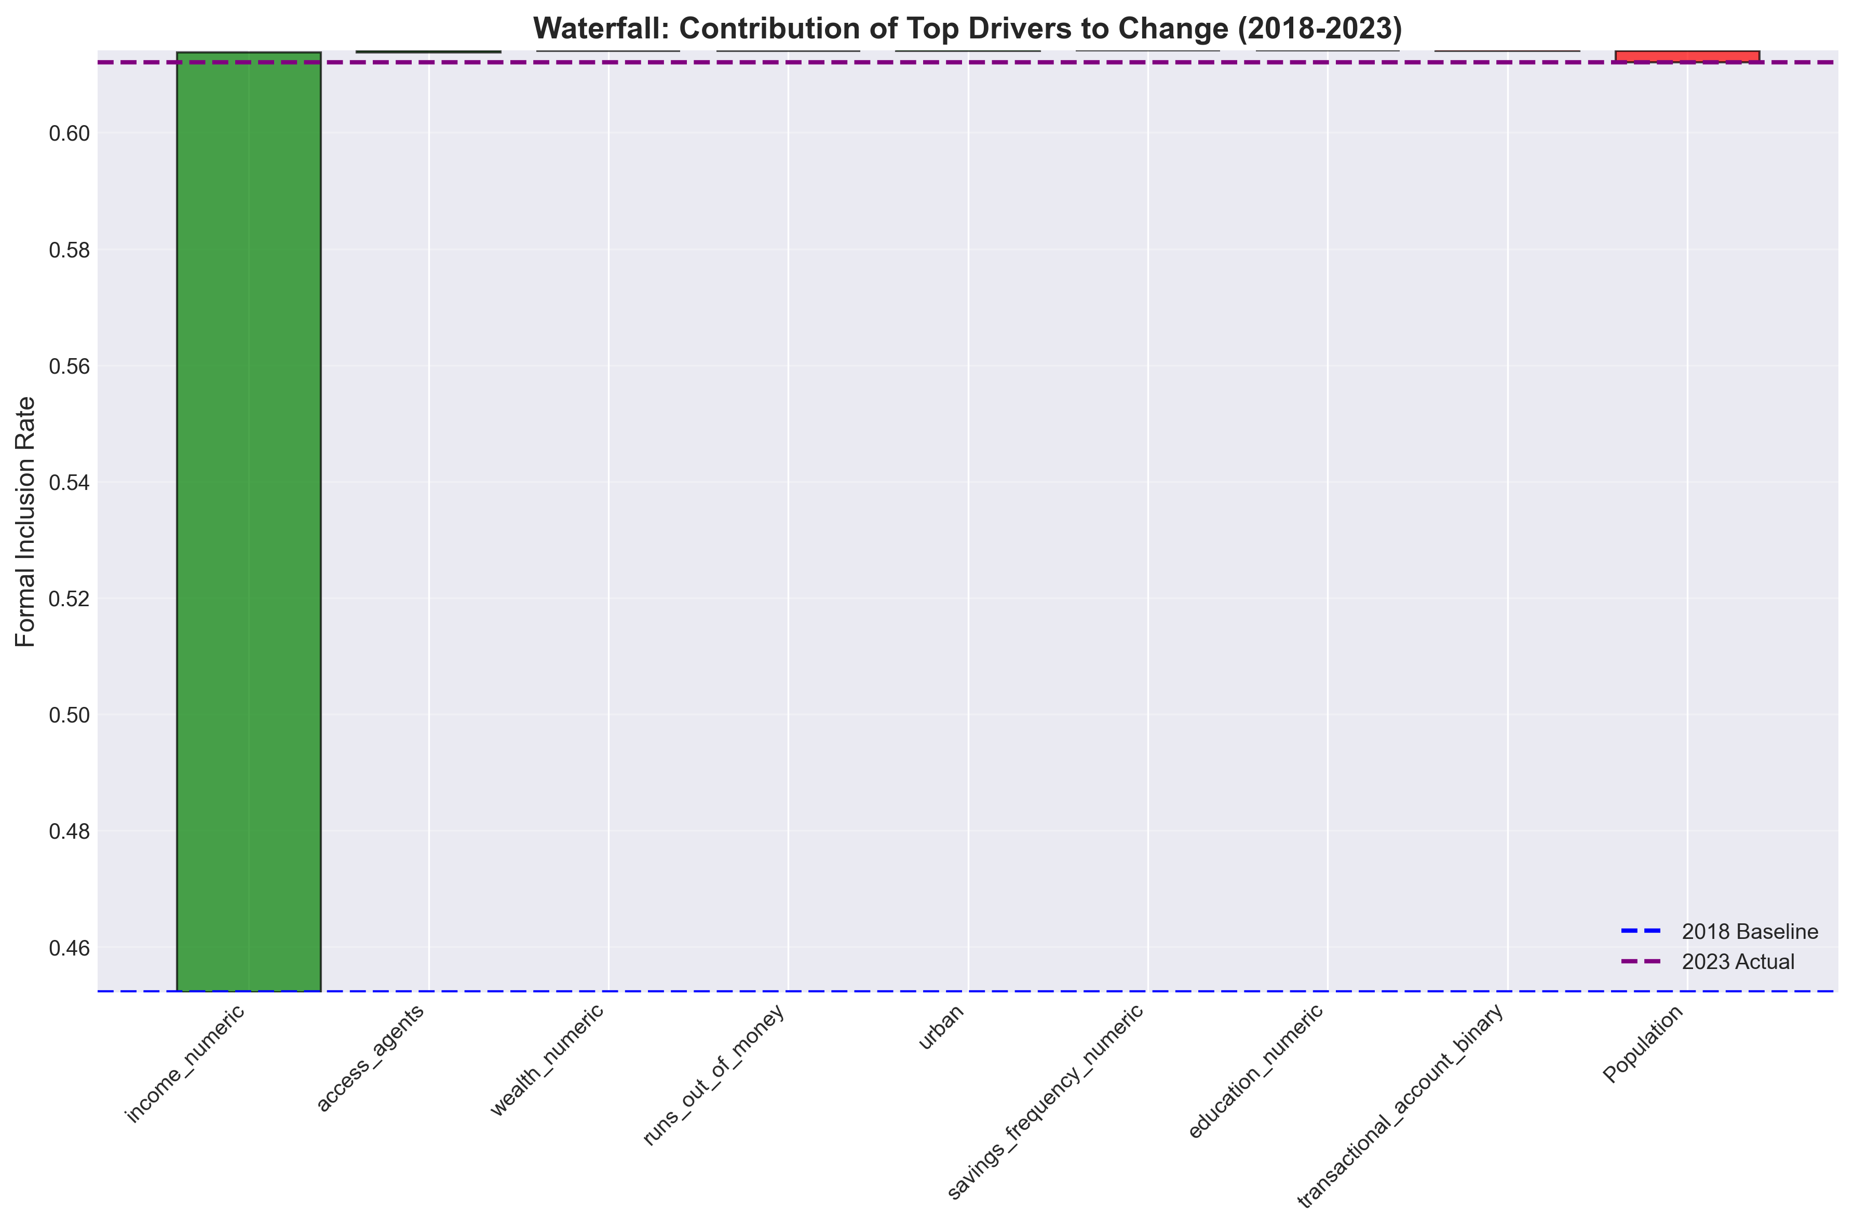
Contribution to Change (2018-2023)

Slide 14
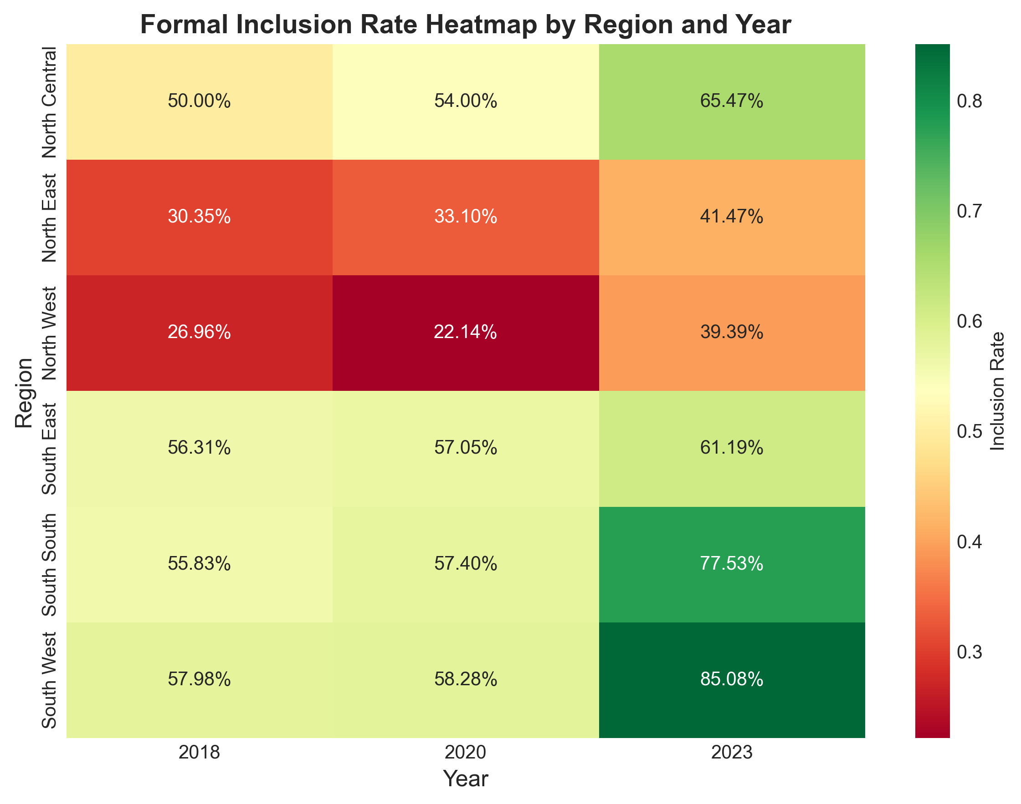
Regional Inclusion Heatmap

Slide 15
Impact Projections (2024-2026)
IF TOP 3 RECOMMENDATIONS IMPLEMENTED:
Agent Expansion: +8pp → 69.2% by 2025
Zero-Balance Accounts: +5pp → 74.2% by 2026
Financial Literacy: +3pp → 77.2% by 2026
COMBINED: Could reach 77% by 2026
(vs. baseline projection of 65%)

Slide 16
Conclusion & Next Steps
KEY INSIGHT: Agent access dominates all other factors
IMMEDIATE ACTIONS:
• Present to CBN Financial Inclusion Secretariat
• Advocate for agent expansion pilot (5 LGAs)
• Develop zero-balance account regulations
LONG-TERM GOAL:
• 80% national inclusion by 2030
• Universal inclusion for all segments

