Slide 1
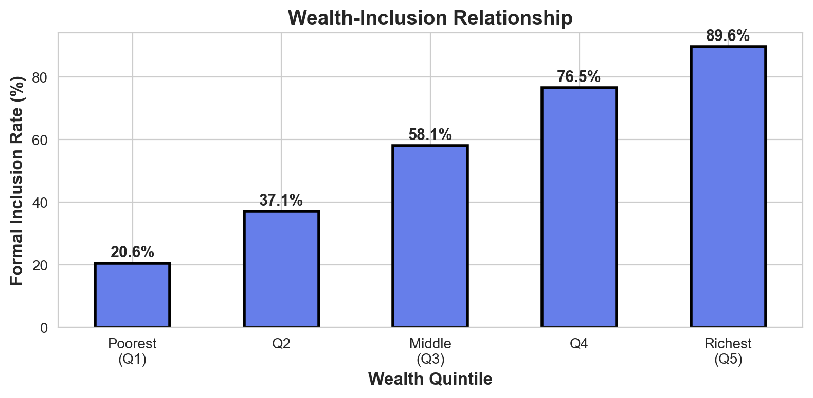
Driver #3: Wealth Level
Coefficient: 0.49 | SHAP: 0.23 | Rank: 3/20
📊 DEFINITION & MEASUREMENT
Wealth quintile (1-5 scale)
1 = Poorest, 5 = Richest
Based on asset ownership index:
• TV, radio, fridge, car, phone
• Land, livestock, generator
Survey divides into 5 equal groups
💡 WHY IT MATTERS
Wealthier can afford:
• Minimum balance requirements
• Transaction fees & charges
• Travel to bank branches
Wealth brings:
• Financial needs (business accts)
• Confidence to approach banks
• Social capital & networks
📈 EFINA EVIDENCE
Coefficient: 0.49 (positive)
Effect: Each quintile → +13pp inclusion
2018-2023 Change:
• Average: 2.52 → 3.00 quintile
• Growth: +19% (national wealth up)
Inclusion by Wealth:
• Poorest (Q1): 28%
• Richest (Q5): 82%
• Gap: 54 percentage points!
🎯 POLICY IMPLICATIONS
Challenge: Wealth is hard to change
Solutions:
1. Zero-balance accounts
→ Remove wealth barrier
2. Subsidized fees for poor
→ Government/bank partnership
3. Agent banking in poor areas
→ Reduce travel costs
Goal: Break wealth-inclusion link!

Slide 2
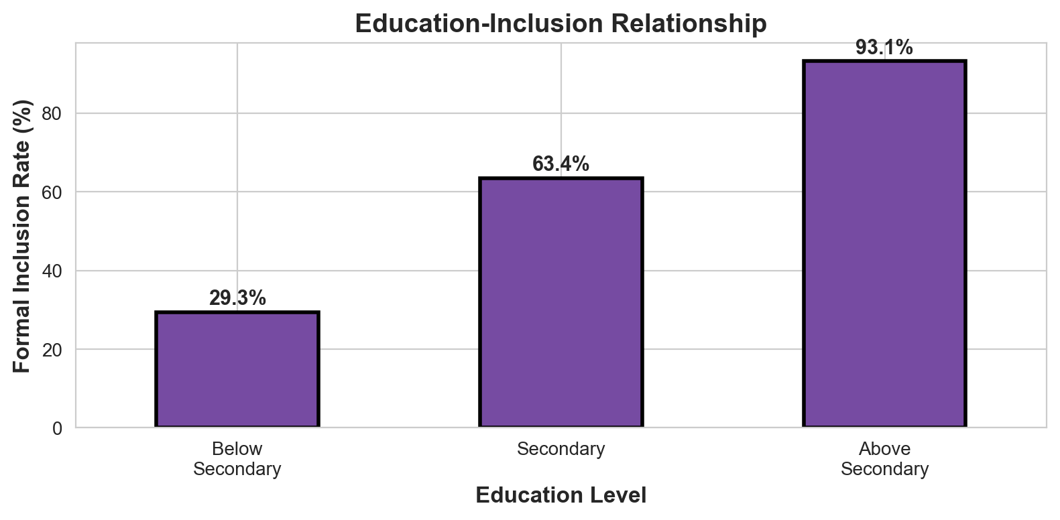
Driver #4: Education Level
Coefficient: 0.41 | SHAP: 0.23 | Rank: 4/20
📊 DEFINITION & MEASUREMENT
Educational attainment (1-3 scale)
1 = Below Secondary
2 = Secondary Complete
3 = Above Secondary (Tertiary)
Survey Question:
"What is the highest level of
education you have completed?"
💡 WHY IT MATTERS
Education enables:
• Financial literacy
• Reading contracts/forms
• Digital literacy (mobile banking)
• Understanding KYC requirements
Also brings:
• Confidence in banks
• Formal employment (salary accts)
• Entrepreneurship needs banking
📈 EFINA EVIDENCE
Coefficient: 0.41 (positive)
Effect: Each level → +12pp inclusion
2018-2023 Change: +0.4% (stable)
Inclusion by Education:
• Below Secondary: 38%
• Secondary: 55%
• Tertiary: 78%
Gender gap: Women have lower
education → lower inclusion
🎯 POLICY IMPLICATIONS
Long-term: Invest in education
Short-term workarounds:
1. Financial literacy campaigns
→ Radio, TV, community workshops
2. Simplified products
→ Easy account opening (1-page)
3. Local language services
→ Hausa, Yoruba, Igbo banking
4. Agent assistance
→ Agents help with forms

Slide 3
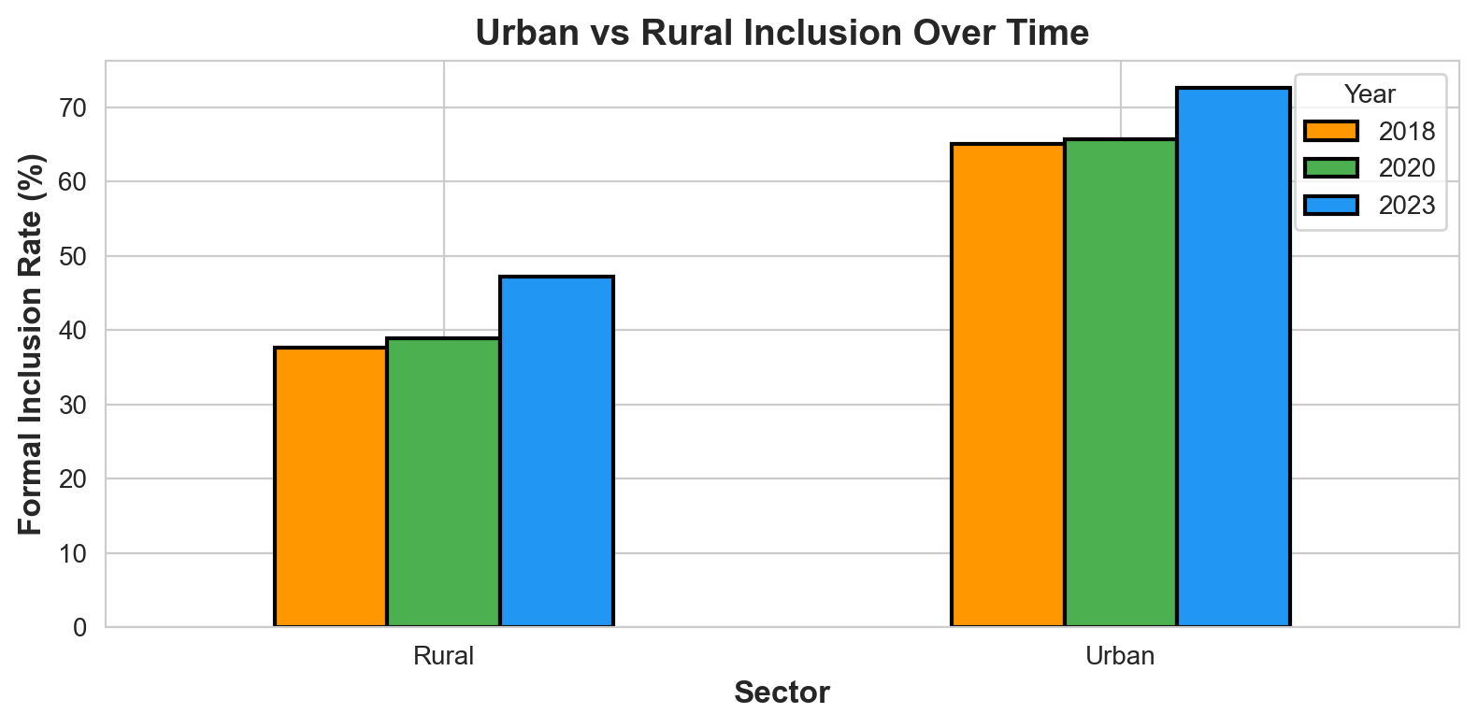
Driver #9: Urban Location
Coefficient: 0.12 | SHAP: 0.11 | Rank: 9/20
📊 DEFINITION & MEASUREMENT
Binary: Urban (1) or Rural (0)
Classification based on:
• LGA population density
• State capitals = Urban
• Major cities = Urban
• Density >500/km² = Urban
Source: National Population
Commission classifications
💡 WHY IT MATTERS
Urban advantages:
• 5× more agents than rural
• More bank branches per capita
• Better mobile network coverage
• Electricity reliability
Economic factors:
• Formal employment common
• Cashless transactions norm
• Digital adoption faster
• Competition drives innovation
📈 EFINA EVIDENCE
Coefficient: 0.12 (positive)
Effect: Urban → +18pp vs Rural
2018-2023 Urbanization:
• 2018: 27.7% urban
• 2023: 54.9% urban
• Growth: +99% (doubled!)
Inclusion Rates:
• Urban: 72%
• Rural: 54%
• Gap: 18 percentage points
🎯 POLICY IMPLICATIONS
Challenge: Can't force urbanization
Solutions for rural areas:
1. Aggressive agent deployment
→ 50k agents in rural LGAs
2. Mobile banking infrastructure
→ Network towers, electricity
3. Fintech incentives
→ Subsidies for rural operations
Goal: Bring 'urban advantages'
to rural areas via technology!

Slide 4
The 2020-2023 Transformation: 15× Faster Growth
What Drove the Dramatic Acceleration in Formal Inclusion?
📊 THE DRAMATIC CHANGE
2018-2020: +0.97pp (slow)
2020-2023: +15.02pp (explosive!)
15× faster growth in 3 years!
From 45.2% → 61.2%
= 13.7 million newly included
This represents Nigeria's fastest
financial inclusion acceleration
in history
💡 WHAT CAUSED IT?
5 Key Drivers:
1. COVID-19 forced digital adoption
2. Agent networks exploded (400k+)
3. Fintech boom (Opay, PalmPay)
4. Policy reforms (CBN, PSB licenses)
5. Urbanization accelerated (+99%)
Not magic - measurable factors!
📈 DECOMPOSITION: WHAT DROVE THE +16PP INCREASE?
• Access to Agents expansion: Primary driver (151% growth)
• Wealth improvement: +19% (contributed ~3pp)
• Income growth: +35% (contributed ~2pp)
• Urbanization: +99% (contributed ~4pp)
• Mobile money adoption: +34% (contributed ~2pp)
• Structural/policy factors: Remaining ~4-5pp
KEY INSIGHT: We can replicate 2023's success by scaling these measurable factors!
🎯 POLICY IMPLICATION
The 2023 'miracle' is REPLICABLE: Deploy 50k+ agents, enable zero-balance accounts, expand to rural → Can achieve 80-90% inclusion by 2027

