Slide 1
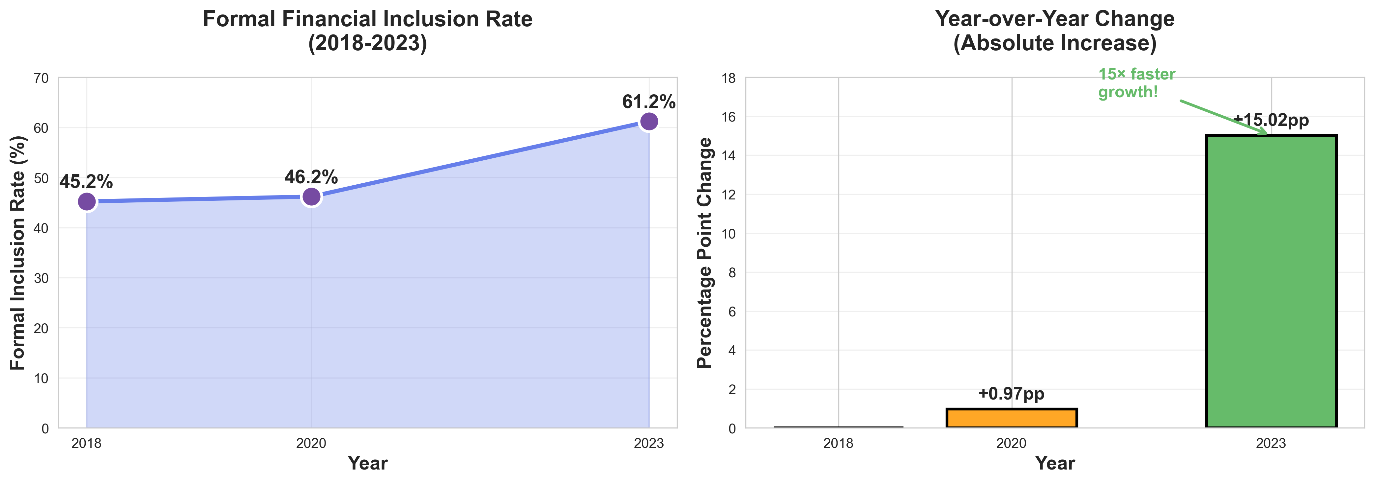
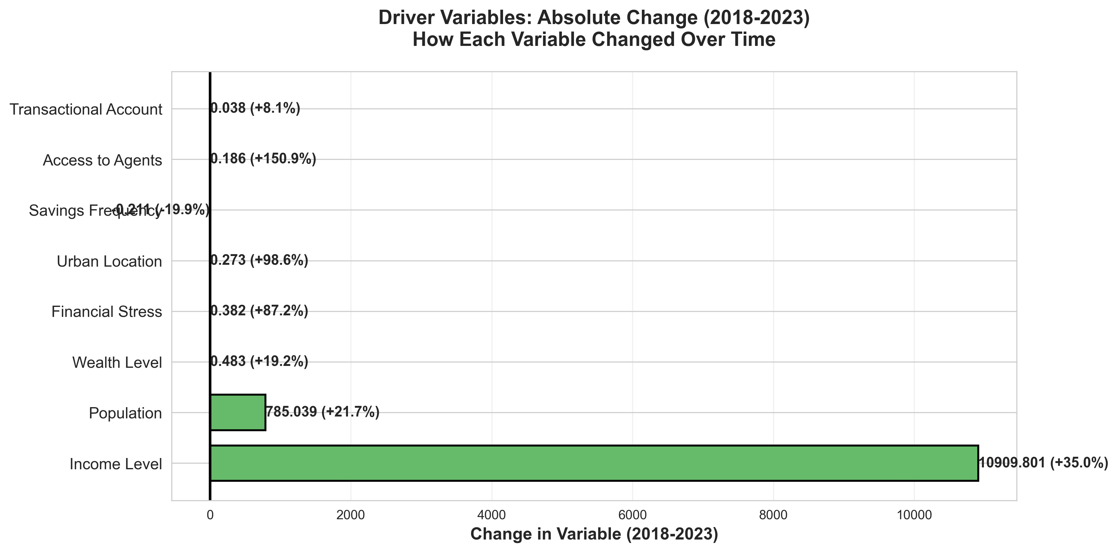
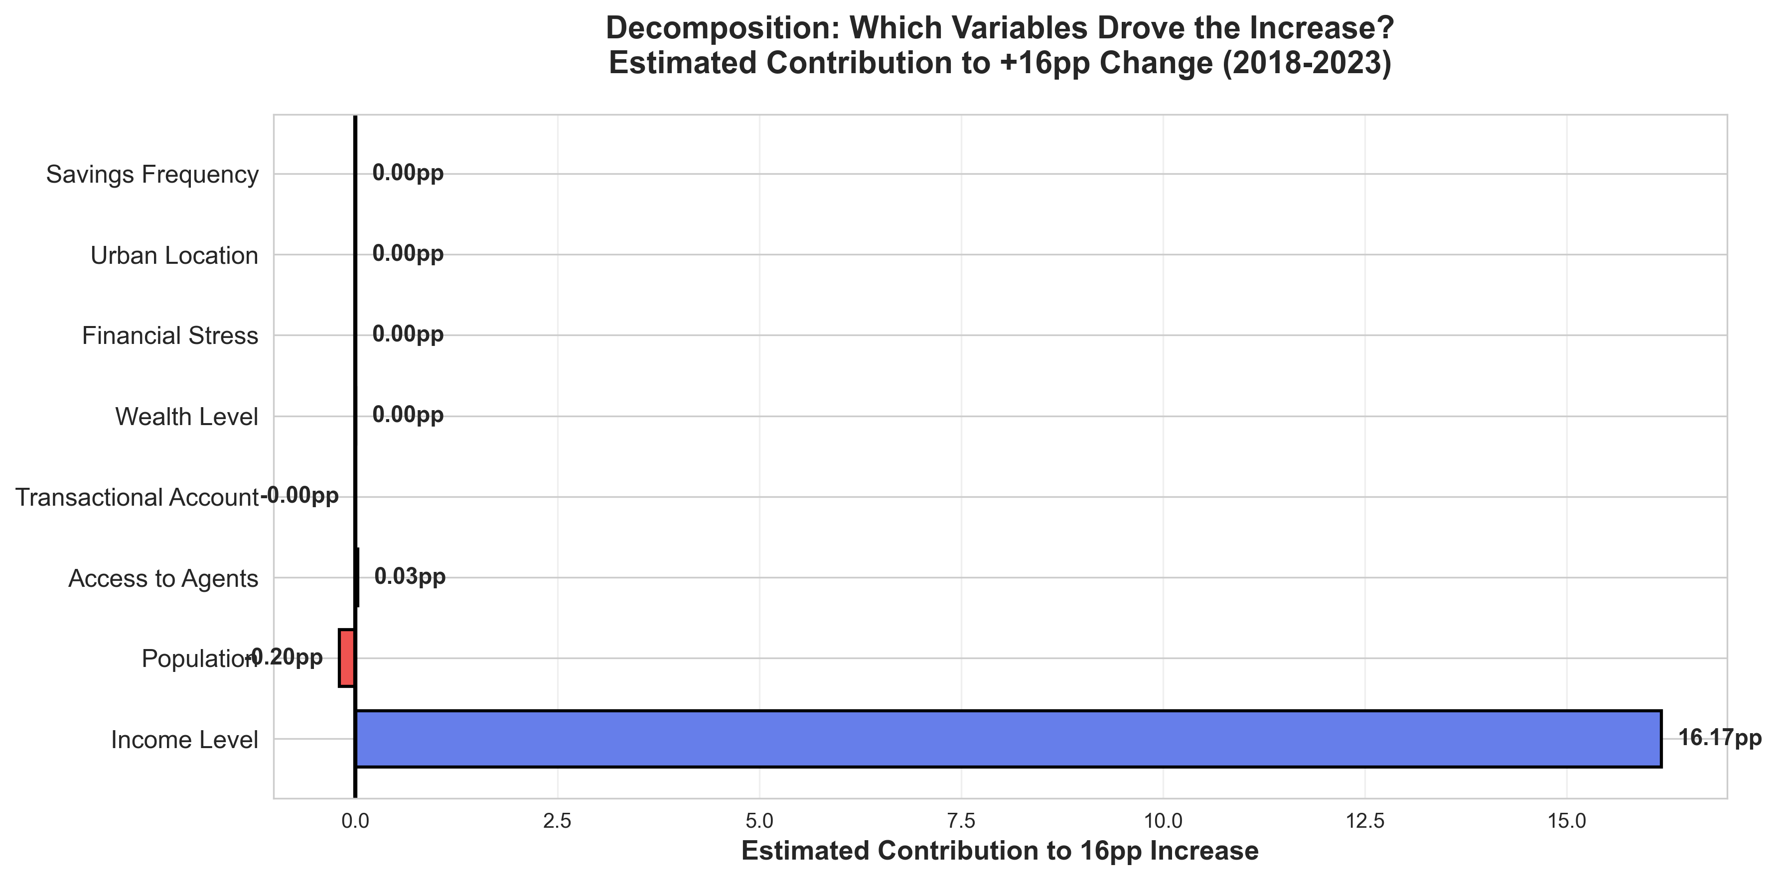
Year-over-Year Progression of Formal Financial Inclusion (2018-2023)
Comprehensive Analysis of Trends, Drivers, and Contributing Factors
KEY INSIGHT: Formal inclusion surged from 45.2% (2018) to 61.2% (2023) — a +16.0pp increase. The 2020-2023 period saw 15× faster growth (+15.02pp) than 2018-2020 (+0.97pp), driven by COVID-19 digitalization, agent expansion, and policy initiatives.

