Slide 1
Figures
Monthly inundation record.
Comparison to previous multiyear records
Annual inundation extend
Seasonality
Comparison to other climate records
Comparison to GRACE, water tower precipitation, delta precip

Slide 2
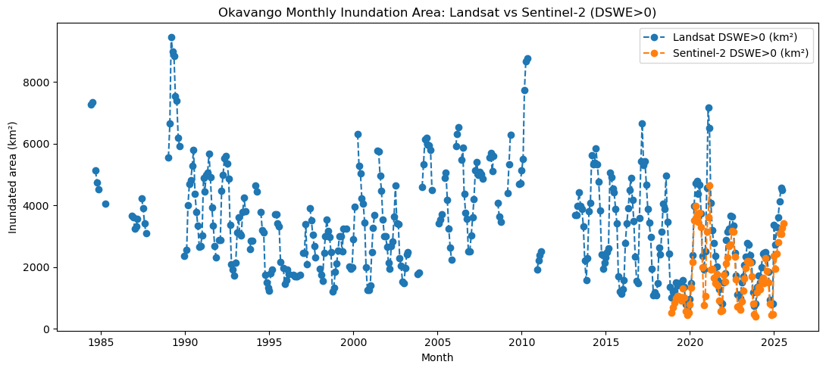

Slide 3
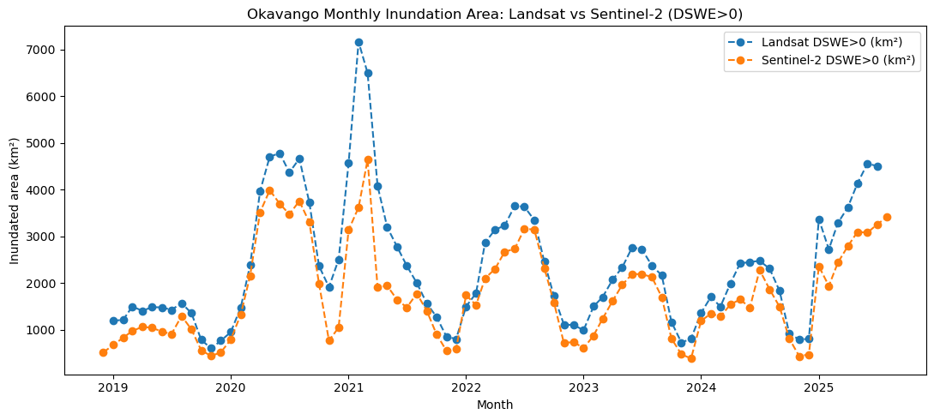
Multiclass
Other visuals…

Slide 4
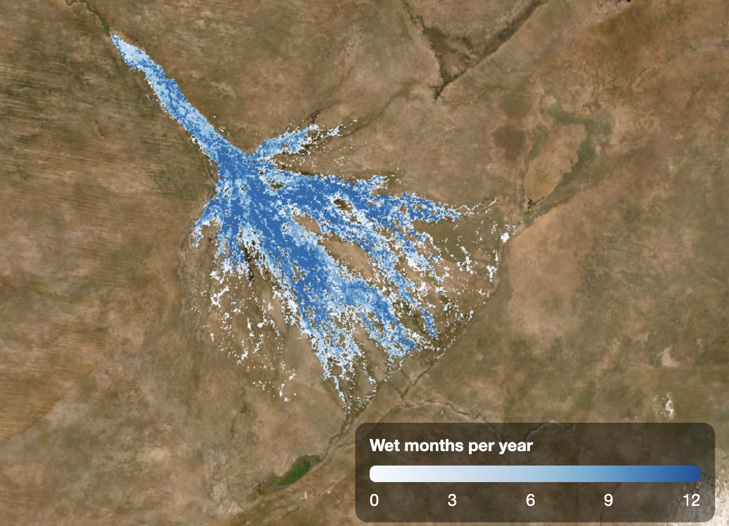

Slide 5
Misc.
Gauge data vs annual rainfall…
Grace with follow on, trends.

