Slide 1
Equivalent Roughness for Overland Flow on Heterogeneous Hillslopes
Simulation Setup
Domain & Physics
1-D hillslope, full Saint-Venant equations
Binary roughness: nᵥ (vegetation) and nₒ (bare)
Hydrograph matching → nₑ for each simulation
Smooth bed topography
Parameter Space
Vegetation fraction fᵥ: 0.1 – 0.9
Patch lengthscale σ (Lᵥ): multiple levels
Storm intensity p: 2 – 8 mm/hr
Storm duration tᵣ: 30 – 120 min
Pattern anisotropy: isotropic + anisotropic
Hundreds of unique simulations

Slide 2
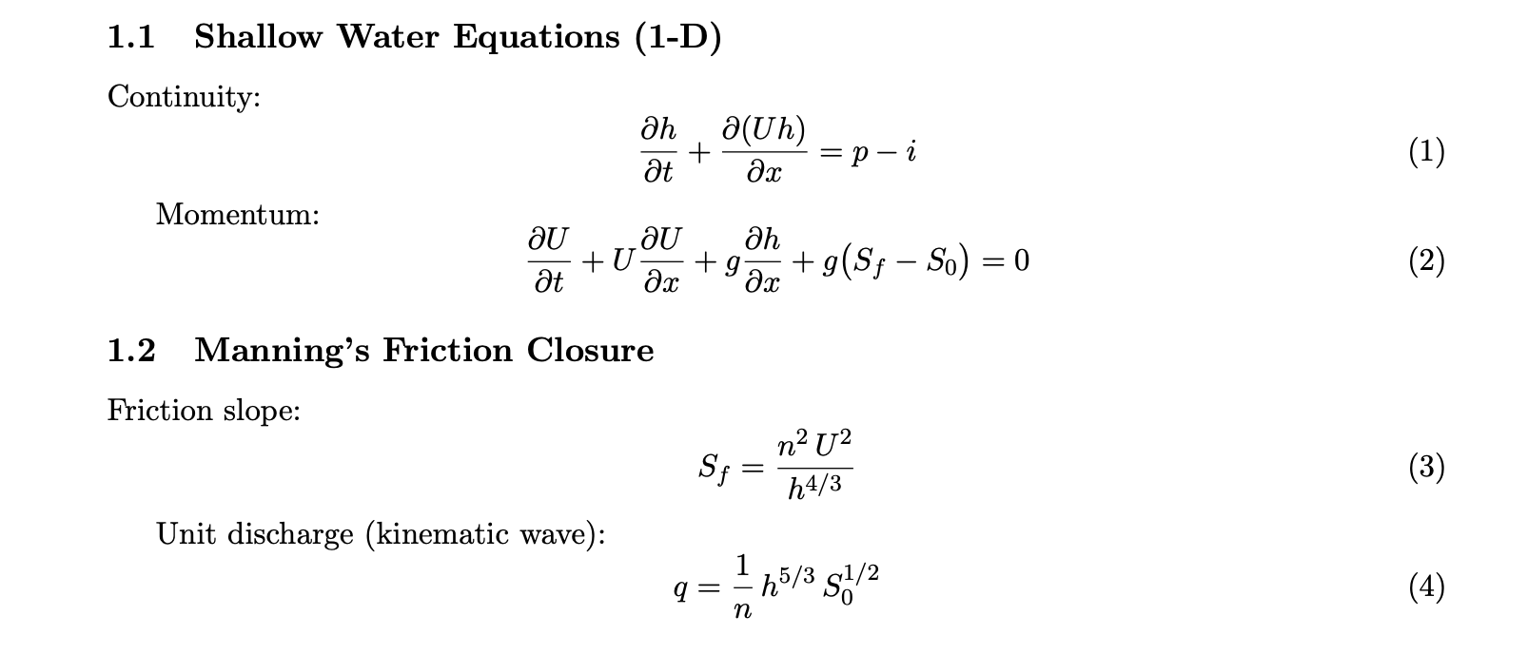

Slide 3
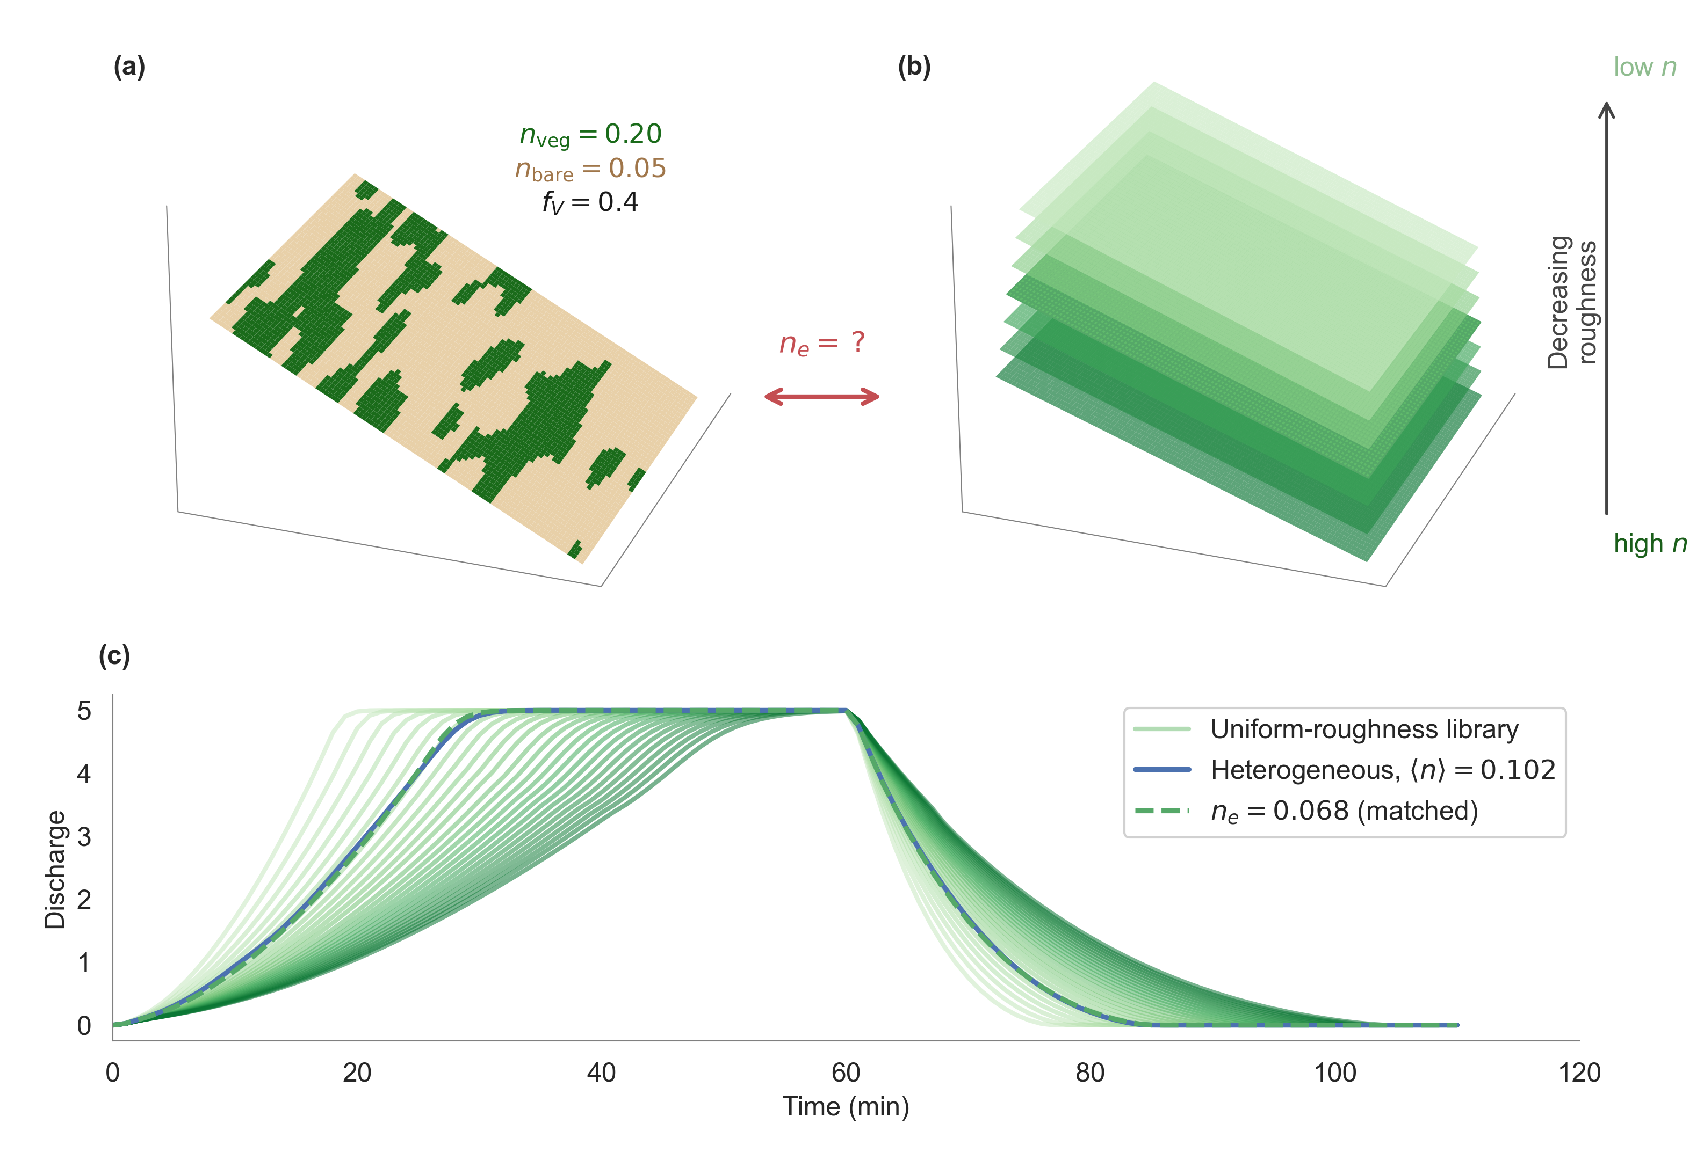
Fig 1
Conceptual sketch illustrating the equivalent-roughness problem on a heterogeneous hillslope. Panel (a) shows the patchy surface,
(b) the uniform-roughness stack, and (c) the matched hydrograph.

Slide 4
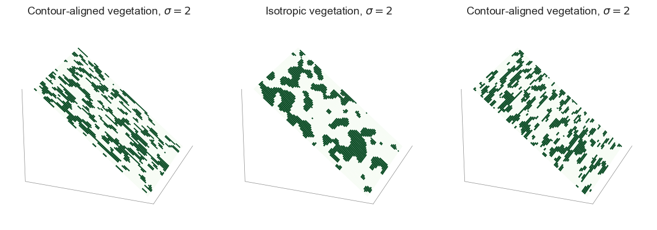
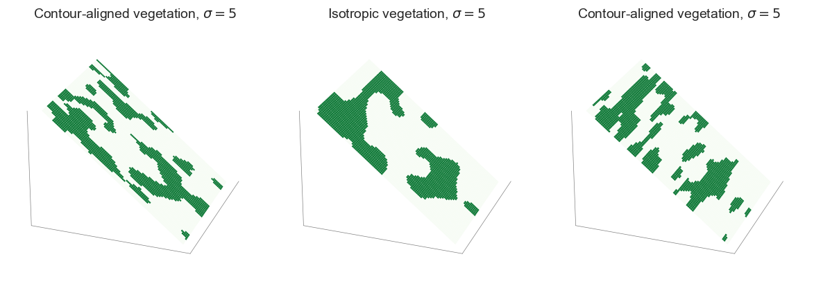

Slide 5
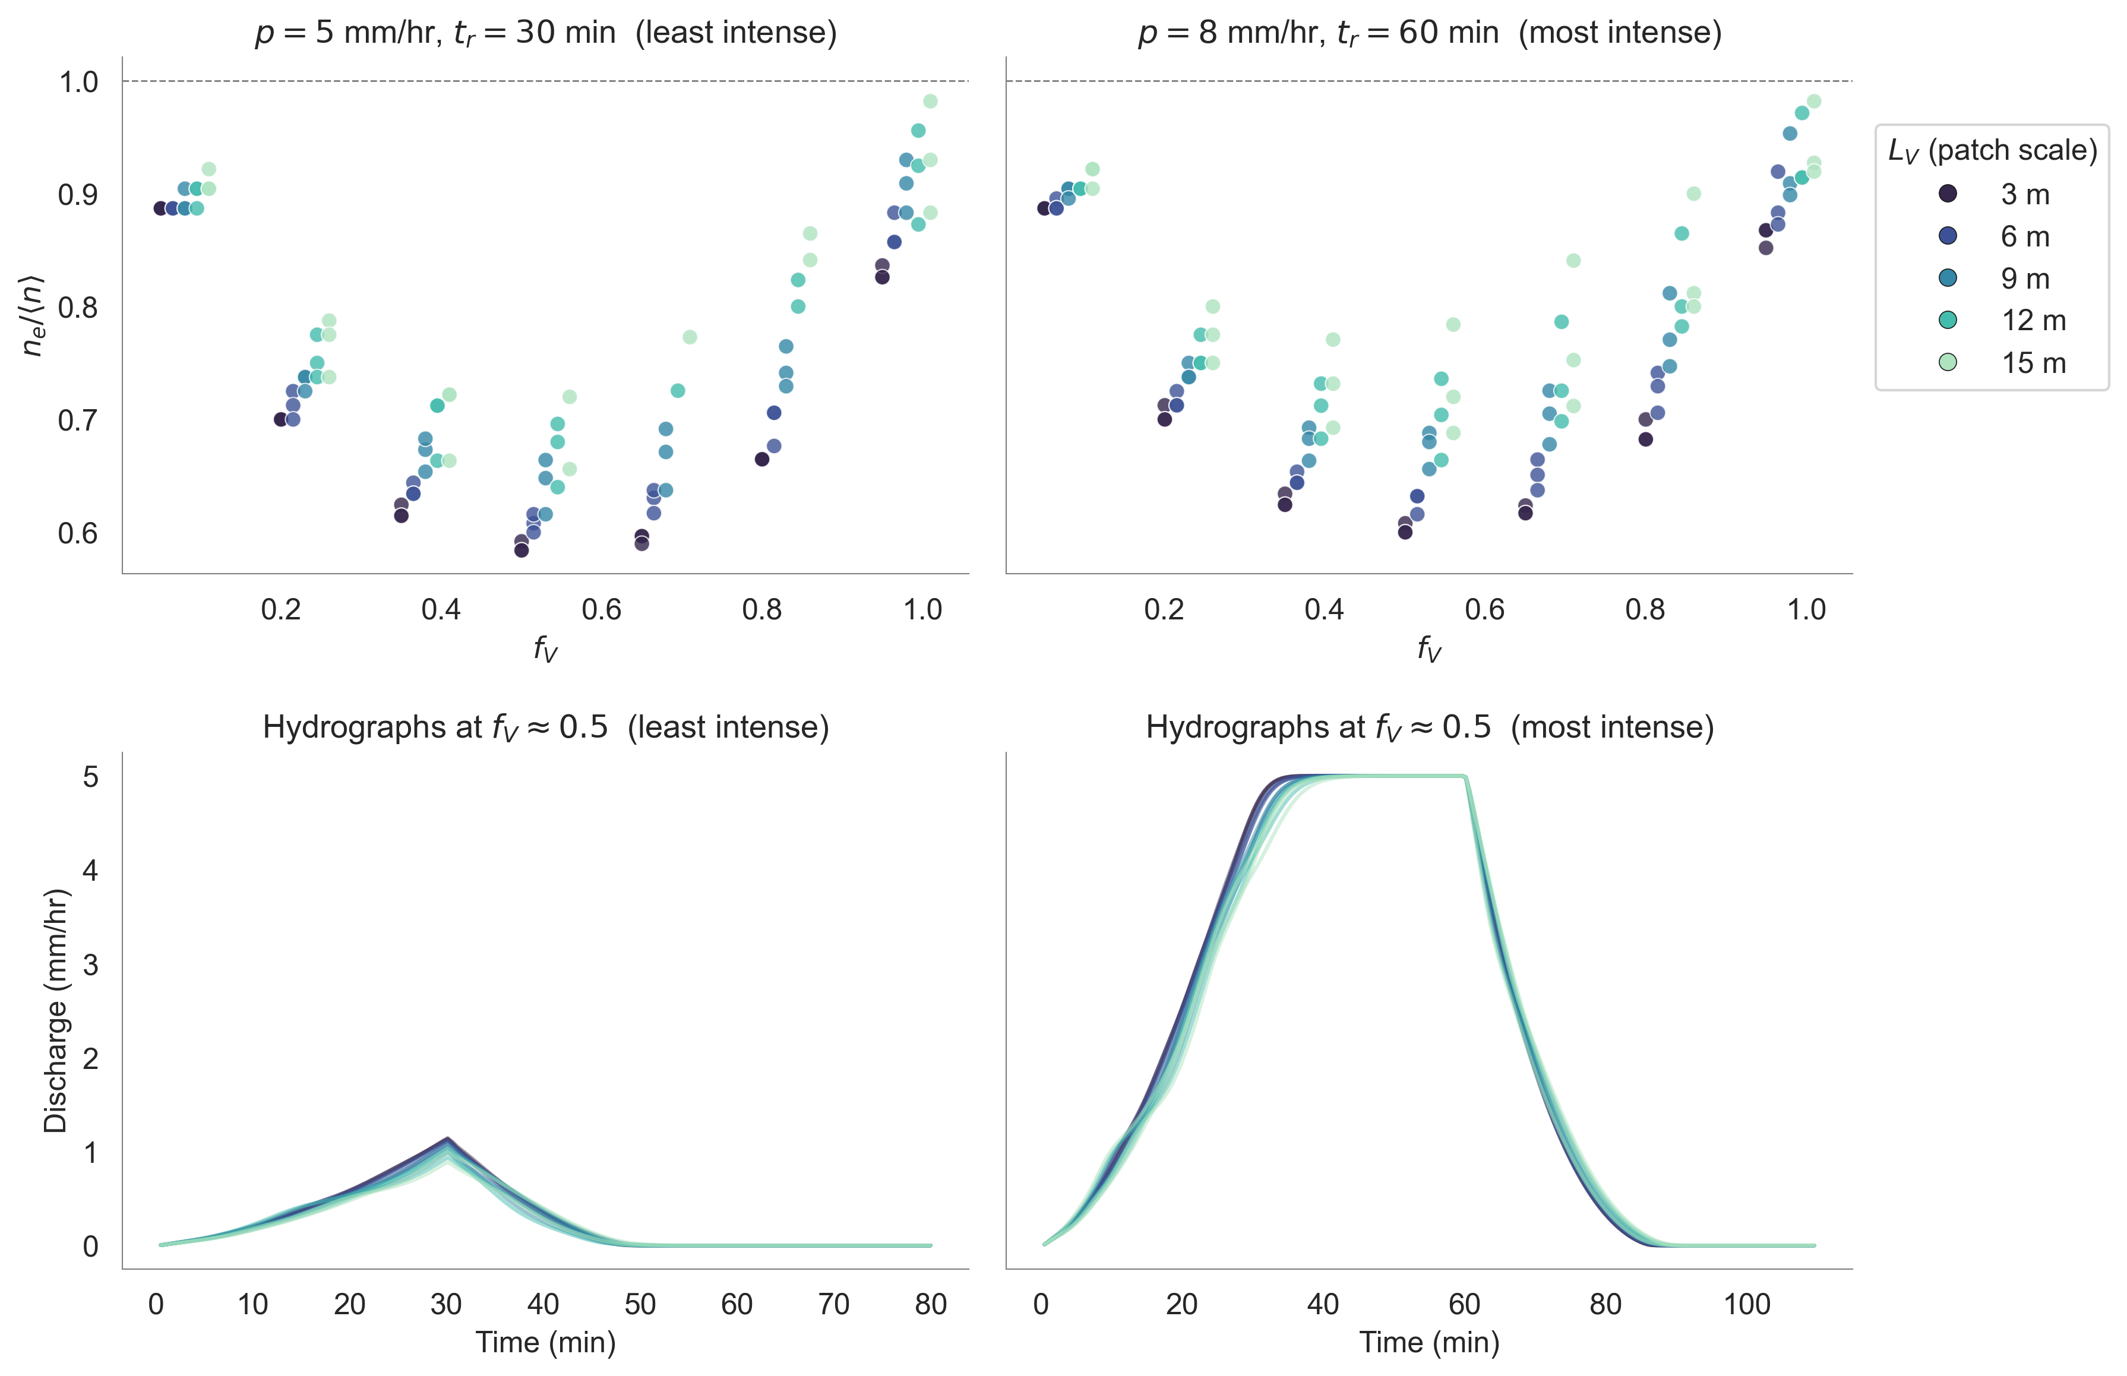
Fig 2

Slide 6
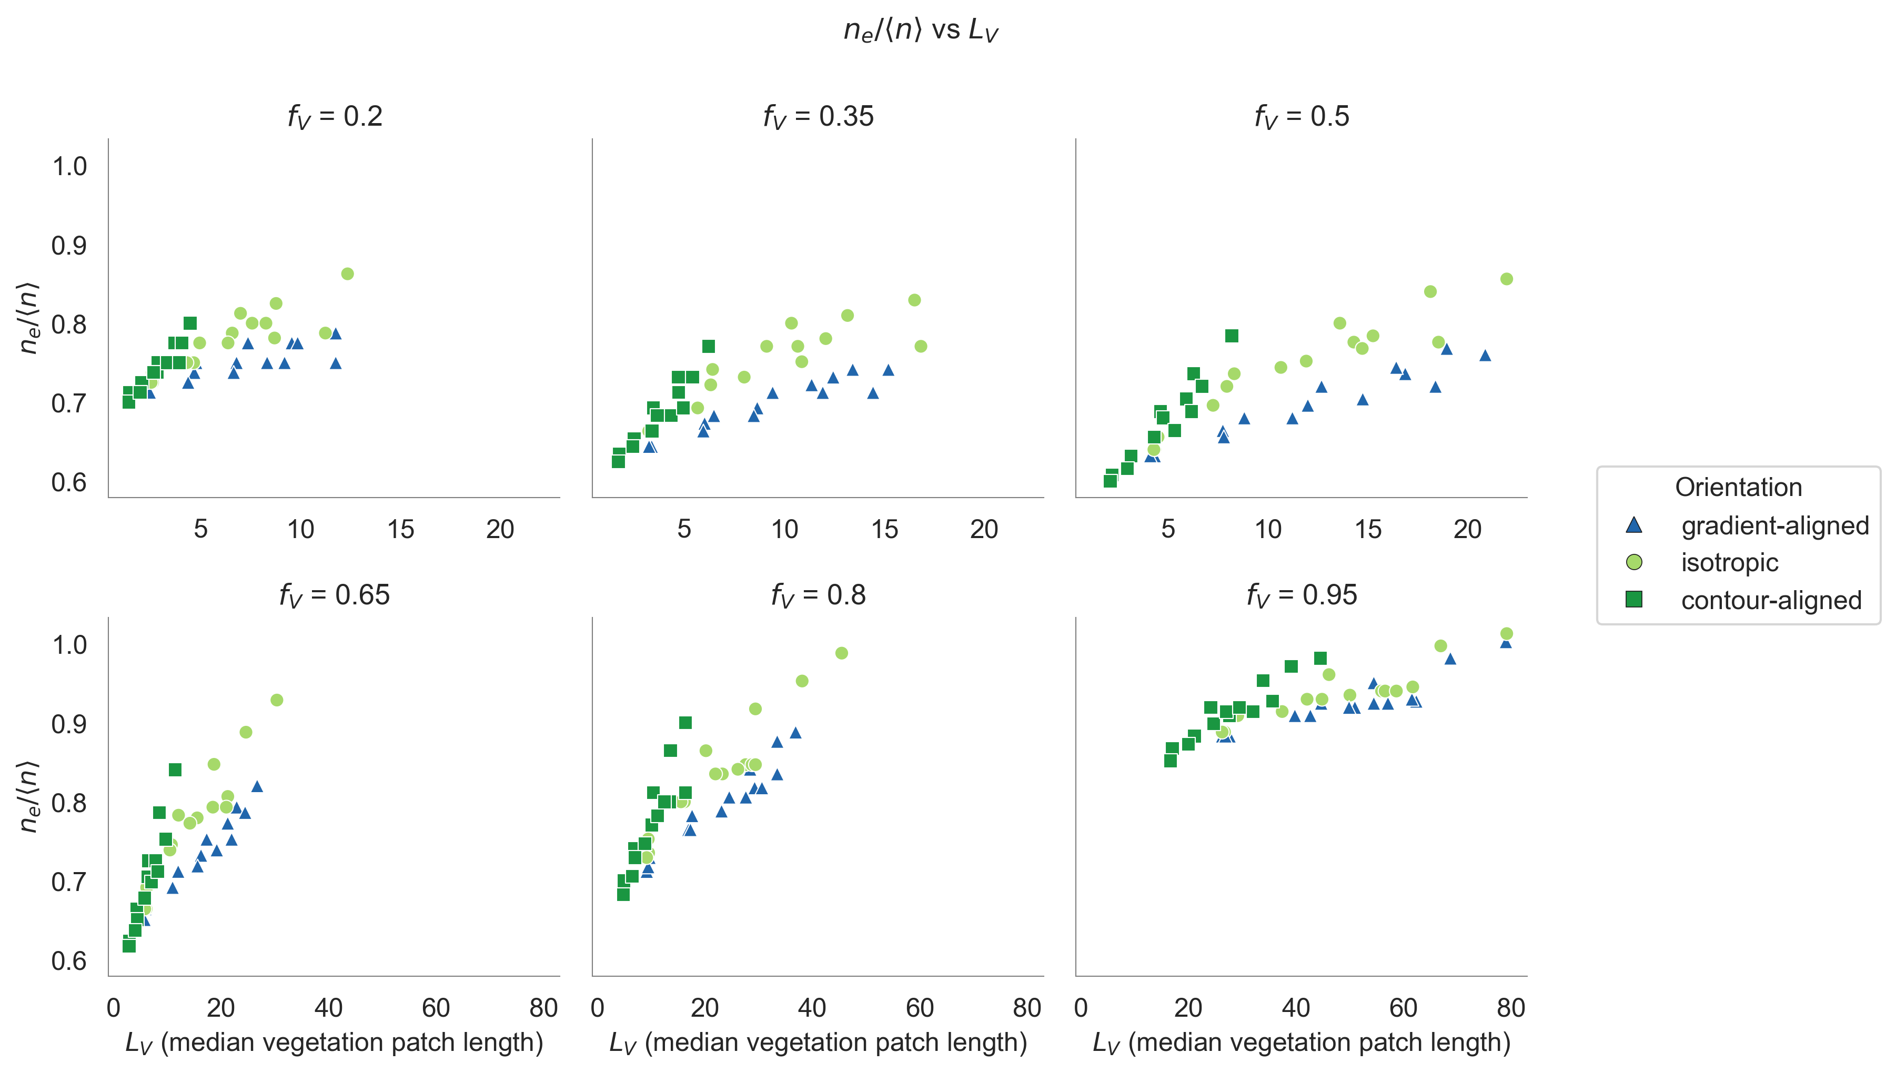
Fig 3

Slide 7
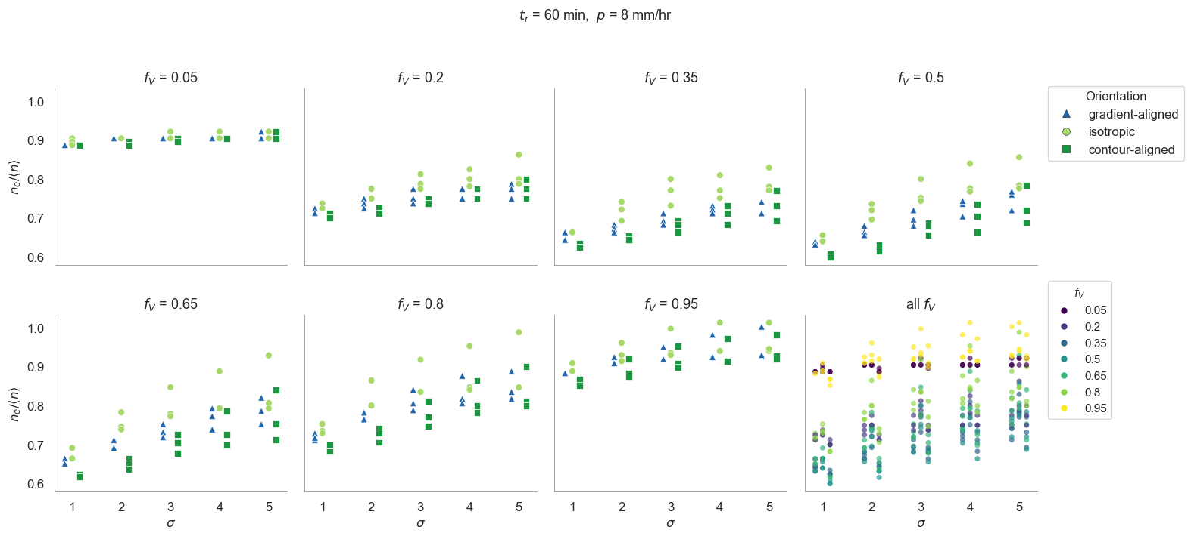

Slide 8
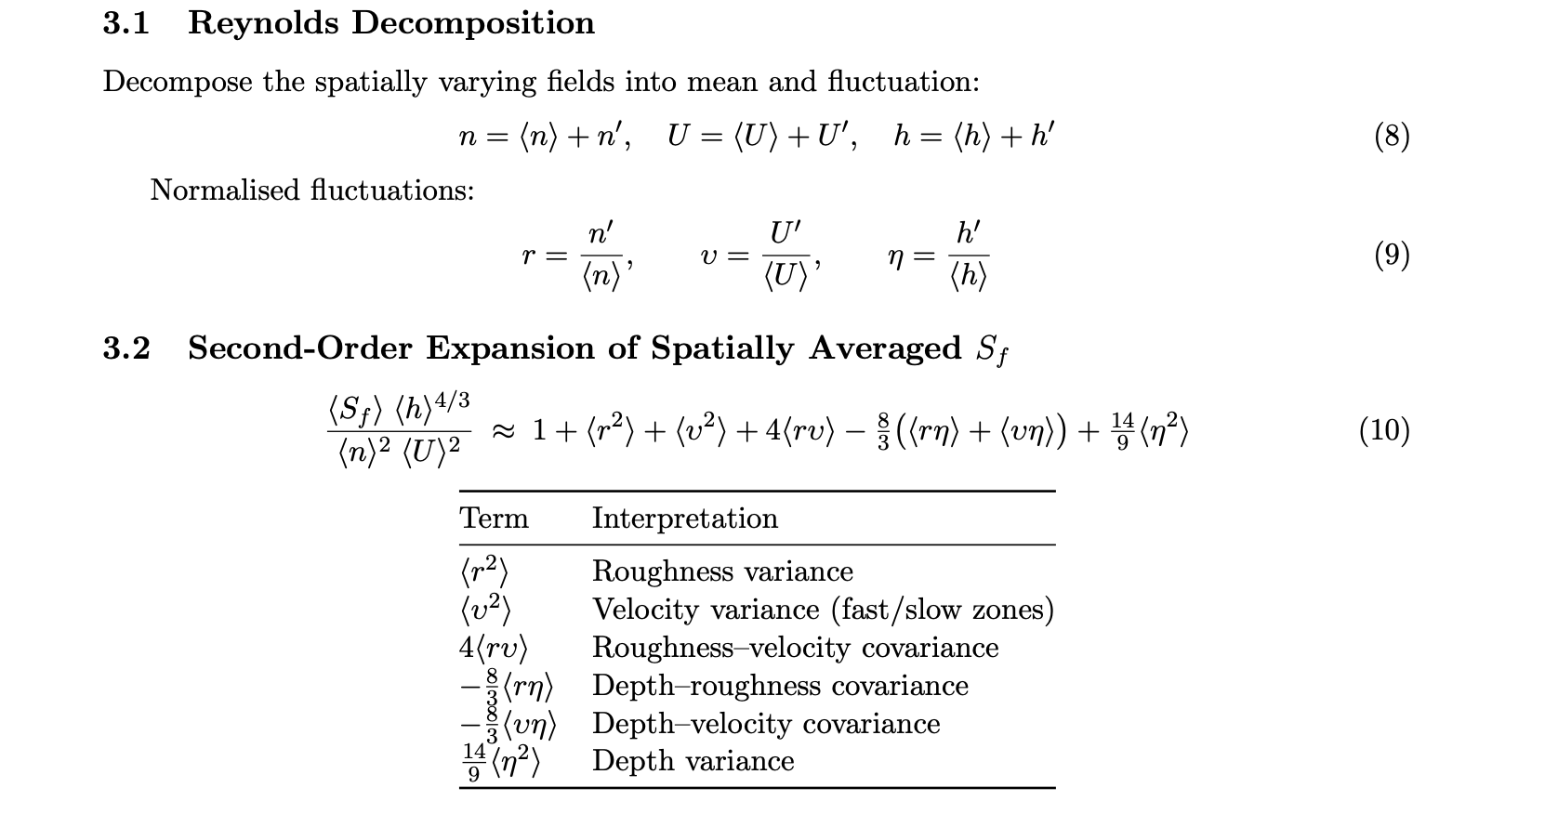

Slide 9
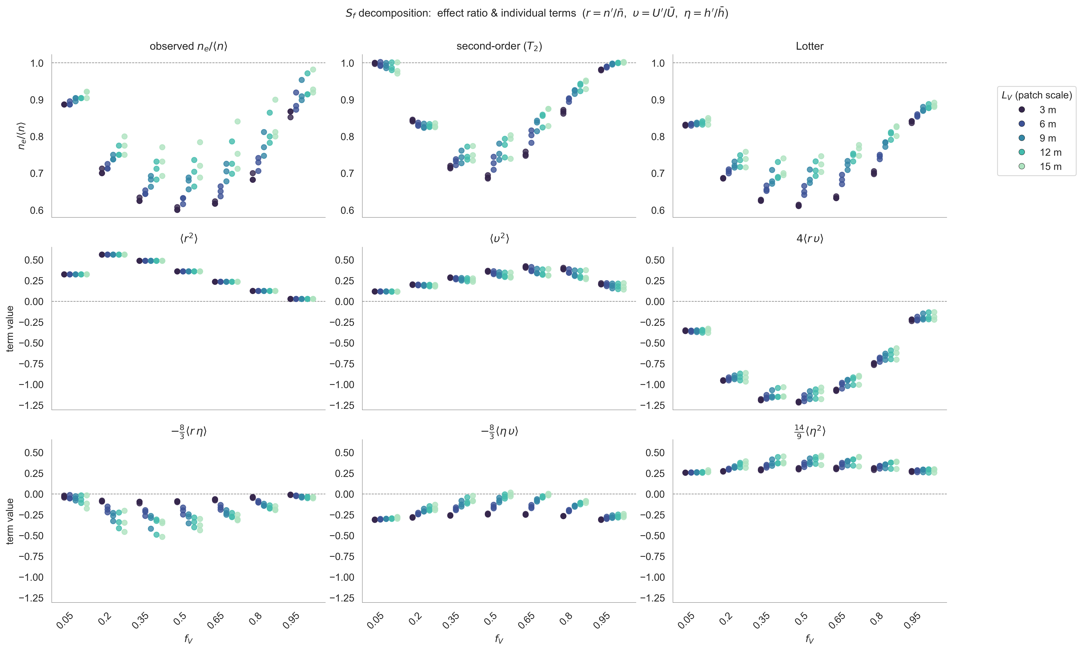
Fig 4

Slide 10
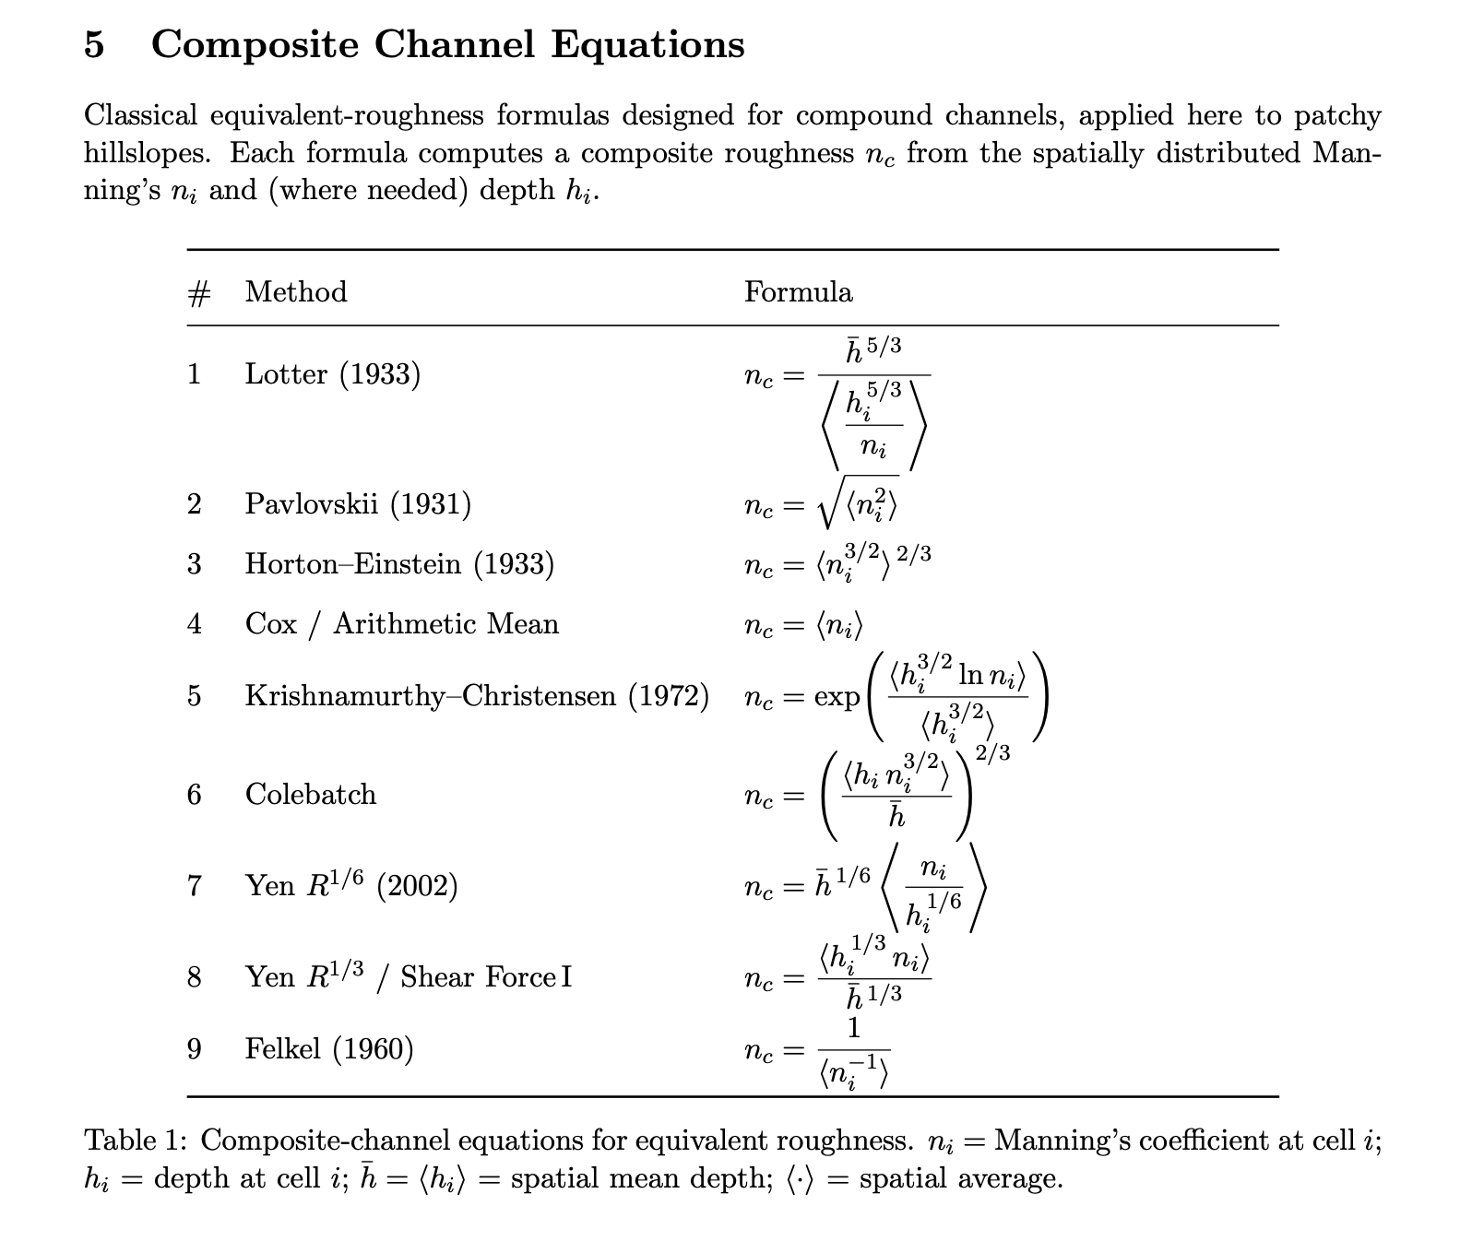

Slide 11
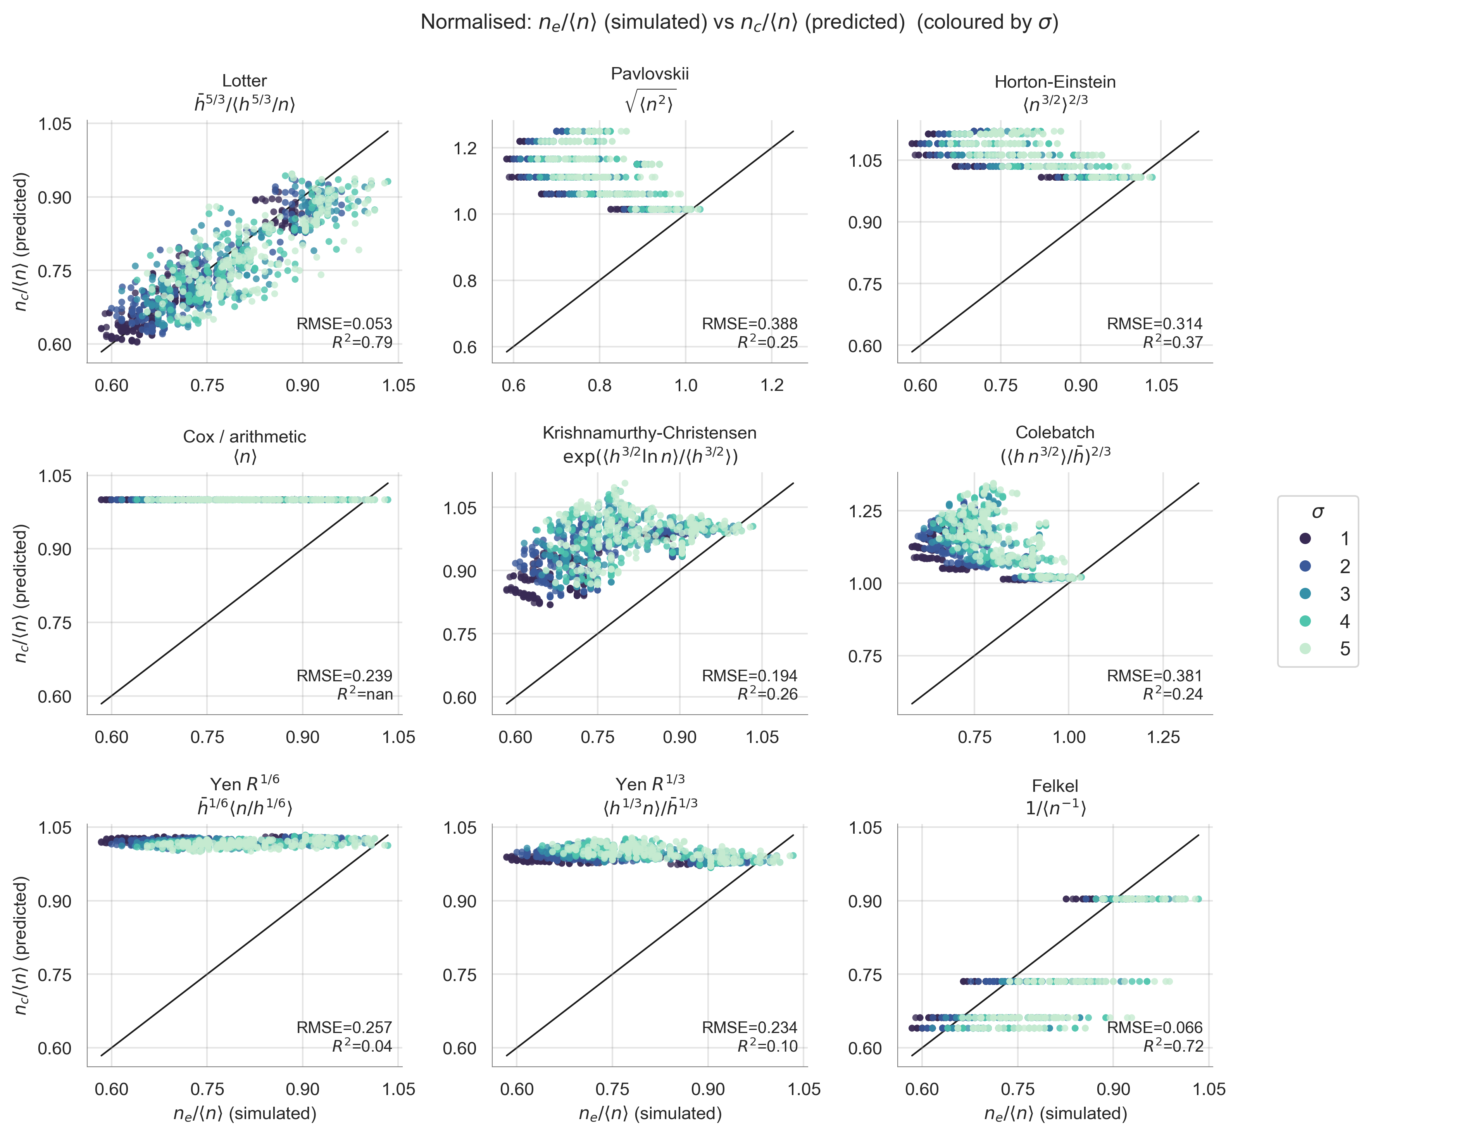
Fig 5
Permeability average.

Slide 12
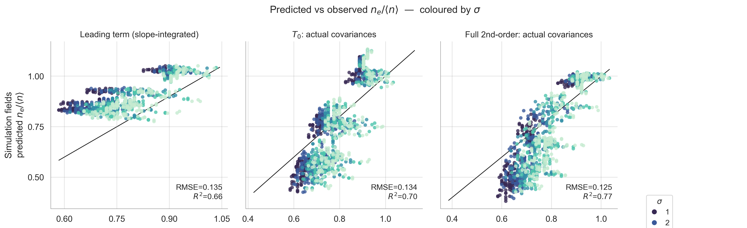
Fig 6

Slide 13
Supplementary Information

Slide 14
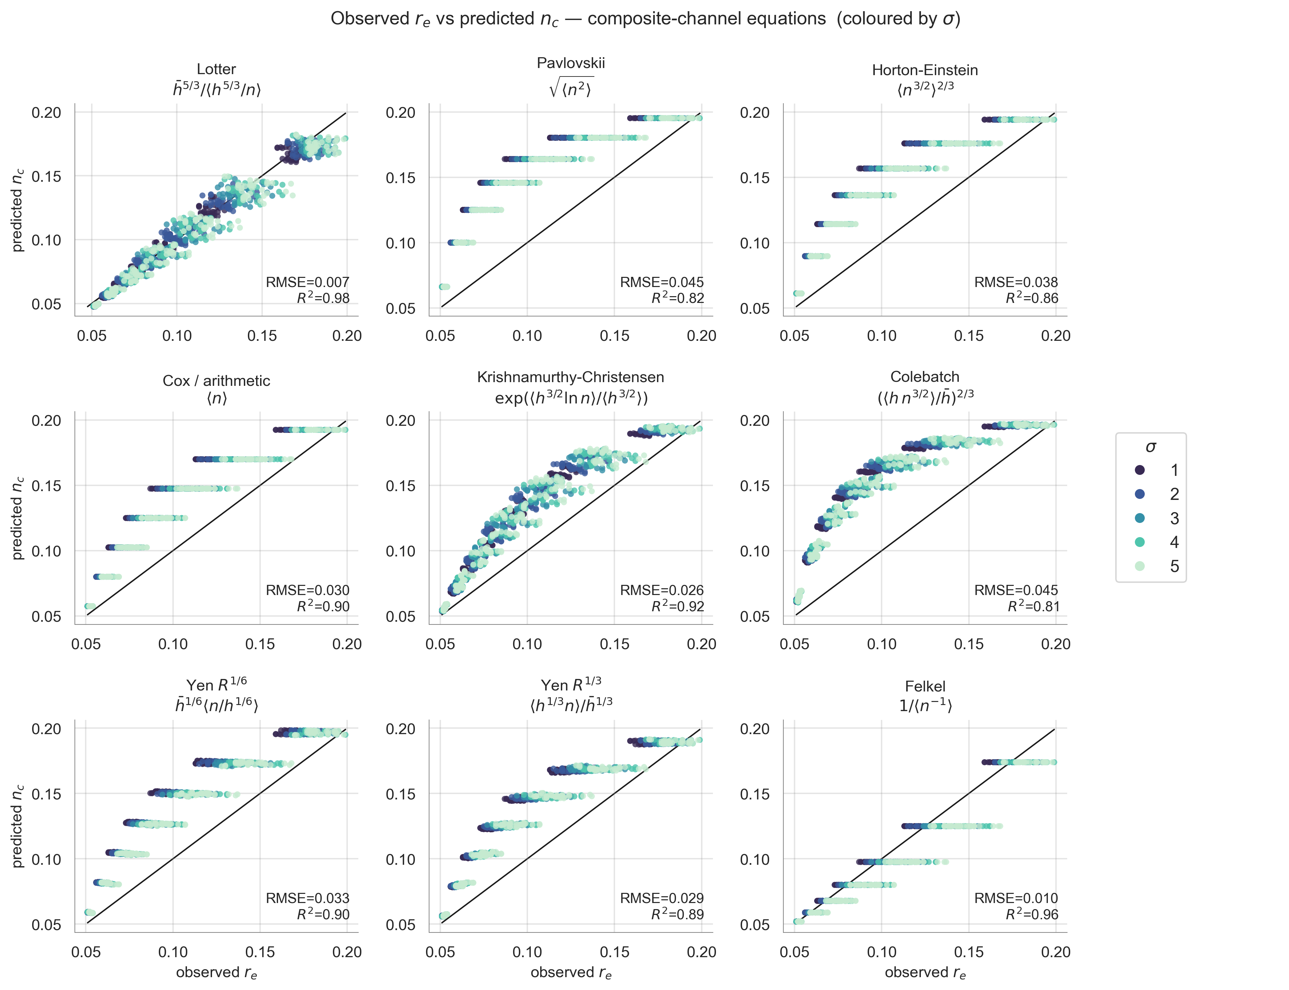
SI1
Absolute r_e vs n_c for nine composite-channel equations, coloured by sigma. Lotter performs best (R2=0.98); Colebatch weakest.

Slide 15
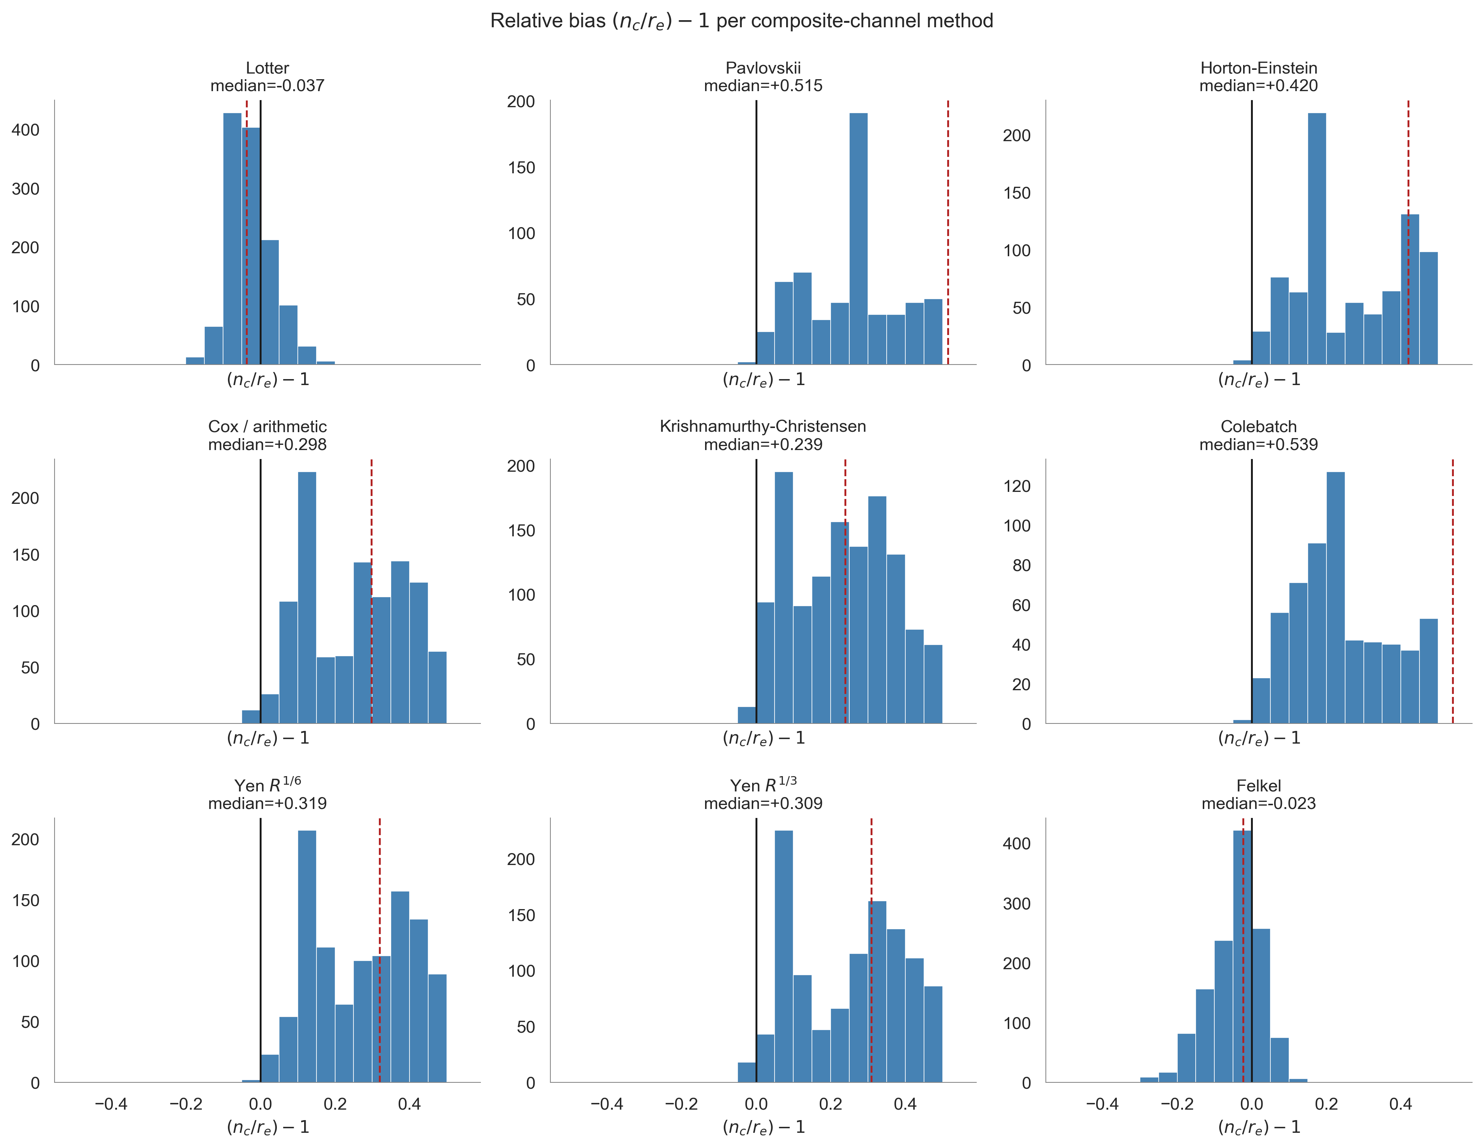
SI2
Per-method relative bias histograms for composite-channel equations. Shows systematic over/under-prediction tendencies.

Slide 16
SI3
$n_e/\langle n\rangle$ vs $L_V$ faceted by $f_V$, coloured by anisotropy orientation. Shows patch-scale dependence of the roughness ratio across vegetation fractions.

Slide 17
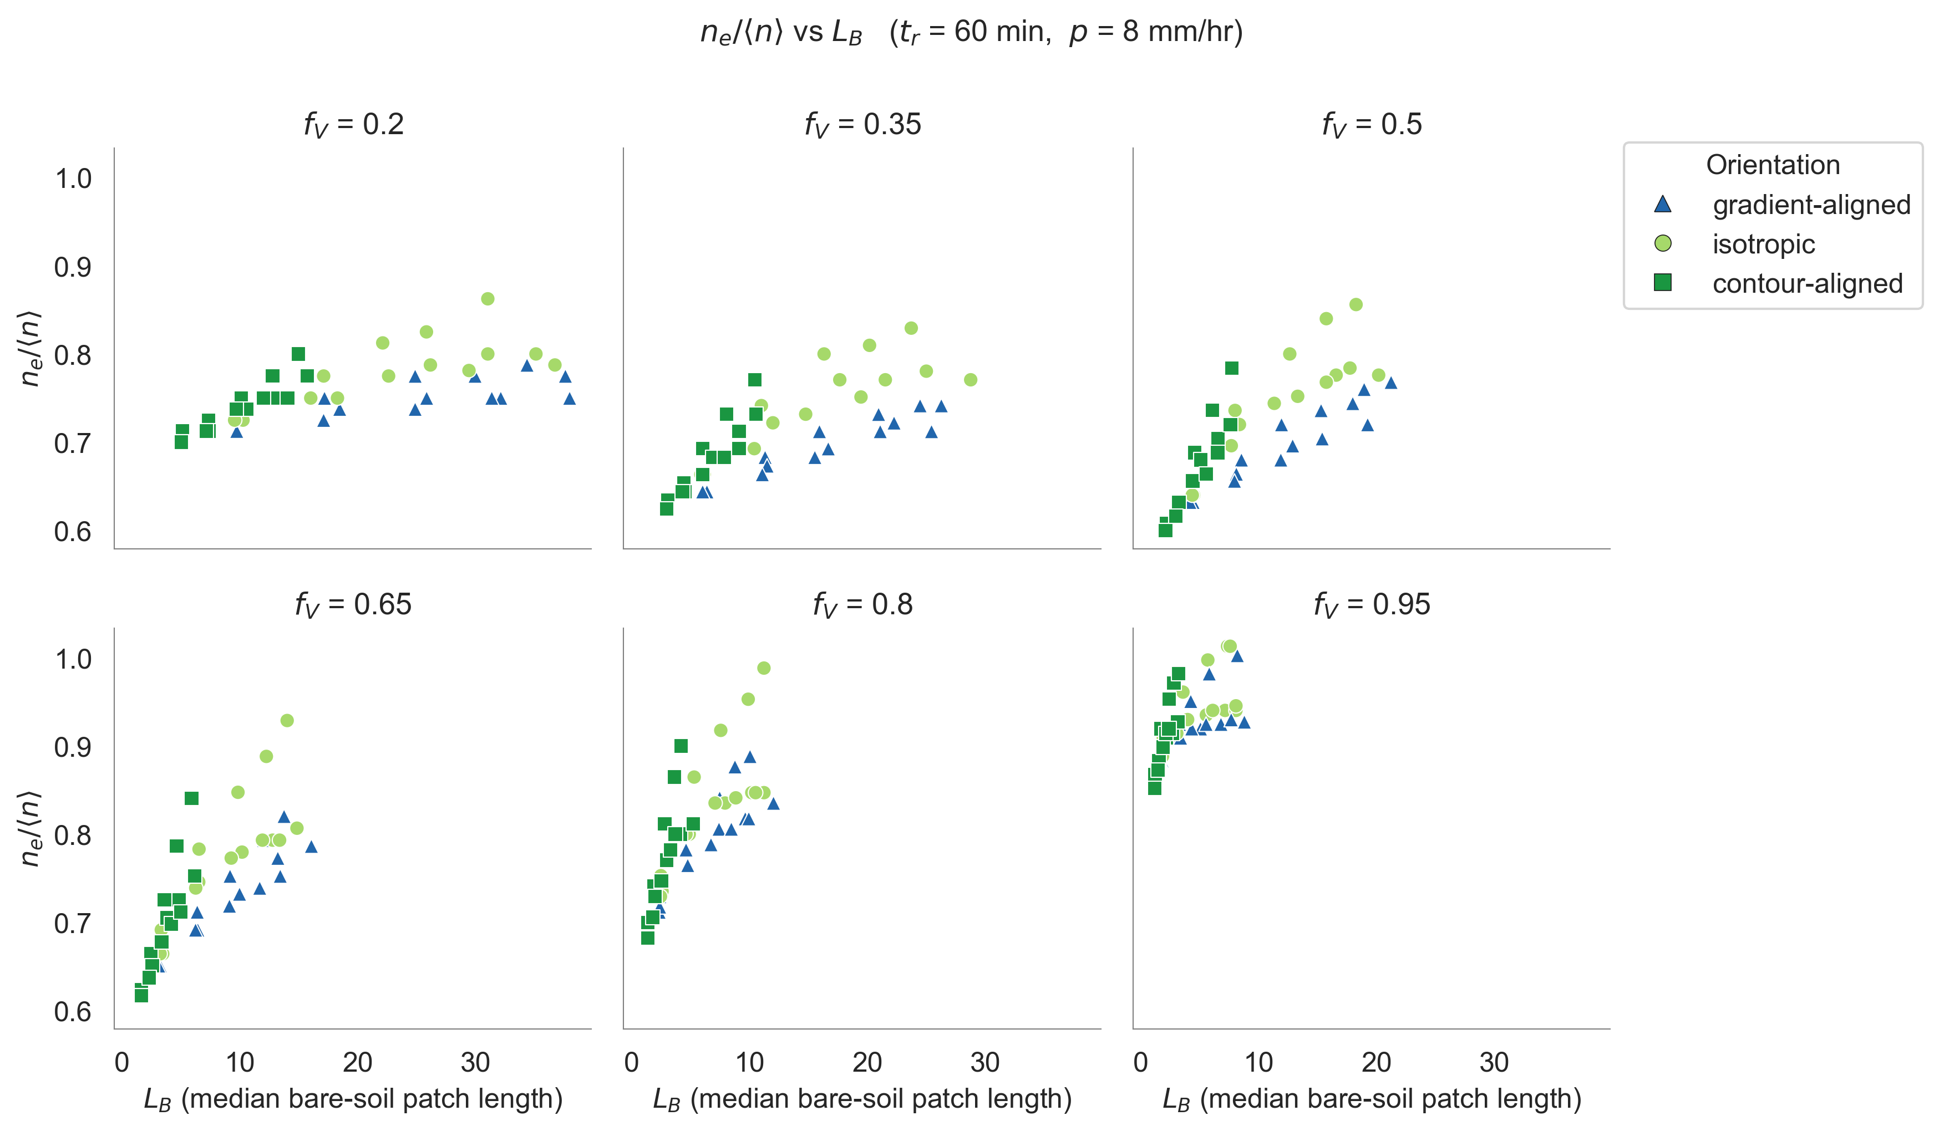
SI4
$n_e/\langle n\rangle$ vs $L_B$ faceted by $f_V$, coloured by anisotropy orientation. Shows bare-soil patch-scale dependence of the roughness ratio across vegetation fractions.

