Slide 1
Înmulțirea polinoamelor
-exemplu-
Stud: OPRIȘ Andrei

Slide 2
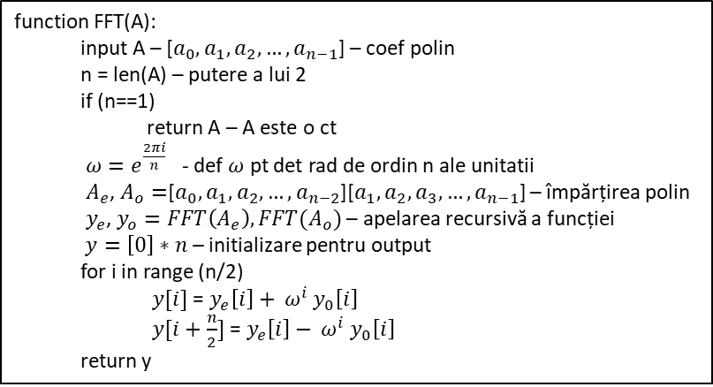

FFT (Transformata Rapidă Fourier)
$A\left(x_{0}\right)=5+3x+2x^{2}+x^{3}$
function FFT(A):
input A – [$a_{0},a_{1},a_{2},…,a_{n−1}$] – coef polin
n = len(A) – putere a lui 2
if (n==1)
return A – A este o ct
$ω=e^{\frac{2πi}{n}}$ - def $ω$ pt det rad de ordin n ale unitatii
$A_{e}$, $A_{o}=$[$a_{0},a_{1},a_{2},…,a_{n−2}$][$a_{1},a_{2},a_{3},…,a_{n−1}$] – împărțirea polin
$y_{e}$, $y_{o}=FFT\left(A_{e}\right),FFT(A_{o})$ – apelarea recursivă a funcției
$y=\left[0\right]∗n$ – initializare pentru output
for i in range (n/2)
$y[i]$ = $y_{e}\left[i\right]+ ω^{i}$ $y_{0}\left[i\right]$
$y[i+\frac{n}{2}]$ = $y_{e}\left[i\right]− ω^{i}$ $y_{0}\left[i\right]$
return y

Slide 3

FFT (Transformata Rapidă Fourier)
$A\left(x_{0}\right)=5+3x+2x^{2}+x^{3}$
FFT[5, 3, 2, 1]
function FFT(A):
input A – [$a_{0},a_{1},a_{2},…,a_{n−1}$] – coef polin
n = len(A) – putere a lui 2
if (n==1)
return A – A este o ct
$ω=e^{\frac{2πi}{n}}$ - def $ω$ pt det rad de ordin n ale unitatii
$A_{e}$, $A_{o}=$[$a_{0},a_{1},a_{2},…,a_{n−2}$][$a_{1},a_{2},a_{3},…,a_{n−1}$] – împărțirea polin
$y_{e}$, $y_{o}=FFT\left(A_{e}\right),FFT(A_{o})$ – apelarea recursivă a funcției
$y=\left[0\right]∗n$ – initializare pentru output
for i in range (n/2)
$y[i]$ = $y_{e}\left[i\right]+ ω^{i}$ $y_{0}\left[i\right]$
$y[i+\frac{n}{2}]$ = $y_{e}\left[i\right]− ω^{i}$ $y_{0}\left[i\right]$
return y

Slide 4

FFT (Transformata Rapidă Fourier)
$A\left(x_{0}\right)=5+3x+2x^{2}+x^{3}$
FFT[5, 3, 2, 1]
n = 4
function FFT(A):
input A – [$a_{0},a_{1},a_{2},…,a_{n−1}$] – coef polin
n = len(A) – putere a lui 2
if (n==1)
return A – A este o ct
$ω=e^{\frac{2πi}{n}}$ - def $ω$ pt det rad de ordin n ale unitatii
$A_{e}$, $A_{o}=$[$a_{0},a_{1},a_{2},…,a_{n−2}$][$a_{1},a_{2},a_{3},…,a_{n−1}$] – împărțirea polin
$y_{e}$, $y_{o}=FFT\left(A_{e}\right),FFT(A_{o})$ – apelarea recursivă a funcției
$y=\left[0\right]∗n$ – initializare pentru output
for i in range (n/2)
$y[i]$ = $y_{e}\left[i\right]+ ω^{i}$ $y_{0}\left[i\right]$
$y[i+\frac{n}{2}]$ = $y_{e}\left[i\right]− ω^{i}$ $y_{0}\left[i\right]$
return y

Slide 5
FFT (Transformata Rapidă Fourier)
$A\left(x_{0}\right)=5+3x+2x^{2}+x^{3}$
FFT[5, 3, 2, 1]
n = 4
function FFT(A):
input A – [$a_{0},a_{1},a_{2},…,a_{n−1}$] – coef polin
n = len(A) – putere a lui 2
if (n==1)
return A – A este o ct
$ω=e^{\frac{2πi}{n}}$ - def $ω$ pt det rad de ordin n ale unitatii
$A_{e}$, $A_{o}=$[$a_{0},a_{1},a_{2},…,a_{n−2}$][$a_{1},a_{2},a_{3},…,a_{n−1}$] – împărțirea polin
$y_{e}$, $y_{o}=FFT\left(A_{e}\right),FFT(A_{o})$ – apelarea recursivă a funcției
$y=\left[0\right]∗n$ – initializare pentru output
for i in range (n/2)
$y[i]$ = $y_{e}\left[i\right]+ ω^{i}$ $y_{0}\left[i\right]$
$y[i+\frac{n}{2}]$ = $y_{e}\left[i\right]− ω^{i}$ $y_{0}\left[i\right]$
return y

Slide 6

FFT (Transformata Rapidă Fourier)
$A\left(x_{0}\right)=5+3x+2x^{2}+x^{3}$
FFT[5, 3, 2, 1]
n = 4
$$ω=e^{\frac{2πi}{4}}=i⇒ω∈[ω^{0},ω^{1},ω^{2},ω^{3}]$$
function FFT(A):
input A – [$a_{0},a_{1},a_{2},…,a_{n−1}$] – coef polin
n = len(A) – putere a lui 2
if (n==1)
return A – A este o ct
$ω=e^{\frac{2πi}{n}}$ - def $ω$ pt det rad de ordin n ale unitatii
$A_{e}$, $A_{o}=$[$a_{0},a_{1},a_{2},…,a_{n−2}$][$a_{1},a_{2},a_{3},…,a_{n−1}$] – împărțirea polin
$y_{e}$, $y_{o}=FFT\left(A_{e}\right),FFT(A_{o})$ – apelarea recursivă a funcției
$y=\left[0\right]∗n$ – initializare pentru output
for i in range (n/2)
$y[i]$ = $y_{e}\left[i\right]+ ω^{i}$ $y_{0}\left[i\right]$
$y[i+\frac{n}{2}]$ = $y_{e}\left[i\right]− ω^{i}$ $y_{0}\left[i\right]$
return y
Notes:
$$ω=e^{\frac{2πi}{4}}=e^{i\frac{π}{2}}=\cos\left(\frac{π}{2}\right)+isin(\frac{π}{2})=i$$

Slide 7

FFT (Transformata Rapidă Fourier)
$A\left(x_{0}\right)=5+3x+2x^{2}+x^{3}$
FFT[5, 3, 2, 1]
n = 4
$$ω=e^{\frac{2πi}{4}}=i⇒ω∈\left[ω^{0},ω^{1},ω^{2},ω^{3}\right]$$
$A_{e}\left(x^{2}\right)=5+2x→\left[5,2\right]$ $A_{o}\left(x^{2}\right)=3+x→\left[3,1\right]$
function FFT(A):
input A – [$a_{0},a_{1},a_{2},…,a_{n−1}$] – coef polin
n = len(A) – putere a lui 2
if (n==1)
return A – A este o ct
$ω=e^{\frac{2πi}{n}}$ - def $ω$ pt det rad de ordin n ale unitatii
$A_{e}$, $A_{o}=$[$a_{0},a_{1},a_{2},…,a_{n−2}$][$a_{1},a_{2},a_{3},…,a_{n−1}$] – împărțirea polin
$y_{e}$, $y_{o}=FFT\left(A_{e}\right),FFT(A_{o})$ – apelarea recursivă a funcției
$y=\left[0\right]∗n$ – initializare pentru output
for i in range (n/2)
$y[i]$ = $y_{e}\left[i\right]+ ω^{i}$ $y_{0}\left[i\right]$
$y[i+\frac{n}{2}]$ = $y_{e}\left[i\right]− ω^{i}$ $y_{0}\left[i\right]$
return y

Slide 8
FFT (Transformata Rapidă Fourier)
Apelarea recursivă a funcției pentru polinoamele liniare obtinuțe
$A\left(x_{0}\right)=5+3x+2x^{2}+x^{3}$
FFT[5, 3, 2, 1]
n = 4
$$ω=e^{\frac{2πi}{4}}=i⇒ω∈\left[ω^{0},ω^{1},ω^{2},ω^{3}\right]$$
$A_{e}\left(x^{2}\right)=5+2x→\left[5,2\right]$ $A_{o}\left(x^{2}\right)=3+x→\left[3,1\right]$
function FFT(A):
input A – [$a_{0},a_{1},a_{2},…,a_{n−1}$] – coef polin
n = len(A) – putere a lui 2
if (n==1)
return A – A este o ct
$ω=e^{\frac{2πi}{n}}$ - def $ω$ pt det rad de ordin n ale unitatii
$A_{e}$, $A_{o}=$[$a_{0},a_{1},a_{2},…,a_{n−2}$][$a_{1},a_{2},a_{3},…,a_{n−1}$] – împărțirea polin
$y_{e}$, $y_{o}=FFT\left(A_{e}\right),FFT(A_{o})$ – apelarea recursivă a funcției
$y=\left[0\right]∗n$ – initializare pentru output
for i in range (n/2)
$y[i]$ = $y_{e}\left[i\right]+ ω^{i}$ $y_{0}\left[i\right]$
$y[i+\frac{n}{2}]$ = $y_{e}\left[i\right]− ω^{i}$ $y_{0}\left[i\right]$
return y
Notes:
$$ω=e^{\frac{2πi}{4}}=e^{i\frac{π}{2}}=\cos\left(\frac{π}{2}\right)+isin(\frac{π}{2})=i$$

Slide 9
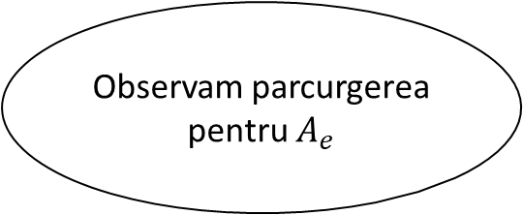

FFT (Transformata Rapidă Fourier)
$A\left(x_{0}\right)=5+3x+2x^{2}+x^{3}$
FFT[5, 3, 2, 1]
n = 4
$$ω=e^{\frac{2πi}{4}}=i⇒ω∈[ω^{0},ω^{1},ω^{2},ω^{3}]$$
$A_{e}\left(x^{2}\right)=5+2x→\left[5,2\right]$ $A_{o}\left(x^{2}\right)=3+x→\left[3,1\right]$
FFT[5, 2] FFT[3,1]
function FFT(A):
input A – [$a_{0},a_{1},a_{2},…,a_{n−1}$] – coef polin
n = len(A) – putere a lui 2
if (n==1)
return A – A este o ct
$ω=e^{\frac{2πi}{n}}$ - def $ω$ pt det rad de ordin n ale unitatii
$A_{e}$, $A_{o}=$[$a_{0},a_{1},a_{2},…,a_{n−2}$][$a_{1},a_{2},a_{3},…,a_{n−1}$] – împărțirea polin
$y_{e}$, $y_{o}=FFT\left(A_{e}\right),FFT(A_{o})$ – apelarea recursivă a funcției
$y=\left[0\right]∗n$ – initializare pentru output
for i in range (n/2)
$y[i]$ = $y_{e}\left[i\right]+ ω^{i}$ $y_{0}\left[i\right]$
$y[i+\frac{n}{2}]$ = $y_{e}\left[i\right]− ω^{i}$ $y_{0}\left[i\right]$
return y
Observam parcurgerea pentru $A_{e}$
Notes:
$$ω=e^{\frac{2πi}{4}}=e^{i\frac{π}{2}}=\cos\left(\frac{π}{2}\right)+isin(\frac{π}{2})=i$$

Slide 10

FFT (Transformata Rapidă Fourier)
$A\left(x_{0}\right)=5+3x+2x^{2}+x^{3}$
FFT[5, 3, 2, 1]
n = 4
$$ω=e^{\frac{2πi}{4}}=i⇒ω∈[ω^{0},ω^{1},ω^{2},ω^{3}]$$
$A_{e}\left(x^{2}\right)=5+2x→\left[5,2\right]$ $A_{o}\left(x^{2}\right)=3+x→\left[3,1\right]$
FFT[5, 2] FFT[3,1]
n=2
function FFT(A):
input A – [$a_{0},a_{1},a_{2},…,a_{n−1}$] – coef polin
n = len(A) – putere a lui 2
if (n==1)
return A – A este o ct
$ω=e^{\frac{2πi}{n}}$ - def $ω$ pt det rad de ordin n ale unitatii
$A_{e}$, $A_{o}=$[$a_{0},a_{1},a_{2},…,a_{n−2}$][$a_{1},a_{2},a_{3},…,a_{n−1}$] – împărțirea polin
$y_{e}$, $y_{o}=FFT\left(A_{e}\right),FFT(A_{o})$ – apelarea recursivă a funcției
$y=\left[0\right]∗n$ – initializare pentru output
for i in range (n/2)
$y[i]$ = $y_{e}\left[i\right]+ ω^{i}$ $y_{0}\left[i\right]$
$y[i+\frac{n}{2}]$ = $y_{e}\left[i\right]− ω^{i}$ $y_{0}\left[i\right]$
return y
Notes:
$$ω=e^{\frac{2πi}{4}}=e^{i\frac{π}{2}}=\cos\left(\frac{π}{2}\right)+isin(\frac{π}{2})=i$$

Slide 11

FFT (Transformata Rapidă Fourier)
$A\left(x_{0}\right)=5+3x+2x^{2}+x^{3}$
FFT[5, 3, 2, 1]
n = 4
$$ω=e^{\frac{2πi}{4}}=i⇒ω∈[ω^{0},ω^{1},ω^{2},ω^{3}]$$
$A_{e}\left(x^{2}\right)=5+2x→\left[5,2\right]$ $A_{o}\left(x^{2}\right)=3+x→\left[3,1\right]$
FFT[5, 2] FFT[3,1]
n=2
$$ω=e^{\frac{2πi}{2}}=−1⇒ω∈[ω^{0},ω^{1}]$$
function FFT(A):
input A – [$a_{0},a_{1},a_{2},…,a_{n−1}$] – coef polin
n = len(A) – putere a lui 2
if (n==1)
return A – A este o ct
$ω=e^{\frac{2πi}{n}}$ - def $ω$ pt det rad de ordin n ale unitatii
$A_{e}$, $A_{o}=$[$a_{0},a_{1},a_{2},…,a_{n−2}$][$a_{1},a_{2},a_{3},…,a_{n−1}$] – împărțirea polin
$y_{e}$, $y_{o}=FFT\left(A_{e}\right),FFT(A_{o})$ – apelarea recursivă a funcției
$y=\left[0\right]∗n$ – initializare pentru output
for i in range (n/2)
$y[i]$ = $y_{e}\left[i\right]+ ω^{i}$ $y_{0}\left[i\right]$
$y[i+\frac{n}{2}]$ = $y_{e}\left[i\right]− ω^{i}$ $y_{0}\left[i\right]$
return y
Notes:
$$ω=e^{\frac{2πi}{4}}=e^{i\frac{π}{2}}=\cos\left(\frac{π}{2}\right)+isin(\frac{π}{2})=i$$

Slide 12

FFT (Transformata Rapidă Fourier)
$A\left(x_{0}\right)=5+3x+2x^{2}+x^{3}$
FFT[5, 3, 2, 1]
n = 4
$$ω=e^{\frac{2πi}{4}}=i⇒ω∈[ω^{0},ω^{1},ω^{2},ω^{3}]$$
$A_{e}\left(x^{2}\right)=5+2x→\left[5,2\right]$ $A_{o}\left(x^{2}\right)=3+x→\left[3,1\right]$
FFT[5, 2] FFT[3,1]
n=2
$$ω=e^{\frac{2πi}{2}}=−1⇒ω∈[ω^{0},ω^{1}]$$
$A_{e}\left(x^{2}\right)=5$ $A_{o}\left(x^{2}\right)=2$
function FFT(A):
input A – [$a_{0},a_{1},a_{2},…,a_{n−1}$] – coef polin
n = len(A) – putere a lui 2
if (n==1)
return A – A este o ct
$ω=e^{\frac{2πi}{n}}$ - def $ω$ pt det rad de ordin n ale unitatii
$A_{e}$, $A_{o}=$[$a_{0},a_{1},a_{2},…,a_{n−2}$][$a_{1},a_{2},a_{3},…,a_{n−1}$] – împărțirea polin
$y_{e}$, $y_{o}=FFT\left(A_{e}\right),FFT(A_{o})$ – apelarea recursivă a funcției
$y=\left[0\right]∗n$ – initializare pentru output
for i in range (n/2)
$y[i]$ = $y_{e}\left[i\right]+ ω^{i}$ $y_{0}\left[i\right]$
$y[i+\frac{n}{2}]$ = $y_{e}\left[i\right]− ω^{i}$ $y_{0}\left[i\right]$
return y
Notes:
$$ω=e^{\frac{2πi}{4}}=e^{i\frac{π}{2}}=\cos\left(\frac{π}{2}\right)+isin(\frac{π}{2})=i$$

Slide 13

FFT (Transformata Rapidă Fourier)
$A\left(x_{0}\right)=5+3x+2x^{2}+x^{3}$
FFT[5, 3, 2, 1]
n = 4
$$ω=e^{\frac{2πi}{4}}=i⇒ω∈[ω^{0},ω^{1},ω^{2},ω^{3}]$$
$A_{e}\left(x^{2}\right)=5+2x→\left[5,2\right]$ $A_{o}\left(x^{2}\right)=3+x→\left[3,1\right]$
FFT[5, 2] FFT[3,1]
n=2
$$ω=e^{\frac{2πi}{2}}=−1⇒ω∈[ω^{0},ω^{1}]$$
$A_{e}\left(x^{2}\right)=5→\left[5\right]$ $A_{o}\left(x^{2}\right)=2→\left[2\right]$ - constante
function FFT(A):
input A – [$a_{0},a_{1},a_{2},…,a_{n−1}$] – coef polin
n = len(A) – putere a lui 2
if (n==1)
return A – A este o ct
$ω=e^{\frac{2πi}{n}}$ - def $ω$ pt det rad de ordin n ale unitatii
$A_{e}$, $A_{o}=$[$a_{0},a_{1},a_{2},…,a_{n−2}$][$a_{1},a_{2},a_{3},…,a_{n−1}$] – împărțirea polin
$y_{e}$, $y_{o}=FFT\left(A_{e}\right),FFT(A_{o})$ – apelarea recursivă a funcției
$y=\left[0\right]∗n$ – initializare pentru output
for i in range (n/2)
$y[i]$ = $y_{e}\left[i\right]+ ω^{i}$ $y_{0}\left[i\right]$
$y[i+\frac{n}{2}]$ = $y_{e}\left[i\right]− ω^{i}$ $y_{0}\left[i\right]$
return y
Notes:
$$ω=e^{\frac{2πi}{4}}=e^{i\frac{π}{2}}=\cos\left(\frac{π}{2}\right)+isin(\frac{π}{2})=i$$

Slide 14

FFT (Transformata Rapidă Fourier)
$A\left(x_{0}\right)=5+3x+2x^{2}+x^{3}$
FFT[5, 3, 2, 1]
n = 4
$$ω=e^{\frac{2πi}{4}}=i⇒ω∈[ω^{0},ω^{1},ω^{2},ω^{3}]$$
$A_{e}\left(x^{2}\right)=5+2x→\left[5,2\right]$ $A_{o}\left(x^{2}\right)=3+x→\left[3,1\right]$
FFT[5, 2] FFT[3,1]
n=2
$$ω=e^{\frac{2πi}{2}}=−1⇒ω∈[ω^{0},ω^{1}]$$
$A_{e}\left(x^{2}\right)=5→\left[5\right]$ $A_{o}\left(x^{2}\right)=2→\left[2\right]$ - constante
FFT[5] FFT[2]
function FFT(A):
input A – [$a_{0},a_{1},a_{2},…,a_{n−1}$] – coef polin
n = len(A) – putere a lui 2
if (n==1)
return A – A este o ct
$ω=e^{\frac{2πi}{n}}$ - def $ω$ pt det rad de ordin n ale unitatii
$A_{e}$, $A_{o}=$[$a_{0},a_{1},a_{2},…,a_{n−2}$][$a_{1},a_{2},a_{3},…,a_{n−1}$] – împărțirea polin
$y_{e}$, $y_{o}=FFT\left(A_{e}\right),FFT(A_{o})$ – apelarea recursivă a funcției
$y=\left[0\right]∗n$ – initializare pentru output
for i in range (n/2)
$y[i]$ = $y_{e}\left[i\right]+ ω^{i}$ $y_{0}\left[i\right]$
$y[i+\frac{n}{2}]$ = $y_{e}\left[i\right]− ω^{i}$ $y_{0}\left[i\right]$
return y
Notes:
$$ω=e^{\frac{2πi}{4}}=e^{i\frac{π}{2}}=\cos\left(\frac{π}{2}\right)+isin(\frac{π}{2})=i$$

Slide 15

FFT (Transformata Rapidă Fourier)
$A\left(x_{0}\right)=5+3x+2x^{2}+x^{3}$
FFT[5, 3, 2, 1]
n = 4
$$ω=e^{\frac{2πi}{4}}=i⇒ω∈[ω^{0},ω^{1},ω^{2},ω^{3}]$$
$A_{e}\left(x^{2}\right)=5+2x→\left[5,2\right]$ $A_{o}\left(x^{2}\right)=3+x→\left[3,1\right]$
FFT[5, 2] FFT[3,1]
n=2
$$ω=e^{\frac{2πi}{2}}=−1⇒ω∈[ω^{0},ω^{1}]$$
$A_{e}\left(x^{2}\right)=5→\left[5\right]$ $A_{o}\left(x^{2}\right)=2→\left[2\right]$ - constante
FFT[5] FFT[2]
function FFT(A):
input A – [$a_{0},a_{1},a_{2},…,a_{n−1}$] – coef polin
n = len(A) – putere a lui 2
if (n==1)
return A – A este o ct
$ω=e^{\frac{2πi}{n}}$ - def $ω$ pt det rad de ordin n ale unitatii
$A_{e}$, $A_{o}=$[$a_{0},a_{1},a_{2},…,a_{n−2}$][$a_{1},a_{2},a_{3},…,a_{n−1}$] – împărțirea polin
$y_{e}$, $y_{o}=FFT\left(A_{e}\right),FFT(A_{o})$ – apelarea recursivă a funcției
$y=\left[0\right]∗n$ – initializare pentru output
for i in range (n/2)
$y[i]$ = $y_{e}\left[i\right]+ ω^{i}$ $y_{0}\left[i\right]$
$y[i+\frac{n}{2}]$ = $y_{e}\left[i\right]− ω^{i}$ $y_{0}\left[i\right]$
return y
Notes:
$$ω=e^{\frac{2πi}{4}}=e^{i\frac{π}{2}}=\cos\left(\frac{π}{2}\right)+isin(\frac{π}{2})=i$$

Slide 16
FFT (Transformata Rapidă Fourier)
$A\left(x_{0}\right)=5+3x+2x^{2}+x^{3}$
FFT[5, 3, 2, 1]
n = 4
$$ω=e^{\frac{2πi}{4}}=i⇒ω∈[ω^{0},ω^{1},ω^{2},ω^{3}]$$
$A_{e}\left(x^{2}\right)=5+2x→\left[5,2\right]$ $A_{o}\left(x^{2}\right)=3+x→\left[3,1\right]$
FFT[5, 2] FFT[3,1]
n=2
$$ω=e^{\frac{2πi}{2}}=−1⇒ω∈[ω^{0},ω^{1}]$$
$A_{e}\left(x^{2}\right)=5→\left[5\right]$ $A_{o}\left(x^{2}\right)=2→\left[2\right]$ - constante
FFT[5] FFT[2]
function FFT(A):
input A – [$a_{0},a_{1},a_{2},…,a_{n−1}$] – coef polin
n = len(A) – putere a lui 2
if (n==1)
return A – A este o ct
$ω=e^{\frac{2πi}{n}}$ - def $ω$ pt det rad de ordin n ale unitatii
$A_{e}$, $A_{o}=$[$a_{0},a_{1},a_{2},…,a_{n−2}$][$a_{1},a_{2},a_{3},…,a_{n−1}$] – împărțirea polin
$y_{e}$, $y_{o}=FFT\left(A_{e}\right),FFT(A_{o})$ – apelarea recursivă a funcției
$y=\left[0\right]∗n$ – initializare pentru output
for i in range (n/2)
$y[i]$ = $y_{e}\left[i\right]+ ω^{i}$ $y_{0}\left[i\right]$
$y[i+\frac{n}{2}]$ = $y_{e}\left[i\right]− ω^{i}$ $y_{0}\left[i\right]$
return y
Notes:
$$ω=e^{\frac{2πi}{4}}=e^{i\frac{π}{2}}=\cos\left(\frac{π}{2}\right)+isin(\frac{π}{2})=i$$

Slide 17
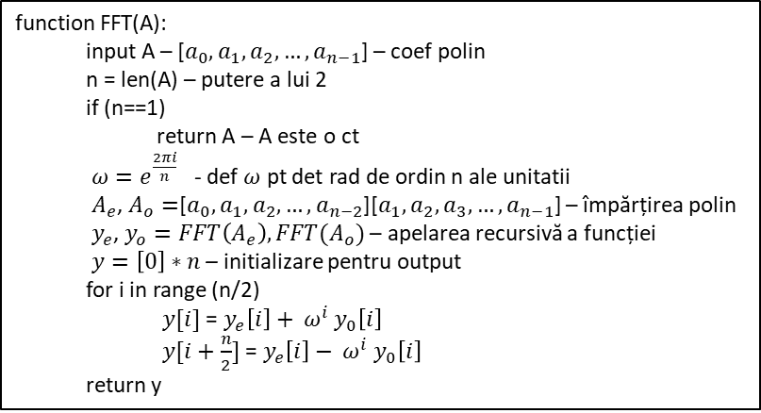

FFT (Transformata Rapidă Fourier)
$A\left(x_{0}\right)=5+3x+2x^{2}+x^{3}$
FFT[5, 3, 2, 1]
n = 4
$$ω=e^{\frac{2πi}{4}}=i⇒ω∈[ω^{0},ω^{1},ω^{2},ω^{3}]$$
$A_{e}\left(x^{2}\right)=5+2x→\left[5,2\right]$ $A_{o}\left(x^{2}\right)=3+x→\left[3,1\right]$
FFT[5, 2] FFT[3,1]
n=2
$$ω=e^{\frac{2πi}{2}}=−1⇒ω∈[ω^{0},ω^{1}]$$
$A_{e}\left(x^{2}\right)=5→\left[5\right]$ $A_{o}\left(x^{2}\right)=2→\left[2\right]$ - constante
FFT[5] $→\left[5\right]$ FFT[2] $→\left[2\right]$
$A_{e}=5$ $A_{o}=2$
function FFT(A):
input A – [$a_{0},a_{1},a_{2},…,a_{n−1}$] – coef polin
n = len(A) – putere a lui 2
if (n==1)
return A – A este o ct
$ω=e^{\frac{2πi}{n}}$ - def $ω$ pt det rad de ordin n ale unitatii
$A_{e}$, $A_{o}=$[$a_{0},a_{1},a_{2},…,a_{n−2}$][$a_{1},a_{2},a_{3},…,a_{n−1}$] – împărțirea polin
$y_{e}$, $y_{o}=FFT\left(A_{e}\right),FFT(A_{o})$ – apelarea recursivă a funcției
$y=\left[0\right]∗n$ – initializare pentru output
for i in range (n/2)
$y[i]$ = $y_{e}\left[i\right]+ ω^{i}$ $y_{0}\left[i\right]$
$y[i+\frac{n}{2}]$ = $y_{e}\left[i\right]− ω^{i}$ $y_{0}\left[i\right]$
return y
Notes:
$$ω=e^{\frac{2πi}{4}}=e^{i\frac{π}{2}}=\cos\left(\frac{π}{2}\right)+isin(\frac{π}{2})=i$$

Slide 18

FFT (Transformata Rapidă Fourier)
$A\left(x_{0}\right)=5+3x+2x^{2}+x^{3}$
FFT[5, 3, 2, 1]
n = 4
$$ω=e^{\frac{2πi}{4}}=i⇒ω∈[ω^{0},ω^{1},ω^{2},ω^{3}]$$
$A_{e}\left(x^{2}\right)=5+2x→\left[5,2\right]$ $A_{o}\left(x^{2}\right)=3+x→\left[3,1\right]$
FFT[5, 2] FFT[3,1]
n=2
$$ω=e^{\frac{2πi}{2}}=−1⇒ω∈[ω^{0},ω^{1}]$$
$A_{e}\left(x^{2}\right)=5→\left[5\right]$ $A_{o}\left(x^{2}\right)=2→\left[2\right]$ - constante
FFT[5] $→\left[5\right]$ FFT[2] $→\left[2\right]$
$y_{e}=5$ $y_{o}=2$
function FFT(A):
input A – [$a_{0},a_{1},a_{2},…,a_{n−1}$] – coef polin
n = len(A) – putere a lui 2
if (n==1)
return A – A este o ct
$ω=e^{\frac{2πi}{n}}$ - def $ω$ pt det rad de ordin n ale unitatii
$A_{e}$, $A_{o}=$[$a_{0},a_{1},a_{2},…,a_{n−2}$][$a_{1},a_{2},a_{3},…,a_{n−1}$] – împărțirea polin
$y_{e}$, $y_{o}=FFT\left(A_{e}\right),FFT(A_{o})$ – apelarea recursivă a funcției
$y=\left[0\right]∗n$ – initializare pentru output
for i in range (n/2)
$y[i]$ = $y_{e}\left[i\right]+ ω^{i}$ $y_{0}\left[i\right]$
$y[i+\frac{n}{2}]$ = $y_{e}\left[i\right]− ω^{i}$ $y_{0}\left[i\right]$
return y
Notes:
$$ω=e^{\frac{2πi}{4}}=e^{i\frac{π}{2}}=\cos\left(\frac{π}{2}\right)+isin(\frac{π}{2})=i$$

Slide 19

FFT (Transformata Rapidă Fourier)
$A\left(x_{0}\right)=5+3x+2x^{2}+x^{3}$
FFT[5, 3, 2, 1]
n = 4
$$ω=e^{\frac{2πi}{4}}=i⇒ω∈[ω^{0},ω^{1},ω^{2},ω^{3}]$$
$A_{e}\left(x^{2}\right)=5+2x→\left[5,2\right]$ $A_{o}\left(x^{2}\right)=3+x→\left[3,1\right]$
FFT[5, 2] FFT[3,1]
n=2
$$ω=e^{\frac{2πi}{2}}=−1⇒ω∈[ω^{0},ω^{1}]$$
$A_{e}\left(x^{2}\right)=5→\left[5\right]$ $A_{o}\left(x^{2}\right)=2→\left[2\right]$ - constante
FFT[5] $→\left[5\right]$ FFT[2] $→\left[2\right]$
$y_{e}=5$ $y_{o}=2$ $y$=[0,0]
function FFT(A):
input A – [$a_{0},a_{1},a_{2},…,a_{n−1}$] – coef polin
n = len(A) – putere a lui 2
if (n==1)
return A – A este o ct
$ω=e^{\frac{2πi}{n}}$ - def $ω$ pt det rad de ordin n ale unitatii
$A_{e}$, $A_{o}=$[$a_{0},a_{1},a_{2},…,a_{n−2}$][$a_{1},a_{2},a_{3},…,a_{n−1}$] – împărțirea polin
$y_{e}$, $y_{o}=FFT\left(A_{e}\right),FFT(A_{o})$ – apelarea recursivă a funcției
$y=\left[0\right]∗n$ – initializare pentru output
for i in range (n/2)
$y[i]$ = $y_{e}\left[i\right]+ ω^{i}$ $y_{0}\left[i\right]$
$y[i+\frac{n}{2}]$ = $y_{e}\left[i\right]− ω^{i}$ $y_{0}\left[i\right]$
return y
Notes:
$$ω=e^{\frac{2πi}{4}}=e^{i\frac{π}{2}}=\cos\left(\frac{π}{2}\right)+isin(\frac{π}{2})=i$$

Slide 20
FFT (Transformata Rapidă Fourier)
$A\left(x_{0}\right)=5+3x+2x^{2}+x^{3}$
FFT[5, 3, 2, 1]
n = 4
$$ω=e^{\frac{2πi}{4}}=i⇒ω∈[ω^{0},ω^{1},ω^{2},ω^{3}]$$
$A_{e}\left(x^{2}\right)=5+2x→\left[5,2\right]$ $A_{o}\left(x^{2}\right)=3+x→\left[3,1\right]$
FFT[5, 2] FFT[3,1]
n=2
$$ω=e^{\frac{2πi}{2}}=−1⇒ω∈[ω^{0},ω^{1}]$$
$A_{e}\left(x^{2}\right)=5→\left[5\right]$ $A_{o}\left(x^{2}\right)=2→\left[2\right]$ - constante
FFT[5] $→\left[5\right]$ FFT[2] $→\left[2\right]$
$y_{e}=5$ $y_{o}=2$ $y$=[0,0]
function FFT(A):
input A – [$a_{0},a_{1},a_{2},…,a_{n−1}$] – coef polin
n = len(A) – putere a lui 2
if (n==1)
return A – A este o ct
$ω=e^{\frac{2πi}{n}}$ - def $ω$ pt det rad de ordin n ale unitatii
$A_{e}$, $A_{o}=$[$a_{0},a_{1},a_{2},…,a_{n−2}$][$a_{1},a_{2},a_{3},…,a_{n−1}$] – împărțirea polin
$y_{e}$, $y_{o}=FFT\left(A_{e}\right),FFT(A_{o})$ – apelarea recursivă a funcției
$y=\left[0\right]∗n$ – initializare pentru output
for i in range (n/2)
$y[i]$ = $y_{e}\left[i\right]+ ω^{i}$ $y_{0}\left[i\right]$
$y[i+\frac{n}{2}]$ = $y_{e}\left[i\right]− ω^{i}$ $y_{0}\left[i\right]$
return y
Notes:
$$ω=e^{\frac{2πi}{4}}=e^{i\frac{π}{2}}=\cos\left(\frac{π}{2}\right)+isin(\frac{π}{2})=i$$

Slide 21

FFT (Transformata Rapidă Fourier)
$A\left(x_{0}\right)=5+3x+2x^{2}+x^{3}$
FFT[5, 3, 2, 1]
n = 4
$$ω=e^{\frac{2πi}{4}}=i⇒ω∈[ω^{0},ω^{1},ω^{2},ω^{3}]$$
$A_{e}\left(x^{2}\right)=5+2x→\left[5,2\right]$ $A_{o}\left(x^{2}\right)=3+x→\left[3,1\right]$
FFT[5, 2] FFT[3,1]
n=2
$$ω=e^{\frac{2πi}{2}}=−1⇒ω∈[ω^{0},ω^{1}]$$
$A_{e}\left(x^{2}\right)=5→\left[5\right]$ $A_{o}\left(x^{2}\right)=2→\left[2\right]$ - constante
FFT[5] $→\left[5\right]$ FFT[2] $→\left[2\right]$
$y_{e}=5$ $y_{o}=2$ $y$=[7,0]
$y\left[0\right]=$ $y_{e}$[0] + $ω^{0}$ $y_{o}[0]$ = 7
function FFT(A):
input A – [$a_{0},a_{1},a_{2},…,a_{n−1}$] – coef polin
n = len(A) – putere a lui 2
if (n==1)
return A – A este o ct
$ω=e^{\frac{2πi}{n}}$ - def $ω$ pt det rad de ordin n ale unitatii
$A_{e}$, $A_{o}=$[$a_{0},a_{1},a_{2},…,a_{n−2}$][$a_{1},a_{2},a_{3},…,a_{n−1}$] – împărțirea polin
$y_{e}$, $y_{o}=FFT\left(A_{e}\right),FFT(A_{o})$ – apelarea recursivă a funcției
$y=\left[0\right]∗n$ – initializare pentru output
for i in range (n/2)
$y[i]$ = $y_{e}\left[i\right]+ ω^{i}$ $y_{0}\left[i\right]$
$y[i+\frac{n}{2}]$ = $y_{e}\left[i\right]− ω^{i}$ $y_{0}\left[i\right]$
return y
Notes:
$$ω=e^{\frac{2πi}{4}}=e^{i\frac{π}{2}}=\cos\left(\frac{π}{2}\right)+isin(\frac{π}{2})=i$$

Slide 22

FFT (Transformata Rapidă Fourier)
$A\left(x_{0}\right)=5+3x+2x^{2}+x^{3}$
FFT[5, 3, 2, 1]
n = 4
$$ω=e^{\frac{2πi}{4}}=i⇒ω∈[ω^{0},ω^{1},ω^{2},ω^{3}]$$
$A_{e}\left(x^{2}\right)=5+2x→\left[5,2\right]$ $A_{o}\left(x^{2}\right)=3+x→\left[3,1\right]$
FFT[5, 2] FFT[3,1]
n=2
$$ω=e^{\frac{2πi}{2}}=−1⇒ω∈[ω^{0},ω^{1}]$$
$A_{e}\left(x^{2}\right)=5→\left[5\right]$ $A_{o}\left(x^{2}\right)=2→\left[2\right]$ - constante
FFT[5] $→\left[5\right]$ FFT[2] $→\left[2\right]$
$y_{e}=5$ $y_{o}=2$ $y$=[7,3]
$y\left[0\right]=$ $y_{e}$[0] + $ω^{0}$ $y_{o}[0]$ = 7 $y\left[1\right]=$ $y_{e}$[0] - $ω^{0}$ $y_{o}[0]$ = 3
function FFT(A):
input A – [$a_{0},a_{1},a_{2},…,a_{n−1}$] – coef polin
n = len(A) – putere a lui 2
if (n==1)
return A – A este o ct
$ω=e^{\frac{2πi}{n}}$ - def $ω$ pt det rad de ordin n ale unitatii
$A_{e}$, $A_{o}=$[$a_{0},a_{1},a_{2},…,a_{n−2}$][$a_{1},a_{2},a_{3},…,a_{n−1}$] – împărțirea polin
$y_{e}$, $y_{o}=FFT\left(A_{e}\right),FFT(A_{o})$ – apelarea recursivă a funcției
$y=\left[0\right]∗n$ – initializare pentru output
for i in range (n/2)
$y[i]$ = $y_{e}\left[i\right]+ ω^{i}$ $y_{0}\left[i\right]$
$y[i+\frac{n}{2}]$ = $y_{e}\left[i\right]− ω^{i}$ $y_{0}\left[i\right]$
return y
Notes:
$$ω=e^{\frac{2πi}{4}}=e^{i\frac{π}{2}}=\cos\left(\frac{π}{2}\right)+isin(\frac{π}{2})=i$$

Slide 23

FFT (Transformata Rapidă Fourier)
$A\left(x_{0}\right)=5+3x+2x^{2}+x^{3}$
FFT[5, 3, 2, 1]
n = 4
$$ω=e^{\frac{2πi}{4}}=i⇒ω∈[ω^{0},ω^{1},ω^{2},ω^{3}]$$
$A_{e}\left(x^{2}\right)=5+2x→\left[5,2\right]$ $A_{o}\left(x^{2}\right)=3+x→\left[3,1\right]$
FFT[5, 2] $→\left[7,3\right]$ FFT[3,1]
n=2
$$ω=e^{\frac{2πi}{2}}=−1⇒ω∈[ω^{0},ω^{1}]$$
$A_{e}\left(x^{2}\right)=5→\left[5\right]$ $A_{o}\left(x^{2}\right)=2→\left[2\right]$ - constante
FFT[5] $→\left[5\right]$ FFT[2] $→\left[2\right]$
$y_{e}=5$ $y_{o}=2$ $y$=[7,3]
$y\left[0\right]=$ $y_{e}$[0] + $ω^{0}$ $y_{o}[0]$ = 7 $y\left[1\right]=$ $y_{e}$[0] - $ω^{0}$ $y_{o}[0]$ = 3
function FFT(A):
input A – [$a_{0},a_{1},a_{2},…,a_{n−1}$] – coef polin
n = len(A) – putere a lui 2
if (n==1)
return A – A este o ct
$ω=e^{\frac{2πi}{n}}$ - def $ω$ pt det rad de ordin n ale unitatii
$A_{e}$, $A_{o}=$[$a_{0},a_{1},a_{2},…,a_{n−2}$][$a_{1},a_{2},a_{3},…,a_{n−1}$] – împărțirea polin
$y_{e}$, $y_{o}=FFT\left(A_{e}\right),FFT(A_{o})$ – apelarea recursivă a funcției
$y=\left[0\right]∗n$ – initializare pentru output
for i in range (n/2)
$y[i]$ = $y_{e}\left[i\right]+ ω^{i}$ $y_{0}\left[i\right]$
$y[i+\frac{n}{2}]$ = $y_{e}\left[i\right]− ω^{i}$ $y_{0}\left[i\right]$
return y
Notes:
$$ω=e^{\frac{2πi}{4}}=e^{i\frac{π}{2}}=\cos\left(\frac{π}{2}\right)+isin(\frac{π}{2})=i$$

Slide 24
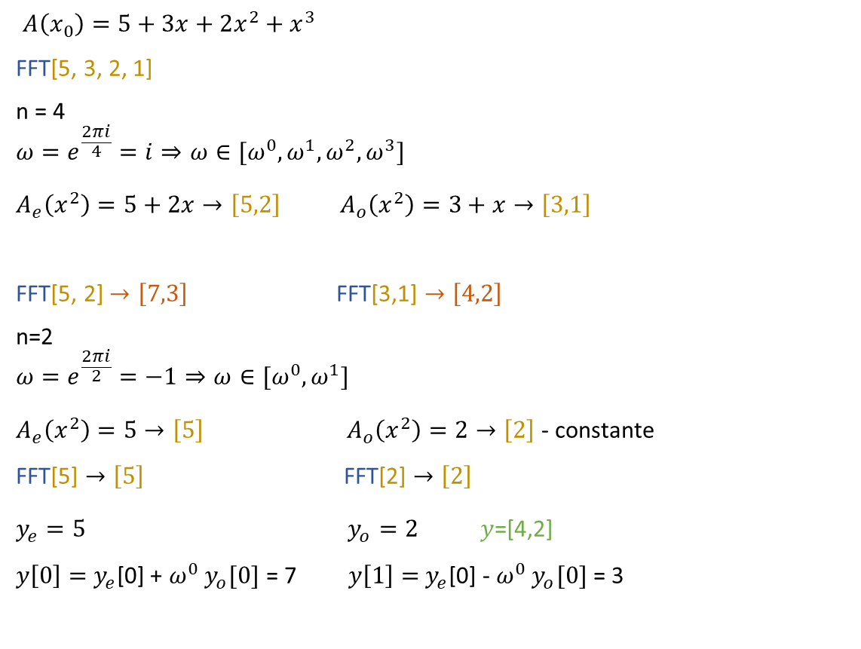
FFT (Transformata Rapidă Fourier)
$A\left(x_{0}\right)=5+3x+2x^{2}+x^{3}$
FFT[5, 3, 2, 1]
n = 4
$$ω=e^{\frac{2πi}{4}}=i⇒ω∈[ω^{0},ω^{1},ω^{2},ω^{3}]$$
$A_{e}\left(x^{2}\right)=5+2x→\left[5,2\right]$ $A_{o}\left(x^{2}\right)=3+x→\left[3,1\right]$
FFT[5, 2] $→\left[7,3\right]$ FFT[3,1] $→\left[4,2\right]$
n=2
$$ω=e^{\frac{2πi}{2}}=−1⇒ω∈[ω^{0},ω^{1}]$$
$A_{e}\left(x^{2}\right)=5→\left[5\right]$ $A_{o}\left(x^{2}\right)=2→\left[2\right]$ - constante
FFT[5] $→\left[5\right]$ FFT[2] $→\left[2\right]$
$y_{e}=5$ $y_{o}=2$ $y$=[4,2]
$y\left[0\right]=$ $y_{e}$[0] + $ω^{0}$ $y_{o}[0]$ = 7 $y\left[1\right]=$ $y_{e}$[0] - $ω^{0}$ $y_{o}[0]$ = 3
function FFT(A):
input A – [$a_{0},a_{1},a_{2},…,a_{n−1}$] – coef polin
n = len(A) – putere a lui 2
if (n==1)
return A – A este o ct
$ω=e^{\frac{2πi}{n}}$ - def $ω$ pt det rad de ordin n ale unitatii
$A_{e}$, $A_{o}=$[$a_{0},a_{1},a_{2},…,a_{n−2}$][$a_{1},a_{2},a_{3},…,a_{n−1}$] – împărțirea polin
$y_{e}$, $y_{o}=FFT\left(A_{e}\right),FFT(A_{o})$ – apelarea recursivă a funcției
$y=\left[0\right]∗n$ – initializare pentru output
for i in range (n/2)
$y[i]$ = $y_{e}\left[i\right]+ ω^{i}$ $y_{0}\left[i\right]$
$y[i+\frac{n}{2}]$ = $y_{e}\left[i\right]− ω^{i}$ $y_{0}\left[i\right]$
return y
Notes:
$$ω=e^{\frac{2πi}{4}}=e^{i\frac{π}{2}}=\cos\left(\frac{π}{2}\right)+isin(\frac{π}{2})=i$$

Slide 25

FFT (Transformata Rapidă Fourier)
$A\left(x_{0}\right)=5+3x+2x^{2}+x^{3}$
FFT[5, 3, 2, 1]
n = 4
$$ω=e^{\frac{2πi}{4}}=i⇒ω∈[ω^{0},ω^{1},ω^{2},ω^{3}]$$
$A_{e}\left(x^{2}\right)=5+2x→\left[5,2\right]$ $A_{o}\left(x^{2}\right)=3+x→\left[3,1\right]$
FFT[5, 2] $→\left[7,3\right]$ FFT[3,1] $→\left[4,2\right]$
$y_{e}=\left[7,3\right]$ $y_{o}=\left[4,2\right]$
function FFT(A):
input A – [$a_{0},a_{1},a_{2},…,a_{n−1}$] – coef polin
n = len(A) – putere a lui 2
if (n==1)
return A – A este o ct
$ω=e^{\frac{2πi}{n}}$ - def $ω$ pt det rad de ordin n ale unitatii
$A_{e}$, $A_{o}=$[$a_{0},a_{1},a_{2},…,a_{n−2}$][$a_{1},a_{2},a_{3},…,a_{n−1}$] – împărțirea polin
$y_{e}$, $y_{o}=FFT\left(A_{e}\right),FFT(A_{o})$ – apelarea recursivă a funcției
$y=\left[0\right]∗n$ – initializare pentru output
for i in range (n/2)
$y[i]$ = $y_{e}\left[i\right]+ ω^{i}$ $y_{0}\left[i\right]$
$y[i+\frac{n}{2}]$ = $y_{e}\left[i\right]− ω^{i}$ $y_{0}\left[i\right]$
return y
Notes:
$$ω=e^{\frac{2πi}{4}}=e^{i\frac{π}{2}}=\cos\left(\frac{π}{2}\right)+isin(\frac{π}{2})=i$$

Slide 26

FFT (Transformata Rapidă Fourier)
$A\left(x_{0}\right)=5+3x+2x^{2}+x^{3}$
FFT[5, 3, 2, 1]
n = 4
$$ω=e^{\frac{2πi}{4}}=i⇒ω∈[ω^{0},ω^{1},ω^{2},ω^{3}]$$
$A_{e}\left(x^{2}\right)=5+2x→\left[5,2\right]$ $A_{o}\left(x^{2}\right)=3+x→\left[3,1\right]$
FFT[5, 2] $→\left[7,3\right]$ FFT[3,1] $→\left[4,2\right]$ $y$=[0, 0, 0, 0]
$y_{e}=\left[7,3\right]$ $y_{o}=\left[4,2\right]$
function FFT(A):
input A – [$a_{0},a_{1},a_{2},…,a_{n−1}$] – coef polin
n = len(A) – putere a lui 2
if (n==1)
return A – A este o ct
$ω=e^{\frac{2πi}{n}}$ - def $ω$ pt det rad de ordin n ale unitatii
$A_{e}$, $A_{o}=$[$a_{0},a_{1},a_{2},…,a_{n−2}$][$a_{1},a_{2},a_{3},…,a_{n−1}$] – împărțirea polin
$y_{e}$, $y_{o}=FFT\left(A_{e}\right),FFT(A_{o})$ – apelarea recursivă a funcției
$y=\left[0\right]∗n$ – initializare pentru output
for i in range (n/2)
$y[i]$ = $y_{e}\left[i\right]+ ω^{i}$ $y_{0}\left[i\right]$
$y[i+\frac{n}{2}]$ = $y_{e}\left[i\right]− ω^{i}$ $y_{0}\left[i\right]$
return y
Notes:
$$ω=e^{\frac{2πi}{4}}=e^{i\frac{π}{2}}=\cos\left(\frac{π}{2}\right)+isin(\frac{π}{2})=i$$

Slide 27

FFT (Transformata Rapidă Fourier)
$A\left(x_{0}\right)=5+3x+2x^{2}+x^{3}$
FFT[5, 3, 2, 1]
n = 4
$$ω=e^{\frac{2πi}{4}}=i⇒ω∈[ω^{0},ω^{1},ω^{2},ω^{3}]$$
$A_{e}\left(x^{2}\right)=5+2x→\left[5,2\right]$ $A_{o}\left(x^{2}\right)=3+x→\left[3,1\right]$
FFT[5, 2] $→\left[7,3\right]$ FFT[3,1] $→\left[4,2\right]$ $y$=[11, 0, 3, 0]
$y_{e}=\left[7,3\right]$ $y_{o}=\left[4,2\right]$
$y\left[0\right]=$ $y_{e}$[0] + $ω^{0}$ $y_{o}[0]$ = 11
$y\left[2\right]=$ $y_{e}$[0] - $ω^{0}$ $y_{o}[0]$ = 3
function FFT(A):
input A – [$a_{0},a_{1},a_{2},…,a_{n−1}$] – coef polin
n = len(A) – putere a lui 2
if (n==1)
return A – A este o ct
$ω=e^{\frac{2πi}{n}}$ - def $ω$ pt det rad de ordin n ale unitatii
$A_{e}$, $A_{o}=$[$a_{0},a_{1},a_{2},…,a_{n−2}$][$a_{1},a_{2},a_{3},…,a_{n−1}$] – împărțirea polin
$y_{e}$, $y_{o}=FFT\left(A_{e}\right),FFT(A_{o})$ – apelarea recursivă a funcției
$y=\left[0\right]∗n$ – initializare pentru output
for i in range (n/2)
$y[i]$ = $y_{e}\left[i\right]+ ω^{i}$ $y_{0}\left[i\right]$
$y[i+\frac{n}{2}]$ = $y_{e}\left[i\right]− ω^{i}$ $y_{0}\left[i\right]$
return y
Notes:
$$ω=e^{\frac{2πi}{4}}=e^{i\frac{π}{2}}=\cos\left(\frac{π}{2}\right)+isin(\frac{π}{2})=i$$

Slide 28

FFT (Transformata Rapidă Fourier)
$A\left(x_{0}\right)=5+3x+2x^{2}+x^{3}$
FFT[5, 3, 2, 1]
n = 4
$$ω=e^{\frac{2πi}{4}}=i⇒ω∈[ω^{0},ω^{1},ω^{2},ω^{3}]$$
$A_{e}\left(x^{2}\right)=5+2x→\left[5,2\right]$ $A_{o}\left(x^{2}\right)=3+x→\left[3,1\right]$
FFT[5, 2] $→\left[7,3\right]$ FFT[3,1] $→\left[4,2\right]$ $y\text{=[11,}\text{ 0}\text{,} \text{3,}\text{ 0}\text{]}$
$y_{e}=\left[7,3\right]$ $y_{o}=\left[4,2\right]$
$y\left[0\right]=$ $y_{e}$[0] + $ω^{0}$ $y_{o}[0]$ = 11
$y\left[2\right]=$ $y_{e}$[0] - $ω^{0}$ $y_{o}[0]$ = 3
function FFT(A):
input A – [$a_{0},a_{1},a_{2},…,a_{n−1}$] – coef polin
n = len(A) – putere a lui 2
if (n==1)
return A – A este o ct
$ω=e^{\frac{2πi}{n}}$ - def $ω$ pt det rad de ordin n ale unitatii
$A_{e}$, $A_{o}=$[$a_{0},a_{1},a_{2},…,a_{n−2}$][$a_{1},a_{2},a_{3},…,a_{n−1}$] – împărțirea polin
$y_{e}$, $y_{o}=FFT\left(A_{e}\right),FFT(A_{o})$ – apelarea recursivă a funcției
$y=\left[0\right]∗n$ – initializare pentru output
for i in range (n/2)
$y[i]$ = $y_{e}\left[i\right]+ ω^{i}$ $y_{0}\left[i\right]$
$y[i+\frac{n}{2}]$ = $y_{e}\left[i\right]− ω^{i}$ $y_{0}\left[i\right]$
return y
Notes:
$$ω=e^{\frac{2πi}{4}}=e^{i\frac{π}{2}}=\cos\left(\frac{π}{2}\right)+isin(\frac{π}{2})=i$$

Slide 29

FFT (Transformata Rapidă Fourier)
$A\left(x_{0}\right)=5+3x+2x^{2}+x^{3}$
FFT[5, 3, 2, 1]
n = 4
$$ω=e^{\frac{2πi}{4}}=i⇒ω∈[ω^{0},ω^{1},ω^{2},ω^{3}]$$
$A_{e}\left(x^{2}\right)=5+2x→\left[5,2\right]$ $A_{o}\left(x^{2}\right)=3+x→\left[3,1\right]$
FFT[5, 2] $→\left[7,3\right]$ FFT[3,1] $→\left[4,2\right]$ $y\text{=[11,}\text{ 3+2}\text{i}\text{,} \text{3,}\text{ 3−2}\text{i}\text{]}$
$y_{e}=\left[7,3\right]$ $y_{o}=\left[4,2\right]$
$y\left[0\right]=$ $y_{e}$[0] + $ω^{0}$ $y_{o}[0]$ = 11
$y\left[2\right]=$ $y_{e}$[0] - $ω^{0}$ $y_{o}[0]$ = 11
$y\left[1\right]=$ $y_{e}$[1] + $ω^{1}$ $y_{o}[1]$ = 3 + 2i
$y\left[3\right]=$ $y_{e}$[1] - $ω^{1}$ $y_{o}[1]$ = 3 - 2i
function FFT(A):
input A – [$a_{0},a_{1},a_{2},…,a_{n−1}$] – coef polin
n = len(A) – putere a lui 2
if (n==1)
return A – A este o ct
$ω=e^{\frac{2πi}{n}}$ - def $ω$ pt det rad de ordin n ale unitatii
$A_{e}$, $A_{o}=$[$a_{0},a_{1},a_{2},…,a_{n−2}$][$a_{1},a_{2},a_{3},…,a_{n−1}$] – împărțirea polin
$y_{e}$, $y_{o}=FFT\left(A_{e}\right),FFT(A_{o})$ – apelarea recursivă a funcției
$y=\left[0\right]∗n$ – initializare pentru output
for i in range (n/2)
$y[i]$ = $y_{e}\left[i\right]+ ω^{i}$ $y_{0}\left[i\right]$
$y[i+\frac{n}{2}]$ = $y_{e}\left[i\right]− ω^{i}$ $y_{0}\left[i\right]$
return y
Notes:
$$ω=e^{\frac{2πi}{4}}=e^{i\frac{π}{2}}=\cos\left(\frac{π}{2}\right)+isin(\frac{π}{2})=i$$

Slide 30
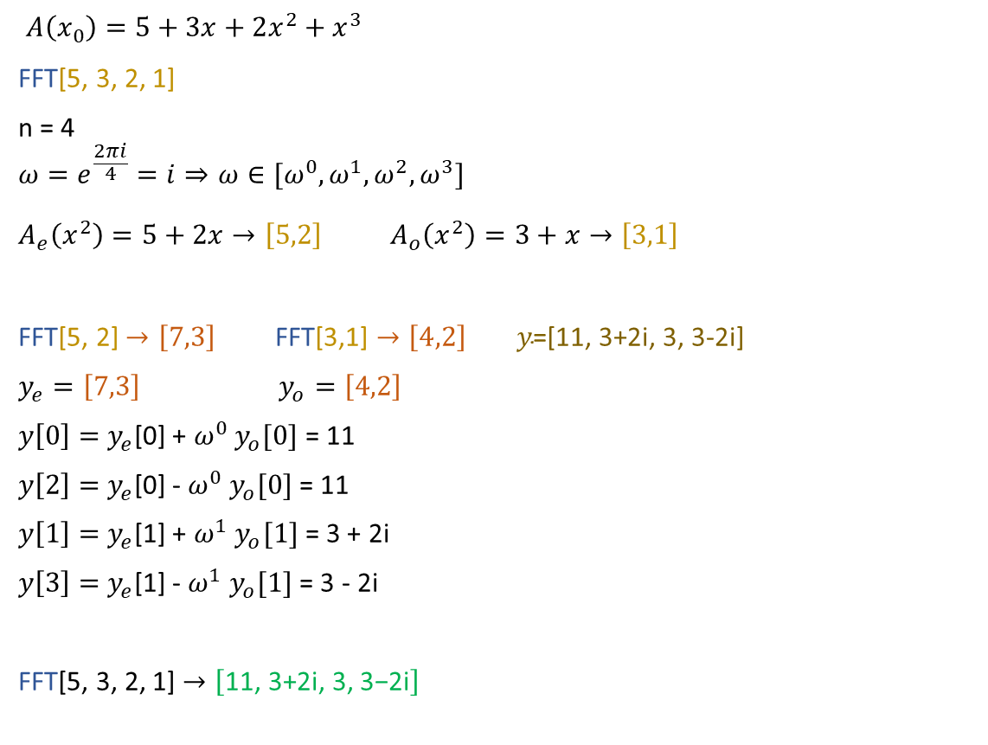
FFT (Transformata Rapidă Fourier)
$A\left(x_{0}\right)=5+3x+2x^{2}+x^{3}$
FFT[5, 3, 2, 1]
n = 4
$$ω=e^{\frac{2πi}{4}}=i⇒ω∈[ω^{0},ω^{1},ω^{2},ω^{3}]$$
$A_{e}\left(x^{2}\right)=5+2x→\left[5,2\right]$ $A_{o}\left(x^{2}\right)=3+x→\left[3,1\right]$
FFT[5, 2] $→\left[7,3\right]$ FFT[3,1] $→\left[4,2\right]$ $y\text{=[11,}\text{ 3+2}\text{i}\text{,} \text{3,}\text{ 3−2}\text{i}\text{]}$
$y_{e}=\left[7,3\right]$ $y_{o}=\left[4,2\right]$
$y\left[0\right]=$ $y_{e}$[0] + $ω^{0}$ $y_{o}[0]$ = 11
$y\left[2\right]=$ $y_{e}$[0] - $ω^{0}$ $y_{o}[0]$ = 11
$y\left[1\right]=$ $y_{e}$[1] + $ω^{1}$ $y_{o}[1]$ = 3 + 2i
$y\left[3\right]=$ $y_{e}$[1] - $ω^{1}$ $y_{o}[1]$ = 3 - 2i
FFT[5, 3, 2, 1] $→\left[\text{11, 3+2}\text{i}\text{, 3, 3−2}\text{i}\right]$
function FFT(A):
input A – [$a_{0},a_{1},a_{2},…,a_{n−1}$] – coef polin
n = len(A) – putere a lui 2
if (n==1)
return A – A este o ct
$ω=e^{\frac{2πi}{n}}$ - def $ω$ pt det rad de ordin n ale unitatii
$A_{e}$, $A_{o}=$[$a_{0},a_{1},a_{2},…,a_{n−2}$][$a_{1},a_{2},a_{3},…,a_{n−1}$] – împărțirea polin
$y_{e}$, $y_{o}=FFT\left(A_{e}\right),FFT(A_{o})$ – apelarea recursivă a funcției
$y=\left[0\right]∗n$ – initializare pentru output
for i in range (n/2)
$y[i]$ = $y_{e}\left[i\right]+ ω^{i}$ $y_{0}\left[i\right]$
$y[i+\frac{n}{2}]$ = $y_{e}\left[i\right]− ω^{i}$ $y_{0}\left[i\right]$
return y
Notes:
$$ω=e^{\frac{2πi}{4}}=e^{i\frac{π}{2}}=\cos\left(\frac{π}{2}\right)+isin(\frac{π}{2})=i$$

