Slide 1
Language Overview
Small language
  Keep it easy, but extensible
  No knowledge of XSLT is needed for simple cases
  Integrate well-known standards for more complex things
Own Namespace with prefix sqf:
http://www.schematron-quickfix.com/validator/process
Standard | Elements
XSLT 2.0 | 49
Schematron | 21
SQF | 15

Slide 2
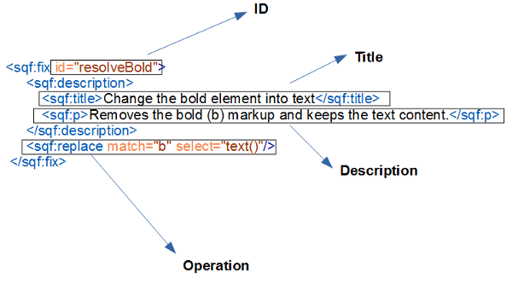
QuickFix structure
  Reference
  title & description
  Activity Elements
  Special cases
    User Entries
    Call-fix
    use-when, use-for-each

Slide 3
Example 1
Replace a node
<sch:rule context="b">
<sch:report test="ancestor::b"
sqf:fix="italic resolve">
Bold in bold is not allowed.</sch:report>
<sqf:fix id="italic">
<sqf:description>
<sqf:title>Change it to italic.</sqf:title>
</sqf:description>
<sqf:replace target="i" node-type="element" select="node()"/>
</sqf:fix>
<sqf:fix id="resolve">
<!--...-->
<sqf:replace select="node()"/>
</sqf:fix>
</sch:rule>

Slide 4
Example 2
Move a node – delete and add
<sch:rule context="title">
<sch:report test="preceding-sibling::abstract" sqf:fix="abstract">
The abstract element shouldn't be placed before the <sch:name/> element.
</sch:report>
<sqf:group id="abstract">
<sqf:fix id="abstract.moveAbstract">
<sqf:description>
<sqf:title>Move the abstract element after the title</sqf:title>
</sqf:description>
<sqf:delete match="preceding-sibling::abstract"/>
<sqf:add match="." select="preceding-sibling::abstract" position="after"/>
</sqf:fix>
<sqf:fix id="abstract.moveTitle"><!--...--></sqf:fix>
<sqf:fix id="abstract.deleteAbstract"><!--...--></sqf:fix>
<sqf:fix id="abstract.deleteTitle"><!--...--></sqf:fix>
</sqf:group>
</sch:rule>

Slide 5
Example 3
Replace sub strings
<sch:rule context="text()">
<sch:report test="matches(., '____')"
sqf:fix="form">
More than three underscores in a row shouldn't be used.</sch:report>
<sqf:fix id="form">
<sqf:description>
<sqf:title>Replace the missused characters by a form element.</sqf:title>
</sqf:description>
<sqf:stringReplace regex="___+">
<form/>
</sqf:stringReplace>
</sqf:fix>
</sch:rule>

Slide 6
Example 4
User Entry – parameter of the QuickFix
<sch:rule context="title">
<sch:assert test="normalize-space(.) != '' " sqf:fix="title"
>A title shouldn't be empty.</sch:assert>
<sqf:fix id="title">
<sqf:description>
<sqf:title>Set a title</sqf:title>
<sqf:p>This QuickFix will set a title by using a User Entry.</sqf:p>
</sqf:description>
<sqf:user-entry name="title" type="xs:string">
<sqf:description>
<sqf:title>Please enter the new title.</sqf:title>
</sqf:description>
</sqf:user-entry>
<sqf:replace target="title" node-type="element"
select="$title" />
</sqf:fix>
</sch:rule>

Slide 7
Example 5
Conditions – provide a QuickFix only if it makes sense
<sch:rule context="html:title">
<sch:assert test="string-length(normalize-space(.)) gt 20 "
sqf:fix="title">
A title shouldn't be empty.</sch:assert>
<sqf:fix id="title" use-when="//html:h1[1][string-length(.) le 20]">
<sqf:description>
<sqf:title>
Set the title to "<sch:value-of select="//html:h1[1]"/>".
</sqf:title>
</sqf:description>
<sqf:replace target="title" node-type="element">
<sch:value-of select="//html:h1[1]"/>
</sqf:replace>
</sqf:fix>
</sch:rule>

Slide 8
Example 6
Generic QuickFixes – in the future
<sch:rule context="html:title">
<sch:assert test="string-length(normalize-space(.)) gt 20 "
sqf:fix="title">
A title shouldn't be empty.</sch:assert>
<sqf:fix id="title" use-for-each="//html:h1[string-length(.) le 20]">
<sqf:description>
<sqf:title>
Set the title to "<sch:value-of select="$sqf:current"/>".
</sqf:title>
</sqf:description>
<sqf:replace target="title" node-type="element">
<sch:value-of select="$sqf:current"/>
</sqf:replace>
</sqf:fix>
</sch:rule>

Slide 9
Example 7
Generic QuickFixes – in the future
<sqf:fix id="title">
<sqf:call-fix ref="createElementRowAsFirstChild">
<sqf:with-param name="match" select="."/>
<sqf:with-param name="el" select="'col'"/>
<sqf:with-param name="count" select="count(max(.//tr/count(td|th)))"/>
</sqf:call-fix>
</sqf:fix>
<sqf:fix id="createElementRowAsFirstChild">
<sqf:param name="match" type="node()*"/>
<sqf:param name="el" type="xs:QName"/>
<sqf:param name="count" type="xs:integer"/>
<sqf:description>
<sqf:title>Create a row of <sch:value-of select="$count"/>
<sch:name path="$el"/> elements as a first child of the
<sch:name path="$match"/> element(s).</sqf:title>
</sqf:description>
<sqf:add match="$match" position="first-child">
<xsl:for-each select="1 to $count">
<xsl:element name="{$el}"/>
</xsl:for-each>
</sqf:add>
</sqf:fix>

