Slide 1


The Power of SQF
Nico Kutscherauer
Octavian Nadolu
octavian_nadolu@oxygenxml.com
@OctavianNadolu
kutscherauer@data2type.de @nkutsche

Slide 2
Second Draft – Overview
Published on 2019-03-08
Generic QuickFixes (@use-for-each)
  Generate a dynamic number of QuickFixes
  Support: Oxygen 20+ / Escali
Flexible content model of sqf:fix
  Support: Oxygen 21? / Escali
Introduction of a first localisation concept
  Support: Oxygen 20+ / Escali

Slide 3
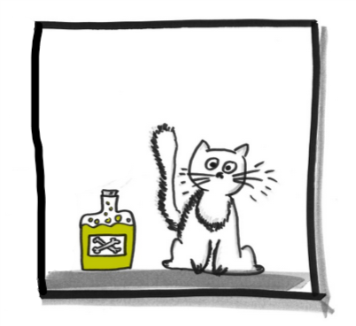
Ignoring in Schematron
Schematron has erros, warnings, informations
Warnings are like Schrödinger's cat:
  If you don't look at it, they are good
  and bad at the same time
  Good warning needs to be marked
  → Ignoring
Ignoring in Schematron is not a big deal:
  Mark the context with a PI or a specific attribute
  Exclude marked nodes from your tests.
Quelle: https://www.leifiphysik.de/

Slide 4
Ignoring in Schematron
Example from our XSLT styleguide
    <sch:pattern id="p_04_unused_items" xmlns:d2t="http://data2type.de/">
    <sch:rule context="*[@d2t:ignore = 'p_04_unused_items']"/>
    <sch:rule context="xsl:template[@name]">
    <!-- Check template usage -->
    <sch:assert test="..."/>
  Elements with the d2t:ignore attribute and the value p_04_unused_items will be ignored.
  For convention the value is equal to the pattern ID.
  With the specific namespace http://data2type.de/ name conflicts are avoided

Slide 5
Ignoring in Schematron
Problem in practice: the user has to know a lot:
  That it is possible to ignore the warning
  That you have to ignore with an ignore attribute.
  The exact URL of the specific namespace
  The exact pattern ID of each Schematron warning
Ignoring with pur Schematorn is not practical

Slide 6
Ignoring with SQF
SQF makes ignoring practical
A simple QuickFix helps:
  <sqf:fix id="ignore_p_04_unused_items">
  <sqf:description>
  <sqf:title>Ignore this warning</sqf:title>
  </sqf:description>
  <sqf:add match="." target="d2t:ignore" node-type="attribute"
  select="'p_04_unused_items'"/>
  </sqf:fix>
  The user has just to use the QuickFix, to ignore the warning

Slide 7
Ignoring with SQF
Remarkable:
  QuickFix is not used to fix the document
  SQF and Schematron interacts
    Schematron checks the document
    QuickFix makes a manipulation
    On next validation circle Schematron reacts depending on that manipulation
Door opener for new ideas

Slide 8
Guided development
Example XSD guide
  Multiple ways to express the same thing in XSD
  Inexperianced users has problems to follow a desing pattern (google based development)
  The XSD guide leads the user through XSD based on a selected design pattern.
  The XSD guid is based on Schematron, SQF and XSLT only

Slide 9
XSD Guide – Demo
https://github.com/octavianN/thePowerOfSQF/Samples/xsdguide/

Slide 10
Guided development
How does it works?
  Interaction by xs:annotation/xs:appInfo/d2t:xsdguide
  User input by <sqf:user-entry>
    Edit Content with @default
  Multiple choice selections by:
    Different QuickFixes
    Generic QuickFixes (@use-for-each)
    Drop-down menu in User Entry
    (Escali plugin only feature: by sqf:user-entry/@default returning a sequence)
  Complex tasks by using XSLT functions

Slide 11
Guided development
XSD Guide is just an example
There are other large and confusing standards in the XML world
  With user without a deep understanding
  You can provide shortcuts for verbose syntax
  You may have to work with PIs for interactions

Slide 12
Thank you!
Questions?
octavian_nadolu@oxygenxml.com
@OctavianNadolu
contact@schematron-quickfix.com
@nkutsche

