Slide 1
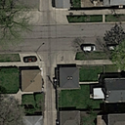
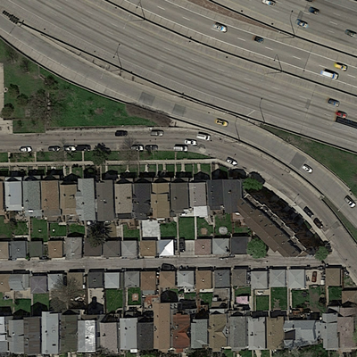

Input: 72 x 72 RGB Image
Output: 1 x 2
[1,0]
Input: 400 x 400 RGB Image
Output: 400 x 400 binary Image

