Slide 1

GENWARE COMPUTER SYSTEMS Inc
2021 TIBCO MODATHON ENTRY
David Mogrovejo – BI Architect
23North, Suite 120
630 Market Street
Wayne
St. Augustine
New Jersey 07470
Florida 32095
Tel/Fax:
(973) 633-6606
Email:
david@genware.com

Slide 2
Case Study
Business Requirement
Summarize avocado sales data for each year.
Showcase how the data is distributed by location
Be able to get more detailed information after marking data.
TIBCO Spotfire MOD
Customized D3-based Violin visualization
It expands the box plot as it displays all the summary data and then adds data distribution which can be further expanded by using the color by capability.

Slide 3
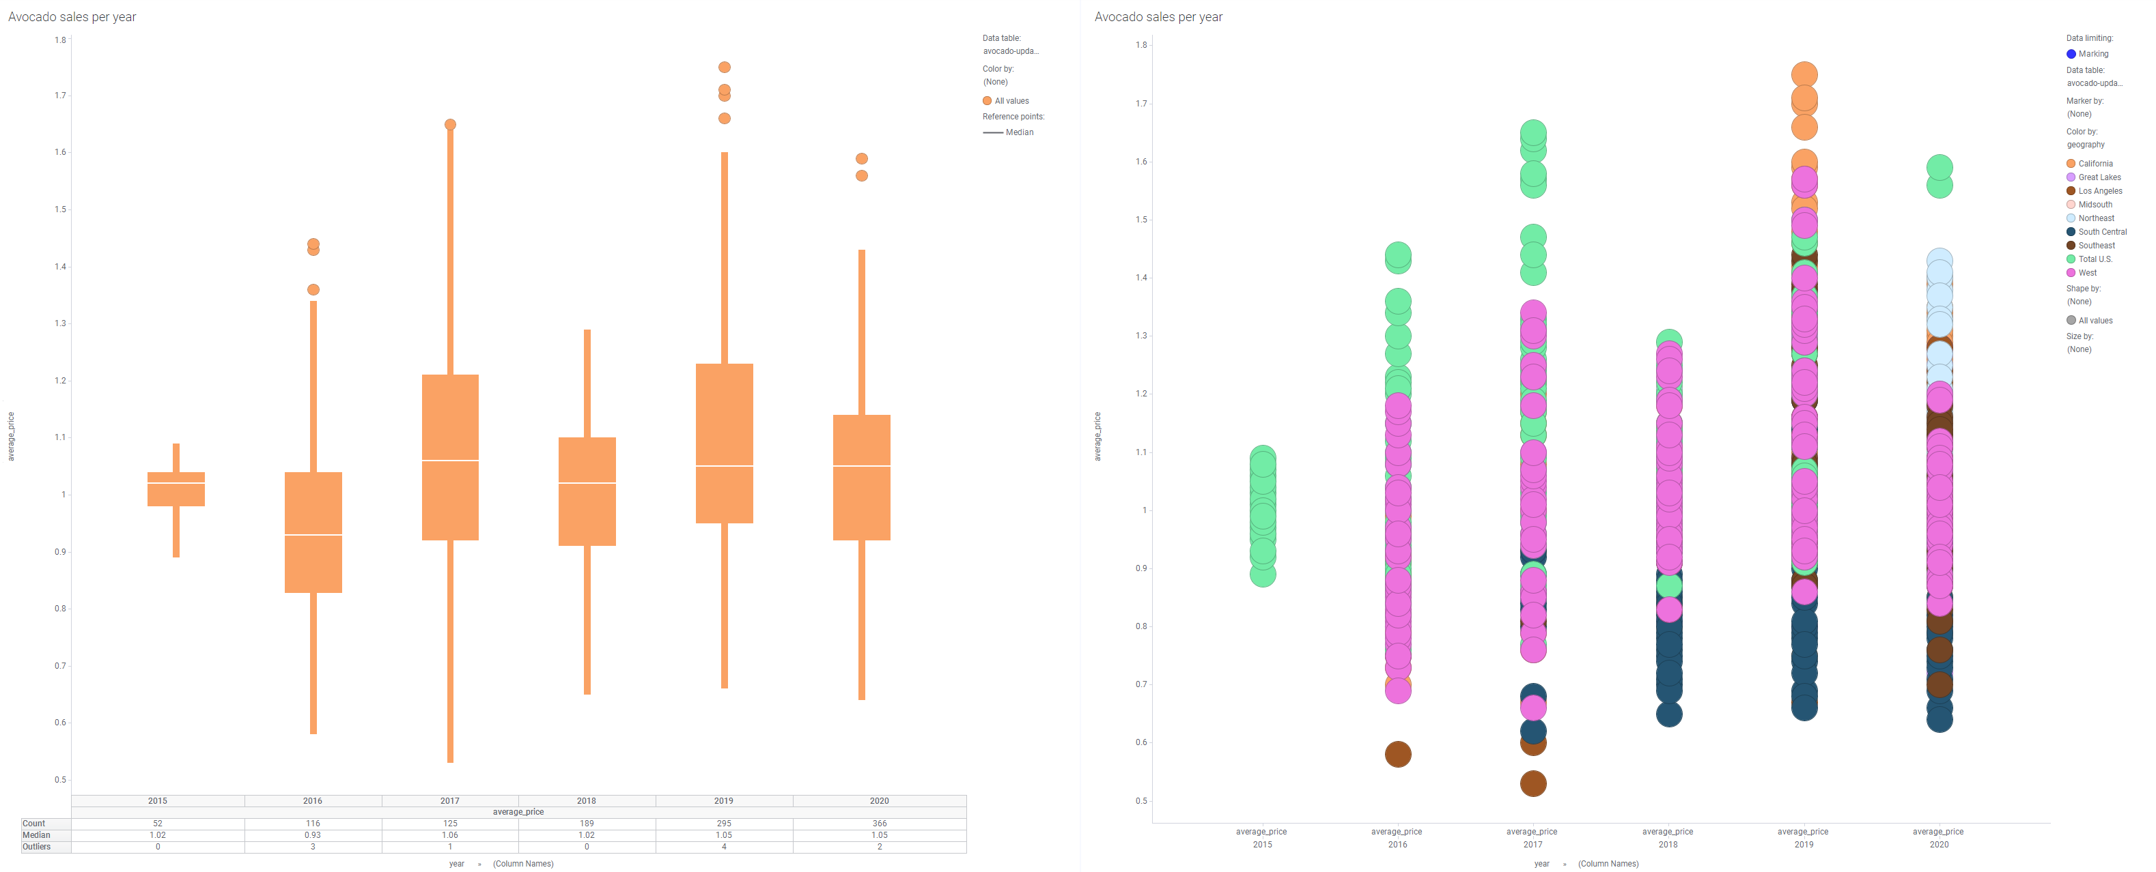
Existing Implementation

Slide 4
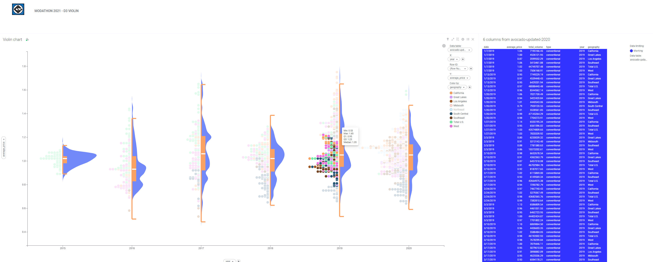
Spotfire MODified

Slide 5
GENWARE COMPUTER SYSTEMS Inc
David Mogrovejo
Solutions Architect
e-mail: david@genware.com
Thank You
Tel (973) 633-6606
Web www.Genware.com

