Slide 1

GENWARE COMPUTER SYSTEMS Inc
2021 TIBCO MODATHON ENTRY
Octavio De Los Santos – Solutions Architect
23North, Suite 120
630 Market Street
Wayne
St. Augustine
New Jersey 07470
Florida 32095
Tel/Fax:
(973) 633-6606
Email:
octavio@genware.com

Slide 2
Case Study
Business Requirement
Improve yield by identifying key contributors to failures during testing
Highlight testing groups affecting yield output
Showcase testing workflow
TIBCO Spotfire MOD
Customized D3-based Sankey visualization
Highlights key contributors to final yield results & testing workflow within same visualization

Slide 3
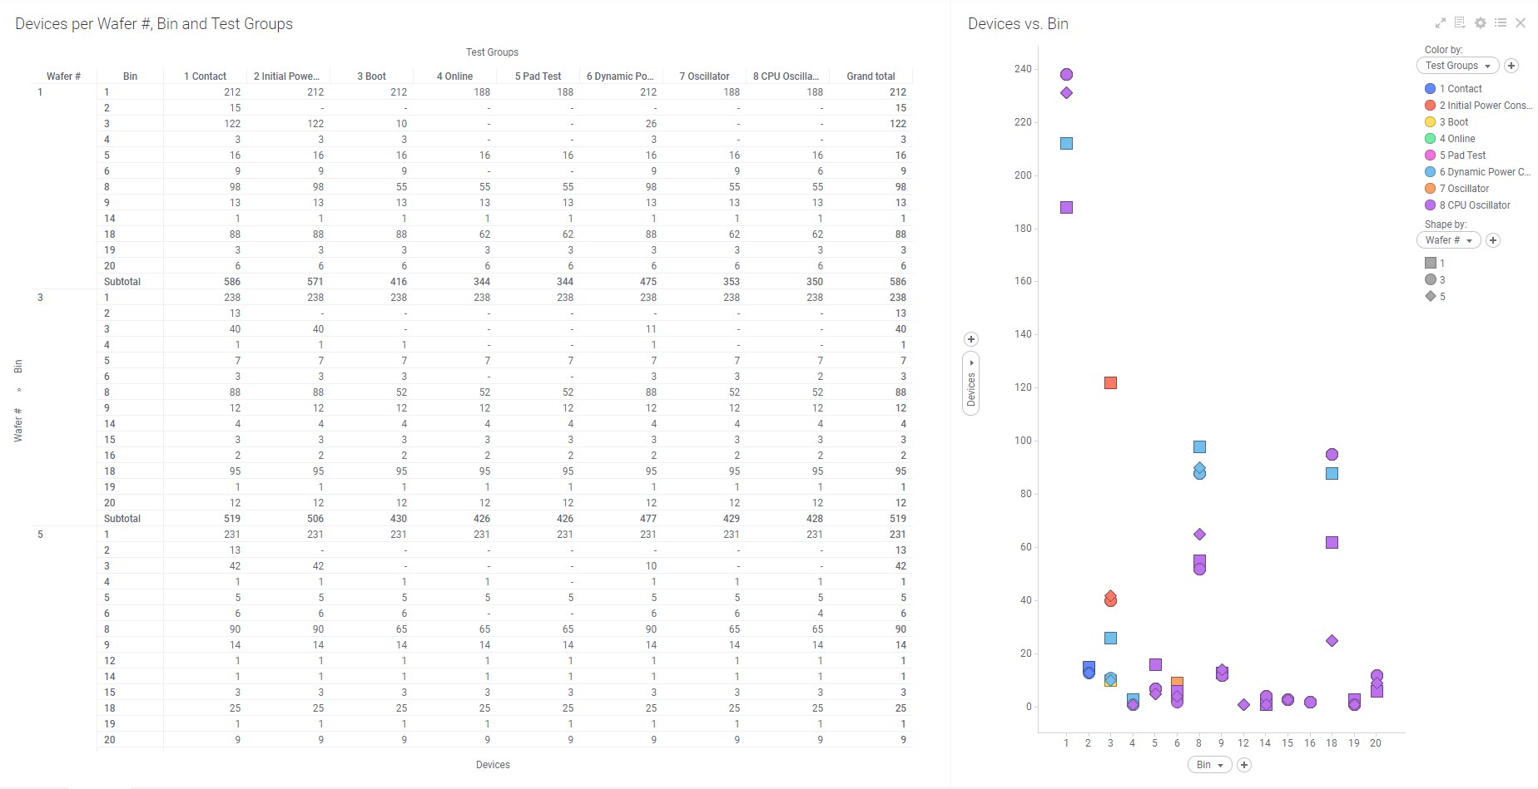
Existing Implementation

Slide 4
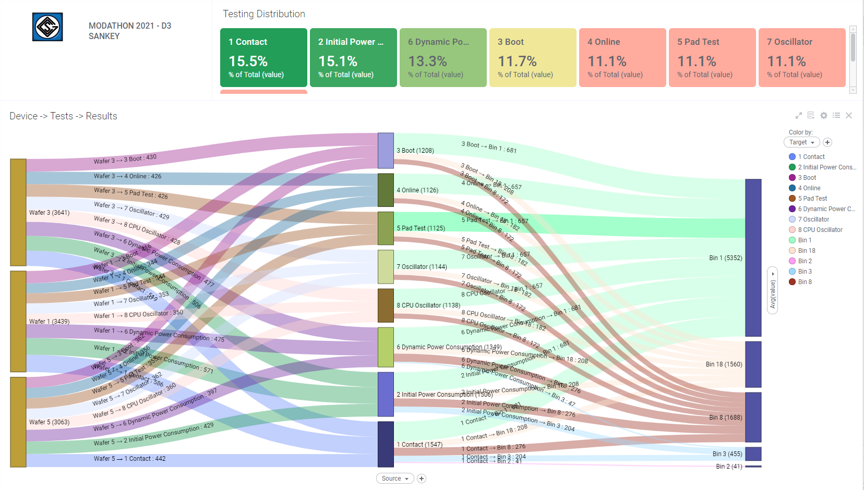
Spotfire MODified

Slide 5
GENWARE COMPUTER SYSTEMS Inc
Octavio De Los Santos
Solutions Architect
e-mail: octavio@genware.com
Thank You
Tel (973) 633-6606
Web www.Genware.com

