Slide 1

GENWARE COMPUTER SYSTEMS Inc
2021 TIBCO MODATHON ENTRY
Previn Chetty – Analytics Architect
Nelson Mandela Square
Maude Street
West Tower
Sandton
Second Floor
South Africa
Tel:
(+27) 83-968-5982
Email:
previn@genware.com

Slide 2
Case Study
Business Requirement
Display any form of hierarchical data in an easily readable format.
Easily navigate and view parent and child relationships.
TIBCO Spotfire MOD
Customized D3-based Treemap visualization
Provides an interactive flow of a dataset hierarchy.

Slide 3
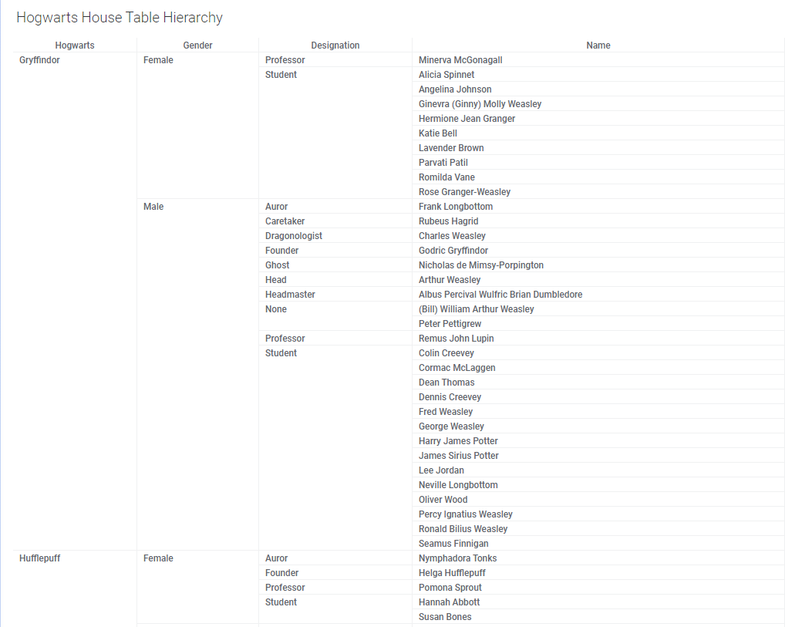
Existing Implementation

Slide 4
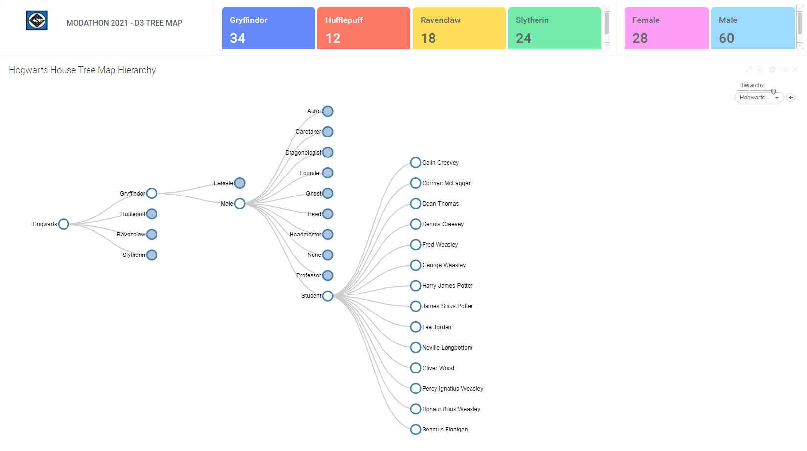
Spotfire MODified

Slide 5
GENWARE COMPUTER SYSTEMS Inc
Previn Chetty
Analytics Architect
e-mail: previn@genware.com
Thank You
Tel: (+27) 83-968-5982
Web: www.Genware.com

