Slide 1
Graphics
Object Orientated Programming in Java
Benjamin Kenwright

Slide 2
Outline
Essential Graphical Principals
JFrame Window (Popup Windows)
Extending JFrame
Drawing from paintComponent
Drawing images/text/graphics
Today’s Practical
Review/Discussion

Slide 3
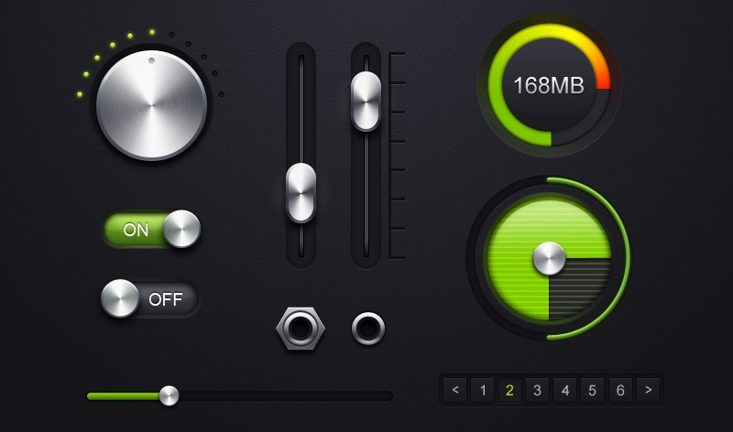
Graphics
How do you draw `complex’ diagrams?
Customize/control what is drawn on our windows
Animated clocks, bar-charts, images,

Slide 4
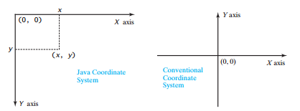
Graphical Coordinate System

Slide 5
JFrame
Simple GUI Window
Lets us perform simple drawing operations
Basic Usage
Instantiate the JFrame and assign text for the title bar
JFrame frame = new Jframe(‘Title’);
Specify size
frame.setSize(width, height)
Designate that closing the window ends the program
frame.setDefaultCloseOperation(JFrame.EXIT_ON_CLOSE);
Show the window
frame.setVisible(true);

Slide 6
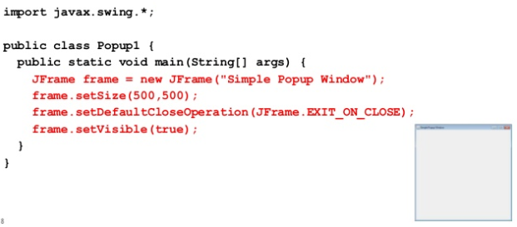
Using JFrame

Slide 7
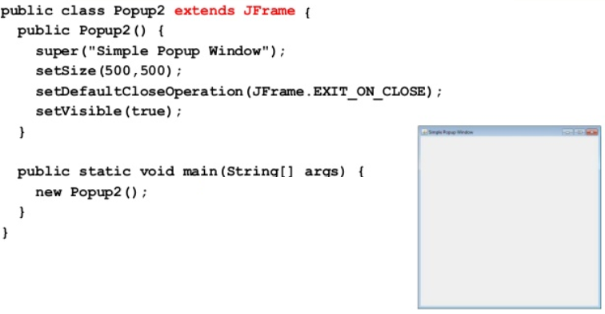
Extending JFrame

Slide 8
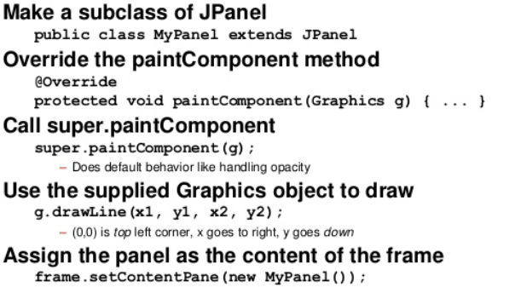
Basic Drawing

Slide 9
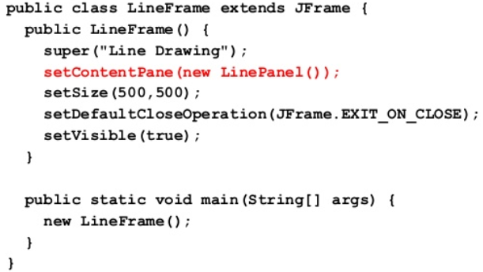
Example JFrame

Slide 10
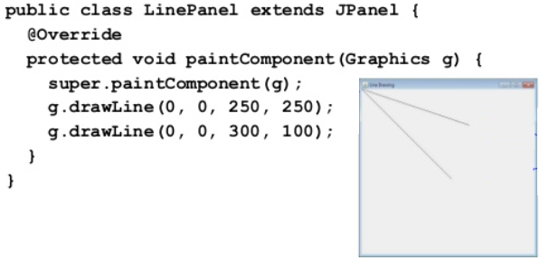
Example JPanel

Slide 11
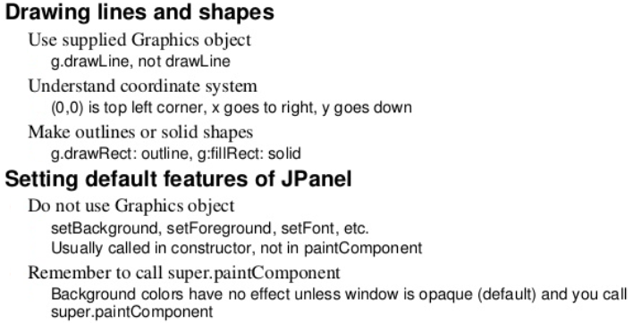
Drawing Methods

Slide 12
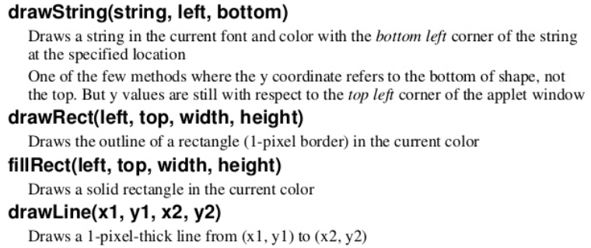
Graphics Class Methods

Slide 13
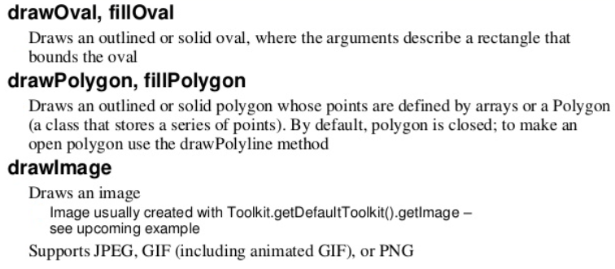
Graphics Class Methods

Slide 14
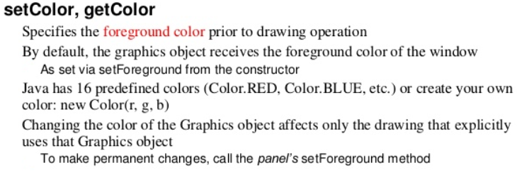
Graphics Class Methods

Slide 15
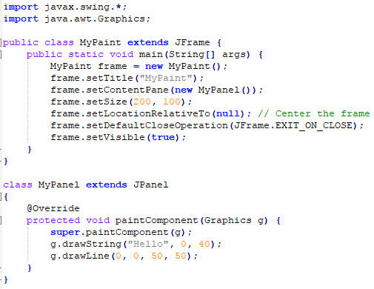
Question
What would be the output
of this program?
Sketch on paper what the
output would look like

Slide 16
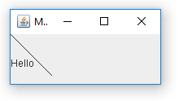
Answer
javac MyPaint.java
java –cp . MyPaint

Slide 17
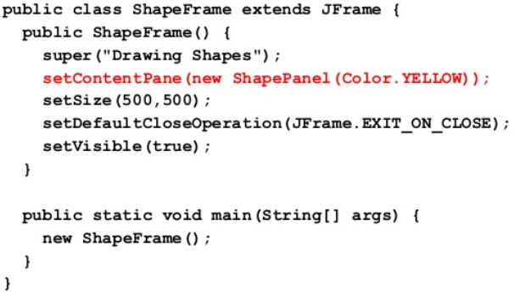
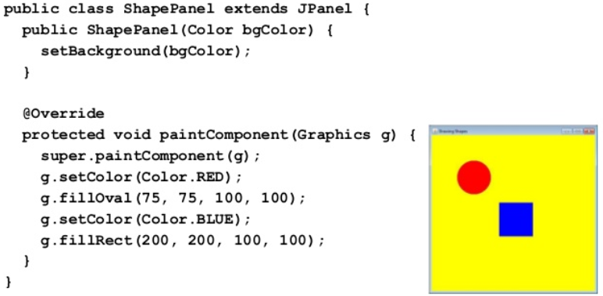
Example
1
2

Slide 18
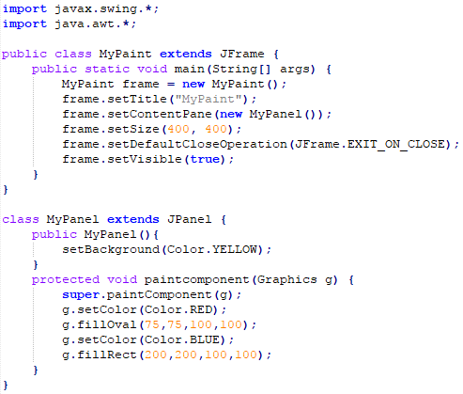
Question
What will the output
for the following program?

Slide 19
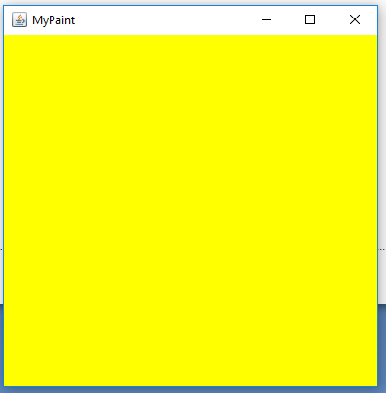
Answer

Slide 20
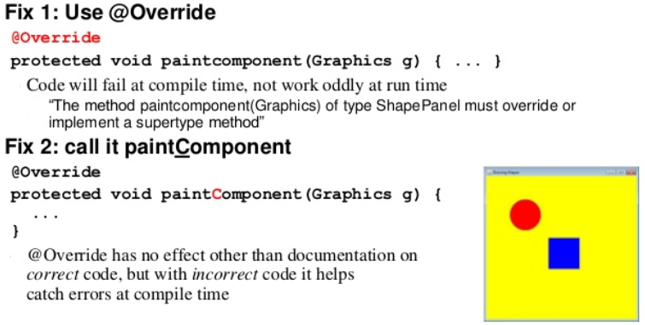
Fixing Problems

Slide 21
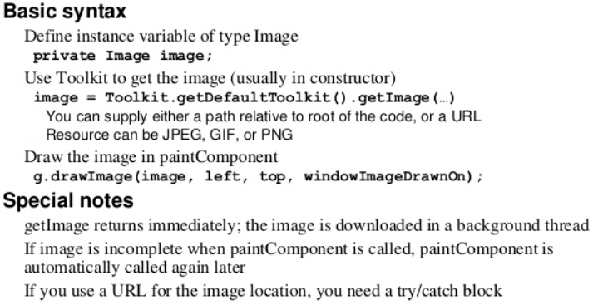
Drawing Images

Slide 22
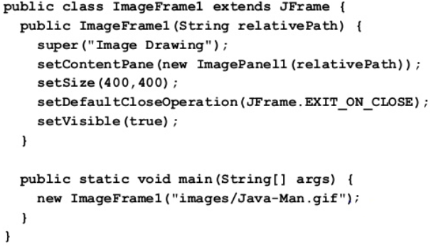
Images

Slide 23
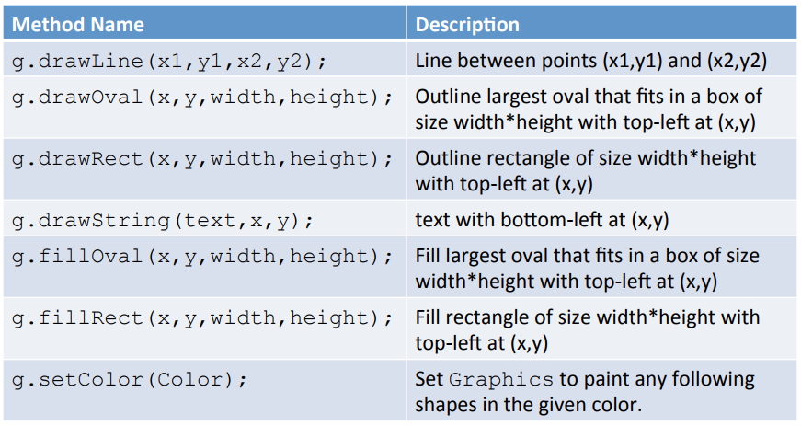
Review Basic Graphic Methods

Slide 24
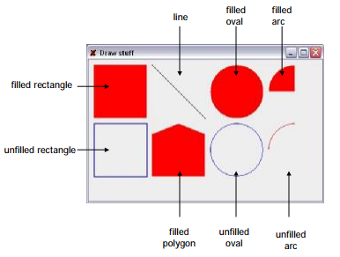
Question
Write down the graphics methods you’d use to draw the following output:

Slide 25
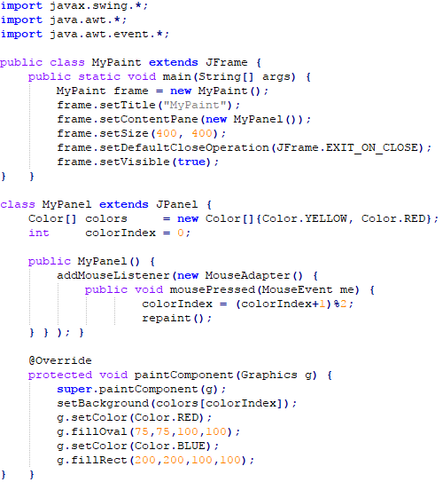
Question
What would the following
program output?
javac MyPaint.java
java –cp . MyPaint

Slide 26
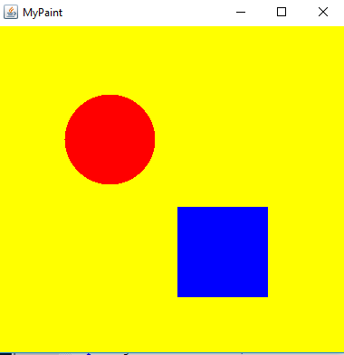
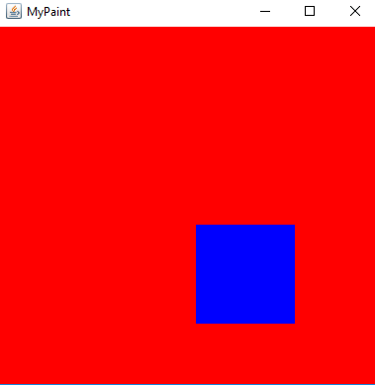
Answer
Left mouse button is pressed

Slide 27
Force Redraw
To notify Java to redraw our window (i.e., call paintComponent)
call ‘repaint()’
For example, add new graphics each time the mouse button is pressed

Slide 28
Review
Graphics can be drawn using a class which extends JPanel
Swing will call the paintComponent method to draw:
protected void paintComponent(Graphics g);
There are a variety of drawing methods:
drawLine(int x1, int y1, int x2, int y2);
drawRect(int x, int y, int w, int h);
drawOval(int x, int y, int w, int h);
drawPolygon(int[] xpoints, int[] ypoints, int npoints);

Slide 29
Other Graphics Capabilities
Lots of GUI Controls
Buttons, sliders, checkboxes, tables, etc
which you can override and improve
Rich 2D drawing
Line properties, translucent drawing, rotating, scaling images, coordinate transforms, ...
Animation
Double-buffering, combining drawing with threads, ..

Slide 30
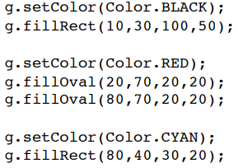

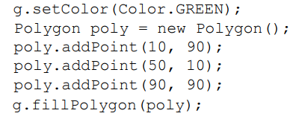

Examples

Slide 31
Experiment
Only scratched the surface of Graphics
Very simple windows and graphics
Combine the graphics with GUI components
Buttons/menus
Custom ‘interfaces’ components
e.g., Override default draw method for a button to create a new improved button look
Events
Mouse button presses (drawing program)
Timing (animations)

Slide 32
Challenge
Create a simple vector drawing program in Java
Clear/load/save drawings
Select buttons for different operations
line, circle, color, ...
Detect mouse button presses
draw lines, drag shapes, pick objects

Slide 33
Summary
Overview Essential Graphical Principles
JFrame, JPanel, paintComponent, @Override (Checking)
Hands-On/Practical
Today is about Graphics with Java
Drawing

Slide 34
This Week
Read Associated Chapters
Comprehensive Edition (Additional Chapters)
Review Slides
Java Exercises
Online Quizzes

Slide 35
Exercises
Chapter exercises 15.1-15.3
Comment your code
Remember to zip the files together
The name of the .zip file should be your student number
(e.g., 39293923923.zip)

Slide 36
Questions/Discussion

Slide 37
