Slide 1
Revision
Object Orientated Programming in Java
Benjamin Kenwright

Slide 2
Outline
Review Java Concepts and Principles
Today’s Practical
Review/Discussion

Slide 3
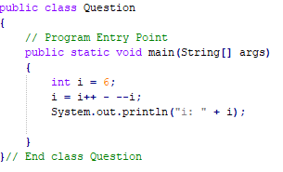
Revision Question
Does the following code compile? If so what would the output be?

Slide 4
Answer
i: 0

Slide 5
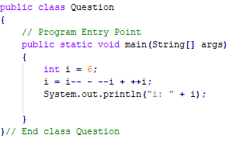
Revision Question
Does the following code compile? If so what would the output be?

Slide 6
Answer
i: 7

Slide 7
Question
Who said:
“I hear and I forget. I see and I remember. I do and I understand"

Slide 8

“I hear and I forget. I see and I remember. I do and I understand"
Confucius

Slide 9
Work Through Problems
Variety of open ended problems
Different difficulty (easy to hard)
Use Java to solve them
Creative and use your initiative

Slide 10
Project Euler
Project Euler is a series of challenging mathematical/computer programming problems that will require more than just mathematical insights to solve
Sharpening your Java programming skills

Slide 11
Euler Project
https://projecteuler.net/
Register
Work through archive exercises
(easy to hard)
As you complete each exercise it will log your achievement
(also show you other peoples solutions)

Slide 12
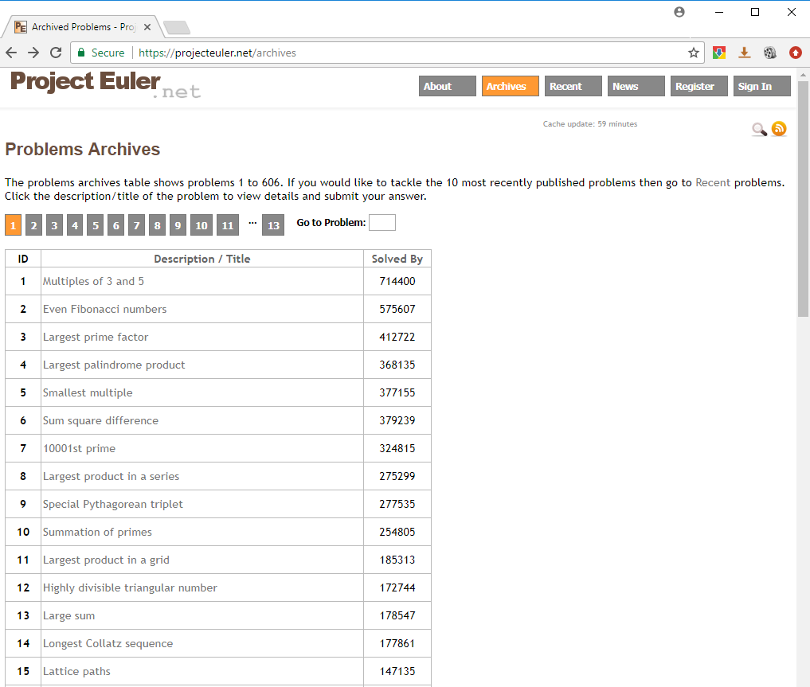
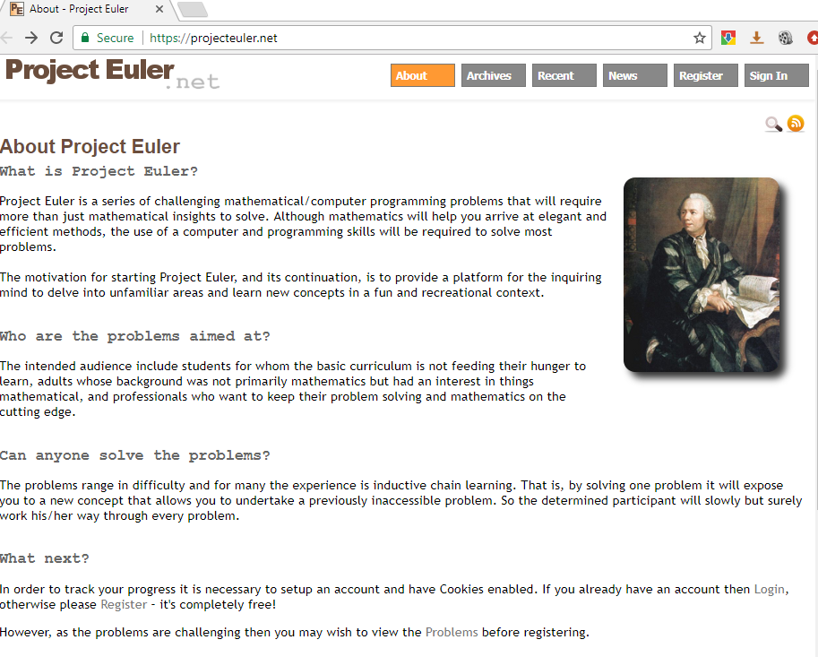

Slide 13
Example
https://projecteuler.net/
Exercise Multiples of 3 and 5

Slide 14
Example
https://projecteuler.net/
Exercise Multiples of 3 and 5
Problem 1
If we list all the natural numbers below 10 that are multiples of 3 or 5, we get 3, 5, 6 and 9. The sum of these multiples is 23.
Find the sum of all the multiples of 3 or 5 below 1000.

Slide 15
Example
https://projecteuler.net/
Exercise Multiples of 3 and 5
Problem 1
If we list all the natural numbers below 10 that are multiples of 3 or 5, we get 3, 5, 6 and 9. The sum of these multiples is 23.
Find the sum of all the multiples of 3 or 5 below 1000.
How to solve this using Java?
Write a simple Java program to calculate the answer

Slide 16
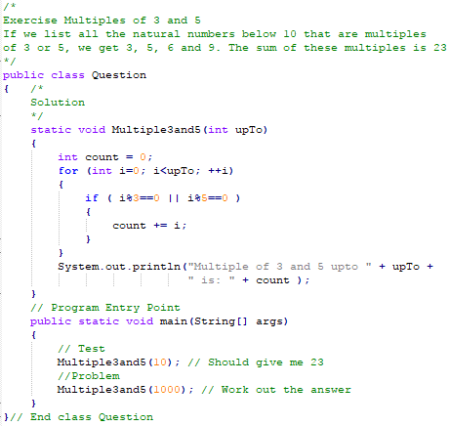
My Example Answer

Slide 17
Answer
Output
Multiple of 3 and 5 upto 10 is: 23
Multiple of 3 and 5 upto 1000 is: 233168
Submit your answer to https://projecteuler.net/. Only then will it allow you to continue to the next question (only if your answer is correct)

Slide 18
Summary
Today writing Java programs to solve various problems (sharpen your abilities)
https://projecteuler.net/
Allow you to review concepts/principles
e.g., look online/review slides/exercises, ..
Hands-On/Practical

Slide 19
This Week
Read Chapters
Review Slides
Exam 2nd January
Revising Regularly
Practicing/Reviewing Material

Slide 20
Questions/Discussion
Let me know how many questions you complete in the first 1 hour
Optionally work as teams

