Slide 1
Graphics
Object Orientated Programming in Java
Benjamin Kenwright

Slide 2
Outline
Essential Graphical Principals
JFrame Window (Popup Windows)
Extending JFrame
Drawing from paintComponent
Drawing images/text/graphics
Today’s Practical
Review/Discussion

Slide 3
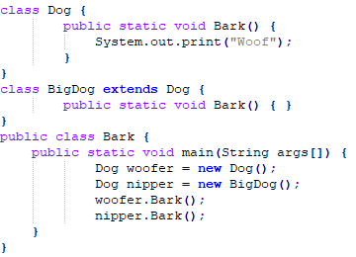
Revision Question
Will the following code compile? If yes then what will be the output?
javac Bark.java
java Bark

Slide 4
Answer
Compile: Yes
Output: WoofWoof

Slide 5
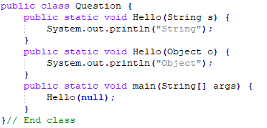
Question
Will the following code compile? If yes then what will be the output?

Slide 6
Answer
Compile: Yes
Output: String

Slide 7
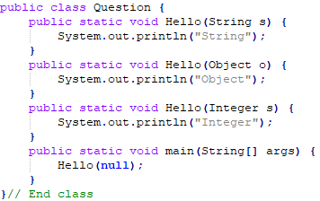
Question
Will the following code compile? If yes then what will be the output?

Slide 8

Answer
Compile: No
Reason: Method is ambiguous

Slide 9
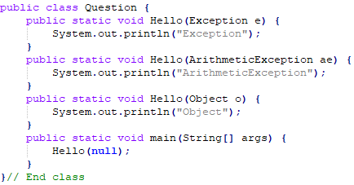
Question
Will the following code compile? If yes then what will be the output?

Slide 10
Answer
Compile: Yes
Output: ArithmeticException

Slide 11
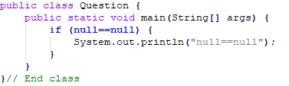
Question
Will the following code compile? If yes then what will be the output?

Slide 12
Answer
Compile: Yes
Output: null==null

Slide 13
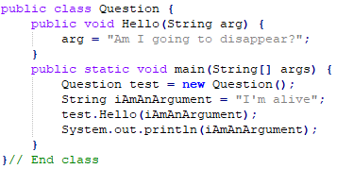
Question
Will the following code compile? If yes then what will be the output?

Slide 14
Answer
Compile: Yes
Output: I’m alive

Slide 15
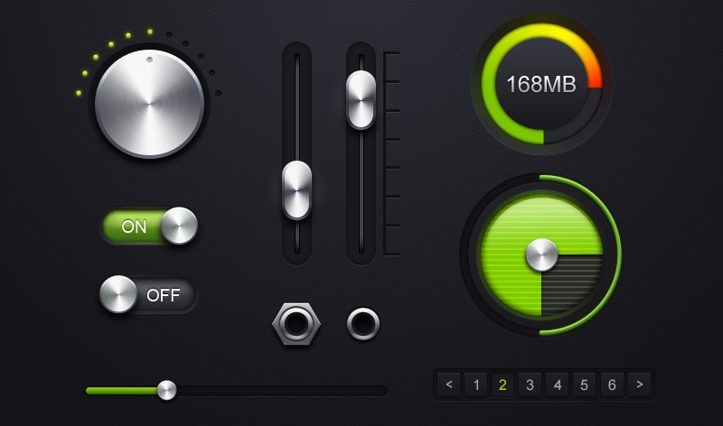
Graphics
How do you draw `complex’ diagrams?
Customize/control what is drawn on our windows
Animated clocks, bar-charts, images,

Slide 16
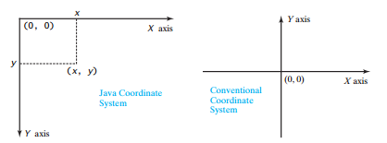
Graphical Coordinate System

Slide 17
JFrame
Simple GUI Window
Lets us perform simple drawing operations
Basic Usage
Instantiate the JFrame and assign text for the title bar
JFrame frame = new Jframe(‘Title’);
Specify size
frame.setSize(width, height)
Designate that closing the window ends the program
frame.setDefaultCloseOperation(JFrame.EXIT_ON_CLOSE);
Show the window
frame.setVisible(true);

Slide 18
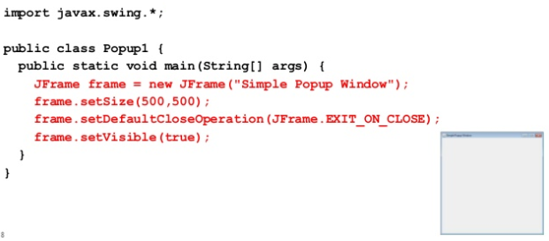
Using JFrame

Slide 19
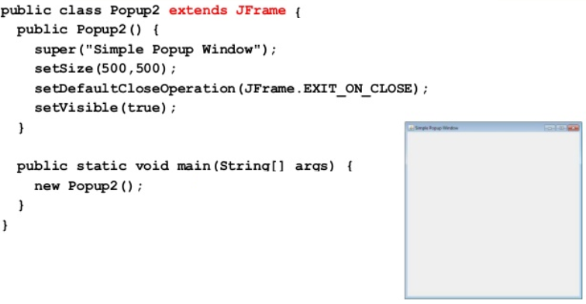
Extending JFrame

Slide 20
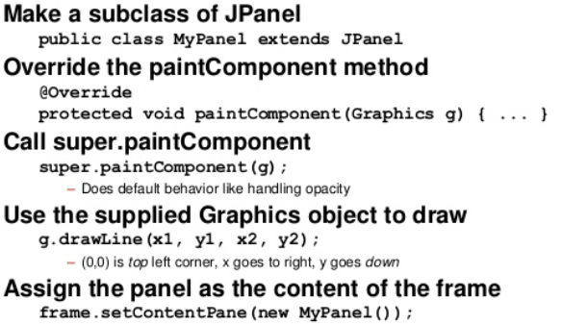
Basic Drawing

Slide 21
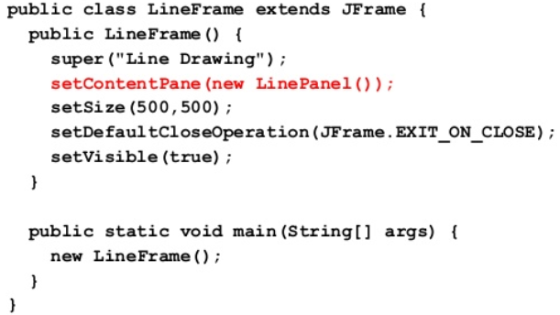
Example JFrame

Slide 22
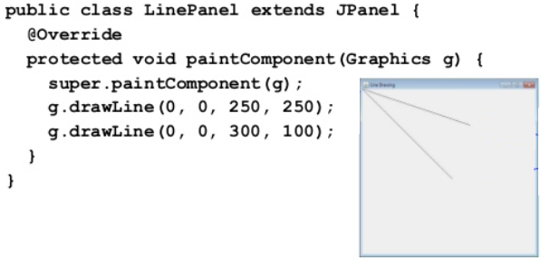
Example JPanel

Slide 23
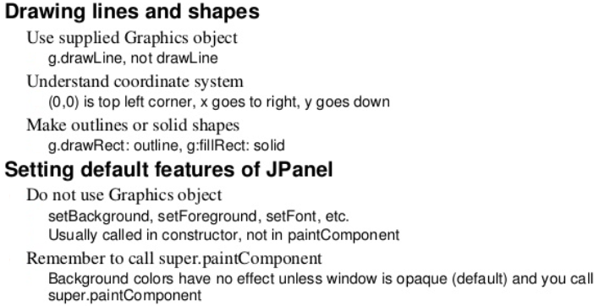
Drawing Methods

Slide 24
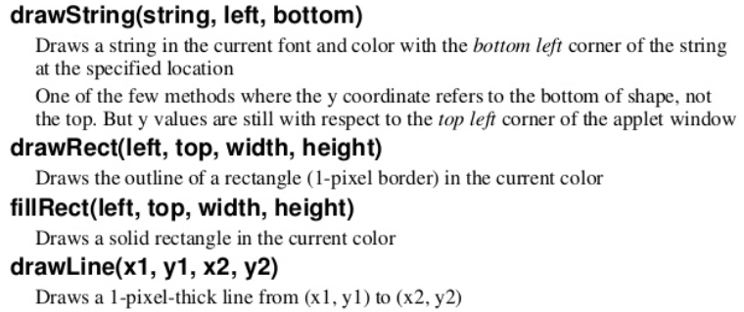
Graphics Class Methods

Slide 25
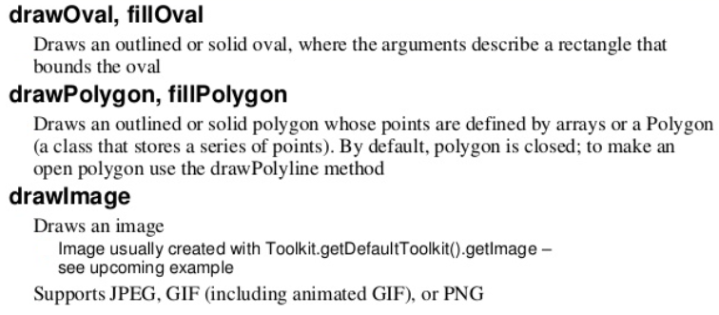
Graphics Class Methods

Slide 26
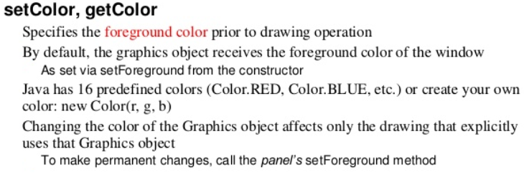
Graphics Class Methods

Slide 27
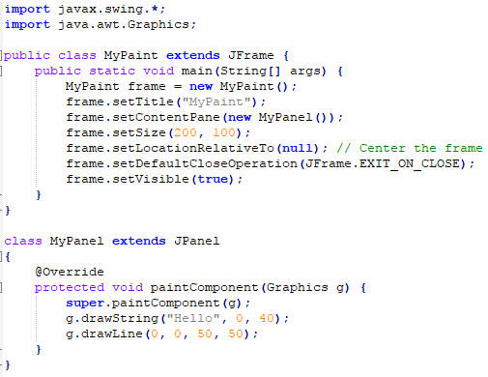
Question
What would be the output
of this program?
Sketch on paper what the
output would look like

Slide 28
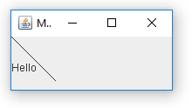
Answer
javac MyPaint.java
java –cp . MyPaint

Slide 29
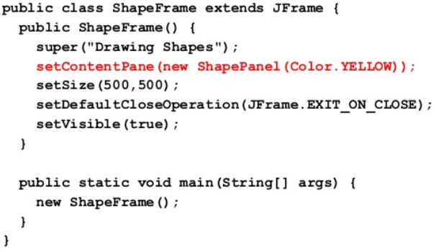
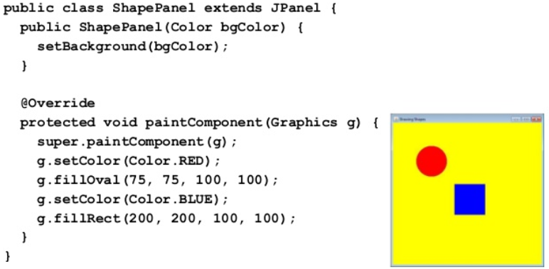
Example
1
2

Slide 30
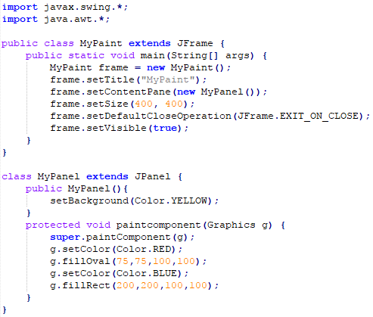
Question
What will the output
for the following program?

Slide 31
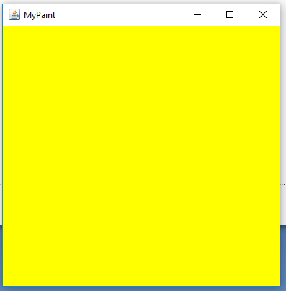
Answer

Slide 32
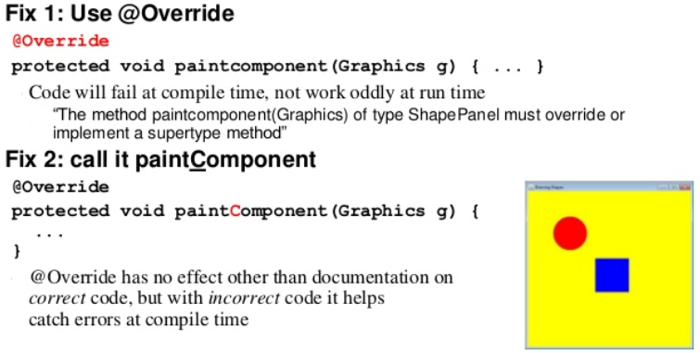
Fixing Problems

Slide 33
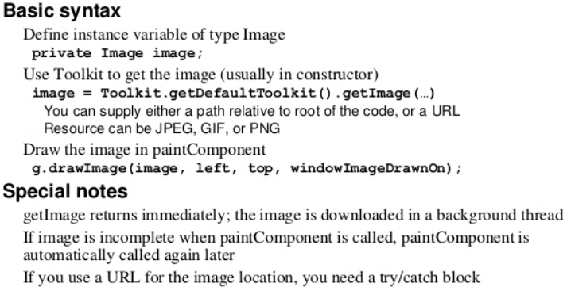
Drawing Images

Slide 34
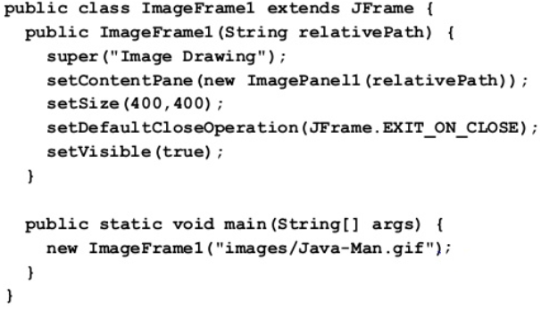
Images

Slide 35
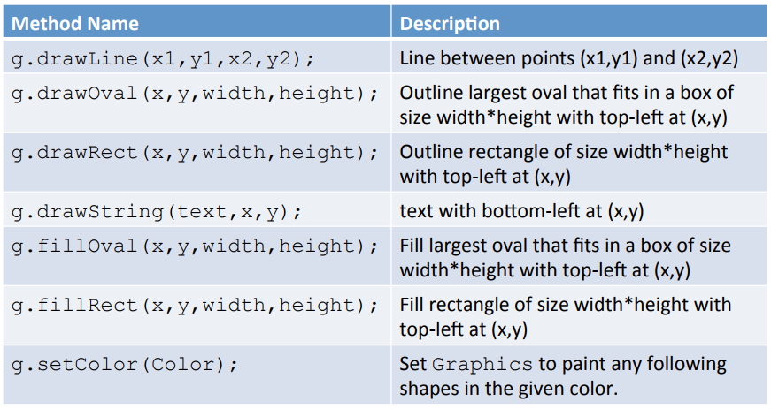
Review Basic Graphic Methods

Slide 36
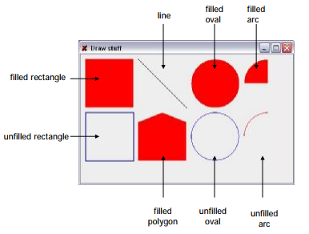
Question
Write down the graphics methods you’d use to draw the following output:

Slide 37
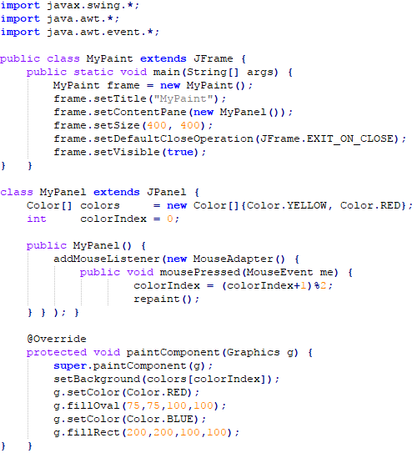
Question
What would the following
program output?
javac MyPaint.java
java –cp . MyPaint

Slide 38
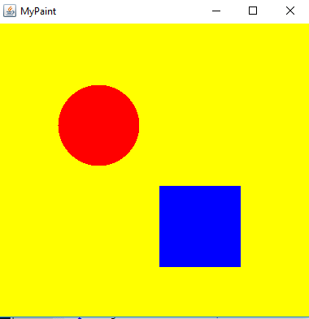
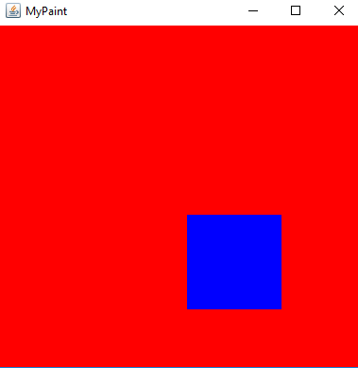
Answer
Left mouse button is pressed

Slide 39
Force Redraw
To notify Java to redraw our window (i.e., call paintComponent)
call ‘repaint()’
For example, add new graphics each time the mouse button is pressed

Slide 40
Review
Graphics can be drawn using a class which extends JPanel
Swing will call the paintComponent method to draw:
protected void paintComponent(Graphics g);
There are a variety of drawing methods:
drawLine(int x1, int y1, int x2, int y2);
drawRect(int x, int y, int w, int h);
drawOval(int x, int y, int w, int h);
drawPolygon(int[] xpoints, int[] ypoints, int npoints);

Slide 41
Other Graphics Capabilities
Lots of GUI Controls
Buttons, sliders, checkboxes, tables, etc
which you can override and improve
Rich 2D drawing
Line properties, translucent drawing, rotating, scaling images, coordinate transforms, ...
Animation
Double-buffering, combining drawing with threads, ..

Slide 42
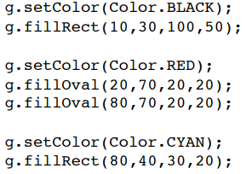

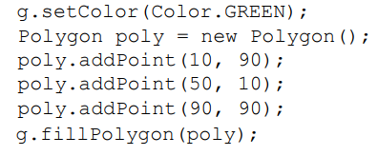

Examples

Slide 43
Experiment
Only scratched the surface of Graphics
Very simple windows and graphics
Combine the graphics with GUI components
Buttons/menus
Custom ‘interfaces’ components
e.g., Override default draw method for a button to create a new improved button look
Events
Mouse button presses (drawing program)
Timing (animations)

Slide 44
Challenge
Create a simple vector drawing program in Java
Clear/load/save drawings
Select buttons for different operations
line, circle, color, ...
Detect mouse button presses
draw lines, drag shapes, pick objects

Slide 45
Summary
Overview Essential Graphical Principles
JFrame, JPanel, paintComponent, @Override (Checking)
Hands-On/Practical
Today is about Graphics with Java
Drawing

Slide 46
This Week
Read Associated Chapters
Comprehensive Edition (Additional Chapters)
Review Slides
Java Exercises
Online Quizzes

Slide 47
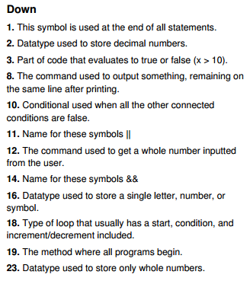
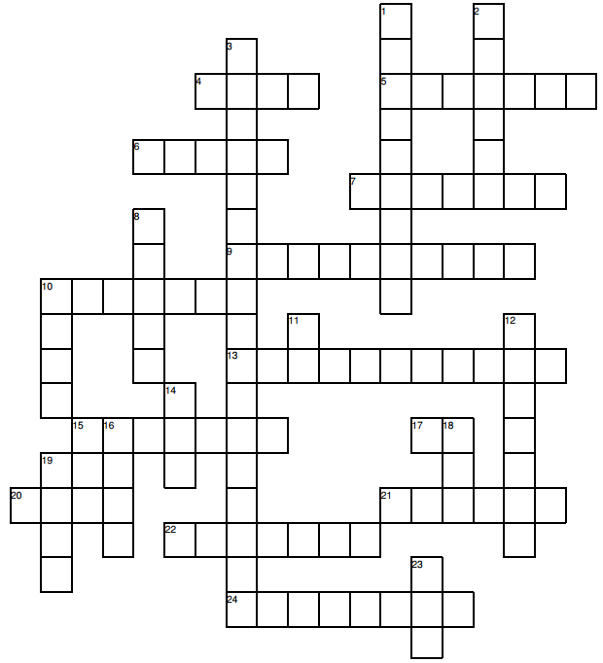
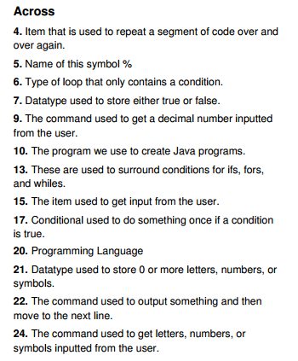
Crossword
s
e
m
i
c
o
l
o
n
o d u l u s

Slide 48
Exercises
Chapter exercises 15.1-15.3
Comment your code
Remember to zip the files together
The name of the .zip file should be your student number
(e.g., 39293923923.zip)

Slide 49
Questions/Discussion

Slide 50
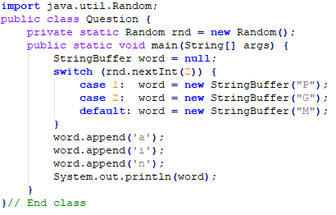
Revision Question
What does the following program print?
Pain, Gain or Main (varies randomly)
Pain or Main (varies randomly)
Main (always)
None of the above

Slide 51
Answer
Investigate for next week...

Slide 52
