Slide 1
Internal Classes and Exceptions
Object Orientated Programming in Java
Benjamin Kenwright

Slide 2


Slide 3
Outline
Exceptions and Internal Classes
Why exception handling makes your code more manageable and reliable
Today’s Practical
Review/Discussion

Slide 4
Question
Have you ever had a program crash?

Slide 5
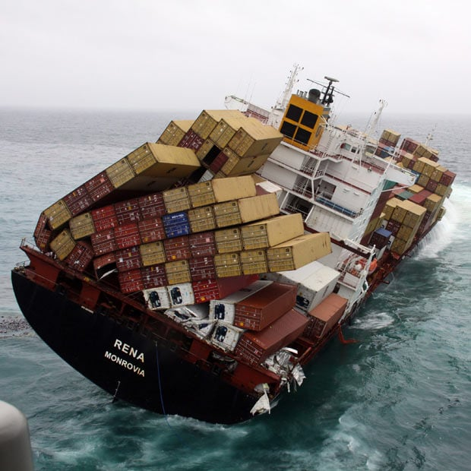
What happens when Program Crashes?

Slide 6
Software Reliability
Why did the program crash?
How could you have prevented the program from crashing?
Who’s fault was it?

Slide 7

Exception Handling
Error handling in general
Java's exception handling mechanism
The catch-or-specify principle
Checked and unchecked exceptions
Exceptions impact/usage
Overloaded methods
Interfaces
Inheritance hierarchies
Constructors

Slide 8
Error Handling
Not all errors can be caught at compile time!
Help -- run-time error! What next …?
First ideas:
System.out.println()
System.err.println() (much better than the previous)
Good guess but some errors call for corrective action, not just warning
In general, printing is a bad idea!
Better: tell someone (not necessarily the user)!

Slide 9
Error Handling, cont.
Establish return code convention
0 vs. !0 in C/C++
boolean in Java
Set value of a global variable
Done in many shells.
In Java use a public static field in a class
Raise an exception, catch it, and act
The idea comes from hardware
Modern language support (Java, Python, Lisp, Ada, C++, C#)

Slide 10
General Errors and Error Handling
Error must be handled
One error in a method can be handled very differently in the clients, this is not a good approach
Can be extremely hard to debug
To handle an error detailed information on the error must be provided
Where did the error occur (class, method, line number)
What type of error
A good error message
Dump of runtime stack? (too much information?)
In object-oriented languages errors are represented by objects

Slide 11
How to Handle Errors
Ignore: False alarm just continue
Report: Write a message to the screen or to a log
Terminate: Stop the program execution.
Repair: Make changes and try to recover the error
To be able to repair would be the best. However, often the best that can be done is the combination of report and terminate

Slide 12
Java's Exception Handling
Exception: An event that occurs during the execution of a program the disrupts the normal transaction flow
A run-time phenomenon
Exception handling is part of the language
Exceptions are objects
Exceptions are structured in a class hierarchy.
It is not possible to ignore an exceptions (nice feature?)
A method specifies, which exception may occur, the client must anticipate these exceptions, otherwise compile-time error
It is sometimes possible to recover to a known good state after an exception was raised

Slide 13
Java's Exception Handling, cont.
Java’s object-oriented way to handle errors
more powerful, more flexible than using return
keywords try, catch, throw, throws, finally
An exception is an object that describes an erroneous or unusual situation
Exceptions are thrown by a program, and may be caught and handled by another part of the program
A program can therefore be separated into a normal execution flow and an exception execution flow
An error is also represented as an object in Java, but usually represents a unrecoverable situation and should not be caught

Slide 14
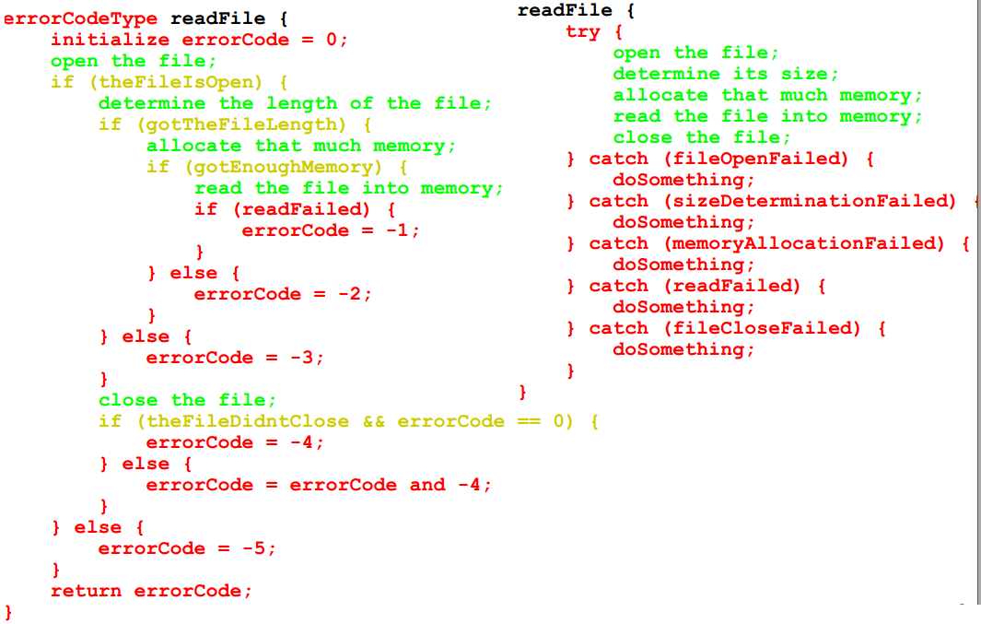
Motivation for Exception Handling

Slide 15
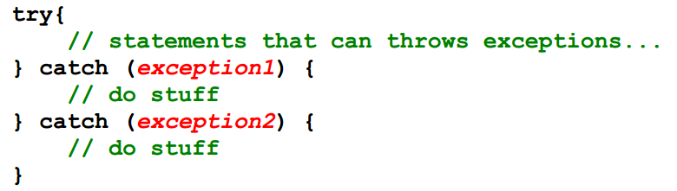
Exception Handling Model
Code where you anticipate a problem:
Detect error, probably with an if create a new exception and throw it
Alternatively let JVM detect error, create, and throw an exception
Code in client (somewhere in message invocation stack)
try, hoping for the best
prepare to catch an exception

Slide 16
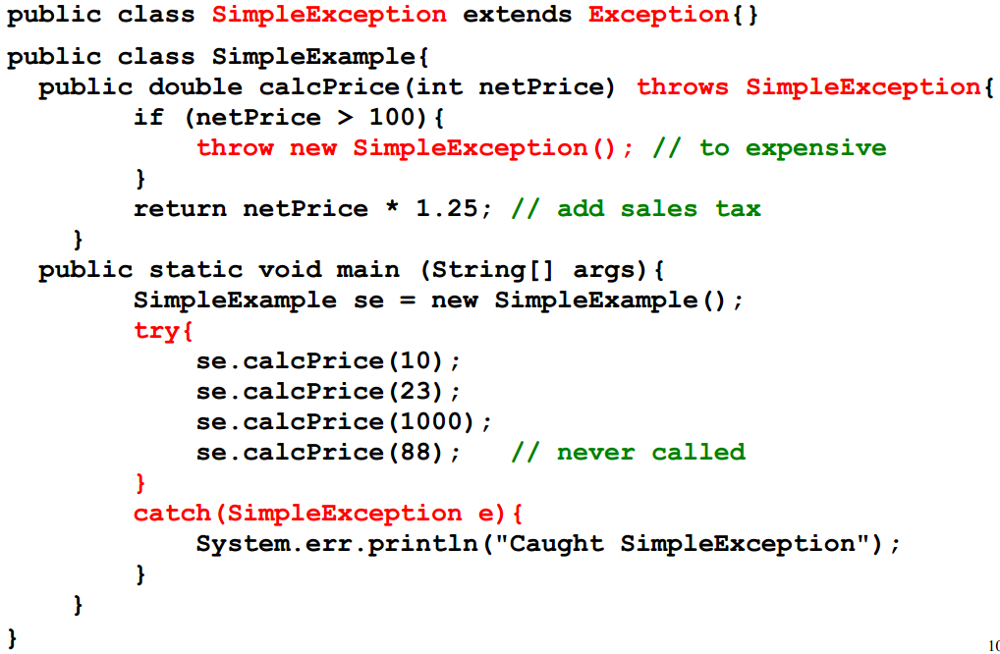
Simple Example

Slide 17
Java's Catch or Specify Requirement
Catch
A method can catch exception by providing and exception handler
Specify
If a method chooses not to catch, then specify which exceptions are thrown
Exceptions are part of a method's public interface

Slide 18
Checked/Unchecked Exceptions
An exception is either checked or unchecked
Checked = checked by the compiler
A checked exception can only be thrown within a try block or within a method that is designated to throw that exception
The compiler will complain if a checked exception is not handled appropriately
An unchecked exception does not require explicit handling, though it could be processed that way.
An example many run-time exceptions are unchecked exceptions

Slide 19
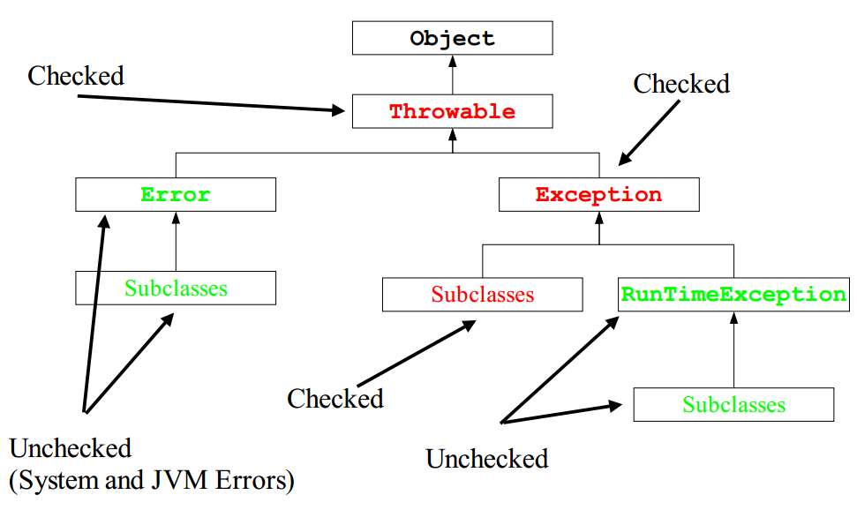
Java's Exception Class Hierarchy

Slide 20
Java's Exception Class Hierarchy, cont.
Throwable
Superclass for all exceptions
Two methods for filling in and printing the stack
Error
Serious internal errors (should not occur in running programs).
Are normally not handled. (report and terminate)
Programs should not throw Error
The catch or specify principle does not apply, because they are so severe
Examples
Dynamic linking failure
Memory shortage
Instantiating abstract class

Slide 21
Java's Exception Class Hierarchy, cont.
Exception
The base class for most exception used in Java programs
The catch or specify principle does apply
Examples of subclasses
IOException
ClassNotFoundException
RuntimeException
Not a good name (all exceptions are at run-time)!
Commonly seen run-time error
The catch or specify principle does not apply, because they are so ubiquitous.
Examples
Divide by zero/Cast error/Null pointer

Slide 22
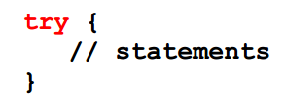
The try Statement
To process an exception when it occurs, the line that throws the exception is executed within a try block
A try block is followed by one or more catch clauses, which contain code to process an exception
Each catch clause has an associated exception type

Slide 23
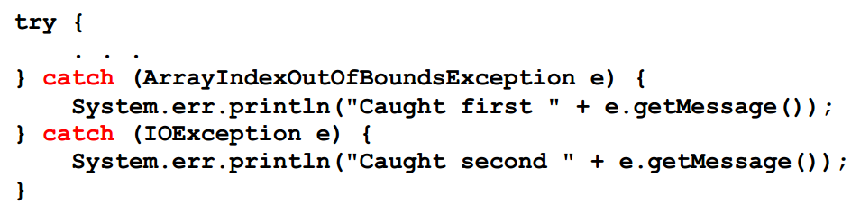
The catch Statement
The catch statement is used for catching exceptions.
A try statement must be accompanied by a catch statement
Try and catch statements can be nested, i.e., try block in try block, etc.

Slide 24
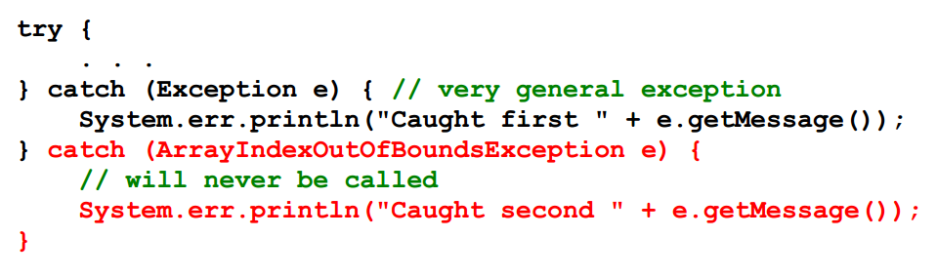
The catch Statement, cont.
When an exception occurs, processing continues at the first catch clause that matches the exception type
The catch statements should be should be listed in most-specialized-exception-first order

Slide 25
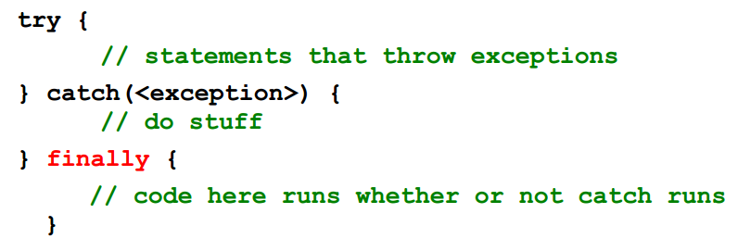
The finally Clause
A try statement can have an optional clause designated by the reserved word finally
If no exception is generated, the statements in the finally clause are executed after the statements in the try block complete.
Also, if an exception is generated, the statements in the finally clause are executed after the statements in the appropriate catch clause complete.

Slide 26
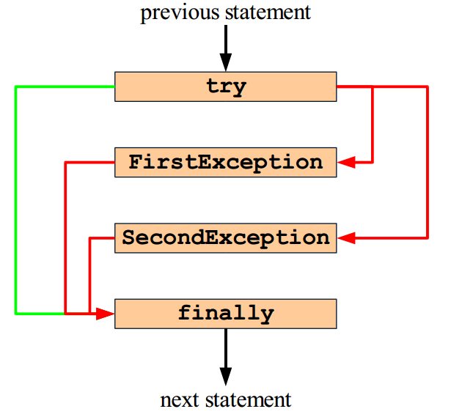
The finally Clause, cont.

Slide 27
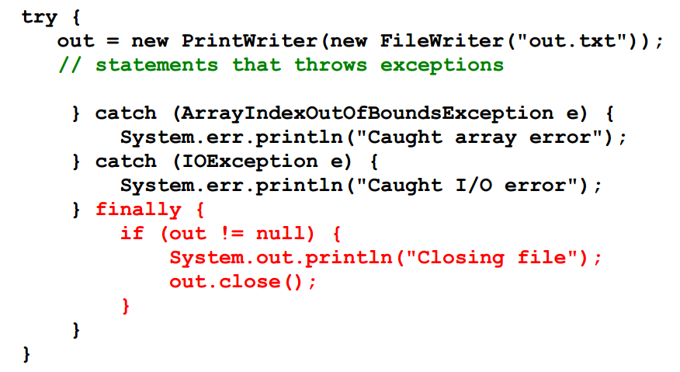
The finally Clause, Example

Slide 28
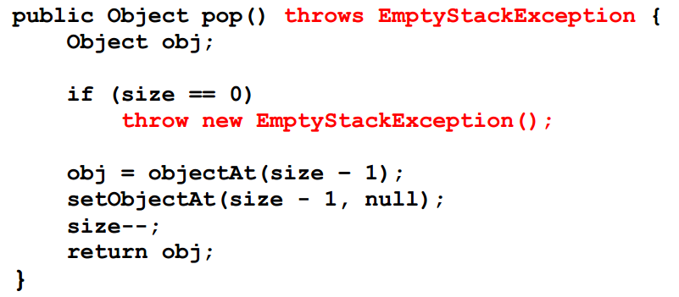
The throw Statement
All methods use the throw an exception

Slide 29
Exception Propagation
If it is not appropriate to handle the exception where it occurs, it can be handled at a higher level
Exceptions propagate up through the method calling hierarchy until they are caught and handled or until they reach the outermost level
A try block that contains a call to a method in which an exception is thrown can be used to catch that exception

Slide 30
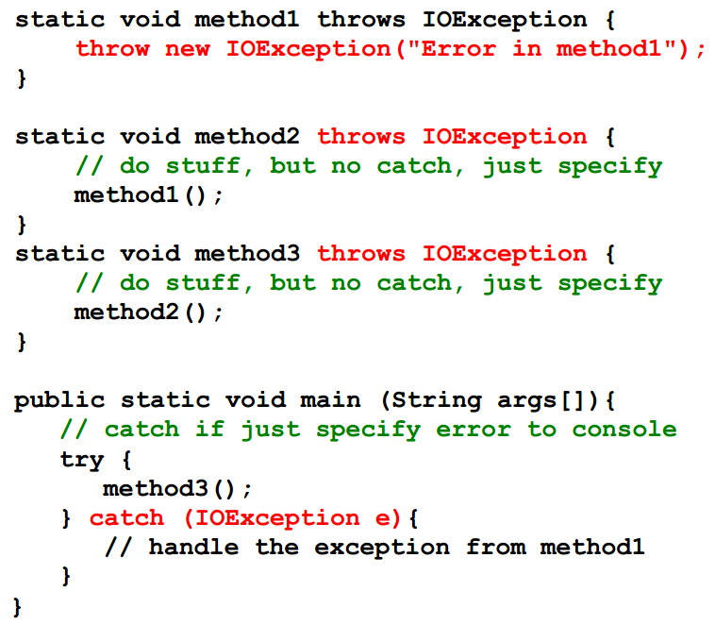
Exception Propagation, Example

Slide 31
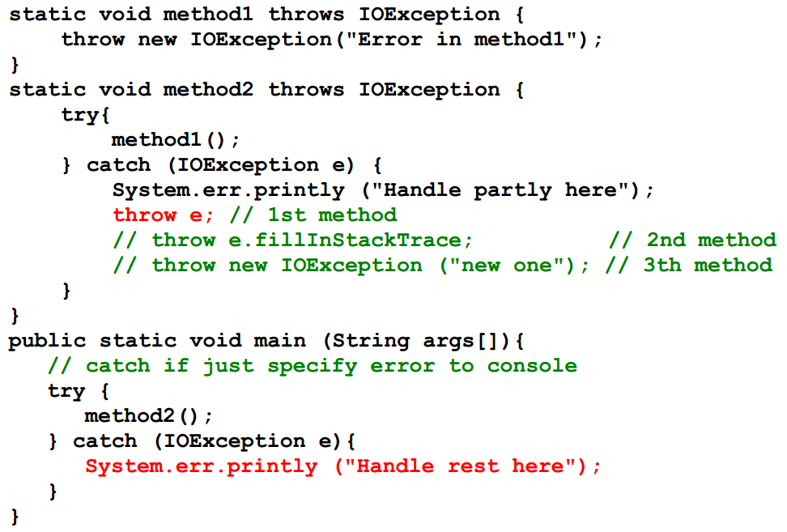
Rethrowing an Exception

Slide 32
Creating New Exceptions
Requires careful design (part of the public interface)
Choose the correct superclass
Choosing the name
The most important thing for new exceptions
Tends to be long and descriptive (ArrayIndexOutOfBoundsException)
Code for exception class typically minimal
Naming convention:
All classes that inherits from Exception has 'Exception' postfixed to their name.
All classes that inherits from Error has 'Error' postfixed to their name

Slide 33
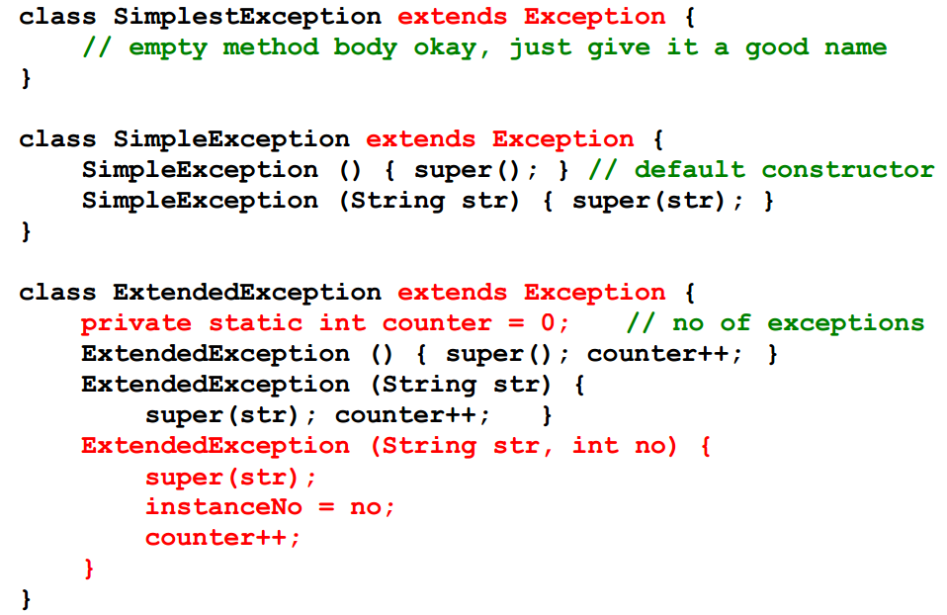
Creating New Exceptions, Example

Slide 34
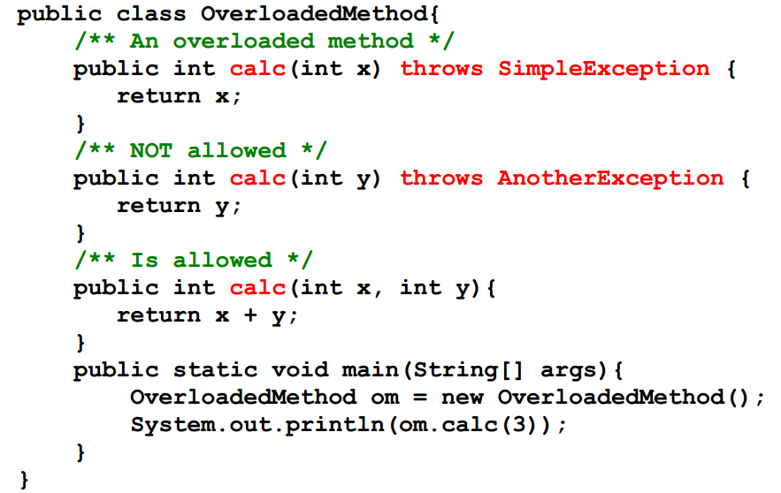
Overloading and Exception
Methods cannot be overloaded based on exception specification

Slide 35
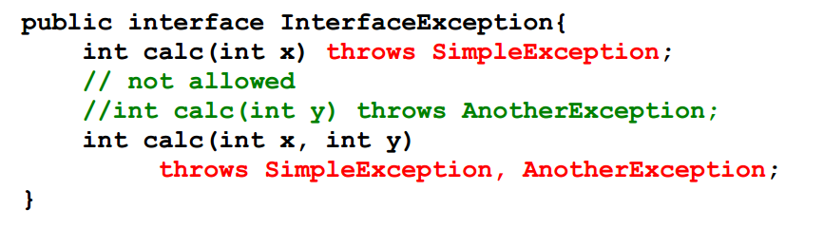
Interfaces and Exceptions
Exceptions can naturally be specified for methods in interfaces

Slide 36
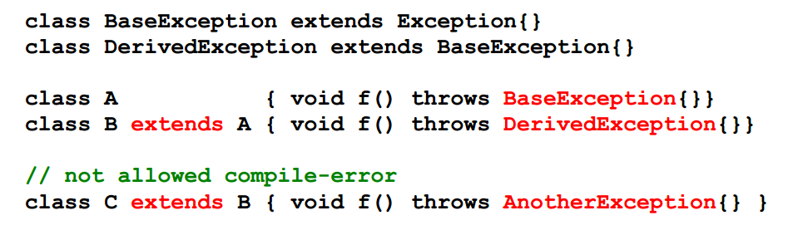
Inheritance and Exceptions
If base-class method throws an exception, derived-class method may throw that exception or one derived from it
Derived-class method cannot throw an exception that is not a type/subtype of an exception thrown by the base-class method
Otherwise subclass cannot be upcasted to base-class

Slide 37
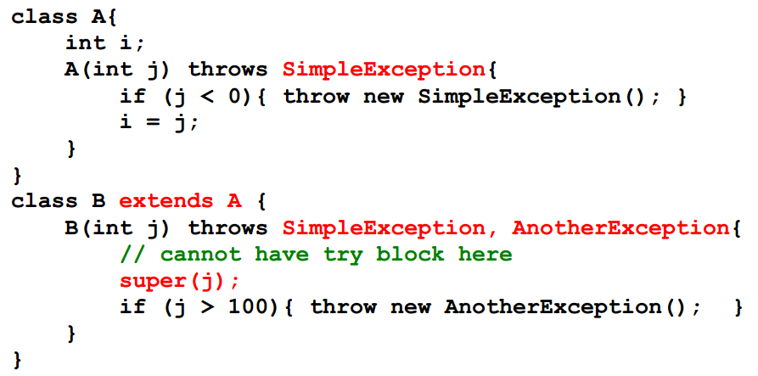
Inheritance and Constructors
Constructors can throw exceptions
Subclass constructor cannot catch exception thrown by a base class constructor

Slide 38
Guidelines
Do not use exceptions for normal control flow!
Slows down the program
Do use exceptions to indicate abnormal conditions!
Handle the error (fully or partially) if you have enough information in the current context. Otherwise, propagate!
Handle group of statements
Do not encompass every single statement in a try block
Use exceptions in constructors!
Do something with the exceptions your code catches!
Clean up using finally

Slide 39
Review
The manner in which an exception is processed is an important design consideration
Advantages of Exceptions
Separates error handling from “regular” code.
Propagation of errors up the call stack.
Handle error in a context
Grouping of error type and differentiation of errors.
Overview
Reuse of error handling code

Slide 40
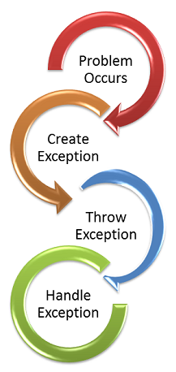
Summary
Overview Java Exceptions and Internal Classes
Hands-On/Practical
Today is about becoming comfortable/familiar with Exceptions

Slide 41
This Week
Read Associated Chapters
Review Slides
Java Exercises
Online Quizzes

Slide 42
Today’s Practical
Programming Exercises (Book):
Chapter 13.1-13.5
(Only code not UML)
Upload single .zip file containing all your java files (only java files).
www.zjnu.xyz
zip file name should be your student number, e.g., 29392929.zip
Remember to comment your code, name/student number at the top of files.
Organise your files so it’s clear to identify each exercise (e.g., file names/folders)
ch13_1.java, ch13_2.java, …

Slide 43
Questions/Discussion

