Slide 1
Classes and Objects
Object Orientated Analysis and Design
Benjamin Kenwright

Slide 2
Outline
Review Previous Weeks
  Object Model, Complexity, ..
What do we mean by Classes and Objects?
Summary/Discussion

Slide 3
Review
Last Week Object Model and Evolution of Software Engineering
Read Chapter 1, 2 and 3
Reviewing material regularly
  e.g., complexity, object orientated concepts, ..

Slide 4
Revision Question
Write down the four elements that Inherent Complexity derives from?

Slide 5
Answer
Inherent Complexity derives from four elements:
complexity of the problem domain
difficulty of managing the development process
flexibility possible through software
problems of characterizing the behavior of discrete systems

Slide 6
Revision Question
What are the three important parts of Object-Oriented Programming (OOP)?
a) uses objects; each object is an instance of some class; classes may be related to one another via inheritance
b) use modules; hierarchical structure; structures must be related to one another via inheritance
c) hierarchical structure; collection of objects; objects must be related to one another via polymorphism

Slide 7
Answer
a) uses objects; each object is an instance of some class; classes may be related to one another via inheritance

Slide 8
Revision Question
Why is modularity important?
Enables us to partitioning a program into individual components can reduce its complexity
Enables us to develop more optimised algorithms
Modularity causes issues with boundaries (or interfaces) within the program

Slide 9
Answer
a) Enables us to partitioning a program into individual components can reduce its complexity

Slide 10
Building Blocks
When we use object-oriented methods to analyze or design a complex software system, our basic building blocks are classes and objects

Slide 11

What Is and What Isn’t an Object?

Slide 12
What Is and What Isn’t an Object?
An object is an entity that has state, behavior, and identity. The structure and behavior of similar objects are defined in their common class. The terms instance and object are interchangeable

Slide 13
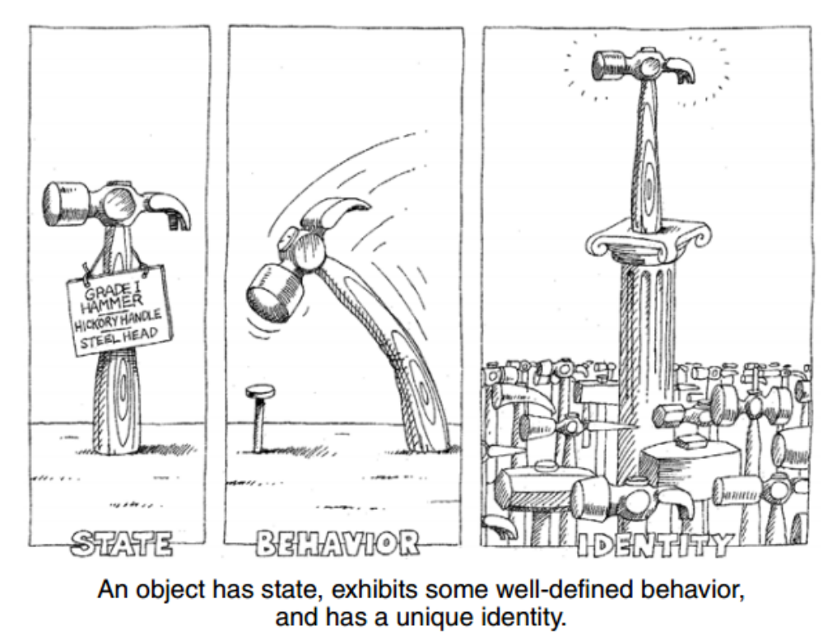

Slide 14
Question
An object is an entity that has:
state, action, dependencies
identity, state, behavior
c) behaviour, action, state
d) class, state, memory

Slide 15
Answer
b) identity, state, behavior

Slide 16
State
The state of an object encompasses all of the (usually static) properties of the object plus the current (usually dynamic) values of each of these properties.

Slide 17
Behavior
Behavior is how an object acts and reacts, in terms of its state changes and message passing.

Slide 18
Identity
Identity is that property of an object which distinguishes it from all other objects

Slide 19
Question
State is how an object acts and reacts, in terms of its state changes and message passing
True
False

Slide 20
Answer
b) False
Behavior is how an object acts and reacts, in terms of its state changes and message passing.

Slide 21
What Is and What Isn’t a Class?

Slide 22
What Is and What Isn’t a Class?
A class is a set of objects that share a common structure, common behavior, and common semantics
A single object is simply an instance of a class
What isn’t a class?
  An object is not a class. Objects that share no common structure and behavior cannot be grouped in a class because, by definition, they are unrelated except by their general nature as objects

Slide 23
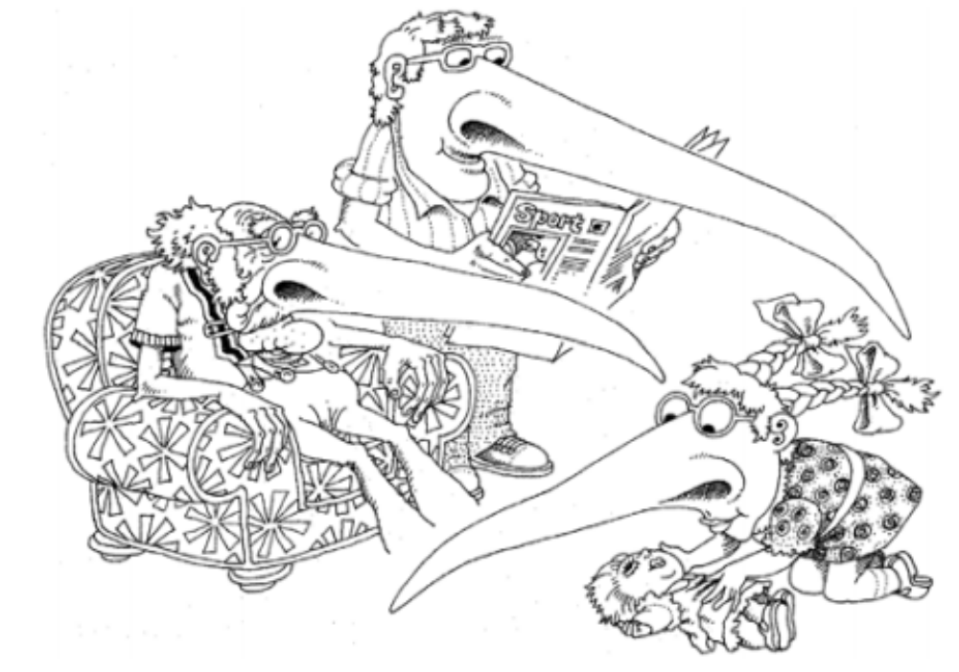
Inheritance

Slide 24
Inheritance
Inheritance is an interesting concept for representing concrete relationships
  Including generalization/specialization relationships
A subclass may inherit the structure and behavior of its superclass

Slide 25
Polymorphism
Generally, the ability to appear in many forms. In object-oriented programming, polymorphism refers to a programming language's ability to process objects differently depending on their data type or class. More specifically, it is the ability to redefine methods for derived classes
Helps develop more concise clean error free code
  Without polymorphism, the developer ends up writing code consisting of large
  case or switch statements (conditional logic)
Inheritance without polymorphism is possible, but it is certainly not very useful
Polymorphism and late binding go hand in hand

Slide 26
The Role of Classes and Objects in Analysis and Design
During analysis and the early stages of design, the developer has two primary tasks:
1. Identify the classes that form the vocabulary of the problem domain
2. Invent the structures whereby sets of objects work together to provide the
behaviors that satisfy the requirements of the problem

Slide 27
Measuring the Quality of an Abstraction
How can one know if a given class or object is well designed?

Slide 28
Measuring the Quality of an Abstraction
Five meaningful metrics to measure the quality of abstraction are:
1. Coupling
2. Cohesion
3. Sufficiency
4. Completeness
5. Primitivenes

Slide 29
Question
What are the five meaningful metrics to measure the quality of abstraction?
a) Contracts, Cohesion, Completeness, Primitivenes, Sufficiency
b) Cohesion, Coupling, Sufficiency, Completeness, Primitivenes
c) Coupling , Cohesion, Safety, Completeness, Primitivenes

Slide 30
Answer
b) Cohesion, Coupling, Sufficiency, Completeness, Primitivenes

Slide 31
Design Decisions
Criteria to be considered when making class design decisions:
  Reusability: Would this behavior be more useful in more than one context?
  Complexity: How difficult is it to implement the behavior?
  Applicability: How relevant is the behavior to the type in which it might be placed?
  Implementation knowledge: Does the behavior’s implementation depend on the internal details of a type?

Slide 32

Discussion Activity
Explain some of the trade-offs decisions that might be made during the analysis and design of a software project?

Slide 33
Summary
Clear understanding of classes and objects
An object has state, behavior, and identity
The structure and behavior of similar objects are defined in their common class
Behavior is how an object acts and reacts in terms of its state changes and message passing

Slide 34
This Week
Review Slides
Quizzes Online
Read Chapter 4

Slide 35

Questions/Discussion

Slide 36
Question
Identity is that property of an object which distinguishes it from all other objects
True
False

Slide 37
Answer
a) True

Slide 38
Question
A class is the same as an object. Objects share common structure and behavior as a class because and by definition are related by their general nature as objects
True
False

Slide 39
Answer
b) False
An object is not a class. Objects that share no common structure and behavior cannot be grouped in a class because, by definition, they are unrelated except by their general nature as objects

