Slide 1
Java Basics
Object Orientated Programming in Java
Benjamin Kenwright

Slide 2
Outline
Essential Java Concepts
  Syntax, Grammar, Formatting, …
  Introduce Object-Orientated Concepts
    Encapsulation, Abstract Data, OO Languages,…
Today’s Practical
Review/Discussion

Slide 3
Last Week
Compile Java Programs
  Javac.exe/Java.exe
Setup IDE
Basic Programs
  Hello World
Simple Debugging
  e.g., Program entry point, hello worlds, print out (println..)
Read Chapters 1 & 2

Slide 4
Question
Java is case sensitive?
A. True
B. False

Slide 5
Answer
A. True

Slide 6
Question
What will be output of x in following code? "class Test{ public static void main(String[] args) { int x = 1; if (x == 1) { x = x + 1} } }"
A. 0
B. 1
C. 2
D. 3
E. Compile Error

Slide 7
Answer
E. Compile Error
Missing semi-colon (;)
C:\pro\zjnu2017.github.io\OOP\examples

Slide 8
Question
What will be output of x in following code? "class Test{ public static void main(String[] args) { int x = 1; if (x == 1) { x = x + 1;} } }"
A. 0
B. 1
C. 2
D. 3
E. Compile Error

Slide 9
Answer
C. 2

Slide 10
Today
Exercises from Chapters 2, 4, 5 and 6
  Data types (boolean, int, string, ..)
  Loops (while, for, …)
  Conditional Logic (if, else, switch, ..)
  Math libraries
  Arrays
  Methods (calling and passing parameters)

Slide 11
Pure Object-Oriented Language
Everything is an object
A program is a set of objects telling each other what to do by sending messages
Each object has its own memory (made up by other objects)
Every object has a type
All objects of a specific type can receive the same messages
Java breaks some of these rules in the name of efficiency

Slide 12
Object Concept
An object is an encapsulation of data
An object has
  identity (a unique reference),
  state, also called characteristics
  behavior
An object is an instance of an abstract data type
An abstract data type is implemented via a class

Slide 13
Abstract Data Type (ADT)
An ADT is a collection of objects (or values) and a corresponding set of methods
An ADT encapsulates the data representation and makes data access possible at a higher level of abstraction
Example 1: A set of vehicles with operations for starting, stopping, driving, get km/litre, etc
Example 2: A time-interval, start time, end time, duration, overlapping intervals, etc

Slide 14
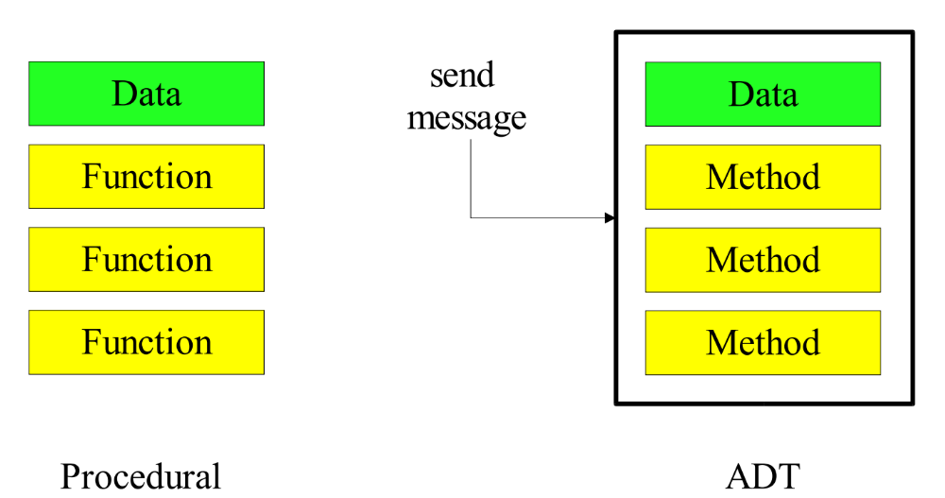
Encapsulation and Information Hiding
Data can be encapsulated such that it is invisible to the "outside world"
Data can only be accessed via methods

Slide 15
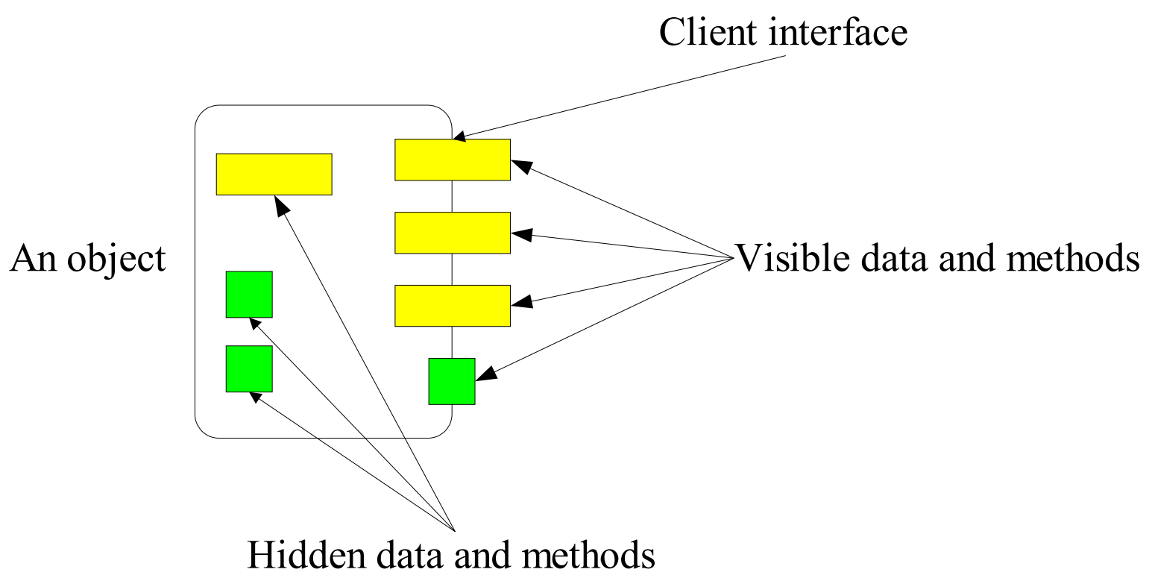
Encapsulation and Information Hiding
What the "outside world" cannot see it cannot depend on!
“Wall" between the object and the "outside world"
The hidden data and methods can be changed without affecting the "outside world"

Slide 16
Class vs. Object
Class
Object
A description of the common properties of a set of objects
A concept
A class is a part of a program
Example 1: Person
Example 2: Album
A representation of the properties of a single instance
A phenomenon
An object is part of data and a program execution
Example 1: Bill Clinton, Bono, Viggo Jensen
Example 2: A Hard Day's Night, Joshua Tree

Slide 17
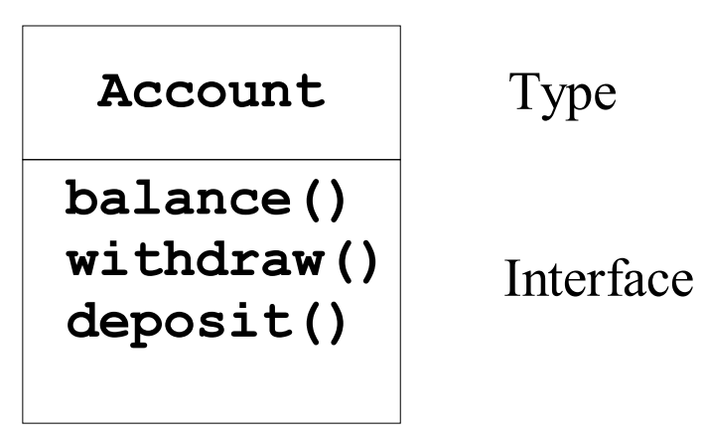
Type and Interface
An object has type and an interface
To get an object: Account a = new Account()
To send a message: a.withdraw()

Slide 18
Instantiating Classes
An instantiation is a mechanism where objects are created from a class
Always involves storage allocation for the object
A mechanism where objects are given an initial state
Static Instantiating
In the declaration part of a program
A static instance is implicitly created
Dynamic Instantiating
In the method part of a program
A dynamic instance is created explicitly with a special command

Slide 19
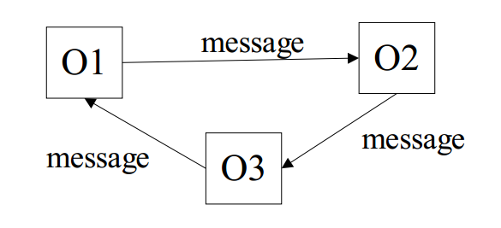
Interaction between Objects
Interaction between objects happens by messages being send
  A message activates a method on the calling object
An object O1 interacts with another object O2 by calling a method on O2
  “O1 sends O2 a message”
The call of a method corresponds to a procedure call in a non object-oriented language such as C or Pascal

Slide 20
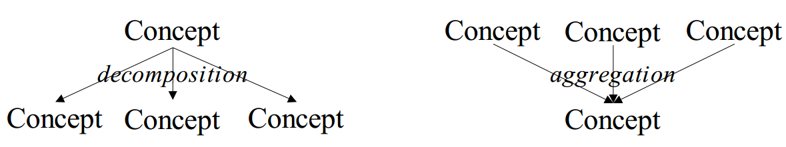
Aggregation and Decomposition
A decomposition splits a single concept into a number of (sub-)concepts
An aggregation consists of a number of (sub-)concepts which collectively is considered a new concept

Slide 21
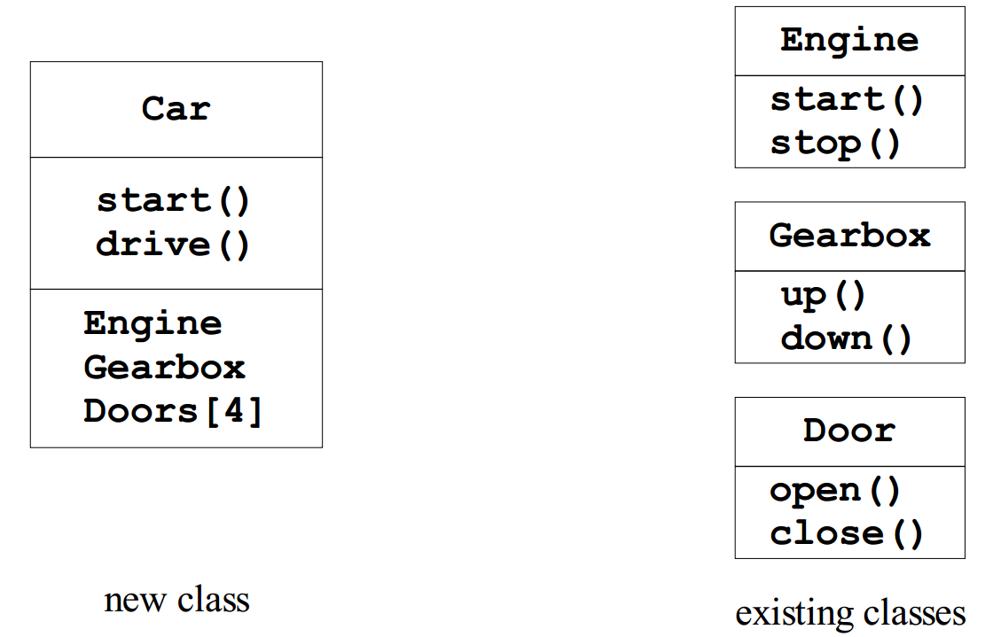
Aggregation and Decomposition, Example
Idea: make new objects by combining existing objects
Reusing the implementation

Slide 22
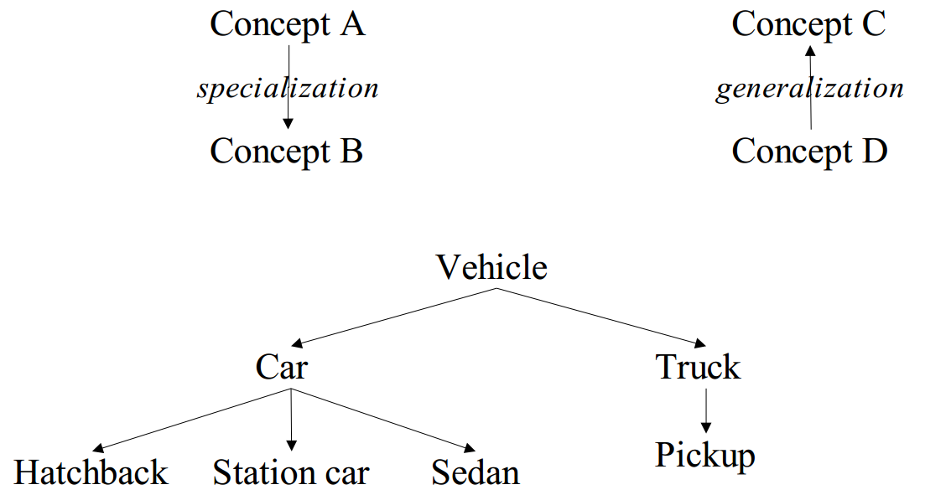
Generalization and Specialization
Generalization creates a concept with a broader scope
Specialization creates a concept with a narrower scope
Reusing the interface

Slide 23
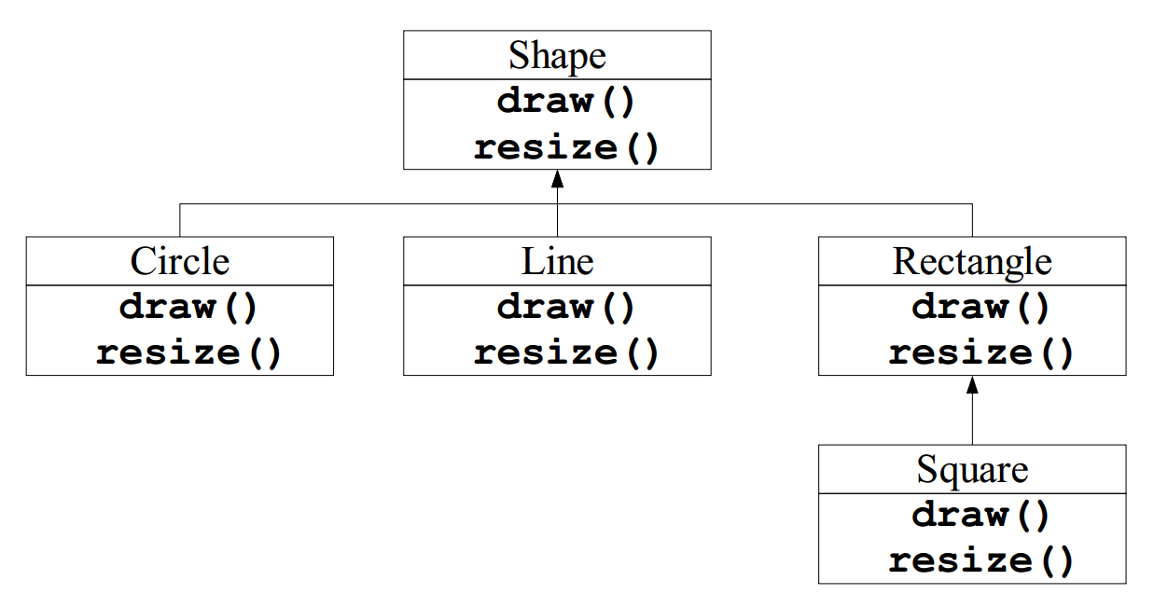
Generalization and Specialization, Example
Inheritance: get the interface from the general class
Objects related by inheritance are all of the same type

Slide 24
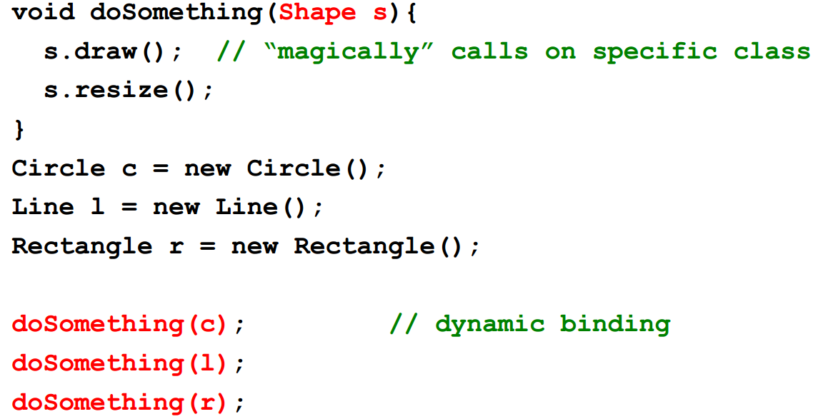
Code Example
Polymorphism: One piece of code works with all shape objects
Dynamic binding: How polymorphism is implemented

Slide 25
Structuring by Program or Data?
What are the actions of the program vs. which data does the program act on
  Top-down: Stepwise program refinement
  Bottom-up: Focus on the stable data parts then add methods
Object-oriented programming is bottom-up. Programs are structure with outset in the data
C and Pascal programs are typically implemented in a more top-down fashion

Slide 26

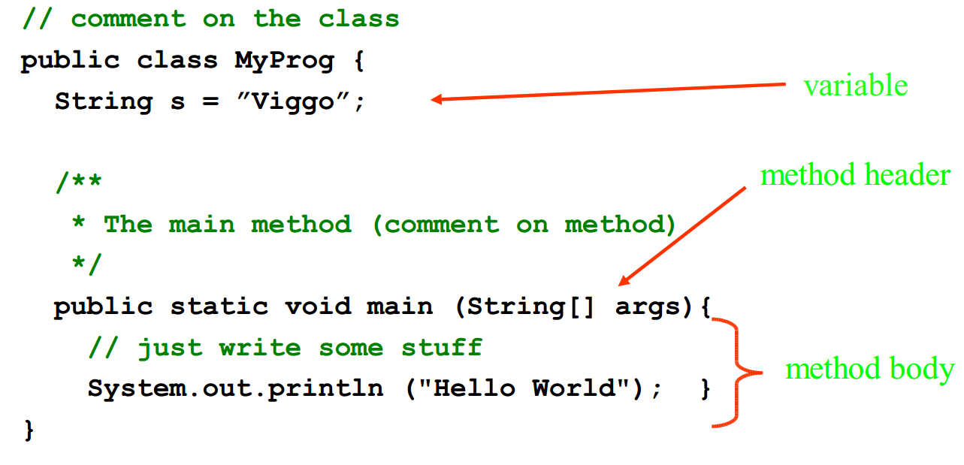
Review Java Program Structure

Slide 27
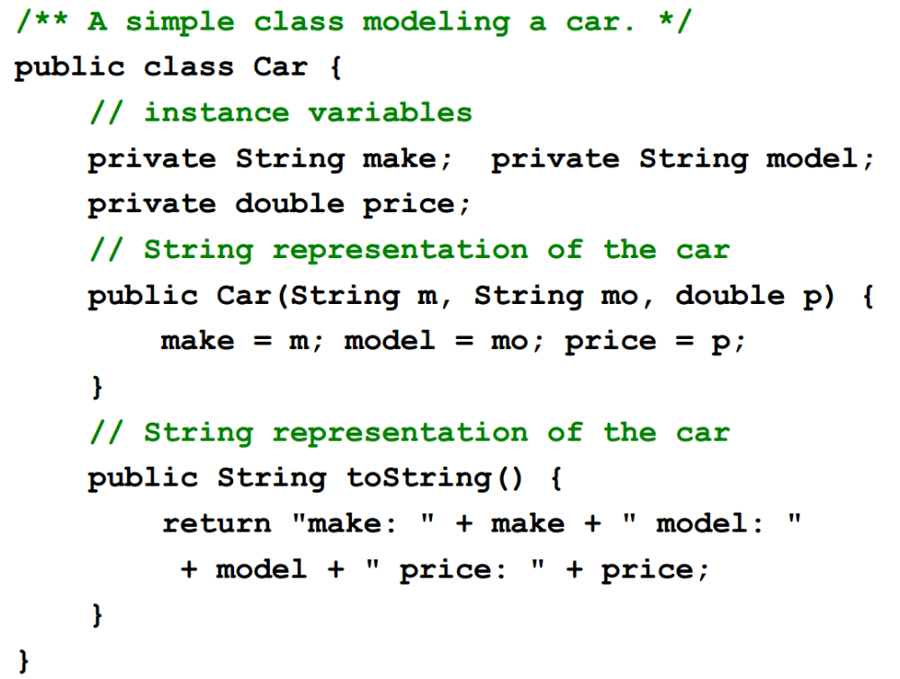
Java Class Example Car

Slide 28
Question
Is Java a `top-down’ or `bottom-up’ programming language?
A. `top-down’
B. `bottom-up’

Slide 29
Answer
B. `bottom-up’
Object-oriented programming is bottom-up. Programs are structure with outset in the data
In OOP, you first write a base class, and constantly derive new child classes from the existing base one (like a Car class will probably derive from a class called Vehicle). So, you start from the basic blocks and go on making it a more complex design.

Slide 30
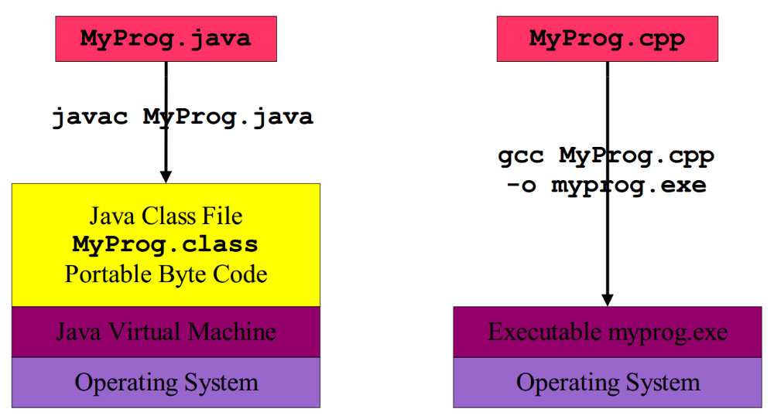
Byte Code vs. Executable

Slide 31
Difference from C/C++
Everything resides in a class
  variables and methods
Garbage collection
Error and exception handling
No global variables or methods
No local static variables
No separation of declaration and implementation (no header files).
No explicit pointer operations (uses references)
No pre-processor (but something similar)
Has fewer "dark corners"
Has a much larger standard library

Slide 32
Question
What displays from the following statements? String word = "abcde"; for (int i = 0; i <4; i+=2) System.out.print(word.charAt(i));
A. ab
B. ac
C. ace
D. bd
// access characters in a String using charAt(i) similar to word[i] in C language

Slide 33
Answer
B. ac

Slide 34
Review Concepts
Classes are "recipes" for creating objects
All objects are instances of classes
An ADT is implemented in a class
Aggregation and decomposition
  “has-a” relationship
Generalization and specialization
  “is-a” or “is-like-a” relationship
Encapsulation
  Key feature of object-oriented programming
  Separation of interface from implementation
  It is not possible to access the private parts of an object

Slide 35
This Week
Read Chapters 3, 4, 5, 6
Review Slides
Complete Java Chapter Exercises
  Practical Exercises
  Submit Exercises
Review `Quizzes’

Slide 36
Summary
Overview Essential Java Language Principles
Hands-On/Practical
Today is about becoming comfortable/familiar with Java and the Programming Syntax/Concepts

Slide 37
Questions/Discussion
Submit Exercise Questions
2.1 to 2.12
Single .zip file with your student number
Remember to comment your code, name/student number at the top of files, separate file for each exercise
ch2_1.java, ch2_2.java, …

