Slide 1
Introduction
Object Orientated Programming in Java
Benjamin Kenwright

Slide 2
Outline
What do we mean by Object Orientated Programming?
Why Java?
Structure of the Course
Assessment/Marking
Today’s Practical
Review/Discussion

Slide 3
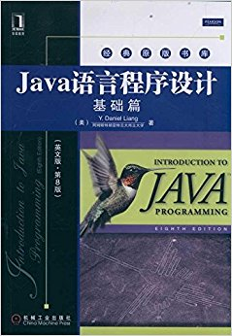
Recommended Reading
Introduction to Java Programming by Daniel Liang (Pearson Publishing)
Ebook Available
https://zjnu2017.github.io/OOP
Chapter 1 & 2
Read This Week

Slide 4
Why Java?

Slide 5
Why Java?
Incredible toolset
Large Community
Java is an Object Oriented language
internally embraces best practices
promotes correct usage
Ease of learning
after learning the basics you’ll find that you can easily grab onto more advanced concepts
Android adoption
Scalable
Easier to Maintain, Cross-Platform, Optimized Performance
Lots of available jobs
…

Slide 6
Why use Object Orientated Programming Techniques?

Slide 7
Why use Object Orientated Programming Techniques?
Sooner rather than later, you’ll have to work with object-oriented code
Modularity
Scalability
Frameworks
Contributing to open source software
Gives you various ways to think and solve problems
More easily translate your programming skills into other Object-Oriented languages
Become a more valuable developer

Slide 8
Question
A programming paradigm is a style, or “way”, of approaching a problem to come up with a solution.
What are the two main programming paradigms?

Slide 9
Answer
Procedural and Object-Oriented

Slide 10
Assessment
1. Attendance and Participation:10%
2. Experiments: 40%;
3. Examination: 50%.

Slide 11
Lessons

Slide 12
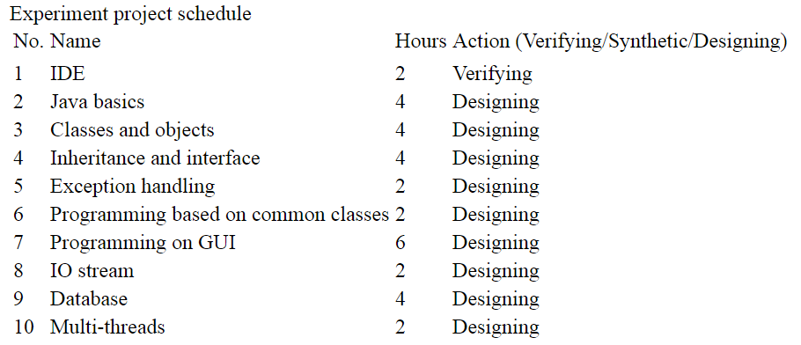
Practicals

Slide 13
Hands-On
Hands-On Course
Exciting & Challenging
Practice/Work through Examples
Experiment/Trial-and-Error
Don’t be afraid to make mistakes
Learn by `DOING’ (not just theory)

Slide 14
Contact
Questions/Issues
Benjamin Kenwright
email: bkenwright@ieee.org
Open Door Policy
Problems/Help
Within Reason

Slide 15
Question
Is Javascript the same as Java?
Yes
No

Slide 16
Answer
(B) No
Java is not to be confused with JavaScript

Slide 17
Today
Getting started with Java
Writing/debugging simple programs
“Hello World”
IDE (Integrated Development Environment)

Slide 18
Steps
1. Work through Chapter 1
2. Setup Java
3. Compile & Run Simple Java Program
e.g., Page 12 Introduction to OOP by Daniel Liang
Command Prompt
4. IDE
e.g., Eclipse (www.eclipse.org)

Slide 19
.java files
.java files are txt files
Edit in any text editor program
Compile .java files to intermediate binary files for that the Java Virtual Machine can execute
.java -> .class files
Move to IDE to make it easier to manage your Java projects
Intel sense, spell-checking, …

Slide 20
Basics
Class per Java file
Class name must match Java file name
E.g., class Test (Test.java)

Slide 21
Example Question
What is the output of this program fragment? Read it carefully!
String greet = "Hi";
String name = "Smedley";
String nickName = name.substring(0,4);
if (nickName == name.substring(0,4));
System.out.println("has real nickname");
else if (greet + name == greet + nickName)
System.out.println("no real nickname");
else
System.out.println("hmmm...changed names?");
A. has real nickname
B. no real nickname
C. hmmm...changed names?
D. it's one of the three lines given in A, B, and C above, we can't tell which one without running the program
E. none, because there is at least one compile-time error

Slide 22
Answer
E. none, because there is at least one compile-time error
test.java:22: error: 'else' without 'if'
else if (greet + name == greet + nickName)
^
1 error

Slide 23
Summary
Overview of the Course/Plan
Hands-On/Practical
Assessment (Breakdown of Marks)
Self Study (Can’t learn from just attending)
Today is about `Getting Started’

Slide 24
Questions/Discussion

