Slide 1
Classes & Objects
Object Orientated Programming in Java
Benjamin Kenwright

Slide 2
Outline
Review
Submissions/Quizzes
Object Orientated Concepts
Classes, Methods, Overloading, Object Creation, Equality, ...
Today’s Practical
Review/Discussion

Slide 3
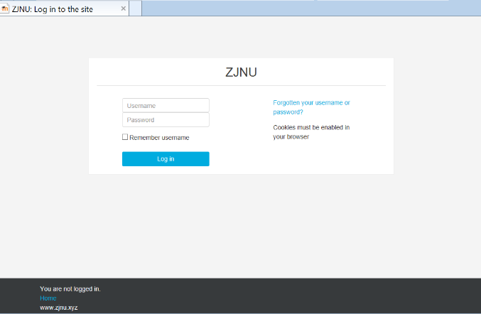
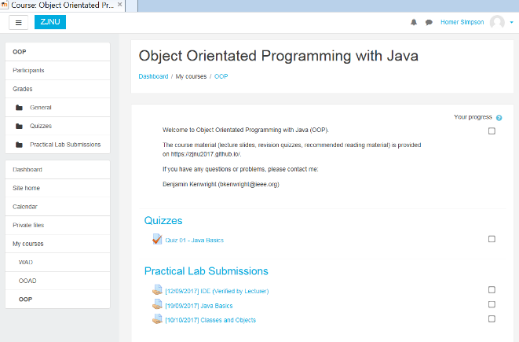
Submissions/Quizzes
Course material (Public)
https://zjnu2017.github.io/
Submissions/Quizzes (Graded/Private)
www.zjnu.xyz
(Login – Student No)
Password Emailed

Slide 4
Online Quizzes
Take the quizzes as many times as you want
Opportunity to `improve’ learn from mistakes (instead of a single pass/fail)
Quizzes contribute to your final mark
10-20 multiple choice questions added each week
Straightforward and help prepare for the final exam

Slide 5
Online Lab Submissions
Each weekly lab submission should be submitted online
Single .zip, .java files from the chapters
Enables you extra time
(e.g., if you require more time than the lab provides – submit up until midnight same day)
Lets me provide regular feedback, guidance and comments

Slide 6
Now…
Review Core Java Concepts
Classes, Methods, Overloading, Object Creation, Equality, ...
Object Orientation Principles

Slide 7
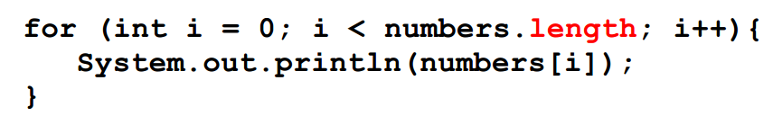
Arrays in Java
Not pointers like in C,
Bounds checking at run-time
int[] numbers; // equivalent
int number[];
int[] numbers = {1, 2, 3, 4, 5, 6, 7};
The size is fixed at compile-time!
int[] numbers = new Integer[getSize()];
The size is fixed at run-time!
Cannot be resized

Slide 8
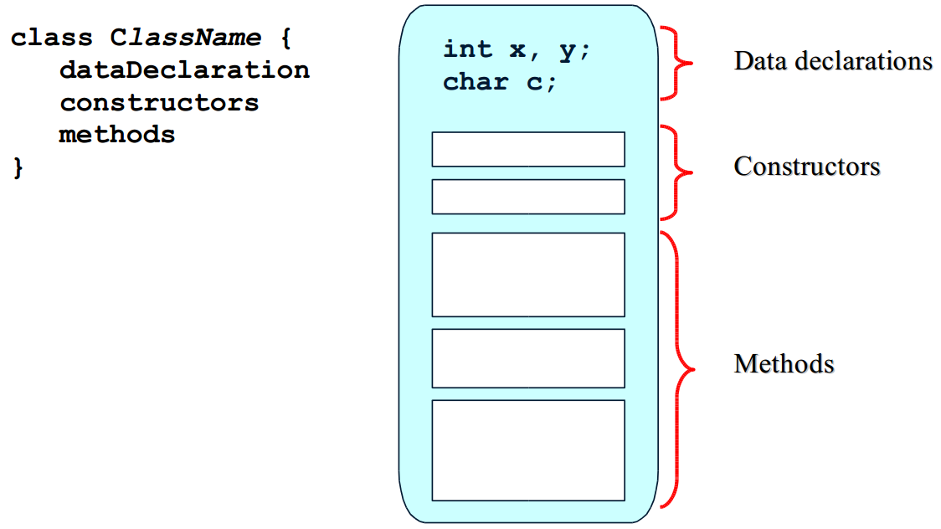
Classes in Java
A class encapsulates a set of properties
Some properties are hidden
The remaining properties are the interface of the class

Slide 9
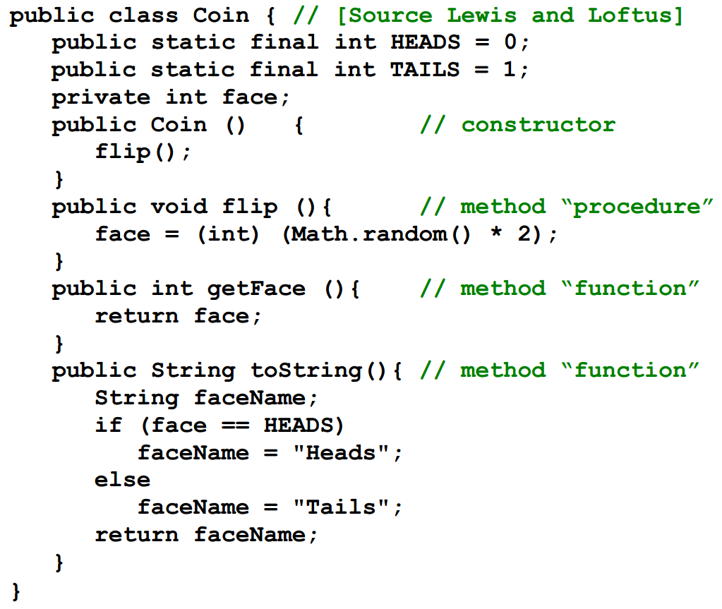
Example of a Class

Slide 10
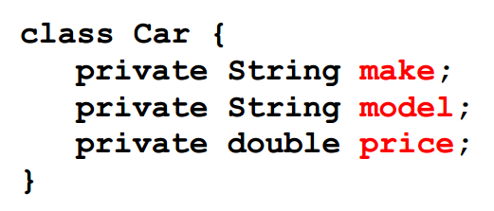
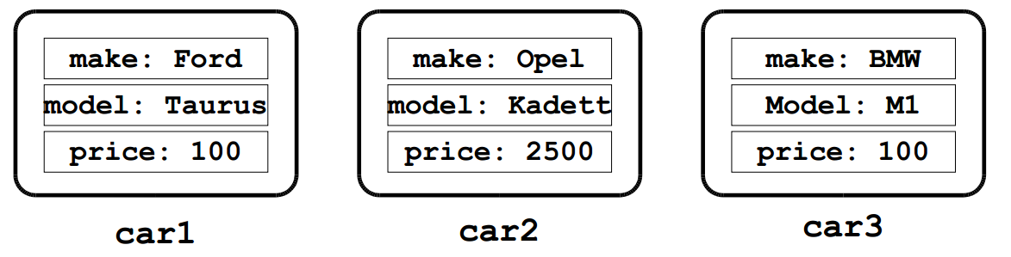
Instance Variables
An instance variable is a data declaration in a class. Every object instantiated from the class has its own version of the instance variables

Slide 11
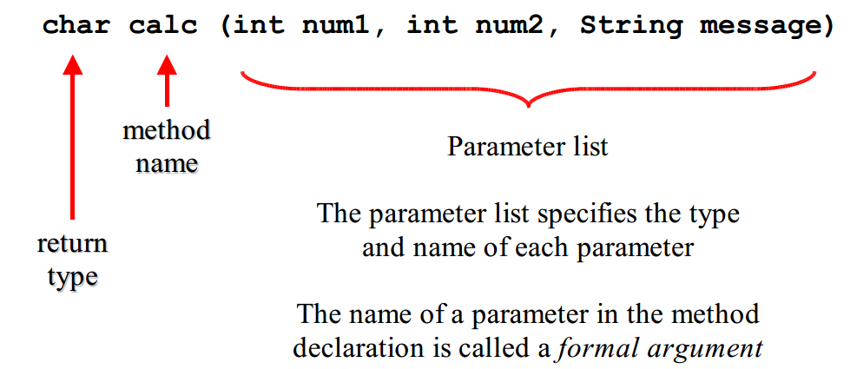
Methods in Java
A method is a function or procedure that reads and/or modifies the state of the class
A function returns a value (a procedure does not).
A procedure has side-effects, e.g., change the state of an object

Slide 12
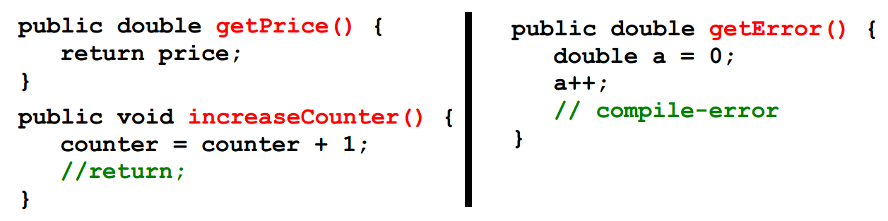
Methods in Java, cont.
All methods have a return type
void for procedures
A primitive data type or a class for functions
The return value
Return stop the execution of a method and jumps out
Return can be specified with or without an expression
Parameter are pass-by-value
Class parameter are passed as a reference

Slide 13
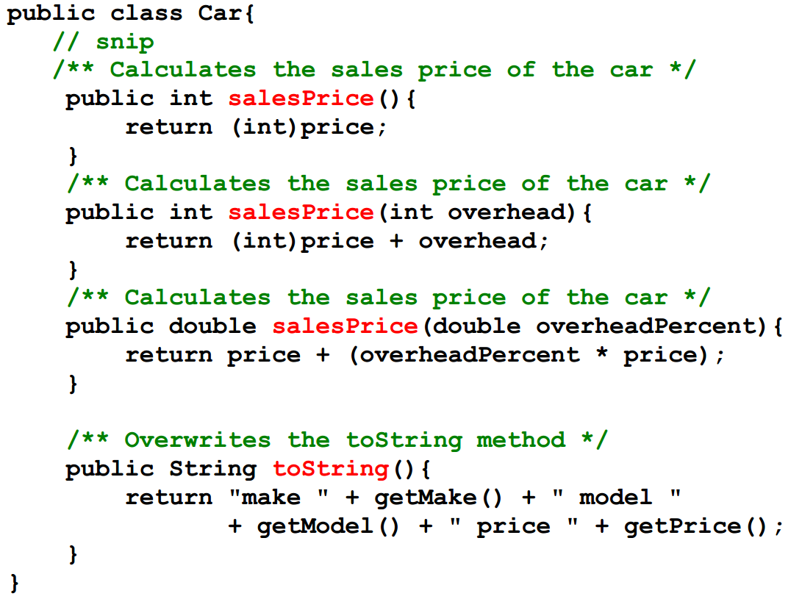
Methods in Java, Example

Slide 14
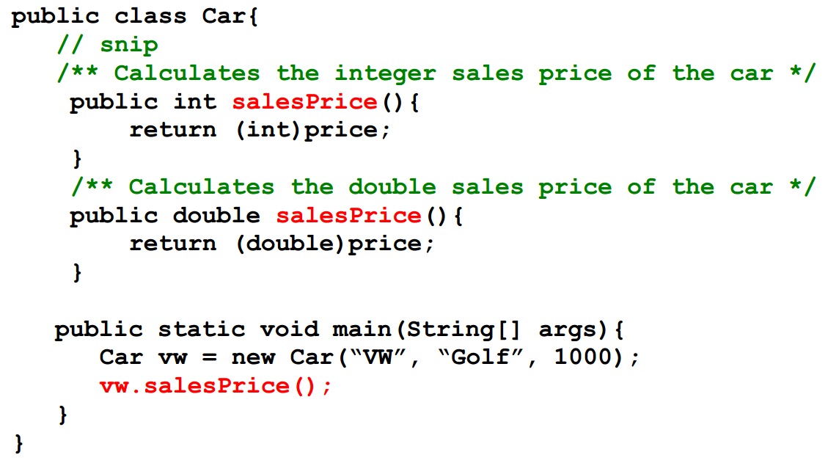
Methods in Java, Example, cont.
What is wrong here?

Slide 15
Ambiguous function overloading (only different by return type)
int salesPrice()
double salesPrice()

Slide 16
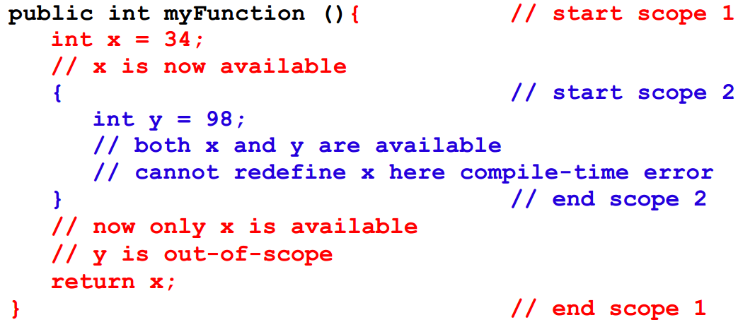
Scope
The redefinition of x in scope 2 is allowed in C/C++

Slide 17
Object Creation in General
Object can be created by
Instantiating a class
Copying an existing object
Instantiating
Static: Objects are constructed and destructed at the same time as the surrounding object.
Dynamic: Objects are created by executing a specific command.
Copying
Often called cloning

Slide 18
Object Destruction in General
Object can be destructed in two way
Explicit, e.g., by calling a special method or operator (C++).
Implicit, when the object is no longer needed by the program (Java)
Explicit
An object in use can be destructed.
Not handling destruction can cause memory leaks.
Implicit
Objects are destructed automatically by a garbage collector
There is a performance overhead in starting the garbage collector
There is a scheduling problem in when to start the garbage collector

Slide 19
Object Creation in Java
Instantiazion: A process where storage is allocated for an “empty” object.
Initialization: A process where instances variables are assigned a start value.
Dynamic instantiazion in Java by calling the new operator
Static instantiazion is not supported in Java.
Cloning implemented in Java via the method clone() in class
java.lang.Object
Initialization is done in constructors in Java
Very similar to the way it is done in C++

Slide 20
Object Destruction in Java
Object destruction in Java is implicit an done via a garbage collector.
Can be called explicitly via System.gc()
A special method finalize is called immediately before garbage collection.
Method in class Object, that can be redefined.
Takes no parameters and returns void.
Used for releasing resources, e.g., close file handles.
Rarely necessary, e.g., “dead-conditions” for error detection purposes

Slide 21
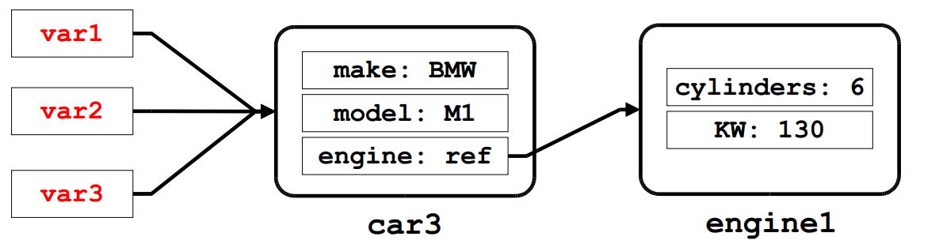
Objects and References
Variables of non-primitive types that are not initialized have the special value null.
Test: var1 == null
Assignment: var2 = null
Object have identity but no name,
i.e., not possible to identify an object O1 by the name of the variable referring to O1.
Aliasing: Many variables referring to the same object

Slide 22
Constructors in Java
A constructor is a special method where the instance variables of a newly created object are initialized with “reasonable” start values.
A class must have a constructor
A default is provided implicitly (no-arg constructor).
A constructor must have the same name as the class.
A constructor has no return value.
That's why it is as special method
A constructor can be overloaded.
A constructor can call other methods (but not vice-versa).
A constructor can call other constructors (via this)

Slide 23
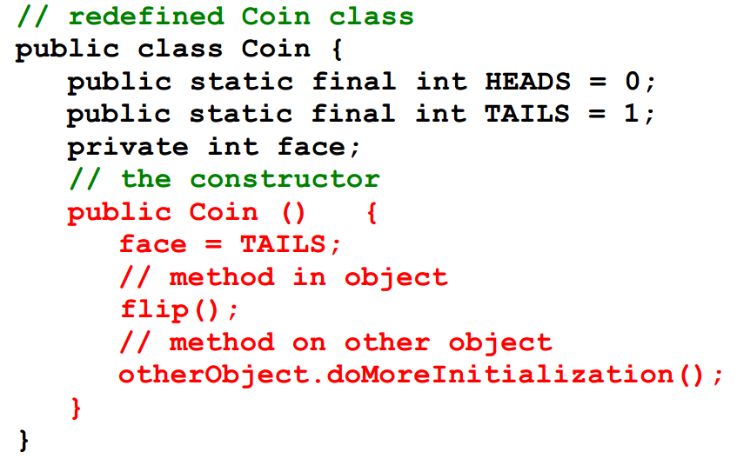
Constructors in Java, cont.
Every class should have a programmer defined constructor, that explicitly guarantees correct initialization of new objects

Slide 24
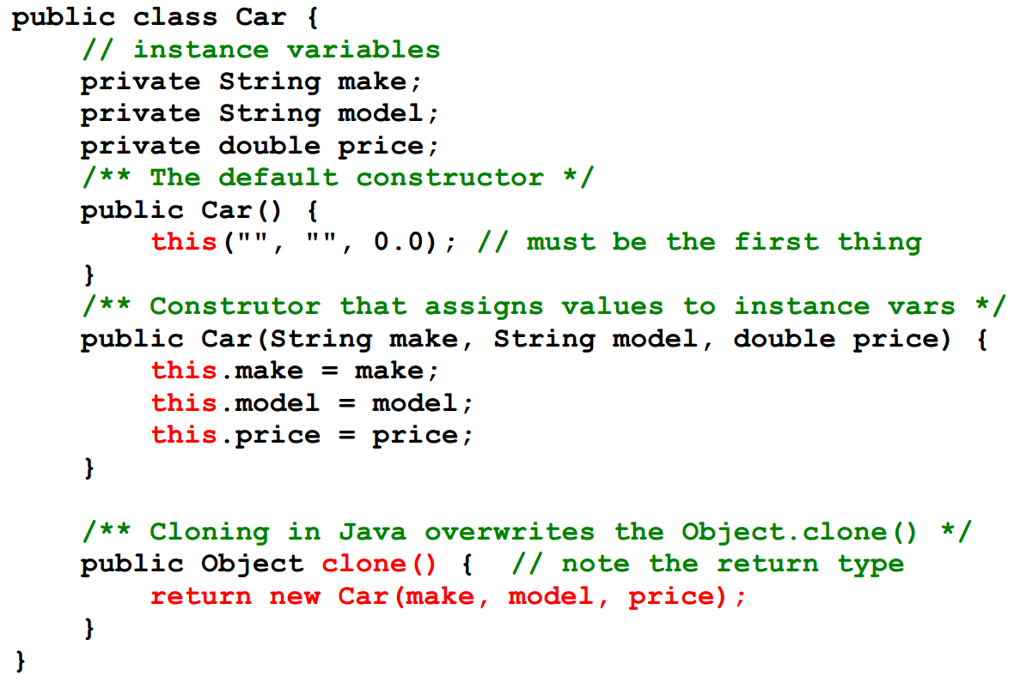
Constructors and Cloning in Java

Slide 25
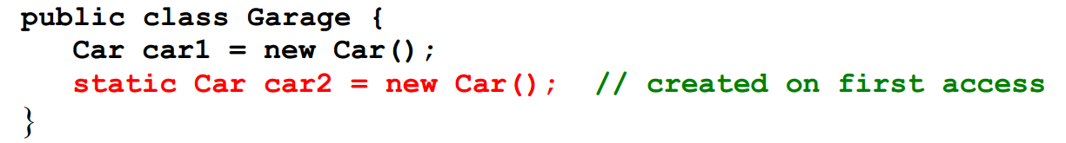
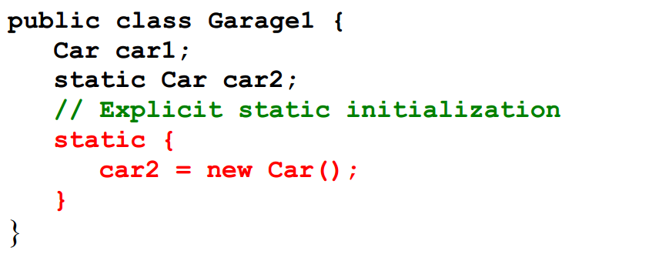
Constructor Initialization

Slide 26
Constructor vs. Method

Slide 27
Constructor vs. Method
Similarities
Can take arguments
all pass-by-value
Can be overloaded
Access modifiers can be specified (e.g., private or public)
Can be final (covered later)
Dissimilarties
Has fixed name (same as the class)
No return value
“returns” a reference to object
Special call via new operator
new Car()
Cannot be called by methods
Default constructor can by synthesised by the system
Cannot be declared static
it is in fact a static method!

Slide 28
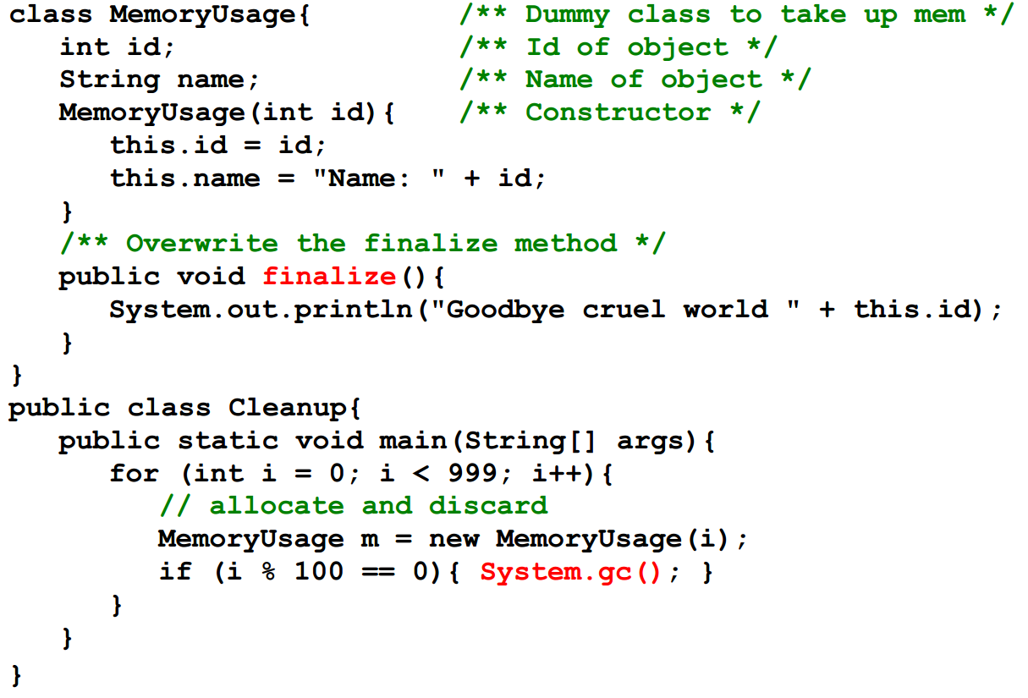
Object Destruction in Java, cont.

Slide 29
Value vs. Object
A value is a data element without identity that cannot change state.
An object is an encapsulated data element with identity, state, and behavior.
An object can behave like value (or record). Is it a good idea?
Values in Java are of the primitive type byte, short, int, long, float, double, boolean, and char
Wrapper classes exists in Java for make the primitive type act as objects

Slide 30
Strings in Java
Strings in Java are of the class String.
Objects of class String behave like values.
Characteristics of Strings
The notation "fly" instantiates the class String and initialize it with the values "f"', "l", and "y".
The class String has many different constructors.
Values in a string cannot be modified (use StringBuffer instead).
Class String redefines the method equals() from class Object

Slide 31
Equality
How to determine if values are equal?
Reference Equality
Returns whether a and b points to the same object.
Shallow Equality
Returns whether a and b are structurally similar.
One level of objects are compared.
Deep Equality
Returns where a and b have object-networks that are structurally similar.
Multiple level of objects are compared recursively

Slide 32
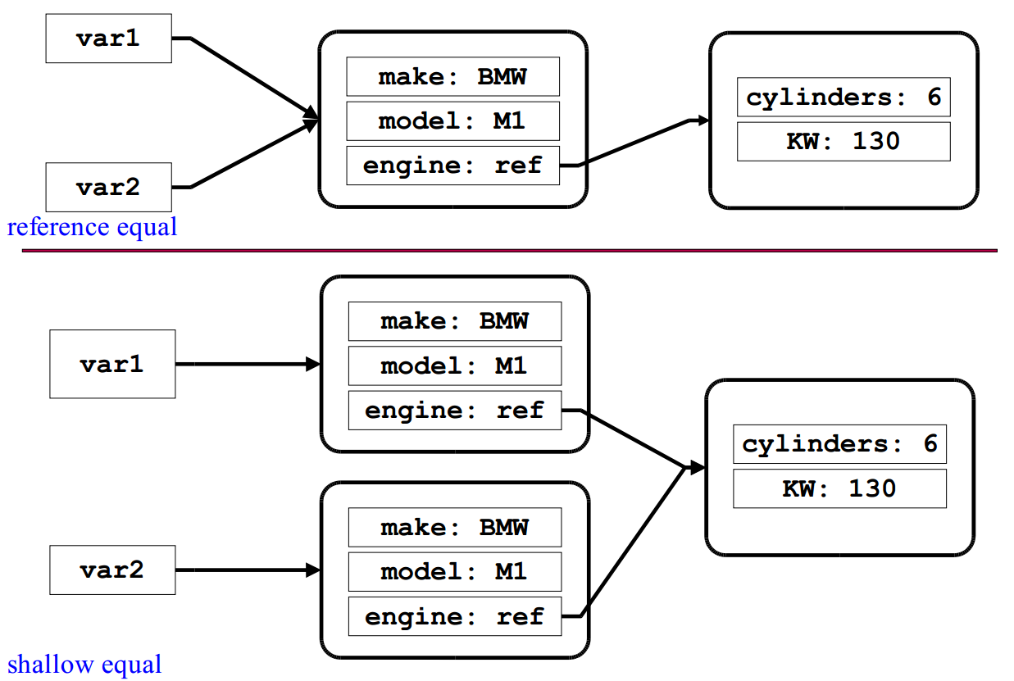
Equality Examples

Slide 33
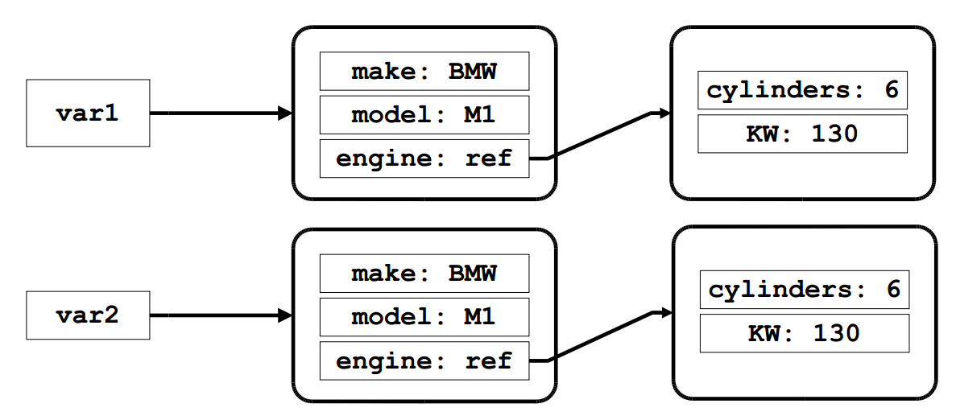
Equality Examples, cont.

Slide 34
Types of Equality in Java
==
Equality on primitive data types
8 == 7
'b' == 'c'
Reference equality on object references
onePoint == anotherPoint
Strings are special
String s1 = "hello"; String s2 = "hello";
if (s1 == s2){
System.out.println(s1 + " equals" + s2);}
equals
Method on the class java.lang.Object
Default works like reference equality.
Can be refined in subclass
onePoint.equals(anotherPoint)

Slide 35
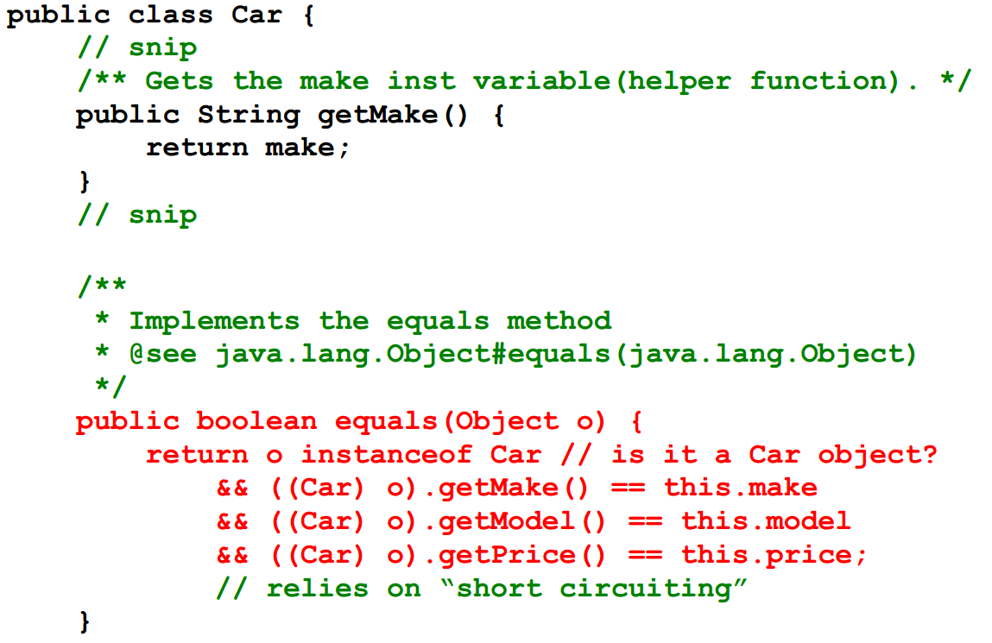
equals example

Slide 36
Summary
Overview Essential OOP Java Principles
Instance variables, Strings, …
Methods, Overloading
Initialization
Garbage collection
Equality
Working with Classes & Objects

Slide 37
Today’s Practical
Programming Exercises (Book):
9.1 to 9.4,
10.1 to 10.5
(Only code not UML)
Upload single .zip file containing all your java files (only java files).
www.zjnu.xyz
zip file name should be your student number, e.g., 29392929.zip
Remember to comment your code, name/student number at the top of files.
Separate file for each exercise
ch9_1.java, ch9_2.java, …
Example contents of your submission:
File: 23902390.zip
ch9_1.java
ch9_2.java
…

Slide 38
This Week
Read Chapters 8, 9, 10
Review Slides
Work through Java Exercises
Complete Quizzes
Online (www.zjnu.xyz)
Contribute to your final mark and help prepare you for the final exam

Slide 39
Questions/Discussion

