Slide 1
Inheritance and Interfaces
Object Orientated Programming in Java
Benjamin Kenwright

Slide 2
Outline
Review
What is Inheritance?
Why we need Inheritance?
Syntax, Formatting, ..
What is an Interface?
Today’s Practical
Review/Discussion

Slide 3
Inheritance
Reuse
Inheritance and methods
Method redefinition
The final keyword
Comparison of inheritance with other approaches and examples

Slide 4
How to Reuse Code?
Write the class completely from scratch (one extreme)
What some programmers always want to do!
Find an existing class that exactly match your requirements (another extreme)
The easiest for the programmer!
Built it from well-tested, well-documented existing classes
A very typical reuse, called composition reuse!
Reuse an existing class with inheritance
Requires more knowledge than composition reuse

Slide 5
Inheritance
Inheritance is a way to derive a new class from an existing class
It is the process where one object acquires the properties of another. With the use of inheritance the information is made manageable in a hierarchical order

Slide 6
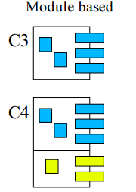
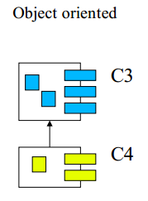

Module Based vs. Object Oriented

Slide 7
Module Based vs. Object Oriented
Class C4 is created by copying C3
There are C3 and C4 instances
Instance of C4 have all C3 properties
C3 and C4 are totally separated
Maintenance of C3 properties must be done two places
Languages, e.g., Ada, Modula2, PL/SQL
Class C4 inherits from C3
There are C3 and C4 instances
Instance of C4 have all C3 properties
C3 and C4 are closely related
Maintenance of C3 properties must be done in one place.
Languages, C++, C#, Java, Smalltalk

Slide 8
Question
Inheritance is a way to derive a new class from an existing class
True
False

Slide 9
Answer
a) True

Slide 10
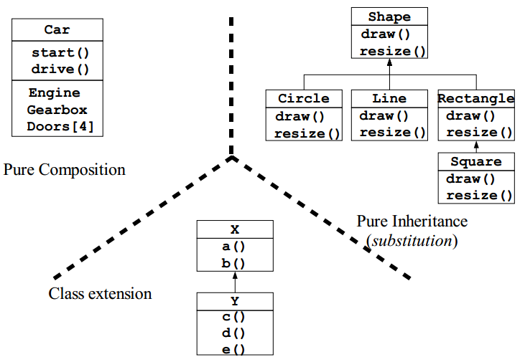
Composition vs. Inheritance

Slide 11
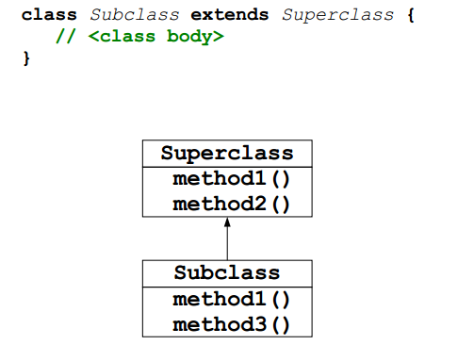
Inheritance in Java (Syntax)

Slide 12
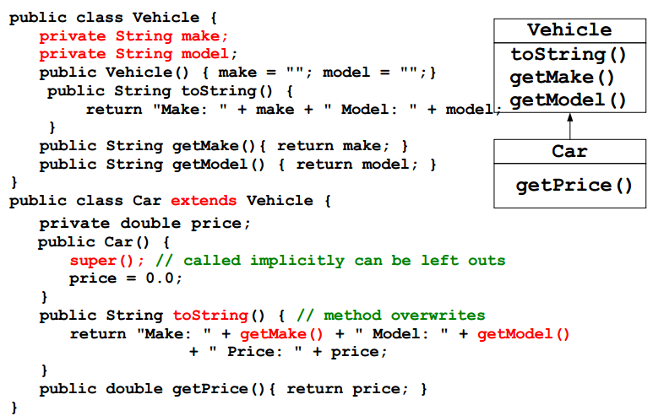
Inheritance Example

Slide 13
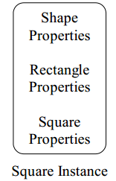
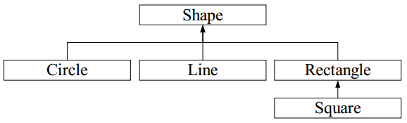
Instantiating and Initialization
The Square, that inherits from Rectangle, that inherits from Shape is instantiated as a single object, with properties from the three classes Square, Rectangle, and Shape

Slide 14
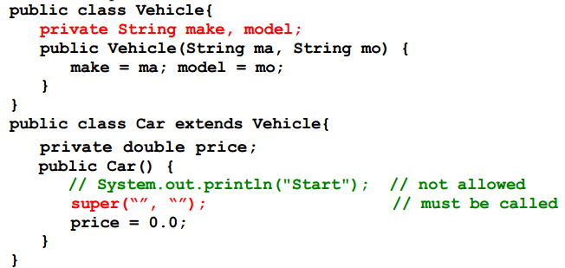
Inheritance and Constructors
Constructors are not inherited
A constructor in a subclass must initialize variables in the class and variables in the superclass
What about private fields in the superclass?
It is possible to call the superclass' constructor in a subclass
Default superclass constructor called if exists

Slide 15
Order of Instantiation and Initialization
The storage allocated for the object is initialized to binary zero before anything else happens
Static initialization in the base class then the derived classes
The base-class constructor is called (all the way up to Object)
Member initializers are called in the order of declaration
The body of the derived-class constructor is called

Slide 16
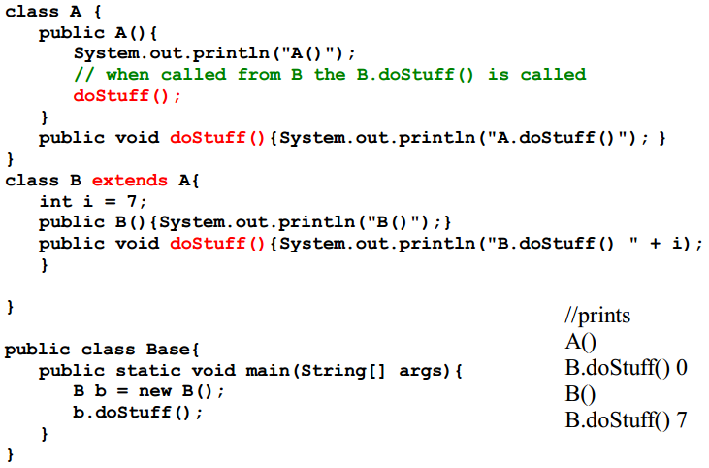
Inheritance and Constructors, cont.

Slide 17
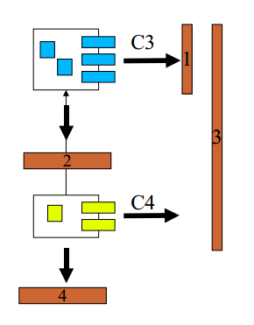
Interface to Subclasses and Clients
The properties of C3 that clients can use
The properties of C3 that C4 can use
The properties of C4 that clients can use
The properties of C4 that subclasses of C4 can use

Slide 18
Question
All methods are inherited including the constructors?
True
False

Slide 19
Answer
b) False
Constructors are not inherited

Slide 20
“Protected” Revisited
It must be possible for a subclass to access properties in a superclass
private will not do, it is to restrictive
public will not do, it is to generous
A protected variable or method in a class can be accessed by subclasses but not by clients
Change access modifiers when inheriting
Properties can be made “more public”
Properties cannot be made “more private”

Slide 21
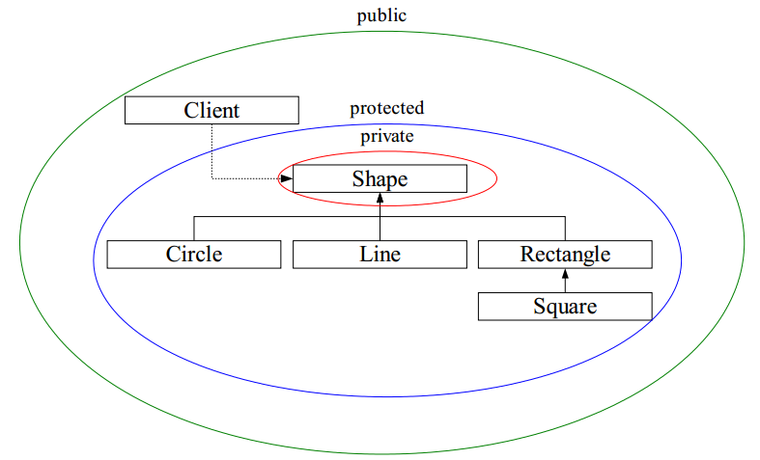
“Protected” Revisited

Slide 22
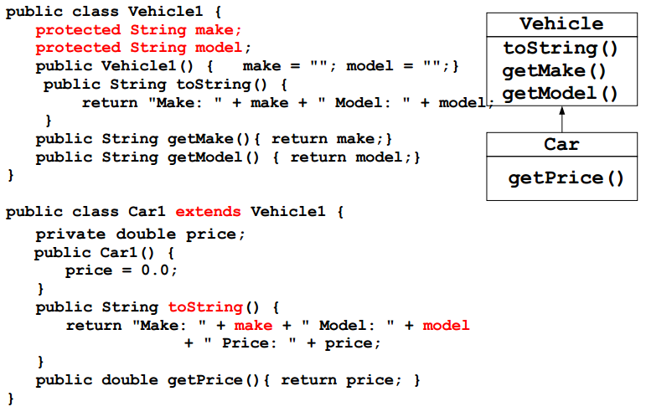
“Protected” Example

Slide 23
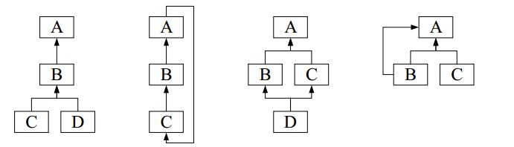
Class Hierarchies in General
Class hierarchy: a set of classes related by inheritance
Possibilities with inheritance
Cycles in the inheritance hierarchy is not allowed
Inheritance from multiple superclass may be allowed
Inheritance from the same superclass more than once may be allowed

Slide 24
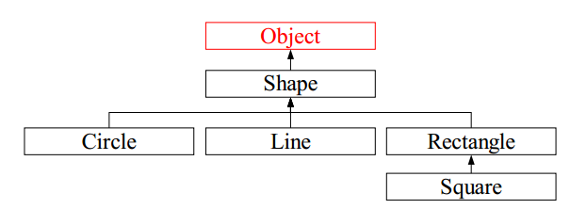
Class Hierarchies in Java
Class Object is the root of the inheritance hierarchy in Java
If no superclass is specified a class inherits implicitly from Object
If a superclass is specified explicitly the subclass will inherit Object

Slide 25
Question
A protected variable or method in a class cannot be accessed by subclasses but not by clients
True
False

Slide 26
Answer
False
A protected variable or method in a class can be accessed by subclasses but not by clients

Slide 27
Method/Variable Redefinition
Redefinition: A method/variable in a subclass has the same name as a method/variable in the superclass
Redefinition should change the implementation of a method, not its semantics
Redefinition in Java class B inherits from class A if
Method: Both versions of the method is available in instances of B. Can be accessed in B via super
Variable: Both versions of the variable is available in instances of B. Can be accessed in B via super

Slide 28
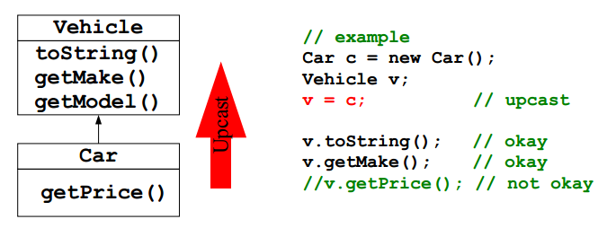
Upcasting
Treat a subclass as its superclass
Central feature in object-oriented program

Slide 29
The final Keyword
Fields
Compile time constant (very useful)
final static double PI = 3.14
Run-time constant (useful)
final int RAND = (int) Math.random * 10
Arguments (not very useful)
double foo (final int i)
Methods
Prevents overwriting in a subclass (use this very carefully)
Private methods are implicitly final
Final class (use this very carefully)
Cannot inherit from the class

Slide 30
Question
Which of these keywords can be used to prevent inheritance of a class?
a) super
b) constant
c) Class
d) final

Slide 31
Answer
d) final

Slide 32
Review
Reuse
Use composition when ever possible more flexible and easier to understand than inheritance
Java supports specialization and extension via inheritance
Specialization and extension can be combined.
A subclass automatically gets the fields and method from the superclass
They can be redefined in the subclass
Java supports single inheritance, all have Object as superclass
Designing good reusable classes is (very) hard!
while(!goodDesign()){ reiterateTheDesign(); }

Slide 33
Question
Which of these classes is a superclass of every class in Java?
a) String class
b) Object class
c) Abstract class
d) ArrayList class

Slide 34
Answer
b) Object class

Slide 35
Method Combination
It is programmatically controlled
Method doStuff on A controls the activation of doStuff on B
Method doStuff on B controls the activation of doStuff on A
Imperative method combination
There is an overall framework in the run-time environment that controls the activation of doStuff on A and B
doStuff on A should not activate doStuff on B, and vice versa
Declarative method combination
Java supports imperative method combination

Slide 36
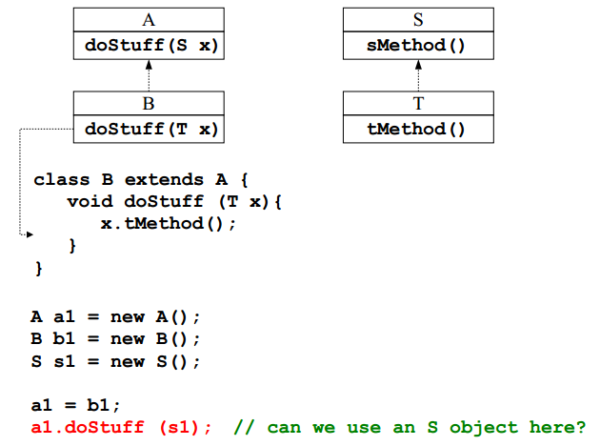
Changing Parameter and Return Types

Slide 37
class S {
void sMethod() { System.out.print("sMethod"); }
}
class T extends S {
void tMethod() { System.out.print("tMethod"); }
}
class A {
void doStuff(S x) { System.out.print("doStuff(S x)"); } }
class B extends A {
void doStuff( T x ) {
System.out.print("doStuff(T x)");
x.tMethod();
} }
class Test
{ public static void main(String[] args)
{
A a1 = new A();
B b1 = new B();
S s1 = new S();
a1 = b1;
a1.doStuff( s1 );
} }
Question
What would the following
program output?
"sMethod“
“tMethod”
“doStuff(S x)”
“doStuff(T x)”
Nothing

Slide 38
Answer
c) “doStuff(S x)”

Slide 39
Question
Java supports multiple inheritance and all objects are superclasses
True
False

Slide 40
Answer
b) False
Java supports single inheritance, all have Object as superclass

Slide 41
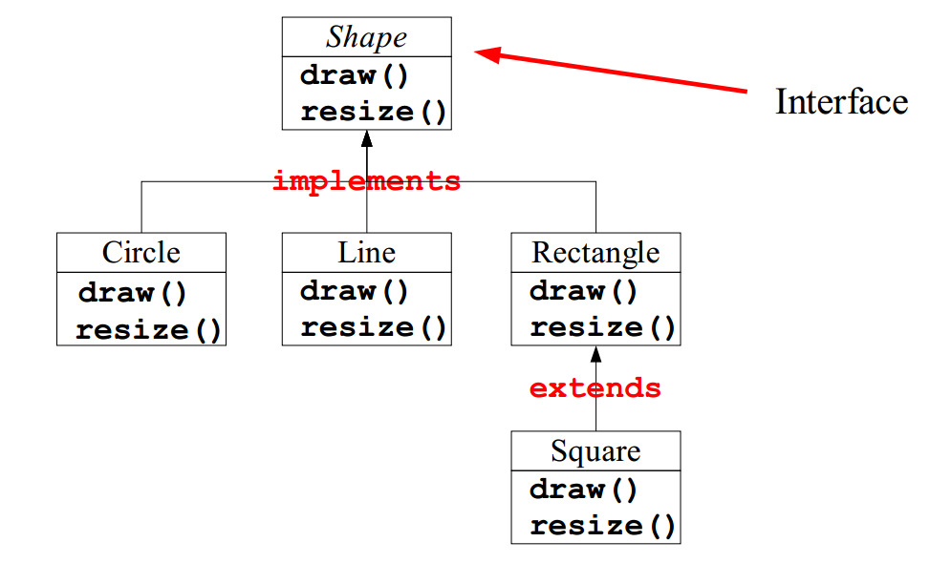
Java's interface Concept

Slide 42
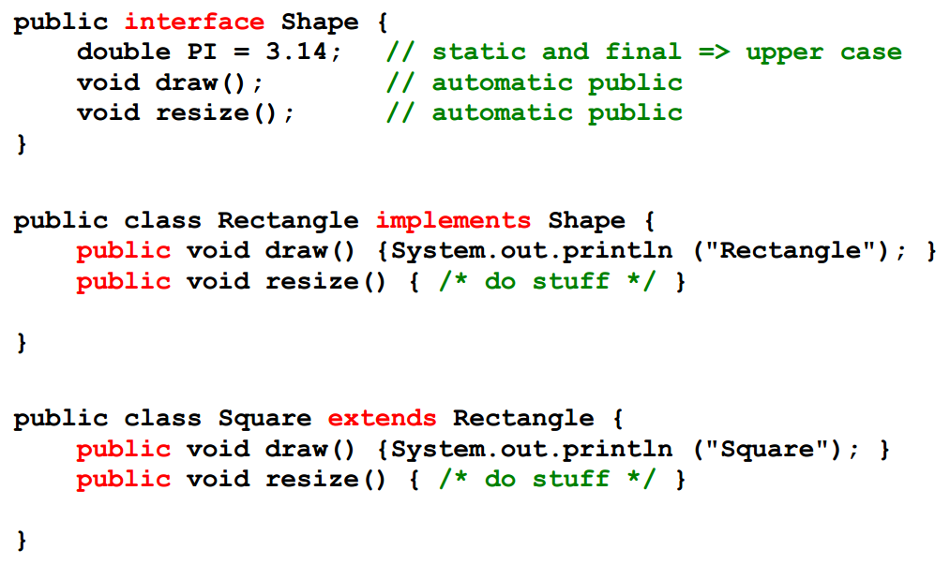
Java's interface Concept, cont.

Slide 43
Java's interface Concept
An interface is a collection of method declarations
An interface is a class-like concept
An interface has no variable declarations or method bodies
Describes a set of methods that a class can be forced to implement
An interface can be used to define a set of “constant”
An interface can be used as a type concept.
Variable and parameter can be of interface types
Interfaces can be used to implement multiple inheritance like hierarchies

Slide 44
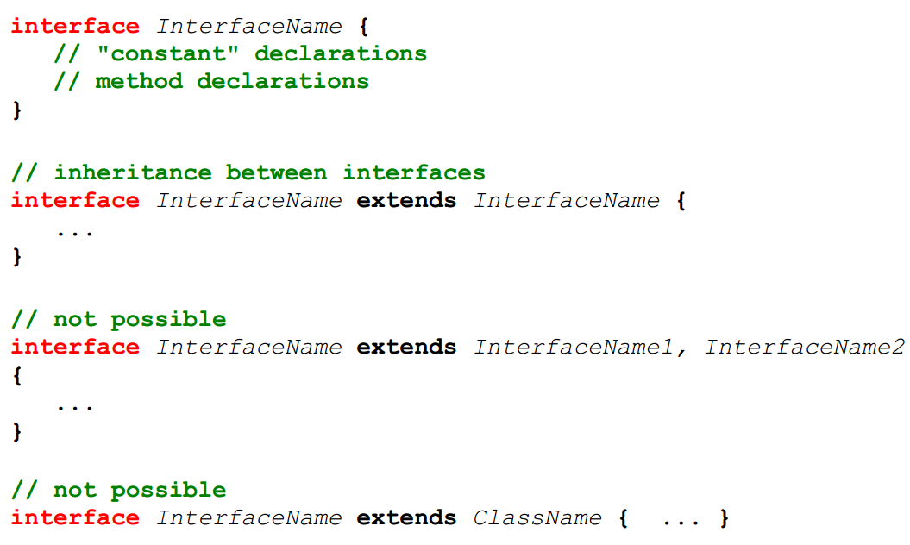
Java's interface Concept

Slide 45
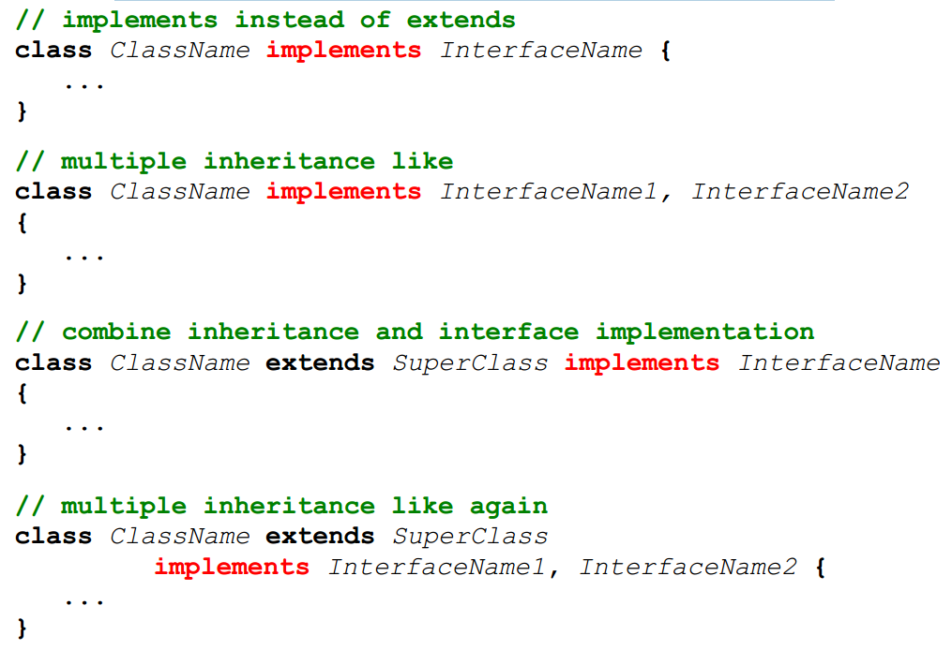
Java's interface Concept, cont

Slide 46
Question
An interface is allowed variable declarations but no method implementations
True
False

Slide 47
Answer
b) False
interface has no variable declarations or method bodies

Slide 48
Multiple Inheritance
Multiple inheritance of implementations is not allowed. Components can inherit multiple interfaces, though
Inheriting multiple interfaces isn't problematic, since you're simply defining new method signatures to be implemented. It's the inheritance of multiple copies of functionality that is traditionally viewed as causing problems, or at the very least, confusion

Slide 49
Semantic Rules for Interfaces
Type
An interface can be used as a type, like classes
A variable or parameter declared of an interface type is polymorph
Any object of a class that implements the interface can be referred by the variable
Instantiation
Does not make sense on an interface
Access modifiers
An interface can be public or “friendly” (the default)
All methods in an interface are default abstract and public
Static, final, private, and protected cannot be used.
All variables (“constants”) are public static final by default
Private, protected cannot be used

Slide 50
Some of Java's Most used Interfaces
Iterator
To run through a collection of objects without knowing how the objects are stored, e.g., in array, list, bag, or set.
More on this in the lecture on the Java collection library
Cloneable
To make a copy of an existing object via the clone() method on the class Object
More on this topic in todays lecture
Serializable
Pack a web of objects such that it can be send over a network or stored to disk. An naturally later be restored as a web of objects
More on this in the lecture on Java's I/O system
Comparable
To make a total order on objects, e.g., 3, 56, 67, 879, 3422, 34234

Slide 51
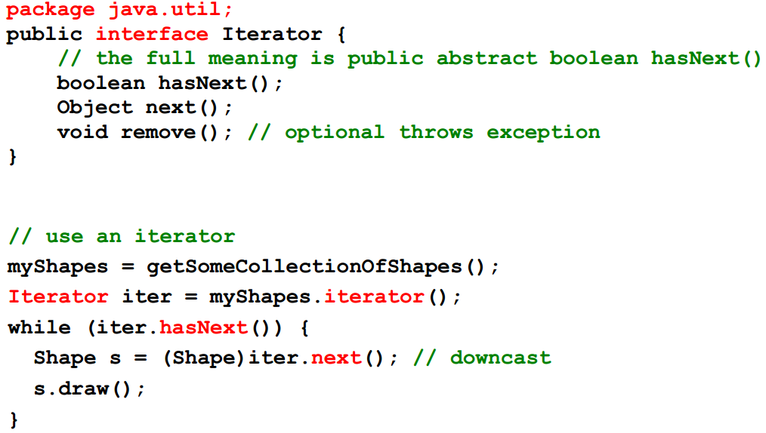
The Iterator Interface
The Iterator interface in the package java.util is a basic iterator that works on collections.

Slide 52
The Cloneable Interface
A class X that implements the Cloneable interface tells clients that X objects can be cloned
The interface is empty, i.e., has no methods
Returns an identical copy of an object.
A shallow copy, by default.
A deep copy is often preferable.

Slide 53
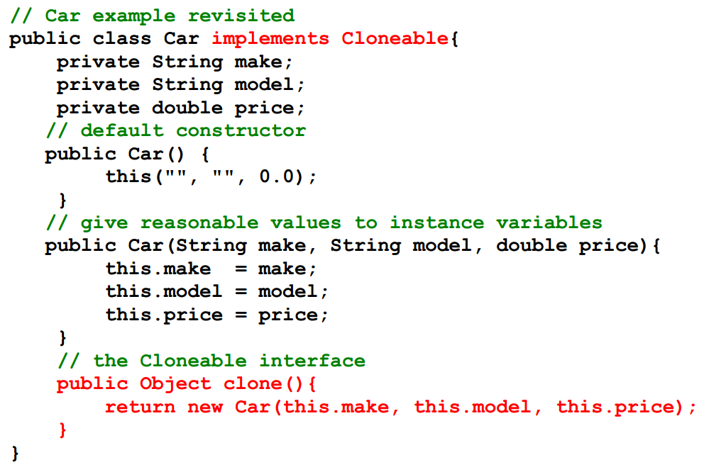
The Cloneable Interface, Example

Slide 54
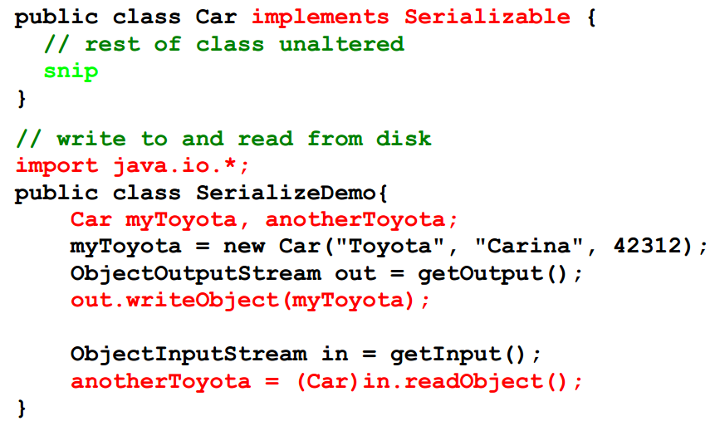
The Serializable Interface
A class X that implements the Serializable interface tells clients that X objects can be stored on file or other persistent media
The interface is empty, i.e., has no methods

Slide 55
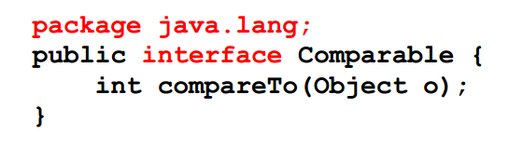
The Comparable Interface
In the package java.lang
Returns a negative integer, zero, or a positive integer as this object is less than, equal to, or greater than the specified object

Slide 56
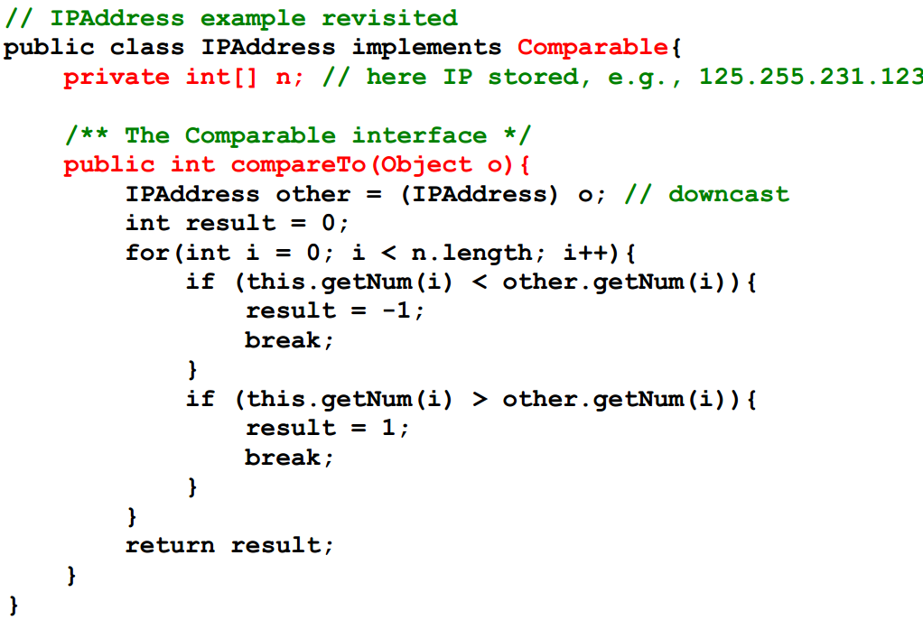
The Comparable Interface, Example

Slide 57
Interface vs. Abstract Class
Interface
Methods can be declared
No method bodies
“Constants” can be declared
Has no constructors
Multiple inheritance possible
Has no top interface
Multiple “parent” interfaces
Abstract Class
Methods can be declared
Method bodies can be defined
All types of variables can be declared
Can have constructors
Multiple inheritance not possible
Always inherits from Object
Only one “parent” class

Slide 58
Interfaces and Classes Combined
Using interfaces objects do not reveal which classes the belong to
With an interface it is possible to send a message to an object without knowing which class(es) it belongs. The client only knows that certain methods are accessible
By implementing multiple interfaces it is possible for an object to change role during its life span.
Design guidelines
Use classes for specialization and generalization
Use interfaces to add properties to classes

Slide 59
Review
Purpose: Interfaces and abstract classes can be used for program design, not just program implementation
Java only supports single inheritance
Java “fakes” multiple inheritance via interfaces
Very flexible because the object interface is totally separated from the objects implementation

Slide 60
Summary
Overview of Inheritance and Interfaces
Hands-On/Practical to help gain a solid understanding of these concepts
Today is about becoming comfortable/familiar these core Object Orientated Principles (i.e., Inheritance and Interfaces)

Slide 61
Today’s Practical
Programming Exercises (Book):
Chapter 11.1-11.5 (Only code not UML)
Upload single .zip file containing all your java files (only java files).
www.zjnu.xyz
zip file name should be your student number, e.g., 29392929.zip
Remember to comment your code, name/student number at the top of files.
Organise your files so it’s clear to identify each exercise (e.g., file names/folders)

Slide 62
This Week
Read Associated Chapters
Review Slides
Java Exercises
Submit Exercise Online
Online Quizzes
Additional quizzes added each week

Slide 63
Questions/Discussion
Demonstrate your ability to use the IDE/Java in the practical
Eclipse
Practical/Submission
Attendance Sheet

