Slide 1
Notation Part 2
Object Orientated Analysis and Design
Benjamin Kenwright

Slide 2
Outline
Review
What do we mean by Notation and UML?
Types of UML View
Continue UML Diagram Types
Conclusion and Discussion
Summary

Slide 3
Review
Package Diagrams
Component Diagrams
Deployment Diagrams
Use Case Diagrams
Activity Diagrams
Class Diagrams
Sequence Diagrams
Interaction Overview Diagrams
Composite Structure Diagrams
State Machine Diagrams
Timing Diagrams
Object Diagrams
Communication Diagrams
Last Week

Slide 4
Sequence Diagrams
Package Diagrams
Component Diagrams
Deployment Diagrams
Use Case Diagrams
Activity Diagrams
Class Diagrams
Sequence Diagrams
Interaction Overview Diagrams
Composite Structure Diagrams
State Machine Diagrams
Timing Diagrams
Object Diagrams
Communication Diagrams

Slide 5
Sequence Diagram
A sequence diagram traces the execution of a scenario in the same context as an object diagram. To a large degree, a sequence diagram is simply another way to represent an object diagram

Slide 6
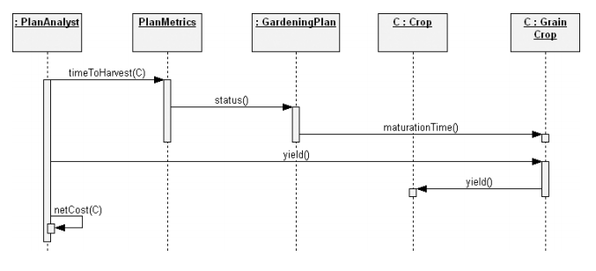
Example

Slide 7
Interaction Overview Diagrams
Package Diagrams
Component Diagrams
Deployment Diagrams
Use Case Diagrams
Activity Diagrams
Class Diagrams
Sequence Diagrams
Interaction Overview Diagrams
Composite Structure Diagrams
State Machine Diagrams
Timing Diagrams
Object Diagrams
Communication Diagrams

Slide 8
Interaction Overview Diagram
Interaction overview diagrams are a combination of activity diagrams and interaction diagrams
Intended to provide an overview of the flow of control between interaction diagram elements

Slide 9
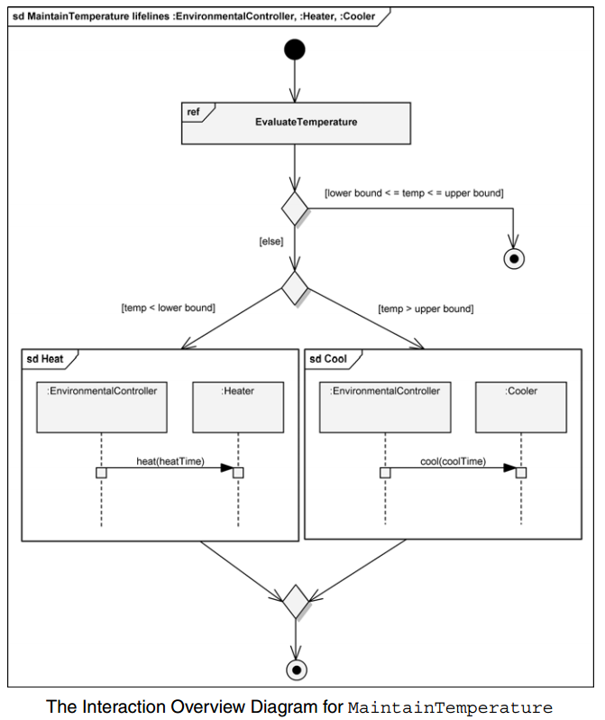
Example

Slide 10
Composite Structure Diagrams
Package Diagrams
Component Diagrams
Deployment Diagrams
Use Case Diagrams
Activity Diagrams
Class Diagrams
Sequence Diagrams
Interaction Overview Diagrams
Composite Structure Diagrams
State Machine Diagrams
Timing Diagrams
Object Diagrams
Communication Diagrams

Slide 11
Composite Structure Diagram
Composite structure diagrams provide a way to depict a structured classifier with the definition of its internal structure.
This internal structure is comprised of parts and their interconnections, all within the namespace of the composite structure.

Slide 12
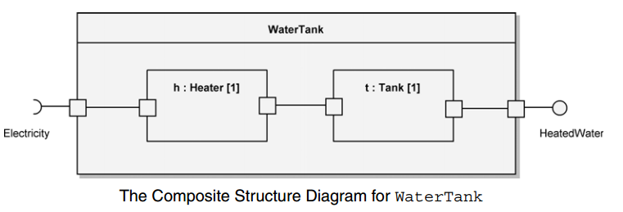
Example

Slide 13
State Machine Diagrams
Package Diagrams
Component Diagrams
Deployment Diagrams
Use Case Diagrams
Activity Diagrams
Class Diagrams
Sequence Diagrams
Interaction Overview Diagrams
Composite Structure Diagrams
State Machine Diagrams
Timing Diagrams
Object Diagrams
Communication Diagrams

Slide 14
State Machine Diagram
A state machine diagram is used to design and understand time-critical systems
A state machine diagram expresses behavior as a progression through a series of states, triggered by events, and the related actions that may occur
These are also known as behavioral state machines

Slide 15
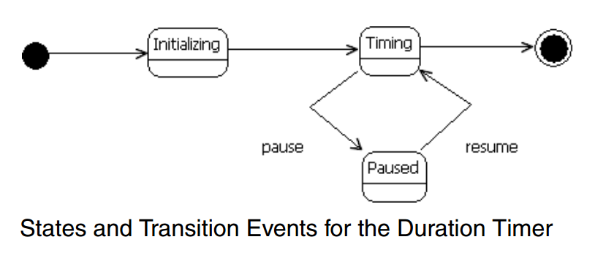
Example

Slide 16
Timing Diagrams
Package Diagrams
Component Diagrams
Deployment Diagrams
Use Case Diagrams
Activity Diagrams
Class Diagrams
Sequence Diagrams
Interaction Overview Diagrams
Composite Structure Diagrams
State Machine Diagrams
Timing Diagrams
Object Diagrams
Communication Diagrams

Slide 17
Timing Diagrams
Timing diagrams are a type of interaction diagram
Their purpose is to show how the states of an element or elements change over time and how events change those states

Slide 18
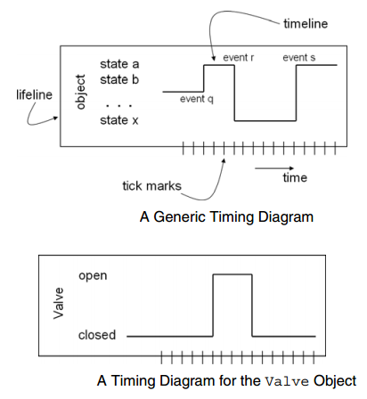
Example

Slide 19
Object Diagrams
Package Diagrams
Component Diagrams
Deployment Diagrams
Use Case Diagrams
Activity Diagrams
Class Diagrams
Sequence Diagrams
Interaction Overview Diagrams
Composite Structure Diagrams
State Machine Diagrams
Timing Diagrams
Object Diagrams
Communication Diagrams

Slide 20
Object Diagram
An object diagram is used to show the existence of objects and their relationships in the logical design of a system
Stated another way, an object diagram represents a snapshot in time of an otherwise transitory stream of events over a certain configuration of objects.

Slide 21
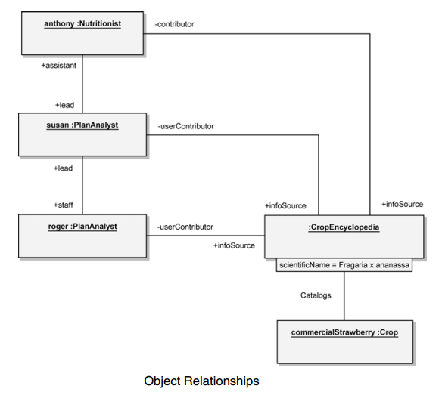
Example

Slide 22
Communication Diagrams
Package Diagrams
Component Diagrams
Deployment Diagrams
Use Case Diagrams
Activity Diagrams
Class Diagrams
Sequence Diagrams
Interaction Overview Diagrams
Composite Structure Diagrams
State Machine Diagrams
Timing Diagrams
Object Diagrams
Communication Diagrams

Slide 23
Communication Diagram
A communication diagram is a type of interaction diagram that focuses on how objects are linked and what messages they pass as they participate in a specific interaction

Slide 24
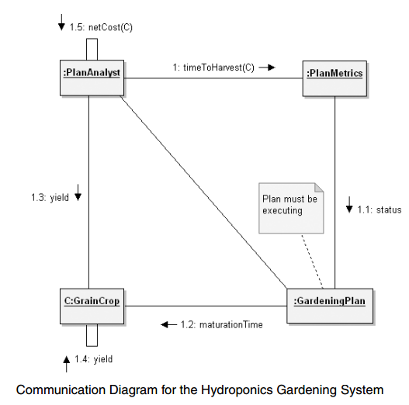
Example

Slide 25

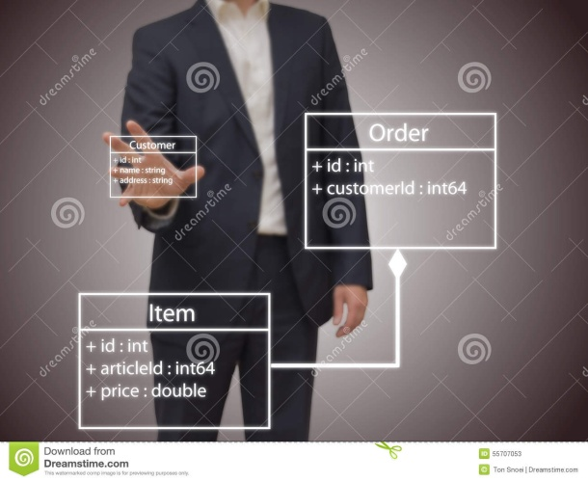
Summary
Clear idea of Notation in Object Orientated Analysis and Design
Visualising System
UML Diagrams (Types)
UML Diagrams

Slide 26
This Week
Review Slides
Read Chapter 6
Online Quizzes
Version Control (GitHub)

Slide 27
Questions/Discussion

