Slide 1
Common Classes
Object Orientated Programming in Java
Benjamin Kenwright

Slide 2
No Lecture
*Revision Week [28/11/2017]
No lecture next week

Slide 3
Outline
Review
Common Classes in Java
File Input/Output/Streams
Sorting Data
Today’s Practical
Review/Discussion

Slide 4
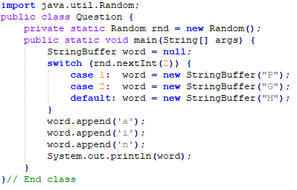
Revision Question
What does the following program print?
Pain, Gain or Main (varies randomly)
Pain or Main (varies randomly)
Main (always)
None of the above

Slide 5
Answer
Missing ‘break’ statement
Random 0 and 1
c) Always ‘Main’

Slide 6
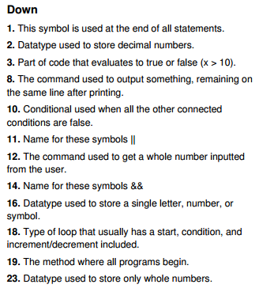
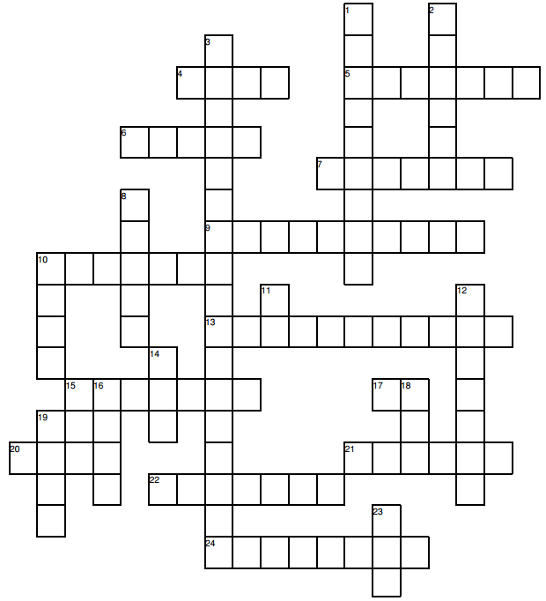
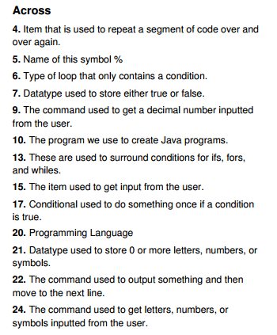
Crossword
s
e
m
i
c
o
l
o
n
o d u l u s

Slide 7
Crossword
Show me today
Record how many you found

Slide 8
The Java I/O System
Binary I/O streams
InputStream
OutputStream
The decorator design pattern
Character I/O streams (Unicode, 16 bits)
Reader
Writer
Comparing Binary I/O to Character I/O
Files and directories
The class File
Object Serialization
Light-weight persistence

Slide 9
I/O Systems
Abstraction of all types of I/O
Memory
File
Directory
Network
Express all configurations
Character, binary, buffered, etc.
Different kinds of operations
For example, Sequential, random access, by line, by word

Slide 10
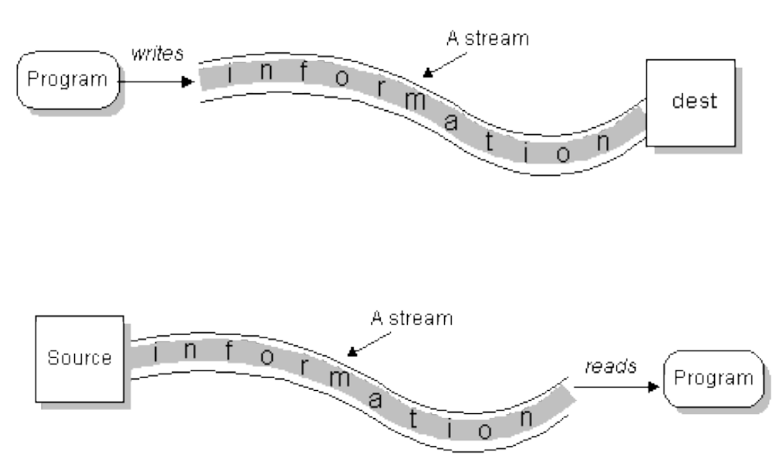
The Stream Concept
A stream is a sequential source of information used to transfer information from one source to another

Slide 11
Streams in Java
There is a huge (and complicated) hierarchy of stream classes in Java
Overview of the stream hierarchy
Reader, root in unicode input hierarchy
Writer, root in unicode output hierarchy
InputStream, root in binary input hierarchy
OutputStream, root in binary output hierarchy
All abstract classes

Slide 12
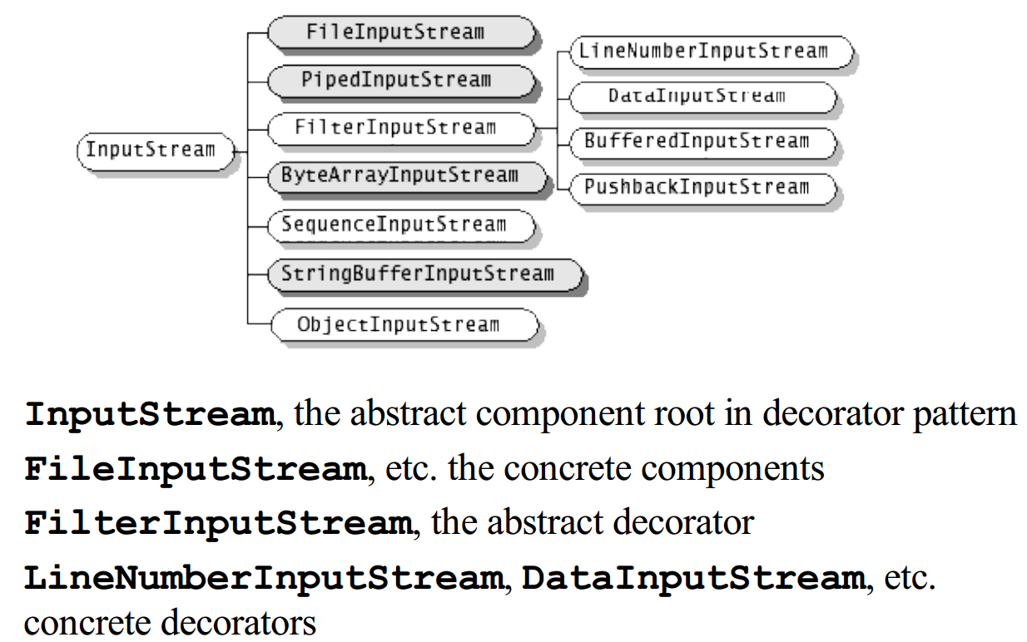
InputStream Hierarchy

Slide 13
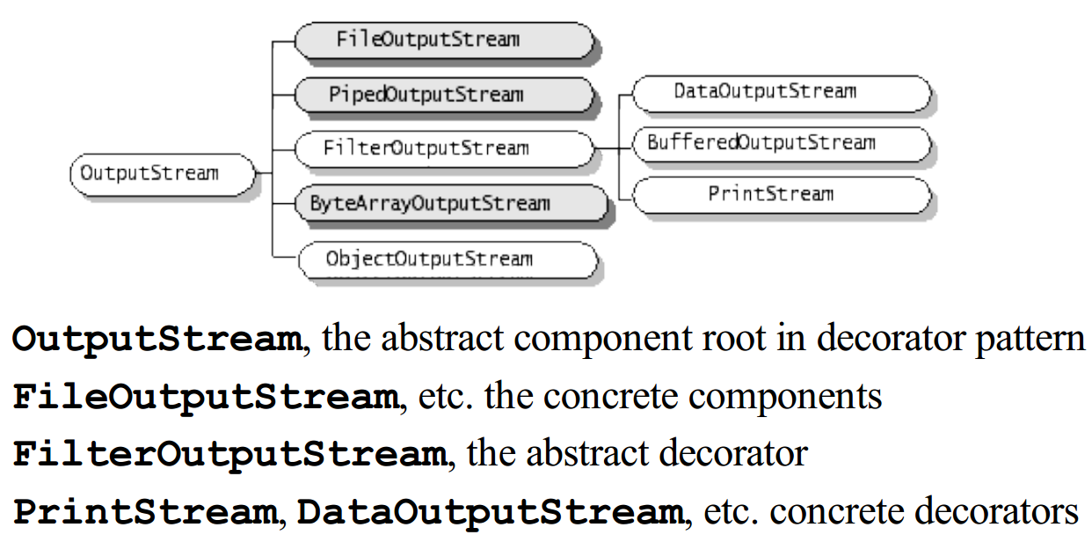
OutputStream Hierarchy

Slide 14
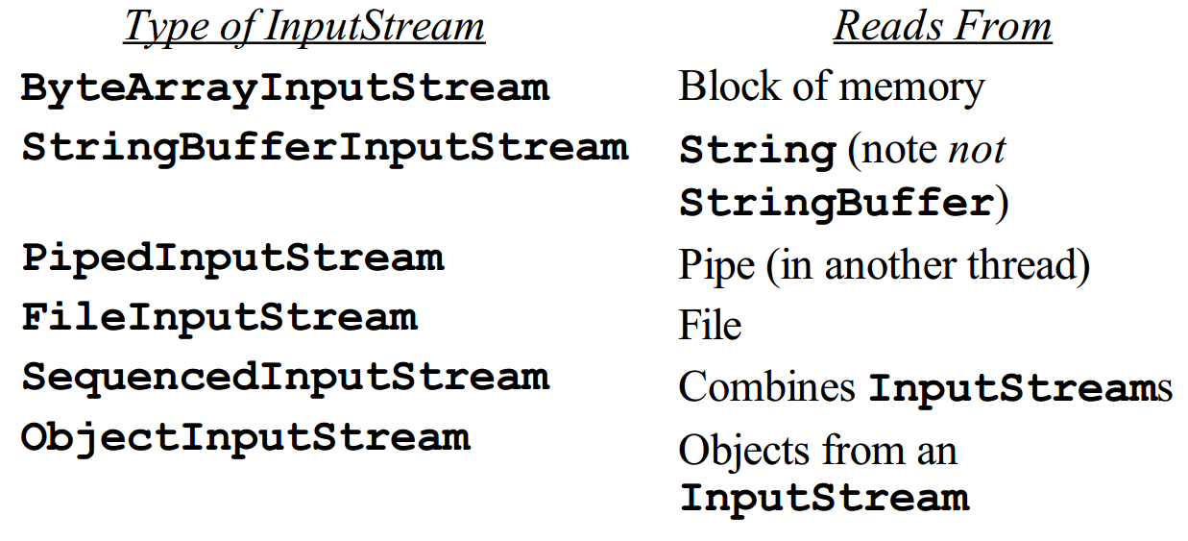
InputStream Types

Slide 15
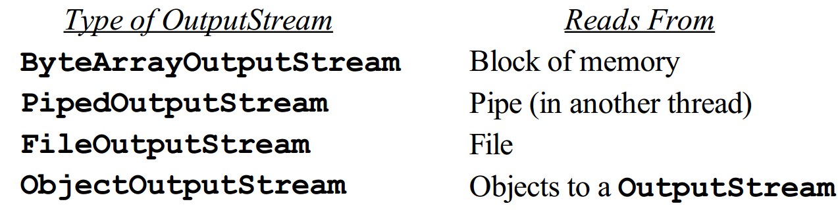
OutputStream Types

Slide 16
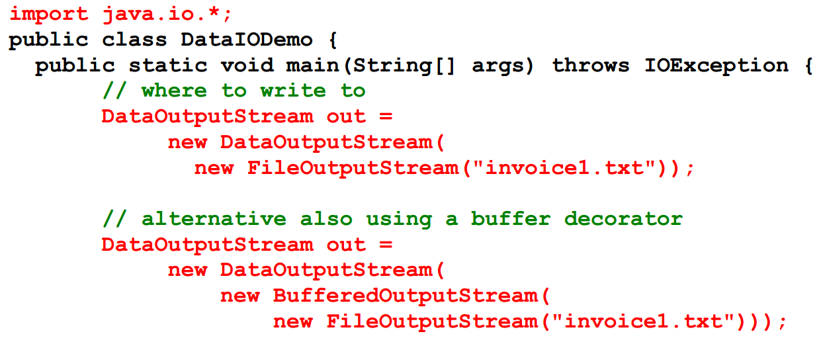
OutputStream, Example

Slide 17
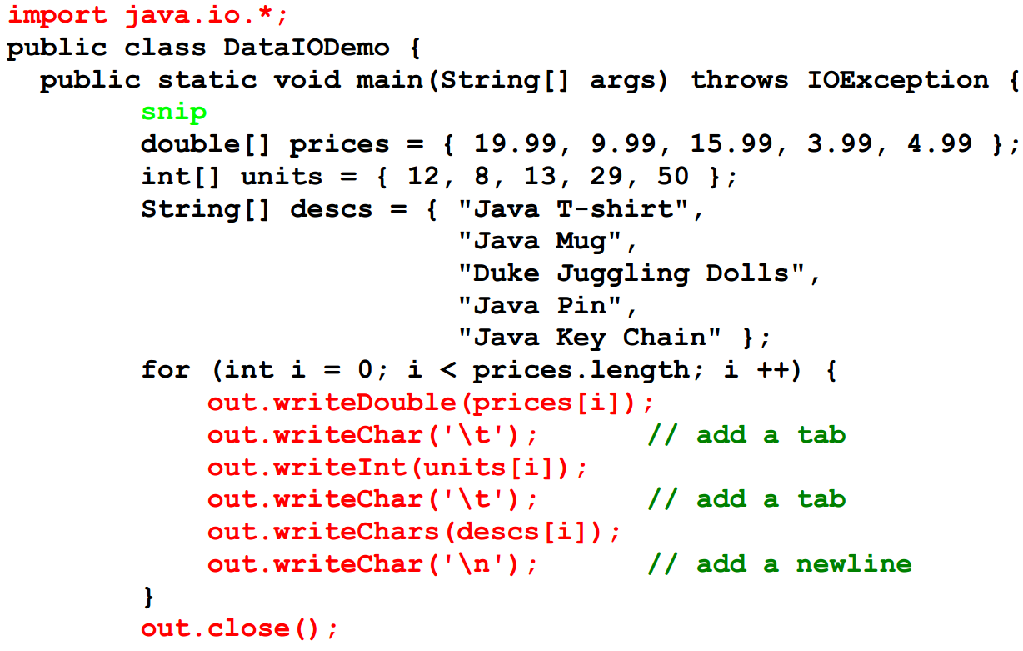
OutputStream, Example, cont.

Slide 18
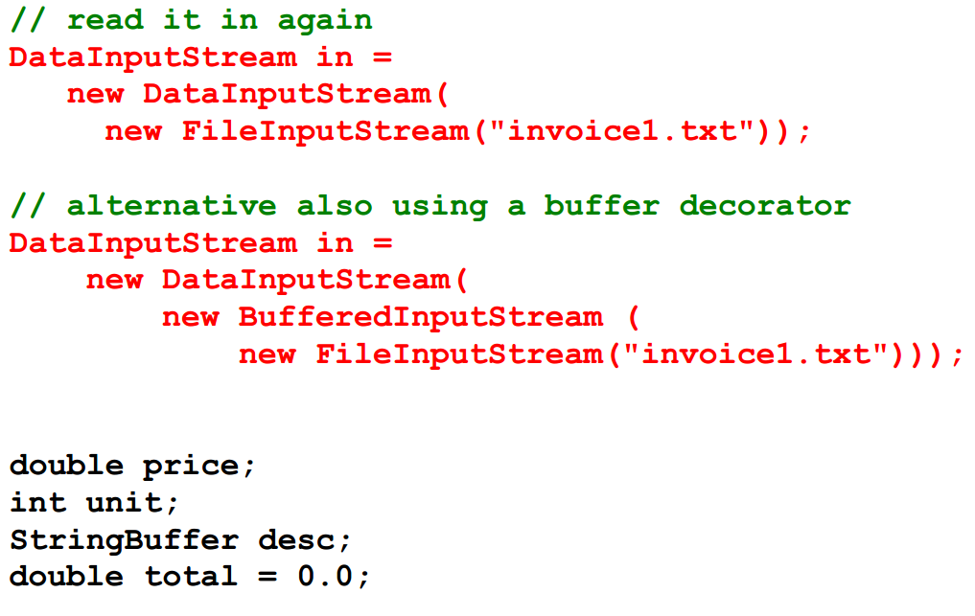
InputStream, Example

Slide 19
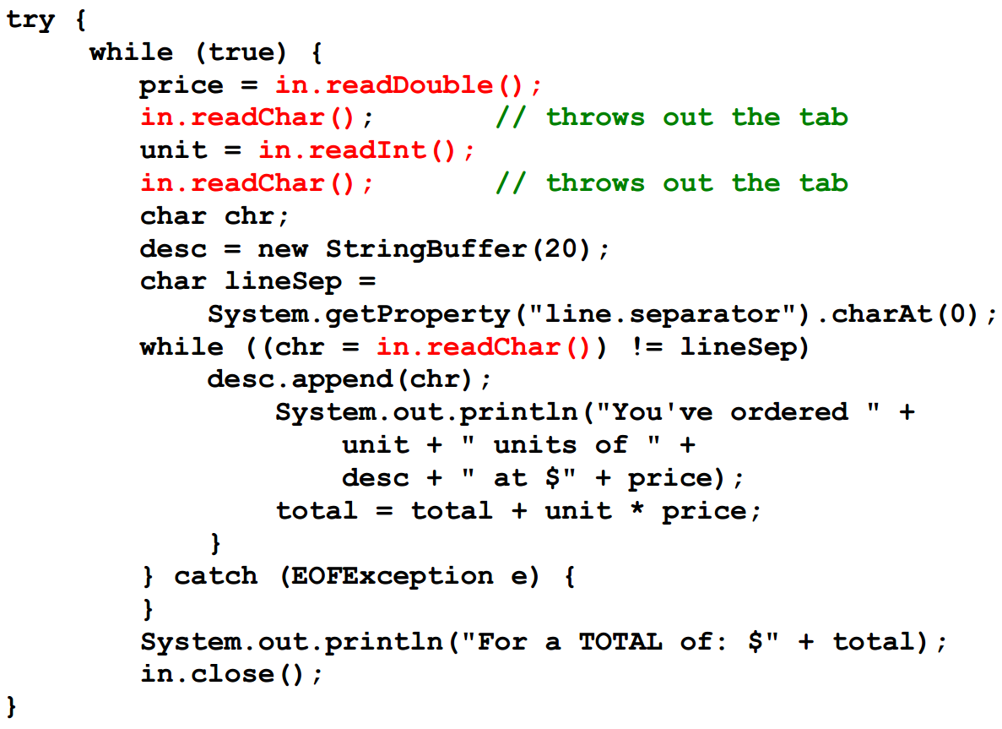
InputStream, Example, cont.

Slide 20
Reader and Writer Classes
Added in Java 1.1
Not meant to replace InputStream and OutputStream
Internationalization Unicode support
Efficiency, designed to solved efficiency problems
Structured in class hierarchies similar to the InputStream and OutputStream hierarchies
Are also using the decorator design pattern

Slide 21
FileReader and FileWriter, Example

Slide 22
Object Serialization
Very hard to do in other programming languages!
Class must implement the Serializable interface
Uses
Output: ObjectOutputStream
writeObject()
Input: ObjectInputStream
readObject()
All relevant parts (the web of object) are serialized.
Lightweight persistence
used in RMI (send objects across a network)
used in JavaBeans

Slide 23
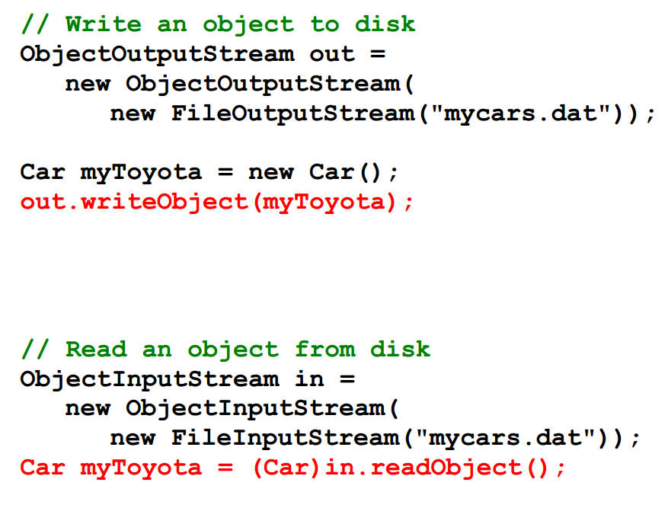
Object Serialization, Example

Slide 24
Review Input/Output
Streams a large class hierarchy for input and output.
The decorator pattern is the key to understanding it
The decorator design pattern may seem strange
Very flexible, but requires extra coding in clients.
There is no C-like printf functionality
For objects to live between program invocations use the
Serializable interface

Slide 25
Sorting Data
Practical today is about sorting data
Why is sorting data so important?
Different sorting algorithms and how to implement them in Java
e.g., bubble sort, merge sort, ..
Note you’ll need to use concepts, such as, Comparable, which we covered in Lecture 4 (i.e., inherence and interfaces)
Chapter 14 in the Recommended Text

Slide 26
Sorting
Sorting is a classic subject in computer science
Sorting algorithms shows creative approaches to problem solving (applied to solve a variety of other problems)
Sorting algorithms are good for practicing fundamental programming techniques using selection statements, loops, methods, and arrays.
Sorting algorithms are excellent examples to demonstrate algorithm performance.

Slide 27
This Week
Read Associated Chapters
Review Slides
Java Exercises
Online Quizzes

Slide 28
Summary
Overview Common Java Classes
Hands-On/Practical
Today is about becoming familiar with Common Classes in Java

Slide 29
Exercises
Chapter 24.1-24.3
Extended Chapters
Note you’ll need to use concepts, such as, Comparable, which we covered in Lecture 4 (i.e., inherence and interfaces)
Chapter 14 in the Recommended Text

Slide 30
Questions/Discussion
No Lecture
*Revision Week [28/11/2017]

