Slide 1
Notation Part 1
Object Orientated Analysis and Design
Benjamin Kenwright

Slide 2
Version Control
Example
Team Princess
3 Members
3 Github Users
e.g.,
Elva1997,
michelle0924hhx,
KimJaeHwang
Each user can join and have lots of repositories.
All members of the common team repository
https://github.com/princess2017

Slide 3
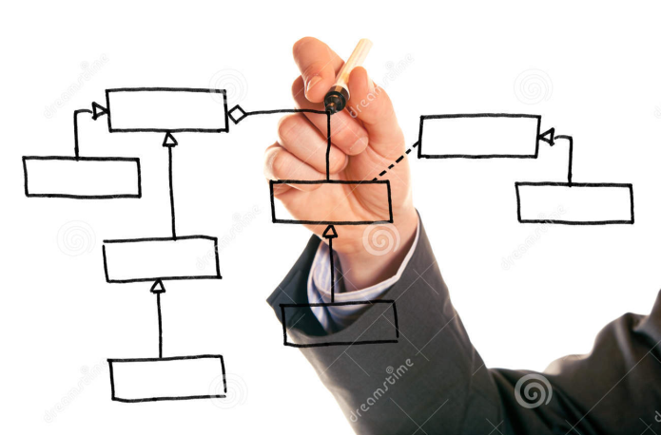
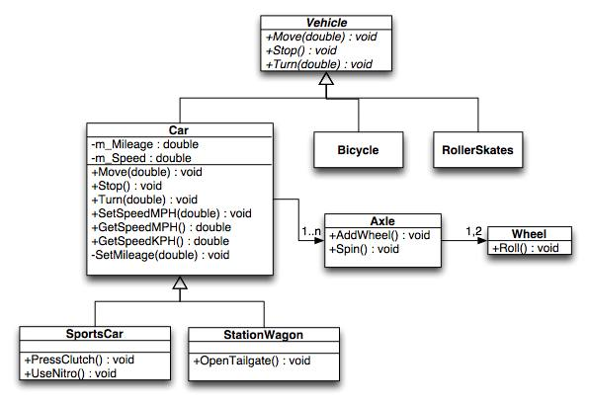
Outline
Review
What do we mean by Notation?
UML Diagrams
Examples of Notation in Analysis and Design
Summary/Discussion
Conclusion

Slide 4
Revision Question
Requirements analysis is critical to the success of a development project.
a) True
b) False
c) Depends upon the size of project

Slide 5
Answer
Answer a)
Explanation: Requirements must be actionable, measurable, testable, related to identified business needs or opportunities, and defined to a level of detail sufficient for system design

Slide 6
Question
Requirements should specify ‘what’ but not ‘how’.
a) True
b) False

Slide 7
Answer
Answer: a)
Explanation: ‘What’ refers to a system’s purpose, while ‘How’ refers to a system’s structure and behavior.

Slide 8
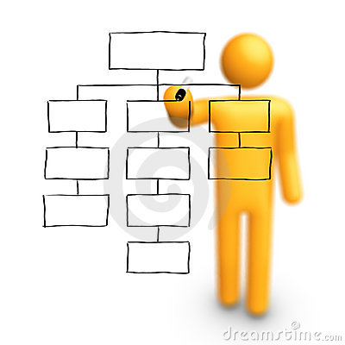
Diagrams
Drawing a diagram does not constitute analysis or design
However, diagrams provide visual aids
Clarifying the concept
Various forms, e.g., 3d-software, whiteboards, napkins, and the backs of envelopes

Slide 9
The Unified Modeling Language (UML)
Primary modeling language used to analyze, specify and design software systems
UML is used to model (i.e., represent) the system being built

Slide 10
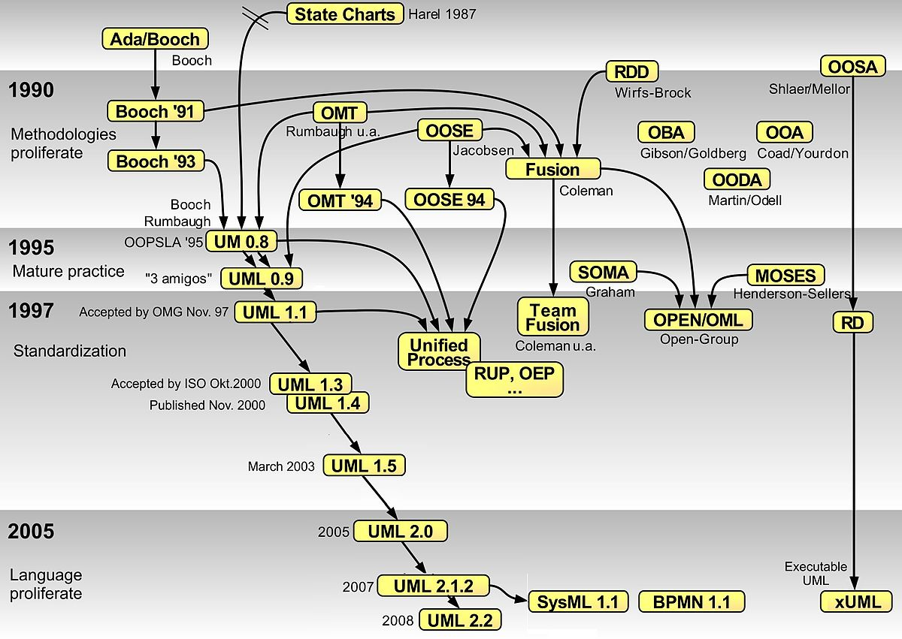

Slide 11

UML has Many Types
Of Diagrams

Slide 12
UML
Unified Modeling Language (UML): is a standardized general-purpose modeling language in the field of object-oriented software engineering. The standard is managed and was created by the Object Management Group (OMG)
UML includes a set of graphic notation techniques to create visual models of object-oriented software-intensive systems.
UML defines different types of diagrams: class (package), object, use case, sequence, collaboration, activity, component, and deployment.
UML has various types of diagrams divided into two main categories

Slide 13
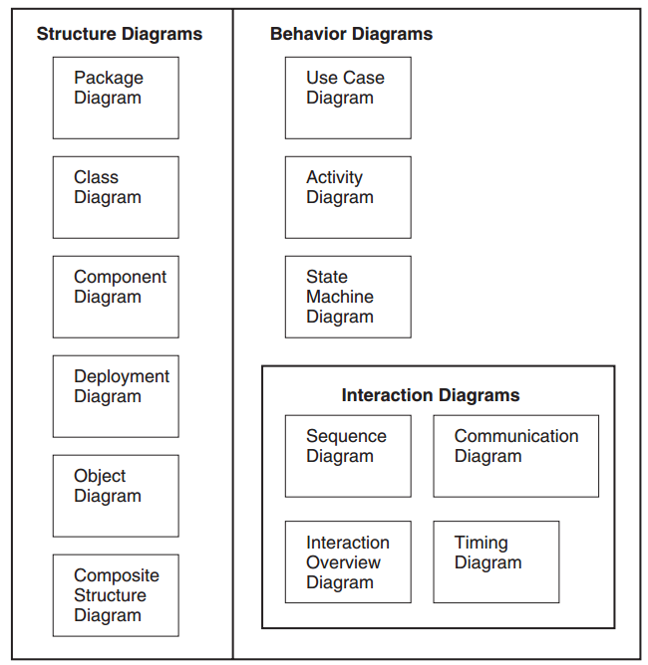
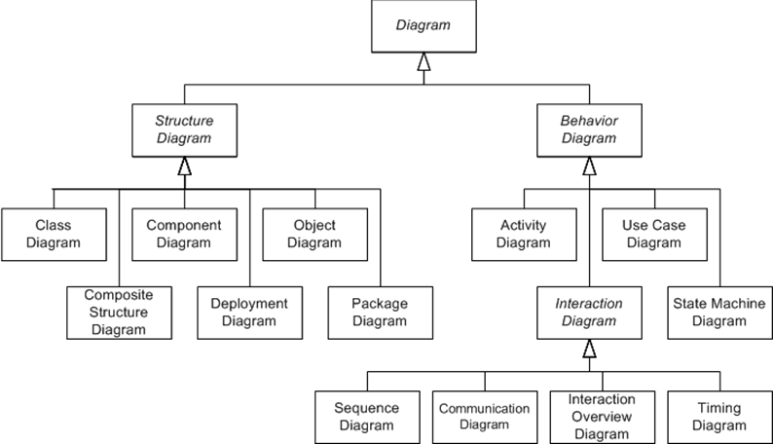
UML Diagrams

Slide 14
UML Diagrams

Slide 15
Two UML Views of System Model
Static (or structural) view: emphasizes the static structure of the system using objects, attributes, operations and relationships. It includes class diagrams and composite structure diagrams.
Dynamic (or behavioral) view: emphasizes the dynamic behavior of the system by showing collaborations among objects and changes to the internal states of objects. This view includes sequence diagrams, activity diagrams and state machine diagrams

Slide 16
Two UML Views of the System Model
Structure Diagrams
Behavior Diagrams
Package Diagram
Component Diagram
Deployment Diagram
Composite Structure Diagrams
Class Diagram
Sequence Diagram
Object Diagrams
Use Case Diagram
Activity Diagram
State Machine Diagrams
Interaction Diagrams
Communication Diagrams
Interaction Overview Diagrams
Timing Diagrams

Slide 17
Question
Is a “Class Diagram” a static or dynamic system model view?
Static (or Structural)
Dynamic (or Behavioral)

Slide 18
Answer
Static (or Structural)

Slide 19

Activity
Write down as many UML diagram views as you can remember
Also state if they’re Static (Structural) or Dynamic (Behavioral)

Slide 20
Structure Diagrams
Structure diagrams emphasize the things that must be present in the system being modelled
Since structure diagrams represent the structure, they are used extensively in documenting the software architecture of software systems.
For example, the component diagram describes how a software system is split up into components and shows the dependencies among these components.

Slide 21
Behavior Diagrams
Behavior diagrams emphasize what must happen in the system being modelled
Since behavior diagrams illustrate the behavior of a system, they are used extensively to describe the functionality of software systems
As an example, the activity diagram describes the business and operational step-by-step activities of the components in a system

Slide 22
Plan
Review diagrams in an order in which one might typically develop them
i.e., instead of reviewing all the structural and then behavioral diagrams seperately

Slide 23
Package Diagrams
Package Diagrams
Component Diagrams
Deployment Diagrams
Use Case Diagrams
Activity Diagrams
Class Diagrams
Sequence Diagrams
Interaction Overview Diagrams
Composite Structure Diagrams
State Machine Diagrams
Timing Diagrams
Object Diagrams
Communication Diagrams

Slide 24
Package Diagram
A package diagram provides the means to organize the artifacts of the development process to clearly present the analysis of the problem space and the associated design
The specific reasons will be varied but will either focus on physically structuring the visual model itself or on clearly representing the model elements through multiple views

Slide 25
Problem (Rational for Package Diagrams)
At the beginning of the project, you only have a limited number of components and everything is simple and beautiful
However, when time flies, more and more components have been created and they start to become unmanageable
As a result, your project becomes hard to navigate and components become difficult to locate when you want to review or make changes

Slide 26
Package Diagrams to the Rescue
How can we fix this problem?
We can make use of Package Diagrams to organize the components into different packages
This helps us categorizing our components according to their natures, making them easier to navigated and locate

Slide 27
Visibility
Public (+) Visible to elements within its containing package, including nested packages, and to external elements
Private (-) Visible only to elements within its containing package and to nested packages

Slide 28
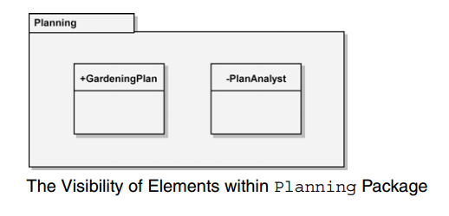
Example

Slide 29
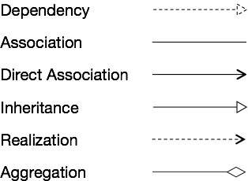
Dependencies between UML elements (including Packages)
Notations for the different types of relationships are as follows

Slide 30
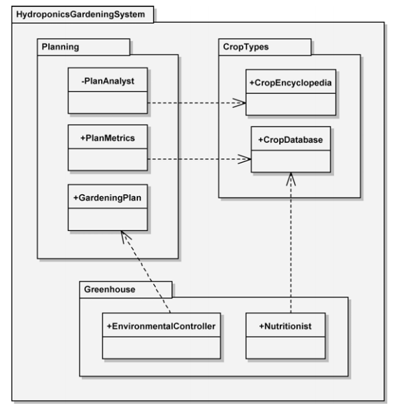
Example

Slide 31
Component Diagrams
Package Diagrams
Component Diagrams
Deployment Diagrams
Use Case Diagrams
Activity Diagrams
Class Diagrams
Sequence Diagrams
Interaction Overview Diagrams
Composite Structure Diagrams
State Machine Diagrams
Timing Diagrams
Object Diagrams
Communication Diagrams

Slide 32
Component Diagram
A component diagram shows the internal structure of components and their dependencies with other components
This diagram provides the representation of components, collaborating through well-defined interfaces, to provide system functionality

Slide 33
Component Notation
Component is a structured classifier, its detailed assembly can be shown with a composite structure using
Parts
Ports, and
Connectors

Slide 34
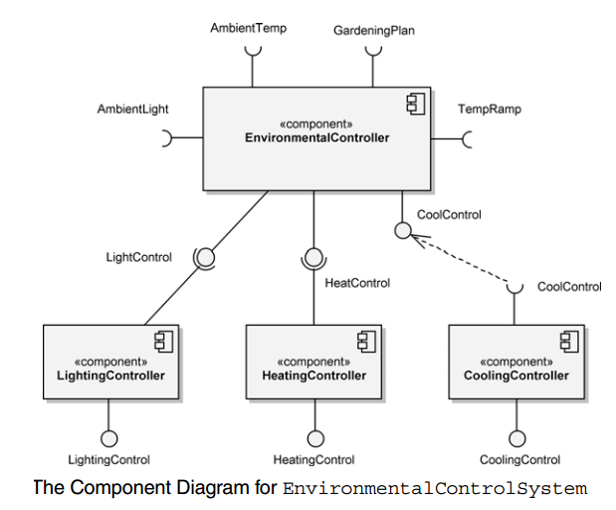
Example

Slide 35
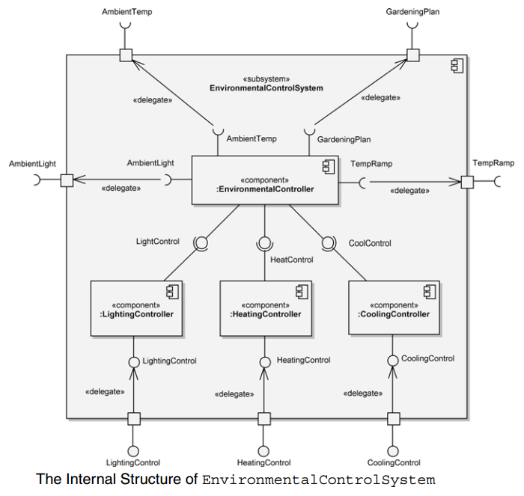
A Component’s Internal Structure

Slide 36
Deployment Diagrams
Package Diagrams
Component Diagrams
Deployment Diagrams
Use Case Diagrams
Activity Diagrams
Class Diagrams
Sequence Diagrams
Interaction Overview Diagrams
Composite Structure Diagrams
State Machine Diagrams
Timing Diagrams
Object Diagrams
Communication Diagrams

Slide 37
Deployment Diagram
A deployment diagram is used to show the allocation of artifacts to nodes in the physical design of a system.
A single deployment diagram represents a view into the artifact structure of a system.
The three essential elements of a deployment diagram are artifacts, nodes, and their connections.

Slide 38
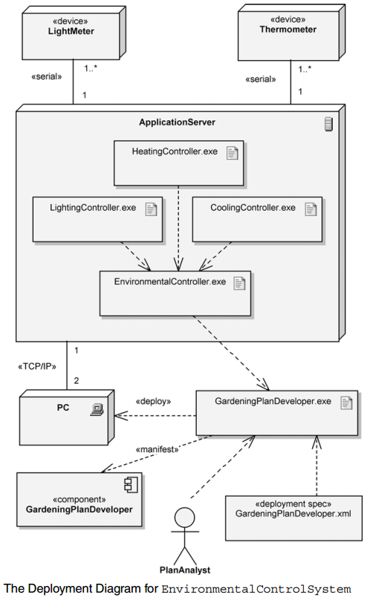
Example

Slide 39
Question
The three essential elements of a deployment diagram are:
a) nodes, connections and their elements
b) artifacts, nodes, and their connections
c) elements, relationships and connectors
d) inheritance, relationships and connectors

Slide 40
Answer
b) artifacts, nodes, and their connections

Slide 41
Use Case Diagrams
Package Diagrams
Component Diagrams
Deployment Diagrams
Use Case Diagrams
Activity Diagrams
Class Diagrams
Sequence Diagrams
Interaction Overview Diagrams
Composite Structure Diagrams
State Machine Diagrams
Timing Diagrams
Object Diagrams
Communication Diagrams

Slide 42
Use Case Diagrams
Use case diagrams are used to depict the context of the system to be built and the functionality provided by that system.
They depict who (or what) interacts with the system.
They show what the outside world wants the system to do.

Slide 43
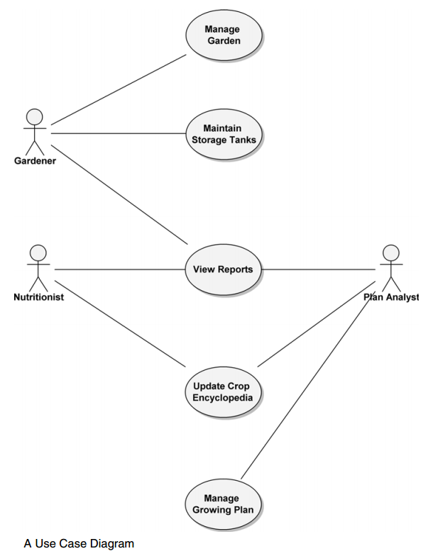
Example

Slide 44
Activity Diagrams
Package Diagrams
Component Diagrams
Deployment Diagrams
Use Case Diagrams
Activity Diagrams
Class Diagrams
Sequence Diagrams
Interaction Overview Diagrams
Composite Structure Diagrams
State Machine Diagrams
Timing Diagrams
Object Diagrams
Communication Diagrams

Slide 45
Activity Diagram
Activity diagrams provide visual depictions of the flow of activities, whether in a system, business, workflow, or other process
These diagrams focus on the activities that are performed and who (or what) is responsible for the performance of those activities.

Slide 46
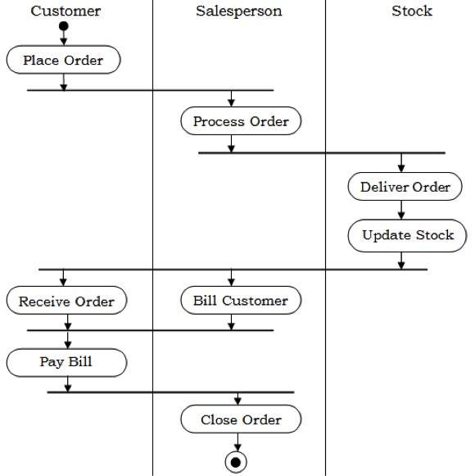
Example

Slide 47
Class Diagrams
Package Diagrams
Component Diagrams
Deployment Diagrams
Use Case Diagrams
Activity Diagrams
Class Diagrams
Sequence Diagrams
Interaction Overview Diagrams
Composite Structure Diagrams
State Machine Diagrams
Timing Diagrams
Object Diagrams
Communication Diagrams

Slide 48
Class Diagram
A class diagram is used to show the existence of classes and their relationships in the logical view of a system
During analysis, class diagrams indicate the common roles and responsibilities of the entities that provide the system’s behavior
During design, class diagrams capture the structure of the classes that form the system’s architecture

Slide 49
Visibility
Public (+) Visible to any element that can see the class
Protected (#) Visible to other elements within the class and to subclasses
Private (-) Visible to other elements within the class
Package (~) Visible to elements within the same package

Slide 50
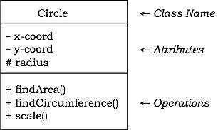
Diagrammatic Representation of a Class

Slide 51
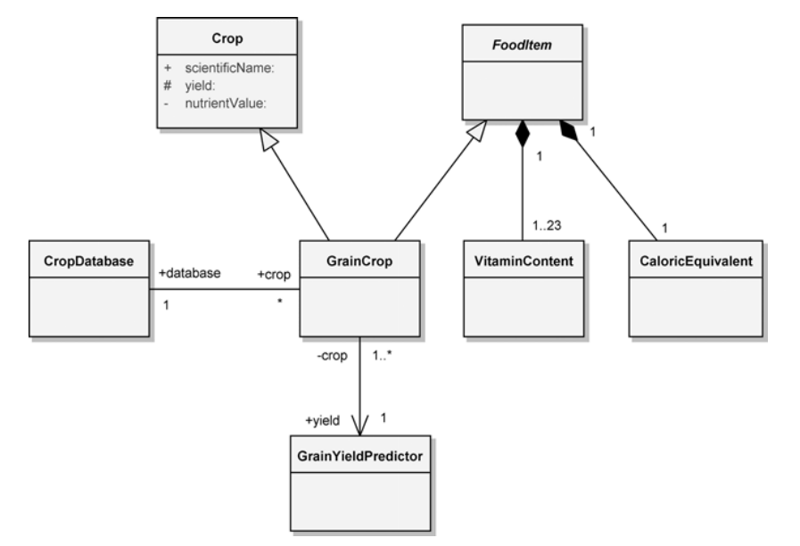
Example

Slide 52
UML Diagrams
Package Diagrams
Component Diagrams
Deployment Diagrams
Use Case Diagrams
Activity Diagrams
Class Diagrams
Sequence Diagrams
Interaction Overview Diagrams
Composite Structure Diagrams
State Machine Diagrams
Timing Diagrams
Object Diagrams
Communication Diagrams
Next Week

Slide 53
Remember
The limitations of UML are the same as any form of communication
The simpler your language, the fewer things you can communicate and the clearer your communications will become
A shape like a square or circle identifies a structure, a line indicates relationship, an arrow indicates movement, or flow

Slide 54
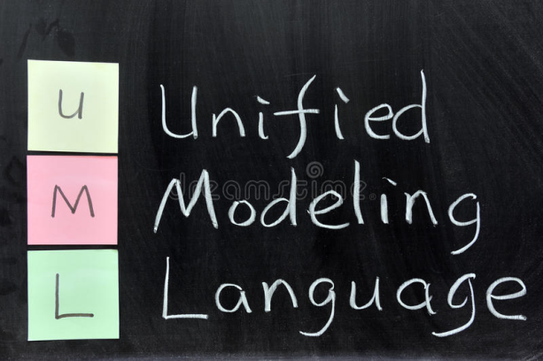

Summary
Fundamentals of Notation in Object Orientated Analysis and Design
Specifically UML and the Different Models/Diagrams
Designing is not the act of drawing a diagram; a diagram simply captures a design

Slide 55
This Week
Review Slides
Read Chapters 5 and 6
Online Quizzes
Version Control (GitHub)

Slide 56
Questions/Discussion

