Slide 1
Polymorphism
Object Orientated Programming in Java
Benjamin Kenwright

Slide 2
Quizzes/Labs
Every single person should have done
  Quiz 00 – Introduction
  Quiz 01 - Java Basics
Every single person should have at least submitted an attempt at the exercises

Slide 3
Outline
Why use polymorphism?
Upcast (and downcast)
Static and dynamic type
Dynamic binding
Polymorphism
  A polymorphic field (the state design pattern)Today’s Practical
Review/Discussion
Summary

Slide 4
Question
Which of these keyword must be used to inherit a class?
a) super
b) this
c) extent
d) extends

Slide 5
Answer
d) extends

Slide 6
Question
Which of these keywords is used to refer to member of base class from a sub class?
a) upper
b) super
c) this
d) None of the mentioned

Slide 7
Answer
Answer: b)
Explanation: whenever a subclass needs to refer to its immediate superclass, it can do so by use of the keyword super.

Slide 8
Question
A class member declared protected becomes member of subclass of which type?
a) public member
b) private member
c) protected member
d) static member

Slide 9
Answer
Answer: b)
Explanation: A class member declared protected becomes private member of subclass.

Slide 10
Question
Which of these is correct way of inheriting class A by class B?
a) class B + class A {}
b) class B inherits class A {}
c) class B extends A {}
d) class B extends class A {}

Slide 11
Answer
Answer: c)

Slide 12
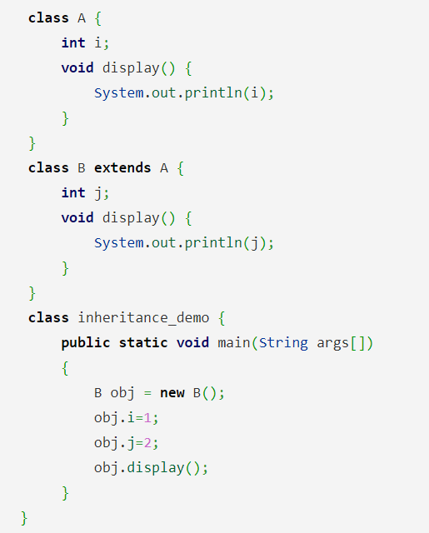
Question
What is the output of this program?
a) 0
b) 1
c) 2
d) Compiler Error

Slide 13
Answer
Answer: c
Explanation: class A & class B both contain display() method, class B inherits class A, when display() method is called by object of class B, display() method of class B is executed rather than that of Class A.
output:
$ javac inheritanceDemo.java
$ java inheritanceDemo
2

Slide 14
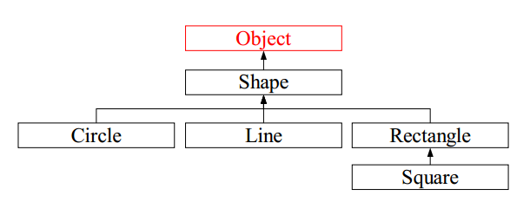
Review Class Hierarchies in Java
Class Object is the root of the inheritance hierarchy in Java
If no superclass is specified a class inherits implicitly from Object
If a superclass is specified explicitly the subclass will inherit indirectly from Object

Slide 15
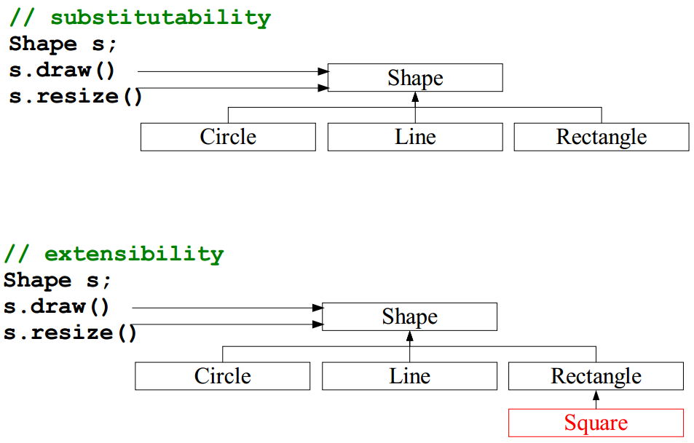
Why Polymorphism?

Slide 16
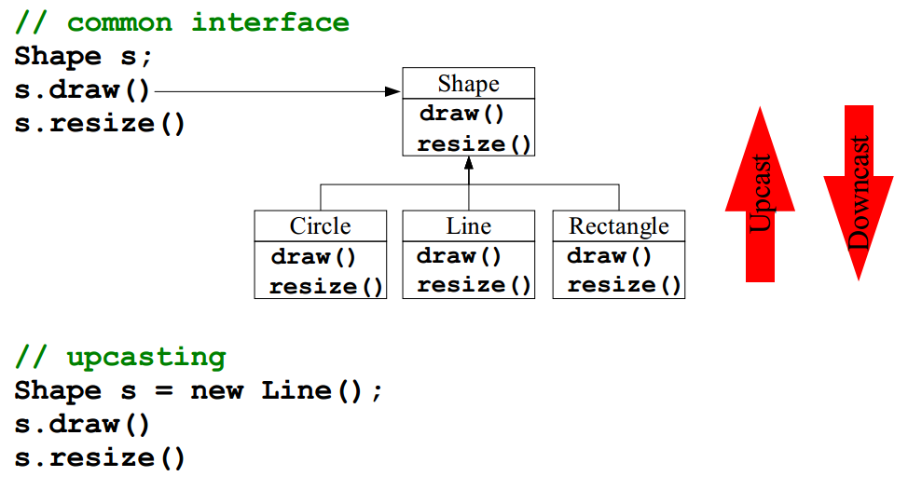

Why Polymorphism?, cont.

Slide 17
Advantages of Upcasting
Advantages
  Code is simpler to write (and read)
  Uniform interface for clients, i.e., type specific details only in class code, not in the client code
  Change in types in the class does not effect the clients
    If type changed within the inheritance hierarchy
  Popular in object-oriented programs
    Many upcast to Object in the standard library

Slide 18
Disadvantages of Upcasting
Disadvantages
  Must explicitly downcast if type details needed in client after object has been handled by the standard library (very annoying sometimes).
Shape s = new Line();
Line l = (Line) s; // downcast

Slide 19
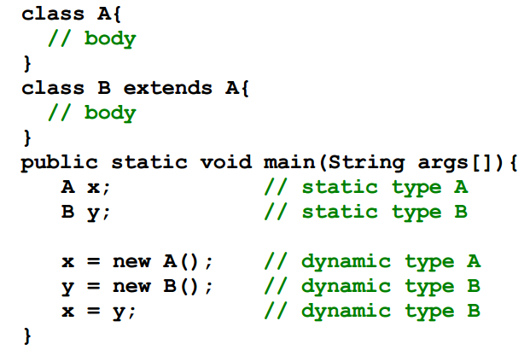
Static and Dynamic Type
The static type of a variable/argument is the declaration type
The dynamic type of a variable/argument is the type of the object the variable/argument refers to

Slide 20
Polymorphism
Informal Example
In a bar you say “I want a beer!”
  What ever beer you get is okay because your request was very generic
In a bar you say “I want a Samuel Adams Cherry Flavored beer!”
  If you do not exactly get this type of beer you are allowed to complain
In chemistry they talk about polymorph materials as an example
  H20 is polymorph (ice, water, and steam)

Slide 21
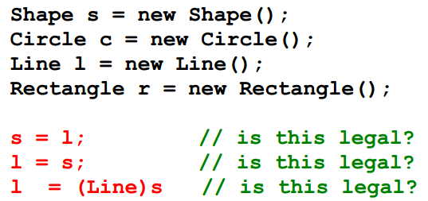
Polymorphism
Polymorphism: “The ability of a variable or argument to refer at run-time to instances of various classes”
The assignment s = l is legal if the static type of l is Shape or
a subclass of Shape
This is static type checking where the type comparison rules can be done at compile-time
Polymorphism is constrained by the inheritance hierarchy

Slide 22
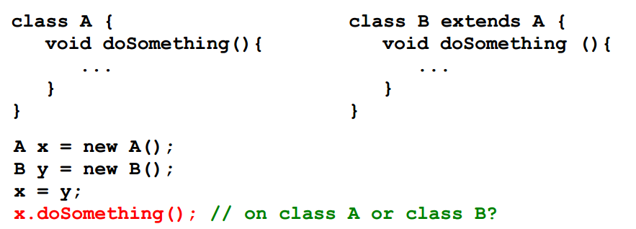
Dynamic Binding
Binding: Connecting a method call to a method body
Dynamic binding: The dynamic type of x determines which method is called (also called late binding)
  Dynamic binding is not possible without polymorphism
Static binding: The static type of x determines which method is called (also called early binding)

Slide 23
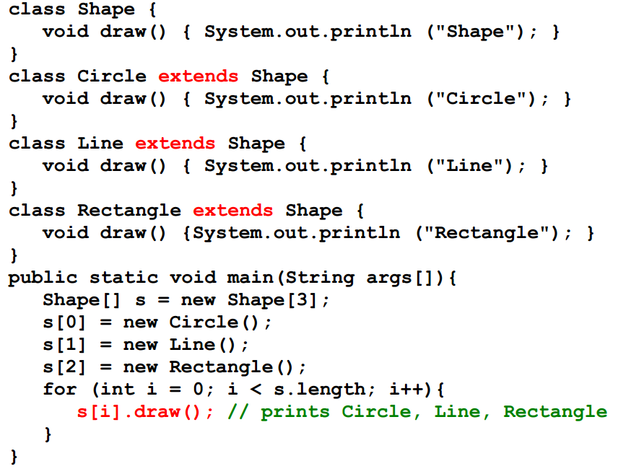
Dynamic Binding, Example

Slide 24
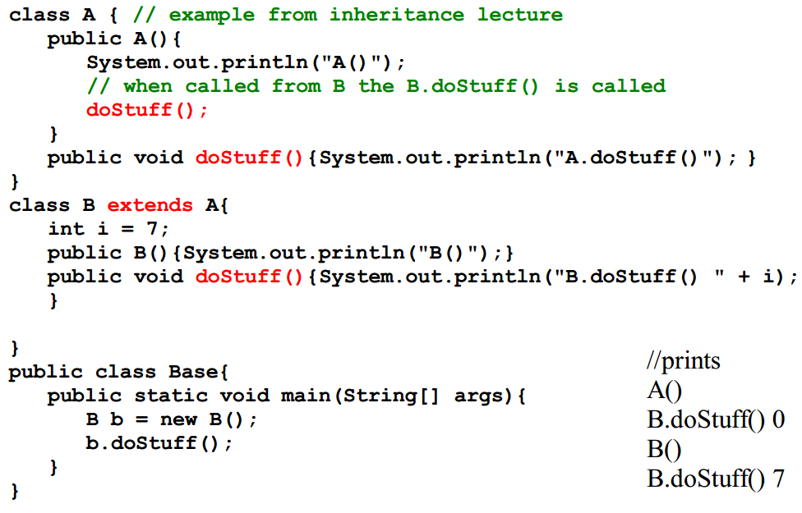
Polymorphism and Constructors

Slide 25
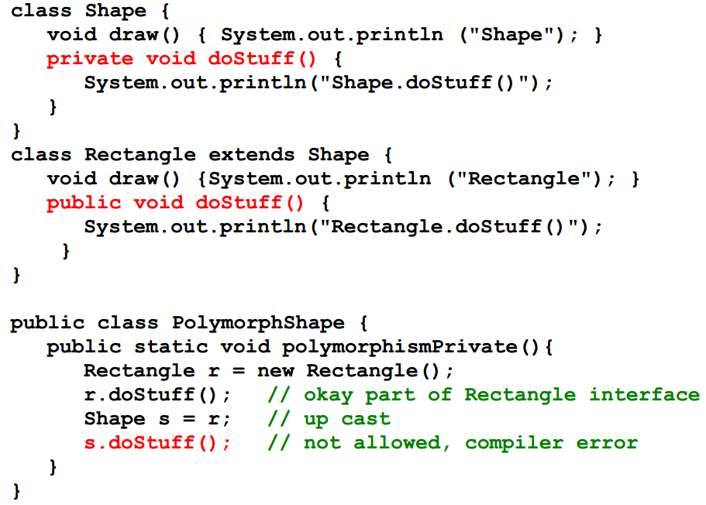
Polymorphism and private Methods

Slide 26
Why Polymorphism and Dynamic Binding?
Separate interface from implementation
  What we are trying to achieve in object-oriented programming!
Allows programmers to isolate type specific details from the main part of the code
  Client programs only use the method provided by the Shape class in the shape hierarchy example.
Code is simpler to write and to read
Can change types (and add new types) with this propagates to existing code

Slide 27
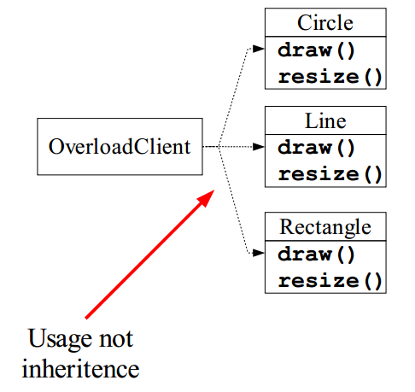
Overloading vs. Polymorphism (1)
Has not yet discovered that the Circle, Line and Rectangle classes are related. (not very realistic but just to show the idea)

Slide 28
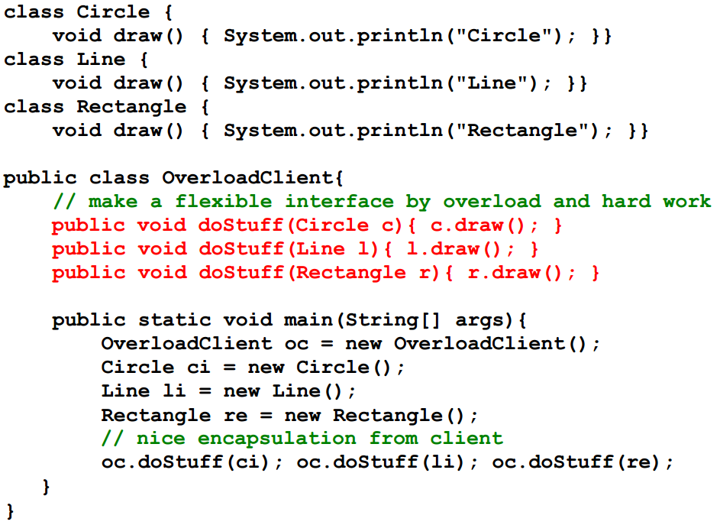
Overloading vs. Polymorphism (2)

Slide 29
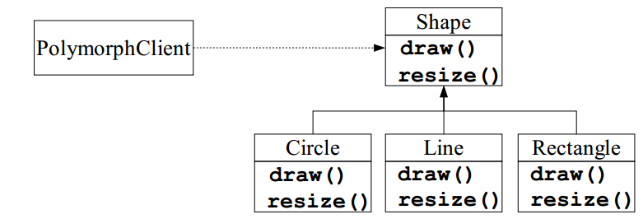
Overloading vs. Polymorphism (3)
Discovered that the Circle, Line and Rectangle class are related are related via the general concept Shape
Client only needs access to base class methods

Slide 30
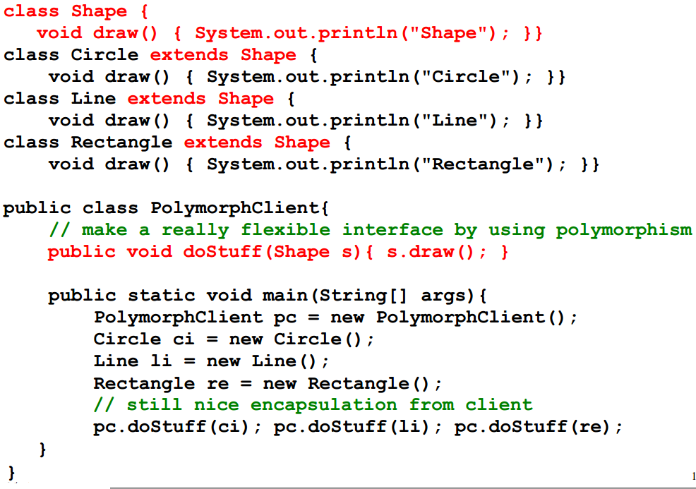
Overloading vs. Polymorphism (4)

Slide 31
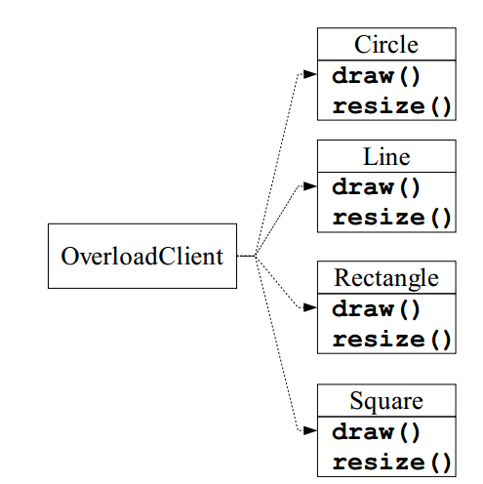
Overloading vs. Polymorphism (5)
Must extend with a new class Square and the client has still not discovered that the Circle, Line, Rectangle, and Square classes are related

Slide 32
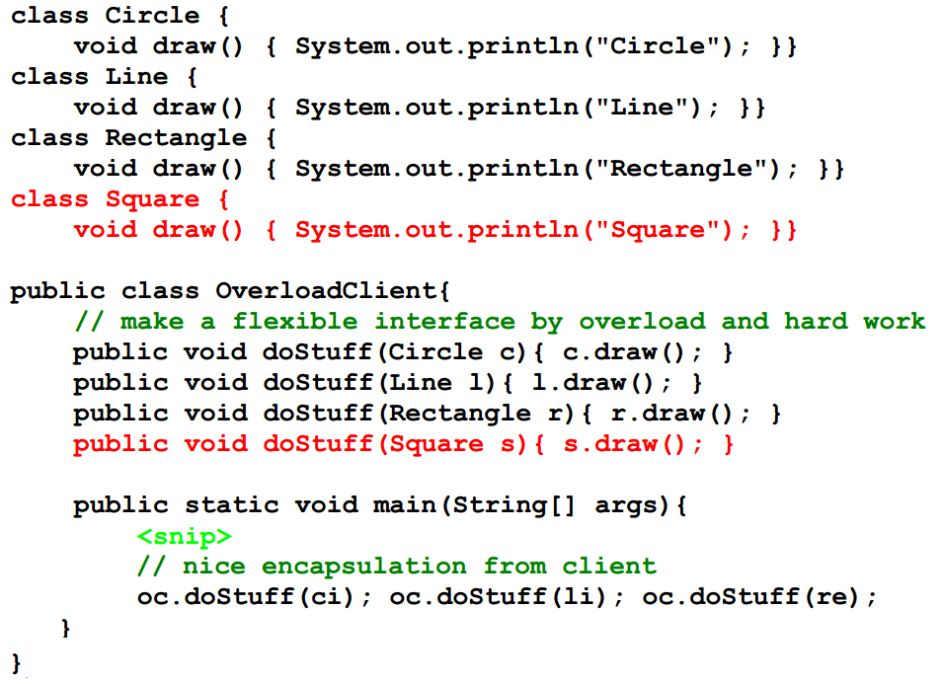
Overloading vs. Polymorphism (6)

Slide 33
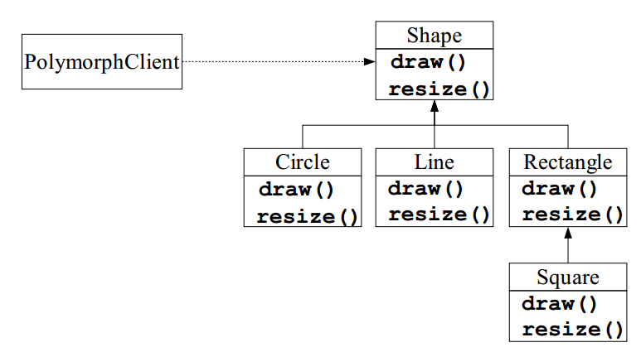
Overloading vs. Polymorphism (7)
Must extend with a new class Square that is a subclass to Rectangle

Slide 34
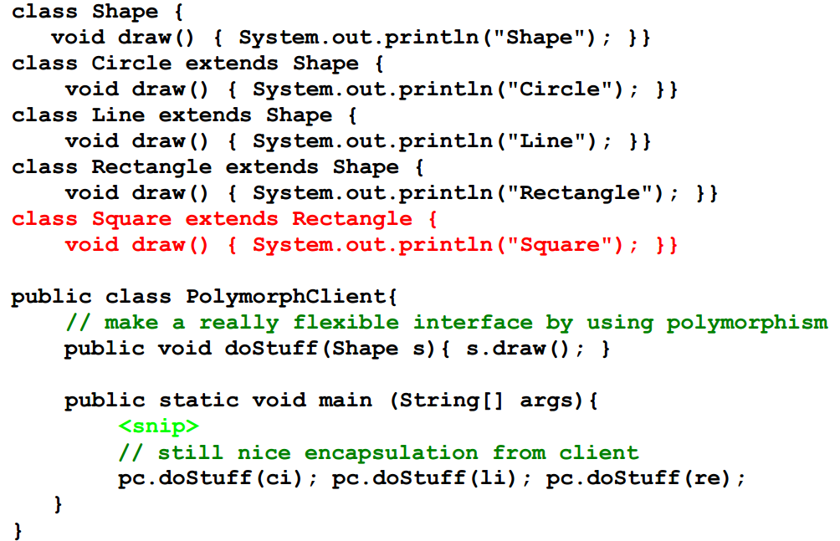
Overloading vs. Polymorphism (8)

Slide 35
The Opened/Closed Principle
Open
  The class hierarchy can be extended with new specialized classes
Closed
  The new classes added do not affect old clients
  The superclass interface of the new classes can be used by old clients
This is made possible via
  Polymorphism
  Dynamic binding

Slide 36
Abstract Class and Method
An abstract class is a class with an abstract method.
An abstract method is method with out a body, i.e., only declared but not defined.
It is not possible to make instances of abstract classes.
Abstract method are defined in subclasses of the abstract class

Slide 37
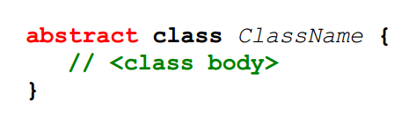
Abstract Classes in Java
Classes with abstract methods must declared abstract
Classes without abstract methods can be declared abstract
A subclass to a concrete superclass can be abstract
Constructors can be defined on abstract classes.
Instances of abstract classes cannot be made
Abstract fields not possible

Slide 38
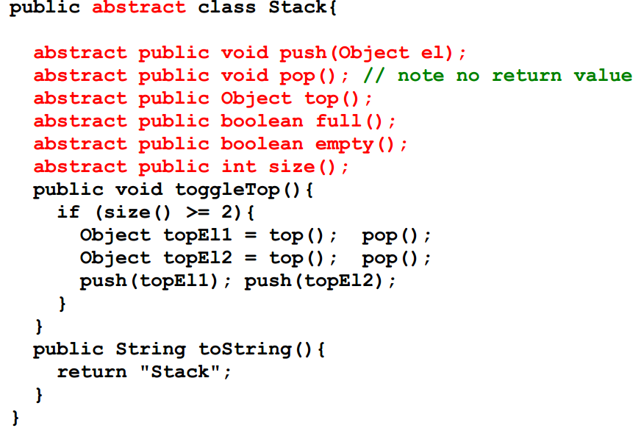
Abstract Class in Java, Example

Slide 39
Abstract Methods in Java
A method body does not have be defined
Abstract method are overwritten in subclasses
Idea taken directly from C++
  pure virtual function
You are saying: “The object should have this properties I just do not know how to implement the property at this level of abstraction.”

Slide 40
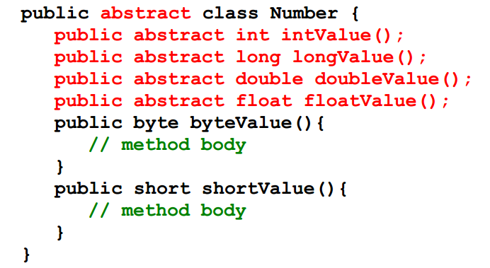
Abstract Methods in Java, Example

Slide 41
Today
Exercises
  [14.1-14.3]
  Submit online your java implementations (single .zip with your student number)
Ensure you’re totally comfortable with object orientated principles
  e.g., inheritance, polymorphism, casing, types, classes, objects, interfaces, abstract classes, …

Slide 42
This Week
Read Associated Chapters
Review Slides
Java Exercises
Online Quizzes

Slide 43
Summary
Polymorphism an object-oriented “switch” statement.
Polymorphism should strongly be preferred over overloading
  Must simpler for the class programmer
  Identical (almost) to the client programmer
Polymorphism is a prerequest for dynamic binding and central to the object-oriented programming paradigm.
  Sometimes polymorphism and dynamic binding are described as the same concept (this is inaccurate).
Abstract classes
  Complete abstract class no methods are abstract but instatiation does not make sense.
  Incomplete abstract class, some method are abstract

Slide 44

Questions/Discussion

Slide 46
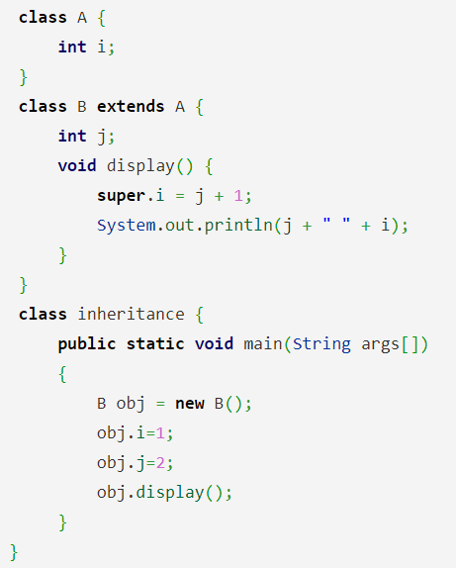
Question
What is the output of this program?
a) 2 2
b) 3 3
c) 2 3
d) 3 2

Slide 47
Answer
Answer: c
output:
$ javac inheritance.java
$ java inheritance
2 3

Slide 48
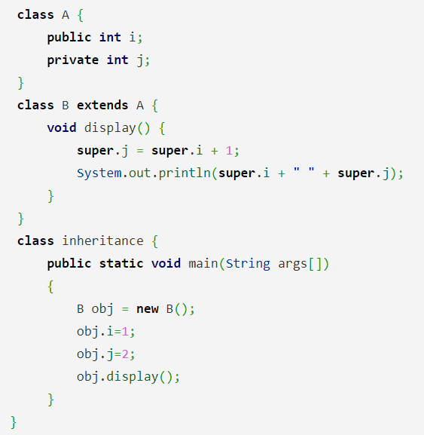
Question
What is the output of this program?
a) 2 2
b) 3 3
c) Runtime Error
d) Compilation Error

Slide 49
Answer
Answer: d)
Explanation: class contains a private member variable j, this cannot be inherited by subclass B and does not have access to it.
output:
$ javac inheritance.java
Exception in thread “main” java.lang.Error: Unresolved compilation problem:
The field A.j is not visible

Slide 50
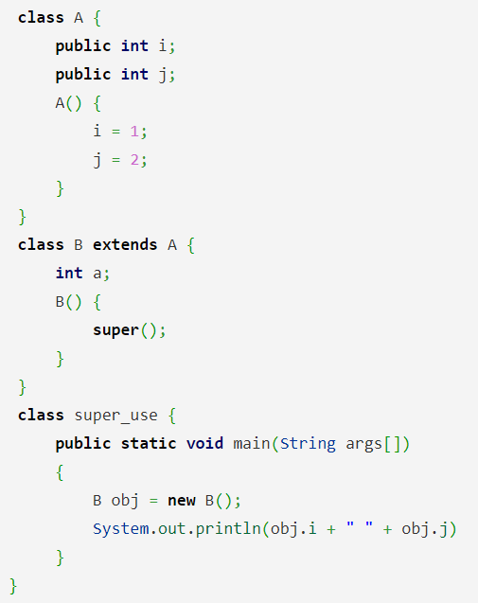
Question
What is the output of this program?
a) 1 2
b) 2 1
c) Runtime Error
d) Compilation Error

Slide 51
Answer
Answer: a)
Explanation: Keyword super is used to call constructor of class A by constructor of class B. Constructor of a initializes i & j to 1 & 2 respectively.
output:
$ javac superExample.java
$ java superExample
1 2

Slide 52
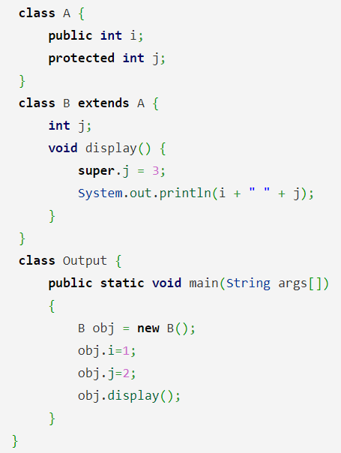
Question
What is the output of this program?
a) 1 2
b) 2 1
c) 1 3
d) 3 1

Slide 53
Answer
Answer: a)
Explanation: Both class A & B have member with same name that is j, member of class B will be called by default if no specifier is used. I contains 1 & j contains 2, printing 1 2.
output:
$ javac Output.java
$ java Output
1 2

