Slide 1
Examples
Object Orientated Analysis and Design
Benjamin Kenwright

Slide 2
Outline
Review
Bringing together all the concepts
Example

Slide 3
Example
Complex System
Develop Solution

Slide 4
Course Registration System
What are we trying to build?
Customer’s problem?
Expand upon the vision statement and associated high-level requirements and constraints
Researching/evidencing
Facts

Slide 5
Simplification
Develop simplified perspective of the problem
Levels to manage the complexity

Slide 6
Ground-Work
Engineering Steps
Realization of a Successful System
System Requirements
Elements and Sub-Systems
Allocation and Interconnection
Meet the System Requirements

Slide 7
Vision Statement
Provide an effective and affordable course registration service for students
Functional Requirements
Provide course registration service
Operate the course registration service
Maintain the course registration service
Nonfunctional Requirements
Level of reliability to ensure adequate service guarantees
Sufficient accuracy to support current and future user needs
Constraints
Compatibility with other systems/standards
Maximal use of commercial-off-the-shelf (COTS) hardware and software

Slide 8
Basic Mechanics
Step 1
• Get the student registration number and his date of birth.
• The registration number should be verified with the existing database of valid registration numbers.
Step 2
• Get the cutoff.
• Compare the cutoffs and record the cutoff along with the student’s registration time.
Step 3
• Display the colleges, whose required cutoff is less than or equal to the student’s total cutoff mark.
• The student must choose his preferred college.
• Display the available courses in the selected college.
• The student must now choose his preferred course.
Step 4
• The student must finally be informed that he has been registered successfully

Slide 9
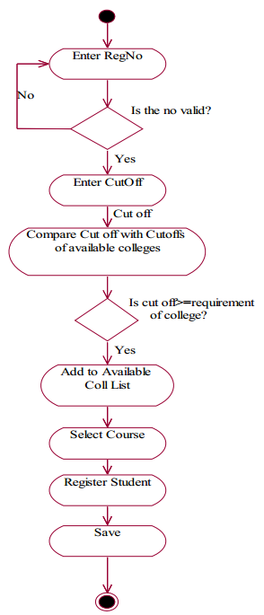
Activity Diagram

Slide 10
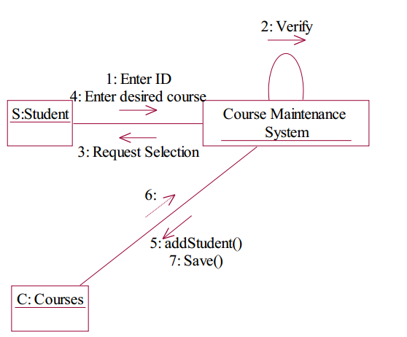
Collaboration Diagram

Slide 11
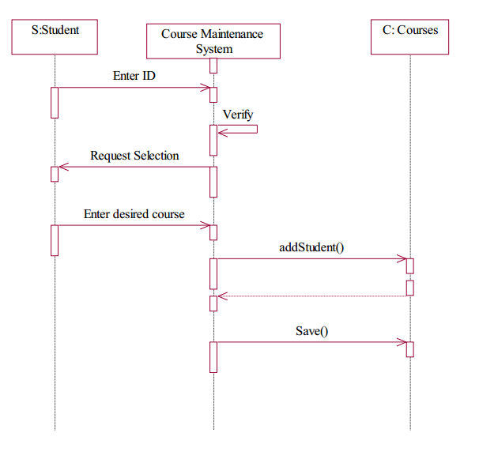
Sequence Diagram

Slide 12
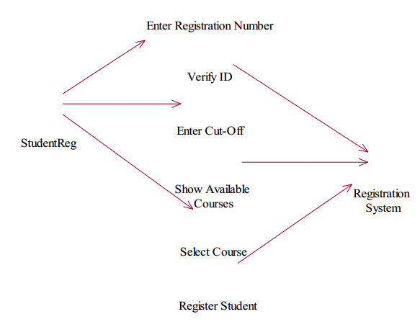
Use Case Diagram

Slide 13
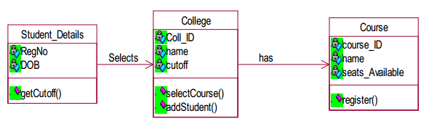
Class Diagram

Slide 14
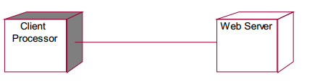
Deployment Diagram

Slide 15
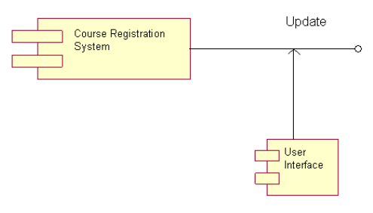
Component Diagram

Slide 16
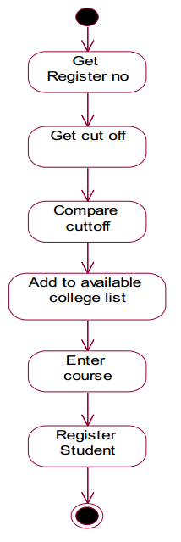
State Chart Diagram

Slide 17
Design/Verification
Testing/verification
Compare against original design
User feedback

Slide 18
Summary
Example Problem/Solution
Review Questions

Slide 19
This Week
Review Slides
Coursework
Reviewing Quiz Questions
Reviewing Associated Chapter

Slide 20
Questions/Discussion

