Slide 1
Classification
Object Orientated Analysis and Design
Benjamin Kenwright

Slide 2
Outline
Review
What do we mean by Classification?
Summary/Discussion
Conclusion

Slide 3
Revision Question
An object is an entity that has:
state, action, dependencies
b) behaviour, action, state
c) class, state, memory
d) state, identity, behavior

Slide 4
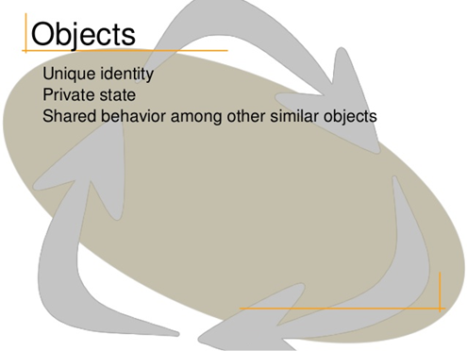
Answer
d) identity, state, behavior

Slide 5
Revision Question
What are the five meaningful metrics to measure the quality of abstraction?
a) Contracts, Cohesion, Completeness, Primitivenes, Sufficiency
b) Cohesion, Coupling, Sufficiency, Completeness, Primitivenes
c) Coupling , Cohesion, Safety, Completeness, Primitivenes

Slide 6
Answer
b) Cohesion, Coupling, Sufficiency, Completeness, Primitivenes

Slide 7
Classification
Classification is the means whereby we order knowledge
  recognize key abstractions and mechanisms with similarities (sameness)
Seeks to group things that have a commonality (e.g., structure or exhibit a common behavior)

Slide 8

Activity
Classify the bowl of objects into groups
(5 Minutes)

Slide 9

Why Classify Objects?

Slide 10
Why Classify Objects?
Helps us to identify generalization, specialization, and aggregation hierarchies among classes
Recognizing common patterns of interaction among objects, we come to invent the mechanisms that serve as the soul of the implementation
Guides decision making about modularization
  We may choose to place certain classes and objects together in the same module or in different modules, depending on the sameness we find among these declarations
Coupling and cohesion also indicate a type of sameness
Plays a role in allocating processes to processors.
  We place certain processes together in the same processor or different processors, depending on packaging, performance, or reliability concerns

Slide 11
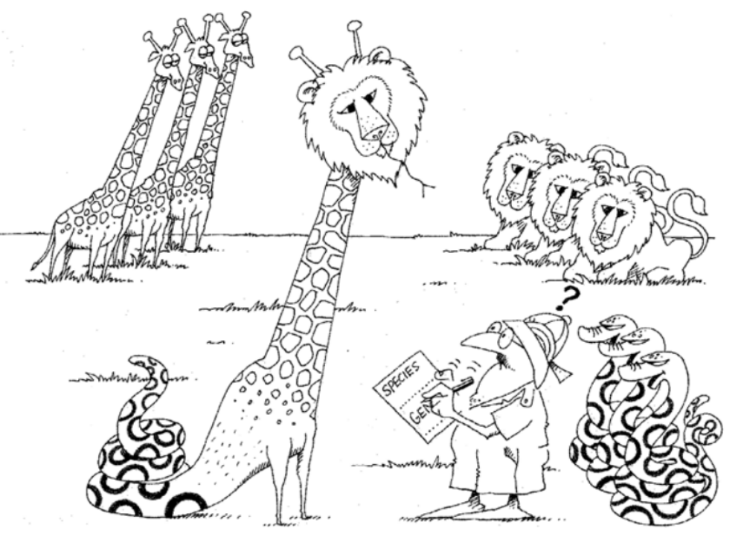
Why is Classification Difficult?

Slide 12
Why is Classification Difficult?
Boundaries are not always absolute
  e.g., fuzzy or overlap multiple classifications
  Example - look at your leg. Where does your knee begin, and where does it end?
  Example - recognizing human speech, how do we know that certain sounds connect to form a word and are not instead a part of any surrounding words?

Slide 13
Classification Dependencies
Classification depends on what you want classification to do
  Highly dependent on the reason for the classification
For example, in Biology, if you want it to reflect precisely the genetic relatedness among species, that will give you one answer. But if you want it instead to say something about levels of adaptation, then you will get another

Slide 14
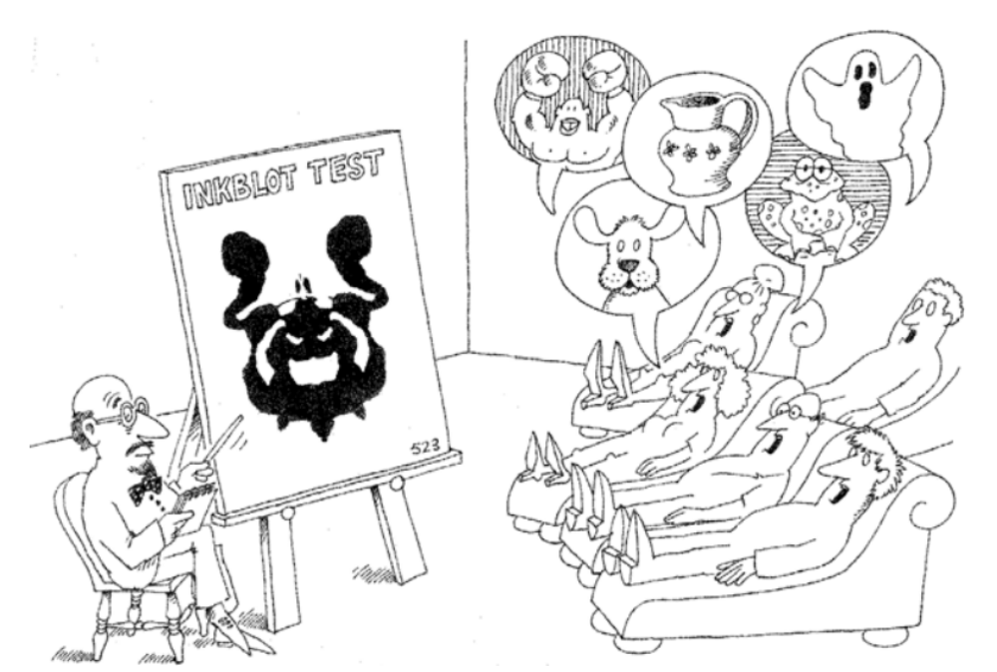
Perspective

Slide 15
Important Factors
Different observers will classify the same object in different ways
Classification is relative to the perspective of the observer doing the classification
Intelligent classification requires a tremendous amount of creative insight
  sometimes the answer is evident, sometimes it is a matter of taste, and at other times, the selection of suitable components is a crucial point in the analysis

Slide 16
Incremental and Iterative Nature of Classification
In practice, it is common to assert a certain class structure early in a design and then revise this structure over time
  Experience, Additional knowledge discoveries, Identify previously unrecognized commonality

Slide 17
Identifying Classes and Objects
Historically, there have been three general approaches to classification:
  1. Classical categorization
  2. Conceptual clustering
  3. Prototype theory

Slide 18
Object-Oriented Analysis
Boundaries between analysis and design are fuzzy
Focus on discovering classes and objects that form the vocabulary of the problem domain
Identify abstractions and mechanisms in our models that will help provide a design solution

Slide 19
Classification Approaches
Approaches for analysis that are relevant to object-oriented systems
  Classical Approaches
  Behavior Analysis
  Domain Analysis
  Use Case Analysis
  CRC Cards
    Class/Responsibilities/Collaborators
  Informal English Description
  Structured Analysis

Slide 20
Key Abstractions and Mechanisms
Identifying Key Abstractions
  appropriate choice of objects depends, of course, on the purposes to which the application will be put and the granularity of information to be manipulated

Slide 21
Question
What are the three approaches to classification:
a) classical categorization, pattern grouping, prototype theory
b) classical categorization, conceptual clustering, prototype theory
c) classical categorization, conceptual clustering, system theory

Slide 22
Answer
b) classical categorization, conceptual clustering, prototype theory

Slide 23
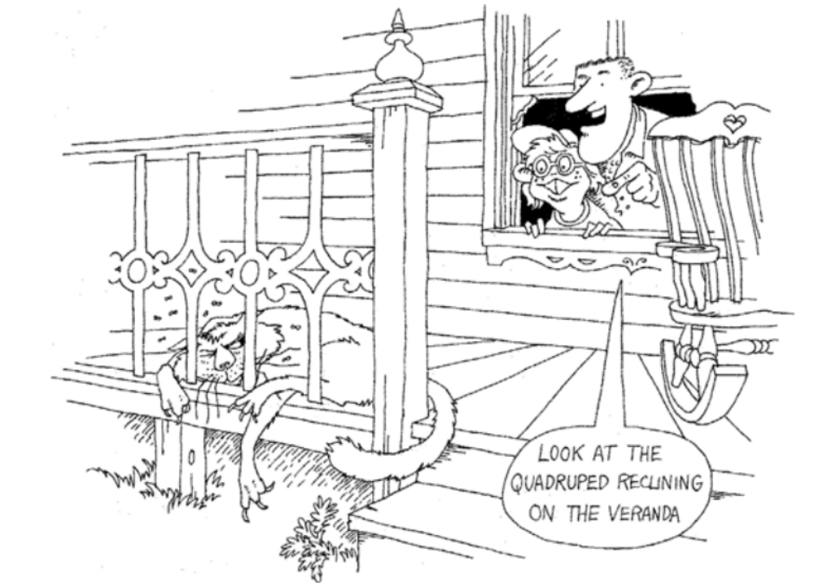
Level of Abstraction

Slide 24
Level of Abstraction
Classes and objects should be at the right level of abstraction: neither too high nor too low

Slide 25
Naming Key Abstractions
Objects should be named with proper noun phrases, such as the Sensor or just simply shape
Classes should be named with common noun phrases, such as Sensor or Shape
The names chosen should reflect the names used and recognized by the domain experts, whenever possible
Modifier operations should be named with active verb phrases, such as draw or moveLeft
Selector operations should imply a query or be named with verbs of the form “to be,” such as extentOf or isOpen
The use of underscores and styles of capitalization are largely matters of personal taste. No matter which cosmetic style you use, at least have your programs be self-consistent

Slide 26
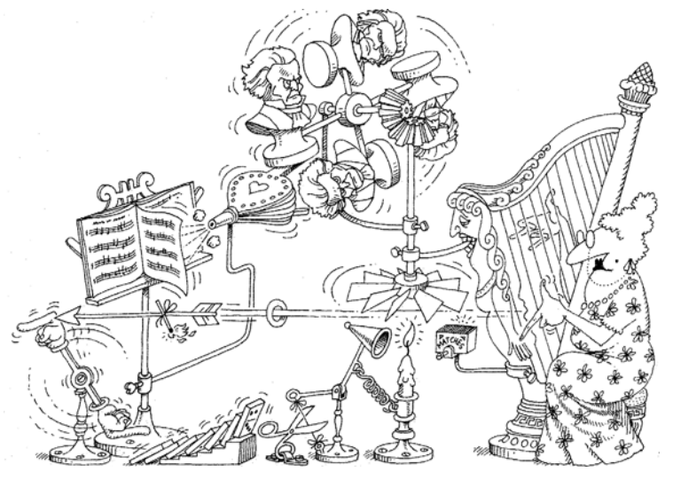
Identifying Mechanisms

Slide 27
Identifying Mechanisms
Mechanisms are the means whereby objects collaborate to provide some higher-level behavior
Mechanisms are actually one in a spectrum of patterns we find in well-structured software systems

Slide 28
Example Mechanisms
A mechanical linkage connects the accelerator directly to the fuel injectors
An electronic mechanism connects a pressure sensor below the accelerator to a computer that controls the fuel injectors (a drive-by-wire mechanism)
No linkage exists. The gas tank is placed on the roof of the car, and gravity causes fuel to flow to the engine. Its rate of flow is regulated by a clip around the fuel line; pushing on the accelerator pedal eases tension on the clip, causing the fuel to flow faster (a low-cost mechanism)

Slide 29
Summary
Clear idea of Classification in Object Orientated Analysis and Design
Classification and the challenging problem of clustering
Classification is an incremental and iterative process
Three approaches to classification include classical categorization (classification by properties), conceptual clustering (classification by concepts), and prototype theory (classification by association with a prototype)

Slide 30
This Week
Review Slides
Read Chapter 5
Online Quizzes
Researching/Planning Project
Version Control
  Regularly submitting project updates
  Each member of the group (evidence)

Slide 31

Questions/Discussion

