Slide 1
Generic Types and Collections
Object Orientated Programming in Java
Benjamin Kenwright

Slide 2
Outline
Review
Essential Generic Type Concepts
Collections with Java
Today’s Practical
Review/Discussion

Slide 3
25th December
Last Day – Quizzes/Exercise Submissions
Grade Taken

Slide 4
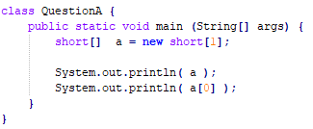
Question
Does the following code compile? What would the output be?

Slide 5

Answer
array address followed by 0
Note: Short variable has default value of 0 if defined as an instance/static variable

Slide 6
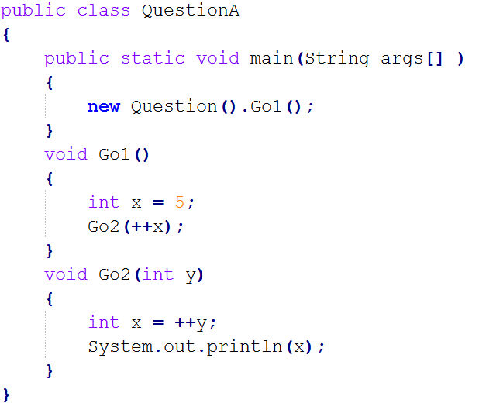
Question
Does the following code compile? What would the output be?

Slide 7

Answer
7

Slide 8
Question
Does the following code compile? What would the output be?

Slide 9

Answer
val:12
3:val

Slide 10
Question
What will the following code print?
a) 1
b) 10
c) 16
d) 31

Slide 11
Answer
c) 16

Slide 12
Question
Does the following code compile? What would the output be?

Slide 13

Answer
96

Slide 14
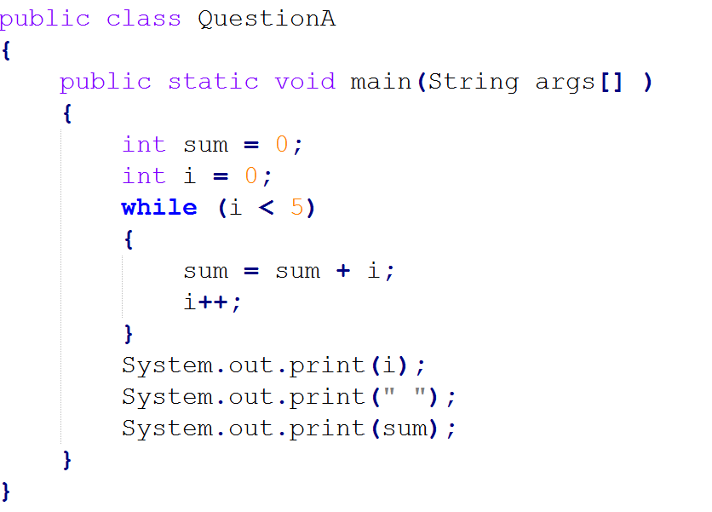
Question
Does the following code compile? What would the output be?

Slide 15
Answer
5 10

Slide 16
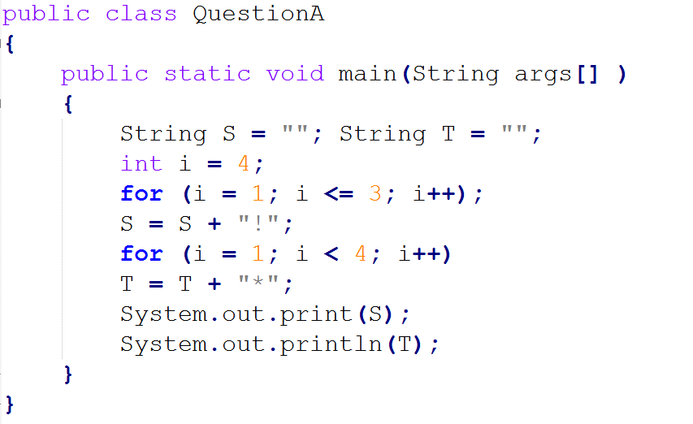
Question
Does the following code compile? What would the output be?
a) (that is, the empty string, printed twice) b) * c) !*** d) !**** e) !!!***

Slide 17
Answer
c) !***

Slide 18
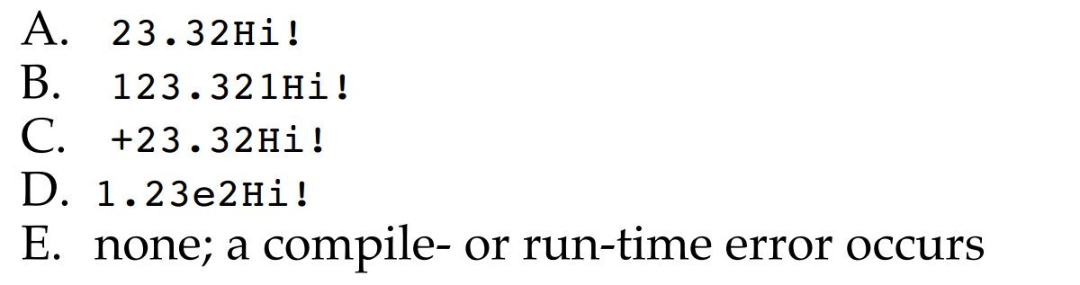
Question
What is the output of the following program?

Slide 19
Answer
B) 123.321Hi!

Slide 20
Generic Types
Generics is the capability to parameterize types
Flexibility to define a class or a method with generic types that the compiler can replace with concrete types

Slide 21
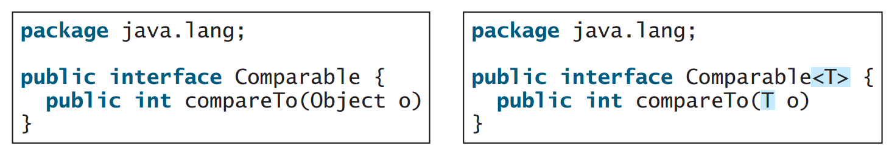
Example
<T> represents the formal generic type
Replaced by an actual concrete type

Slide 22
Why use Generic Types?

Slide 23
Why use Generics?
Identify errors at compile time
Explicit type checking
Robust and reliable programs

Slide 24
Example
Arrays
Create array for `strings':
Only add `strings’ to the array

Slide 25
Example

Slide 26
Writing Generic Class
Specify the ‘Type’ in the class definition
e.g., <E>, <T>, …
Use the Type as needed

Slide 27
Example

Slide 28
Example cont.
Generic Type ‘Integer’
Output 1

Slide 29
Summary
Generic Types with Java
Advantages of Generic Types
Flexibility/Robustness
Incorporate Generic Types into your implementations
Examples

Slide 30
This Week
Read Associated Chapters
Review Slides
Java Exercises

Slide 31
25th December
Remember
Last Day – Quizzes/Exercise Submissions
Grade Taken

Slide 32
Exercises
Exercises 21.1 to 21.2 (Generics)
25.1 to 25.2 (Arrays/Lists)

Slide 33
Questions/Discussion

