Slide 1
Network Programming
Object Orientated Programming in Java
Benjamin Kenwright

Slide 2
Outline
Essential Networking with Java
Introduction to Java networking features
It is much easier to write networking programs in Java than in C++
But less efficient
Today’s Practical
Review/Discussion

Slide 3
Today
Networking basics
IP addresses, ports, protocols, client-server interaction
Socket-level programming
Writing a client (Socket)
Writing a server (ServerSocket)
Communicating with web servers
Retrieving information (URL, URLConnection)
Sending information

Slide 4
Why is Networking Important?

Slide 5
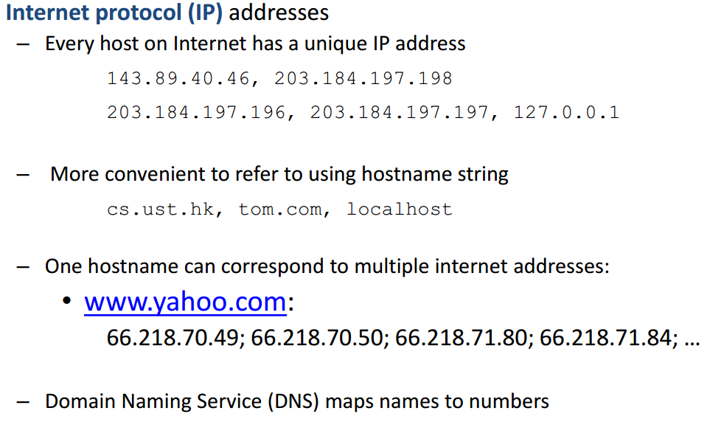
Networking Basics

Slide 6
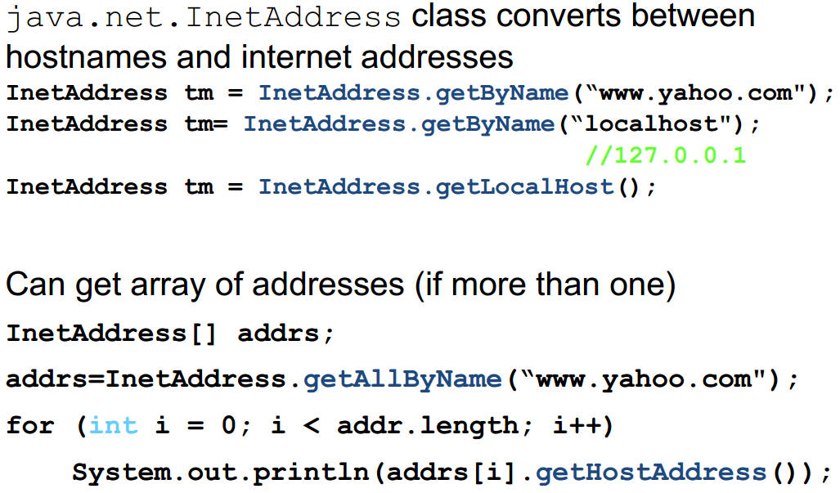
Networking Basics

Slide 7
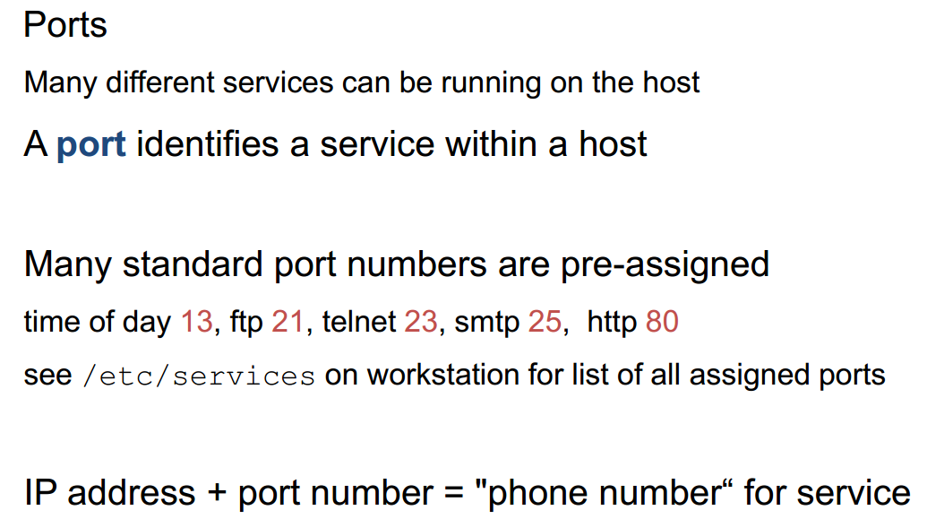
Networking Basics

Slide 8
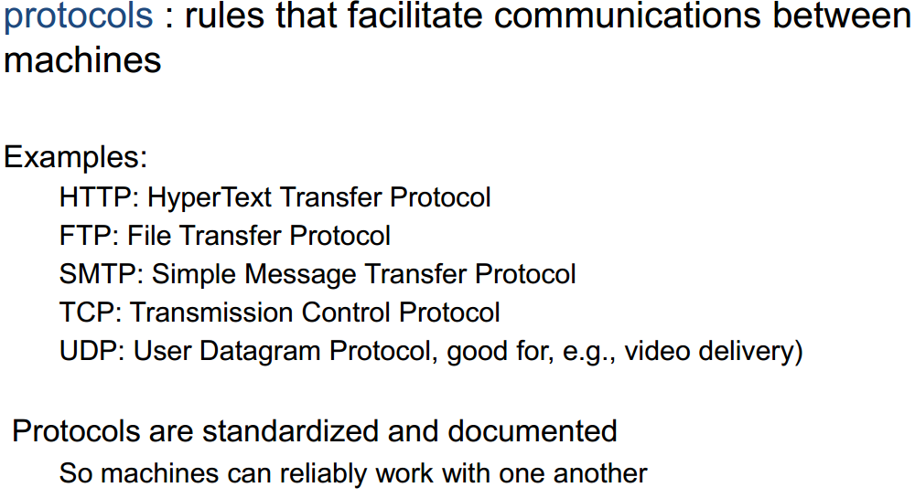
Networking Basics

Slide 9
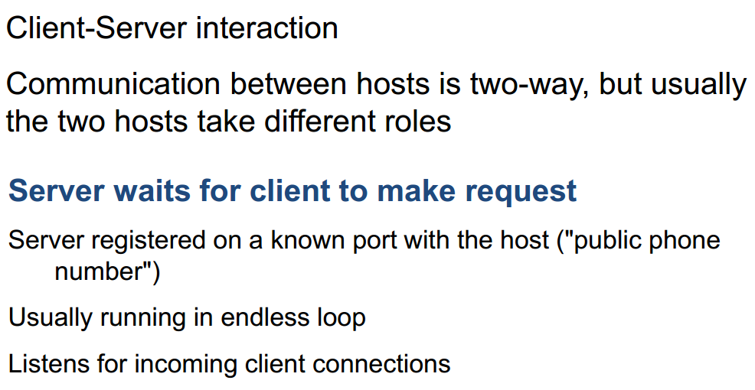
Networking Basics

Slide 10
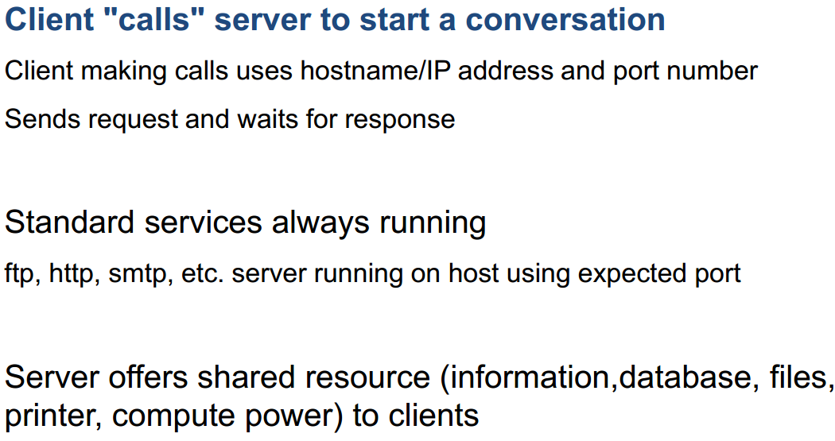
Networking Basics

Slide 11
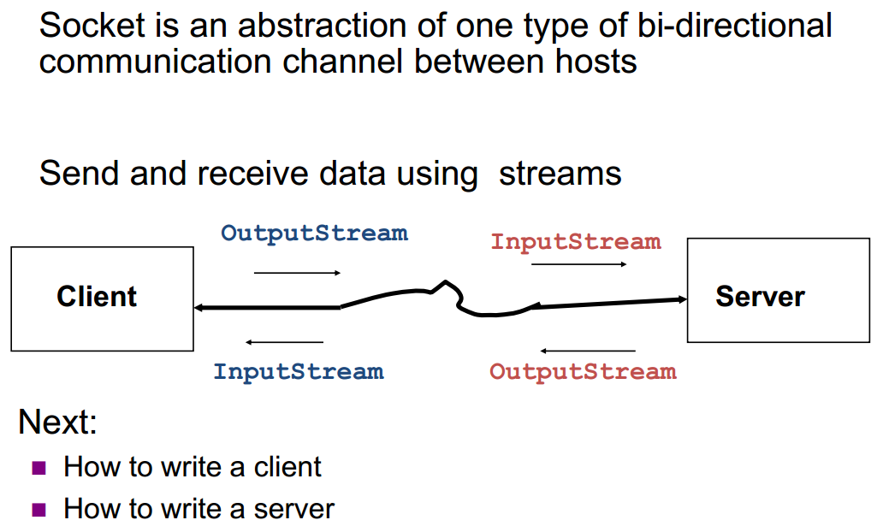
Socket-Level Programming

Slide 12
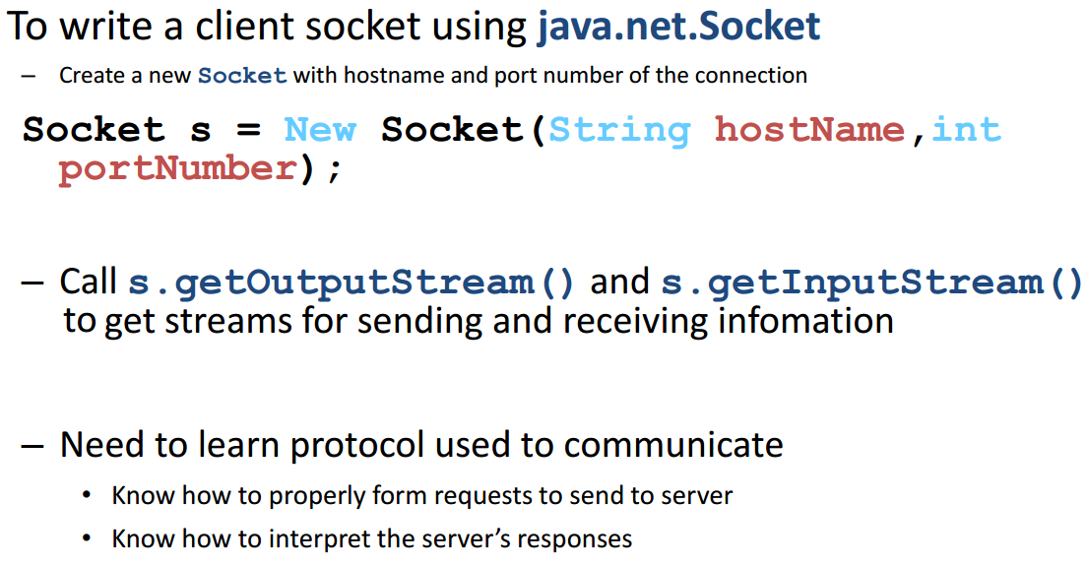
Writing Clients

Slide 13
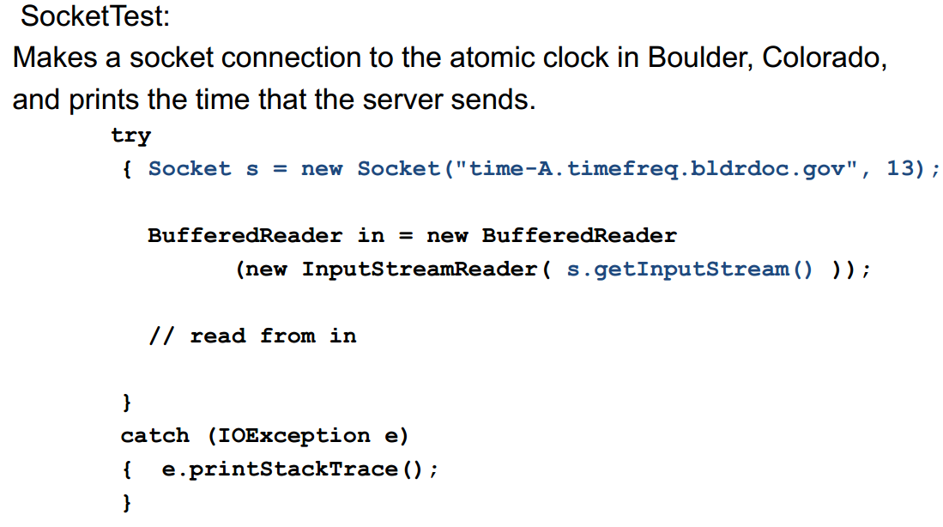
Writing Clients

Slide 14
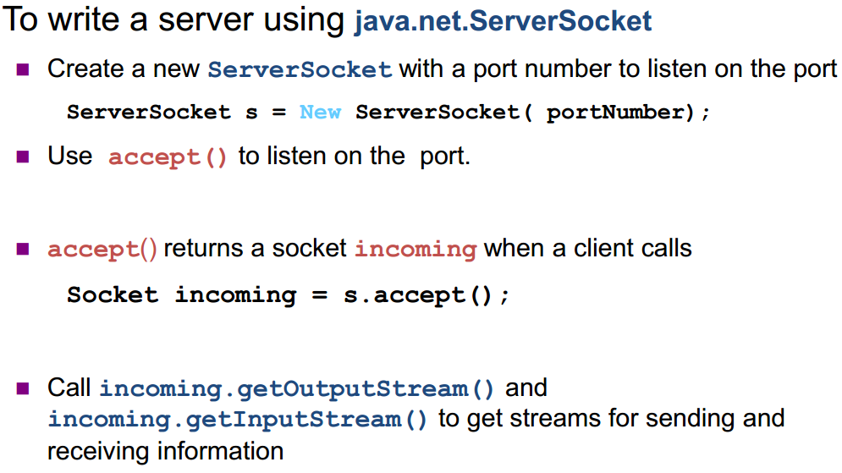
Writing Servers

Slide 15
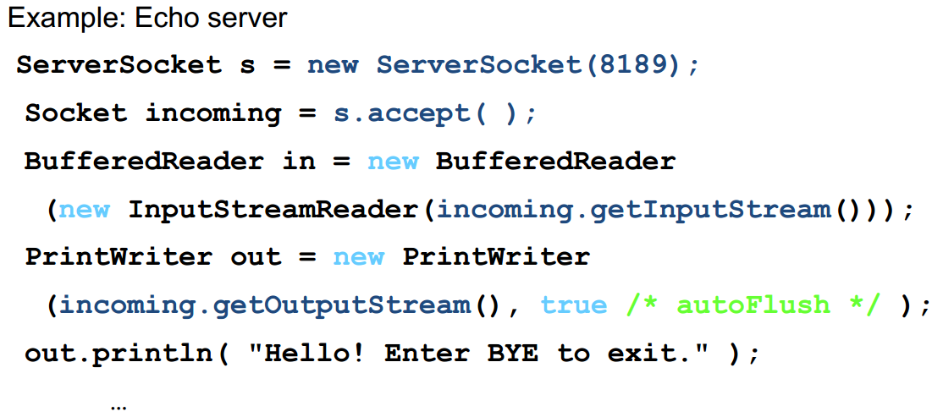
Writing Servers

Slide 16
Security Note
Many machines now refuse socket connections due to security considerations

Slide 17
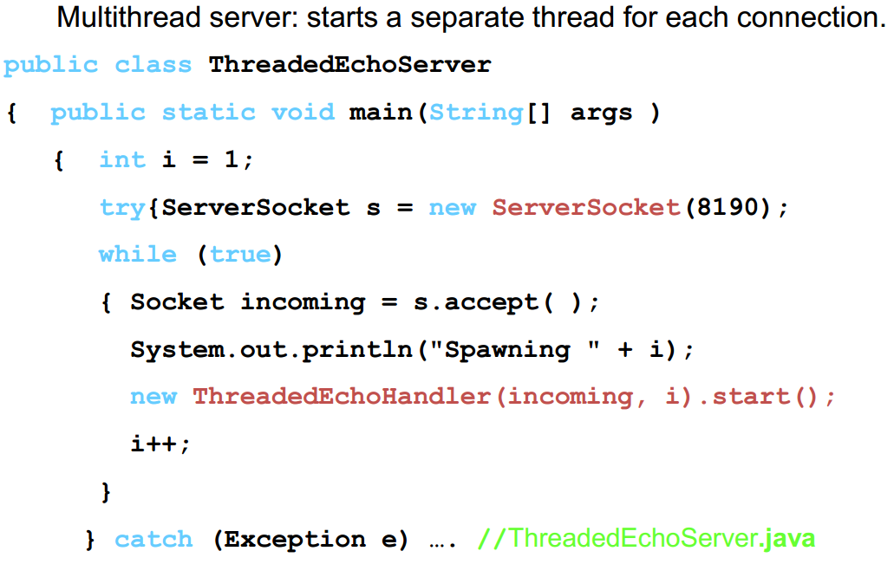
Writing Servers

Slide 18
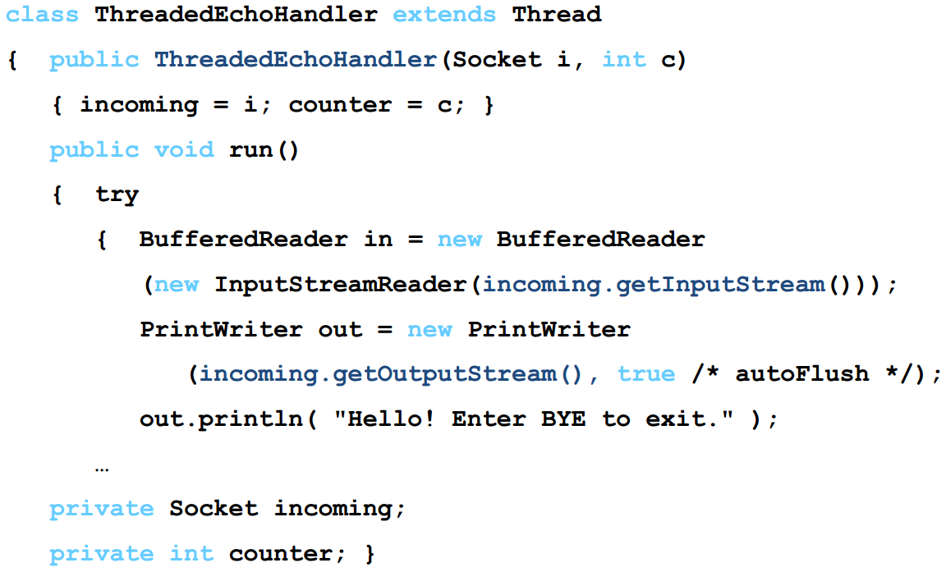
Writing Servers

Slide 19
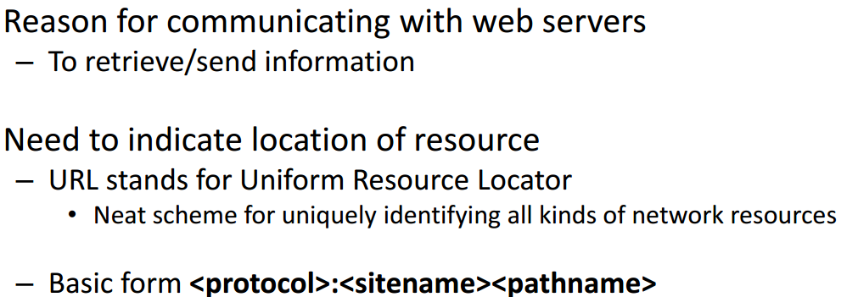
Communicating with Web Servers
http://www.zjnu.cn/index.html
ftp://ftp.zjnu/pub//test.java
file:/MyDisk/Letters/file.txt
Protocols include files, http, ftp, gopher, news, mailto, etc

Slide 20
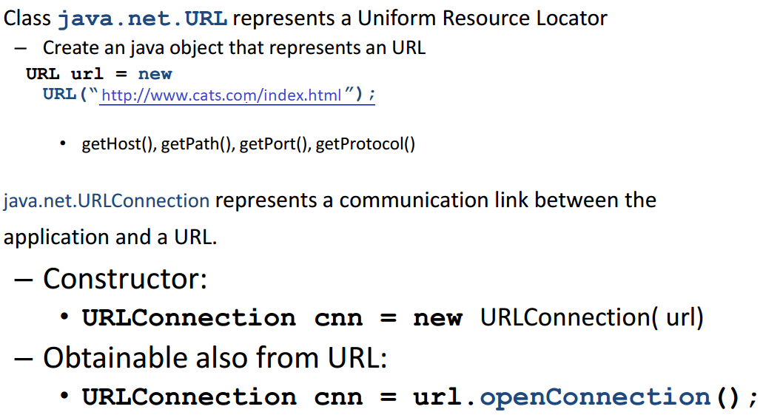
Communicating with web servers

Slide 21
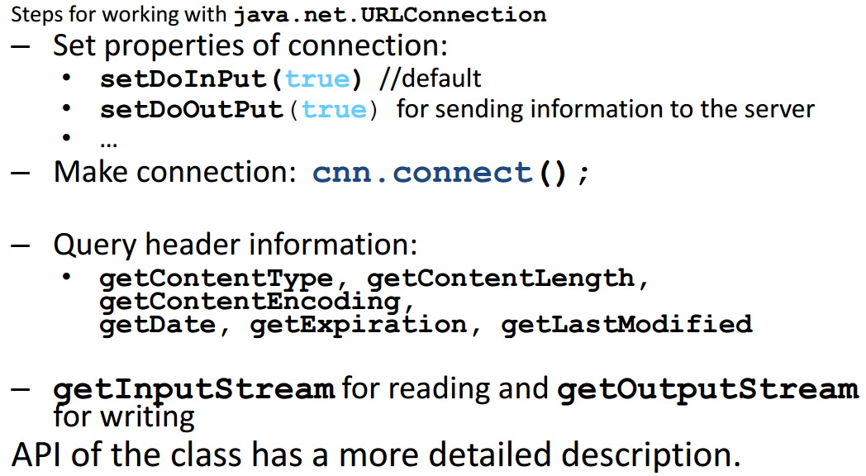
Communicating with web servers

Slide 22
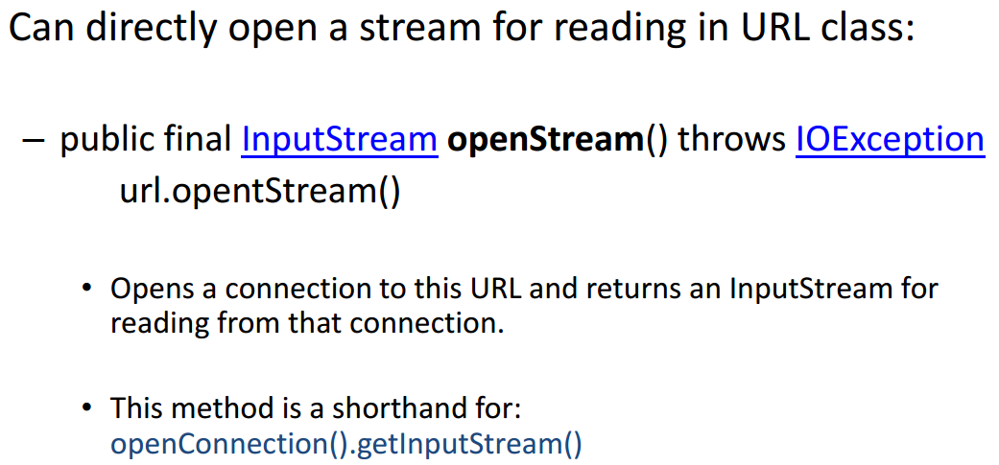
Communicating with web servers

Slide 23
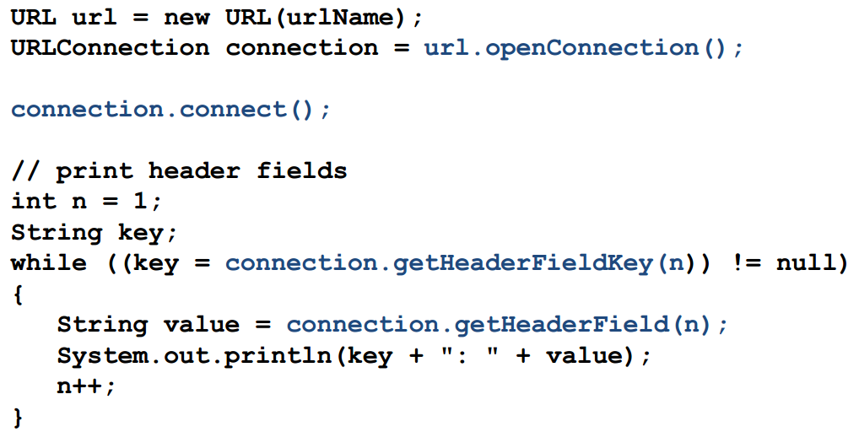
Retrieving Information

Slide 24
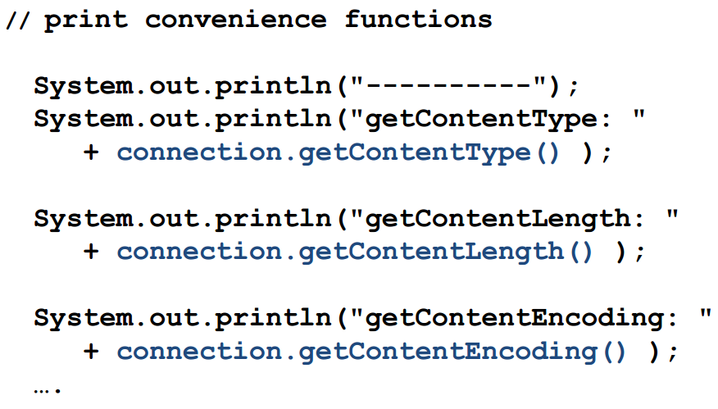
Retrieving Information

Slide 25
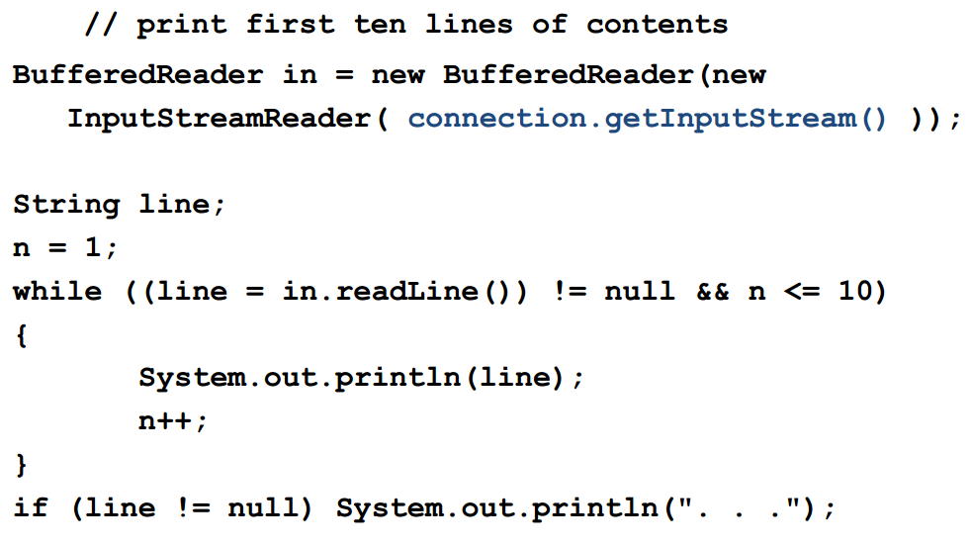
Retrieving Information

Slide 26
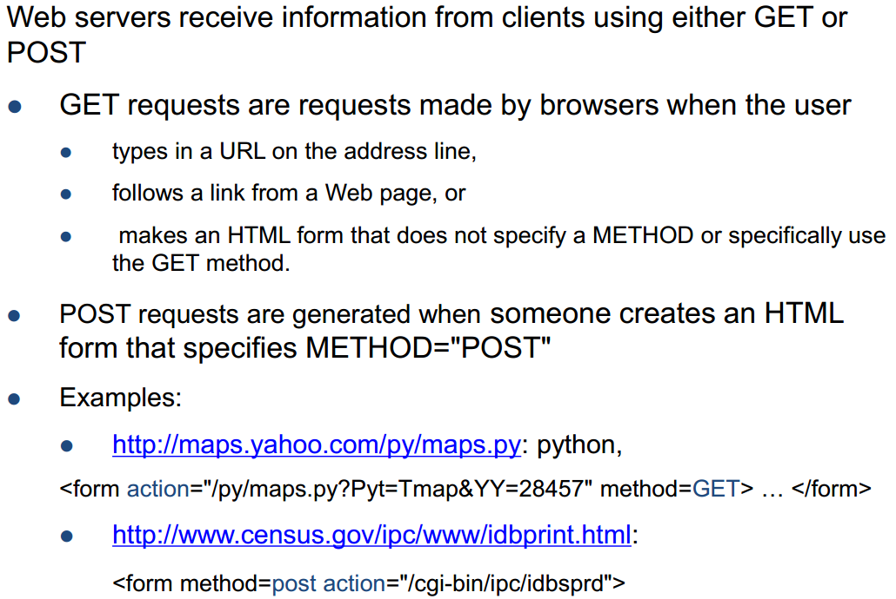
Sending Information

Slide 27
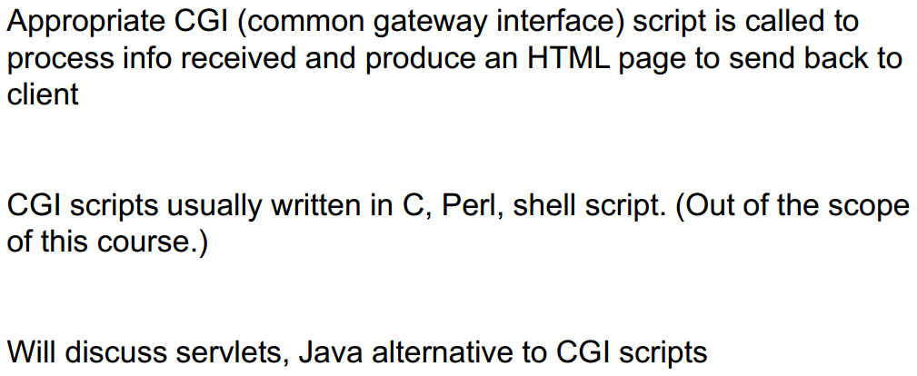
Sending Information

Slide 28
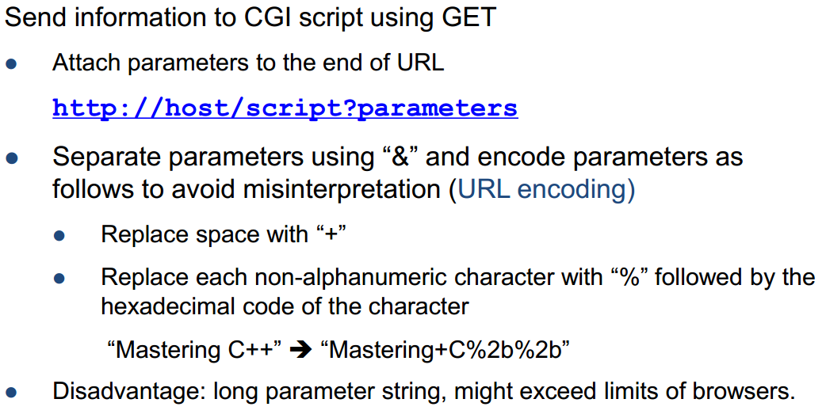
Sending Information

Slide 29
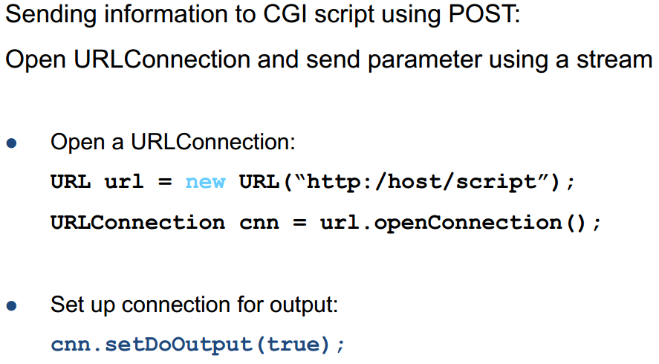
Sending Information

Slide 30
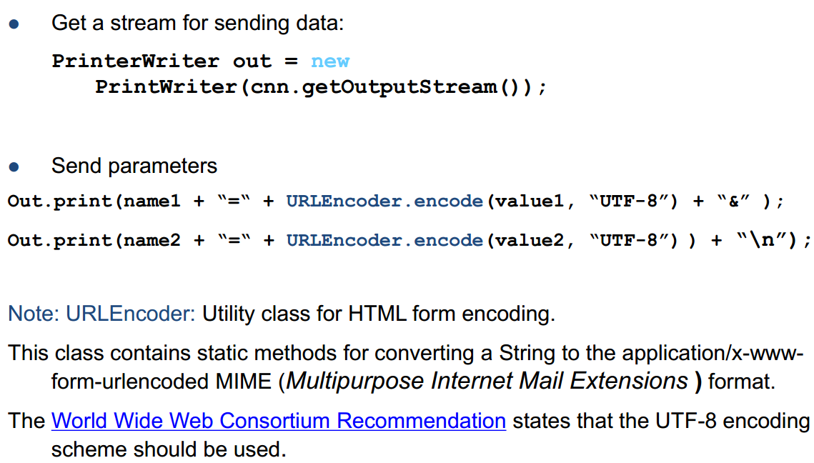
Sending Information

Slide 31
Summary
Essential Java Networking
Ports/IP/Sending/Receiving Data
Java Implementation Examples
Hands-On/Practical
Today is about becoming basic Java Networking

Slide 32
This Week
Read Associated Chapters
Review Slides
Java Exercises
Online Quizzes
25th December (Last Date)
Getting Ready Exam

Slide 33
Today’s Exercises
Chapter 30 – Exercise 30.1
Opportunity to review/revisit previous chapters
Solid understanding each of the concepts

Slide 34

Warning

Slide 35
Questions/Discussion

