Slide 1
Network Programming
Object Orientated Programming in Java
Benjamin Kenwright

Slide 2
Outline
Essential Networking with Java
Introduction to Java networking features
It is much easier to write networking programs in Java than in C++
But less efficient
Today’s Practical
Review/Discussion

Slide 3
Today
Review
Networking basics
IP addresses, ports, protocols, client-server interaction
Socket-level programming
Writing a client (Socket)
Writing a server (ServerSocket)
Communicating with web servers
Retrieving information (URL, URLConnection)
Sending information

Slide 4
Revision Sessions
14:00-21:10 this Friday in 29-106
No attendance record
Opportunity for you to review all the material
Prepare you for the exam

Slide 5
Exam
2nd January
You should review:
Quiz Questions
Crossword
Slides/Example Questions
Recommended Text

Slide 6
Exam
Mix
Written Exercises
Explanations/Essay
Code Samples
Analyze/Understand
Multiple Choice
Yes/No
ABC

Slide 7
Example Questions
Is Java the same as Javascript?
Is Java case sensitive?
What is he symbol used at the end of all statements?
What is the datatype used to store decimal numbers?
What is the method where all programs begin?
What is the name of this symbol `%'?
Type of loop that only contains a condition?
What is the datatype used to store a single letter, number, or symbol?

Slide 8
Answer
Is Java the same as Javascript? : No
Is Java case sensitive? : Yes
What is he symbol used at the end of all statements? : Semi-colon
What is the datatype used to store decimal numbers? : double/float
What is the method where all programs begin? : main
What is the name of this symbol `%'? : Modulus
Type of loop that only contains a condition? : while
What is the datatype used to store a single letter, number, or symbol? : char

Slide 9
Question
Which of these is correct way of inheriting class A by class B?
a) class B + class A {}
b) class B inherits class A {}
c) class B extends A {}
d) class B extends class A {}

Slide 10
Answer
Answer: c)

Slide 11
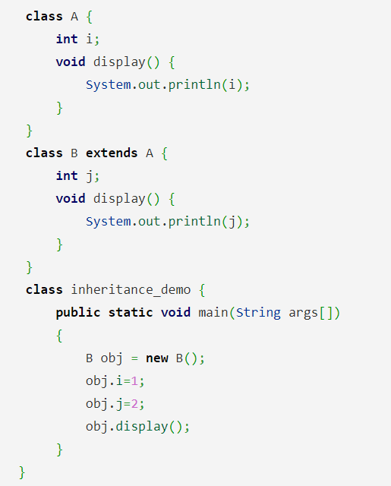
Question
What is the output of this program?
a) 0 b) 1 c) 2 d) Compiler Error

Slide 12
Answer
Answer: c
Explanation: class A & class B both contain display() method, class B inherits class A, when display() method is called by object of class B, display() method of class B is executed rather than that of Class A.
output:
$ javac inheritanceDemo.java
$ java inheritanceDemo
2

Slide 13
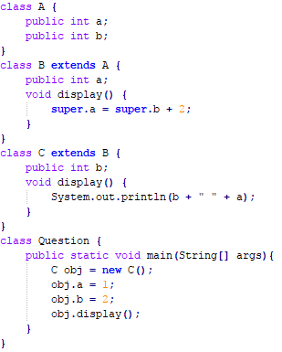
Question
Does the following code compile? If so what is the output?

Slide 14
Answer
2 1

Slide 15
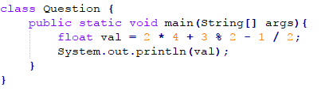
Question
What is the output for the following program?

Slide 16
Answer
9.0

Slide 17
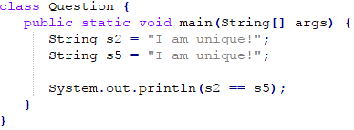
Question
Will the following code compile? If so what would be the output?

Slide 18
Answer
True

Slide 19
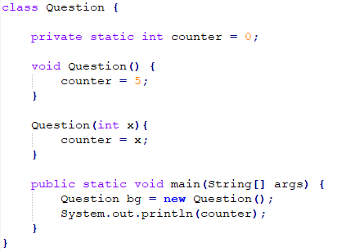
Question
Will the following code compile? If so what would the output be?

Slide 20
Answer
No
Question.java: error: constructor Question in class Question cannot be applied to given types;
Question bg = new Question();
^
required: int
found: no arguments
reason: actual and formal argument lists differ in length
1 error

Slide 21
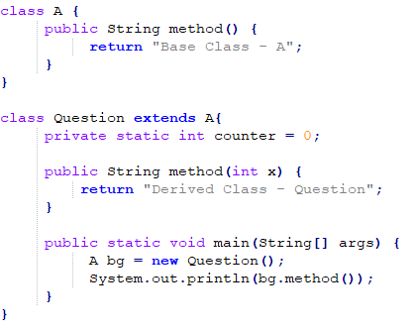
Question
Will the following code compile? If so what would be the output?

Slide 22
Answer
Base Class – A
Though Base Class handler is having the object of Derived Class but its not overriding as now with a definition having an argument ,derived class will have both method () and method (int) and hence its overloading.

Slide 23
Why is Networking Important?

Slide 24
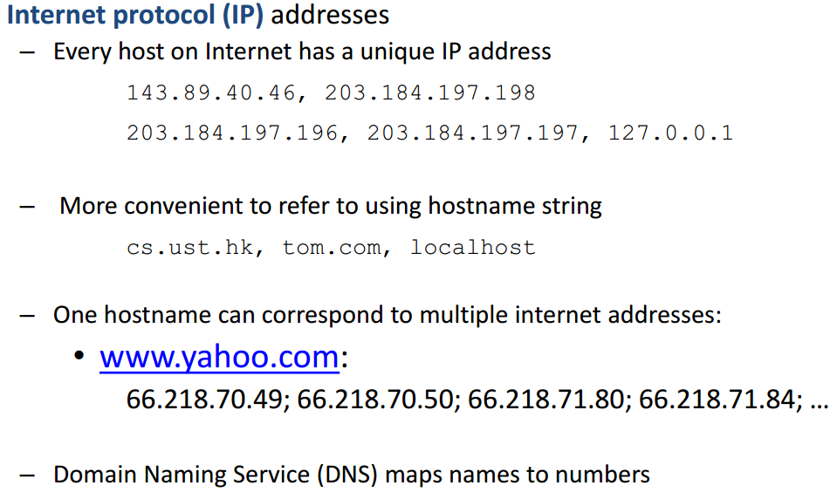
Networking Basics

Slide 25
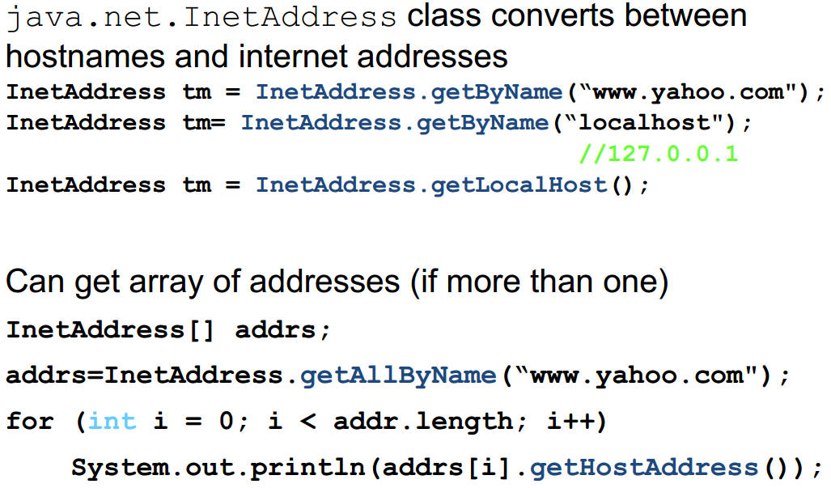
Networking Basics

Slide 26
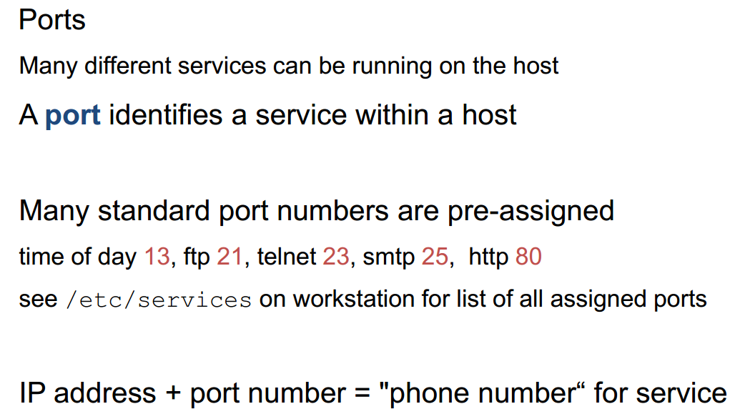
Networking Basics

Slide 27
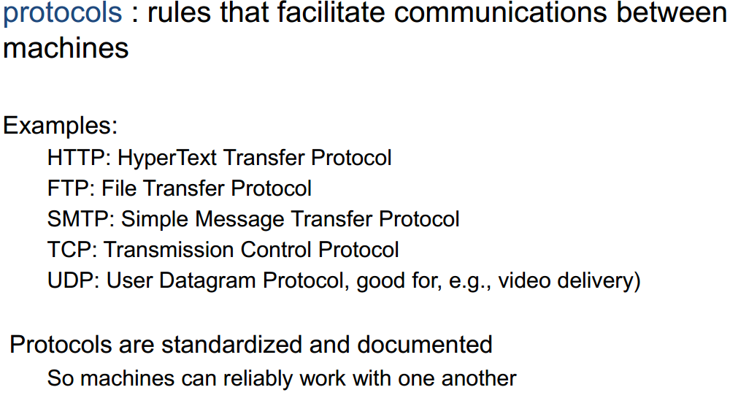
Networking Basics

Slide 28
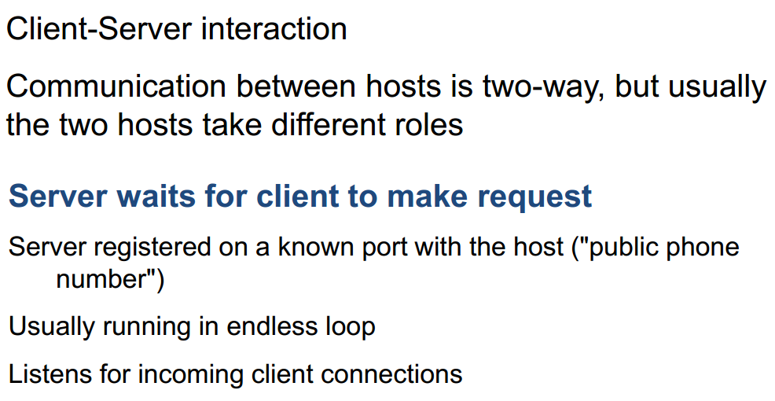
Networking Basics

Slide 29
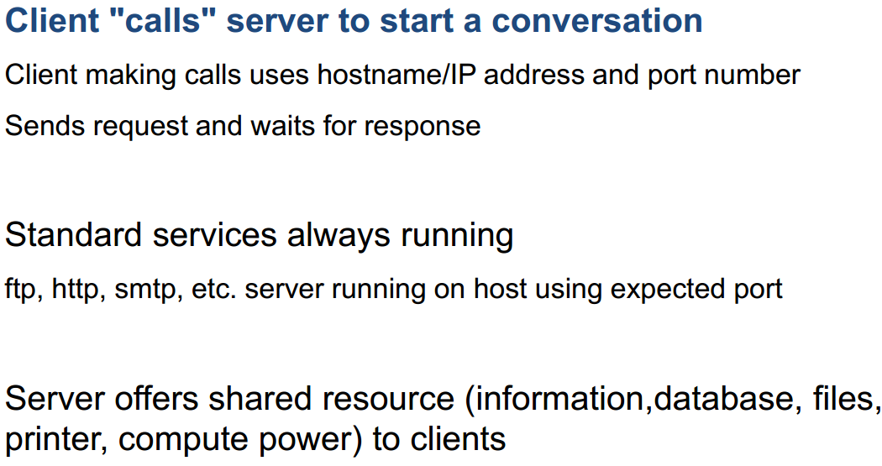
Networking Basics

Slide 30
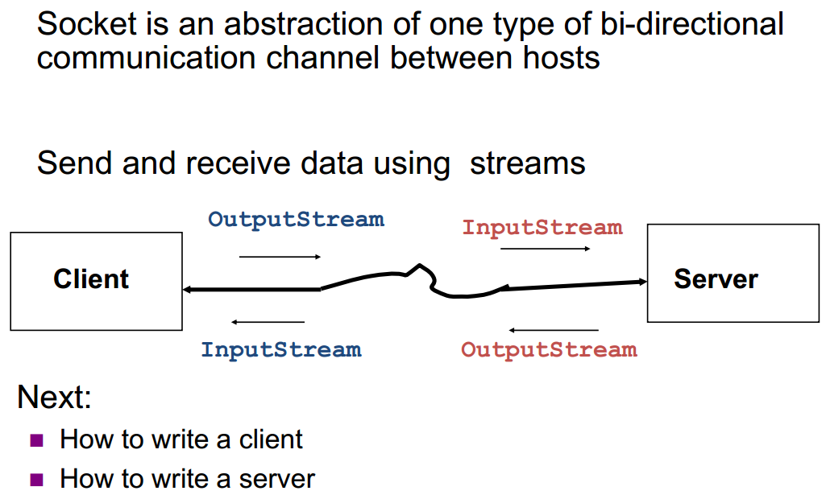
Socket-Level Programming

Slide 31
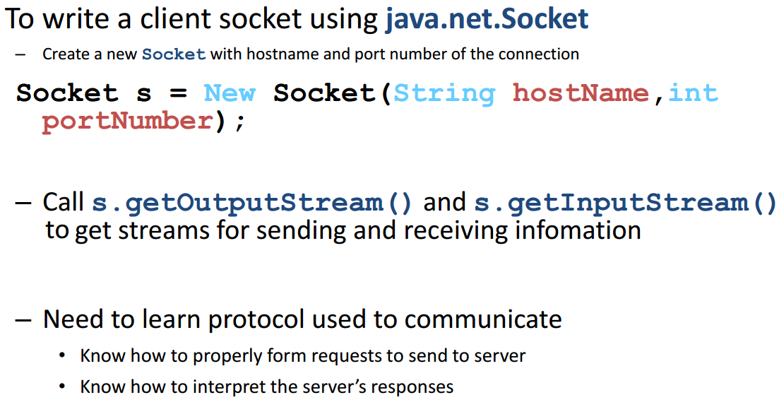
Writing Clients

Slide 32
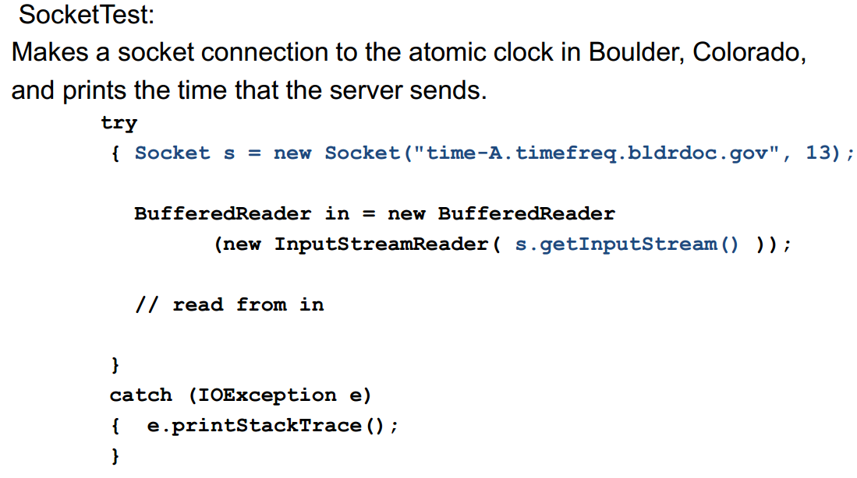
Writing Clients

Slide 33
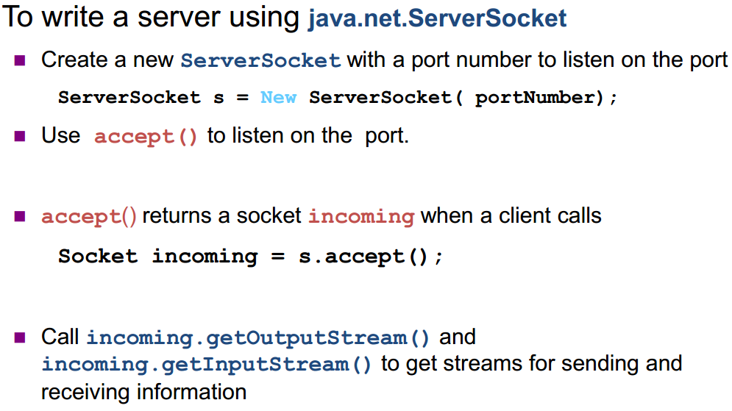
Writing Servers

Slide 34
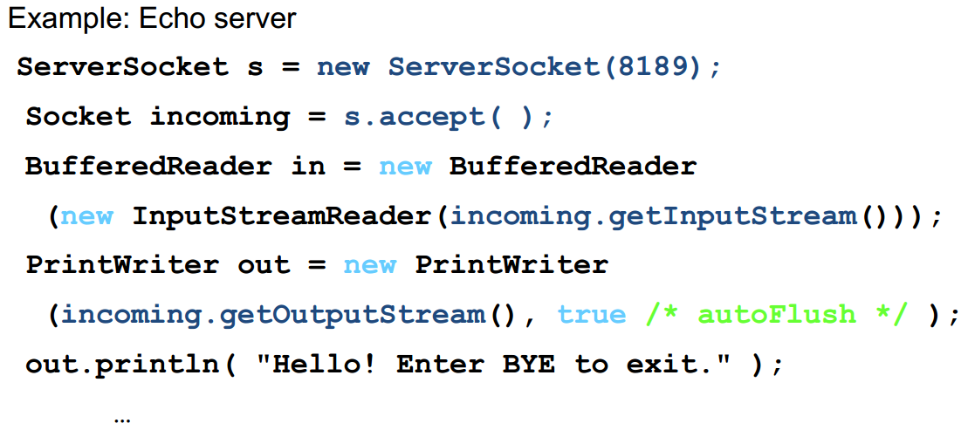
Writing Servers

Slide 35
Security Note
Many machines now refuse socket connections due to security considerations

Slide 36
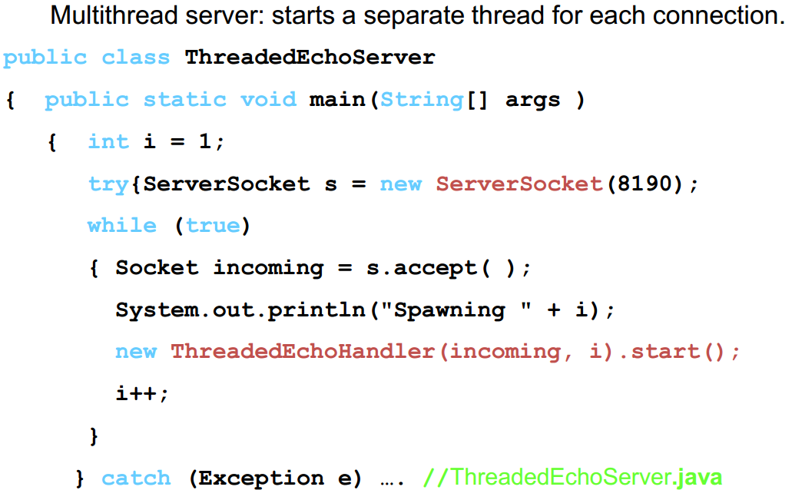
Writing Servers

Slide 37
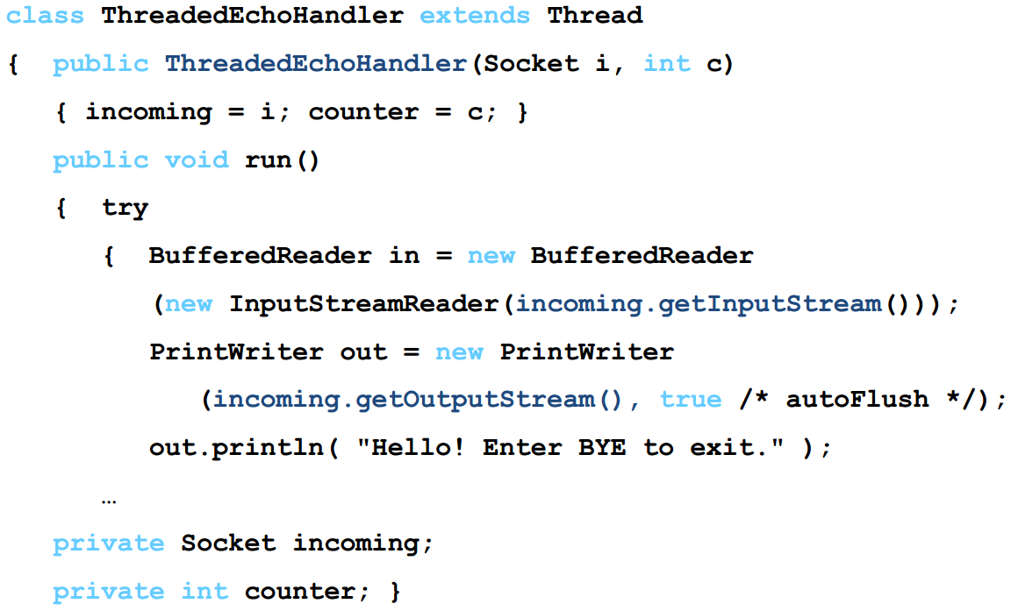
Writing Servers

Slide 38
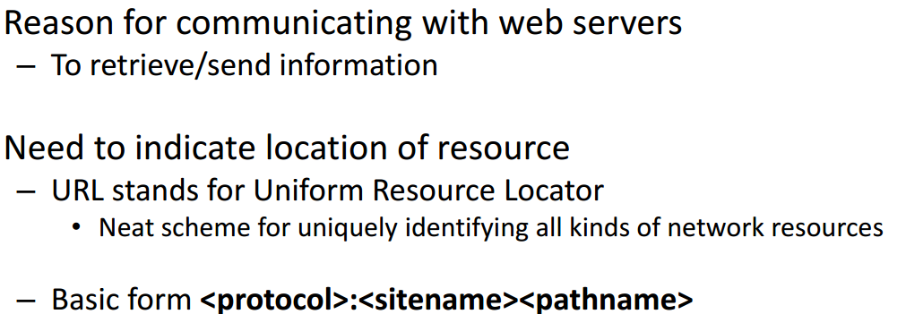
Communicating with Web Servers
http://www.zjnu.cn/index.html
ftp://ftp.zjnu/pub//test.java
file:/MyDisk/Letters/file.txt
Protocols include files, http, ftp, gopher, news, mailto, etc

Slide 39
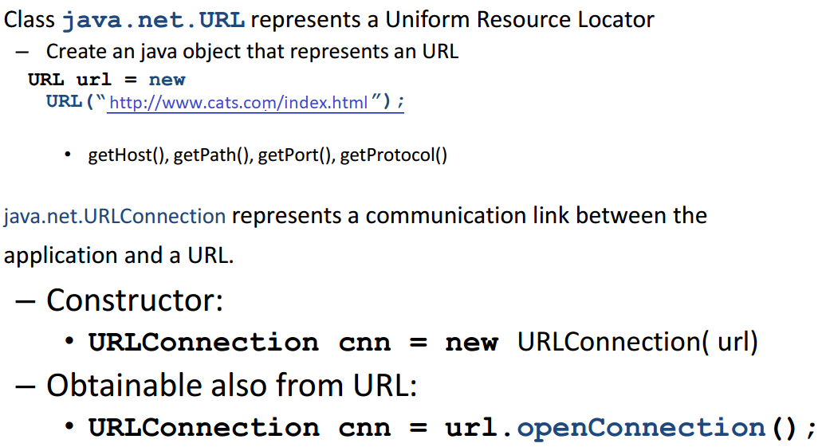
Communicating with web servers

Slide 40
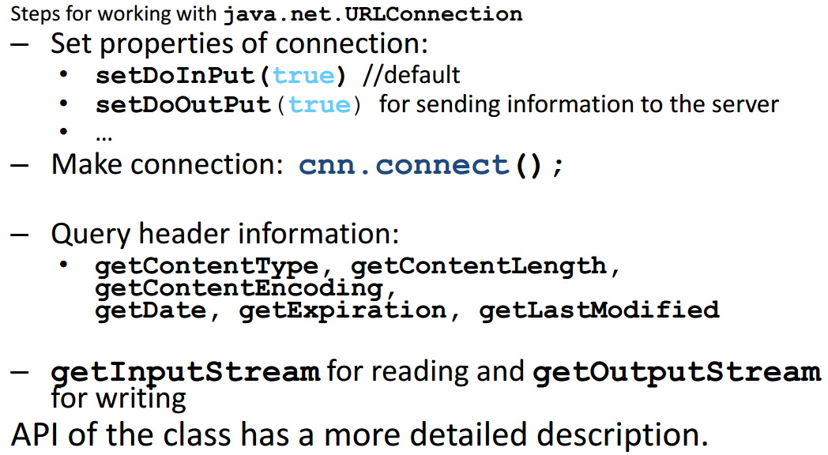
Communicating with web servers

Slide 41
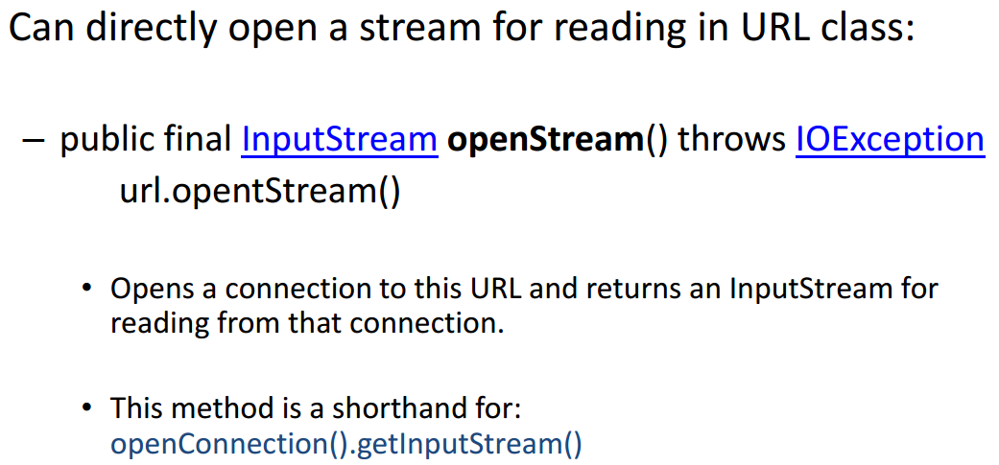
Communicating with web servers

Slide 42
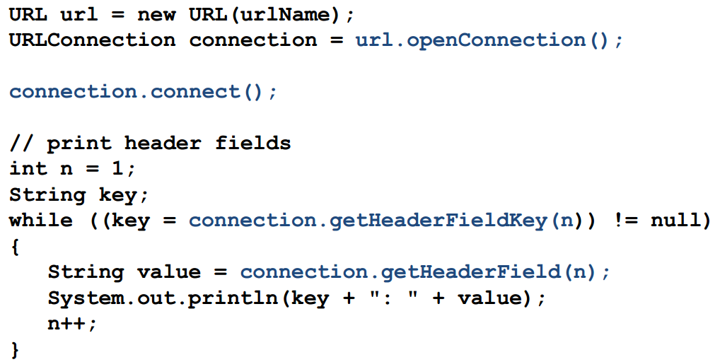
Retrieving Information

Slide 43
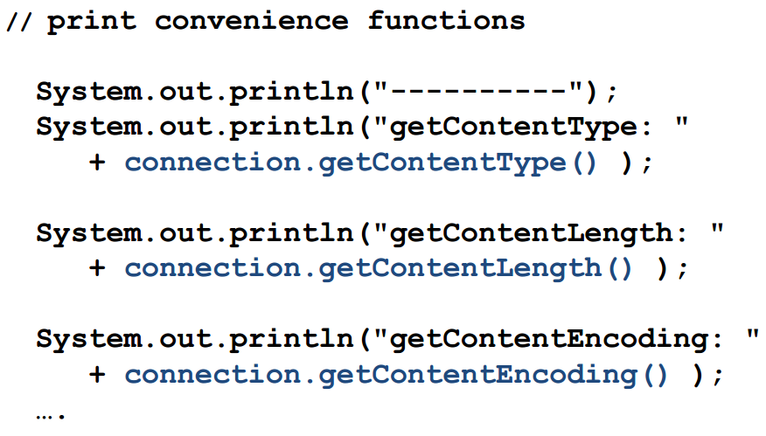
Retrieving Information

Slide 44
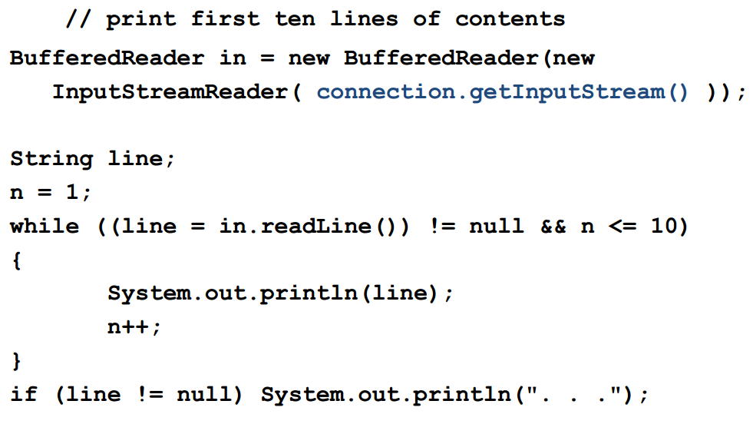
Retrieving Information

Slide 45
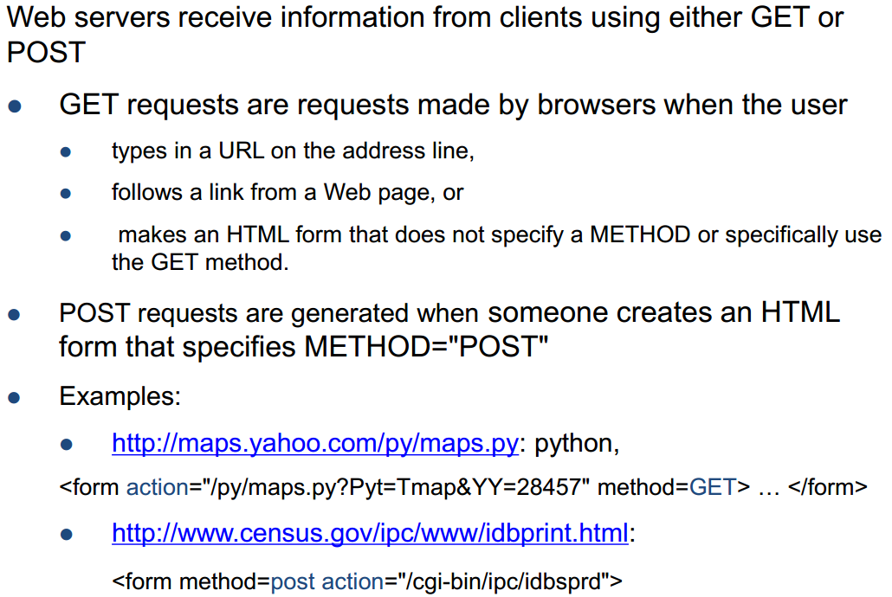
Sending Information

Slide 46
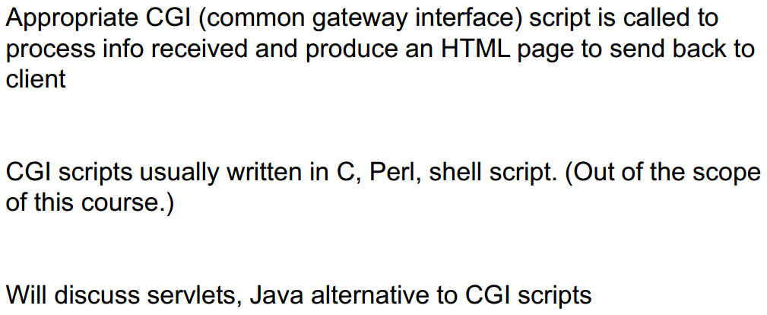
Sending Information

Slide 47
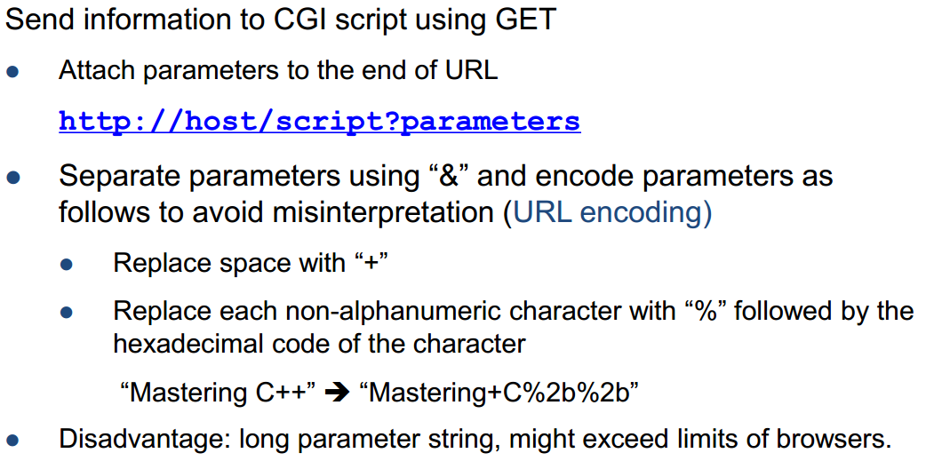
Sending Information

Slide 48
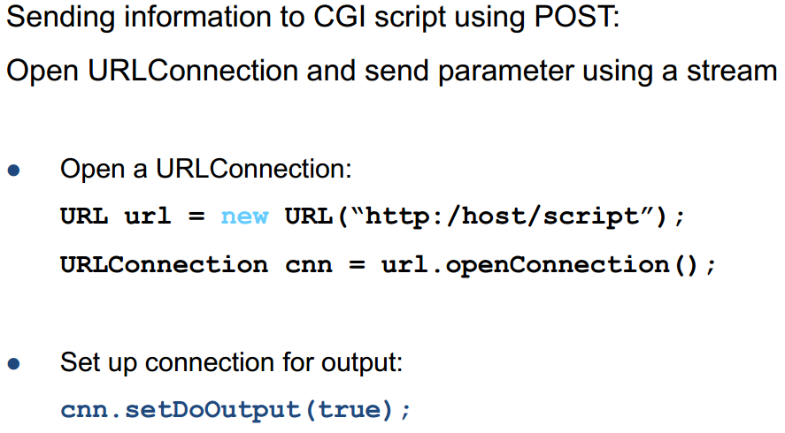
Sending Information

Slide 49
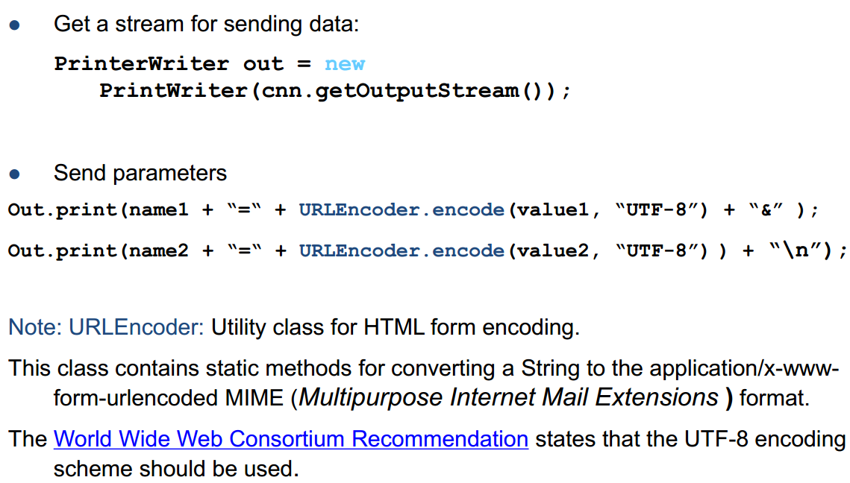
Sending Information

Slide 50
Summary
Essential Java Networking
Ports/IP/Sending/Receiving Data
Java Implementation Examples
Hands-On/Practical
Today is about becoming basic Java Networking

Slide 51
This Week
Read Associated Chapters
Review Slides
Java Exercises
Online Quizzes
25th December (Last Date)
Getting Ready Exam

Slide 52
Today’s Exercises
Chapter 30 – Exercise 30.1
Opportunity to review/revisit previous chapters
Solid understanding each of the concepts

Slide 53
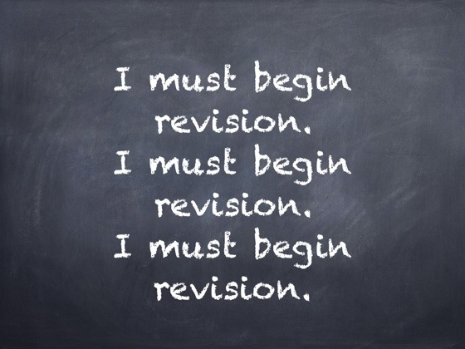
Warning

Slide 54

Investigate
Can you instantiate this class?

Slide 55
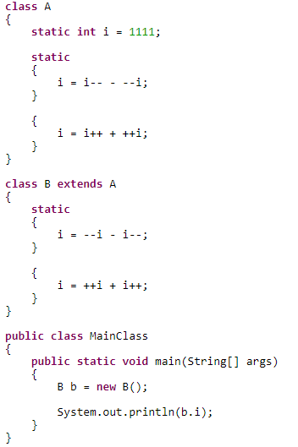
Investigate
What will be the output of the following program?

Slide 56
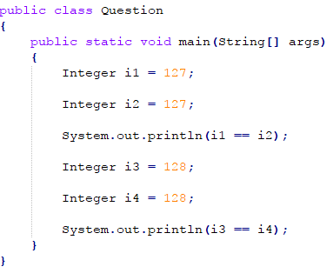
Investigate
What would the output be?

Slide 57
Questions/Discussion

