Slide 1
Internal Classes and Exceptions
Object Orientated Programming in Java
Benjamin Kenwright

Slide 2
Outline
Exceptions and Internal Classes
Today’s Practical
Review/Discussion

Slide 3
Question
Have you ever had a program crash the system?

Slide 4
Why did it crash?
How could you have prevented it crashing?

Slide 5
Exception Handling
Error handling in general
Java's exception handling mechanism
The catch-or-specify principle
Checked and unchecked exceptions
Exceptions impact/usage
  Overloaded methods
  Interfaces
  Inheritance hierarchies
  Constructors

Slide 6
Error Handling
Not all errors can be caught at compile time!
Help -- run-time error! What next …?
First ideas:
  System.out.println()
  System.err.println() (much better than the previous)
Good guess but some errors call for corrective action, not just warning
In general, printing is a bad idea!
Better: tell someone (not necessarily the user)!

Slide 7
Error Handling, cont.
Establish return code convention
  0 vs. !0 in C/C++
  boolean in Java
Set value of a global variable
  Done in many shells.
  In Java use a public static field in a class.
Raise an exception, catch it, and act
  The idea comes from hardware.
  Modern language support (Java, Python, Lisp, Ada, C++, C#)

Slide 8
General Errors and Error Handling
Error must be handled where the occur
  One error in a method can be handled very differently in the clients, this is not a good approach. Repeating handling of the same error
  Can be extremely hard to debug
To handle an error detailed information on the error must be provided
  Where did the error occur (class, method, line number)
  What type of error
  A good error message
  Dump of runtime stack? (too much information?)
In object-oriented languages errors are represented by objects

Slide 9
How to Handle Errors
Ignore: False alarm just continue
Report: Write a message to the screen or to a log
Terminate: Stop the program execution.
Repair: Make changes and try to recover the error
To be able to repair would be the best. However, often the best that can be done is the combination of report and terminate

Slide 10
Java's Exception Handling
Exception: An event that occurs during the execution of a program the disrupts the normal transaction flow
  A run-time phenomenon
Exception handling is part of the language
Exceptions are objects
Exceptions are structured in a class hierarchy.
It is not possible to ignore an exceptions (nice feature?)
  A method specifies, which exception may occur, the client must anticipate these exceptions, otherwise compile-time error
It is sometimes possible to recover to a known good state after an exception was raised

Slide 11
Java's Exception Handling, cont.
Java’s object-oriented way to handle errors
  more powerful, more flexible than using return
  keywords try, catch, throw, throws, finally
An exception is an object that describes an erroneous or unusual situation
Exceptions are thrown by a program, and may be caught and handled by another part of the program
A program can therefore be separated into a normal execution flow and an exception execution flow
An error is also represented as an object in Java, but usually represents a unrecoverable situation and should not be caught

Slide 12
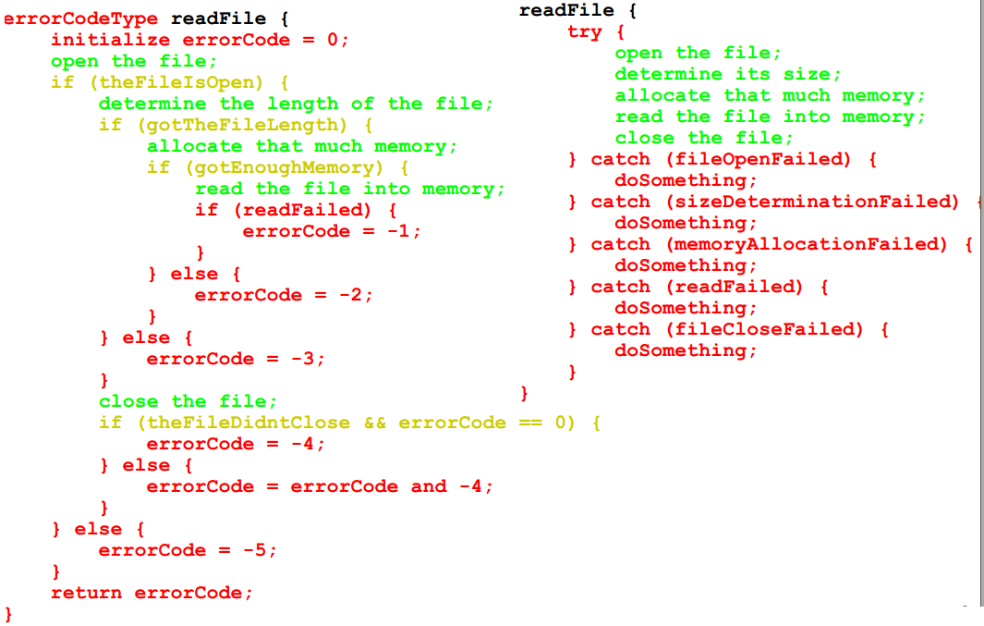
Motivation for Exception Handling

Slide 13
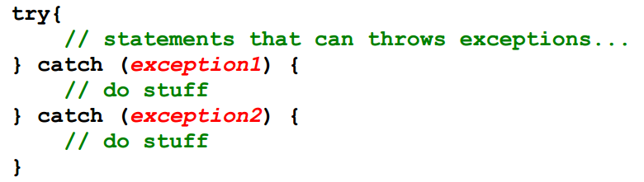
Exception Handling Model
Code where you anticipate a problem:
  Detect error, probably with an if create a new exception and throw it
  Alternatively let JVM detect error, create, and throw an exception
Code in client (somewhere in message invocation stack)
  try, hoping for the best
  prepare to catch an exception

Slide 14
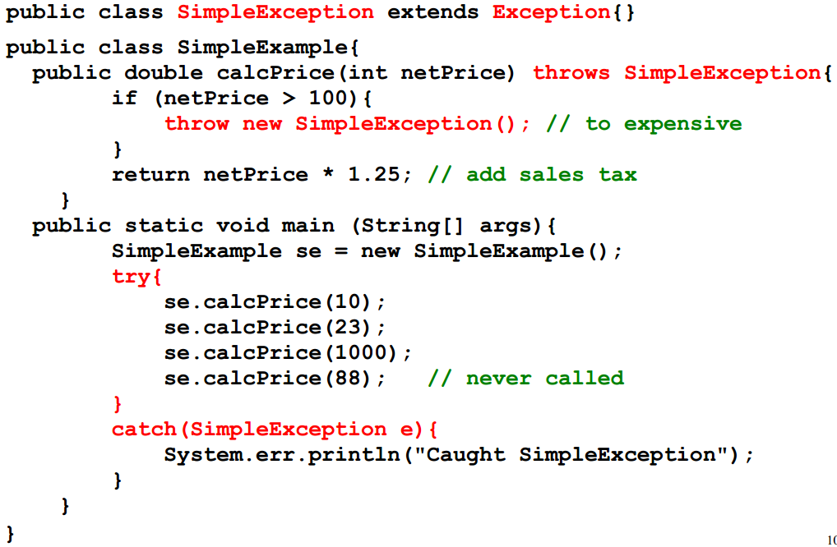
Simple Example

Slide 15
Java's Catch or Specify Requirement
Catch
  A method can catch exception by providing and exception handler
Specify
  If a method chooses not to catch, then specify which exceptions are thrown
  Exceptions are part of a method's public interface

Slide 16
Checked/Unchecked Exceptions
An exception is either checked or unchecked
  Checked = checked by the compiler
A checked exception can only be thrown within a try block or within a method that is designated to throw that exception
  The compiler will complain if a checked exception is not handled appropriately
An unchecked exception does not require explicit handling, though it could be processed that way.
An example many run-time exceptions are unchecked exceptions

Slide 17
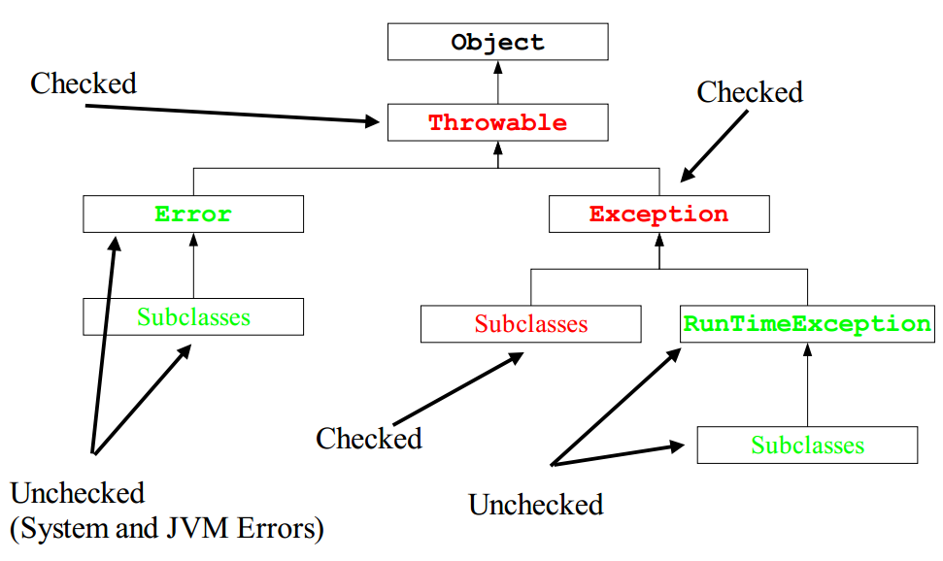
Java's Exception Class Hierarchy

Slide 18
Java's Exception Class Hierarchy, cont.
Throwable
  Superclass for all exceptions
  Two methods for filling in and printing the stack
Error
  Serious internal errors (should not occur in running programs).
  Are normally not handled. (report and terminate)
  Programs should not throw Error
  The catch or specify principle does not apply, because they are so severe
  Examples
    Dynamic linking failure
    Memory shortage
    Instantiating abstract class

Slide 19
Java's Exception Class Hierarchy, cont.
Exception
  The base class for most exception used in Java programs
  The catch or specify principle does apply
  Examples of subclasses
    IOException
    ClassNotFoundException
RuntimeException
  Not a good name (all exceptions are at run-time)!
  Commonly seen run-time error
  The catch or specify principle does not apply, because they are so ubiquitous.
  Examples
    Divide by zero/Cast error/Null pointer

Slide 20
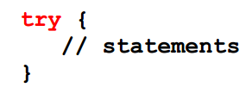
The try Statement
To process an exception when it occurs, the line that throws the exception is executed within a try block
A try block is followed by one or more catch clauses, which contain code to process an exception
Each catch clause has an associated exception type

Slide 21
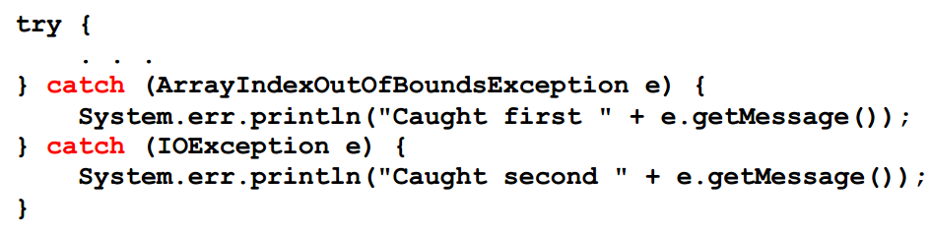
The catch Statement
The catch statement is used for catching exceptions.
A try statement must be accompanied by a catch statement.
Try and catch statements can be nested, i.e., try block in try block, etc.

Slide 22
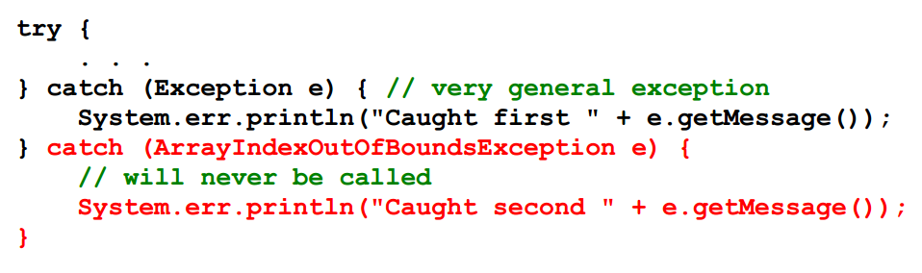
The catch Statement, cont.
When an exception occurs, processing continues at the first catch clause that matches the exception type
The catch statements should be should be listed in most-specialized-exception-first order

Slide 23
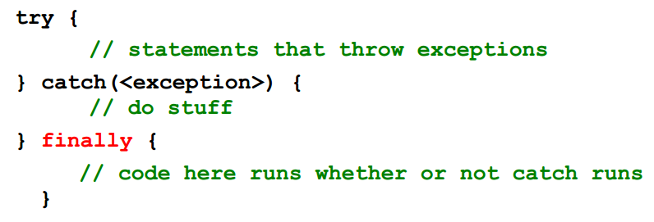
The finally Clause
A try statement can have an optional clause designated by the reserved word finally.
If no exception is generated, the statements in the finally clause are executed after the statements in the try block complete.
Also, if an exception is generated, the statements in the finally clause are executed after the statements in the appropriate catch clause complete.

Slide 24
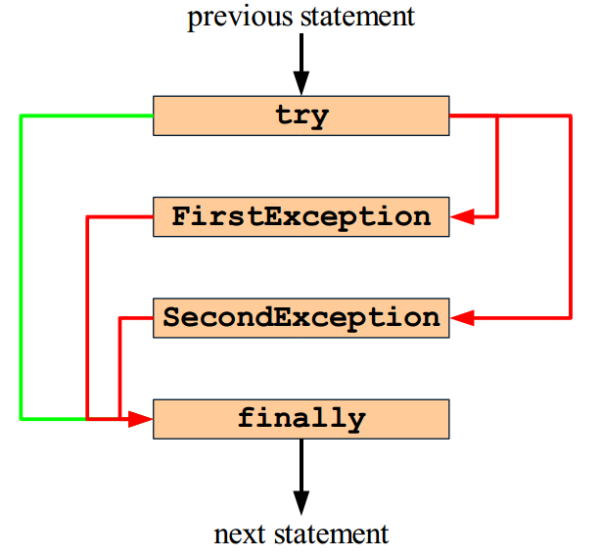
The finally Clause, cont.

Slide 25
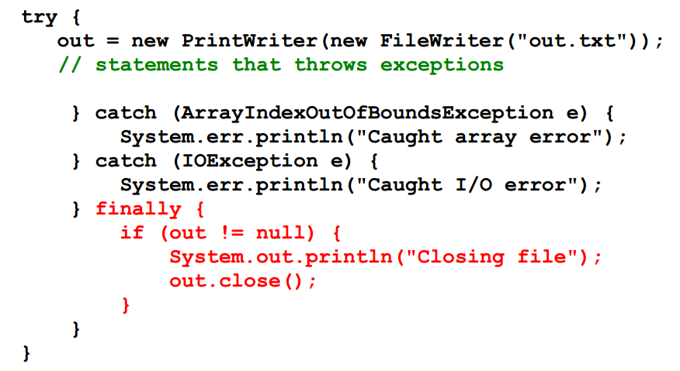
The finally Clause, Example

Slide 26
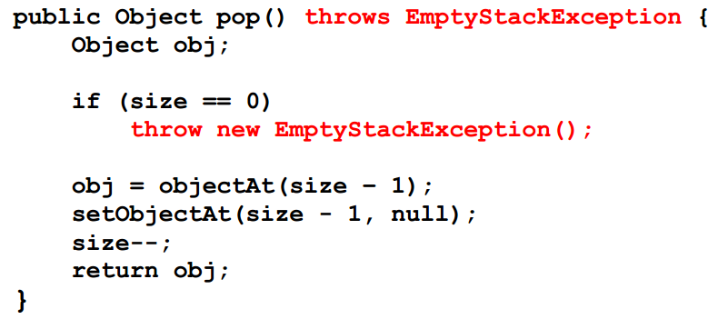
The throw Statement
All methods use the throw statement to throw an exception

Slide 27
Exception Propagation
If it is not appropriate to handle the exception where it occurs, it can be handled at a higher level
Exceptions propagate up through the method calling hierarchy until they are caught and handled or until they reach the outermost level.
A try block that contains a call to a method in which an exception is thrown can be used to catch that exception

Slide 28
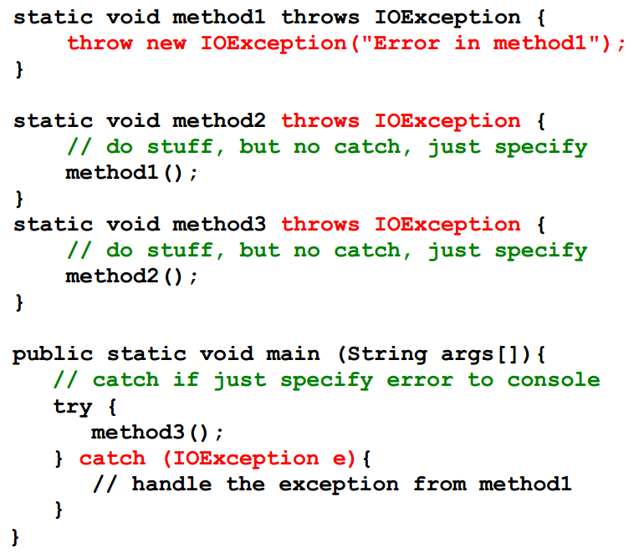
Exception Propagation, Example

Slide 29
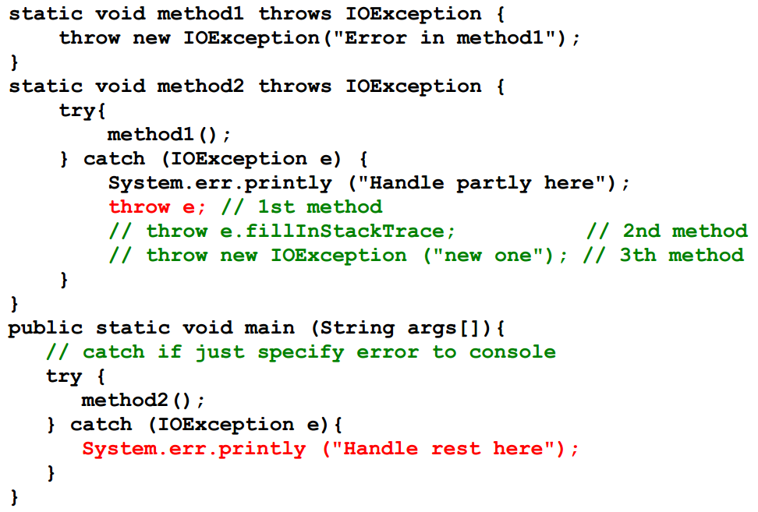
Rethrowing an Exception

Slide 30
Creating New Exceptions
Requires careful design (part of the public interface).
Can an existing Exception be used?
Choose the correct superclass.
Choosing the name
  The most important thing for new exceptions.
  Tends to be long an descriptive (ArrayIndexOutOfBoundsException)
Code for exception class typically minimal
Naming convention:
  All classes that inherits from Exception has 'Exception' postfixed to their name.
  All classes that inherits from Error has 'Error' postfixed to their name

Slide 31
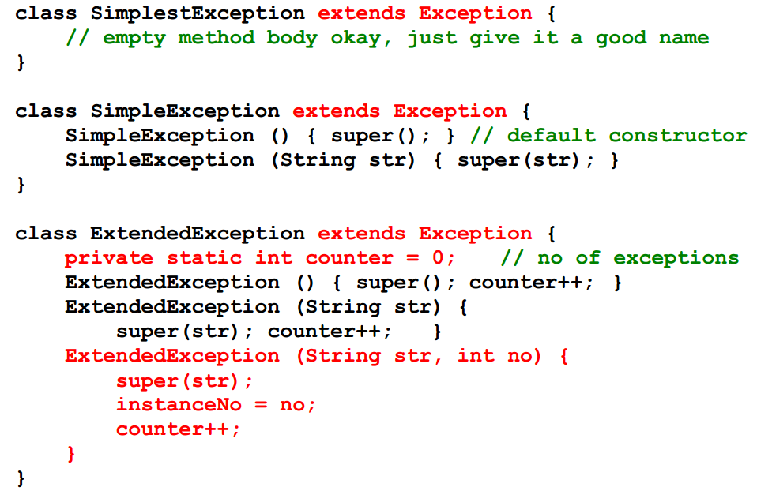
Creating New Exceptions, Example

Slide 32
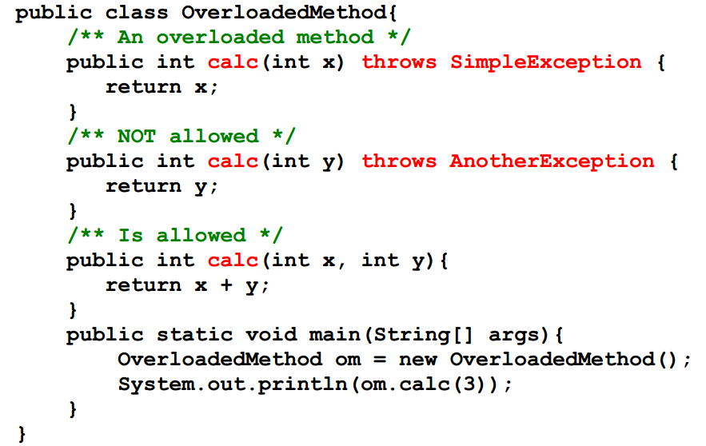
Overloading and Exception
Methods cannot be overloaded based on exception specification

Slide 33
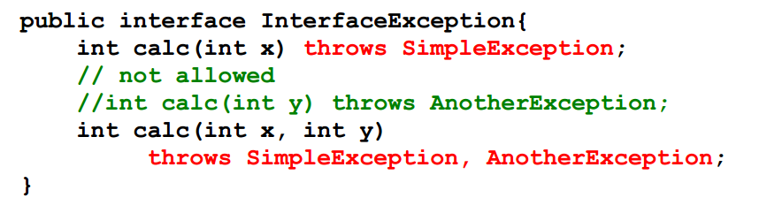
Interfaces and Exceptions
Exceptions can naturally be specified for methods in interfaces

Slide 34
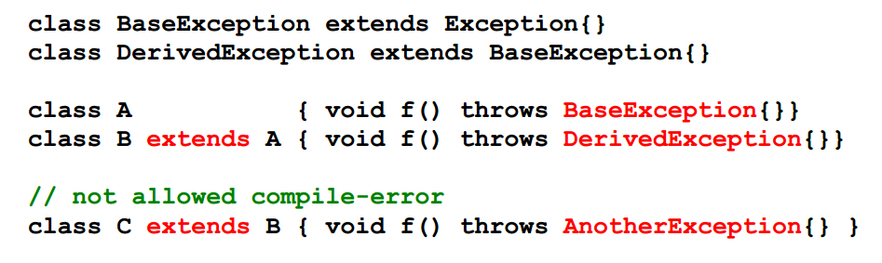
Inheritance and Exceptions
If base-class method throws an exception, derived-class method may throw that exception or one derived from it
Derived-class method cannot throw an exception that is not a type/subtype of an exception thrown by the base-class method
  Otherwise subclass cannot be upcasted to base-class

Slide 35
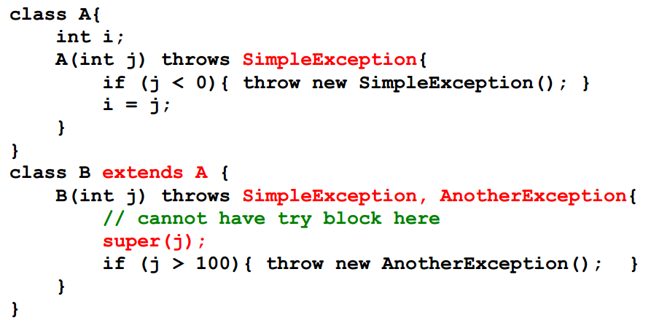
Inheritance and Constructors
Constructors can throw exceptions
Subclass constructor cannot catch exception thrown by a base class constructor

Slide 36
Guidelines
Do not use exceptions for normal control flow!
  Slows down the program
Do use exceptions to indicate abnormal conditions!
Handle the error (fully or partially) if you have enough information in the current context. Otherwise, propagate!
Handle group of statements
  Do not encompass every single statement in a try block
Use exceptions in constructors!
Do something with the exceptions your code catches!
Clean up using finally

Slide 37
Review
The manner in which an exception is processed is an important design consideration
Advantages of Exceptions
  Separates error handling from “regular” code.
  Propagation of errors up the call stack.
    Handle error in a context
  Grouping of error type and differentiation of errors.
    Overview
    Reuse of error handling code

Slide 38
This Week
Read Associated Chapters
Review Slides
Java Exercises
Online Quizzes

Slide 39
Summary
Overview Java Exceptions and Internal Classes
Hands-On/Practical
Today is about becoming comfortable/familiar with Exceptions

Slide 40
Today’s Practical
Programming Exercises (Book):
  Chapter 12.1-12.7
  (Only code not UML)
Upload single .zip file containing all your java files (only java files).
  www.zjnu.xyz
  zip file name should be your student number, e.g., 29392929.zip
Remember to comment your code, name/student number at the top of files.
Organise your files so it’s clear to identify each exercise (e.g., file names/folders)
  ch12_1.java, ch12_2.java, …

Slide 41

Questions/Discussion

