Slide 1

JavaScript Syntax
Web Authoring and Design
Benjamin Kenwright

Slide 2

Milestone Dates
Demonstrate Coursework 1
Friday (15th December)
10 Minutes Each
Coursework 2 (Group Project)
Website (XMAS)
Javascript Game (xmas theme)
Team 2-3 People
29th December (Friday)
Demonstrate/Present Group Work

Slide 3
Group Names
Let me know who your groups are
2-3 People

Slide 4
Outline
Review
Fundamental Syntax Javascript
Summary
Review/Discussion

Slide 5
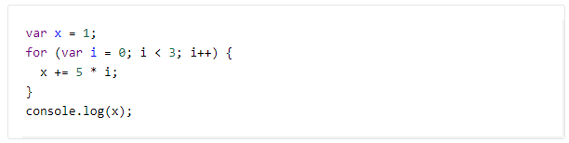
Revision Question
What will the following code print?
a) 1
b) 10
c) 16
d) 31

Slide 6
Answer
c) 16

Slide 7
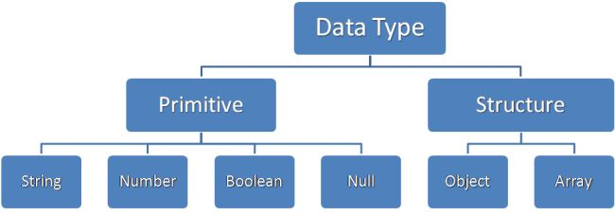
JavaScript Data Types

Slide 8
Primary Data Types (Primitive)
String
Number
Boolean

Slide 9
Composite Data Types (reference)
Object
Array

Slide 10
Special Data Types
Null
Undefined

Slide 11
Overview of Types
String : A strings of any characters enclosed in quotes is a string primitive.
Number : A number by itself is a number primitive, all numbers in JavaScript are 64-bit floating-point numbers.
Boolean : It will store Variables or expressions which are either true or false.
Object: A collections of properties and methods. In Javascript, anything that is not a primitive is an Object.
Arrays : Arrays are regular objects, both objects and arrays can have properties and methods.
Null : It has only one value in JavaScript: null.
Undefined : It treated as a variable that has been declared, but has never had a value assigned to it.

Slide 12
Var in Javascript
var anyData;

Slide 13
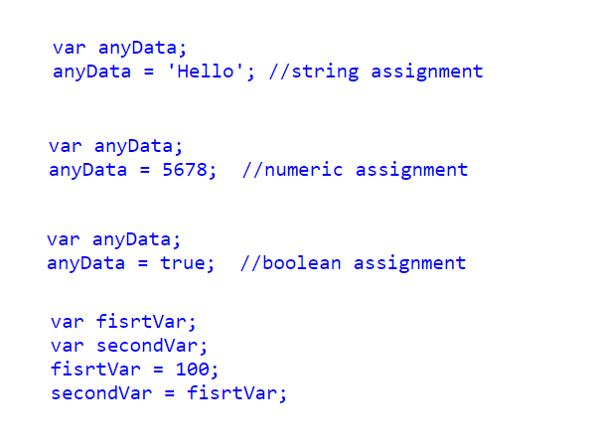
Example var

Slide 14

Question
Combining Data Types
What would be in variable xyz?

Slide 15

Answer

Slide 16

Question
What would be in variable xyz this time?

Slide 17

Answer

Slide 18
Scope of JavaScript Variables
The Javascript variable has only two scopes, Global and Local.
When you declare a variable within your function , its scope is local, that means you can use that variable only inside that function.
If a variable declare outside the function, its scope is Global.

Slide 19

Constants
Javascript you can define read-only Constant variables with const keyword

Slide 20
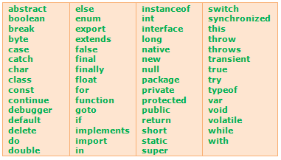
JavaScript keywords

Slide 21
Question
How many Javascript keywords could you write down?

Slide 22
Question
How many scope levels does Javascript have?
one
two
three
unlimited

Slide 23
Answer
b) two
The Javascript variable has only two scopes, Global and Local.

Slide 24

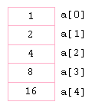
JavaScript Array Object

Slide 25
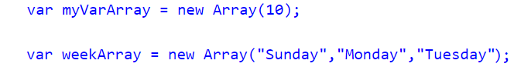
Constructors
Already know the number of items that would store in an array, you can pass the number to the constructor of an Array Object
Directly initialize the Array elements when declaring an Array Object

Slide 26
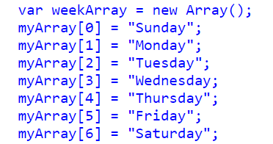
From 0...
JavaScript array indexes start from 0 (zero) and continue as 1,2,3 etc..

Slide 27

Displaying
Displaying Javascript Array elements
You can display Array elements in several ways. The following methods will show all elements from an Array.

Slide 28

Javascript Array Length
Length property of Javascript Array return the number of elements contains in an Array. Javascript Array index starts from 0 so the length of an array is equal to the last index + 1

Slide 29
Arrays Undefined Values
Arrays are automatically growing and dynamically sized to accommodate any type of data that is added to them
Add or remove elements from an array, the length of the array will change as needed
Declare an Array with constructor, each slot will be set to "undefined"

Slide 30
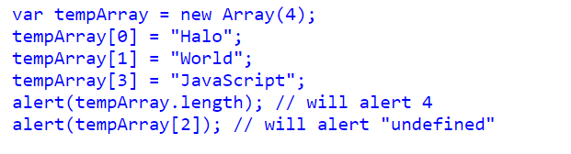
Example

Slide 31
Other Array Methods
Array.push()
Array.contains()
Array.sort()
Array.splice()
Array.slice()
Array.join()

Slide 32
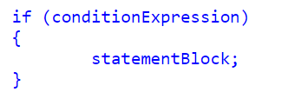
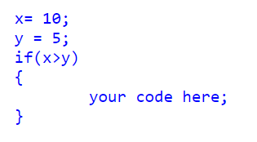
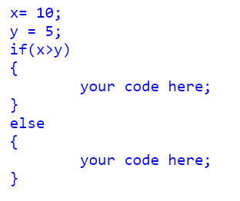
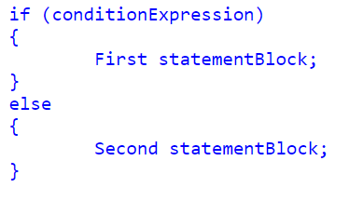
Conditional Statements

Slide 33
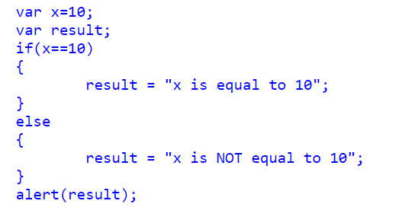
Alternative if..else Syntax (? Ternary Operator)

Slide 34
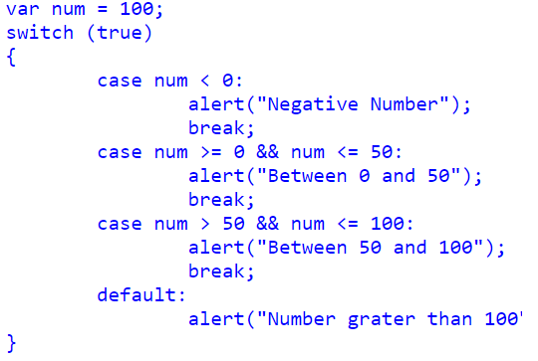
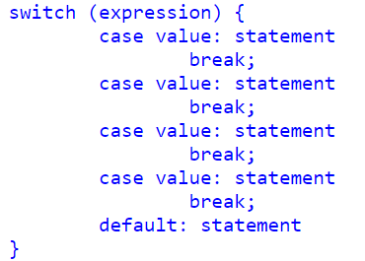
Switch Statements

Slide 35
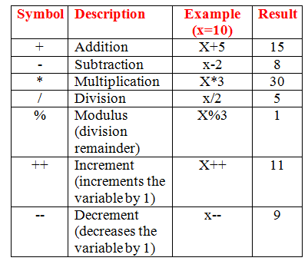
Arithmetic Operators

Slide 36
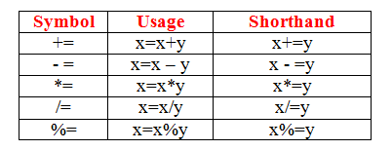
Assignment Operators

Slide 37
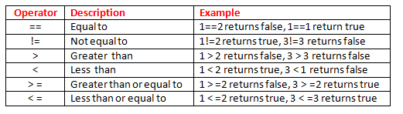
Comparison Operators

Slide 38
Logical Operators
AND (&&) : Allows you to check if both of two conditions are met
OR (||) : Allows you to check if one of two conditions are met
NOT (!) : Allows you to check if something is not the case

Slide 39
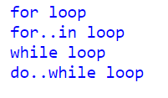
Loops in JavaScript

Slide 40
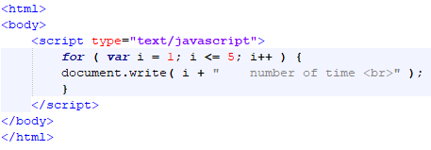
Javascript for loop

Slide 41
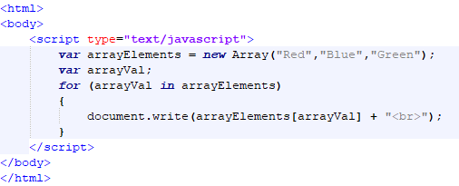
Javascript for..in Loop

Slide 42
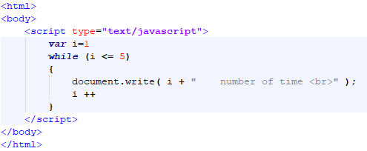
Javascript while Loop

Slide 43
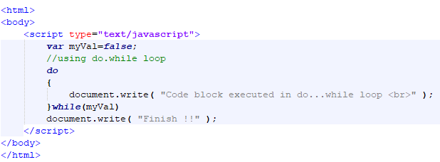
Javascript do..while loop

Slide 44
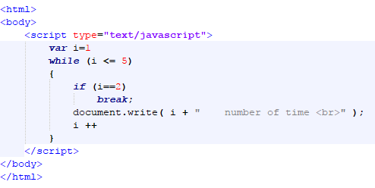
Javascript Break statement

Slide 45
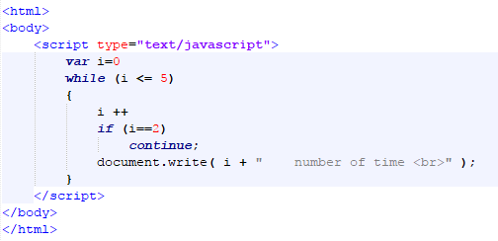
Continue statement

Slide 46
This Week
Review Slides
Read Associated Chapters
Work through Javascript Examples
Update GitHub Account/Webpage
Start Group Project

Slide 47
Summary
Overview of Javascript Syntax
Examples
Hands-On/Practical

Slide 48
Questions/Discussion

Slide 49
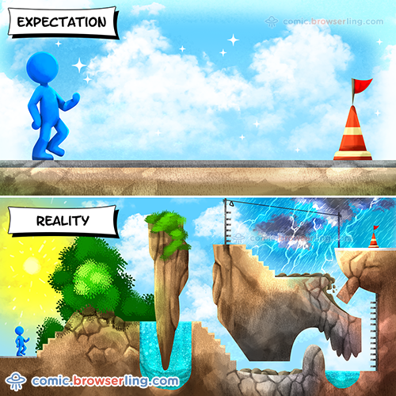
Learning JavaScript

Slide 50
Questions Next Week
Questions to Investigate for Next Week

Slide 51

Question
What order does f receive its arguments?
foo bar baz
foo baz bar
bar foo baz
foo baz

Slide 52
Question
Which of the following is correct about the expression 1==“1.0” in Javascript?
It returns false. The two values have different types.
It returns true. The two values are converted to strings and are equal.
It returns false. The two values are converted to strings and are not equal.
It returns true. The two values are converted to numbers and are equal.

Slide 53
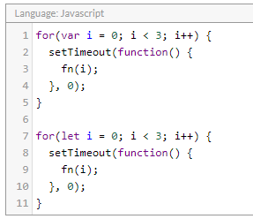
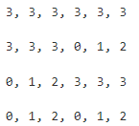
What arguments will fn receive, in order?
a)
b)
c)
d)

