Slide 1
Hyperlinks, Tables, Forms and Frameworks
Web Authoring and Design
Benjamin Kenwright

Slide 2
Outline
Review Previous Material
HTML Tables, Forms and Frameworks
Summary
Review/Discussion

Slide 3
Email?
Did everyone get an email from me yesterday (Tuesday)?
Login details quizzes/submissions

Slide 4
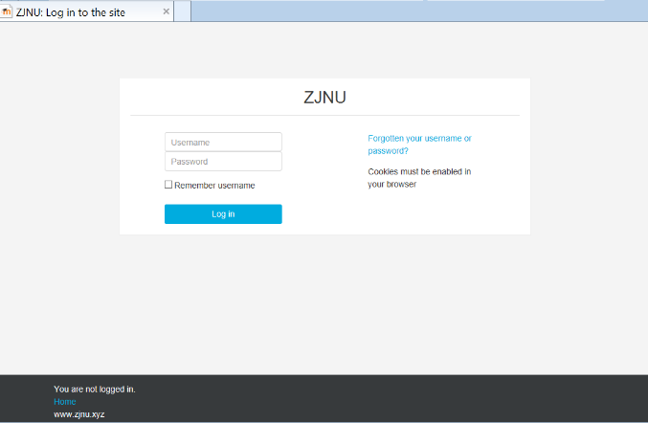
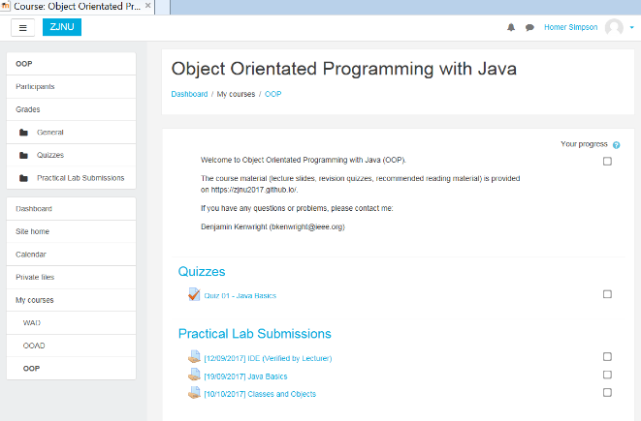
Submissions/Quizzes
Course material (Public)
https://zjnu2017.github.io/
Submissions/Quizzes (Graded/Private)
www.zjnu.xyz
(Login – Student No)
Password Emailed

Slide 5
Why Online Quizzes?
Take the quizzes as many times as you want
Opportunity to `improve’ learn from mistakes (instead of a single pass/fail)
Quizzes contribute to your final mark
10-20 multiple choice questions added each week
Straightforward and help prepare for the final exam

Slide 6
Why Online Coursework Submissions?
Experiment/project submission should be submitted online
Single .zip for each `task’
Specified this week
Enables you access to your coursework
(e.g., you can review it regularly/backed up)
Lets me provide feedback, guidance and comments which you can review

Slide 7
Submit GitHub URL
This week – submit GitHub URL Online
For example:
“https://name.github.io”
Valid default page (index.html)
Structure (folders/images/..)

Slide 8

Discussion Activity
What is the best webpage on the internet?
Share examples of interesting website and `what’ makes them `amazing’?

Slide 9
Review Question
Basic syntax for XHTML tags and attributes is:
a. <tag attribute=value> </tag>
b. <tag attribute=value> <tag>
c. <tag attribute=”value”> <tag>
d. <tag attribute=”value”> </tag>

Slide 10
Answer
Answer: d

Slide 11
Review Question
What is the correct HTML for inserting an image?
a. <img href="image.gif>
b. <image src="image.gif">
c. <img>image.gif</img>
d. <img src="image.gif">

Slide 12
Answer
Answer: d

Slide 13
Meta Data Tags
Located in the <head></head> section
Useful for search engines/classification
<meta name="author" content="your name" />
<meta name="description" content="" />
<meta charset="UTF-8">

Slide 14
Redirection
Meta tags can be used to perform the task of HTTP headers like redirection and refresh
<meta http-equiv="refresh" content="5;url=http://www.bing.com/">
Content attribute refers to the time interval in seconds before the refresh is performed and redirected

Slide 15
Forms
Add interactivity to your web documents by way of the <form> tag
Form tag you can add to your web pages a guestbook, order forms, surveys, get feedback

Slide 16
Form Tags
Basic construction of a HTML form is this...
<form> - begin a form
<input> - ask for information in one of several different ways
<input> - there can be as many input areas as you wish
</form> - end a form

Slide 17
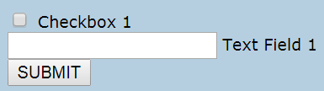
Form Example
<form name="myform“ action=“server.php" method="post">
<input type="checkbox" /> Checkbox 1<br />
<input type="text" /> Text Field 1<br />
<input type="submit" value="SUBMIT" />
</form>

Slide 18
Form Method
GET
contains all of the form information encoded as part of the address
http://example.com/foo.html?bar=some+data&baz=test%2B%3D%5Bdata%5D
has limitations
POST
Larger files
Encodes and passes the data with the html request

Slide 19
HTML Form Controls
Different types of form controls that you can use to collect data using HTML form:
Text Input Controls
Checkboxes Controls
Radio Box Controls
Select Box Controls
File Select boxes
Hidden Controls
Clickable Buttons
Submit and Reset Button

Slide 20
Form Attributes & Descriptions
type
Indicates the type of input control and for text input control it will be set to text.
name
Used to give a name to the control which is sent to the server to be recognized and get the value
value
This can be used to provide an initial value inside the control.
size
Allows to specify the width of the text-input control in terms of characters.
maxlength
Allows to specify the maximum number of characters a user can enter into the text box.

Slide 21
Hidden Form Controls
Hidden form controls are used to hide data inside the page
e.g., pass information in the submission
<input type = "hidden" name = "pagename" value = "10" />

Slide 22
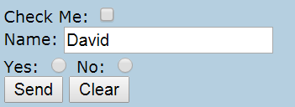
HTML Input Elements
<form name="myform" action="mailto:youremail@email.com" method="post">
Check Me: <input type="checkbox" /><br />
Name: <input type="text" value="David" /><br />
Yes: <input type="radio" /> No: <input type="radio" /><br />
<input type="submit" value="Send" />
<input type="reset" value="Clear" />
</form>

Slide 23
Managing Form Submission
Active Server
.php, .python
Javascript
Show examples of this later in the course when we start working with Javascript

Slide 24
Taste of Javascript to Come
Try this HTML out…
<HTML>
<HEAD>
<TITLE>Test Input</TITLE>
<SCRIPT LANGUAGE="JavaScript">
function testResults (form) {
var TestVar = form.inputbox.value;
alert ("You typed: " + TestVar);
}
</SCRIPT>
</HEAD>
<BODY>
<FORM NAME="myform" ACTION="" METHOD="GET">Enter something in the box: <BR>
<INPUT TYPE="text" NAME="inputbox" VALUE=""><P>
<INPUT TYPE="button" NAME="button" Value="Click" onClick="testResults(this.form)">
</FORM>
</BODY>
</HTML>
Notice that the form has no action="______" attribute. Without that attribute, the form will submit to the same web page that contains the form

Slide 25
Example
<html>
<form name="myForm">
<input type="button" name="mybutton" value="Press Me" onClick="alert('Hello World')">
</form>
</html>
Note key attributes of a form (i.e., type, name, value, ..)

Slide 26
Discussion Activity
Explain from your own experience where you would use forms?
E.g., where on your website would you have a form?

Slide 27
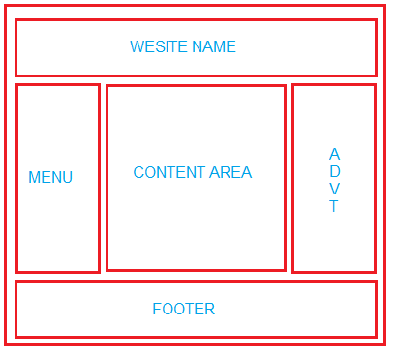
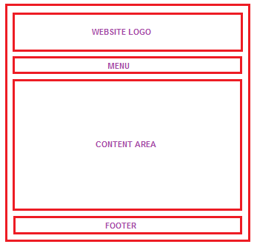
Tables & Website Layouts
Shows an image of a simple website layout using html tables

Slide 28
Tables & Layout
Tables are supported older browsers
Simple and easy to implement
Can become complex for more intricate websites (i.e., we’ll talk about CSS scripts later)
For instance, when creating a website layout , it is better to avoid nested tables. Nesting tables can lead to complex tables layouts and increase in page load time.

Slide 29
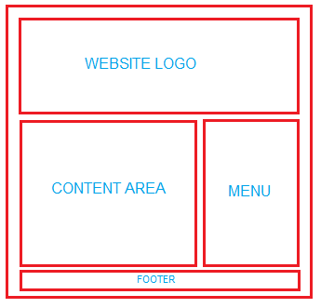
Example
website logo
content area
navigation options on the right side
footer at the bottom location (copyright/details)

Slide 30
Try this HTML out…
<html>
<head></head>
<body >
<table border=2 bordercolor=red width=98% align=center>
<tr><td align=center colspan=2>
<br><br><br>
WEBSITE NAME
<br><br><br>
</td></tr>
<tr><td width=70% align=center>
<br><br><br><br><br><br><br><br><br><br><br>
You Can write your main content here
<br><br><br><br><br><br><br><br><br><br><br>
</td><td width=30% align=center>
MENU
</td></tr>
<tr><td align=center colspan=3> <br>
FOOTER
<br></td></tr>
</table>
</body>
</html>

Slide 31
Practical Task
This Weeks Practical Exercises
Create a website using only `Tables’
Control the table widths/heights
Background images for cells
Upload your Table webpage GitHub

Slide 32
Question
Form attribute type for hiding data is:
secret
blank
hidden
passive
mask

Slide 33
Answer
c) hidden
<input type="hidden" name="pagename" value="10" />

Slide 34

Interesting HTML Tags (Audio)
Sound
<audio loop autoplay id="audio-example"> <source src="/wp-content/uploads/flamingos.mp3"> </audio>
Add controls attributes for letting the user control the sound (stop/start/volume)
<audio controls><source src="https://www.computerhope.com/jargon/m/example.mp3" /></audio>

Slide 35
Preview Audio & Javascript
<!DOCTYPE html>
<html>
<body>
<audio id="player" src="horse.mp3"></audio>
<br/><br/>
<button onclick="document.getElementById('player').play()">Play</button>
<button onclick="document.getElementById('player').pause()">Pause</button>
<button onclick="document.getElementById('player').volume+=0.1">Volume Up</button>
<button onclick="document.getElementById('player').volume-=0.1">Volume Down</button>
</body>
</html>

Slide 36
Interesting HTML Tags (Background Image)
<!-- Add background image to your page -->
<html>
<head>
<style type="text/css">
body {background-image:url(myimage.gif);}
</style>
</head>
<body>
Hello
</body>
</html>
Preview of CSS
http://www.w3school.com.cn/tiy/t.asp?f=csse_background-image

Slide 37

Interesting HTML Tags (Tool Tips)
<span title=“See, this is the tooltip. :)”>Move your mouse over me!</span>

Slide 38
Question
An acronym for Joint Photographic Experts Group; refers to a type of file format used for images that appear on web pages. Many photographs are saved with the JPEG file format.
a) jpg
b) powder
c) png
d) view

Slide 39
Answer
a) jpg

Slide 40
Question
Web page content that does not change or allow user interaction has dynamic content
True
False

Slide 41
Answer
b) False

Slide 42
This Week
Review Slides
Read Associated Chapters
Update Website (GitHub)
Submit your GitHub URL
www.zjnu.xyz
Online Quizzes
Practical Tasks
Table Layout Webpage

Slide 43
Summary
HTML Tables, Forms and Frameworks
Version Control
Hands-On/Practical

Slide 44
Questions/Discussion

