Slide 1
Table-Based Web Pages
Web Authoring and Design
Benjamin Kenwright

Slide 2
Outline
What do we mean by Table-Based Web Sites?
Review Table Tags/Structure
Tips/Debugging/Applications
Summary
Review/Discussion

Slide 3
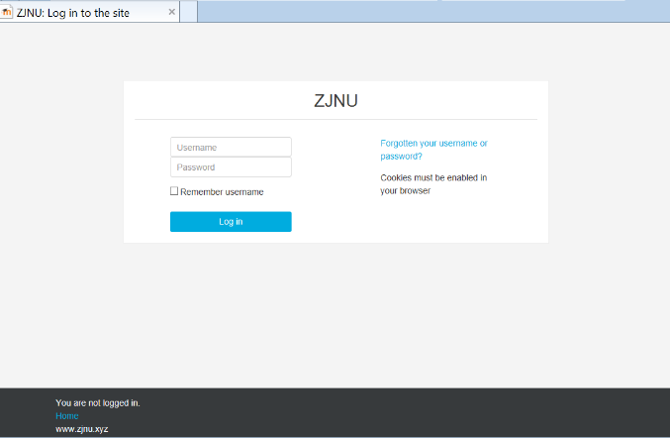
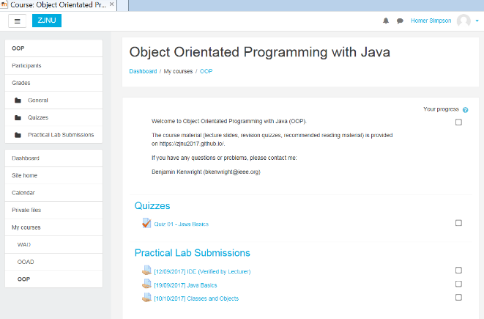
Submissions/Quizzes/GitHub
Course material (Public)
https://zjnu2017.github.io/
Submissions/Quizzes (Graded/Private)
www.zjnu.xyz
(Login – Student No)
Password Emailed

Slide 4

Activity
Show examples of students Github websites
(5-10 Minutes)

Slide 5
Review
Basic Tags
h1~h6, p, body, title, img, a, strong, b, em, i, ...
List Tags
ul li, ol li, dl dt dd, ..
Form Tags
form, fieldset, legend, label, input, select, option, textarea, button, ..
Table Tags
table, thead, tbody, tfoot, tr, td, colgroup, col
…

Slide 6
What are Tables for?
Share examples and thoughts on what HTML could be used for?
(5 Minutes)

Slide 7
HTML Tables and Tags
The table element is used to represent multiple dimensions data. How to organize and present tabular data in a web page or application is interesting and challenging
The table element is made from these 5 parts:
Table caption - <caption>
Row group - <thead>, <tbody>, <tfoot>
Column group - <colgroup>, <col>
Table rows - <tr>
Table cells - <td>, <th>

Slide 8
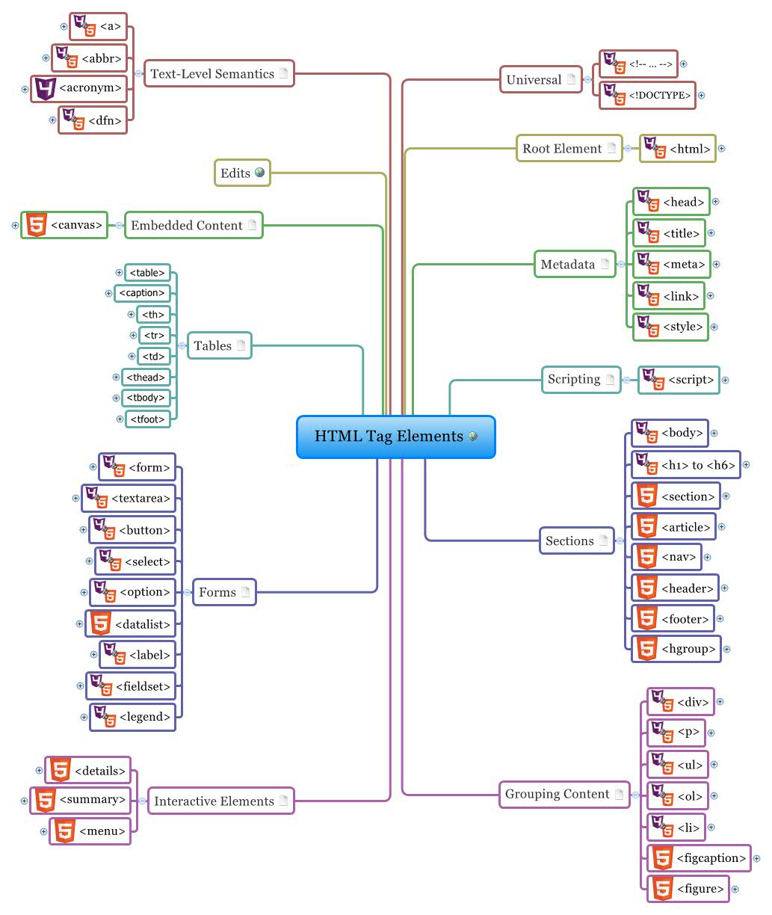

Slide 9
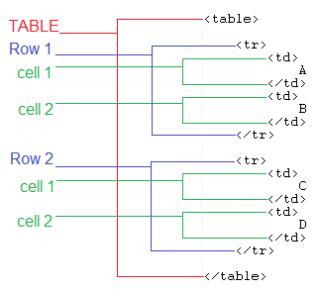
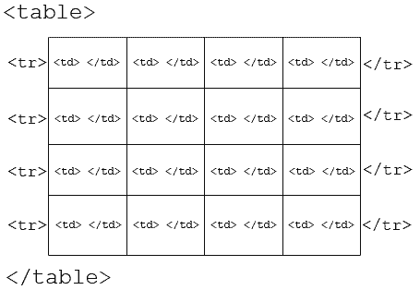
Review Table Tags

Slide 10
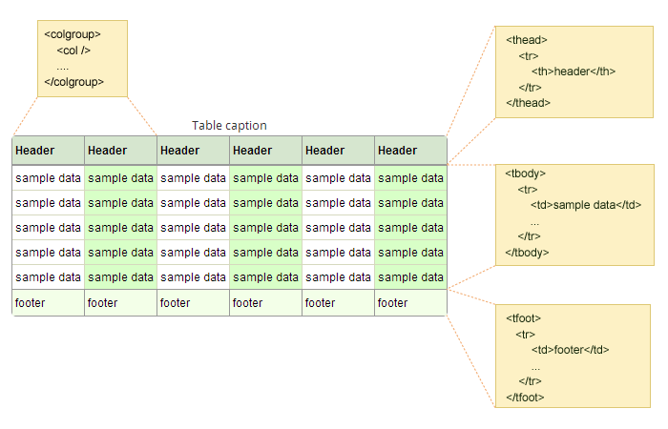

Slide 11
Question
What is the tag to identify a row inside of a table?
a) <tr>
b) <row>
c) <th>
d) <td>

Slide 12
Answer
a) tr

Slide 13
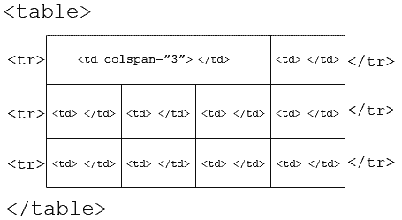
Colspan/Rowspan

Slide 14
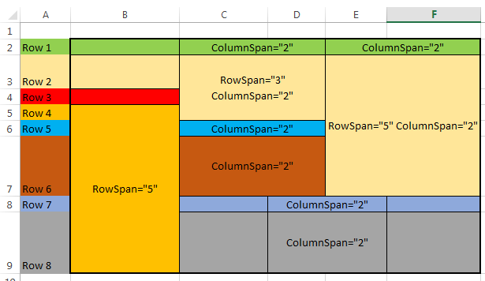

Slide 15
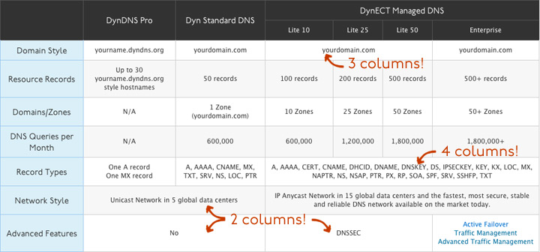

Slide 16
Question
Which of the following are table tags?
a) table, thead, tr, td
b) colspan, table, tr
c) table, tt, tr, td

Slide 17
Answer
a) table, thead, tr, td
Other options include table row elements and attributes

Slide 18
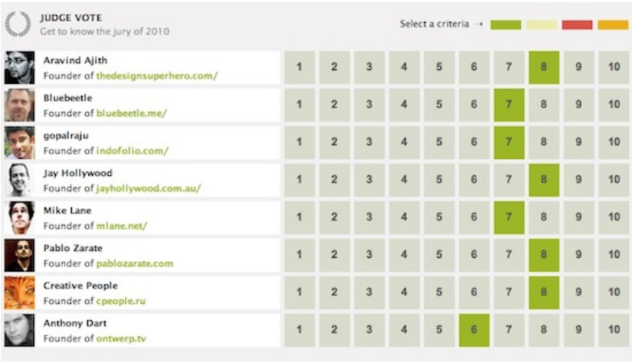
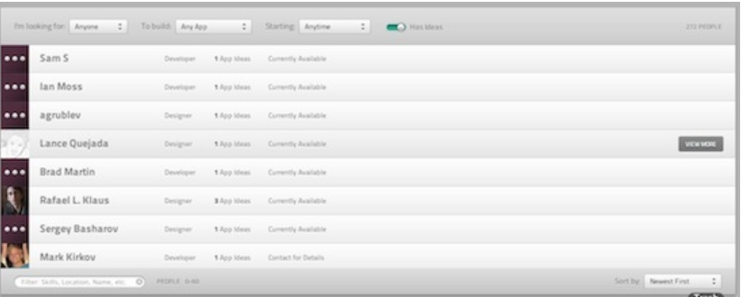
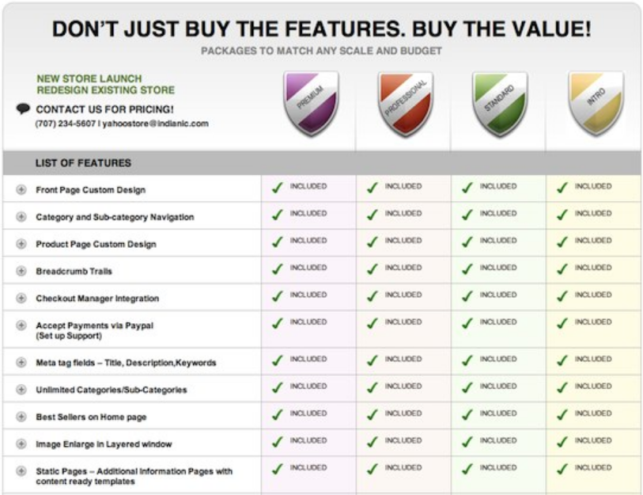
HTML Table Examples

Slide 19
HTML Table Tips

Slide 20
TIP 1 - Keep your tables as simple as possible
Nesting tables 'inside' tables is ok - but keep it to the minimum
You can usually achieve the same layout effect by using more rows and columns in your main table

Slide 21
TIP 2 - Keep your tables as short as possible
Better to have a sequence of smaller tables than one big one

Slide 22
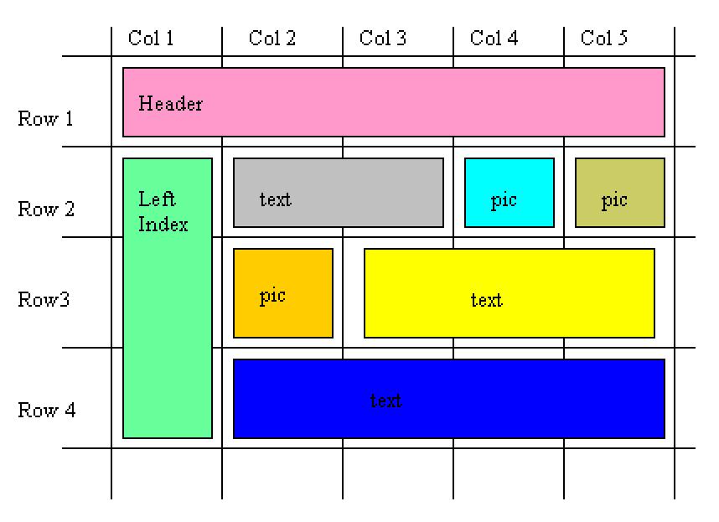
TIP 3 - Pen and Paper First
Plan your initial layout

Slide 23
TIP 4 - Label the empty 'TD' data cells (Debugging)
Once you have completed the blank table then label/number the data cells so you can see which is which when you start filling them up
I know it sounds a bit 'simple' - but when you start filling the cells up with content, the page in your html editor expands enormously and its much easier to locate a cell in your editor if its labelled than if its not

Slide 24
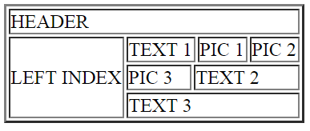
<table border=“1”>
<tr> ** Row 1 **
<td colspan="5">HEADER</td>
</tr>
<tr> ** Row 2 **
<td rowspan="3">LEFT INDEX</td>
<td colspan="2">TEXT 1</td>
<td>PIC 1</td>
<td>PIC 2</td>
</tr>
<tr> ** Row 3 **
<td>PIC 3</td>
<td colspan="3">TEXT 2</td>
</tr>
<tr> ** Row 4 **
<td colspan="4">TEXT 3</td>
</tr>
</table>

Slide 25
TIP 5 – Table Width="%"
Declare the size of the table either as fixed units
e.g., <table width="700"> where 700 is measured in pixels
or you can define it as a percentage (%) of the screen its viewed in
e.g., <table width="100%">

Slide 26
TIP 6 – Borders and colours to see what you are doing
The normal border effect you get using "border=1" is quite ugly really and most of the time you will have set the parameter to border="0". However - while you are building your table - and especially when you a faulting a table - turn up the volume to border="2" so you can see what you are doing

Slide 27
TIP 7 - Table attribute "SUMMARY".
The table attribute "summary" should be used to describe what is inside the table for the convenience of non visual site visitors
Example:
<table width="100%" summary="Top page table incorporating top header bar, left side index bar and data cells of text and pictures">

Slide 28
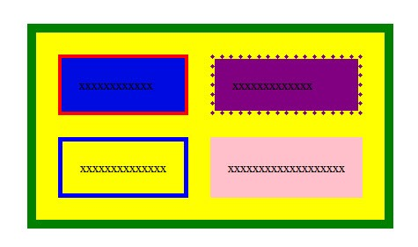
Table Background Colour
You can set the background color of your table and cells simply by using "bgcolor" attribute

Slide 29
Table Background Colour
<table bgcolor="yellow" cellpadding="20" cellspacing="25" style="border:10 solid green">
<tr>
<td bgcolor="light blue" style="border:4 solid red">xxxxxxxxxxxx</td>
<td bgcolor="purple" style="border:5 dotted purple">xxxxxxxxxxxxx</td>
</tr>
<tr>
<td style="border:5 solid blue">xxxxxxxxxxxxxx</td>
<td bgcolor="pink">xxxxxxxxxxxxxxxxxxx</td>
</tr>
</table>

Slide 30
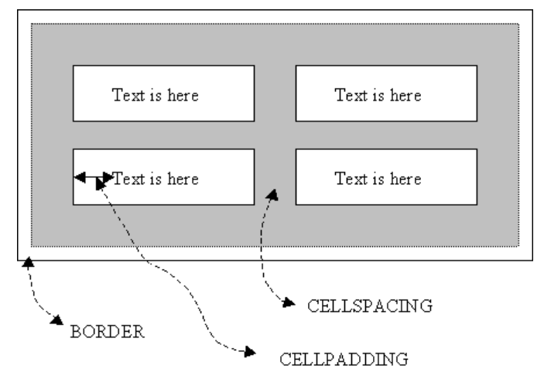
Cellpadding and Cellspacing
Control spacing between content and borders

Slide 31
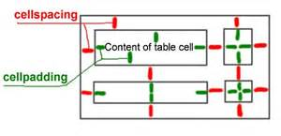
Cellpadding and Cellspacing
Cellpadding is an attribute of <table> tag. By using cellpadding attribute you can set the amount of space between the contents of the cell and the cell wall
Cellspacing is also an attribute of <table> tag. By using cellspacing attribute you can set the amount of space between the table cells
Example: <table cellpadding="4">
Example <table cellspacing="4">

Slide 32
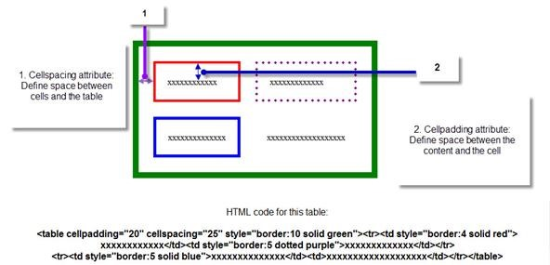
Cellpadding and Cellspacing

Slide 33
Table Background Image
Background attribute to add any images as background of your table or to each cell separately
<table>
<tr>
<td style="background: url(tree.jpg);">
..
</table>

Slide 34
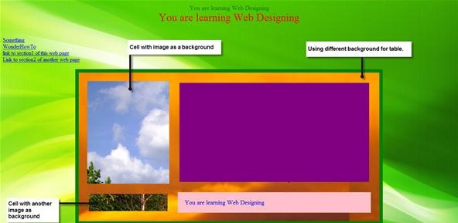

Slide 35
Question
This attribute of the table HTML element configures the amount of space between the content of each table cell and the edge of the table cell
a) cell
b) valign
c) cellpadding
d) colspan

Slide 36
Answer
c) cellpadding

Slide 37
Question
HTML element that configures the row(s) in the table footer area is “tbody”
True
False

Slide 38
Answer
b) False
It should be “tfoot”

Slide 39

Table Borders
You can also apply border to your image by using the "style" attribute
<img style="border:5 solid yellow" src=“world.jpg" height="200" width="400" alt="image">

Slide 40
Note on Anchors
Open links in a new window using the ‘target’ attribute
<a href=“cat.html" target="_blank" >Link to Cats</a>
Clickable Images
Take advantage of graphics
<a href=“cats.html" target="_blank" ><img src="path of the image"></a>

Slide 41
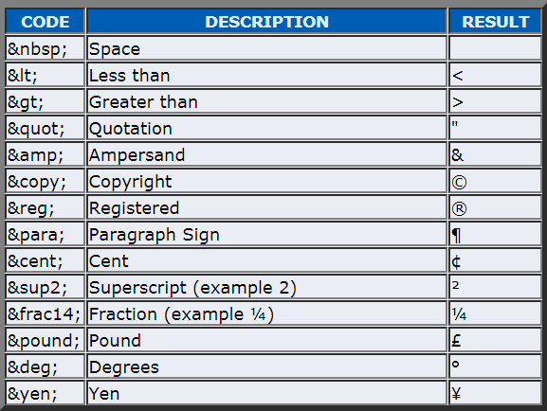
Special Characters
Display HTML coding on your web page for visitors to see (e.g., <, >, &, ..)
Popular escape codes:

Slide 42
Sub and Sup
Example:
Regular Text.
<sub> Lowered SUB text. </sub>
Regular text.
<sup> Raised SUP text. </sup>

Slide 43
This Week
Review Slides
Read Associated Chapters
Practical Tasks
Experiment and Have Fun
Online Quizzes
Additional quizzes each week
Update Github Website
Regularly make commits/updates
Structure your/folders/sections
Manage/demonstrate different features/techniques

Slide 44
Summary
Overview of Traditional Table-Based HTML Techniques
See how HTML Tables allow you to format/represent data/layouts in an organised manner
Next week we’ll move onto CSS for controlling/formatting
Split Content from Formatting
Greater control and customizability

Slide 45

Questions/Discussion

Slide 47
Individual Project
Develop and Implement at Tutorial Website on HTML/CSS
Published on Github
Show regular progressive updates
Github commit history/log
(Submitted with the final website at the end)
Multiple Pages
Theme
Professional Solution

Slide 48
Deliverables
Easy to use/Structured
Navigation section,
Logo section
Header/Footer
…
Website:
Contact page,
About page
Home page
Content pages (Tutorials/Information)
Resizable
Support different browsers
+
Style:
Consistent layout/theme
Modern and interesting (use colours and formatting)
`fav' icon (browser tab)
Comments in html
Images (.jpg/.gifs), ..
`Professional implementation'
Use of tags/styles/formatting should be done in a professional/well organised way

Slide 49
Revision Questions

Slide 50
Question
How would you automatically transfer your visitors to a new web page?

Slide 51
Answer
You can do it with the help of meta tag mentioned below:
<META HTTP-EQUIV="Refresh" CONTENT="2";
URL="http://www.cats.com">
Place this tag between <HEAD></HEAD>
It will load yousite.com in 2 seconds.

Slide 52
Question
What is a <dl> tag in HTML?
definition list tag
delete tag
double tab tag
table column tag

Slide 53
Answer
a) definition list tag
<dl> is a definition list tag used in HTML
It is used with <dt> and <dd>
<dt> list the item while <dd> describes it

Slide 54
Question
Colspan=n can be added to only what tag?
a) Table
b) Td
c) Tr

Slide 55
Answer
Answer b)

